Slide 1
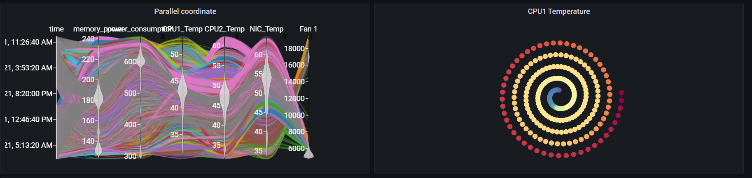
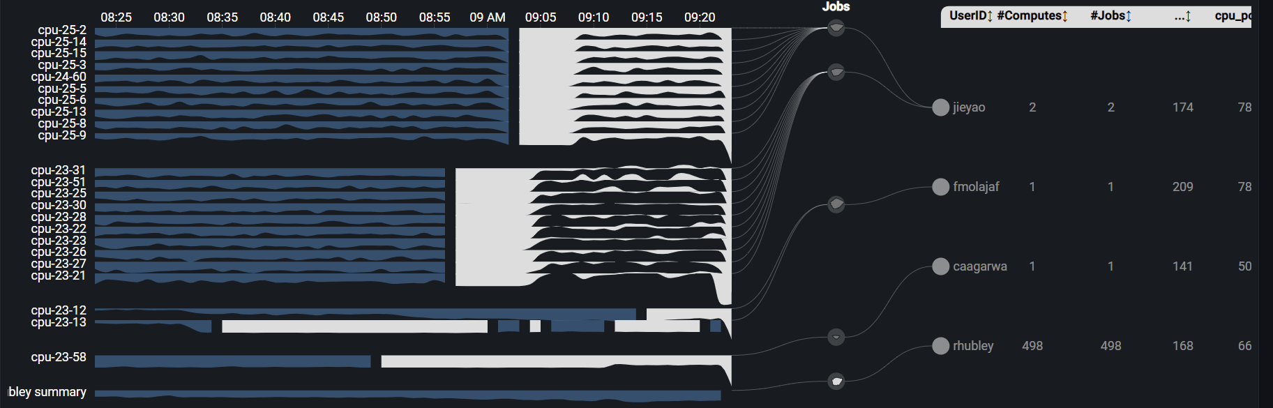
Cluster
Weekly report

Slide 2
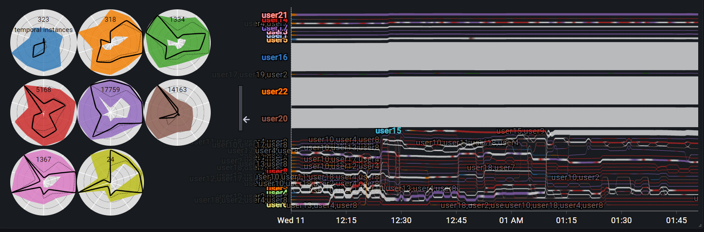
Cluster - Sankey

Slide 3
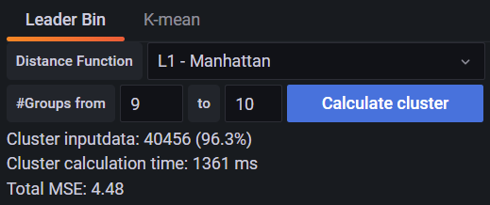
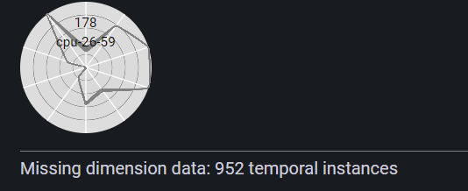
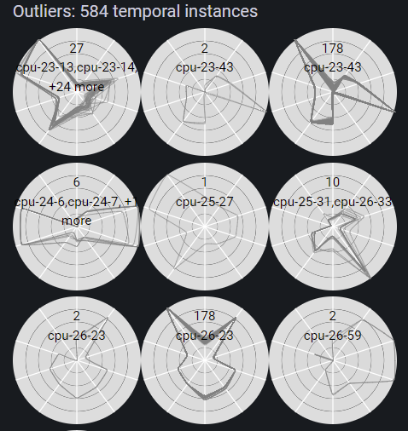
Cluster – Outlier and missing dimension data
Remove missing dimension data
Detect outliers using MST
Calculate clusters on the remaining data

Slide 4
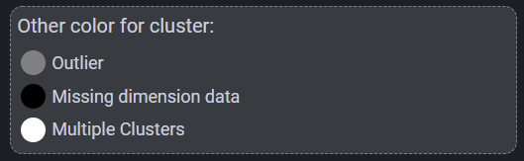
Cluster - Sankey

Slide 5
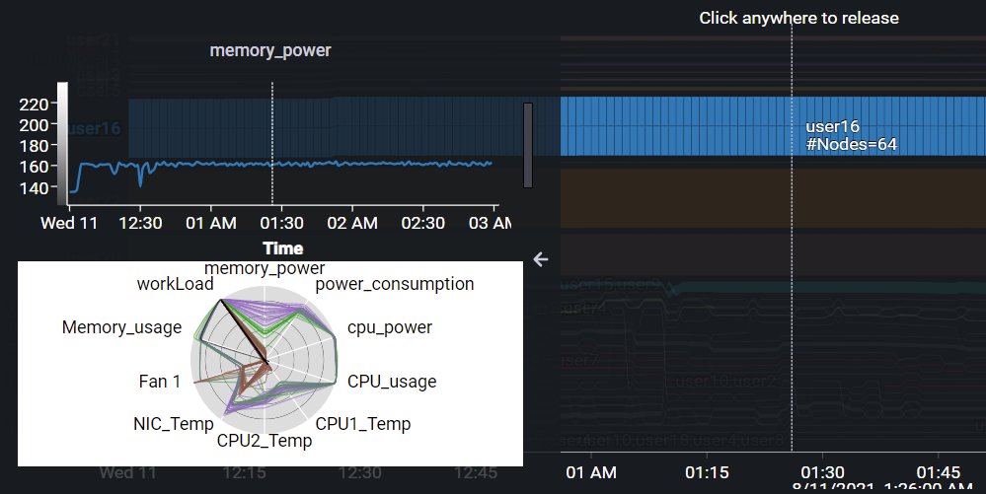
Cluster - Sankey

Slide 6
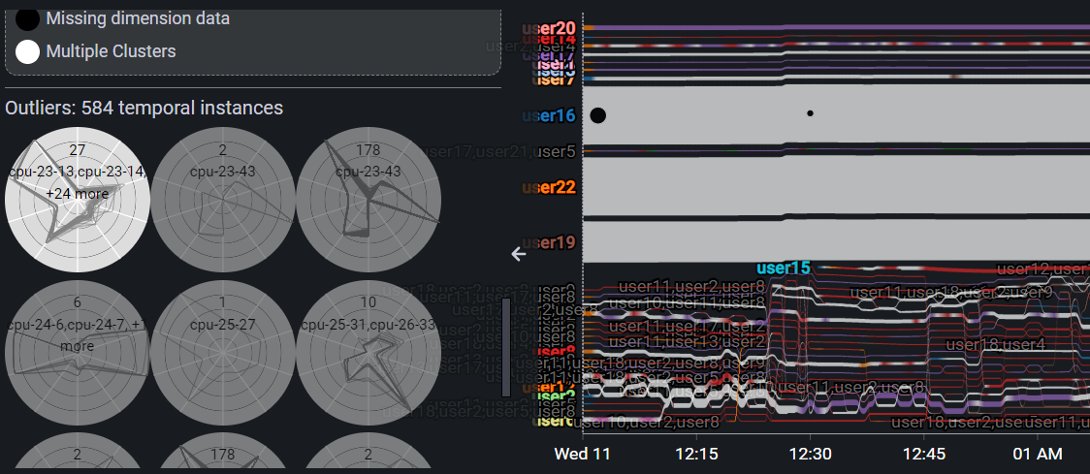
Cluster – Outlier highlight
Mouseover outlier group to locate outlier point on the stream with black circles.
The size of circle related to #compute

Slide 7
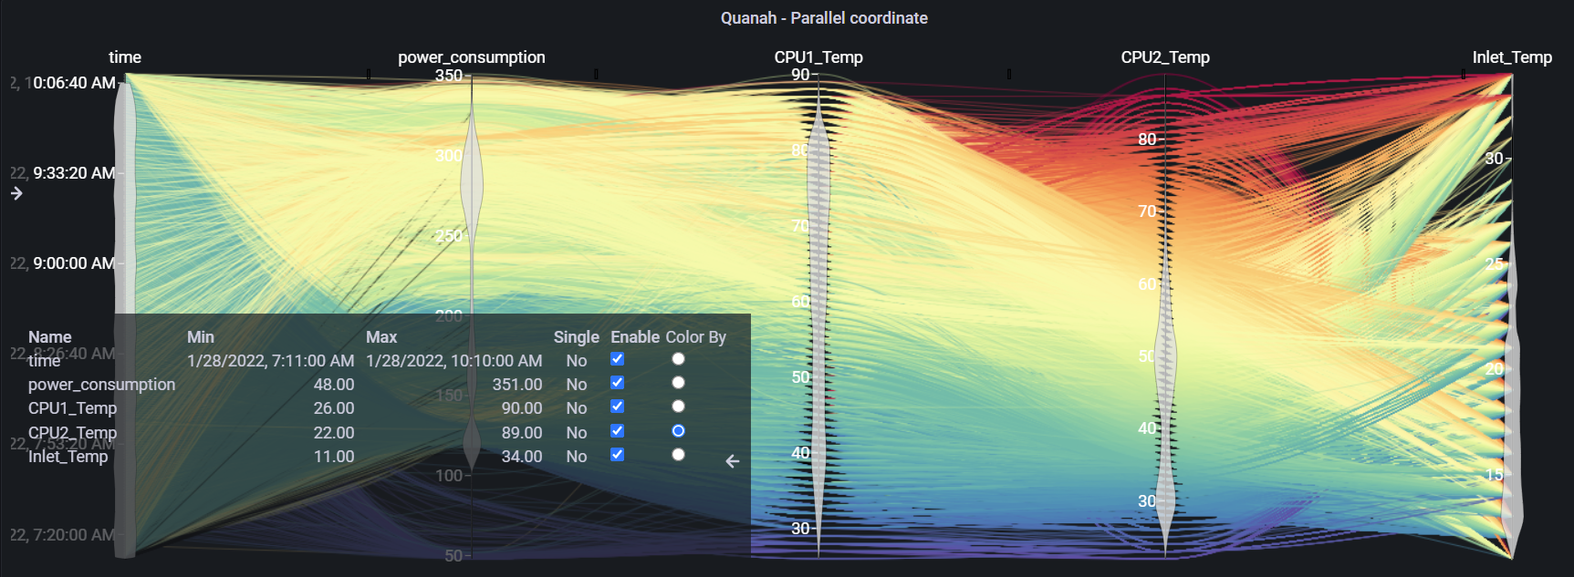
Cluster – Future work
Data scale to 0-1 from min-max data - Calculate min-max for each dimension not for unit ( Temperature)
=> Get general range for dimension and metric (manage metric range?)

