Slide 1
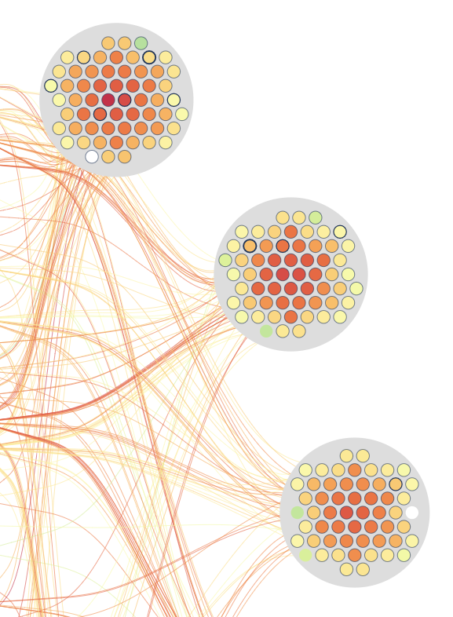
Thermal paste replacement
Use case report

Slide 2
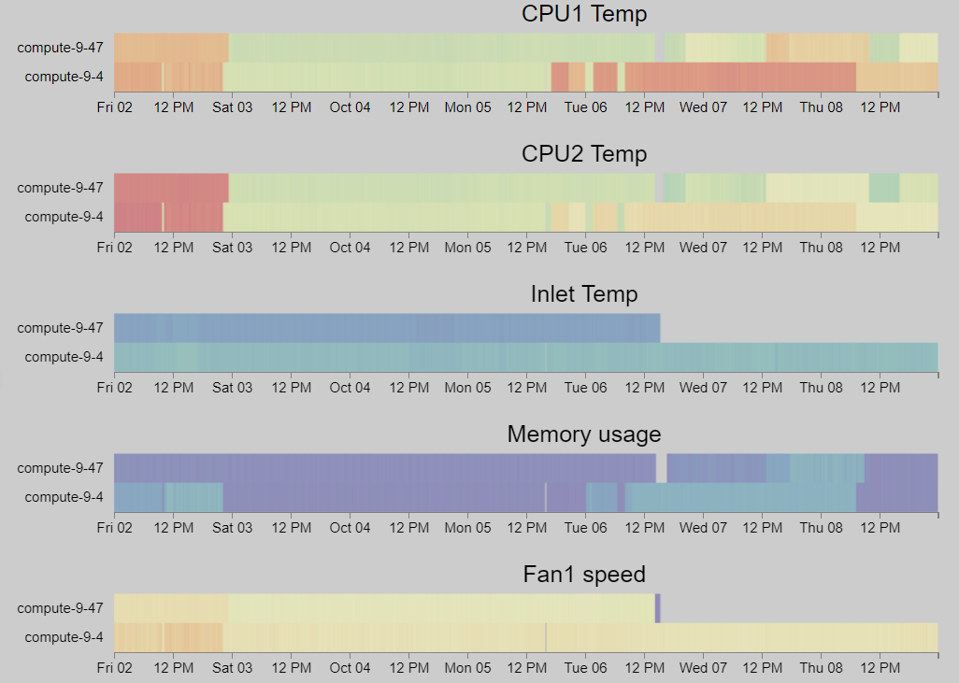
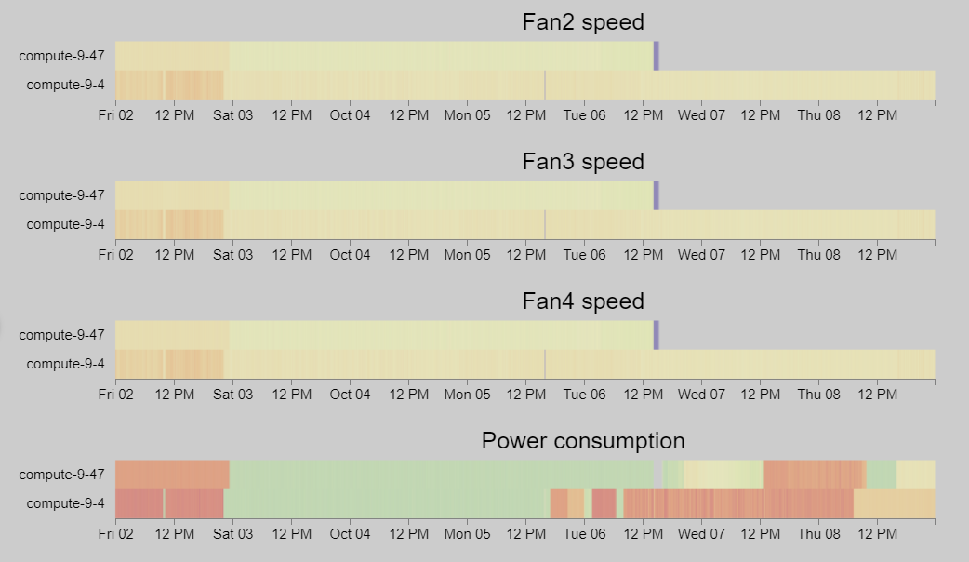
compute-9-4 & 9-47
Oct 2, 2020 0:00:00 PM – Oct 9, 2020 0:00:00 PM
Duration: 7 days
Interval: 5 minutes
#Timesteps: 2016
#Computes: 467

Slide 3
4
1
Replacement occurs
2
Compute-9-4 start
1
2
3
3
Compute-9-47 event
4
Compute-9-47
CPU temperature v.s. Memory usage

Slide 4
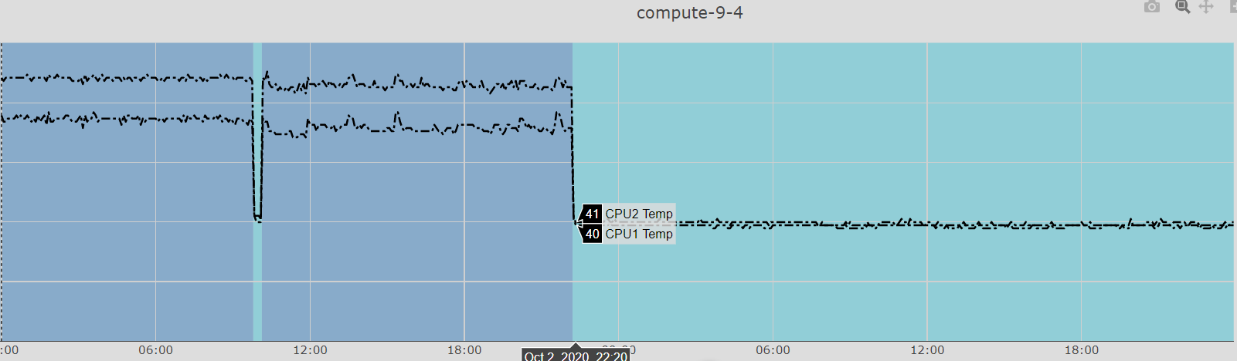
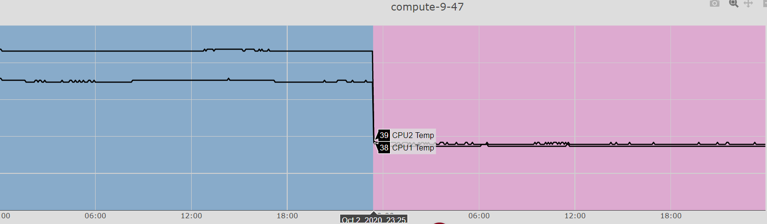
100
80
60
40
20
0
100
80
60
40
20
0

Slide 5
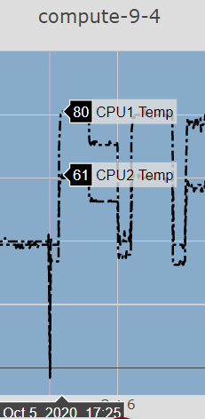
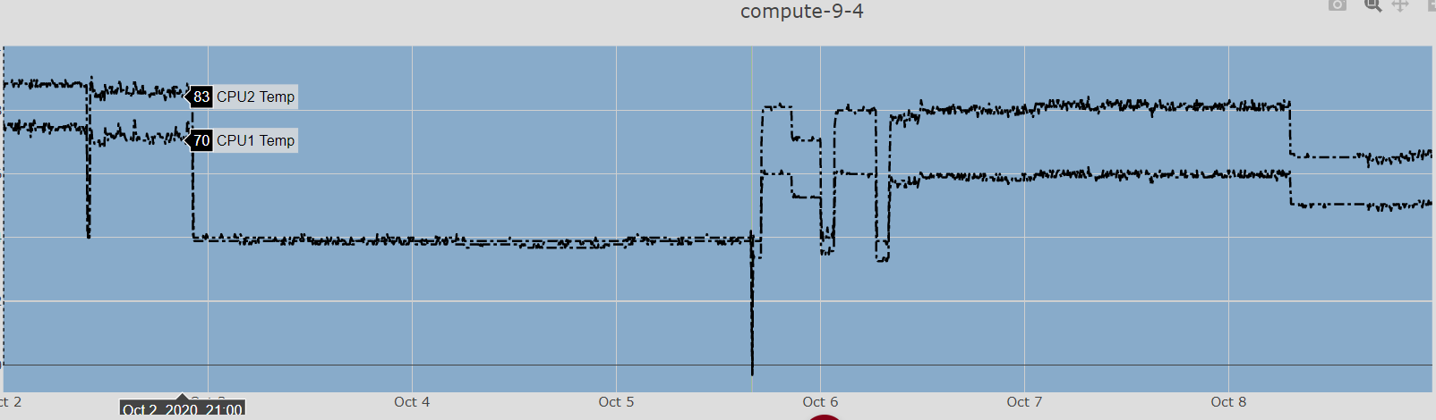
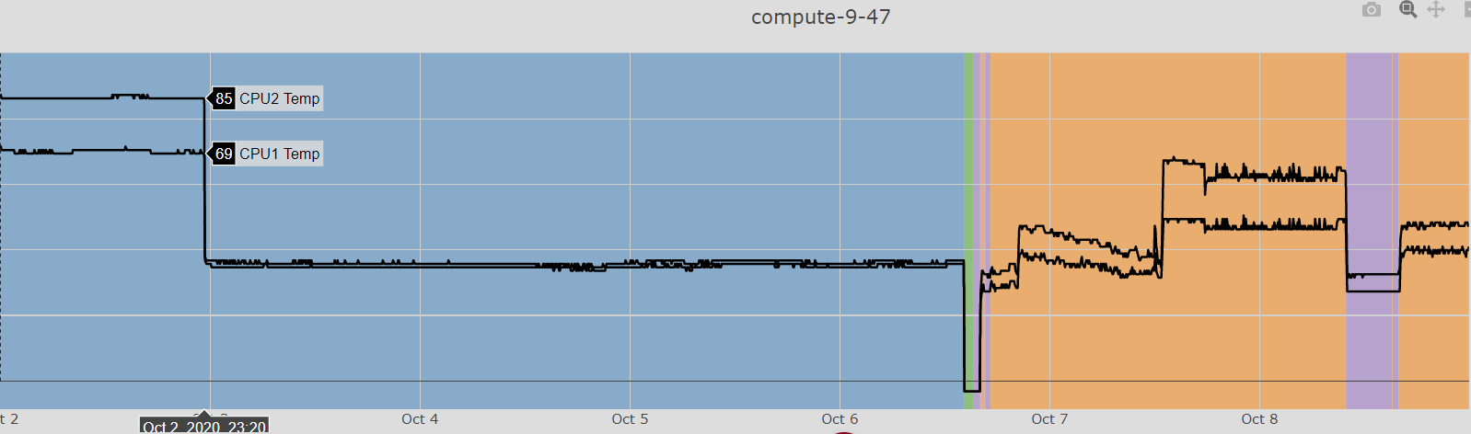
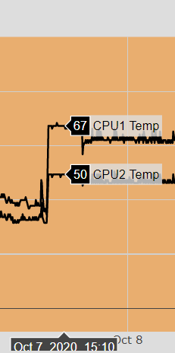

Slide 6
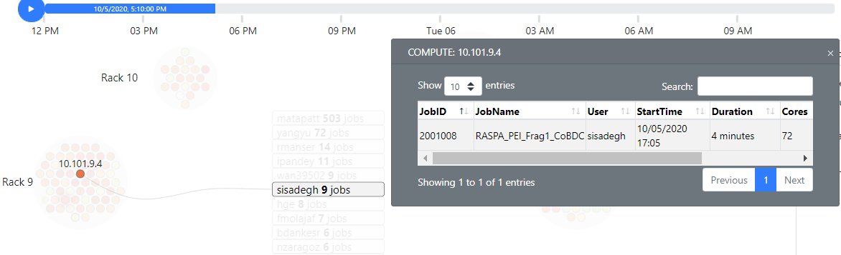
Job info investigate
https://idatavisualizationlab.github.io/HPCC/jobviewer/index.html?timeStart=2020-10-05T12:00:00-05:00&timeEnd=2020-10-06T12:00:00-05:00

Slide 7
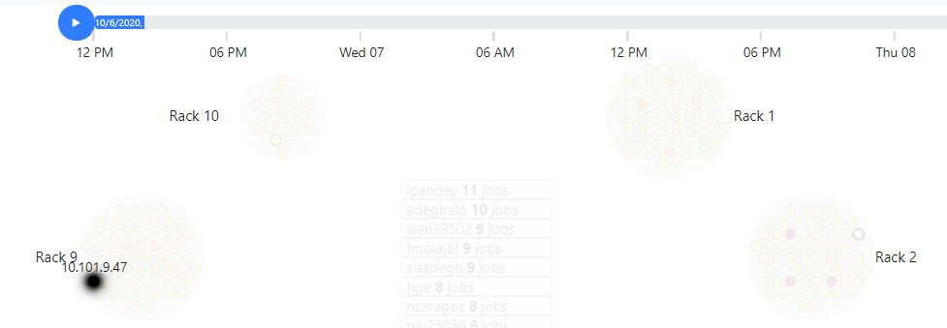
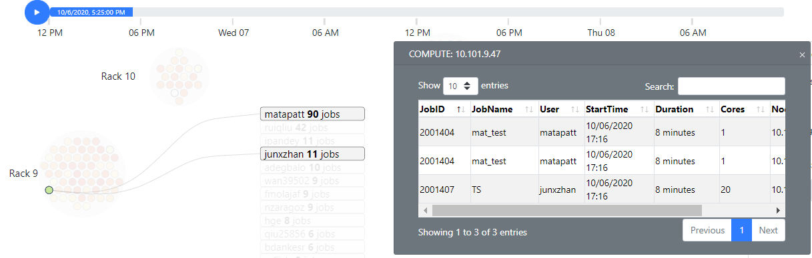
Job info investigate
https://idatavisualizationlab.github.io/HPCC/jobviewer/index.html?timeStart=2020-10-06T12:00:00-05:00&timeEnd=2020-10-08T12:00:00-05:00

Slide 8
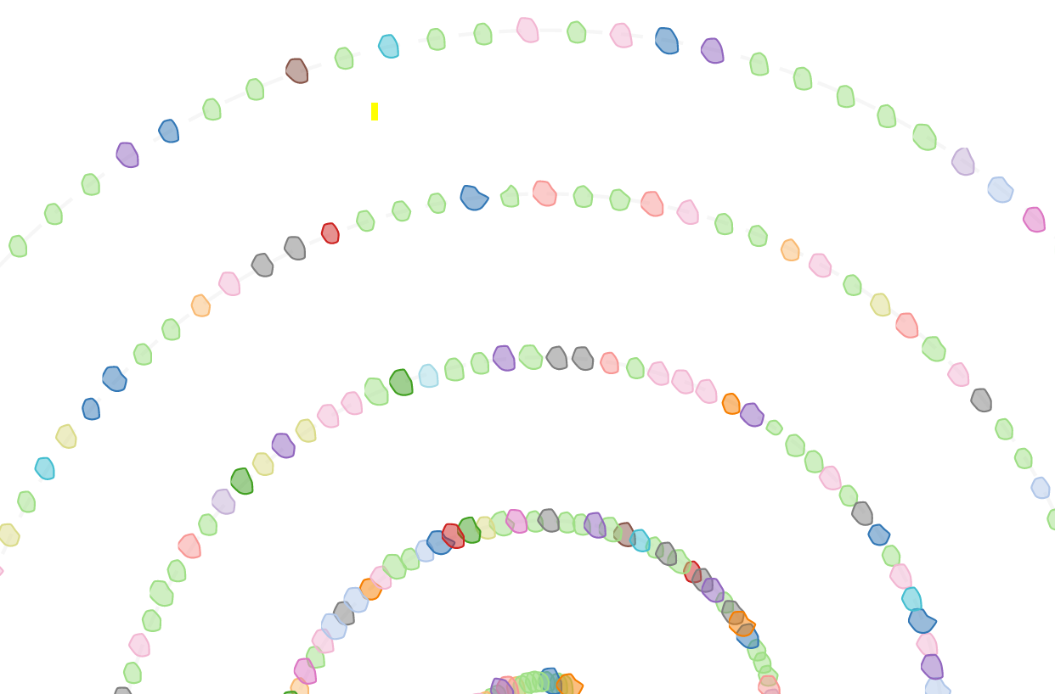
Thank you for your attention

