Slide 1
Text Detection and Recognition
3A Project
Zhixing Cao & Yuesong Shen

Slide 2
Outline
Introduction
Text detection
Text extraction & text recognition
Conclusion & demonstration

Slide 3

Introduciton
Text recognition ➔ Machine that reads

Slide 4
Introduction
3 steps:
Text detection
Text extraction
Text recognition

Slide 5
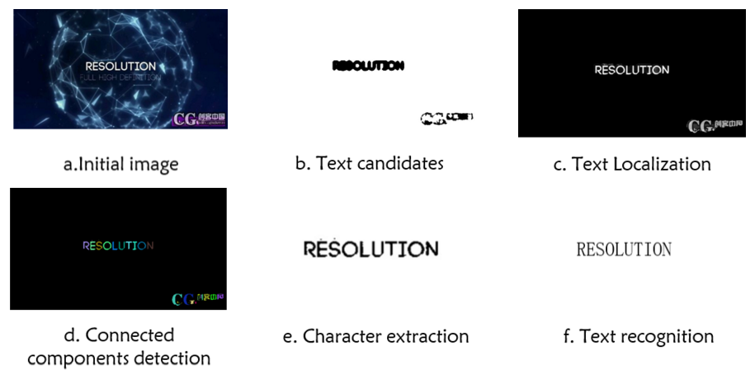
Introduction

Slide 6
Text detection

Slide 7
Text detection
Processus:
Input: image ➔ edge maps (Sobel) ➔
Features ➔ Clustering (K-means) ➔
Post processing ➔ Output: Text zones

Slide 8
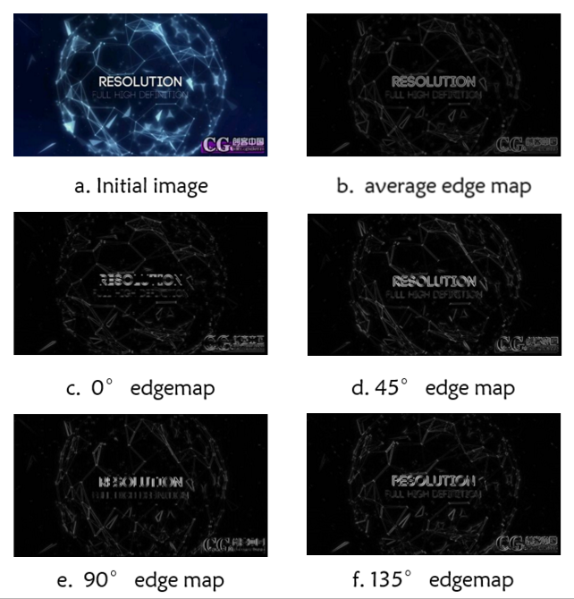
Text detection
edge maps:
Apply Sobel edge filter on 4 directions.

Slide 9
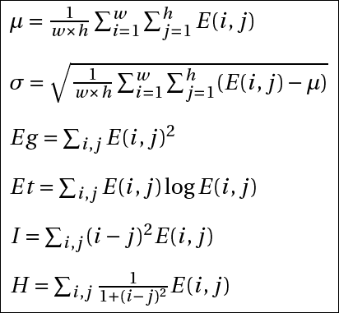
Text detection
Features:
(in each sliding window)
Mean
Standard deviation
Energy
Entropy
Gravity center
Expectation

Slide 10
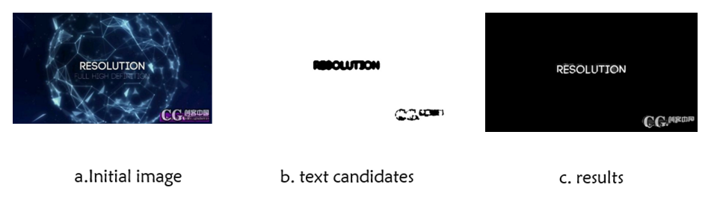
Text detection
Clustering:
K-means (k = 2) on 4x6 = 24 features

Slide 11
Text detection
Post processing:
Morphological image processing
(dilation & erosion operations)
Empirical non-text zone elimination

Slide 12
Text extraction & recognition

Slide 13
Conclusion

