Slide 1
Time-of-Flight Coding
Jonas Messner & Nicholas Gaudio
04/10/2019

Slide 2
Indirect Time-of-Flight Fundamentals

Slide 3
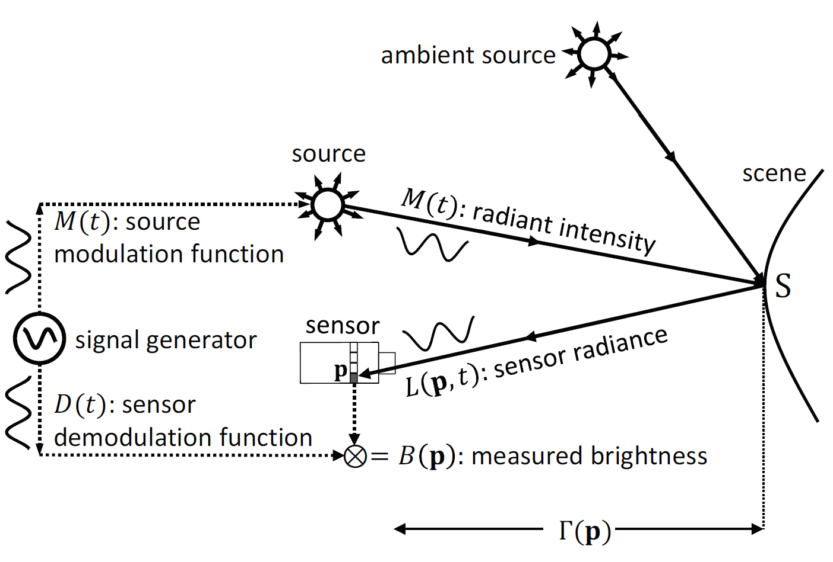
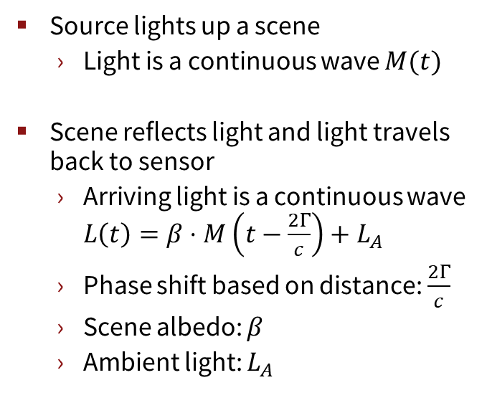
ToF Imager Basics
Source lights up a scene
Light is a continuous wave $M(t)$
Scene reflects light and light travels back to sensor
Arriving light is a continuous wave $L\left(t\right)=β⋅M\left(t−\frac{2Γ}{c}\right)+L_{A}$
Phase shift based on distance: $\frac{2Γ}{c}$
Scene albedo: $β$
Ambient light: $L_{A}$
Source: Mohit Gupta, Andreas Velten, Shree K. Nayar, and Eric Breitbach. 2018. What Are Optimal Coding Functions for Time-of-Flight Imaging?. ACM Trans. Graph. 37, 2, Article 13 (February 2018), 18 pages. DOI: https://doi.org/10.1145/3152155

Slide 4
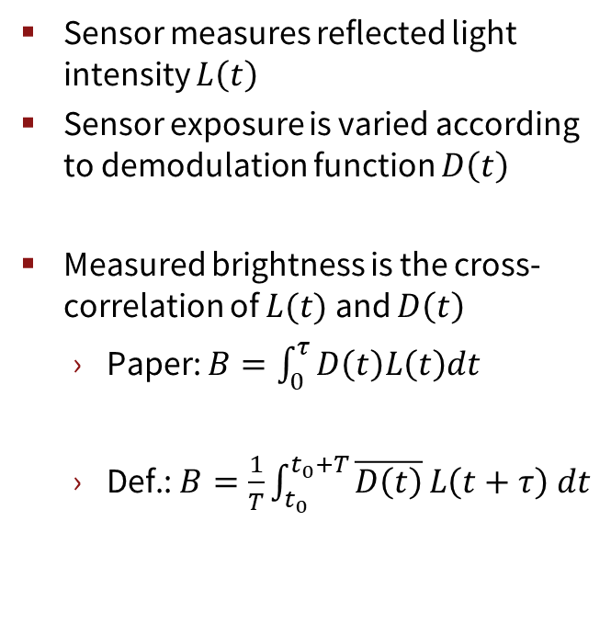
ToF Imager Basics
Sensor measures reflected light intensity $L\left(t\right)$
Sensor exposure is varied according to demodulation function $D\left(t\right)$
Measured brightness is the cross-correlation of $L(t)$ and $D\left(t\right)$
Paper: $B=\int_{0}^{τ}{D\left(t\right)L\left(t\right)dt}$
Def.: $B=\frac{1}{T}\int_{t_{0}}^{t_{0}+T}{\overline{D\left(t\right)}}L\left(t+τ\right) dt$
Source: Mohit Gupta, Andreas Velten, Shree K. Nayar, and Eric Breitbach. 2018. What Are Optimal Coding Functions for Time-of-Flight Imaging?. ACM Trans. Graph. 37, 2, Article 13 (February 2018), 18 pages. DOI: https://doi.org/10.1145/3152155

Slide 5
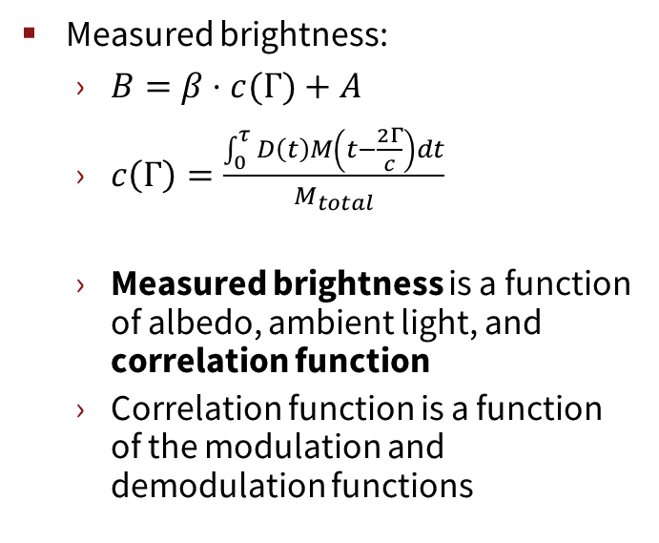
ToF Imager Basics
Measured brightness:
$B=β⋅c(Γ)+A$
$c\left(Γ\right)=\frac{\int_{0}^{τ}{D\left(t\right)M\left(t−\frac{2Γ}{c}\right)dt}}{M_{total}}$
Measured brightness is a function of albedo, ambient light, and correlation function
Correlation function is a function of the modulation and demodulation functions
Source: Mohit Gupta, Andreas Velten, Shree K. Nayar, and Eric Breitbach. 2018. What Are Optimal Coding Functions for Time-of-Flight Imaging?. ACM Trans. Graph. 37, 2, Article 13 (February 2018), 18 pages. DOI: https://doi.org/10.1145/3152155

Slide 6
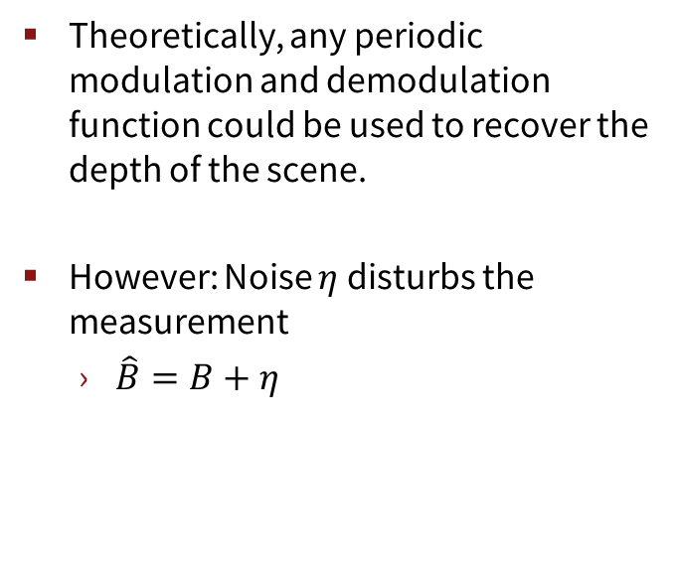
ToF Imager Basics
Theoretically, any periodic modulation and demodulation function could be used to recover the depth of the scene.
However: Noise $η$ disturbs the measurement
$\hat{B}=B+η$
Source: Mohit Gupta, Andreas Velten, Shree K. Nayar, and Eric Breitbach. 2018. What Are Optimal Coding Functions for Time-of-Flight Imaging?. ACM Trans. Graph. 37, 2, Article 13 (February 2018), 18 pages. DOI: https://doi.org/10.1145/3152155

Slide 7
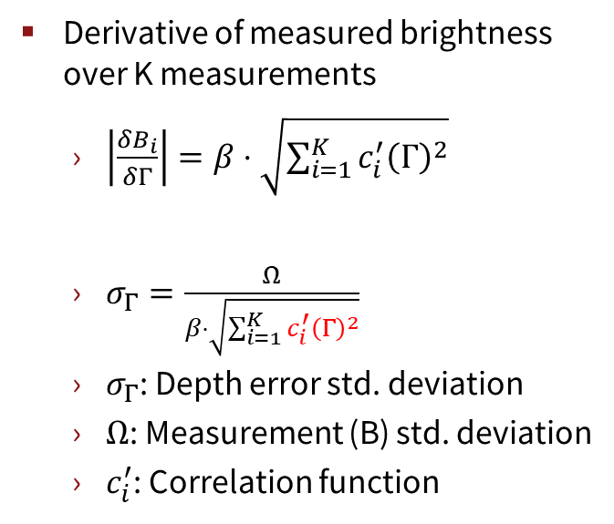
ToF Imager Basics
Derivative of measured brightness over K measurements
$\left|\frac{δB_{i}}{δΓ}\right|=β⋅\sqrt{\sum_{i=1}^{K}{c_{i}^{′}{\left(Γ\right)}^{2}}}$
$σ_{Γ}=\frac{Ω}{β⋅\sqrt{\sum_{i=1}^{K}{c_{i}^{′}{\left(Γ\right)}^{2}}}}$
$σ_{Γ}$: Depth error std. deviation
$Ω$: Measurement (B) std. deviation
$c_{i}^{′}$: Correlation function
Source: Mohit Gupta, Andreas Velten, Shree K. Nayar, and Eric Breitbach. 2018. What Are Optimal Coding Functions for Time-of-Flight Imaging?. ACM Trans. Graph. 37, 2, Article 13 (February 2018), 18 pages. DOI: https://doi.org/10.1145/3152155

Slide 8
Coding Functions

Slide 9
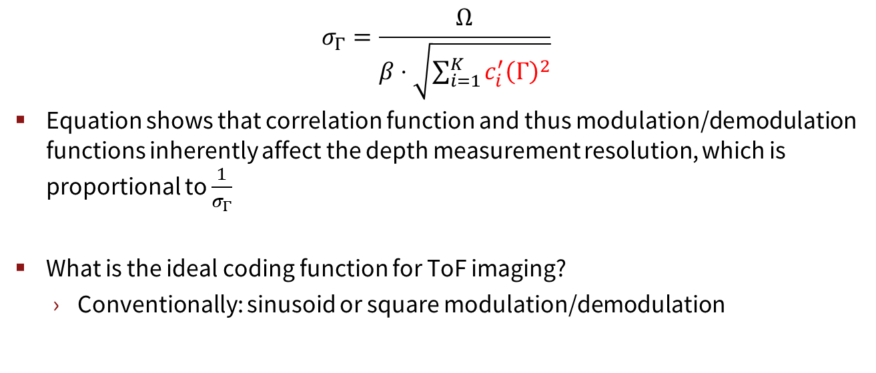
Coding Functions
$$σ_{Γ}=\frac{Ω}{β⋅\sqrt{\sum_{i=1}^{K}{c_{i}^{′}{\left(Γ\right)}^{2}}}}$$
Equation shows that correlation function and thus modulation/demodulation functions inherently affect the depth measurement resolution, which is proportional to $\frac{1}{σ_{Γ}}$
What is the ideal coding function for ToF imaging?
Conventionally: sinusoid or square modulation/demodulation

Slide 10
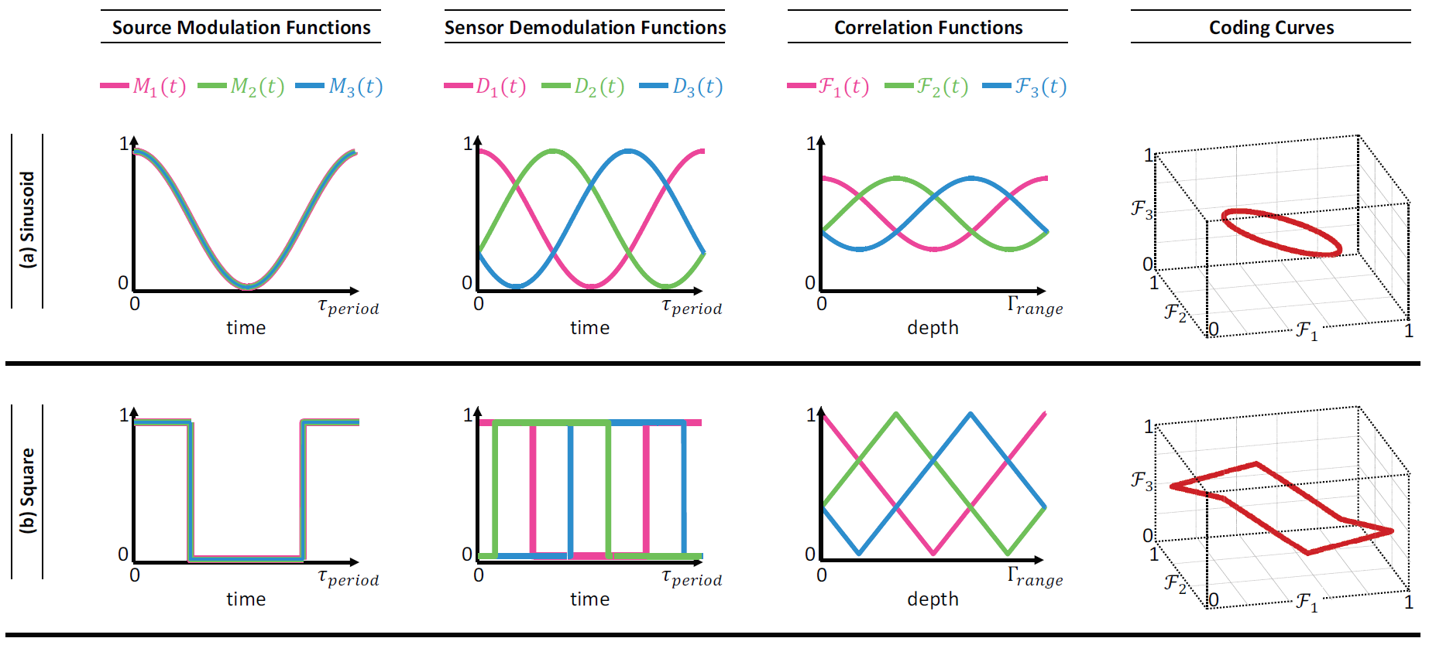
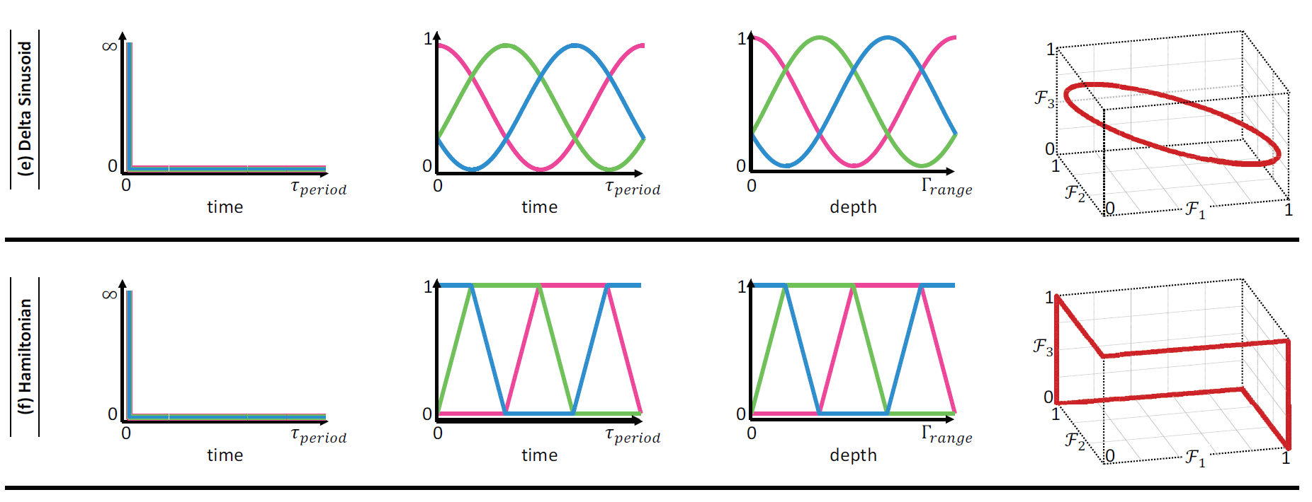
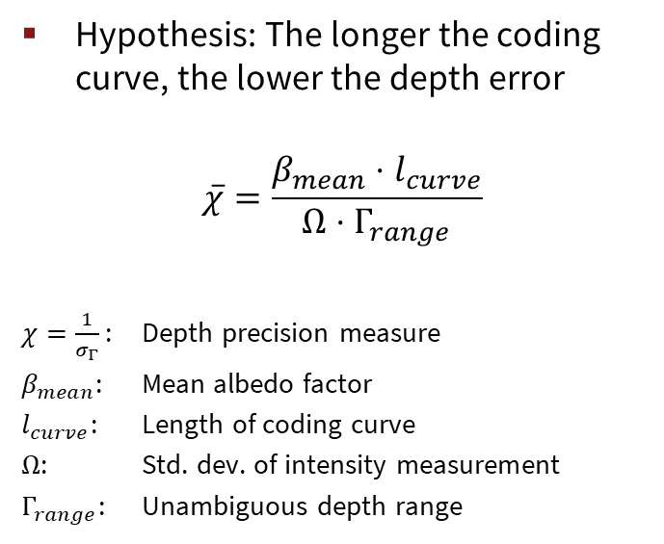
Coding Functions
Hypothesis: The longer the coding curve, the lower the depth error
$$\overline{χ}=\frac{β_{mean}⋅l_{curve}}{Ω⋅Γ_{range}}$$
$χ=\frac{1}{σ_{Γ}}$ : Depth precision measure
$β_{mean}$: Mean albedo factor
$l_{curve}$: Length of coding curve
$Ω$: Std. dev. of intensity measurement
$Γ_{range}$: Unambiguous depth range
Source: Mohit Gupta, Andreas Velten, Shree K. Nayar, and Eric Breitbach. 2018. What Are Optimal Coding Functions for Time-of-Flight Imaging?. ACM Trans. Graph. 37, 2, Article 13 (February 2018), 18 pages. DOI: https://doi.org/10.1145/3152155

Slide 11
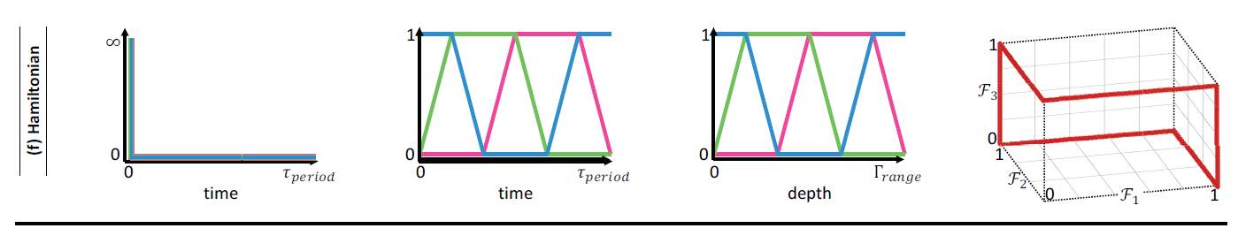
Coding Functions
Paper by M. Gupta et al. shows Hamiltonian coding
Has better depth resolution than sinusoid and square
Is not provably optimal
Question: Can we use a Generative Adversarial Networks (GAN) in order to generate the ideal coding function depending on the scene?
Source: Mohit Gupta, Andreas Velten, Shree K. Nayar, and Eric Breitbach. 2018. What Are Optimal Coding Functions for Time-of-Flight Imaging?. ACM Trans. Graph. 37, 2, Article 13 (February 2018), 18 pages. DOI: https://doi.org/10.1145/3152155

Slide 12
Project Idea

Slide 13
Project Idea – Coding function design using DL
Groundtruth
Coding functions
Albedo
Distance fall off
Noise
…
Input
Generate
ToF data
Raw → Depth
Loss function
Coding functions:
1 modulation +
K demodulation
RGB-D data
Groundtruth

Slide 14
Project Idea – Coding function design using DL
Backpropagate loss to adjust coding functions
Input
Generate
ToF data
Raw → Depth
(CF / CNN)
Loss function
Coding functions:
1 modulation +
K demodulation
RGB-D data
Groundtruth

Slide 15
Project Idea – Coding function design using DL
Start off simple… no neural network
Pixelwise loss function that compares generated ToF image and groundtruth
Number of demodulation functions (K) has to be greater or equal to 3
Input
Generate
ToF data
Raw → Depth
(Closed Form)
Loss function
Coding functions:
1 modulation +
K demodulation
RGB-D data
Groundtruth

Slide 16
Project Idea – Coding function design using DL
Replace closed form solution with CNN
Can we reduce the number of demodulation functions to 2?
How much does e.g. object recognition accuracy degrade?
Input
Generate
ToF data
Raw → Depth
(CNN)
Loss function
Coding functions:
1 modulation +
K demodulation
RGB-D data
Groundtruth

Slide 17
Project Idea – Coding function design using DL
Further considerations:
Coding functions are setup as arbitrary signals (e.g. 100 data points each)
Possible datasets (RGB-D data):
NYU dataset (most common 3D dataset)
SUN dataset
Shapenet
3D Face dataset?

Slide 18
Project Idea – Coding function design using DL
Goals:
Find general optimal coding functions
Find specific optimal coding functions
E.g. for the scenario of 3D face recognition
As all faces have similar shape there could be a special coding function that works particularly well for faces
Compare the result to sinusoid, square and hamiltonian coding
If simulator comes out: Simulate and compare

Slide 19
Roadmap

Slide 20
Roadmap
Study the simulator
Finalize dataset (Shapenet, Face-Dataset, NYU)
Generate ToF image
Perhaps adjust modeling to get better results
Pixel-wise loss and backprop using the closed form solution for raw-to-depth
Replace closed form solution with CNN

Slide 21
Simulator Example

Slide 22
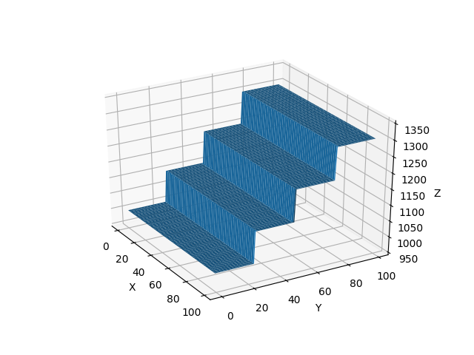
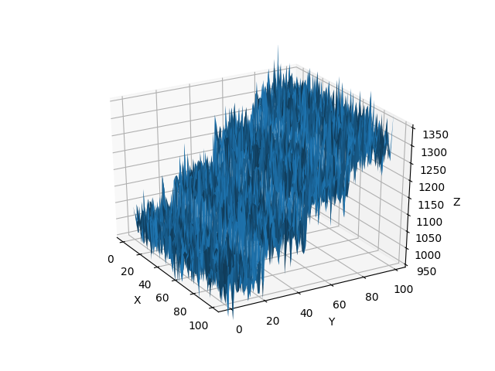
Simulator Example – Sinusoidal Coding
Mean Squared Error: 1670.07

Slide 23
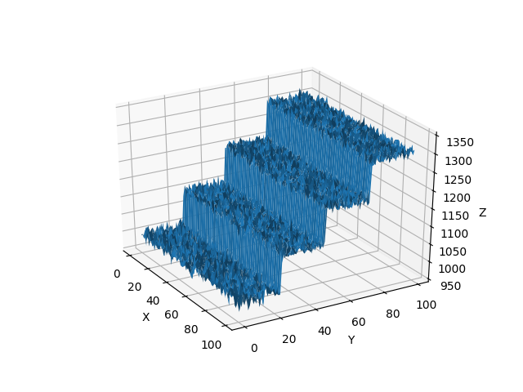
Simulator Example – Hamiltonian Coding
Mean Squared Error: 112.77

Slide 24
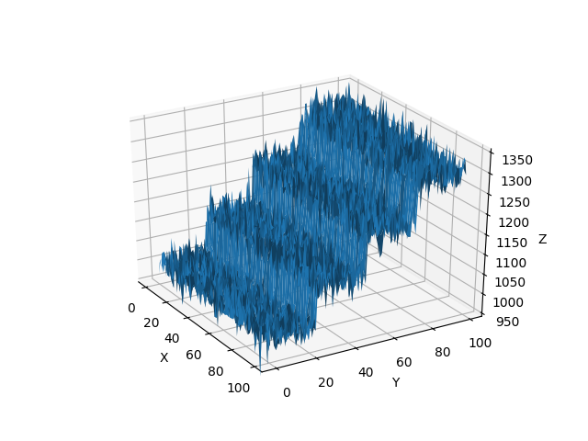
Simulator Example – Square Coding
Mean Squared Error: 630.01

Slide 25
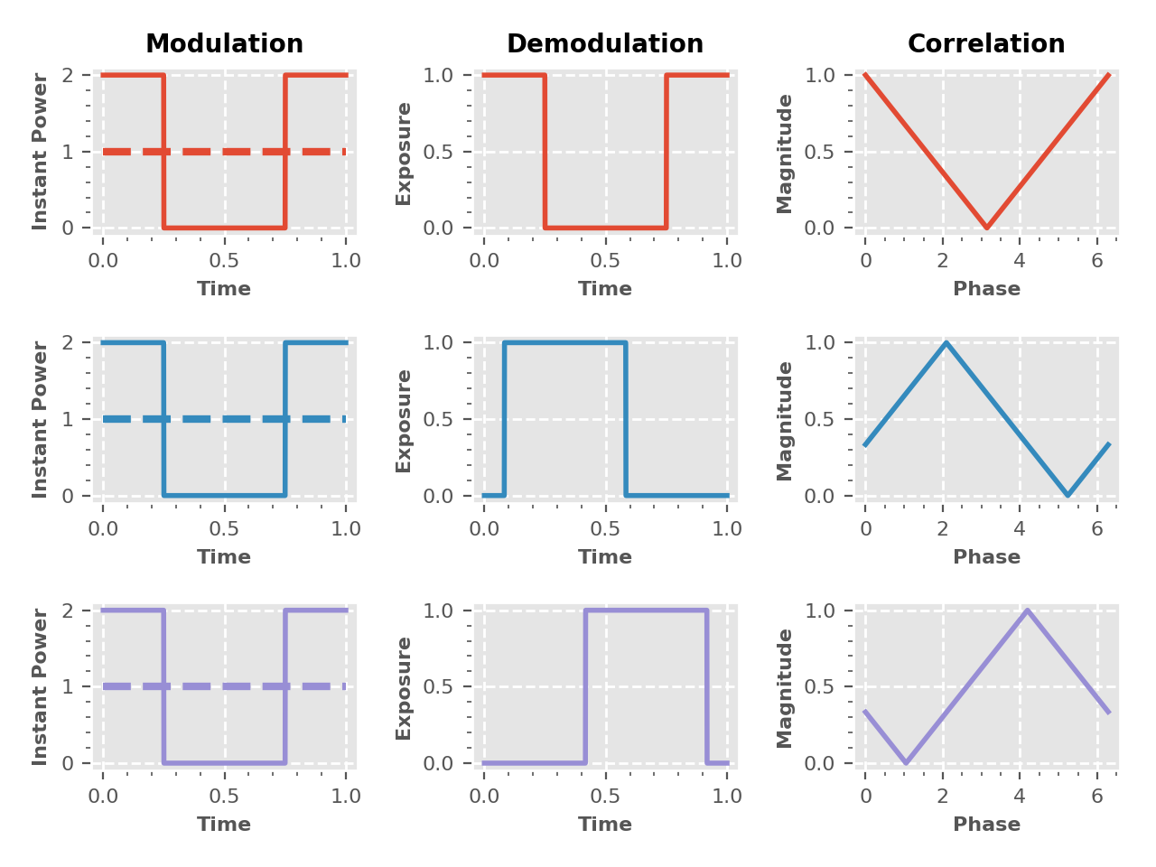
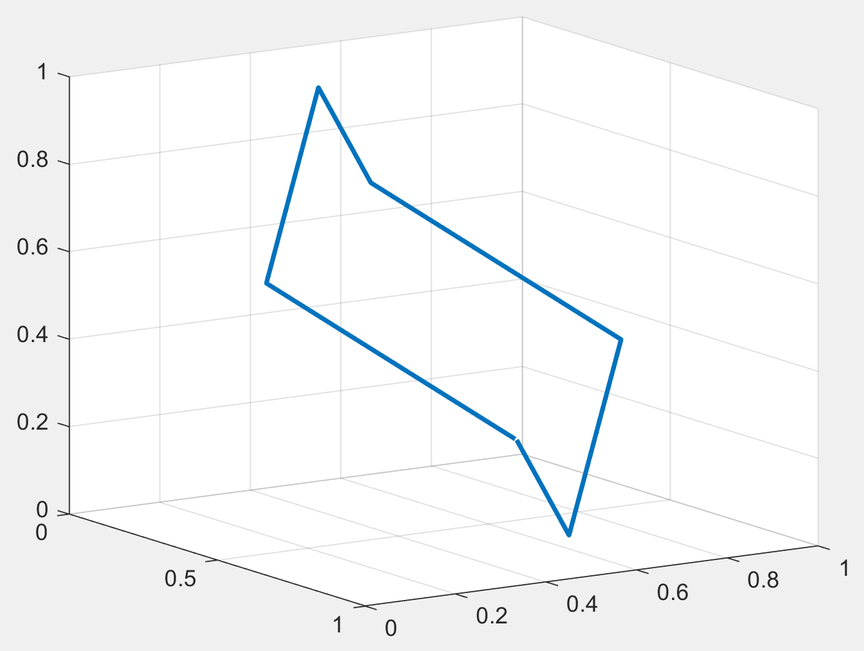
Simulator Example – How about different length pulses

Slide 26
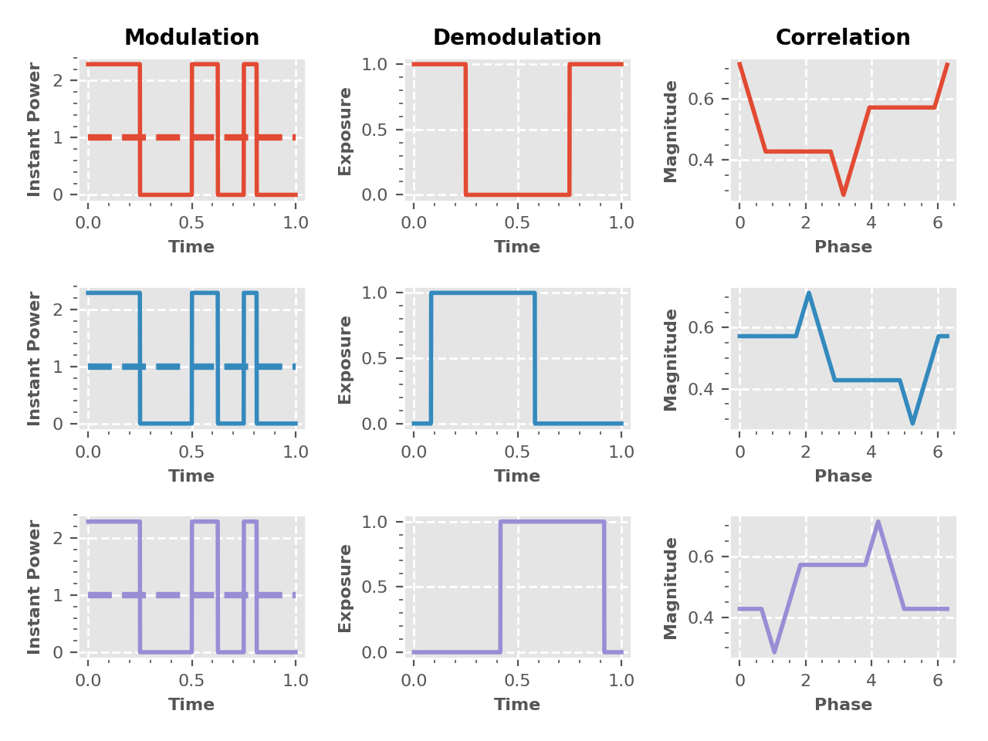
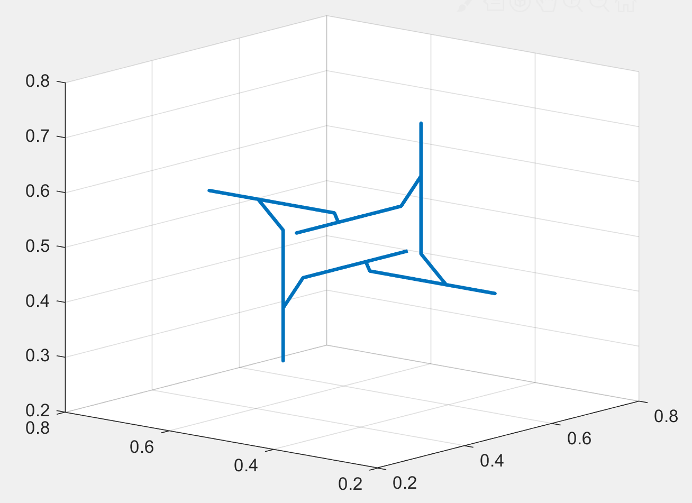
Simulator Example – How about different length pulses

Slide 27
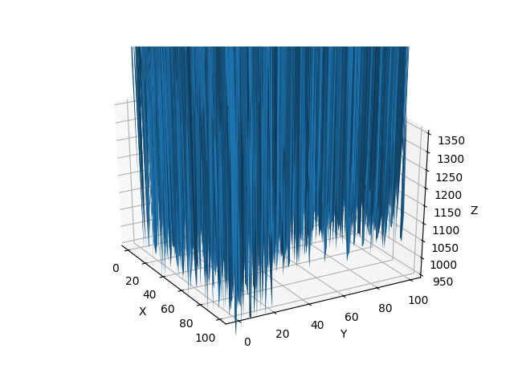
Simulator Example – Square Coding

Slide 28
Simulator Example – Optimal Coding
?

