Slide 1
Time-of-Flight Coding
Jonas Messner & Nicholas Gaudio
04/10/2019

Slide 2
Indirect Time-of-Flight Fundamentals

Slide 3
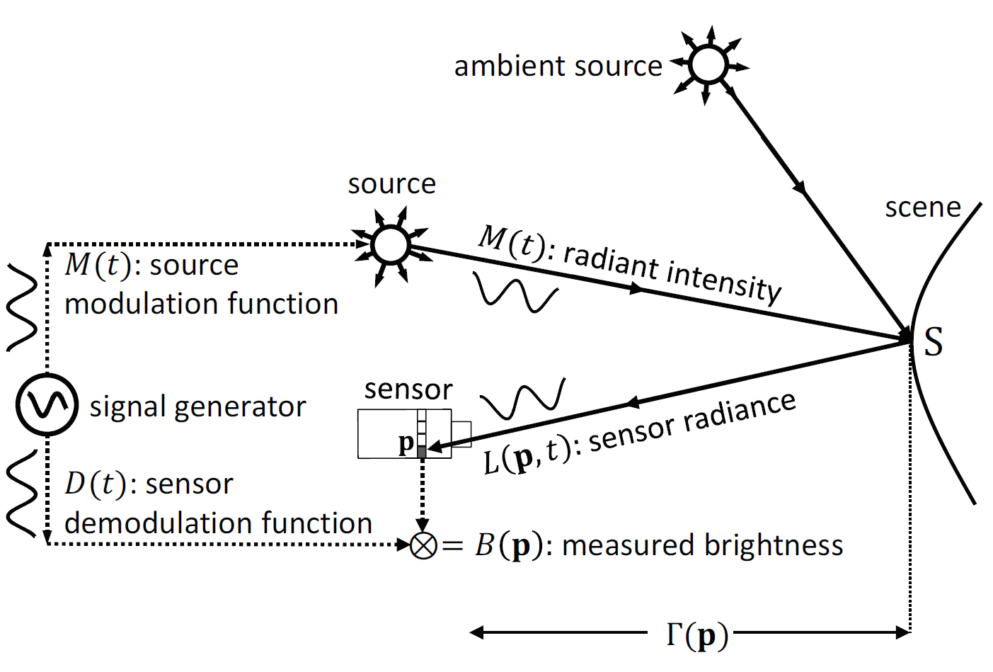
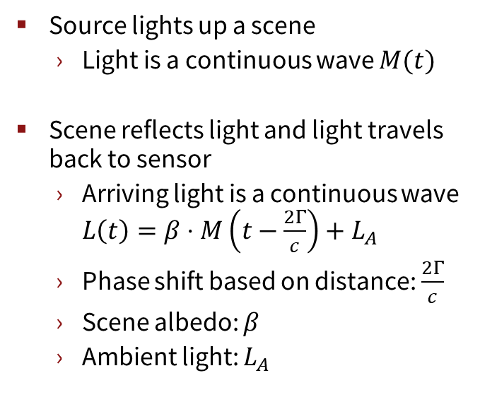
ToF Imager Basics
Source lights up a scene
Light is a continuous wave $M(t)$
Scene reflects light and light travels back to sensor
Arriving light is a continuous wave $L\left(t\right)=β⋅M\left(t−\frac{2Γ}{c}\right)+L_{A}$
Phase shift based on distance: $\frac{2Γ}{c}$
Scene albedo: $β$
Ambient light: $L_{A}$
Source: Mohit Gupta, Andreas Velten, Shree K. Nayar, and Eric Breitbach. 2018. What Are Optimal Coding Functions for Time-of-Flight Imaging?. ACM Trans. Graph. 37, 2, Article 13 (February 2018), 18 pages. DOI: https://doi.org/10.1145/3152155

Slide 4
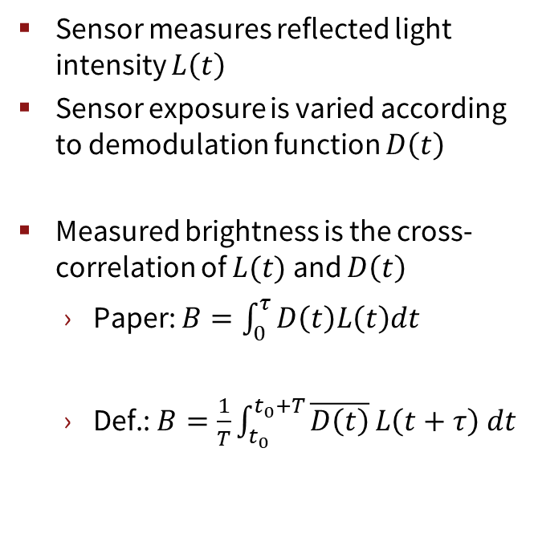
ToF Imager Basics
Sensor measures reflected light intensity $L\left(t\right)$
Sensor exposure is varied according to demodulation function $D\left(t\right)$
Measured brightness is the cross-correlation of $L(t)$ and $D\left(t\right)$
Paper: $B=\int_{0}^{τ}{D\left(t\right)L\left(t\right)dt}$
Def.: $B=\frac{1}{T}\int_{t_{0}}^{t_{0}+T}{\overline{D\left(t\right)}}L\left(t+τ\right) dt$
Source: Mohit Gupta, Andreas Velten, Shree K. Nayar, and Eric Breitbach. 2018. What Are Optimal Coding Functions for Time-of-Flight Imaging?. ACM Trans. Graph. 37, 2, Article 13 (February 2018), 18 pages. DOI: https://doi.org/10.1145/3152155

Slide 5
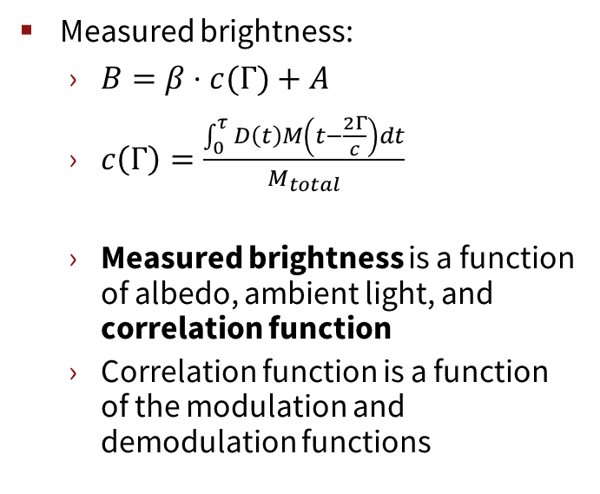
ToF Imager Basics
Measured brightness:
$B=β⋅c(Γ)+A$
$c\left(Γ\right)=\frac{\int_{0}^{τ}{D\left(t\right)M\left(t−\frac{2Γ}{c}\right)dt}}{M_{total}}$
Measured brightness is a function of albedo, ambient light, and correlation function
Correlation function is a function of the modulation and demodulation functions
Source: Mohit Gupta, Andreas Velten, Shree K. Nayar, and Eric Breitbach. 2018. What Are Optimal Coding Functions for Time-of-Flight Imaging?. ACM Trans. Graph. 37, 2, Article 13 (February 2018), 18 pages. DOI: https://doi.org/10.1145/3152155

Slide 6
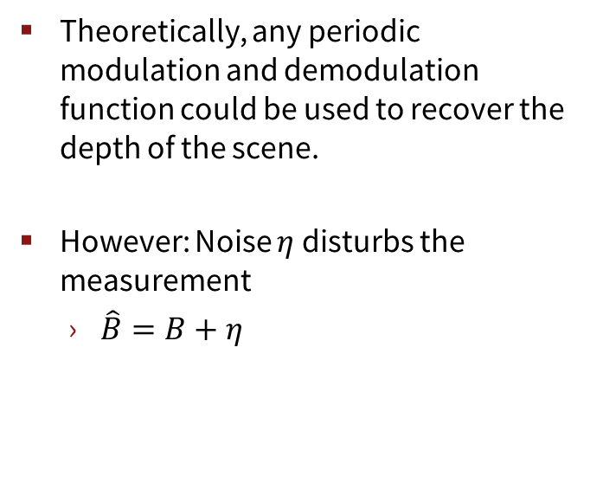
ToF Imager Basics
Theoretically, any periodic modulation and demodulation function could be used to recover the depth of the scene.
However: Noise $η$ disturbs the measurement
$\hat{B}=B+η$
Source: Mohit Gupta, Andreas Velten, Shree K. Nayar, and Eric Breitbach. 2018. What Are Optimal Coding Functions for Time-of-Flight Imaging?. ACM Trans. Graph. 37, 2, Article 13 (February 2018), 18 pages. DOI: https://doi.org/10.1145/3152155

Slide 7
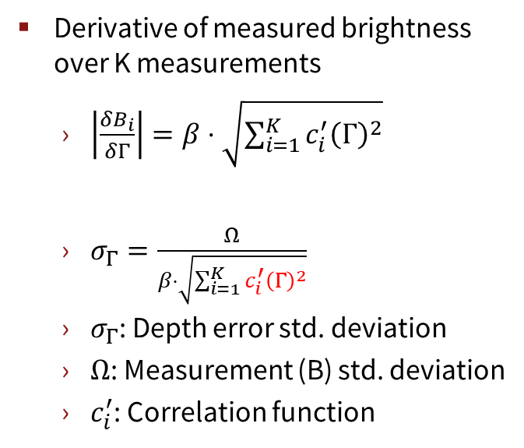
ToF Imager Basics
Derivative of measured brightness over K measurements
$\left|\frac{δB_{i}}{δΓ}\right|=β⋅\sqrt{\sum_{i=1}^{K}{c_{i}^{′}{\left(Γ\right)}^{2}}}$
$σ_{Γ}=\frac{Ω}{β⋅\sqrt{\sum_{i=1}^{K}{c_{i}^{′}{\left(Γ\right)}^{2}}}}$
$σ_{Γ}$: Depth error std. deviation
$Ω$: Measurement (B) std. deviation
$c_{i}^{′}$: Correlation function
Source: Mohit Gupta, Andreas Velten, Shree K. Nayar, and Eric Breitbach. 2018. What Are Optimal Coding Functions for Time-of-Flight Imaging?. ACM Trans. Graph. 37, 2, Article 13 (February 2018), 18 pages. DOI: https://doi.org/10.1145/3152155

Slide 8
Coding Functions

Slide 9
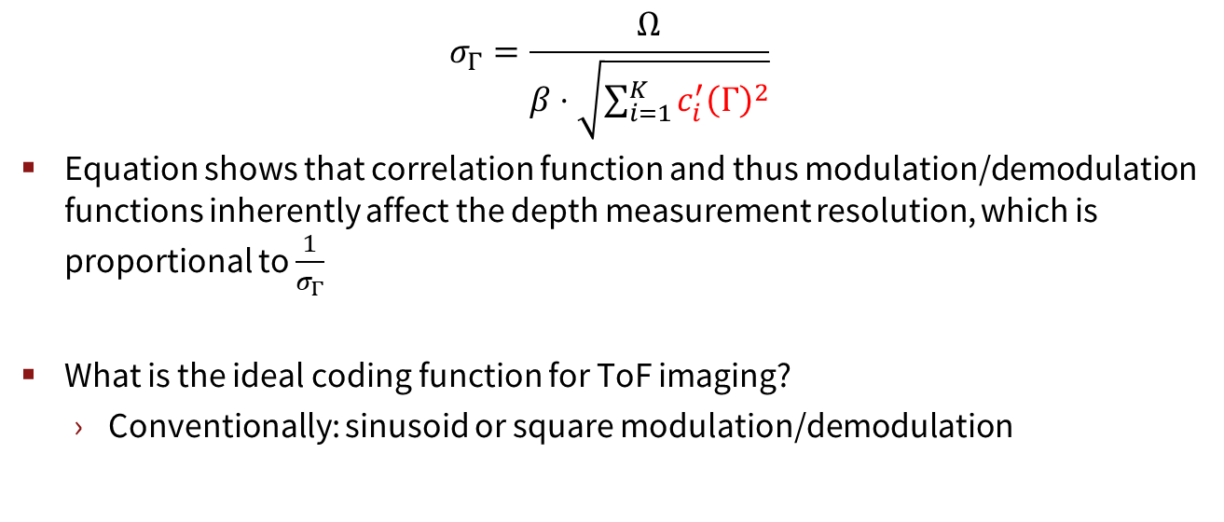
Coding Functions
$$σ_{Γ}=\frac{Ω}{β⋅\sqrt{\sum_{i=1}^{K}{c_{i}^{′}{\left(Γ\right)}^{2}}}}$$
Equation shows that correlation function and thus modulation/demodulation functions inherently affect the depth measurement resolution, which is proportional to $\frac{1}{σ_{Γ}}$
What is the ideal coding function for ToF imaging?
Conventionally: sinusoid or square modulation/demodulation

Slide 10
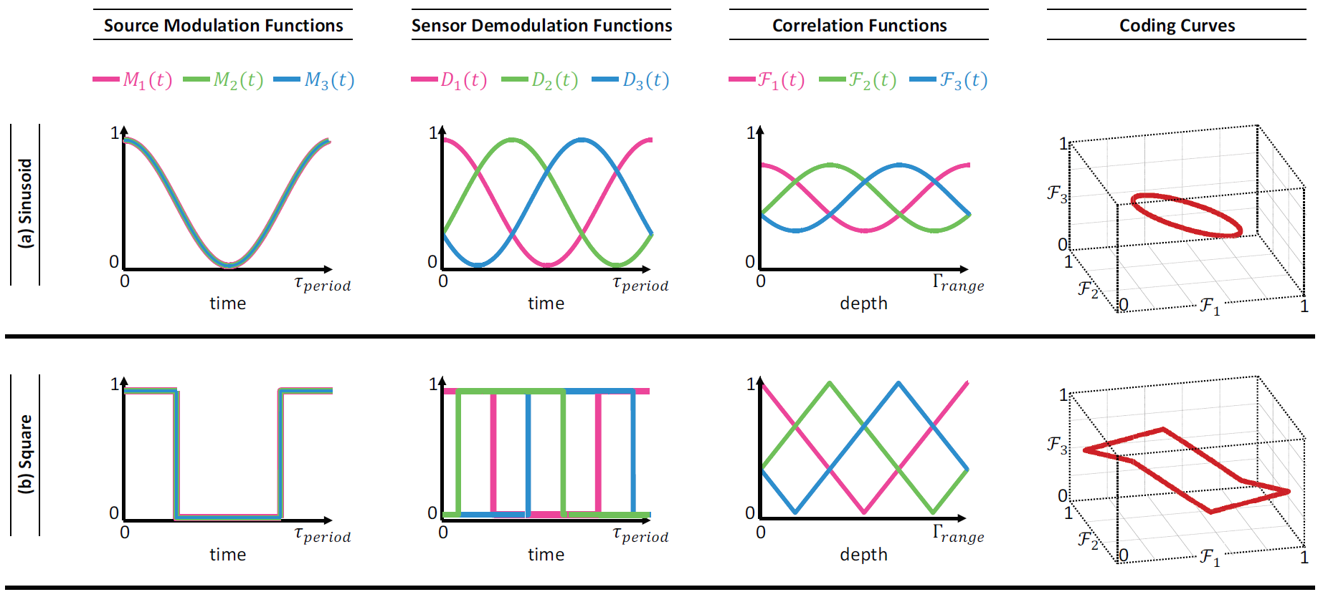
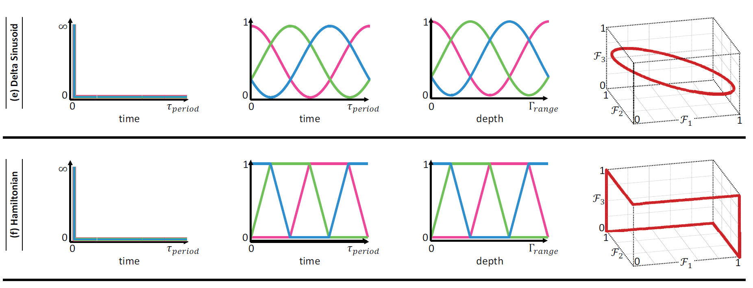
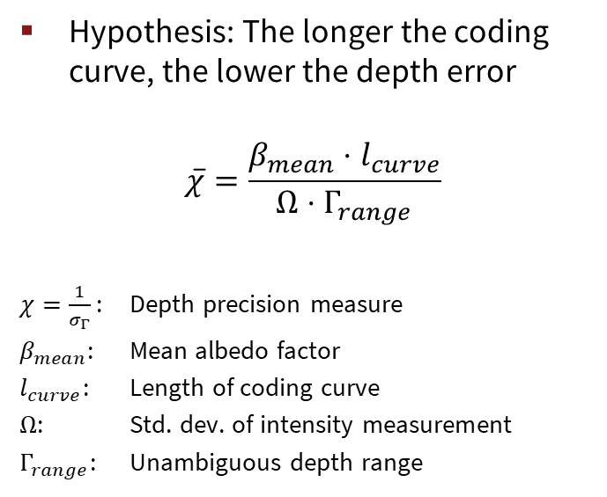
Coding Functions
Hypothesis: The longer the coding curve, the lower the depth error
$$\overline{χ}=\frac{β_{mean}⋅l_{curve}}{Ω⋅Γ_{range}}$$
$χ=\frac{1}{σ_{Γ}}$ : Depth precision measure
$β_{mean}$: Mean albedo factor
$l_{curve}$: Length of coding curve
$Ω$: Std. dev. of intensity measurement
$Γ_{range}$: Unambiguous depth range
Source: Mohit Gupta, Andreas Velten, Shree K. Nayar, and Eric Breitbach. 2018. What Are Optimal Coding Functions for Time-of-Flight Imaging?. ACM Trans. Graph. 37, 2, Article 13 (February 2018), 18 pages. DOI: https://doi.org/10.1145/3152155

Slide 11
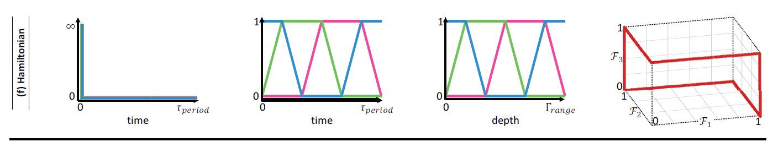
Coding Functions
Paper by M. Gupta et al. shows Hamiltonian coding
Has better depth resolution than sinusoid and square
Is not provably optimal
Question: Can we use a Generative Adversarial Networks (GAN) in order to generate the ideal coding function depending on the scene?
Source: Mohit Gupta, Andreas Velten, Shree K. Nayar, and Eric Breitbach. 2018. What Are Optimal Coding Functions for Time-of-Flight Imaging?. ACM Trans. Graph. 37, 2, Article 13 (February 2018), 18 pages. DOI: https://doi.org/10.1145/3152155

Slide 12
Project Idea

Slide 13
Project Idea – Coding function design using DL
Groundtruth
Coding functions
Albedo
Distance fall off
Noise
…
Input
Generate
ToF image
Neural Network
Loss function
Coding functions:
1 modulation +
3 demodulation
RGB-D data
Groundtruth

Slide 14
Project Idea – Coding function design using DL
Backpropagate loss to adjust coding functions
Input
Generate
ToF image
Neural Network
Loss function
Coding functions:
1 modulation +
3 demodulation
RGB-D data
Groundtruth

Slide 15
Project Idea – Coding function design using DL
Start off simple… no neural network
Pixelwise loss function that compares generated ToF image and groundtruth
Enforce maximal similarity between two 3D depth maps
Coding functions
Generate
ToF image
Loss function
RGB-D data
Pixelwise loss

Slide 16
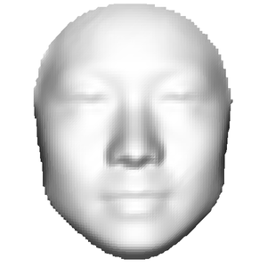
Project Idea – Coding function design using DL
Include an encoding neural network
Issue: No spatial awareness
=
Coding functions
Generate
ToF image
Encoding
CNN
Loss function
RGB-D data
Encoding
CNN
Loss between encodings

Slide 17
Project Idea – Coding function design using DL
≠
Add a decoding neural network which enforces spatial awareness in the encoding
Coding functions
Generate
ToF image
Encoding
CNN
Decoding
CNN
RGB-D data
Encoding
CNN
Decoding
CNN

Slide 18
Project Idea – Coding function design using DL
≠
Add loss function and train encoding and decoding neural networks
Coding functions
Generate
ToF image
Encoding
CNN
Decoding
CNN
Loss function
RGB-D data
Encoding
CNN
Decoding
CNN
Loss function

Slide 19
Project Idea – Coding function design using DL
Remove decoding network insert loss function after the encoding stage
Train coding function that gives optimal similarity of encodings
Coding functions
Generate
ToF image
Encoding
CNN
Loss function
RGB-D data
Encoding
CNN

Slide 20
Project Idea – Coding function design using DL
Potential issue: A very noisy ToF image leads to the same encoding as the groundtruth depth → bad. Perhaps this can be addressed when training the encoder and decoder.
Coding functions
Generate
ToF image
Encoding
CNN
Loss function
RGB-D data
Encoding
CNN

Slide 21
Project Idea – Coding function design using DL
Further considerations:
Coding functions are setup as arbitrary signals (e.g. 100 data points each)
Possible datasets (RGB-D data):
NYU dataset (most common 3D dataset)
SUN dataset
Shapenet
3D Face dataset?

Slide 22
Project Idea – Coding function design using DL
Goals:
Find general optimal coding functions
Find specific optimal coding functions
E.g. for the scenario of 3D face recognition
As all faces have similar shape there could be a special coding function that works particularly well for faces
Compare the result to sinusoid, square and hamiltonian coding
If simulator comes out: Simulate and compare

Slide 23
Roadmap

Slide 24
Roadmap
Study the simulator
Finalize dataset (Shapenet, Face-Dataset, NYU)
Generate ToF image
Perhaps adjust modeling to get better results
Pixel-wise loss and backprop
Train encoding-decoding network (U-Net)
Train coding function with encoding network (decoding network removed)

