Slide 1


INTERPRETING RAMAN SPECTROSCOPY TOWARDS DIAGNOSTIC PURPOSES : AN EXPLAINABLE DEEP-LEARNING BASED APPROACH
Double Master – Università di Milano Bicocca – Université Nice Côte d’Azur
Master's thesis defence
Supervisor : Prof.ssa Vincenzina Messina
Co-Supervisor : Dott. Dario Bertazioli
SINGLAN Nina
867646 - 21604881

Slide 2
OVERVIEW
Introduction
Results
?
Methodology
Problem statement
Notes:
In this presentation, we will see :
- 1. The global context of this project
- 2. The problem of this particular thesis
- 3. The methodology used to answer this problem.
- 4. The results obtained.
- 5. The discussion raised by them.

Slide 3
INTRODUCTION

Slide 4



GLOBAL CONTEXT
Need for non-invasive and rapid diagnosis system
Method called Raman Spectroscopy can analyse saliva samples
Deep Learning techniques can help to decodes these spectra
Notes:
This project is part of a collaboration between the UNIMIB and the LABION. The global project is to propose a new, rapid and non-invasive way to diagnose several diseases. With the Raman Spectroscopy it is possible to analyse saliva samples. And with Deep Learning method it is possible to decodes quickly these spectra.

Slide 5
PROBLEM STATEMENT

Slide 6
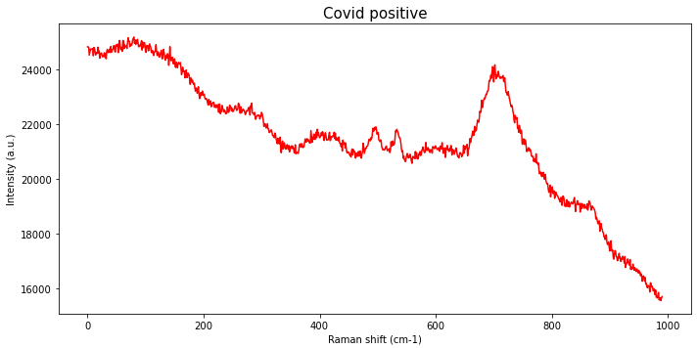
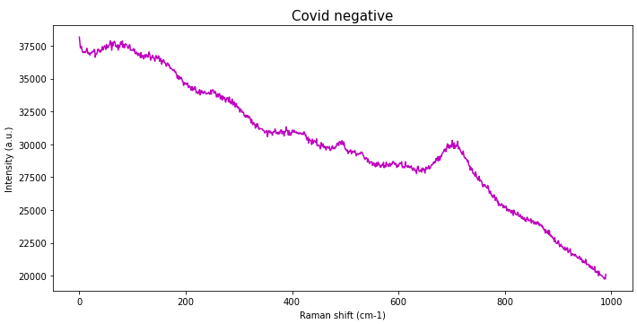

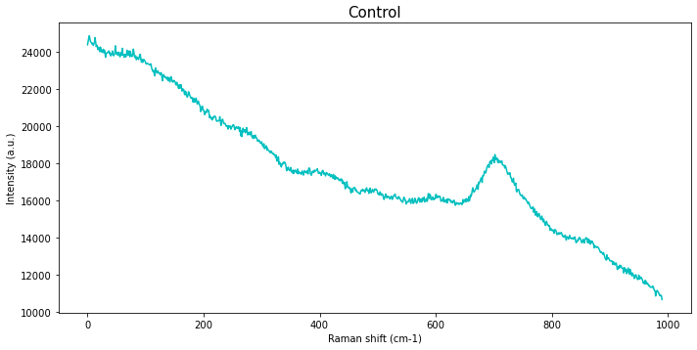
DATA
SARS-Cov-2
30 Cov+
+
37 Cov-
+
34 CTRLs
=
101 patients involved
Covid Positive
Laser
Salivary Sample
Detector
Covid Negative
~ 25 spectra for each patient
~ 2500 total spectra
Control
Notes:
Using Raman Spectroscopy technique, spectra are obtained. There are 30 Covid Positive Patient, 37 Covid Negative ones and 30 Control. We obtain about 25 spectra per patient.

Slide 7
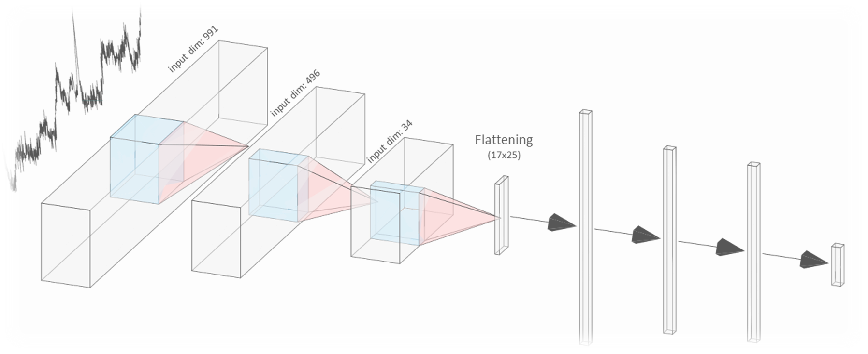
MODEL
89%
Dense
Neurons: 732
Dense
Neurons: 189
Dense
Neurons: 152
Softmax
Neurons: 3
MaxPooling
Kernel Size: 6
Strides: 3
MaxPooling
Kernel Size: 3
Strides: 2
Conv1D
Filters: 100
Kernel Size: 100
Strides: 1
Conv1D
Filters: 100
Kernel Size: 5
Strides: 2
Conv1D
Filters: 25
Kernel Size: 9
Strides: 5

Slide 8

PROBLEM
Treatment
Data
Model
Decision
HOW CAN WE UNDERSTAND THE MODEL AND THEREFORE TRUST IT?

Slide 9
METHODOLOGY

Slide 10


CLASS ACTIVATION MAPPING
Already applied to spectra
Visual explanation
Need to modify and retrain the model

Slide 11
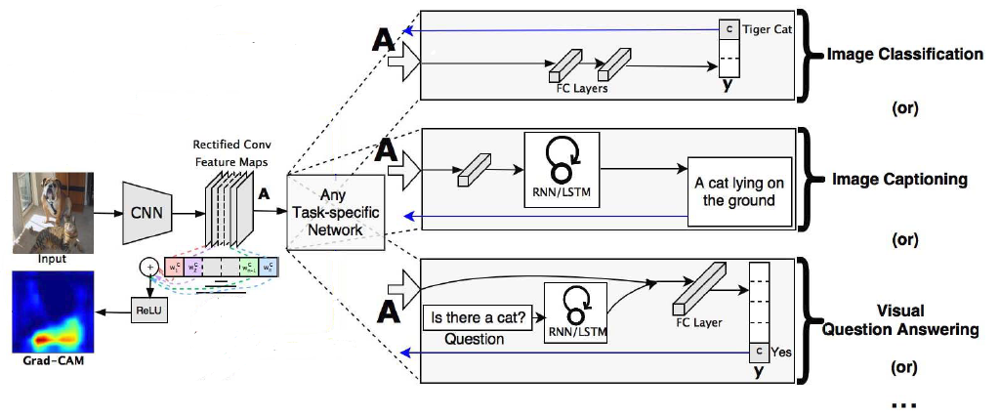
GRADIENT CAM
USABLE WITH EVERY CNN
Never applied to spectral data

Slide 12
RESULTS

Slide 13
CAM : CUT MODEL
Re-training very time consuming !
Global Average Pooling layer
81.7%

Slide 14
RESULTS AT SPECTRA LEVEL
Covid Positive classified as Cov+
Control classified as Cov+

Slide 15
GENERALIZATION
Number of spectra (%) in which a variable is important for Cov+ classification

Slide 16
GRADIENT CAM : RESULTS
Covid Positive classified as Cov+
Control classified as Cov+

Slide 17
GENERALIZATION
Number of spectra (%) in which a variable is important for Cov+ classification

Slide 18
DISCUSSION

Slide 19
LACK OF GENERALIZATION
Hypothesis : Due to the Leave-One-Patient-Out Cross-Validation, there is no general important variable
Model trained over the 0th fold of the Leave-One-Patient-Out Cross-Validation.
Model trained over the 2th fold of the Leave-One-Patient-Out Cross-Validation.
BOTH MODELS DO NOT AGREE ON WHICH ARE THE IMPORTANT VARIABLE !!!

Slide 20
FUTURE WORKS

Slide 21




FUTURE WORKS
Notes:
1 – Analyse results with help of specialist
2 – Investigate LOPOCV and new model definition
3 – Go further with CAM and explore other XAI techniques

Slide 22


