Slide 1
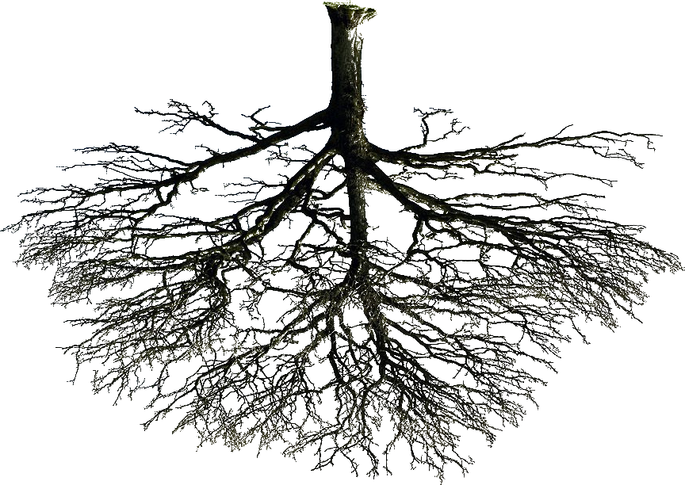
Trees and Forests
A Quick Overview
By Munir Winkel

Slide 2
Questions for the Audience
What do you know about:
1) decision trees
2) random forests?
How could they be used?

Slide 3
Potential Answers
Decision Trees:
“set of splitting rules used to segment the predictor space into a number of simple regions”
1) Regression Trees;
2) Classification Trees;

Slide 4
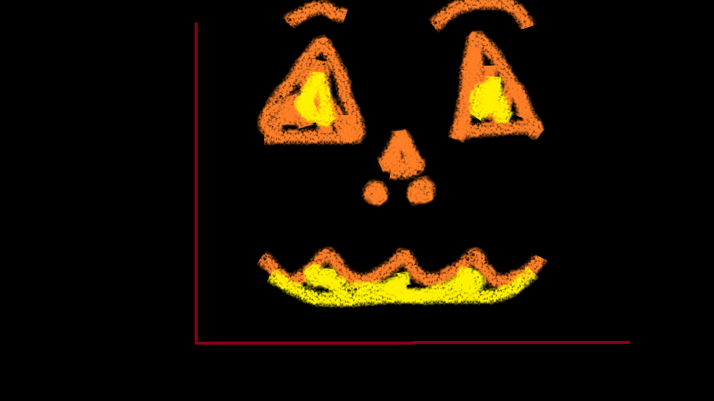
Fake Life Example
Notes:
Source :https://www.lcghd.org/documents/Ebola%20Decision%20Tree%20-%20CDC%20Consultation%20ODH%20Sep%2024%202014.pdf

Slide 5
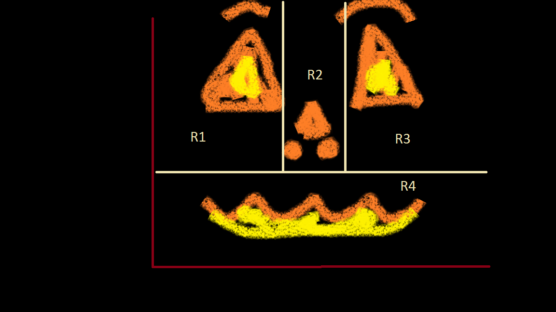
Fake Life Example
Notes:
Source :https://www.lcghd.org/documents/Ebola%20Decision%20Tree%20-%20CDC%20Consultation%20ODH%20Sep%2024%202014.pdf

Slide 6
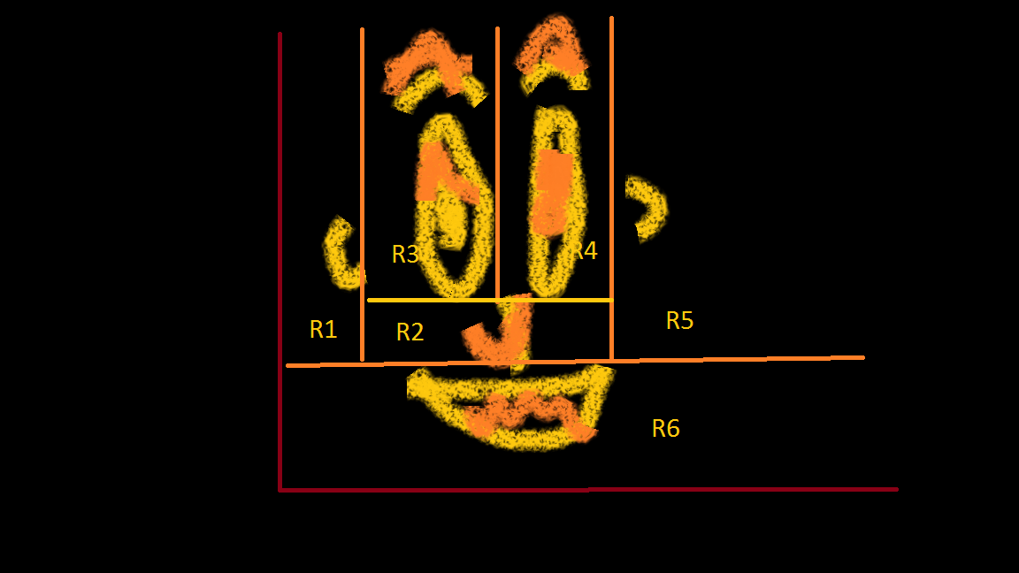
Fake Life Example
Notes:
Source :https://www.lcghd.org/documents/Ebola%20Decision%20Tree%20-%20CDC%20Consultation%20ODH%20Sep%2024%202014.pdf

Slide 7
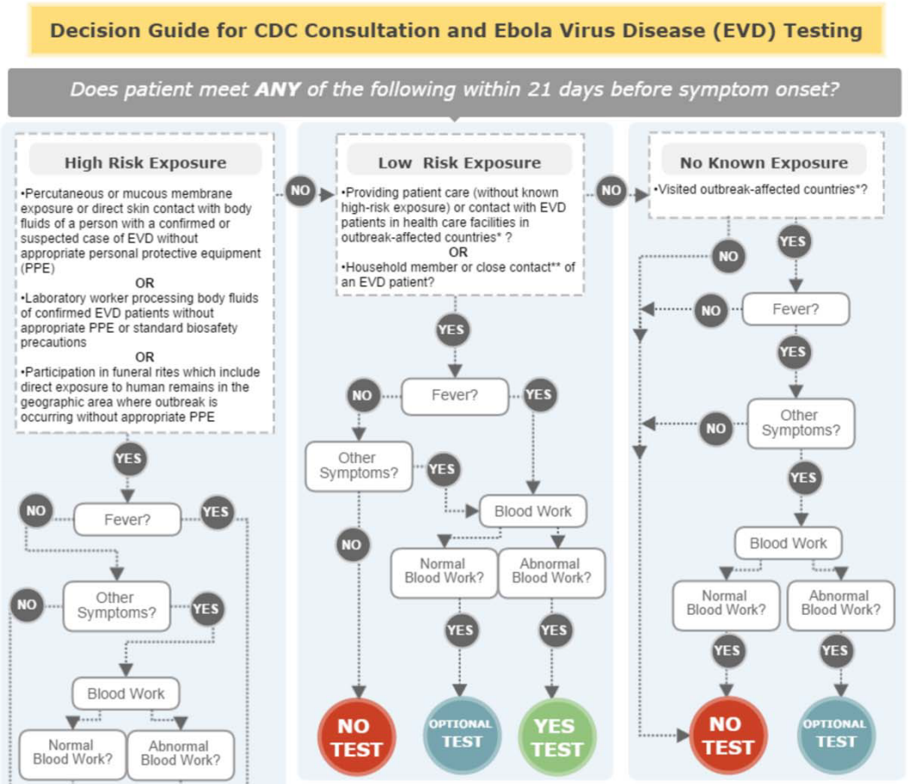
Real Life Example
Notes:
Source :https://www.lcghd.org/documents/Ebola%20Decision%20Tree%20-%20CDC%20Consultation%20ODH%20Sep%2024%202014.pdf

Slide 8
Create Your Own Decision Tree
Goal:
Predict if someone will go to a Halloween party this year
Task:
Come up with 3 – 5 good questions
Rule:
You cannot directly ask this question

Slide 9
Random Forests
Can be thought of as …
Combining the results of numerous decision trees, each of which is potentially:
1) using different (subsets of) data;
2) using different (subsets of) predictors;

Slide 10
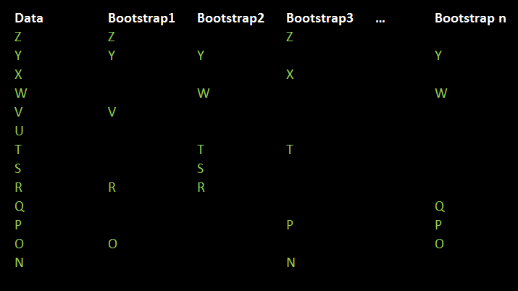
Random Forests
Step 1 ) Bootstrap

Slide 11
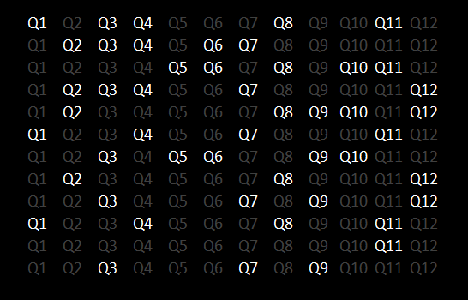
Random Forests
Step 2) Select m <= p input variables
Regression: m = p/3 classification: m = sqrt(p) bagging: m=p

Slide 12
Random Forests: Then What?
After bootstrapping …
After selecting m <= p “predictors” …
Classification: “majority vote”
Regression: “average”

Slide 13
How Do These Work?
Split the predictor space:
1) according to what criteria?
- Gini , RSS, classification error,
cross entropy
Make predictions based on:
1) majority vote
2) mean of responses in space

Slide 14
What’s the Catch?
Good news:
- decision trees are easy to interpret
Bad news:
- not necessary great at prediction
- subject to high variability

Slide 15
An Example in R
Requires the following R packages:
- tree
- randomForest
(notice the capital F)

Slide 16
Topics Not Covered Here
“Greedy Algorithm”
“Boosting”
“Variable Importance”
“Gini Index”
“Out-of-Bag Error Estimation”
“CART Trees”
“ID3 Rule”
“Cross Entropy”
“Theory of Relativity”

