Slide 1
Support Vector Machines
Presented By Jami Jackson

Slide 2
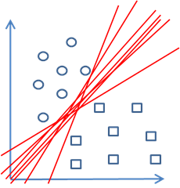
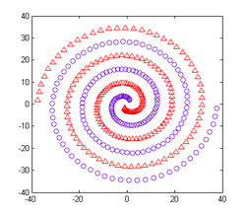
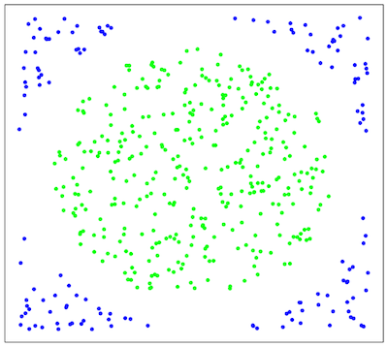
What do they Try to Solve?

Slide 3
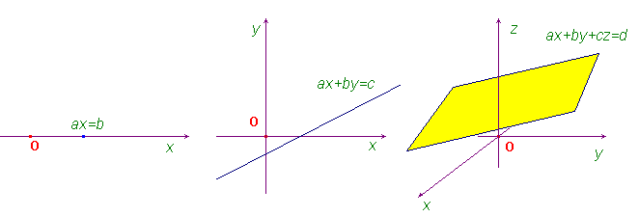
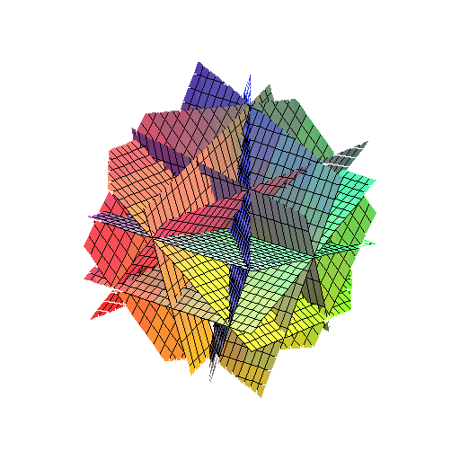
Hyperplanes

Slide 4
Property of the Hyperplane

Slide 5
Separating Hyperplane

Slide 6
The Maximal Margin Hyperplane is the Solution to the Optimization Problem:

Slide 7
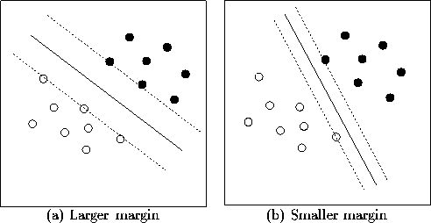
Maximal Margin Classifier

Slide 8
Support Vector Classifier
Define a hyperplane by
The optimization problem is
Subject to
where M is the margin and are slack variables.
A classification rule induced by f(x) is

Slide 9
Example of the Soft Margin of the Support Vector Classifier

Slide 10
Effect of the Tuning Parameter

Slide 11
Can We Use a Linear Boundary Here?

Slide 12
What Does it Mean to Enlarge the Feature Space?
2p Features
Then

Slide 13
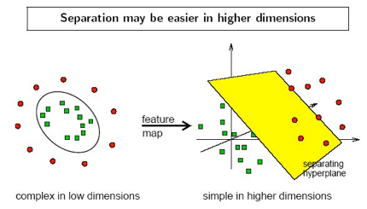
Separation by Support Vector Machines

Slide 14
How the Inner Product is Involved
The inner product of two observations is given by
The linear support vector classifier can be written as
This can be re-written as

Slide 15
Support Vector Machines
The solution function can take the form
is the collection of support vectors and K is the kernel function.

Slide 16
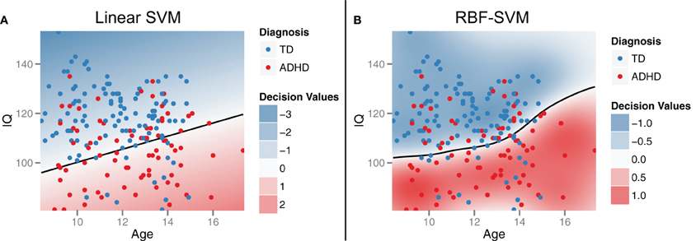
Examples of Kernel Functions
Insights into multimodal imaging classification of ADHD
Colby John B, Rudie Jeffrey D, Brown Jesse A, Douglas Pamela K, Cohen Mark S, Shehzad
Zarrar
Front. Syst. Neurosci., 16 August 2012

Slide 17
A Comparison to Other Methods

Slide 18
Extensions of the Support Vector Machine
Multiclass Problems
Penalization Method
Regression
Combined with Other Methods

Slide 19
How to Implement Support Vector Machines

Slide 20
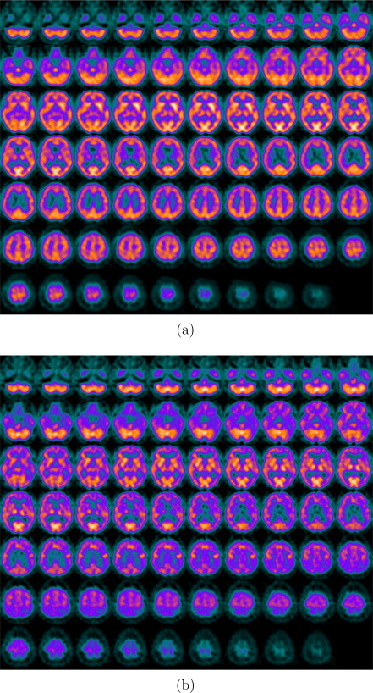
Computer-Aided Diagnosis of Alzheimer’s Type Dementia
Normal Subject
Patient affected by Alzheimer’s Type Dementia
J. Ramírez, J.M. Górriz, D. Salas-Gonzalez, A. Romero, M. López, I. Álvarez, M. Gómez-Río,
Computer-aided diagnosis of Alzheimer’s type dementia combining support vector machines and
discriminant set of features, Information Sciences, Volume 237, 10 July 2013, Pages 59-72,

Slide 21
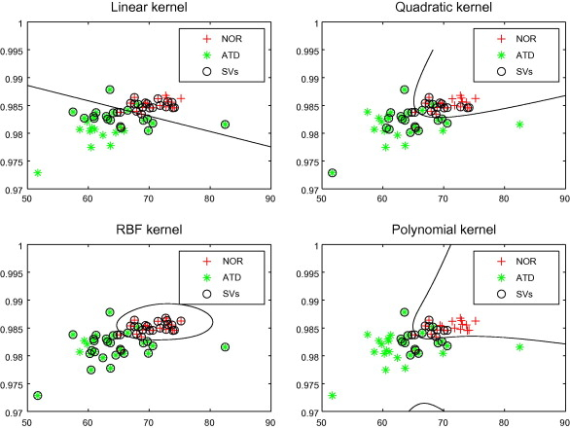
Computer-Aided Diagnosis of Alzheimer’s Type Dementia

Slide 22
Some Limitations to Consider
Choice of kernel
Choice of kernel parameters
Training Time
Multiclass

Slide 23
What’s Coming Next?
Brian Naughton:
Support Vector Machines for Ranking Models
November 14th.
Penny (Huimin) Peng:
Discriminant Analysis
November 21st.

