Slide 1
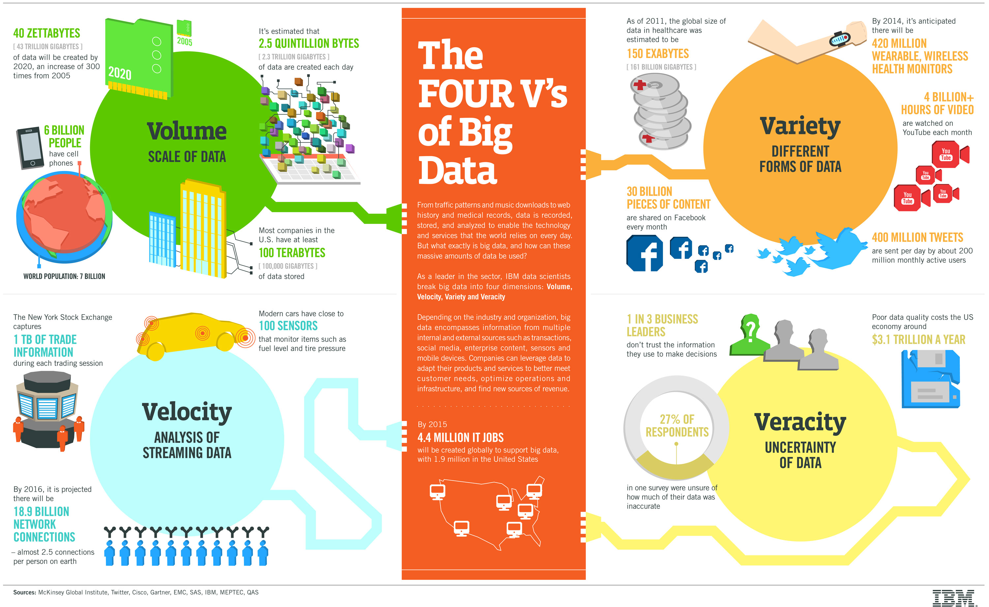
Big Data Infographic
Is “big data” the same as data science?

Slide 2
Five Data Science Skills
Technical
Communication
Collaboration
Tools
Subject Matter Expertise
Adapted from Michael Rappa,
NCSU Institute for Advanced Analytics

