Slide 1
MACHINE LEARNING WITH GRAPHS / CASE STUDY
Beyond Weisfeiler–Lehman
Persistent and cycle-aware graph representations
Implement established methods. Modify cycle features. Measure the effect.
WL · P-WL · P-WL-C · λ weighting · Binary cycles
01 / 17
Notes:
Our goal is implementation, controlled modification, and measurement, not guaranteed improvement.
Completed: WL, P-WL, P-WL-C and λ weighting on MUTAG and PTC-MR; P-WL-C-Binary on MUTAG only. PTC-MR binary encoding was not evaluated.

Slide 2
Graph structure carries more than node counts
Local neighborhoods can hide global topology
UNIFORM SIX-CYCLE
TWO DISJOINT TRIANGLES
Same degree and uniform labels
Different component and cycle counts
Question: do persistence and cycle features change graph classification?
MLG CASE STUDY / MOTIVATION
02
Notes:
Graph classification assigns a label to an entire graph. Tabular counts can omit connectivity; labeled neighborhood patterns retain more structure. WL offers efficient explicit features and induced graph kernels, but can miss global connectivity and cycles. This counterexample illustrates a limitation, not a claim that all WL features ignore every cycle. checks.py validates the example.

Slide 3
Two molecular benchmarks
MUTAG is primary; PTC-MR provides supplementary evidence
Dataset
Graphs /
classes
Class counts
(−1, +1)
Nodes /
edges
Atom / bond
label types
Average nodes /
edges
MUTAG
188 / 2
63, 125
3,371 / 3,721
7 / 4
17.93 / 19.79
PTC-MR
344 / 2
192, 152
4,915 / 5,054
18 / 4
14.29 / 14.69
WHAT THE GRAPHS ENCODE
TASK CONTEXT
Atoms are nodes; bonds are edges
MUTAG: mutagenicity of aromatic nitro compounds
Both datasets use categorical node and edge labels
Methods use node labels and topology; bond labels are ignored
PTC-MR: carcinogenicity classification for male rats
Dataset statistics recomputed from the local original TU archives and checked against _data.json.
MLG CASE STUDY / DATA
03
Notes:
All numeric statistics were recomputed from local original TU archives and checked against _data.json; raw classes are −1/+1. PTC-MR-Binary: Not evaluated (out of scope). Both datasets contain small molecular graphs with categorical labels and no continuous node or edge attributes.

Slide 4
Two papers define the method progression
Neighborhood refinement first; persistent topology next
2011 / SHERVASHIDZE ET AL.
2019 / RIECK, BOCK & BORGWARDT
Weisfeiler–Lehman
Graph Kernels
Persistent Weisfeiler–Lehman
Efficient graph features from iterative neighborhood-label refinement and subtree counts.
Adds filtration-based component persistence and cycle contributions to WL features.
Contribution: scalable explicit kernel features
Contribution: persistent H₀ and H₁ information
WL neighborhood counts → persistent components + cycles
P-WL-C is established literature. λ weighting and binary cycle encoding are project adaptations.
MLG CASE STUDY / RESEARCH FOUNDATION
04
Notes:
Shervashidze et al. (2011) propose efficient kernels for labeled graph classification via iterative neighborhood-label refinement and concatenated subtree-pattern counts; local refinement can miss global topology. Rieck et al. (2019) enrich WL features using filtrations and persistent connected-component/cycle information. Its Algorithm 1 and §2.3.2 define P-WL and P-WL-C. Cycle inclusion is established literature, not our novel invention. Our source-following caps/ties, inductive vocabularies, h≤6 and modern RF defaults are documented choices; λ and binary are custom adaptations. Full citations appear on slide 17.

Slide 5
Weisfeiler–Lehman refines node labels
A node signature records its label and the multiset around it
NEIGHBORHOOD A
NEIGHBORHOOD B
ℓₕ(v) = hash(ℓₕ₋₁(v), sorted neighbor labels)
A
A
Repeat for h = 1…H
B
B
B
C
A | {B, B}
A | {B, C}
φWL(G) concatenates label counts from every depth.
Explicit graph vector → inner product is the induced WL kernel
MLG CASE STUDY / METHODS
05
Notes:
At depth 0, ℓ₀(v) is the categorical node label. Each later label hashes the previous label with the sorted multiset of neighbor labels. The feature vector concatenates label-count coordinates for iterations 0…h. The induced kernel is k(G,G′)=⟨φ(G),φ(G′)⟩. Experiments feed explicit vectors to a Random Forest without constructing a Gram matrix. Implementation: wl.py signature, wl_features, cumulative. SHA256 names keep graph-local caching independent of other graphs.

Slide 6
Persistent WL weights label occurrences by merge lifetime
A filtration inserts edges from low weight to high weight
w = 1.0
w = 1.4
w = 2.0
cycle closure
Vₕ(a) = Σ persistence(v)ᵖ for vertices with refined label a
p ∈ {1, 2} · concatenate across depths 0…H · p controls edge distance and contribution power
Unlike raw counts, a label’s feature value also reflects how long its vertices remain connected.
MLG CASE STUDY / METHODS
06
Notes:
At h=0, w(u,v)=1+1[ℓ(u)≠ℓ(v)]. At h>0, add the Minkowski p-distance between previous-label neighbor-count vectors. Start with vertices at zero and insert existing edges in stable increasing weight order. Component merges give deaths; surviving components are capped at the maximum edge weight (edgeless fallback 1). Vₕ(a)=Σ death(v)^p over vertices with label a; concatenate h=0…H, p∈{1,2}. Implementation: pwl.edge_weights, pwl.persistence, pwl.pwl_features. Attribution follows source index order; no arbitrary reindexing-invariance claim.

Slide 7
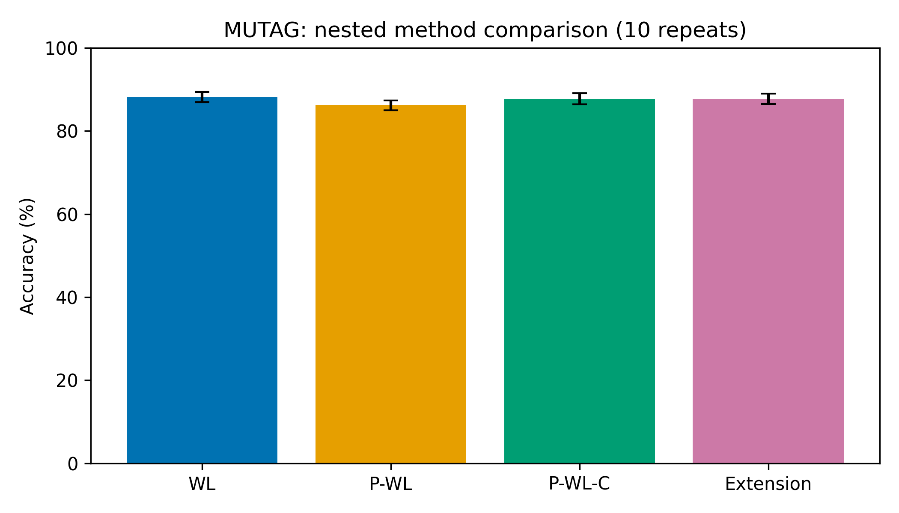
Cycle contributions add a second topological signal
A cycle appears when a new edge joins vertices already connected
A
B
A
A
B
CLOSING EDGE CREATES H₁
MUTAG +1.61 pp vs P-WL
Cₕ(a) adds the closing edge weight to its endpoint-label bins.
PTC-MR −0.55 pp vs P-WL
Same-label endpoints contribute twice. No triangles are filled.
MLG CASE STUDY / METHODS
07
Notes:
A graph cycle is a closed route; cycle information complements merge-only H₀ features. If an inserted edge connects already-connected vertices, it births H₁. Cₕ(a)=Σ w(e)^p × (1[ℓₕ(u)=a]+1[ℓₕ(v)=a]) for cycle-closing edges. Same-label endpoints contribute twice. φP-WL-C concatenates all V and C coordinates with depth namespaces and a zero-inclusive cycle alphabet. No triangles are filled. This feature is from Rieck et al. and is core to the study. MUTAG: P-WL 86.17%, P-WL-C 87.77%, +1.60526 pp; WL 88.19%. PTC-MR: P-WL 62.77%, P-WL-C 62.22%, −0.55210 pp. Figure source: results/full/MUTAG_ablation.png.

Slide 8
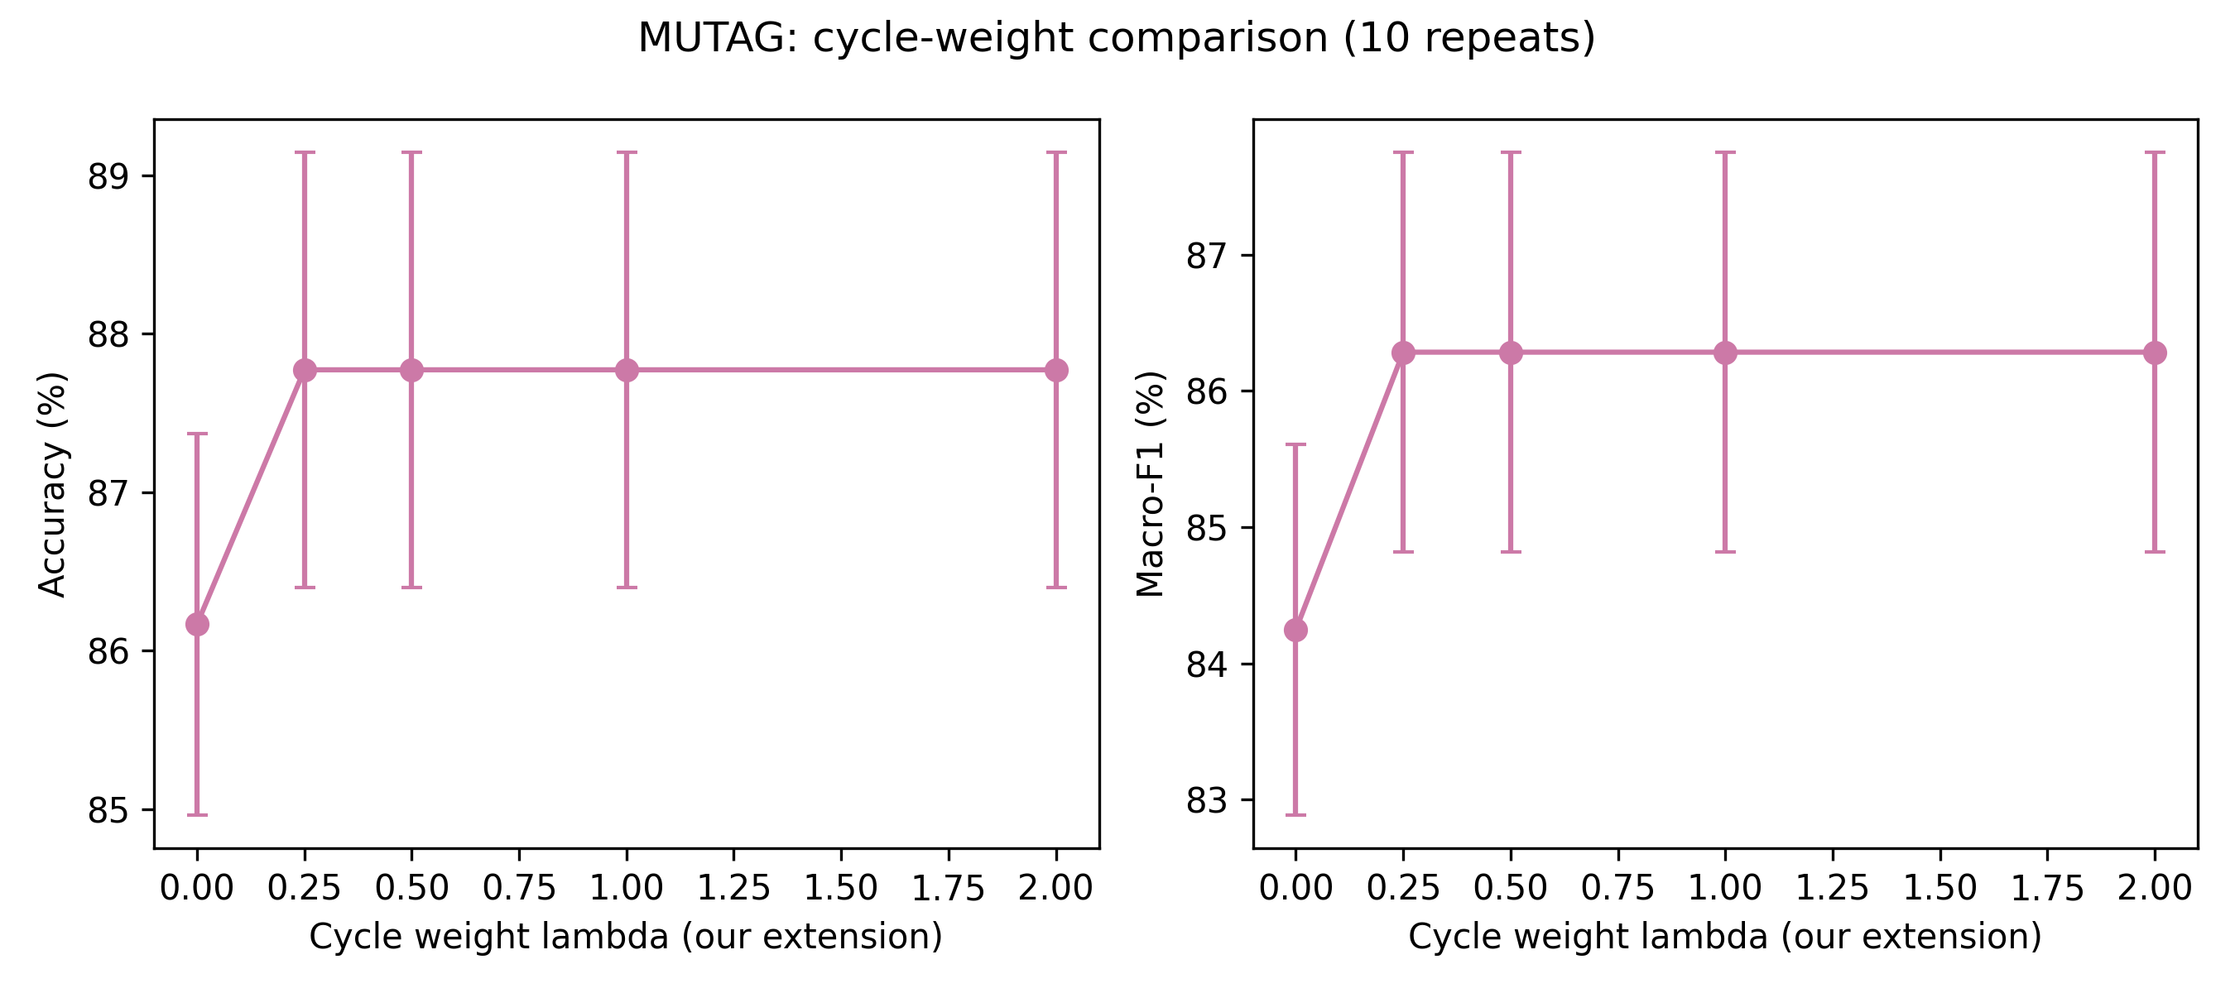
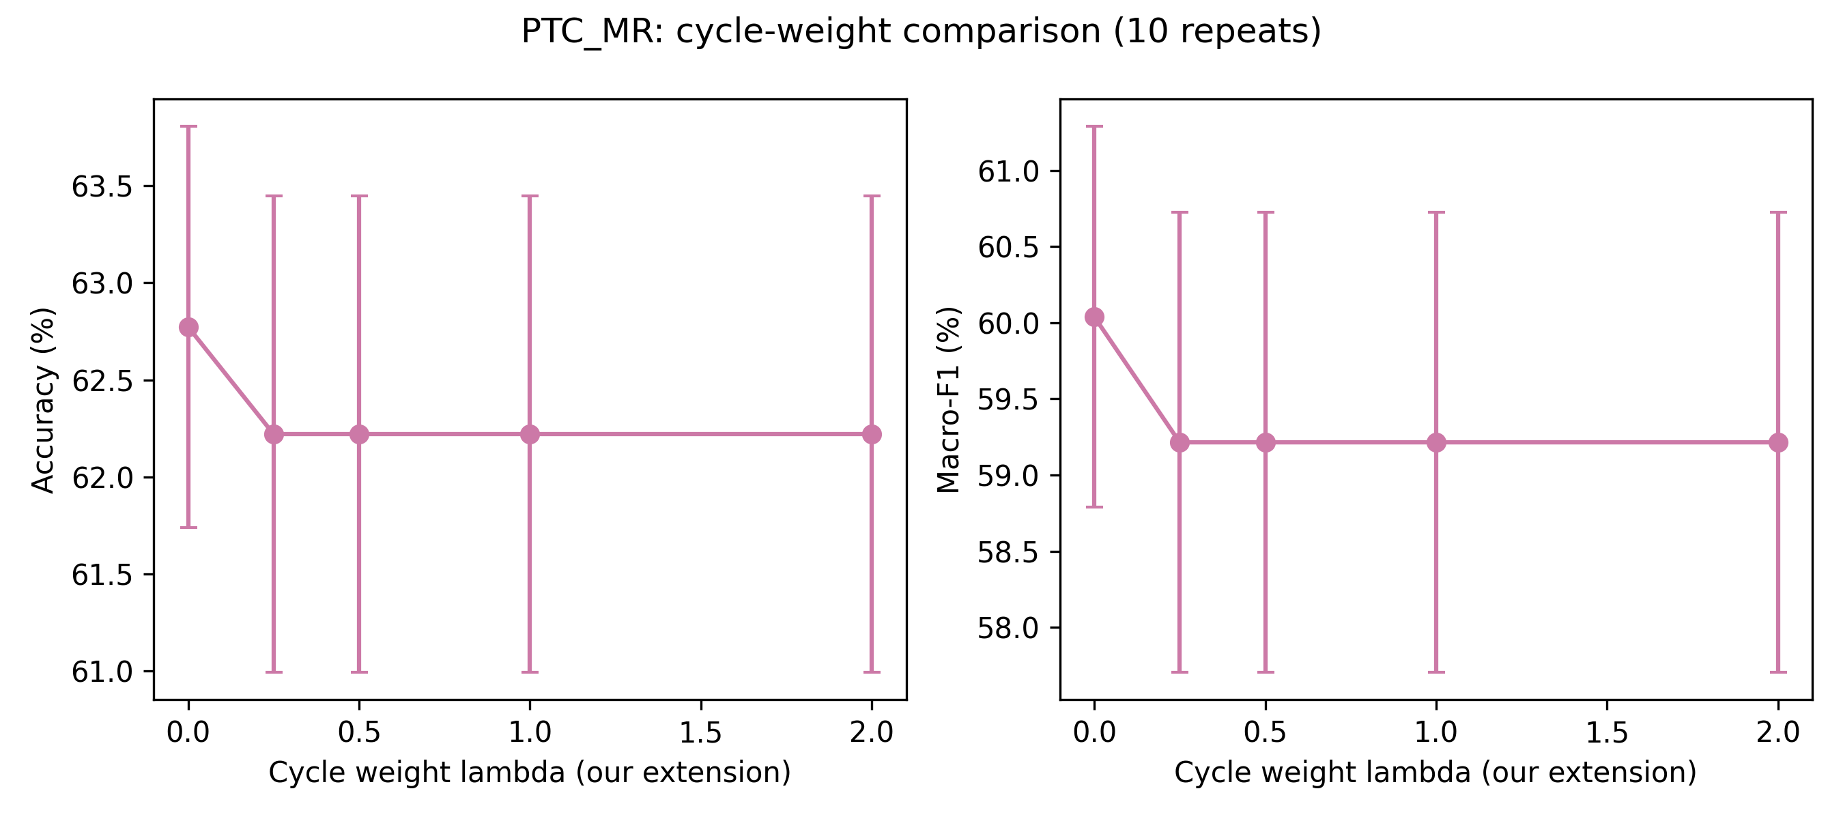
Tested positive λ values matched predictions
Observed across 100 outer folds per dataset; no universal guarantee
REPRESENTATION
φλ = [ V , λC ]
λ = 0
P-WL
λ = 0.25
P-WL-C
λ = 0.5
P-WL-C
λ = 1
P-WL-C
λ = 2
P-WL-C
Identical predictions across 100 tested folds per dataset
MLG CASE STUDY / METHODS
08
Notes:
λ∈{0,0.25,0.5,1,2}. At λ=0 the cycle columns are physically omitted, which equals P-WL including RF feature sampling. Every tested positive λ yielded identical predictions and selected h/p/tree parameters across the 100 tested outer folds for each dataset. This is an observed result under the tested settings, not a universal mathematical guarantee. Scaling preserves value order, and axis-aligned trees often retain split partitions. The selected model can differ slightly because it also chooses include/exclude. Do not call 0.25 optimal: it wins exact ties. Figures: results/full/MUTAG_lambda.png and results/full/PTC_MR_lambda.png.

Slide 9
Binary cycle encoding asks whether magnitude matters
The transformation keeps cycle presence and collapses positive magnitudes
BEFORE / MAGNITUDE
AFTER / PRESENCE
Cycle block C
Binary cycle block B
0
2
8
0
3
0
1
1
0
1
B = 1[C≠0]
The persistence block V stays unchanged; only the completed cycle coordinates are binarized.
Magnitude → presence
MUTAG accuracy: −1.72 pp
MLG CASE STUDY / CUSTOM MODIFICATION
09
Notes:
Hypothesis: cycle presence may matter more than magnitude. Bₕ(a)=1[Cₕ(a)≠0] and φbinary=[V,B]. Binarize the completed aggregate coordinate, not each edge. V remains untouched; keys, ordering, zero-inclusive vocabulary, and dimensions are preserved. This is a representation change unlike positive λ rescaling. The binary cycle modification was evaluated on MUTAG only. Implementation: pwl.combine_binary; binary_cycle reads existing corrected caches without persistence or graph preprocessing.

Slide 10
One cached feature pipeline supports all variants
Feature vocabulary is learned inside each training split
DATA
WL
PERSISTENCE
VARIANTS
VOCABULARY
MODEL
EVALUATION
Original TU
graphs
Label
refinement
V and C
features
Magnitude / λ /
binary
Train-only
vectorizer
Random
Forest
Saved nested
fold estimates
DATA.PY
WL.PY
PWL.PY
TU archive loading
Refinement and counts
Filtration, V and C
EVALUATE.PY
BINARY_CYCLE.PY
FINALIZE_CASE_STUDY.PY
Splits, RF and checkpoints
MUTAG cache-only extension
Prediction audit and figures
No global feature matrix: DictVectorizer refits on each inner and outer training split.
MLG CASE STUDY / IMPLEMENTATION
10
Notes:
Dataset → preprocessing → WL refinement → persistent V/C → feature variants → training-only vocabulary → Random Forest → nested evaluation. data.py handles original TUDataset/NetworkX preprocessing; wl.py refinement; pwl.py persistence and variants; evaluate.py shared splits, RF, selection and checkpoints; binary_cycle.py the cache-only MUTAG runner; test_binary.py transformation/resume regression checks; finalize_case_study.py prediction audit, comparisons, figures and reports. Cached graph-local features are transformed without globally fitting vocabularies.

Slide 11
Nested cross-validation separates selection from testing
Each outer test fold stays untouched during model selection
10 repeats × 10 outer folds = 100 held-out evaluations per dataset
ONE OUTER SPLIT
Outer training set
Refit selected model
Outer test fold
Inner 5-fold CV
select h, p, trees, λ
Train on all outer
training graphs
Evaluate once
Accuracy + Macro-F1
SEARCH
FOREST
SELECTION
h = 0…6 · p = 1,2 · 25/50/100 trees
Gini · sqrt features · bootstrap · seed 42
Mean inner accuracy; deterministic tie order
Reported variability is population SD over ten fold-averaged repeat means; it is descriptive.
MLG CASE STUDY / EVALUATION
11
Notes:
Original MUTAG folds: 10 repeats × 10 stratified outer folds; five inner folds per outer train. h=0…6, p={1,2}, trees={25,50,100}; λ method additionally selects its prespecified grid. Binary uses the same 42 h/p/tree candidates per outer split. RF: gini, sqrt feature sampling, bootstrap, unlimited depth, min split 2, leaf 1, no class balancing, seed 42, one thread per forest; 8 outer workers. Outer seeds 0…9; inner seeds 1000+10r+f. Select by mean inner accuracy; ties: lower h, p, trees, λ. Metrics: accuracy and macro-F1 with zero_division=0. Mean ± population SD over ten fold-averaged repeat means. Inner selection prevents tuning on outer test scores. Diagnostic outer curve maxima are not final model selections.

Slide 12
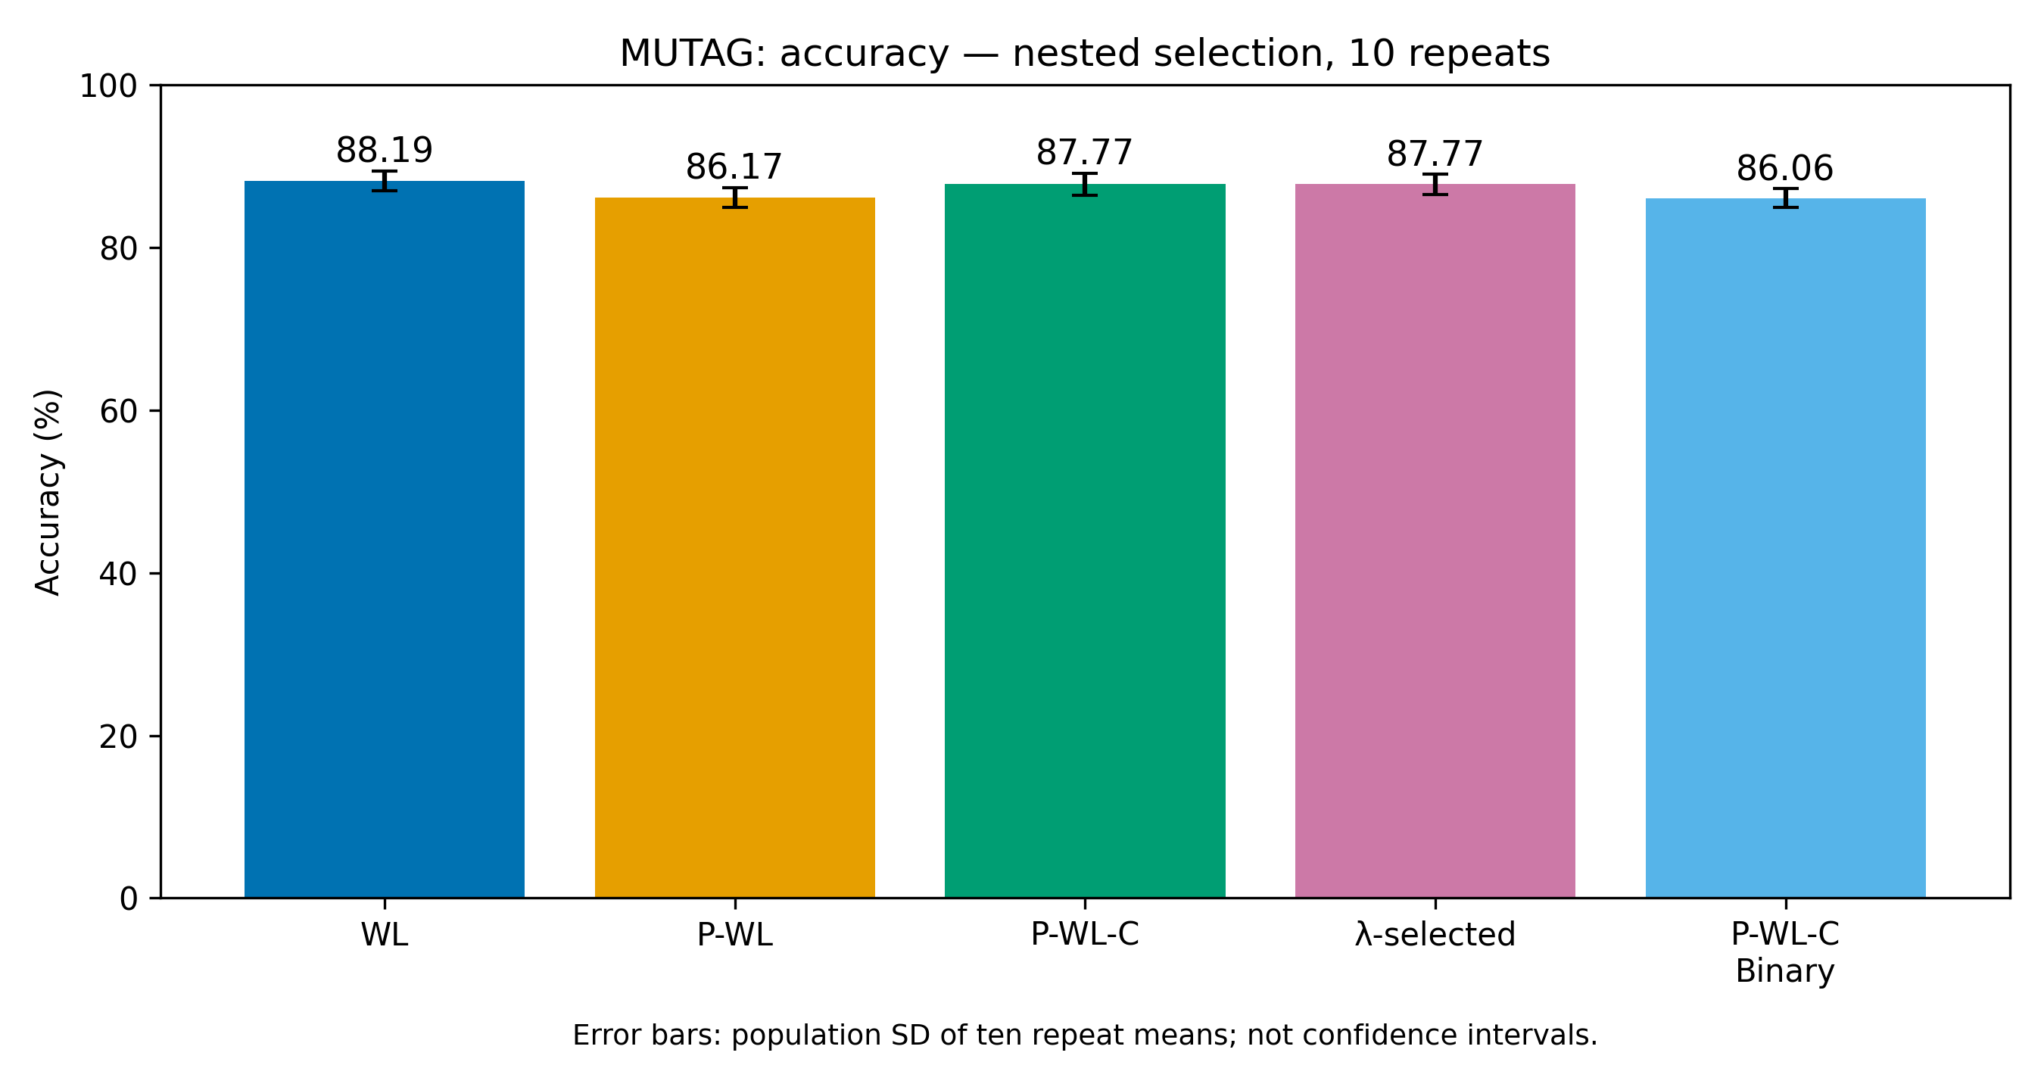
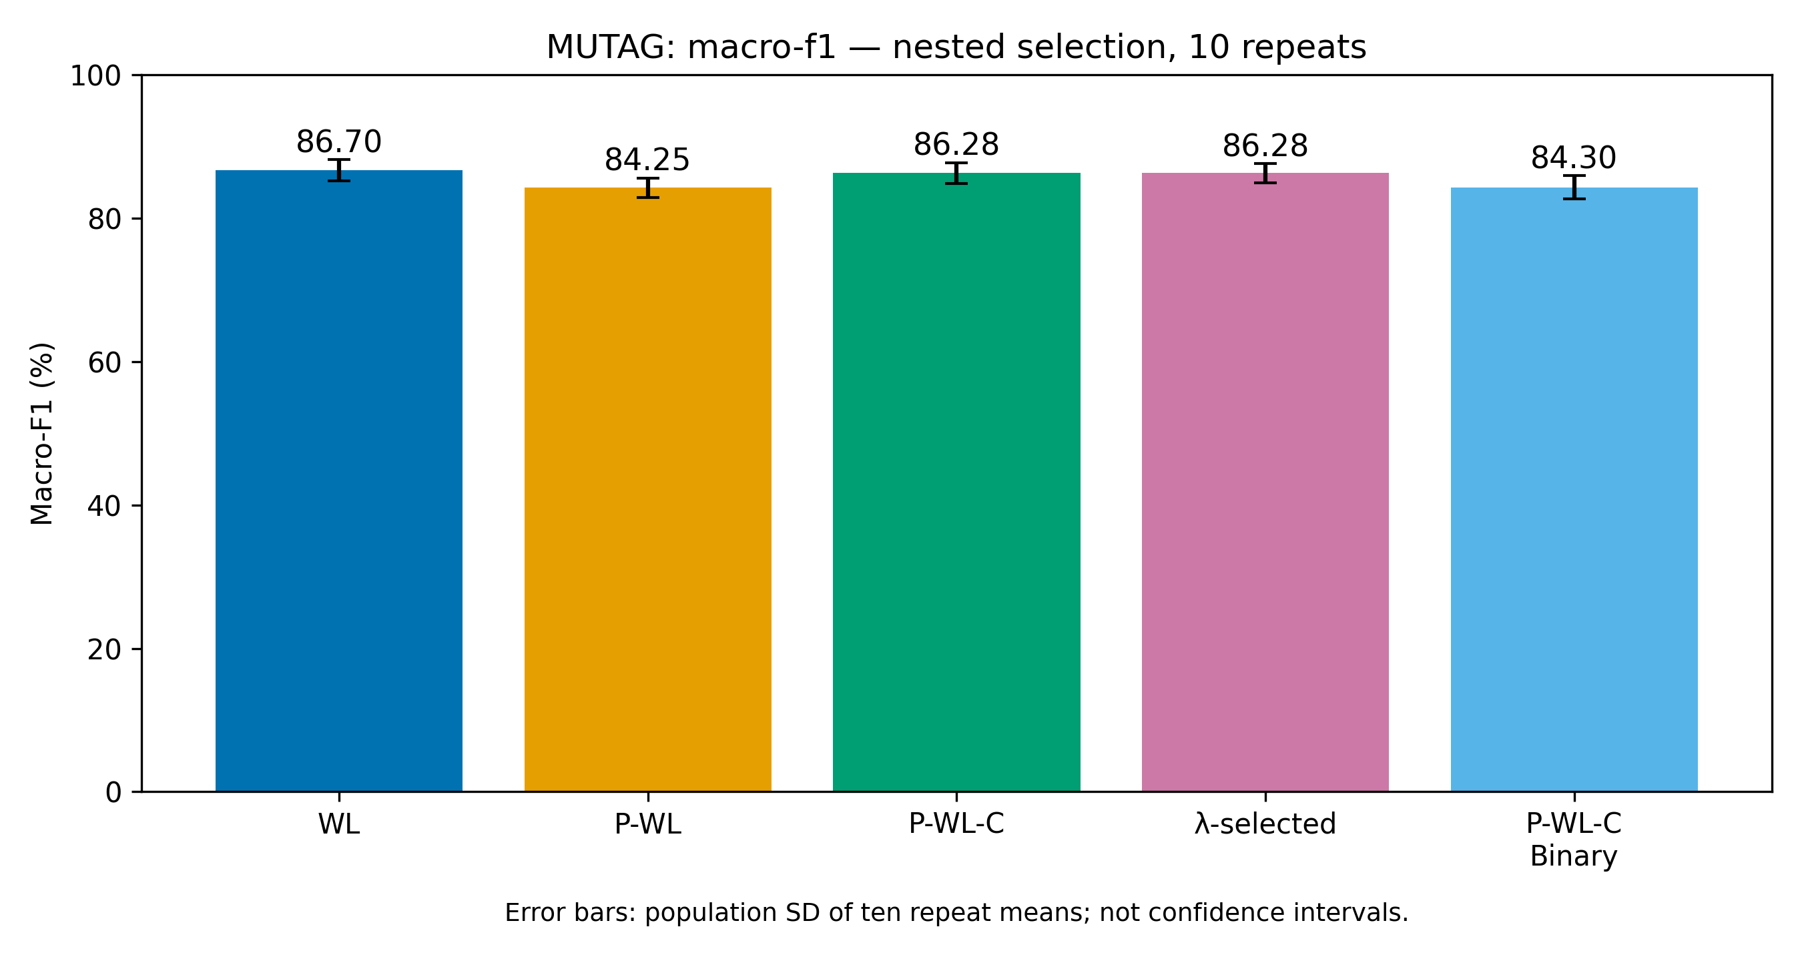
MUTAG: WL leads; cycles recover part of the persistence gap
Mean ± SD across ten repeat-level estimates, in percent
Method
Accuracy (%)
Macro-F1 (%)
WL
88.19 ± 1.23
86.70 ± 1.46
P-WL
86.17 ± 1.20
84.25 ± 1.36
P-WL-C
87.77 ± 1.37
86.28 ± 1.47
λ-selected
87.77 ± 1.26
86.28 ± 1.35
P-WL-C-Binary
86.06 ± 1.16
84.30 ± 1.60
MLG CASE STUDY / RESULTS
12
Notes:
All rows are completed nested estimates from results/full and the audited binary extension. WL has the best mean accuracy (88.19%) and macro-F1 (86.70%). P-WL-C improves over P-WL by 1.60526 pp accuracy and 2.03762 pp macro-F1. Binary versus P-WL-C is −1.71637 pp accuracy and −1.98133 pp Macro-F1. SD describes repeat variation. These descriptive differences do not establish statistical significance. Exact table sources: results/full/summary.csv and results/binary-cycle/comparison_summary.csv; underlying selected fold rows: results/full/MUTAG_folds.csv and results/binary-cycle/MUTAG_folds.csv. Original accuracy and macro-F1 figures: results/binary-cycle/figures/MUTAG_accuracy_comparison.png and MUTAG_macro_f1_comparison.png.

Slide 13
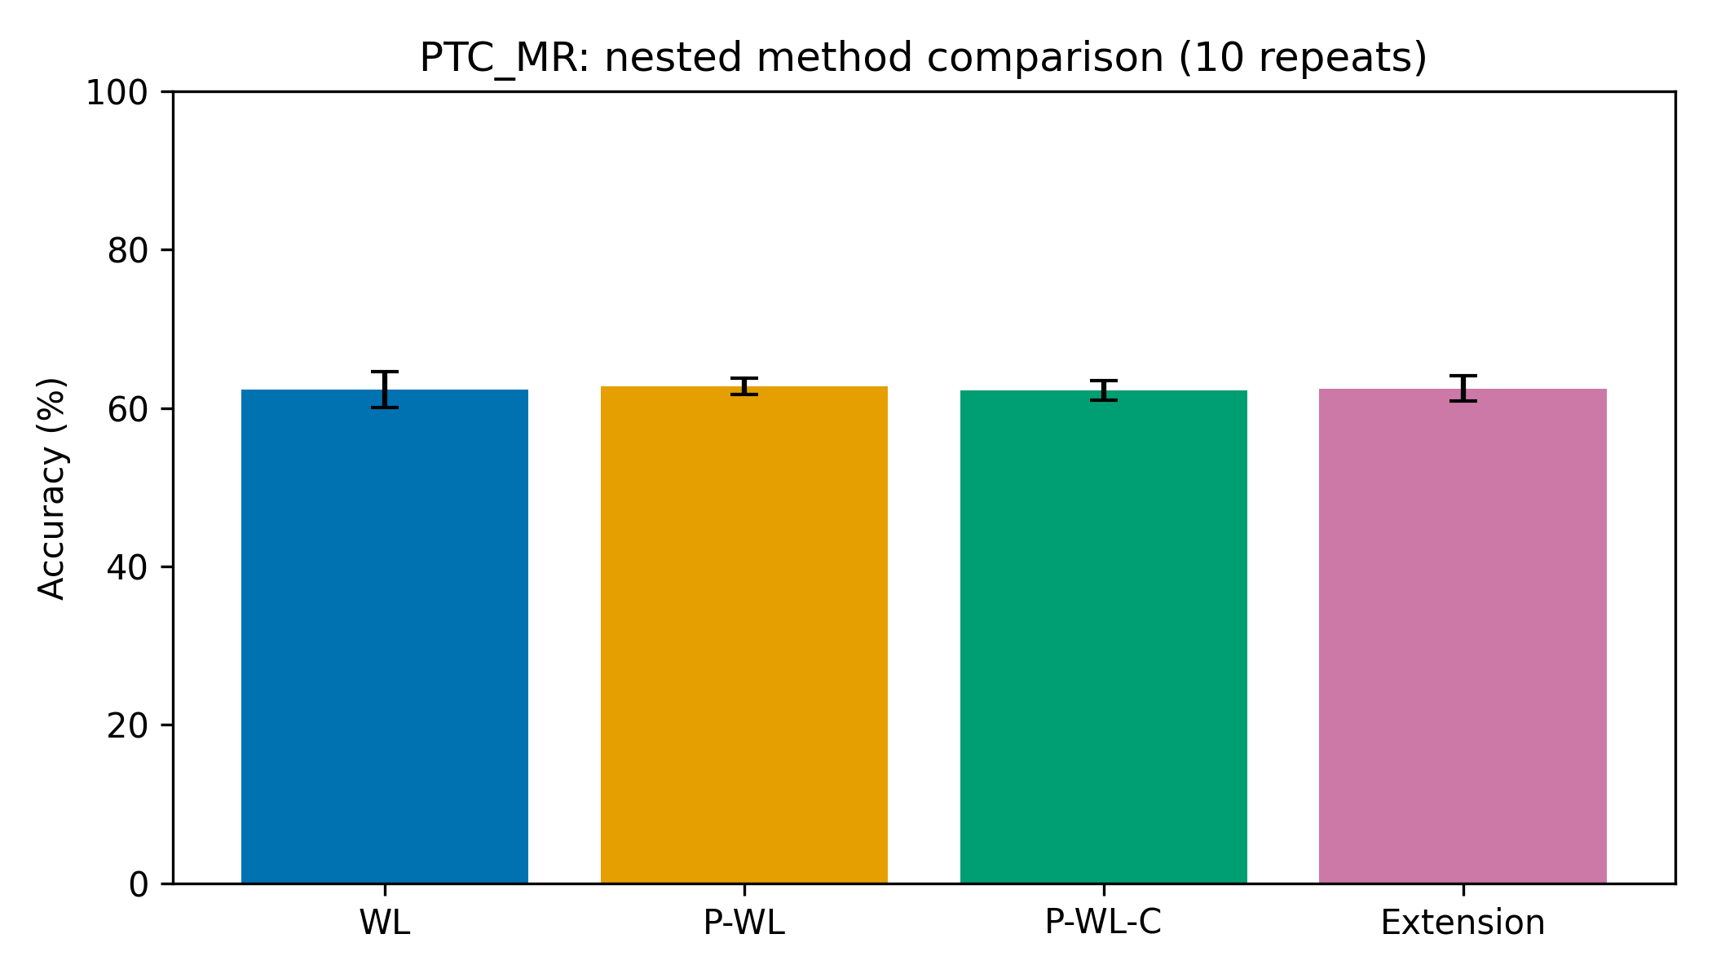
PTC-MR: cycles did not improve the selected model
Binary was evaluated only on primary MUTAG; PTC-MR provides supplementary baseline comparisons
Method
Accuracy (%)
Macro-F1 (%)
WL
62.33 ± 2.25
59.54 ± 2.47
P-WL
62.77 ± 1.03
60.04 ± 1.25
P-WL-C
62.22 ± 1.23
59.21 ± 1.51
λ-selected
62.49 ± 1.55
59.62 ± 1.87
P-WL-C-Binary
Not evaluated
Not evaluated
Binary cycle encoding: NOT RUN · OUT OF SCOPE
MLG CASE STUDY / SUPPLEMENTARY RESULT
13
Notes:
Binary-cycle encoding was evaluated only on MUTAG as the primary modification experiment. PTC-MR was used for supplementary baseline comparisons, so binary was not evaluated there. P-WL has the highest mean accuracy and macro-F1 on PTC-MR. Cycles versus P-WL: −0.55210 pp accuracy and −0.82427 pp macro-F1. Unlike MUTAG, adding cycles reduced selected-method averages. Binary: not evaluated and out of scope for PTC-MR. Sources: results/full/PTC_MR_folds.csv, results/full/summary.csv and results/full/PTC_MR_ablation.png.

Slide 14
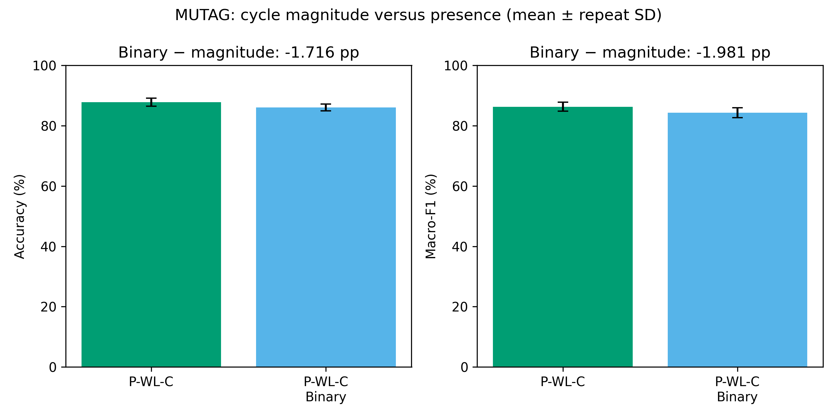
Each change altered the representation; effects varied by dataset
Paired score differences are descriptive comparisons of selected pipelines
MUTAG change
Accuracy Δ (pp)
Macro-F1 Δ (pp)
WL → P-WL
−2.02632
−2.45825
P-WL → P-WL-C
+1.60526
+2.03762
P-WL-C → λ-selected
−0.00292
−0.00751
P-WL-C → Binary
−1.71637
−1.98133
PTC-MR SUPPLEMENTARY
Change
Accuracy
Macro-F1
WL → P-WL
+0.44034
+0.49549
OBSERVED EFFECT
P-WL → P-WL-C
−0.55210
−0.82427
Cycles helped over P-WL on MUTAG and hurt on PTC-MR. Positive λ scaling stayed neutral. Binary fell 1.72 pp in MUTAG accuracy.
P-WL-C → λ-selected
+0.26471
+0.40320
Differences compare independently selected nested pipelines; they are descriptive, not significance tests.
MLG CASE STUDY / RESULTS INTERPRETATION
14
Notes:
MUTAG impacts: WL→P-WL −2.02632 pp accuracy / −2.45825 pp macro-F1; P-WL→P-WL-C +1.60526 / +2.03762; P-WL-C→λ-selected −0.00292 / −0.00751; P-WL-C→binary −1.71637 / −1.98133. PTC-MR changes: +0.44034/+0.49549, −0.55210/−0.82427, +0.26471/+0.40320 respectively. Binary versus magnitude paired figure: results/binary-cycle/figures/MUTAG_cycle_binary_comparison.png. These are independently selected pipelines and descriptive differences, not guaranteed improvements. Joint retuning can interact with representation.

Slide 15
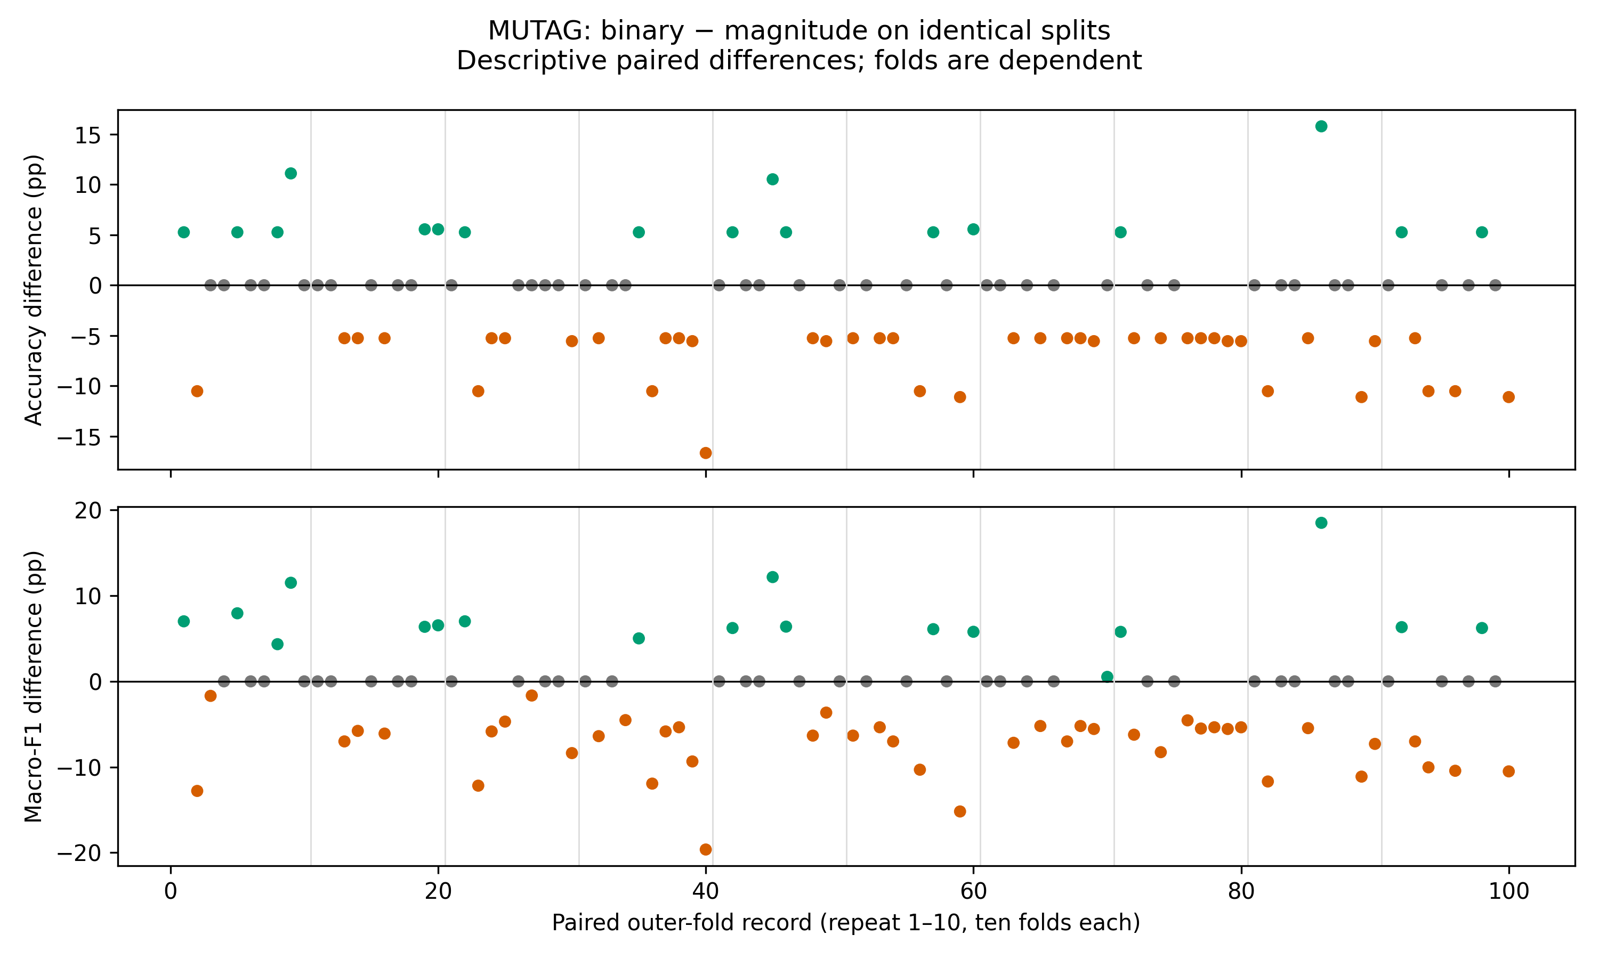
Binary encoding changed predictions across many folds
Most paired folds were mixed or tied; the average change was negative
BINARY VS P-WL-C
67 / 100
folds with changed predictions
SELECTED SETTINGS CHANGED
96 / 100 folds
h: 83 · p: 47 · trees: 67
114 of 1,880 graph-prediction opportunities changed; accuracy paired outcomes: 17 up, 41 down, 42 tied.
MLG CASE STUDY / INTERPRETATION
15
Notes:
Predictions changed on 67/100 folds and 114/1,880 graph-prediction opportunities across repeats. Selected (h,p,trees) changed on 96/100 folds; h=83, p=47, trees=67 changes. Accuracy paired outcomes: 17 improvements, 41 worsens, 42 ties. Macro-F1: 18 improvements, 44 worsens, 38 ties. Binary encoding changed predictions and reduced mean accuracy. Cycle magnitudes may carry useful information; this is an interpretation, not a causal result. Joint retuning also changed selected parameters, so the measured difference is between nested method pipelines, not a fixed-model intervention. Figure: results/binary-cycle/figures/MUTAG_paired_fold_differences.png.

Slide 16
The study meets implement–modify–measure with a mixed result
Negative results are valid research findings; binary encoding reduced accuracy
Established methods
Tested adaptations
Measured evidence
WL, P-WL and P-WL-C implemented from their papers. Cycle features are a paper method.
λ scaling had no effect at positive values. Binary encoding reduced MUTAG accuracy.
Cycles helped over P-WL on MUTAG, hurt on PTC-MR, and stayed below WL on MUTAG.
P-WL-C-Binary: 86.06 ± 1.16% accuracy · 84.30 ± 1.60% Macro-F1
Limits: two small datasets, dependent repeated folds, descriptive SD, no significance test, and binary evaluated only on MUTAG.
Future work: independent benchmarks, edge-label-aware features, and other classifiers.
MLG CASE STUDY / CONCLUSION
16
Notes:
Studied WL kernels and persistent WL; implemented counts, component weights and cycle contributions; tested custom λ and binary adaptations. Cycles helped versus P-WL on MUTAG and hurt on PTC-MR. Positive λ magnitudes were neutral. P-WL-C-Binary accuracy 86.06±1.16%; macro-F1 84.30±1.60%. Versus P-WL-C: −1.71637 pp accuracy and −1.98133 pp macro-F1. The binary-cycle accuracy decrease is a valid negative experimental finding. Negative results are valid research findings and should be reported with the positive results. Limitations: small, imbalanced datasets; repeated folds reuse graphs and are dependent; SD is descriptive, not a confidence interval; no significance test or causal mechanism is claimed. Binary was requested after the earlier study, so it is a follow-up experiment, not an independently preregistered benchmark. Depth 0–6 differs from the paper’s 0–10. Inductive vocabularies, fixed modern RF defaults, ignored edge labels, and source-order tie handling are documented adaptations. No PTC-MR binary generalization claim is justified. Future directions were not tested.

Slide 17
References and local evidence
Method definitions, dataset origins and saved evidence
1
Shervashidze, N. et al. (2011). “Weisfeiler-Lehman Graph Kernels.” Journal of Machine Learning Research, 12(77), 2539–2561.
3
BorgwardtLab/P-WL. Authors’ implementation; snapshot and source hashes retained locally.
https://www.jmlr.org/papers/v12/shervashidze11a.html
https://github.com/BorgwardtLab/P-WL
2
Rieck, B., Bock, C. & Borgwardt, K. (2019). “A Persistent Weisfeiler-Lehman Procedure for Graph Classification.” ICML, PMLR 97, 5448–5458.
4
TUDataset catalogue and bibliography. Dataset origins: Debnath et al. (1991), J. Med. Chem. 34(2), 786–797; Helma et al. (2001), Bioinformatics 17, 107–108.
https://proceedings.mlr.press/v97/rieck19a.html
https://chrsmrrs.github.io/datasets/docs/datasets/
Experiment claims trace to saved local folds and repeat means, not to published paper accuracies.
MLG CASE STUDY / REFERENCES
17
Notes:
1. Shervashidze, N., Schweitzer, P., van Leeuwen, E. J., Mehlhorn, K., & Borgwardt, K. M. (2011). Weisfeiler-Lehman Graph Kernels. Journal of Machine Learning Research, 12(77), 2539–2561. https://www.jmlr.org/papers/v12/shervashidze11a.html. Local: references/wl-paper.pdf and references/wl-paper.txt.
2. Rieck, B., Bock, C., & Borgwardt, K. (2019). A Persistent Weisfeiler-Lehman Procedure for Graph Classification. Proceedings of ICML, PMLR 97, 5448–5458. https://proceedings.mlr.press/v97/rieck19a.html. Local paper PDF/text; Algorithm 1, §2.3.2, Eqs. 9–12.
3. BorgwardtLab/P-WL author implementation: https://github.com/BorgwardtLab/P-WL. Snapshot identity and file hashes: references/repository-head.txt and references/source_hashes.json.
4. TUDataset catalogue and bibliography: https://chrsmrrs.github.io/datasets/docs/datasets/ and https://chrsmrrs.github.io/datasets/docs/bibliography/. Dataset origins: Debnath et al. (1991), Structure-activity relationship of mutagenic aromatic and heteroaromatic nitro compounds, J. Med. Chem. 34(2), 786–797; Helma et al. (2001), The Predictive Toxicology Challenge 2000–2001, Bioinformatics 17, 107–108. Numerical dataset statistics in this study come from local original TU archives. Experiment claims trace to saved local predictions, not the papers’ reported scores.

