Slide 1
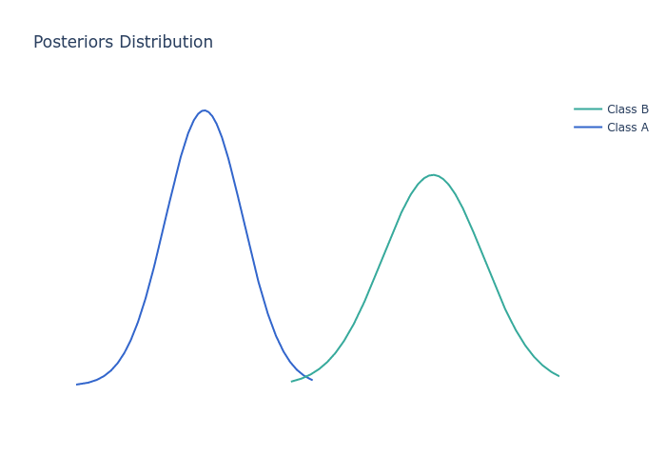
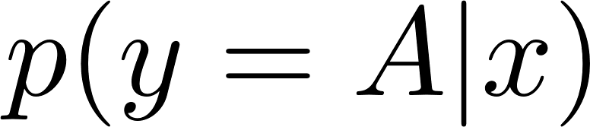
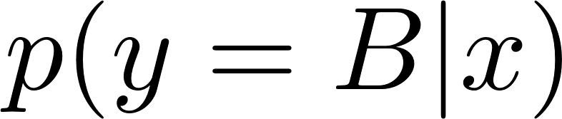





A
B
$$\vec{v_{2}}$$
$$\vec{v_{1}}$$
$$r$$
Expected Separation
Imbalanced Separation
Informative Region

