Slide 1
Title: Auto Tutor
Presented by : Golla Narasimha
From AITS Kadapa

Slide 2
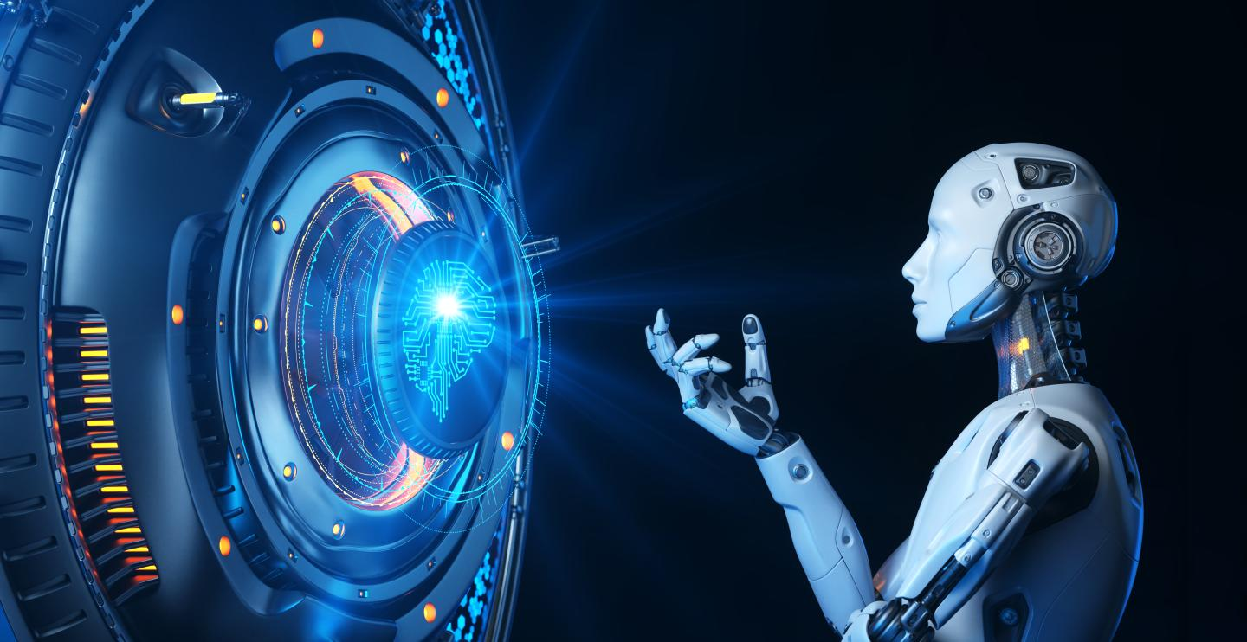
Introduction
Auto Tutor is an AI-powered automated learning platform that interacts with students like a human tutor. It provides personalized answers, explains complex topics, and supports independent learning using advanced AI technologies.

Slide 3
Problem Statement
Traditional learning methods often lack:
Instant doubt clarification
Personalized learning guidance
Adaptive tutoring support
Accessibility outside the classroom
Students need a smart solution to get knowledge anytime, anywhere.

Slide 4
Aim of the Project
To design and develop an AI-based Auto Tutor system that enables students to ask academic questions and receive accurate, quick, and personalized responses.

Slide 5
Objectives
To create a user-friendly learning assistant
To integrate AI/ML for intelligent response generation
To provide instant and reliable learning support
To ensure continuous improvement using student interaction data

Slide 6
Technologies Used
Category | Technology | Purpose
AI Model / NLP | GPT-4.0 (OpenAI) | Generates intelligent, accurate answers to student queries
Image Generation | DALL·E | Creates visual learning content & diagrams on demand
Speech-to-Text | Whisper | Converts student voice queries into text for processing
Frontend | HTML, CSS, JavaScript / React | Interactive user interface for students
Backend | Flask / Node.js API | Handles request processing & AI model communication
Deployment | Cloud Hosting / Vercel / Render | Runs the application online

Slide 7
Key Features
AI-based live tutoring
Natural language processing
Personalized learning recommendations
Easy-to-use interface
Detailed explanation for each query
Supports multiple subjects
Available 24x7

Slide 8
Workflow
Student enters question
Query sent to AI engine (ChatGPT or ML model)
Response generated based on trained data & NLP
Result displayed to student
Feedback collected to improve future responses

Slide 9
Comparision
Tool | Used For | Benefits
ChatGPT | Query Response, NLP | Highly accurate, conversational
Perplexity | Web-integrated knowledge | Reliable + cited answers
Auto Tutor | Student-focused learning | Tailored academic guidance

Slide 10
Advantages
Enhances self-learning capability
Immediate doubt solving
Reduces dependency on instructors
Increases subject understanding
Saves time for both students & teachers

Slide 11
Results and Future Scope
Voice-based tutoring
Support for regional languages
Integration with online learning platforms
Performance analytics for students
AI-based test generation
Auto Tutor successfully delivers:
Quick answers
Better student engagement
Accurate clarification to academic doubts
Adaptive learning suggestions

Slide 12
Applications
Personal learning
Colleges & Universities
E-learning platforms
Coaching centers
School computer labs
Remote learning

Slide 13
Conclusion
  Auto Tutor proves to be a transformative AI-based learning solution that assists students with instant, accurate, and personalized guidance. It enhances the overall learning experience by simplifying complex concepts through intelligent explanations. With continuous availability and adaptive responses, it supports self-paced learning and boosts student confidence. By reducing dependency on teachers for frequent clarification, it empowers learners to explore and grow independently. This system demonstrates how AI can significantly improve educational accessibility and academic success.

