Slide 1
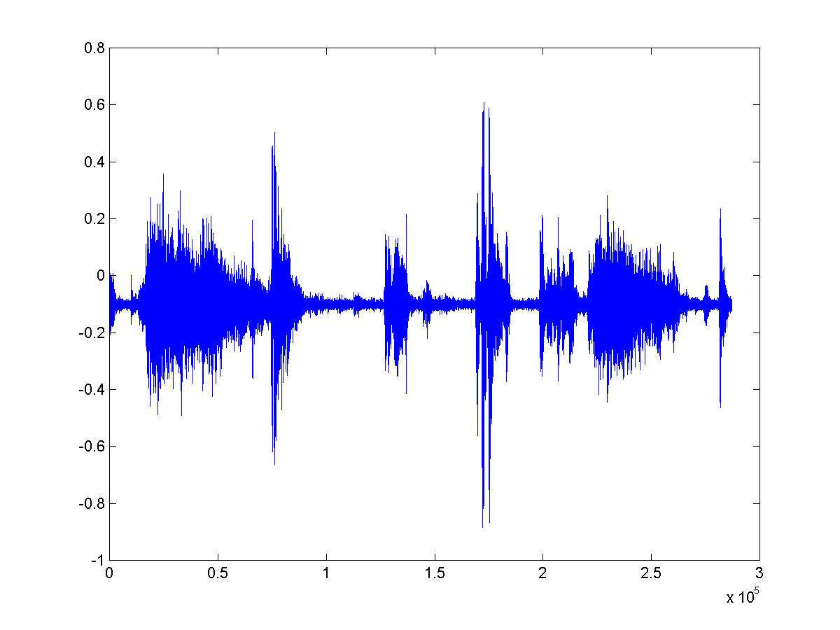

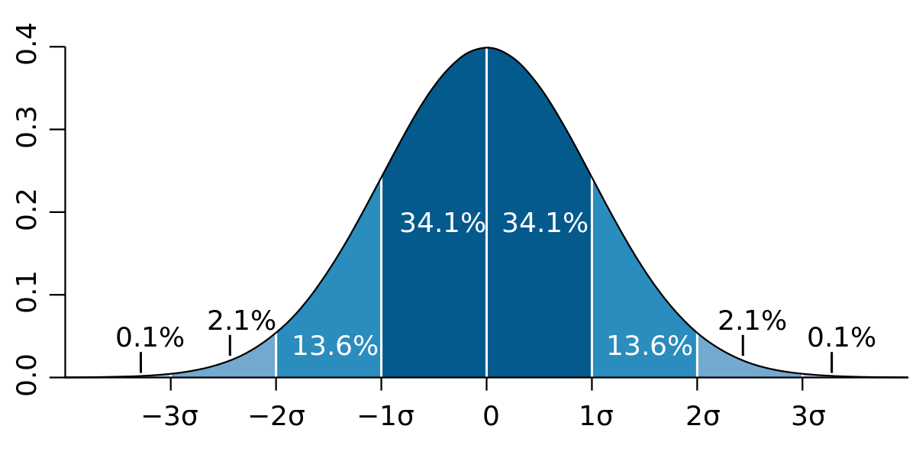
PAUSE DETECTION & MFCC FEATURE EXTRACTION

Slide 2
Speech Signal
Slowly time varying signal
5-100 msec → Characteristics are fairly stationary
First 200 msec of Corresponds to
Speech Recording → Silence

Slide 3
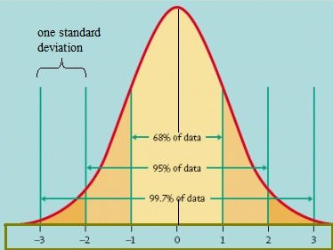
Approach
→Probability Density Function → Mahalanobis Distance
(Linear Pattern Classifier)

Slide 4
Approach
PDF →To specify the probability of the random variable falling within a particular range of values
Mahalanobis Distance/Z score → |x-Mean|
Standard Deviation

Slide 5
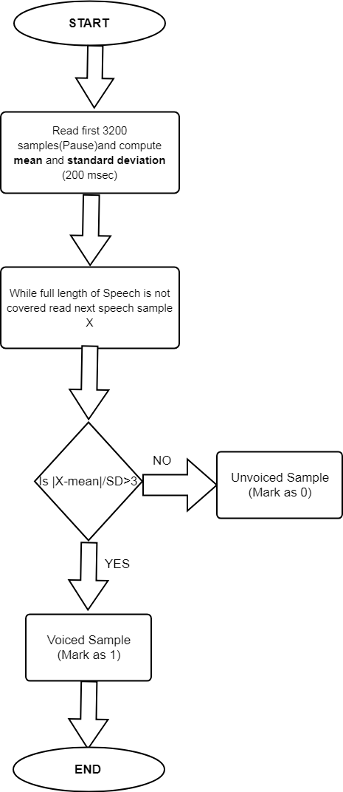


Slide 6

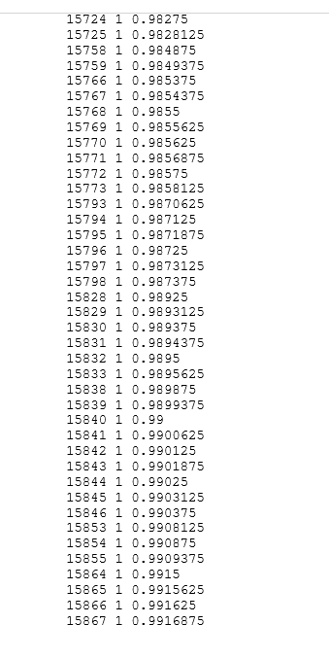
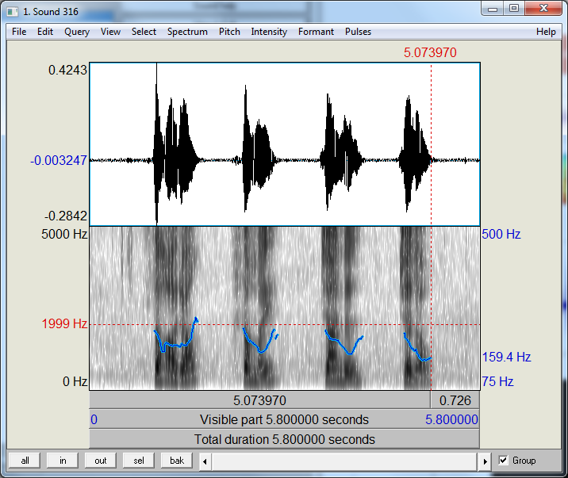
OUTPUT
Voice 1 --> 0.9-1.48 sec
Voice 2 --> 2.3-2.6 sec
Voice 3 --> 3.5-3.9 sec
Voice 4 --> 4.6-4.9 sec

Slide 7
MFCC Feature Extraction

Slide 8
FFT
Spectrum
Mel Scale Filtering
Mel Frequency Spectrum
Speech Signal
Log()
Cepstral Coefficients
Derivative
Discrete Cosine Function
Feature Vector

Slide 9
Important Terms
Sampling rate= 16000 Hz
Window size = 32ms
Frame length= Sampling rate * Window size
Number of samples = Sampling rate*Audio duration
Total Number of frames = Number of samples / Frame length
Number of MFCC coefficients per frame = 13
Total number of MFCC coefficients = 13 * Total Number of frames

Slide 10
Example
Frame length= 16000 * 0.032 = 512
Number of samples for 6secs video = 16000*6 = 96000 samples
Total Number of frames = 96000/512 = 188
Total number of MFCC coefficients = 13*188 = 2444

