Slide 1
Storm-The-Castle
an introduction to MVC, AR design pattern using Castle MonoRail and ActiveRecord
rev 2
Date: 2009/10/04

Slide 2
Topic in discussion
Model-View-Controller Design Pattern
Castle MonoRail
ActiveRecord Design Pattern
Castle ActiveRecord
Getting start ...

Slide 3
About Me !
Chorn Sokun
Quick Basic > VB6 > C# > Monorail
Blogs at http://chornsokun.wordpress.com
Participates in Open Source projects, mainly Castle Project

Slide 4
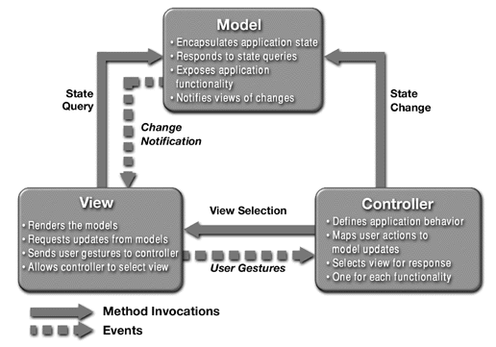
Model-View-Controller (MVC)

Slide 5
Model-View-Controller (Cont.)
Separation of Concern (SoC)
  Model : Data
  View : UI
  Controller : Facilitator
Leverage Test-Driven Development
  Model testing is easier than UI testing
  Model & UI can be test separately

Slide 6

Castle.MonoRail [http://svn.castleproject.org:8080/svn/castle/trunk ]
MVC Web Framework
Build on top of ASP.NET infrastructure
  Caching
  Session Management
  Authorization & Authentication and more ...
Inspired by Ruby on Rails
  Convention over configuration
Support Multiple view (template engine)
  NVelocity – using Velocity template syntax
  Brail – using boo syntax
  AspView – using WebForm like (.master)

Slide 7
Convention ( URL ←→Action )
http://localhost:9829/student/edit.rails?id=12
Nothing new
Controller
Nothing new
Action
Aspnet_isapi.dll
Ref: Ken Egozi’s monorail-2003-1233603200076139-3.ppt

Slide 8
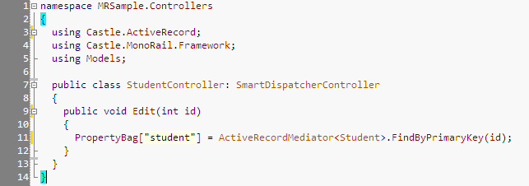
Convention ( URL ←→Action )
Ref: Ken Egozi’s monorail-2003-1233603200076139-3.ppt

Slide 9
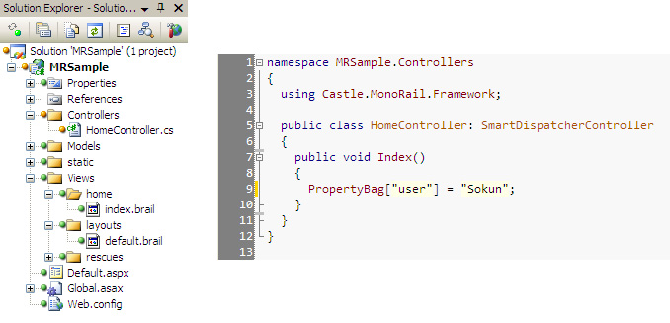


Basic MonoRail Setup

Slide 10
Basic MonoRail Setup (cont.)
References assemblies
  Castle.Core.dll
  Castle.MonoRail.Framework.dll
  Castle.Components.Common.TemplateEngine.dll
  Castle.MonoRail.Views.Brail.dll
Standard Application Layout
  Views – storing all view template file (.brail, .vm etc)
    Layouts : master page or site layout
    Rescues: template for handling errors
  Controller – controller classes
  static – store images, javascript, css
  Models – storing application domain objects

Slide 11
ActiveRecord (AR)
a well-known pattern described in Patterns of Enterprise Application Architecture (PoEAA) http://bit.ly/PoEAA
Usage
  Static methods act on the whole set of records
  Instances represents each row

Slide 12
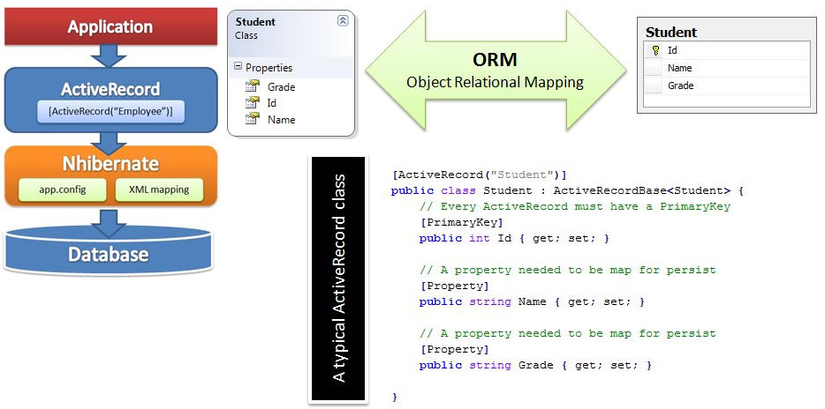

Castle.ActiveRecord
* I tend not to treat ActiveRecord as an ORM by itself

Slide 13
Getting Start
svn co http://storm-the-castle.googlecode.com/svn/tags/barcamppp
Monorail
  Controller
    RenderView
    RenderShareView
  View
    OutputSubView
ActiveRecord
  Hierarchical Mapping
  Many-To-Many Mapping & CRUD
  Mapping with composite primary key

Slide 14
References
Model View Controller Pattern – best practice software engineering
Model View Controller – wikipedia.org
MonoRail (MR) – Castle MonoRail (.Net)
http://www.castleproject.org – official castle project website
http://using.castleproject.org – castle project online collaboration wiki.
http://groups.google.com/group/castle-project-users

Slide 15

THANK YOU !
Follow Me !
http://twitter.com/csokun

