Slide 1
A Data Research on Climate Change
Ning Shangguan
3/28/2021

Slide 2

Questions about the Climate Change
1. Is the climate change real?
2. How does the climate change look like?
3. Is the CO₂ emission from fossil fuel causing the climate change?

Slide 3
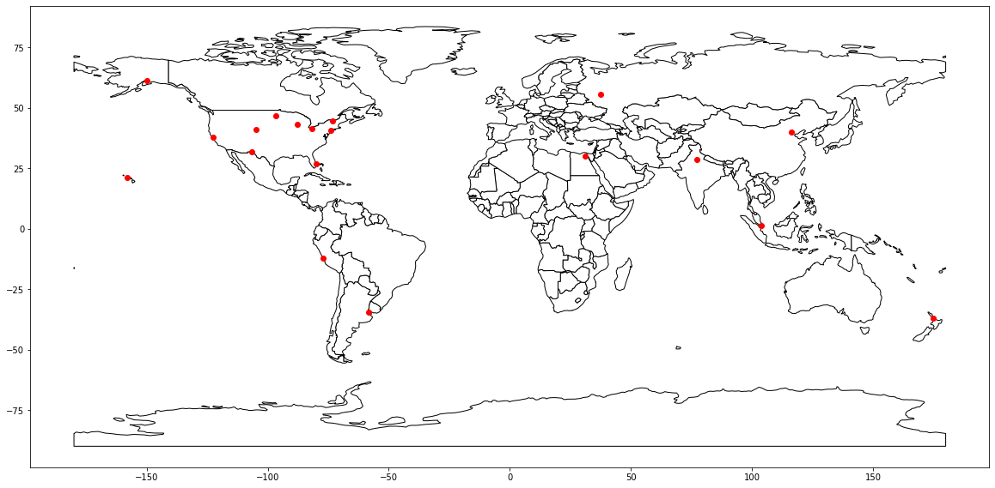
Totally 19 cities were selected to see the mean temperature change over the 20 years (1995-2015)
Data Source:
https://academic.udayton.edu/kissock/http/weather/

Slide 4
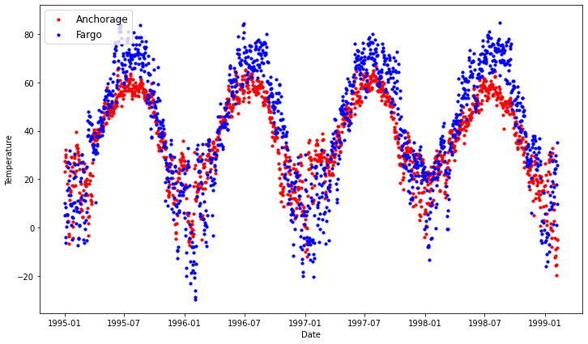
Daily Mean Temperature of Cities
Too many data points, Difficult to see clearly.

Slide 5
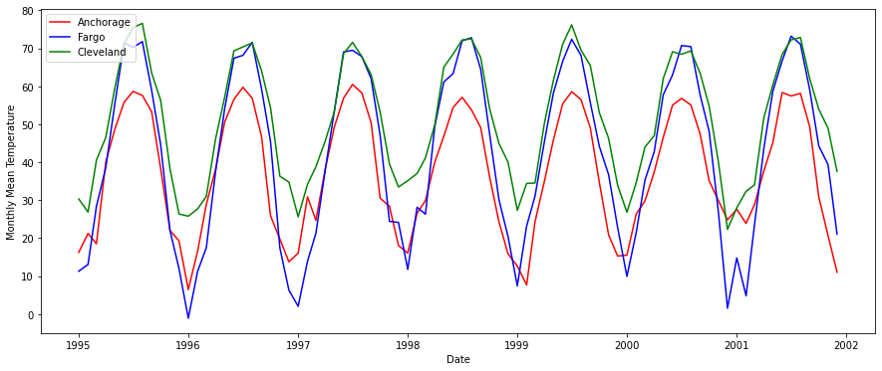
Monthly Mean Temperature of US Cities

Slide 6
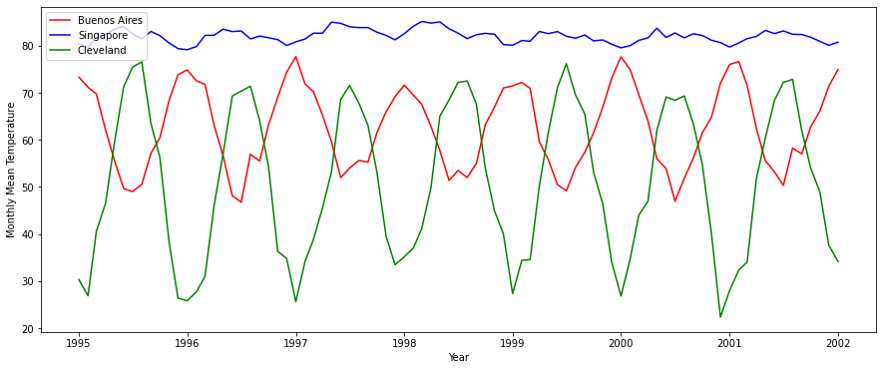
Monthly Mean Temperature of International Cities

Slide 7
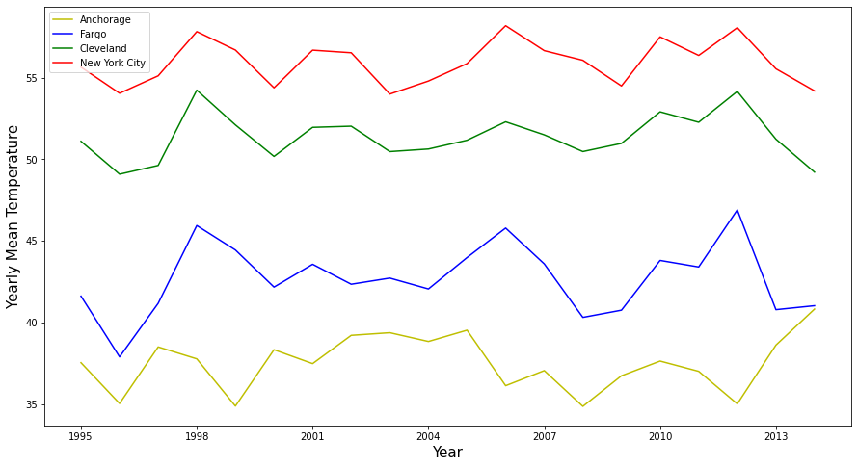
Yearly Mean Temperature Comparisons
Climate Change is still not obvious to see

Slide 8
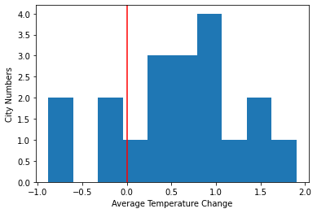
Mean Temperature Changes
Take mean temperature of 1995-1999 (T1) and mean temperature of 2010-2104 (T2)
ΔT=T2-T1
Cities ΔT (°F)
Anchorage 1.074367
Fargo 0.969164
West_Palm_Beach_ 0.640763
Burlington 1.026773
El_Paso 1.368277
Cheyenne 0.728467
San_Francisco 0.451889
Cleveland 0.735532
Milwaukee 0.246579
New York City 0.470892
Honolulu -0.114274
Egypt_Cairo 1.605934
India_Delhi 0.888429
China_Beijing -0.878986
Singapore_Temp -0.129509
Auckland 0.059801
Russia_Moscow 1.904925
Buenos_Aires 1.060245
_Lima -0.836762

Slide 9
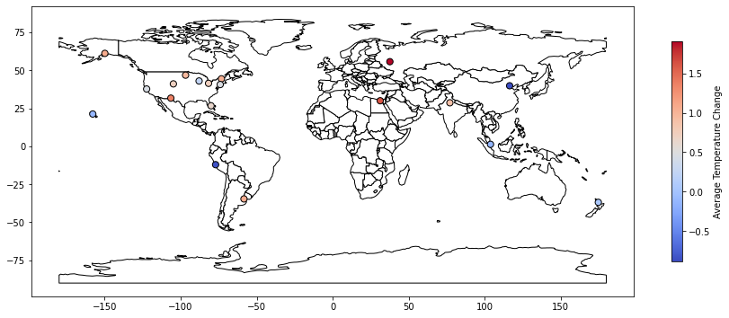
Cities and Their Five Years Mean Temperature Changes

Slide 10
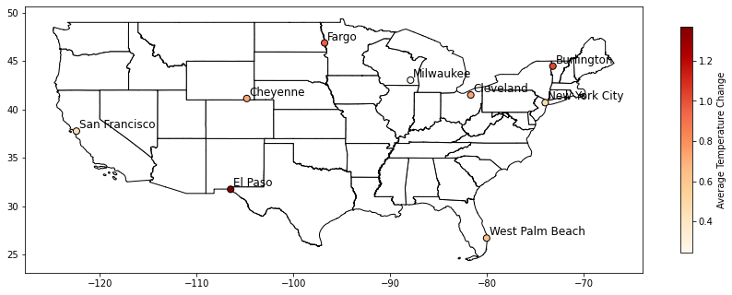
US Cities and Their Five Years Mean Temperature Changes

Slide 11
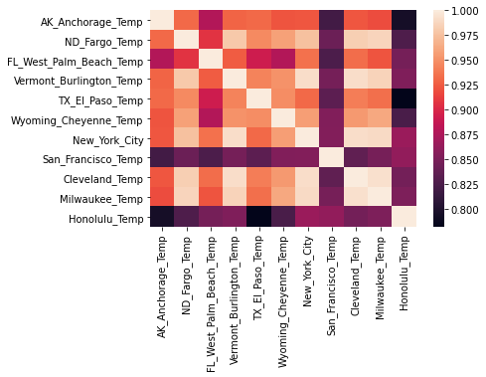
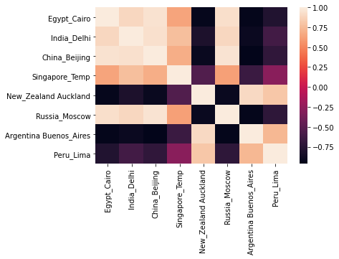
Correlation of Monthly Mean Temperature of Cities

Slide 12
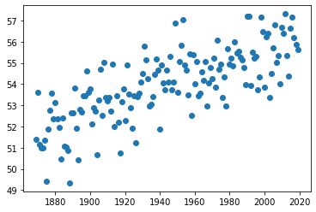
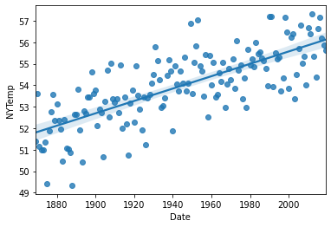
Yearly Mean Temperature of New York City (1869-2019)
www.weather.gov/media/okx/Climate/CentralPark/monthlyannualtemp.pdf
Temperature vs Year Correlation: 0.746
T=51.88+0.0278(Y-1869) (°F)
Every 15 years, the mean temperature of NYC increases 0.42 °F, it is consistent with the previous result
of NYC ΔT=0.47 °F (15 years of time span, mean temperature of 5 years).

Slide 13
Prediction I:
If I know some other cities (Burlington and Cleveland) of monthly mean temperature, can I predict the monthly mean temperature of New York city?
KNN model: K =7, Train Score= 0.989, Test Score=0.987
Linear Regression: Train Score= 0.994, Test Score= 0.992, MAE=1.065°F
Gradient Boosting: Train Score= 0.999, Test Score= 0.992, MAE= 1.160 °F
Conclusion: It is easy to predict a city’s temperature if you know the temperature of other US cities at the same time.

Slide 14
Prediction II:
Based on the 150 years of historical data of the monthly mean temperature of New York city, can we predict the future temperatures of NYC?
KNN model: K=1, Test Score =0.791; K=2, Test Score =0.673..
Linear Regression: Train Score = 0.965, Test Score= 0.964, MAE= 2.384°F
Gradient Boosting: Train Score = 0.969, Test Score= 0.965, MAE= 2.376°F
Random Forest: Test Score= 0.948, MAE= 2.759 °F
Gradient Boosting cannot give a future temperature prediction (like 2100), only Linear Regression works well.

Slide 15
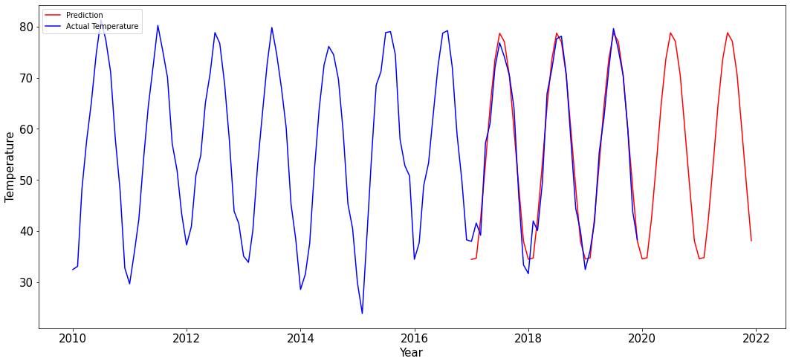
NYC Actual Monthly Mean Temperature and the Prediction by Linear Regression

Slide 16
Prediction III
If I know the monthly mean temperature of NYC, Milwaukee, Cleveland and Burlington, can I predict the monthly mean temperature of NYC next year?
KNN model: K =11, Train Score= 0.944, Test Score=0.907
Linear Regression: Train Score= 0.975, Test Score= 0.944
Gradient Boosting: Train Score= 0.993, Test Score= 0.932
Conclusion: Adding data of other US cities did not help predicting a US city’s temperature next year.

Slide 17
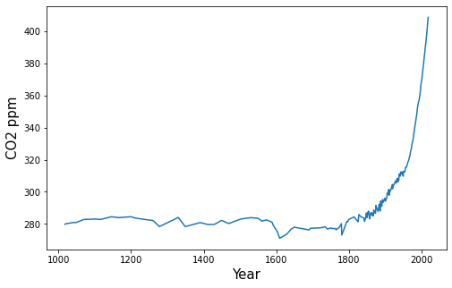
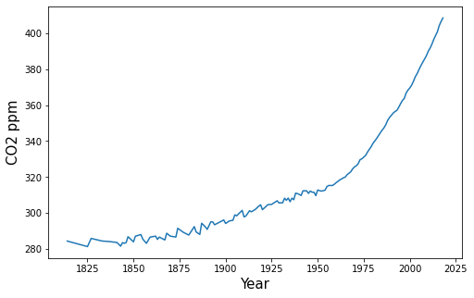
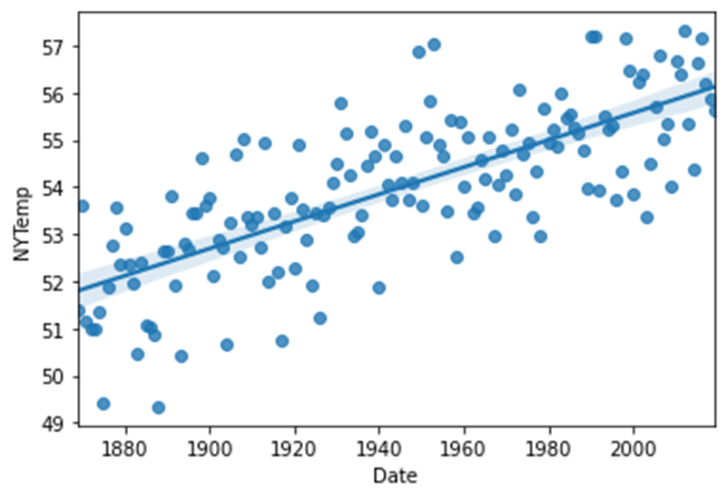
The Remaining Question: The Relationship Between CO₂ Concentration and the Earth Mean Temperature
Data from https://ourworldindata.org/grapher/global-co-concentration-ppm
With the recent years of rapid increase of CO₂ concentration in atmosphere, could we still expect the linear increase of the mean temperature?

Slide 18
Summary:
The climate change of earth is a complicated phenomenon, 20 years of climate data is not big enough to give us a clear understanding. During the 20 years, we see many variations and fluctuations of mean temperature of each year.
Overall, most of the selected cities have increased mean temperature over 5 years compared with 15 years ago, it shows the trend of the earth temperature increase and the variations of the climate change.
The 150 years of weather data of New York City shows a clear picture of the yearly mean temperature increase trend.
The relationship between the CO₂ concentration in atmosphere and the mean temperature of earth still needs more research and waits for a better answer.

