Slide 1


Topic- GSR9 (Annually Return-Nill)
Prepared By: Xperts Tax
Sec- 44
GST Act 2017
केवल एक मिनट में GSTR 9 भरें
For more; www.xpertstax.com
Mail:xpertstaxhelp@gmail.com
Associates:
Anujgupta & Co.
Rajat Kalsi & Associates

Slide 2

Objective:
After seeing this videos & Slides, you will be able-:
To file GST-9, annually Nill return.
Time Required:1-2 mint (Maximum)
Process:
Step- 1: Go to web: www.gst.gov.in
Step- 2: Login-: enter credential and login
Step- 3: Select Financial Year-: 2017-18
Step- 4 Click- Compute liabilities
Step- 5- Filed return
Precautions:
Check all GSTR 3B and GSTR 1 are filled.
Check there are no input or output tax payable are exist.
For more :
www.xpertstax.com

Slide 3
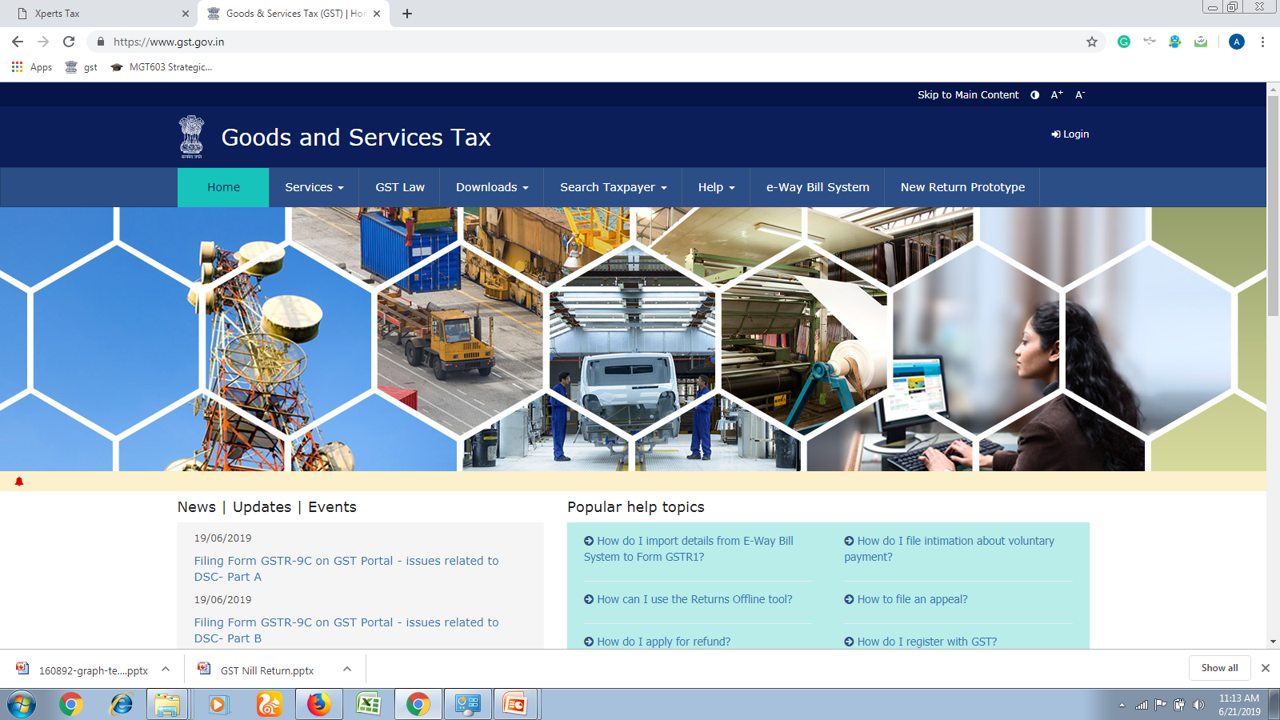
Go to -: www.gst.gov.in

Slide 4
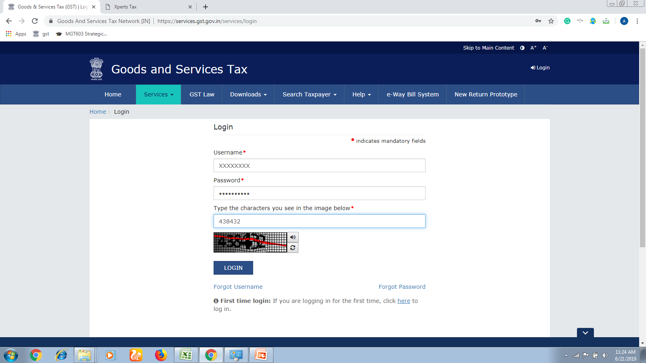
Step- 2: Login-: enter credential and login

Slide 5
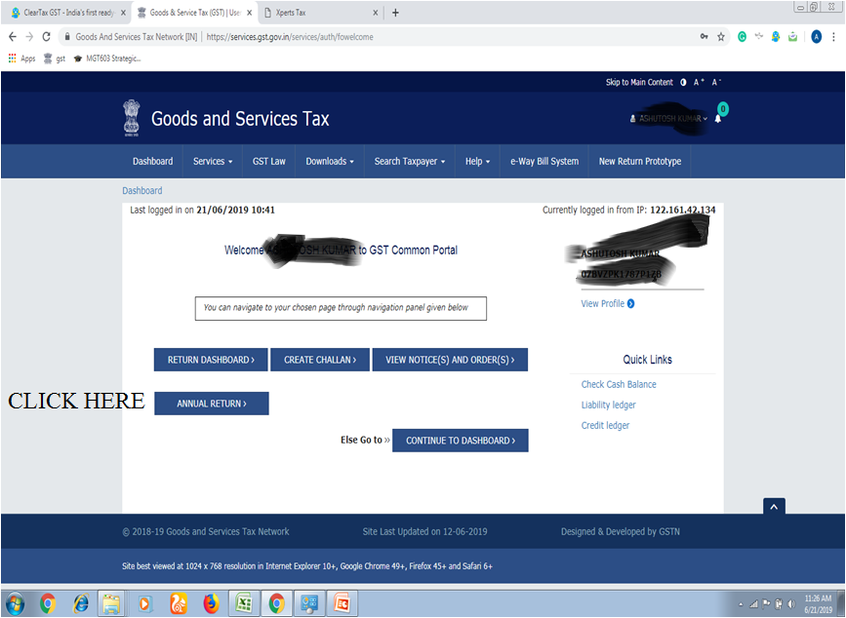
Step- 3: Select Financial Year-: 2017-18

Slide 6
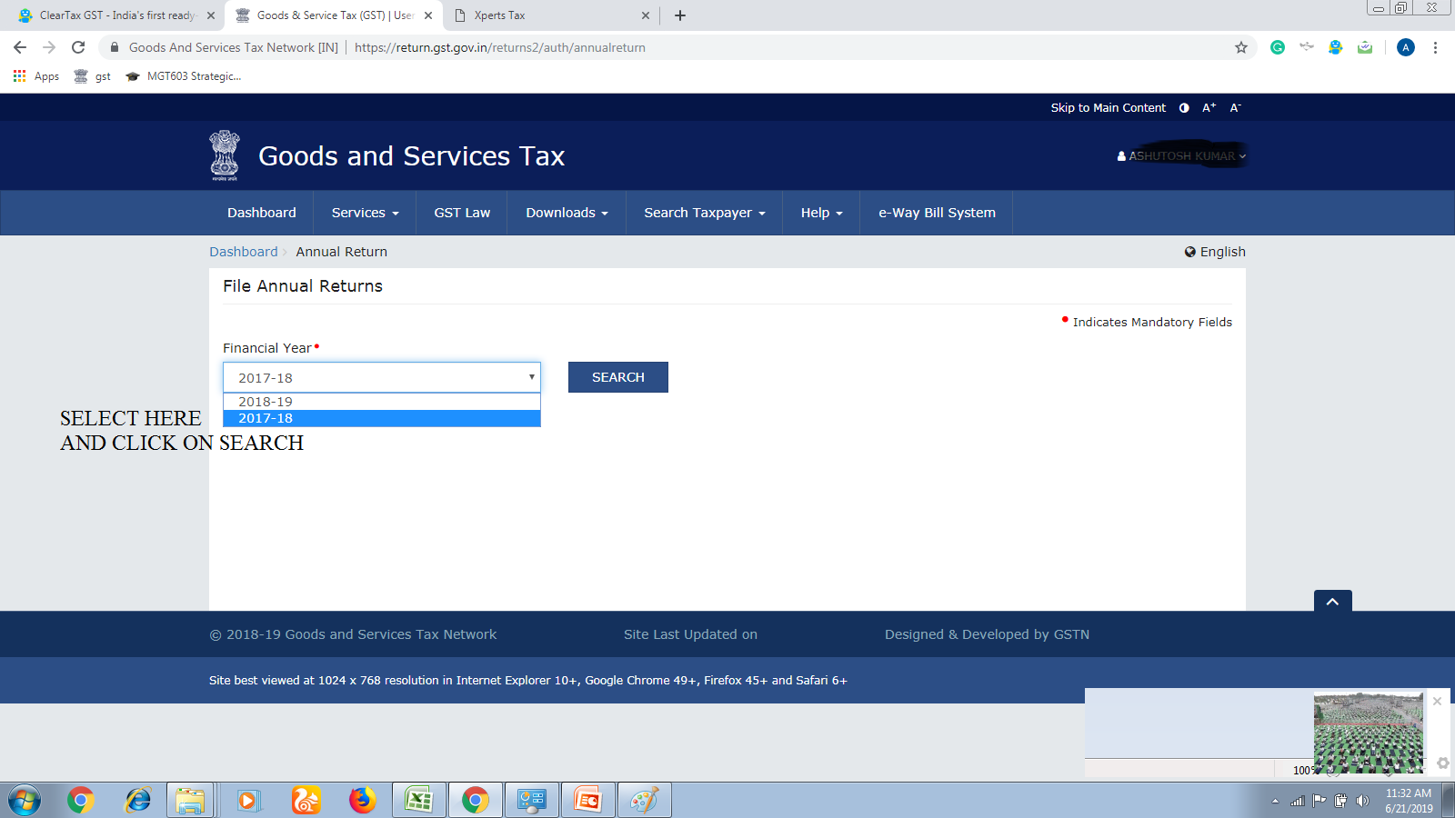

Slide 7
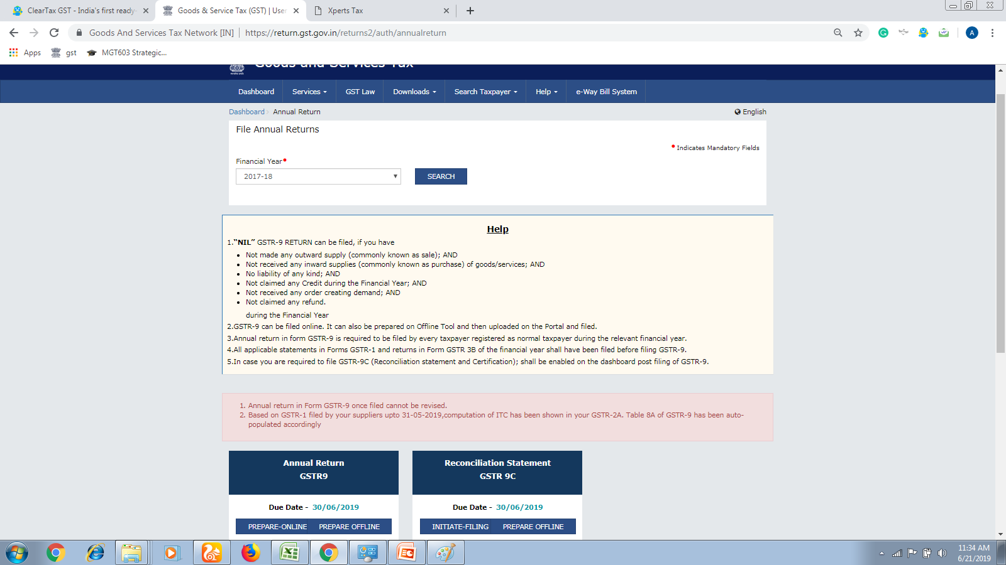
Click on- GSTR 9,-> Prepare online

Slide 8
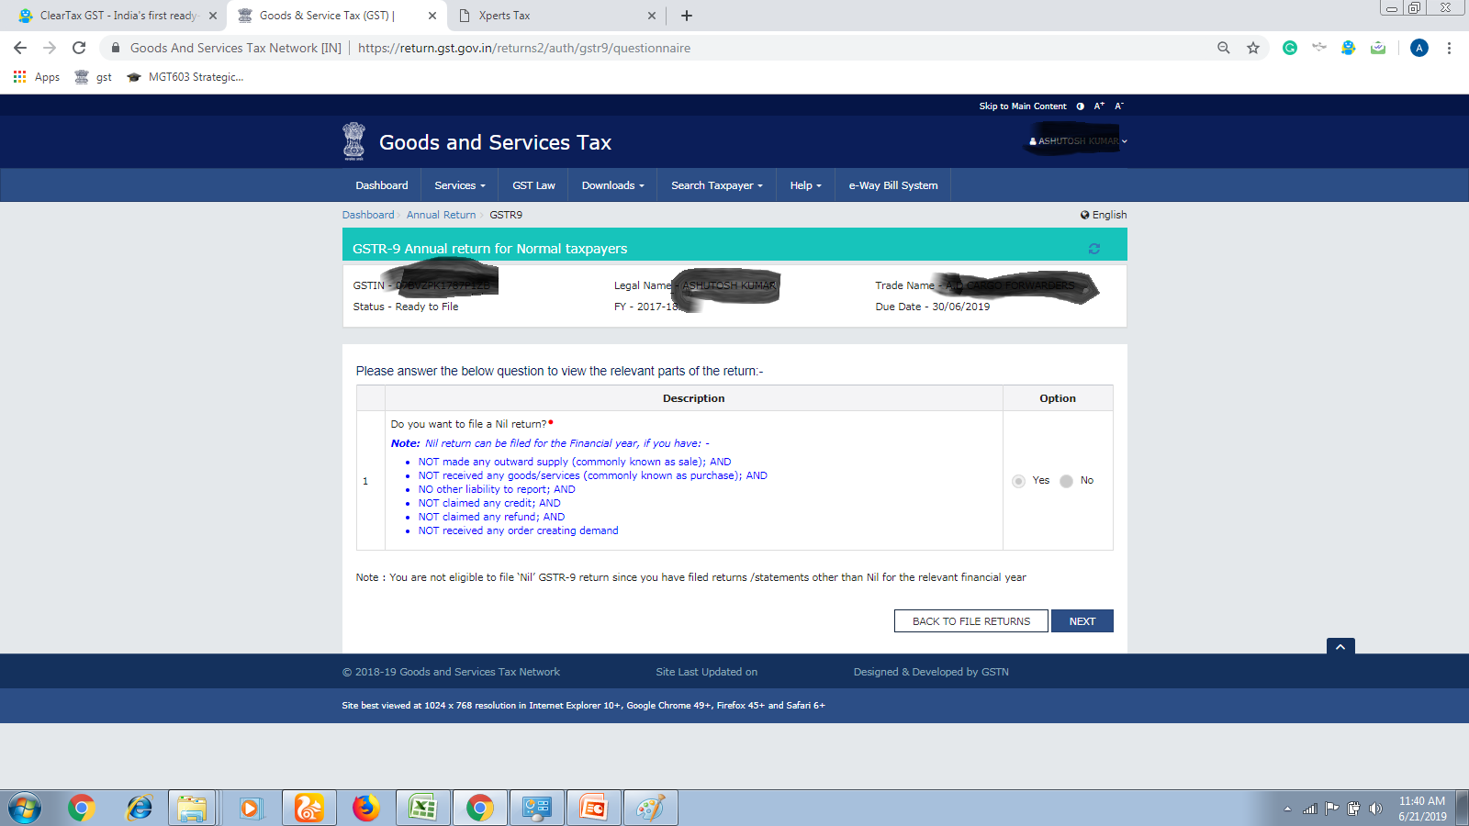
Click on- Yes- > then on Next

Slide 9
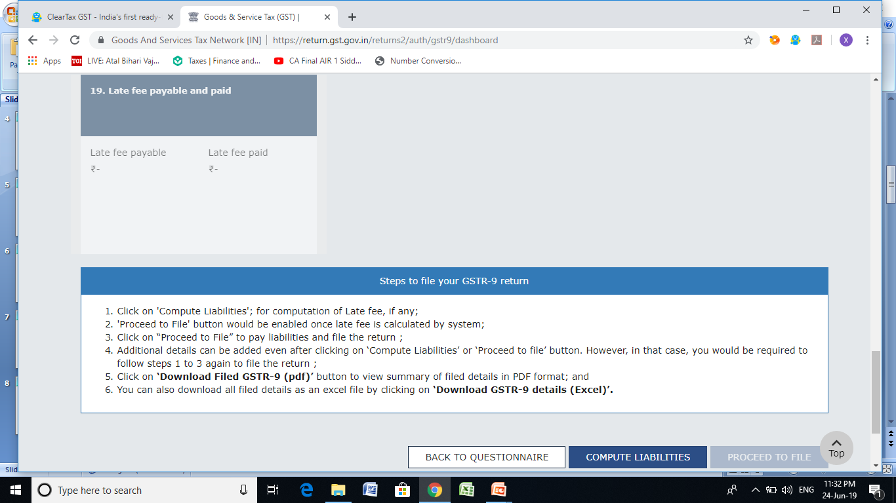
Click on- Compute Liabilities-> Then Click on Proceed to File

