Slide 1

NAME: NSHIMIYIMANA Christian
Reg number 25rp20576
Project name: smart car parking prediction system

Slide 2
i. PROBLEM STATEMENT
Nowadays Finding an available parking space is difficult in busy areas like hotels or other place that many people, so drivers waste time looking for parking. that why we decided to do this project “Smart car Parking Prediction System ” in order make life easy for drivers
Why is it important?
Reduces traffic congestion.
Saves fuel and time.
Provides data-driven insights for city planning.

Slide 3
ii. Dataset description
Dataset is in csv excel” parking_dataset.”contains features(input) and target.
Features('Day', 'Hour', 'Weather', 'Weekend', 'NearbyEvent', 'OccupiedLastHour' )
Target: we have two target(0 or 1)our target will be if there is parking available means [YES(1)] if not [NO(0)])
Size of dataset: 500 rows × 6 columns
I have two type of data :- numerical data(hours,weekend,occupied lasthour) and categorical data(days and weather)
Source:https://www.kaggle.com/datasets/ananthr1/parking-prediction

Slide 4
iii. EDA findings
Univariate Analysis: first I used univariate by looking at one variable at time. In following slide there is Histograms for Day, Hour, Weather
Bivariate Analysis: it Compares one feature with the target variable . Correlation between Hour and free slots, Event and frees lots
Multivariate Analysis: Studies relationships among multiple features together.
To detect correlations, collinearity, and feature interactions that affect predictions.
Pair plots to visualize feature interactions
Missing Values & Outliers: Dataset is clean; no missing values, small number of outliers handled in notebook code.

Slide 5
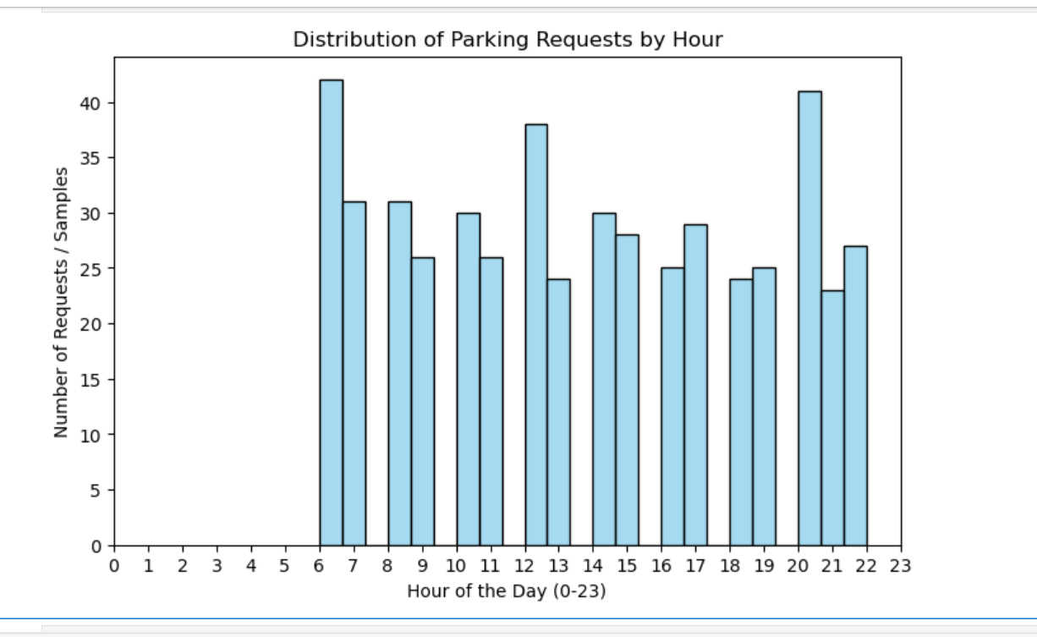
Visual presentation of univariate analysis of hours
Histogram for Hour

Slide 6
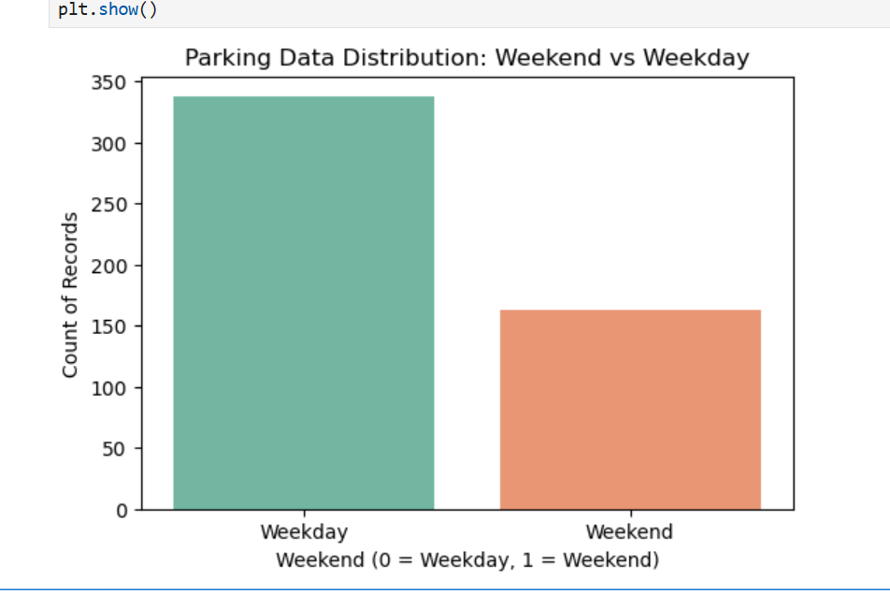
Visual presention on univariate data
Histogram of weekends

Slide 7
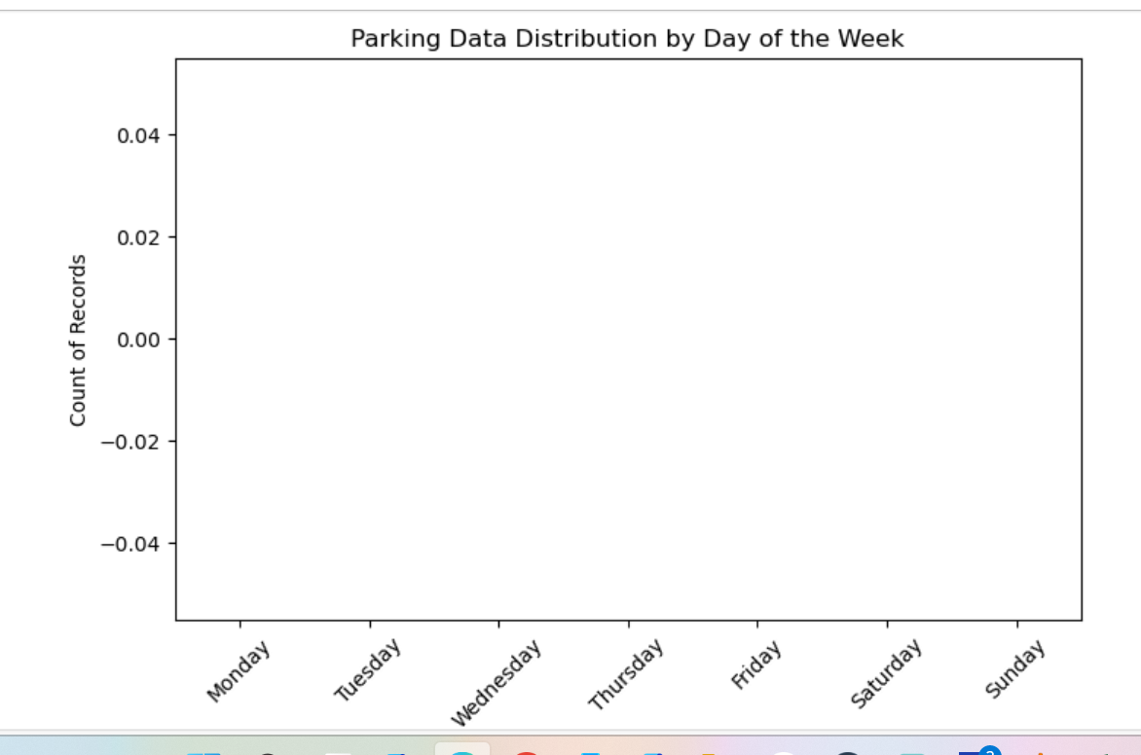
Visual presentation on univariate data
Histogram of days of week

Slide 8
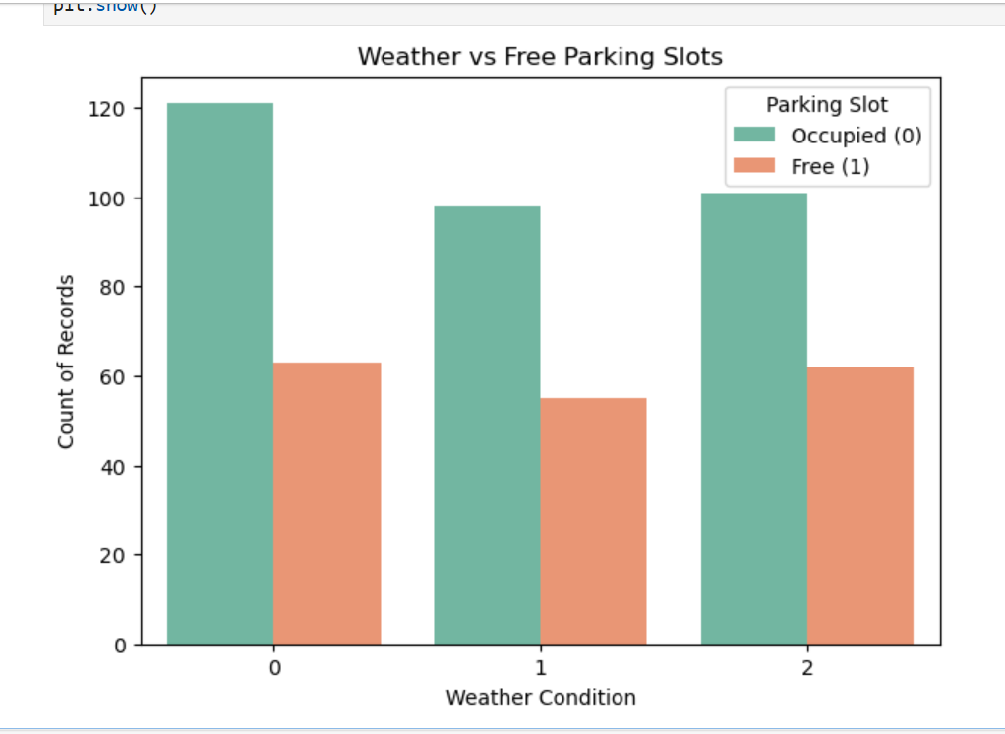
Visual presentation on bivariate data
Bar chart for Weather vs free slots

Slide 9
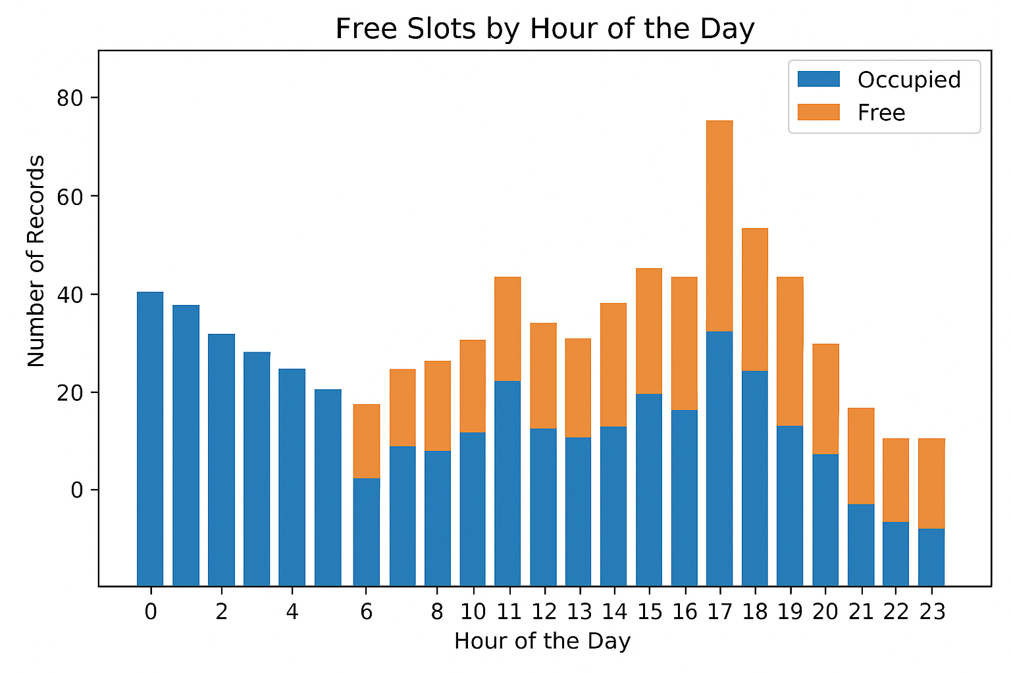
Visual presentation on bivariate data
Bar chart for Hours vs free slots

Slide 10
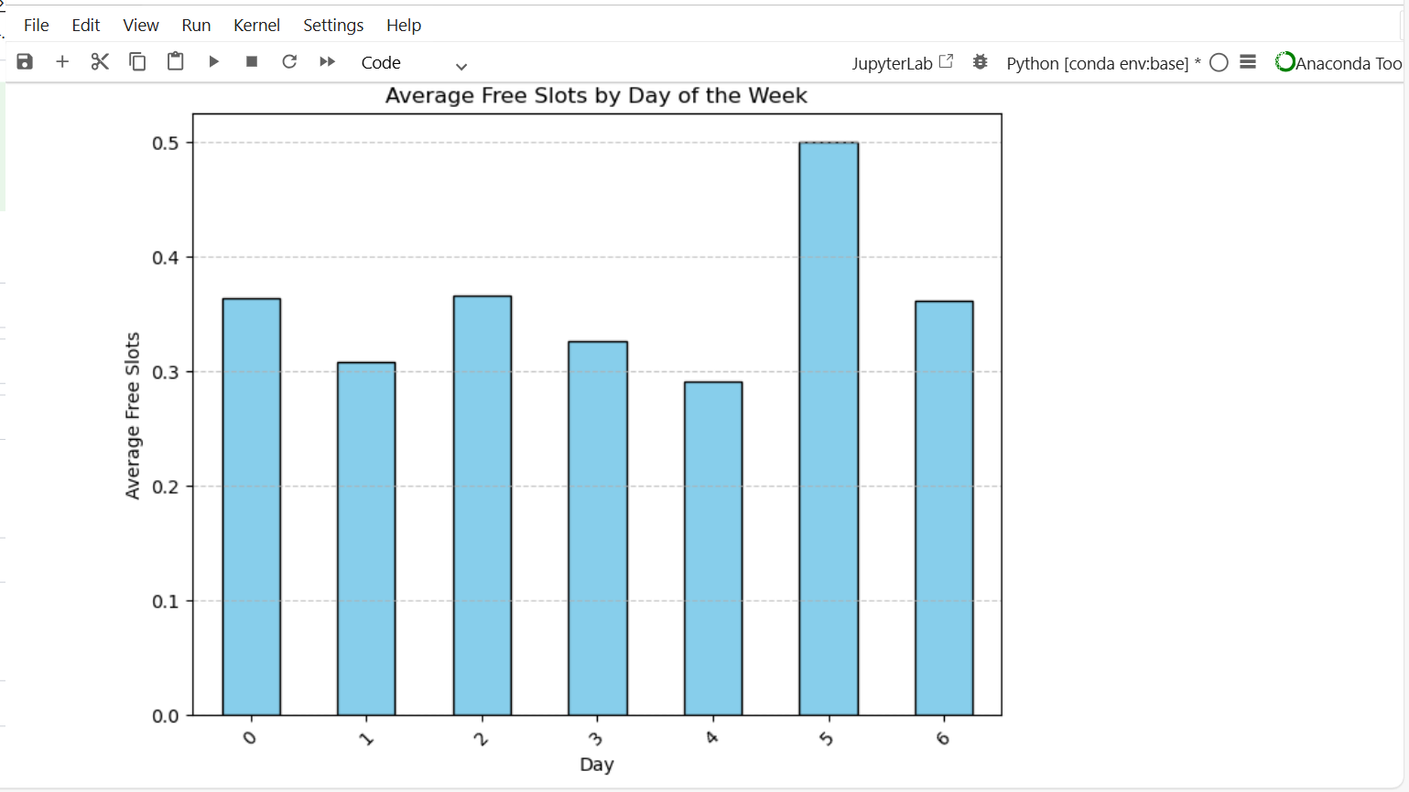
Visual presentation on bivariate data
Bar chart for day of week vs free slots

Slide 11
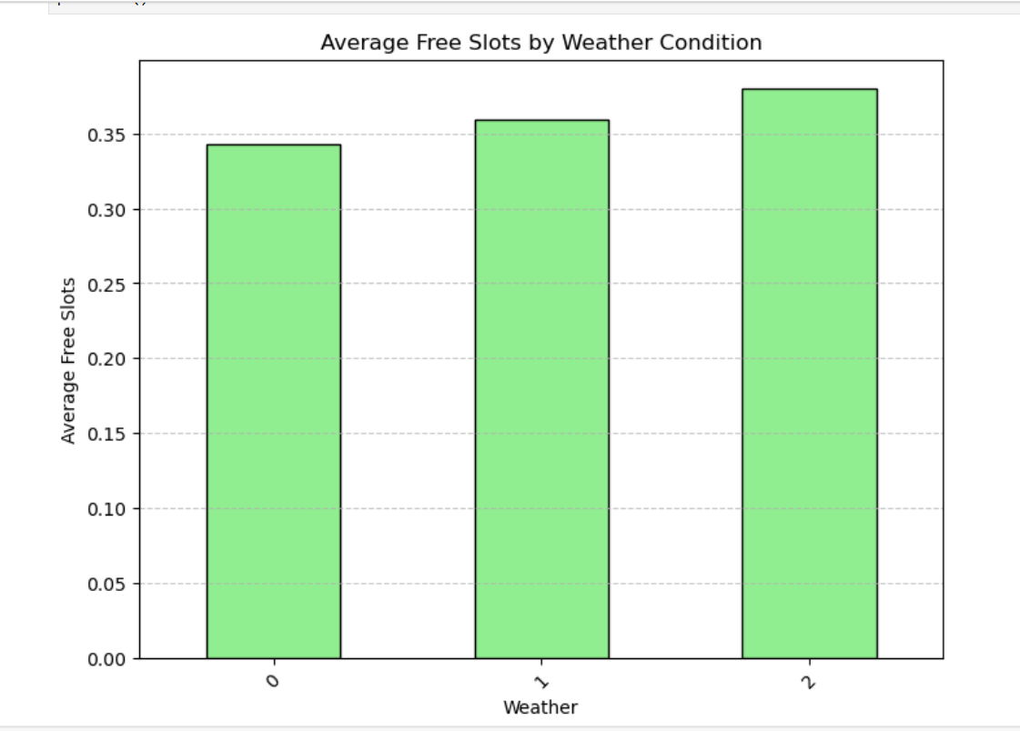
Bar chart for weather vs free slots

Slide 12
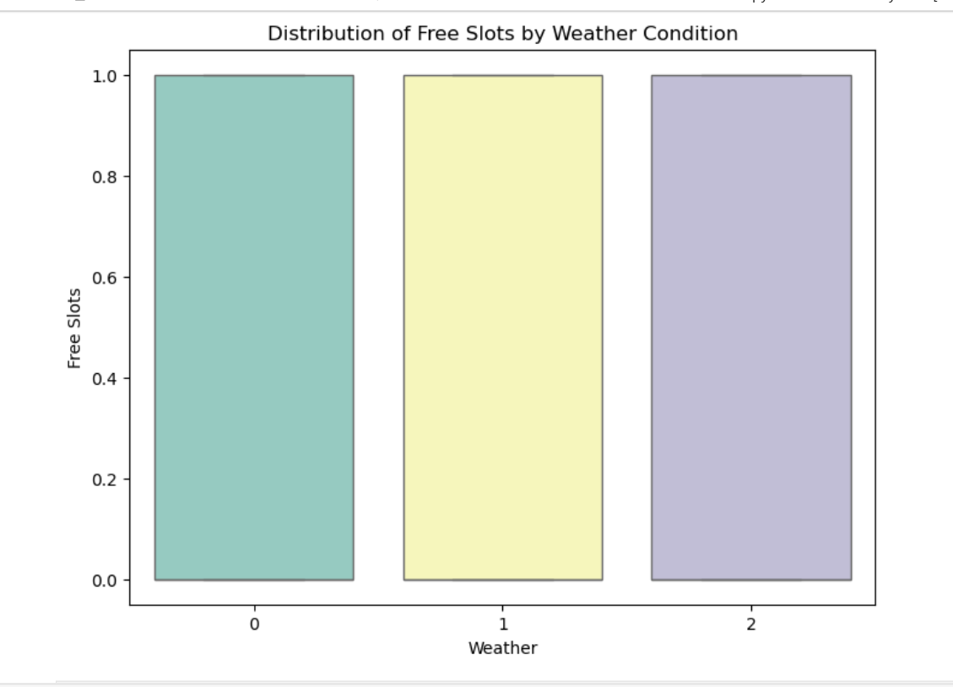
Visual presentation on multivariate data
1. Boxplot for Free Slots vs Features

Slide 13
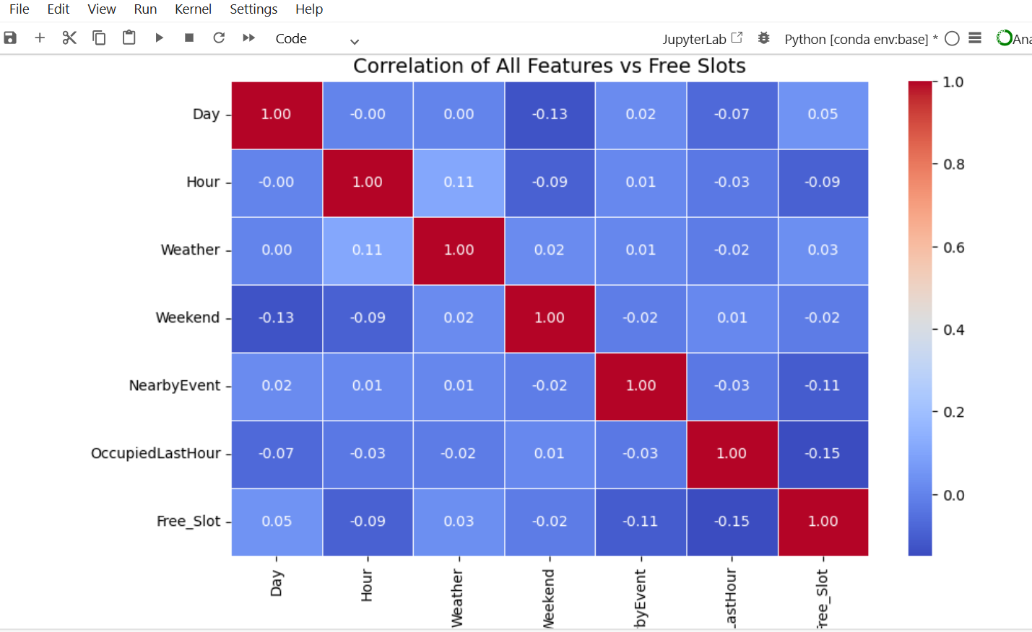
2. Correlation matrix of features and target

Slide 14
iv. Feature engineering steps applied and justification
1. Check missing values and handle missing values: no missing values in dataset
# Check how many missing values in each column
print(Park_dataset.isnull().sum())
Day :0 ,Hour :0, Weather :0 Weekend :0 NearbyEvent: 0 OccupiedLastHour: 0 Free_Slot: 0 dtype: int64
2. Handle outliers and anomalies: in my dataset there is no outliers and anomals
Code:

Slide 15
Code to check outliers and anomarls
# Function to detect outliers using IQR
def detect_outliers_iqr(data, column):
Q1 = data[column].quantile(0.25)
Q3 = data[column].quantile(0.75)
IQR = Q3 - Q1
lower = Q1 - 1.5 * IQR
upper = Q3 + 1.5 * IQR
outliers = data[(data[column] < lower) | (data[column] > upper)]
return outliers, lower, upper

Slide 16
Perform Data Transformation
This help to prepare dataset for machine learning by converting categorical values into numbers and scaling numerical features.
In the target column free slots (days and weather) is categorical data so we need “Encode the label”
Code: le_day = LabelEncoder()le_weather = LabelEncoder()Park_dataset["Day"] = le_day.fit_transform(Park_dataset["Day"])Park_dataset["Weather"] = le_weather.fit_transform(Park_dataset["Weather"])
Missing values, outliers, and categorical features are handled. Data is transformed and encoded to improve model accuracy.

Slide 17
Apply feature extraction if relevant
Feature extraction: PCA not needed (dataset is small).
Text extraction not needed (no text).
v. Model building and evaluation process
Model: A machine learning algorithm (Decision Tree) is trained to predict free slots based on historical patterns. The model is tested using accuracy and performance metrics to ensure reliable predictions.
Train and test model: Train Decision Tree modelmodel = DecisionTreeClassifier(random_state=42)model.fit(X_train, y_train)
Our model is trained on occuracy of 53% , 53 because we ha small dataset.

Slide 18
vi. Model deployment details
Deployment of model done by using streamlit framework.
The app is deployed using Streamlit, allowing users to interact via a web interface. They can input their desired time and conditions, and the app predicts free slots while showing their inputs for transparency. You can access it online use of using this link:https://parkingsapp-dygyu9wc8ptfhamedgflpn.streamlit.app/
The app has place to input data and predict weather button you click on to show the results.
The following slides there is picture to show deployed model.

Slide 19
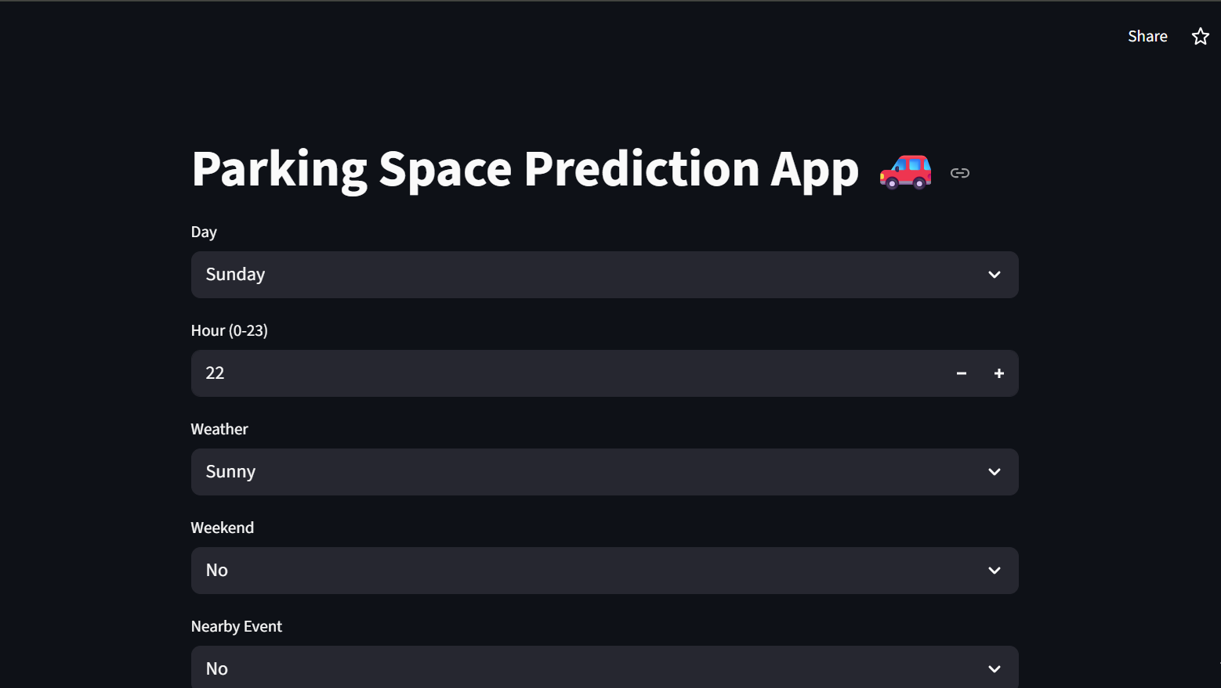
Model deployed interface screen shoot The deployed app to predict parking space, so here is for input

Slide 20
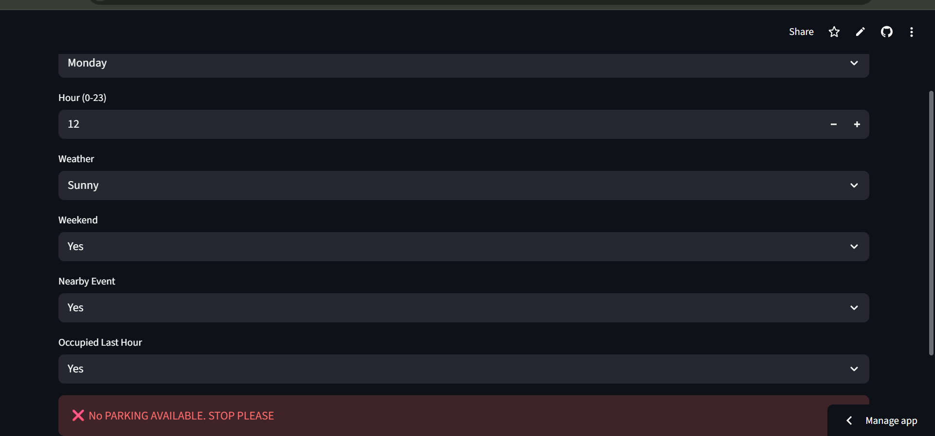
APP interface on output

Slide 21
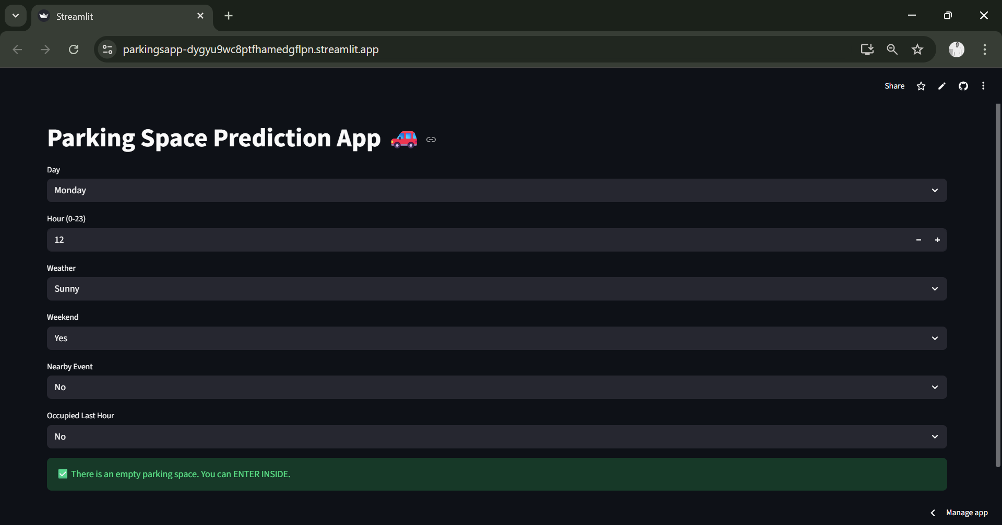
Our App working This app provides a simple, user-friendly tool that supports better planning and reduces the time spent searching for parking.

Slide 22
Thank you!!!!

