Slide 1
Expense Tracker Application
By Nathan Shin

Slide 2
Design Considerations & Approach
Tech Stack
  Backend, Frontend, and Database to deliver a lightweight web-app quickly.
Implementation of Functionality
  At a minimum, must provide required functionality
    Total Expense
    Total Expense by Category
    Expense Trend
    Highest and Lowest Spend Category
Features
  Add/Delete Expenses, Bar Graph Data, etc…

Slide 3
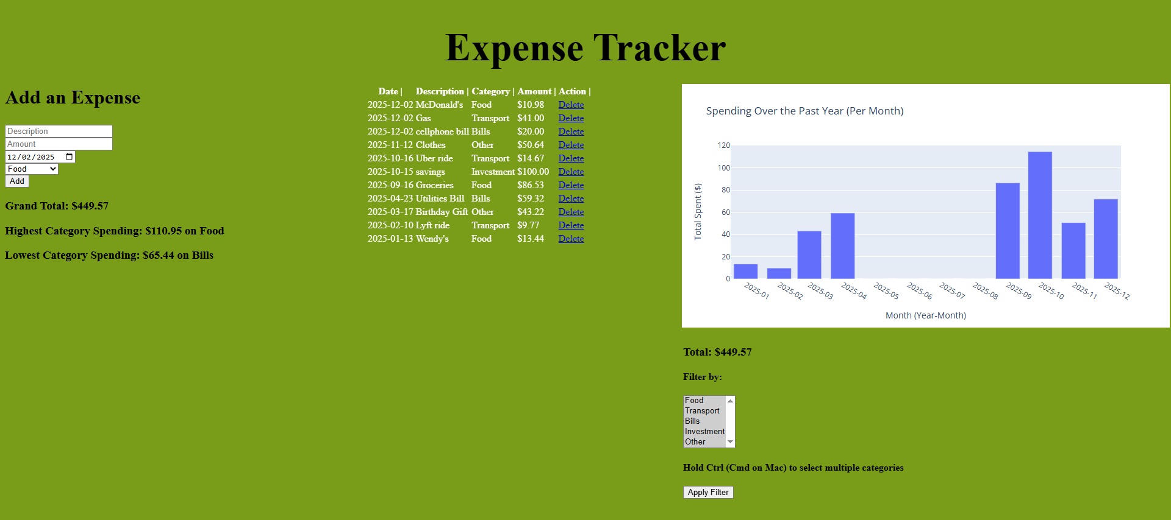
App Overview
Left Side : Add expense section, Grand total of all expenses with category of highest and lowest spendings.
Middle : A table showing all the expenses, filtered by the desired categories (All categories selected on app start).
Right Side: Bar graph showing spending from 1 year ago - present, along with filter category options and total of all bars in bar graph added up.

Slide 4



Tech Stack
Backend : Flask - Lightweight, easy to set up.
Frontend : HTML/CSS - Simplistic integration with backend.
Database : SQLite : Serverless, portable, and maintenance free.

Slide 5
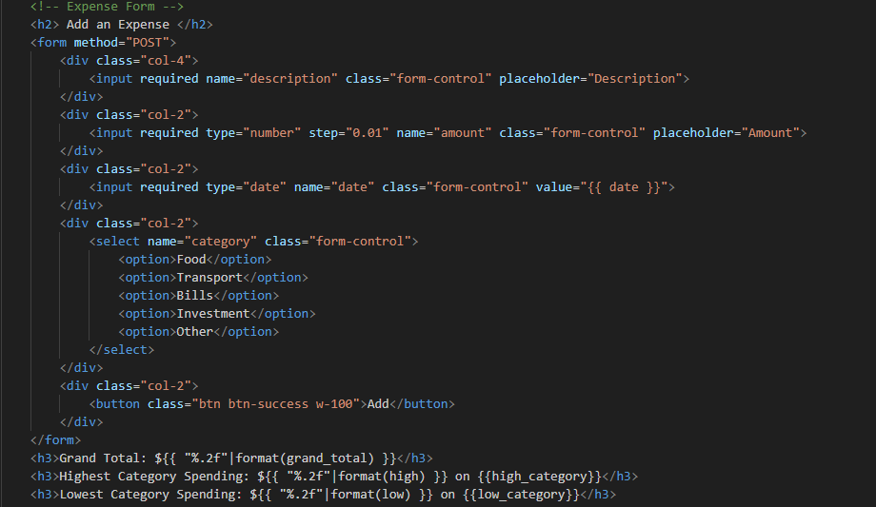
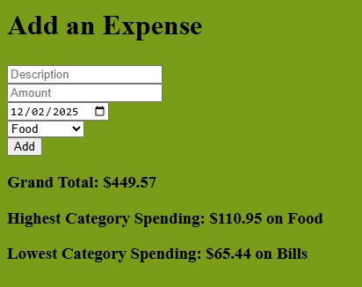
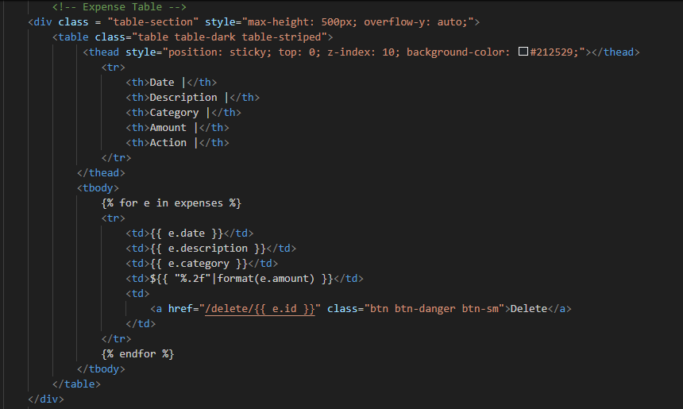
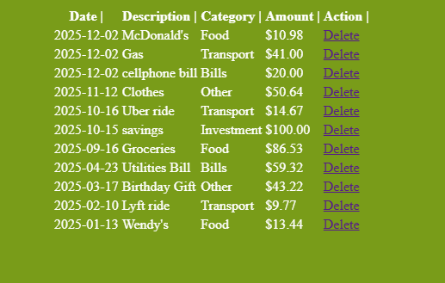
Important Files (frontend) : index.html, styles.css
index.html
  Structures the contents that is seen on the web-app
styles.css
  Styles and formats the contents of the html file.

Slide 6
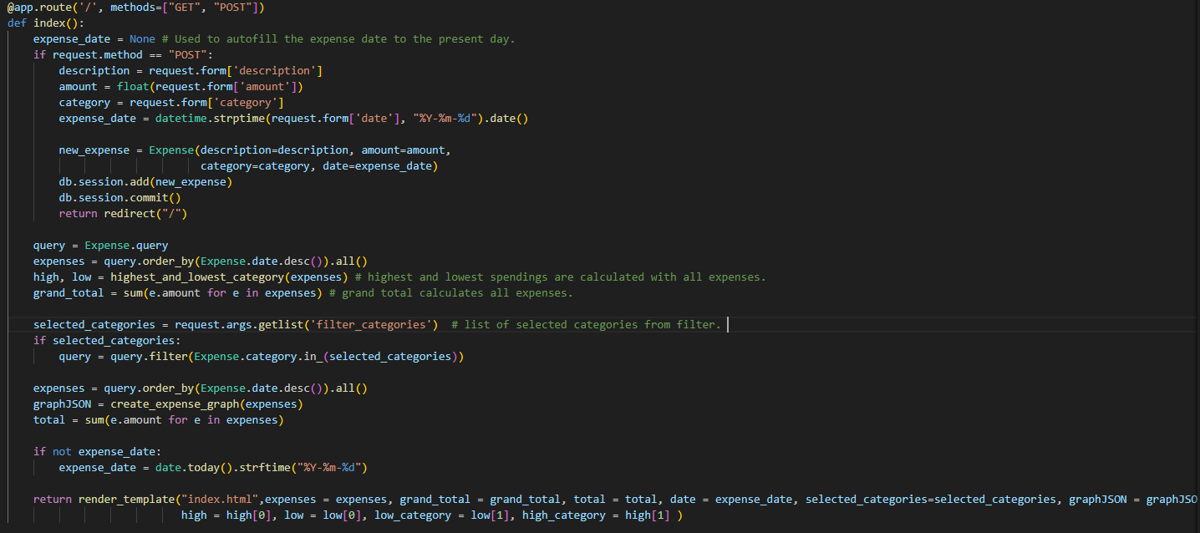
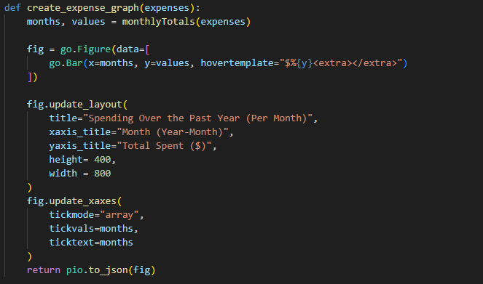
Important Files (backend) : app.py and visualization.py
app.py
  Contains code to start the web-app, initialize the db, add/delete expenses, and render the html template.
visualization.py
  Has functions used to create the bar graph and to calculate the highest and lowest category spending.

Slide 7
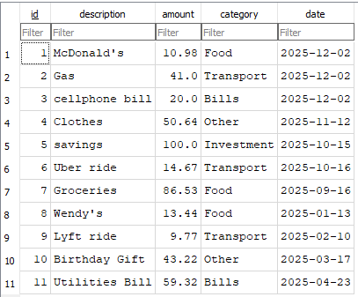
Important Files (database) : expense.db
expense.db - Stores the expense data in a relational database that uses SQL, featuring one table with columns as follows:
  id (Primary Key) - Unique ID for expense
  description - Description of expense
  amount - Money spent (in $)
  category- type of expense (Food, Bills, Transport, Investment, Other)
  date - When the expense occurred (M/D/Y).

Slide 8


Running the App
Required Software
  Python
  Git Bash
  Web Browser (Chrome, Firefox, Microsoft Edge, etc..)
Run Process (Windows)
  Locate the desired directory for the app (can be anywhere), right click and select the option “Open Git Bash Here”
  A Git Bash Terminal Window will appear, enter the follow commands:
    git clone https://github.com/nshin09/Expense-Tracker-Application.git
    cd Expense-Tracker-Application
    pip install -r requirements.txt
    flask run
  On the web browser of your choice, search the following
    localhost:5000
  The app should now be successfully running!
    On subsequent runs, it is only necessary to open git bash in the directory of the app and run the command “flask run”.

Slide 9
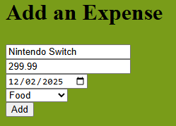
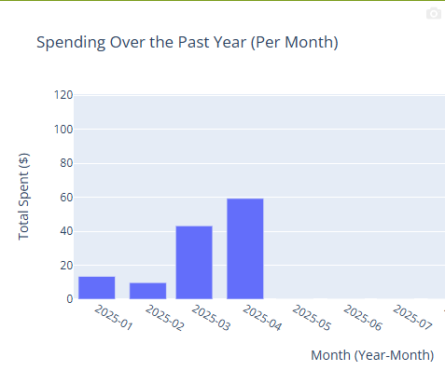
Testing / Verification
Total Expense
  At the start of the app there should be a value next where it says “Grand Total”. It should be equal to all the expenses added up in the table in the middle (without filter options). Only adding and deleting expenses should affect this value.
Total Expense by Category
  To the right of the page, there is a “Filter by:” option. When the categories are selected and the “Apply Filter” button is clicked, the table rows, total, and bar graph should change to data reflecting only the categories that were selected.
  Total reflects the total money spent of selected categories.
Expense Trend
  The bar graph shows spendings of the selected categories spanning from the 1 year ago to the present. To verify its functionality, add all the category totals for each month and see if it corresponds correctly with the bar graph.
Highest and Lowest Spend Category
  To verify this function, filter by all categories and manually add up all the expenses from each category and calculate the highest and lowest spending. In the case of a tie, a category wins by priority in the following order (Most to least) : Food, Bills, Transport, Investment, Other.

Slide 10



Future Design Improvements
Scalability
  Change tech stack to Spring Boot + React.js + Amazon RDS
    Allows for good performance if many users were to use the app.
Addition of an “edit” button
  Current design is configured where in order to change an expense attribute, the expense must be deleted and a new one must be created.
New table to store account data
  Create another table in DB for storing user account information, where each user has their own personalized expense tracker information.

