Slide 1
Position Measurements with CRV
Using Arrival Time and Light Yield Differences
Test runs 1002,1005-1018 from June 2017

Slide 2
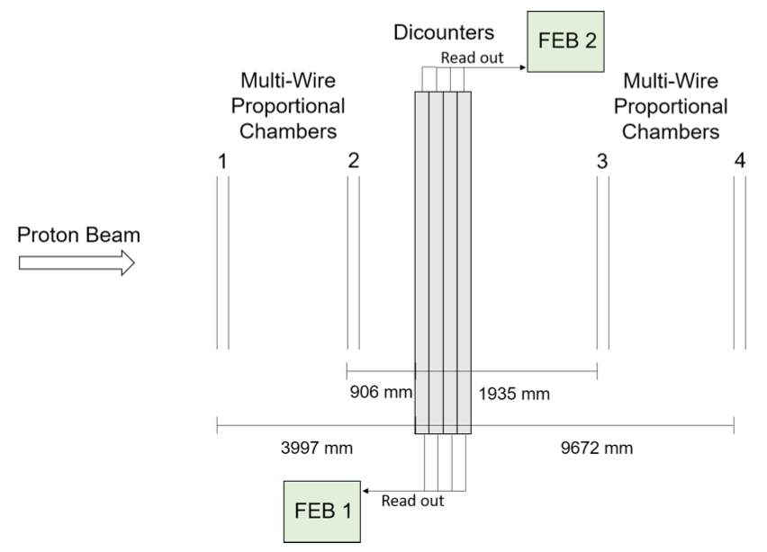
Go Figure (Test Beam Run Setup)
CRV has no wired chambers...

Slide 3
Motivation
Estimate position of muons using time and light yield differences

Slide 4
Method
Test runs 1002,1005-1018 from June 2017
beam position varied from 5 to 2250mm from FEB1 end
Used channels 2,3
Plotted Wire-chamber measured x-position
Plotted calculated x-position with formulae
using arrival time difference on opposite ends of fiber
using light yield difference on opposite ends of fiber
0
4
8
12
1
5
9
13
2
6
10
14
p⁺
*not to scale
3
7
11
15

Slide 5

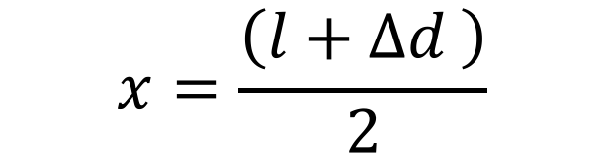



Time Difference Method (Using One Fiber, Channel 2)
$$d_{1}$$
$$d_{2}$$
2
2
1
2
x
FEB 1
0
2m
l
= 3m
FEB 2
$$\left(t_{1}−t_{2}\right)∙v=∆d$$
$$x=\frac{\left(l+∆d \right)}{2}$$
$$\left(t_{1}−t_{2}−t_{c}\right)∙v=∆d$$

Slide 6
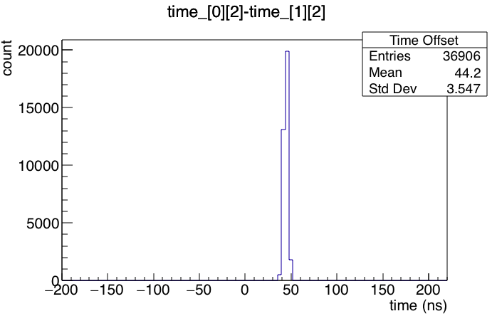
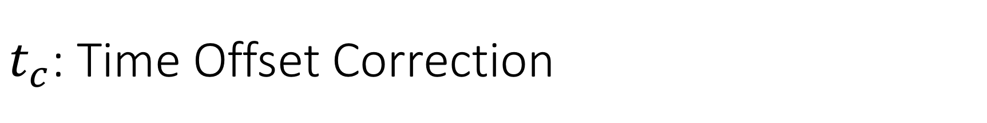
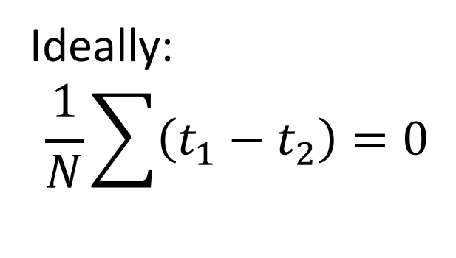

$t_{c}$: Time Offset Correction
Run 1007
2
2
1
2
0
1.5m
3m
FEB 1
FEB 2
But...
Ideally:
$$\frac{1}{N}\sum{\left(t_{1}−t_{2}\right)}=0$$
$$t_{c}$$

Slide 7

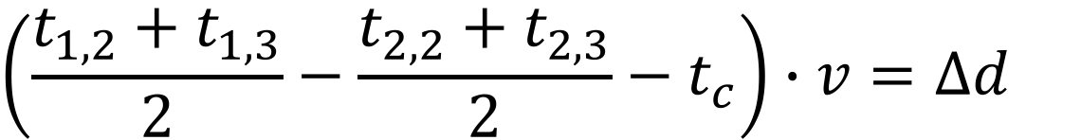
Time Difference Method (Using Both Fibers, Channels 2 &3)
One Fiber
$$\left(t_{1}−t_{2}−t_{c}\right)∙v=∆d$$
$$\left(\frac{t_{1,2}+t_{1,3}}{2}−\frac{t_{2,2}+t_{2,3}}{2}−t_{c}\right)∙v=∆d$$
Two Fibers

Slide 8
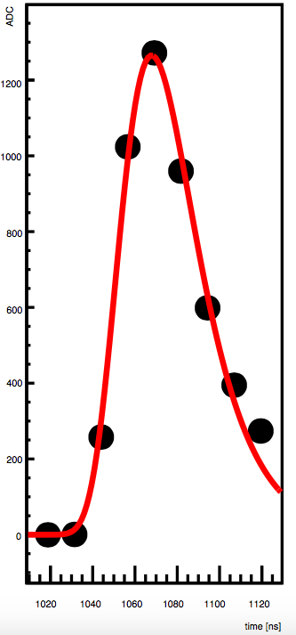
Leading Edge Time vs. Peak Time
Two types of arrival times recorded by FEBs
Leading edge (LE) time
Peak time (or simply, time)

Slide 9

Speed of Light Calculation
Run 1005
$$d_{1}$$
$$d_{2}$$
2
2
1
2
x
FEB 1
0
2m
l
= 3m
FEB 2
$$∆d=v∙\left(t_{1}−t_{2}−t_{c}\right)$$

Slide 10
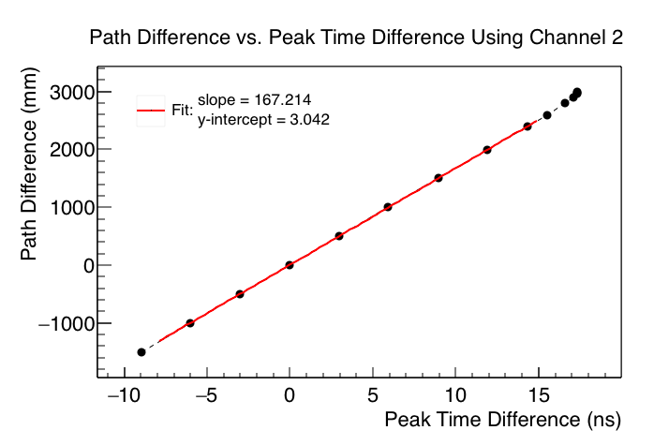
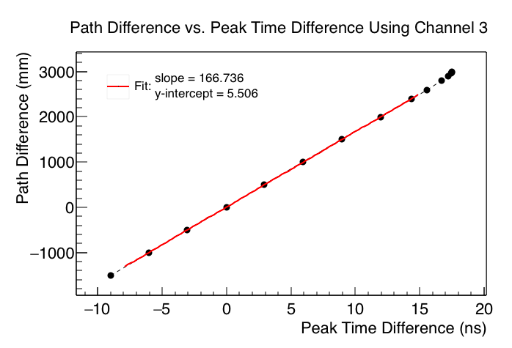
Using Peak Time
v_{using peak time} ≈ 166.975mm/ns

Slide 11
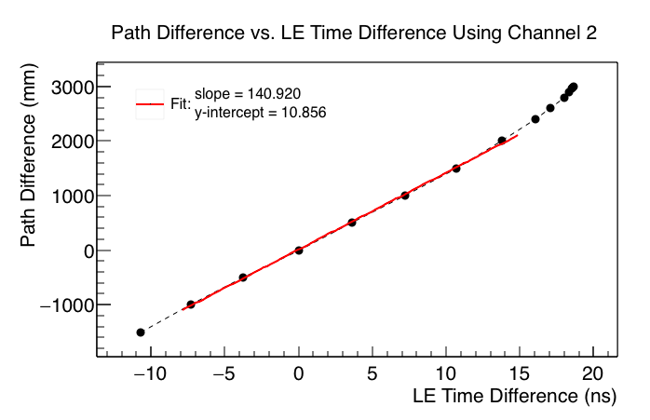

Using LE Time
v_{using LE time} ≈ 140.835mm/ns

Slide 12
Position Plots
Run 1002

Slide 13
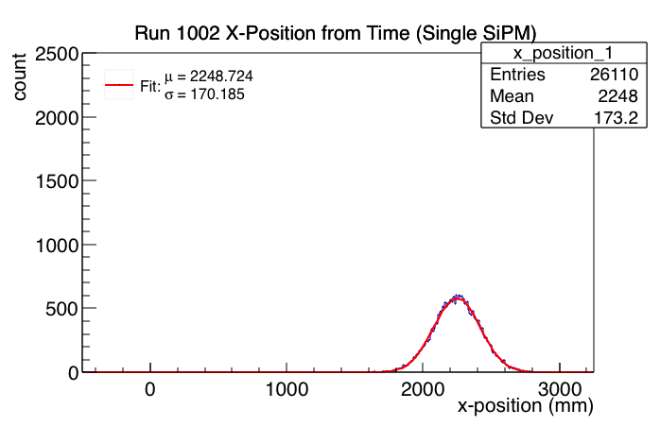
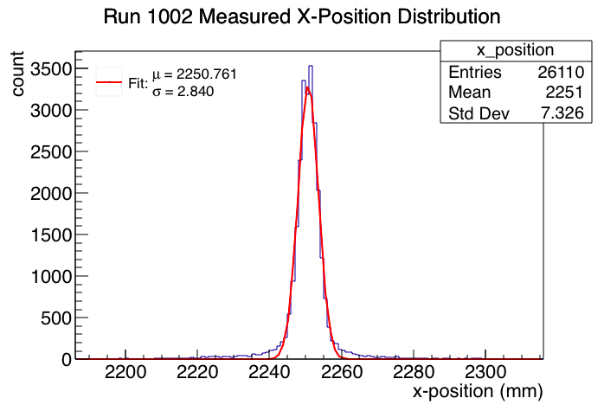
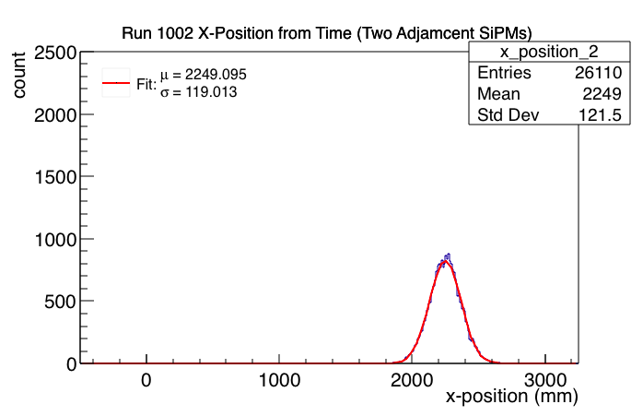
Using Peak Time

Slide 14
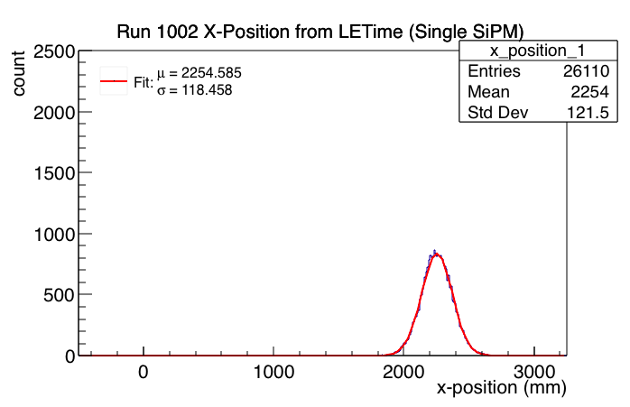
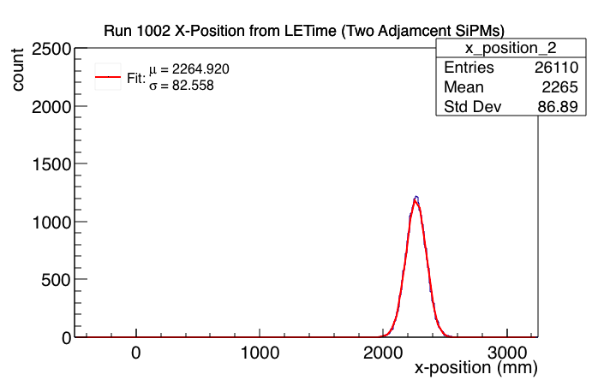
Using LE Time

Slide 15
Position Plots
Run 1018

Slide 16
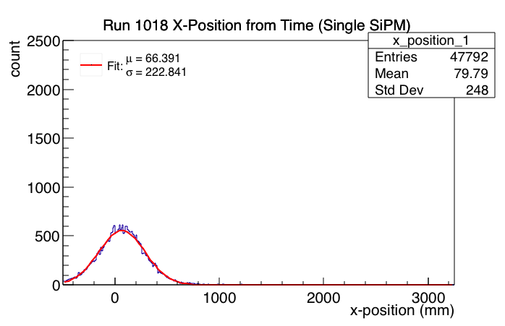
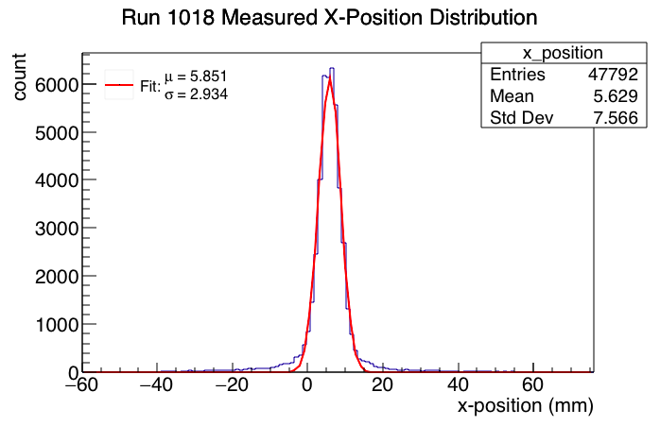
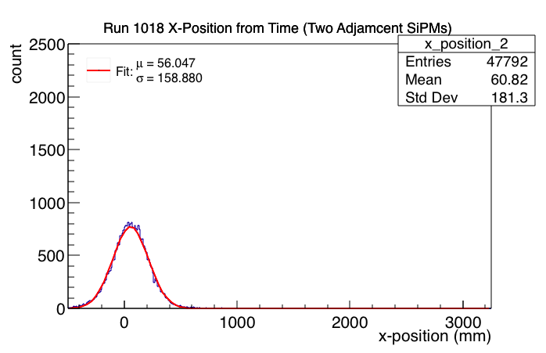
Using Peak Time

Slide 17
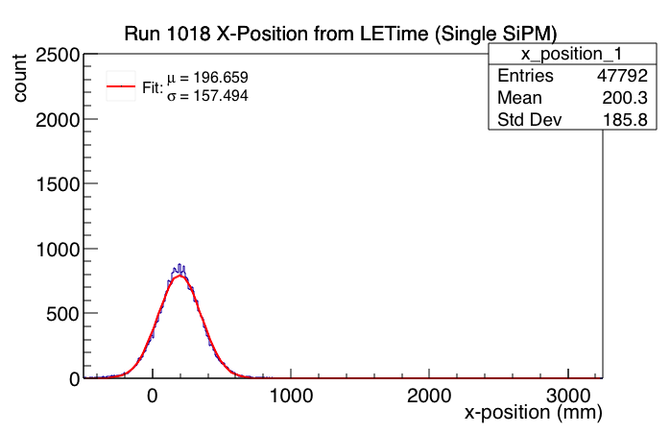
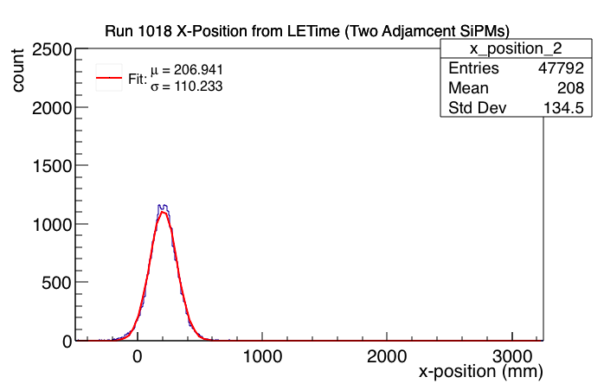
Using LE Time

Slide 18
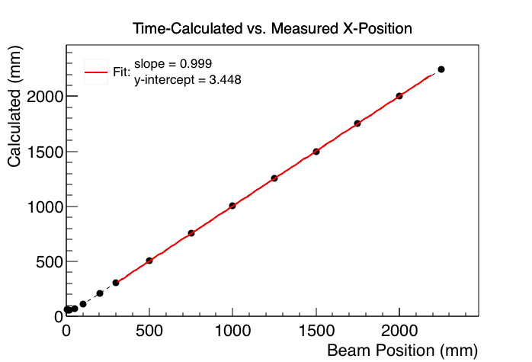
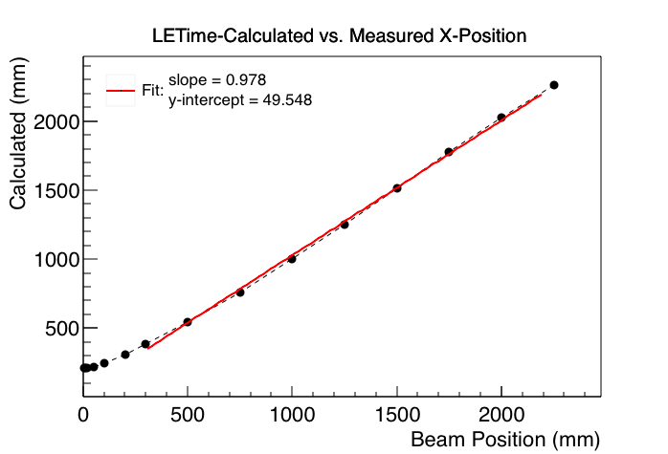
Correlation Plots

Slide 19
Statistics
When both fibers are used, for both peak and LE time methods...
standard deviation becomes smaller
average position becomes less accurate

Slide 20
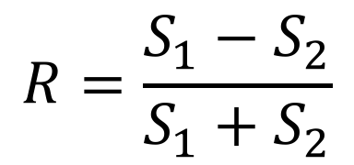
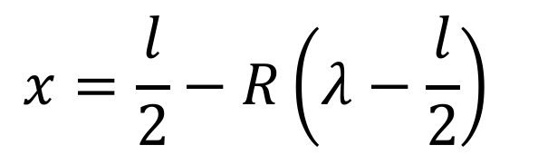
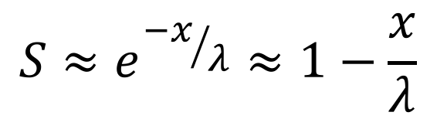
Light Yield Difference Method
$$d_{1}$$
$$d_{2}$$
2
2
1
2
light
light
x
FEB 1
0
$$R=\frac{S_{1}−S_{2}}{S_{1}+S_{2}}$$
l
= 3m
FEB 2
$$S≈e^{{−x}/λ}≈1−\frac{x}{λ}$$
?
$$x=\frac{l}{2}−R\left(λ−\frac{l}{2}\right)$$

Slide 21
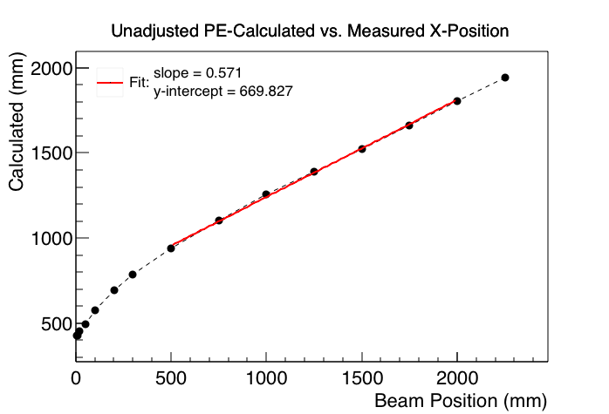
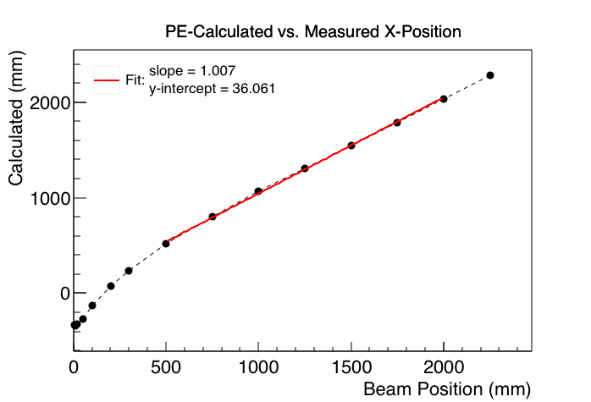
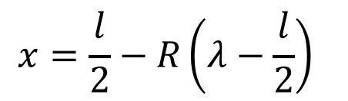
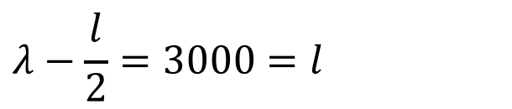
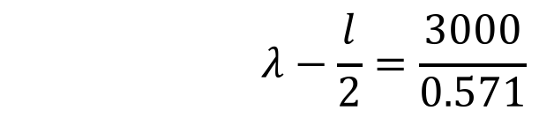
Approximating Unknown Attenuation Length (λ)
$$x=\frac{l}{2}−R\left(λ−\frac{l}{2}\right)$$
$$λ−\frac{l}{2}=3000=l$$
$$λ−\frac{l}{2}=\frac{3000}{0.571}$$

Slide 22
Position Plots
Run 1002

Slide 23
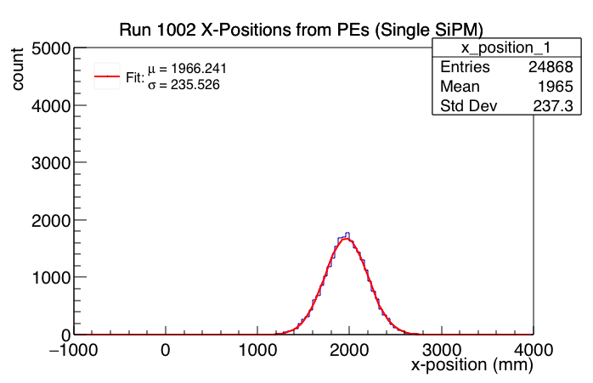
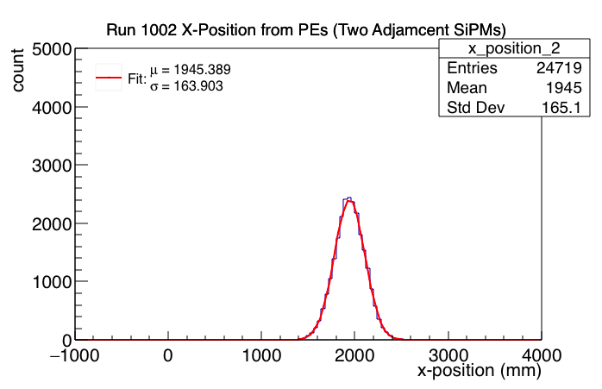


Using $λ−\frac{l}{2}=3000$ mm
$λ$ = 4,500 mm

Slide 24
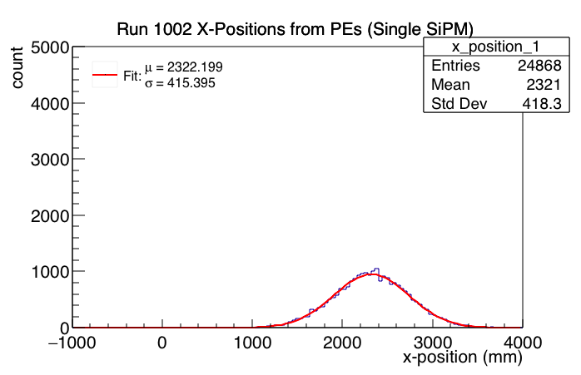
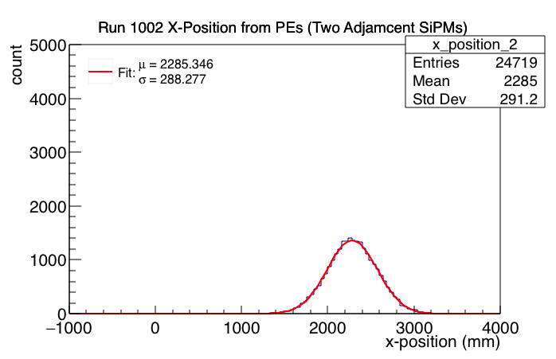


Using $λ−\frac{l}{2}=\frac{3000}{0.571}$ mm
$λ$ = 6,754 mm

Slide 25
Position Plots
Run 1018

Slide 26
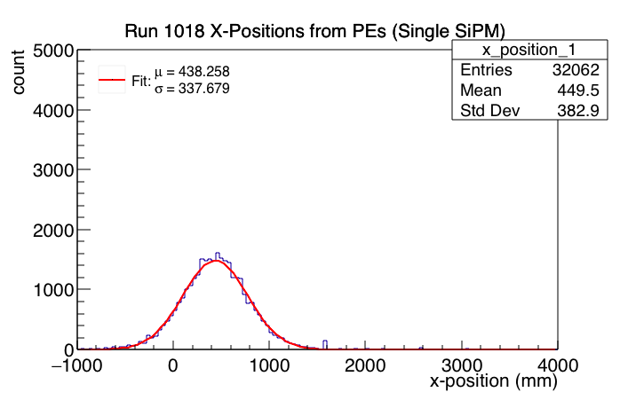
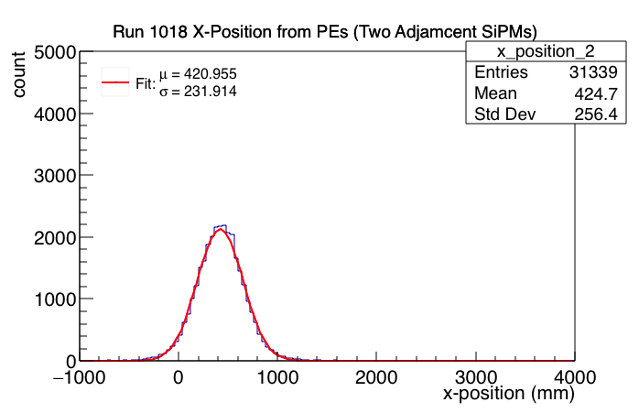
Using $λ−\frac{l}{2}=3000$ mm
$λ$ = 4,500 mm

Slide 27
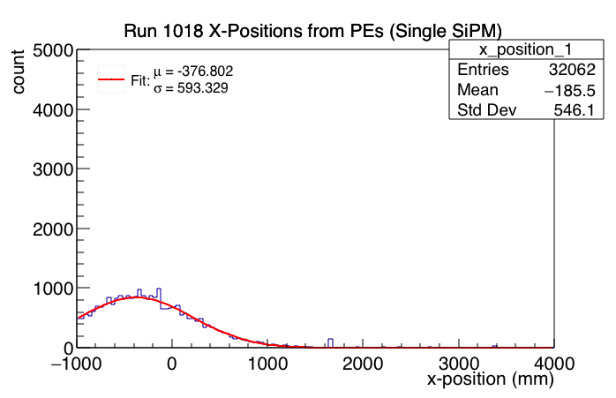
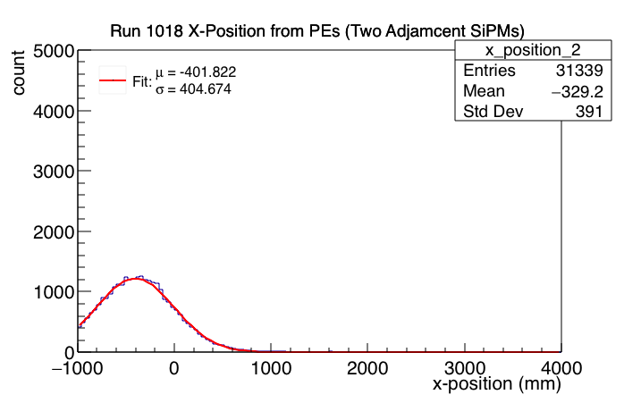

Using $λ−\frac{l}{2}=\frac{3000}{0.571}$ mm
$λ$ = 6,754 mm

