Slide 1
“End Data” Analysis
Studying light drop-off effects for proton beams at the end of counter
Test runs 716-722, 725

Slide 2
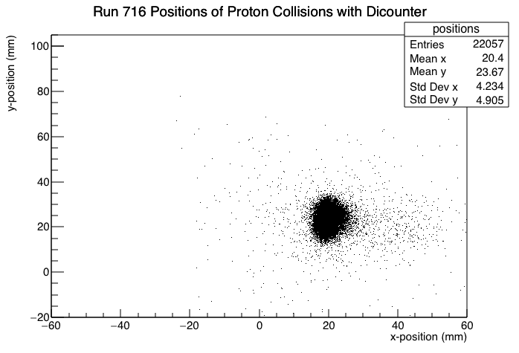
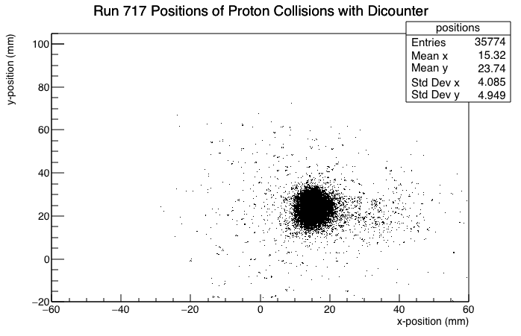
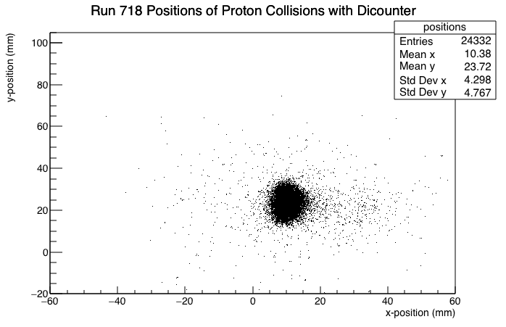

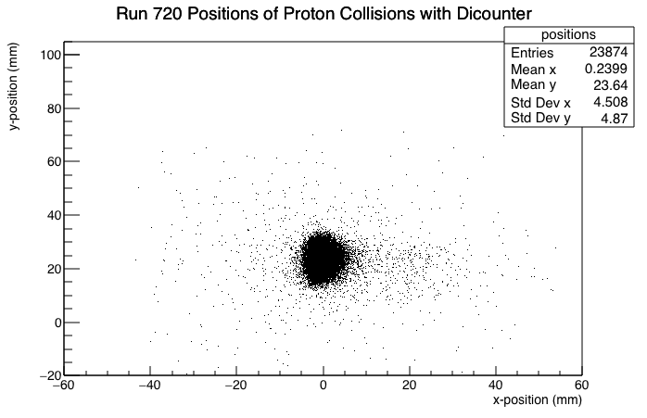
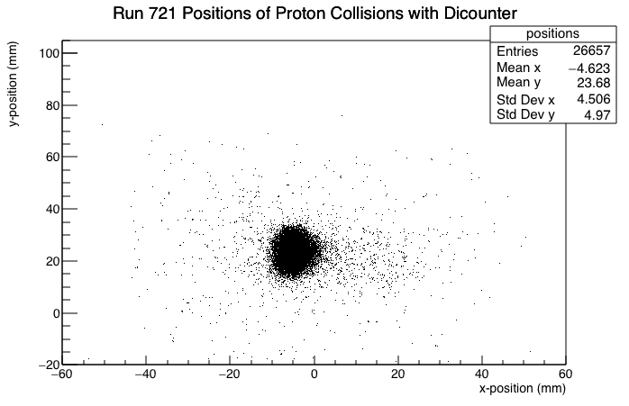
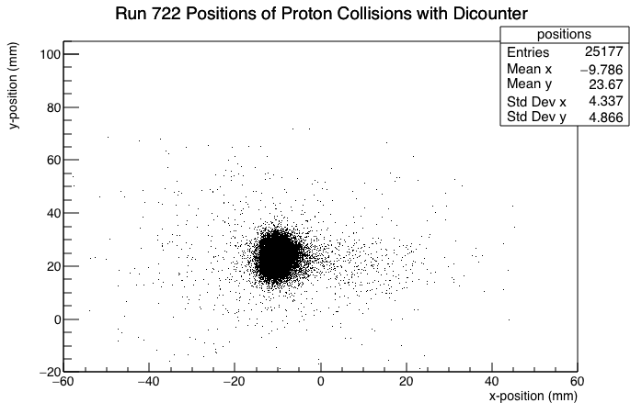

Proton Beam Positions Plots
X-Position: -10mm to 21mm
Y-Position: 24mm

Slide 3
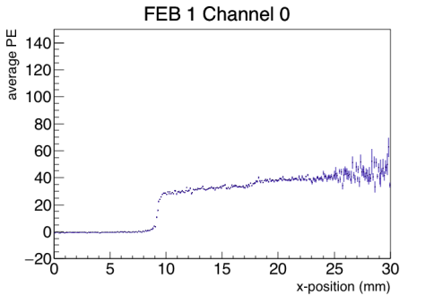
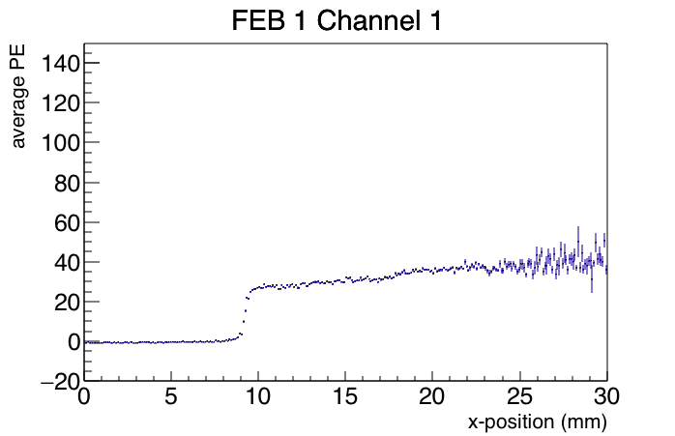
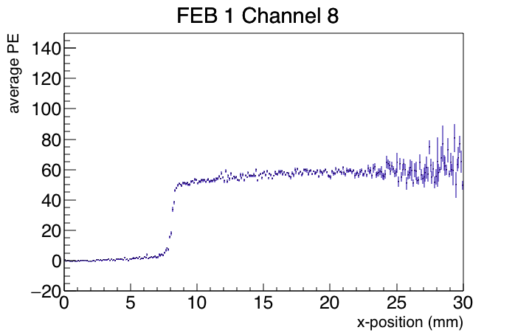
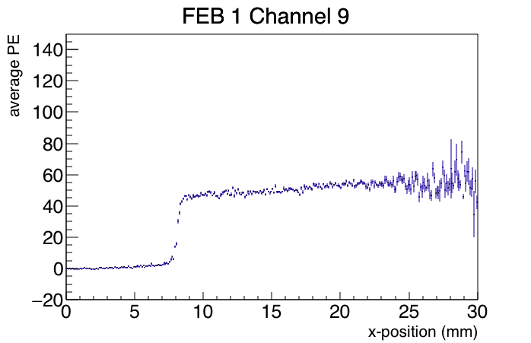
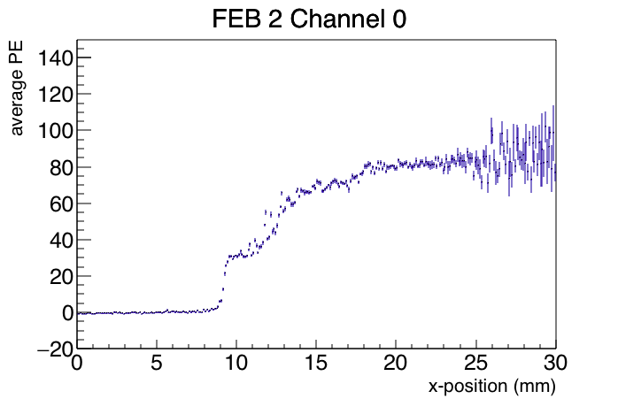
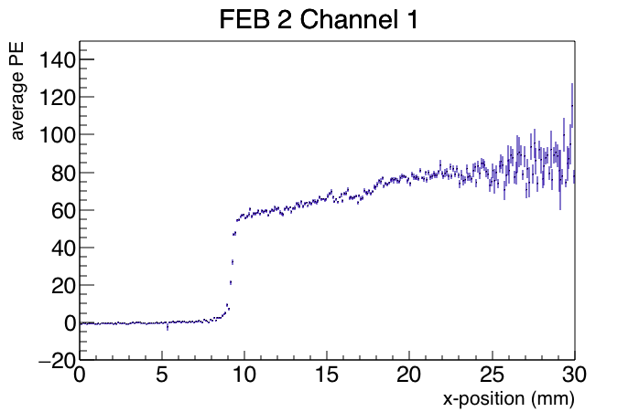
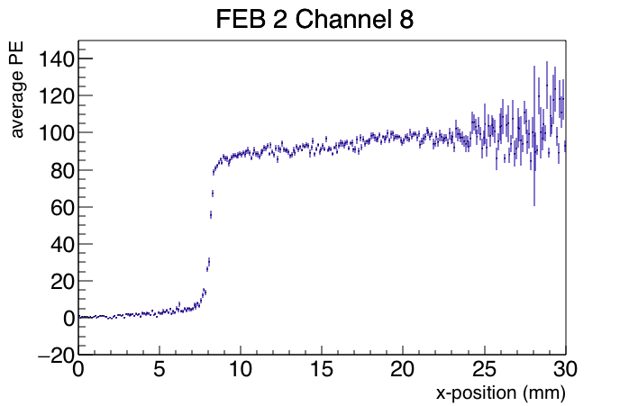
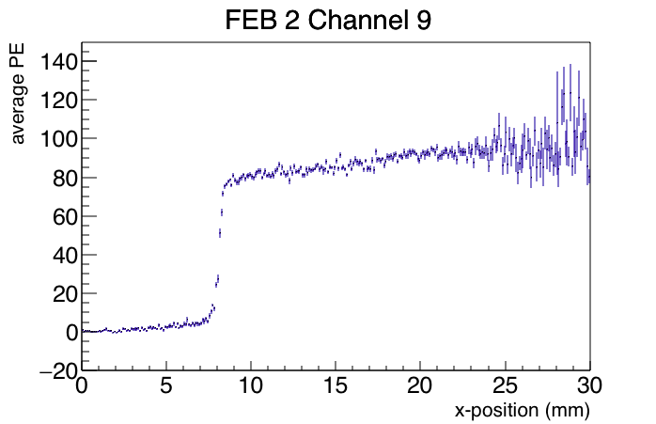
Average PE vs. Proton Beam X-Position Plots
FEB 1 @ x = 3000mm
FEB 2 @ x = 0mm
Channels with 2*2 SiPM:
Channels 0,1 counters w. bare ends
Channels 8,9 counters w. reflective ends
Bin size = 0.1mm (300 bins)

Slide 4
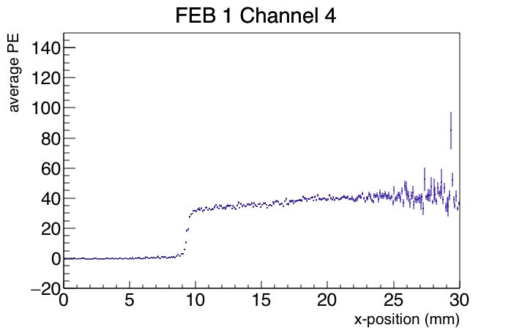
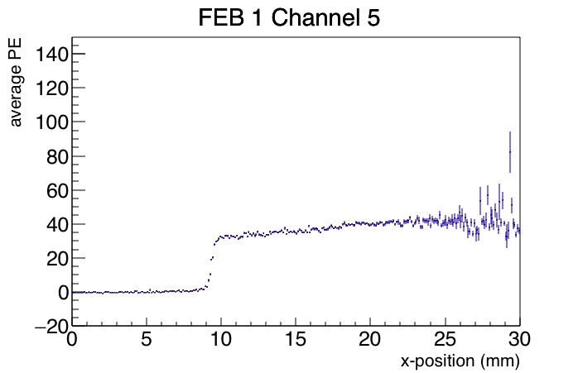
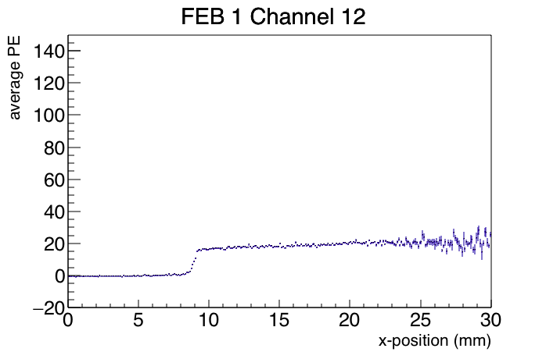
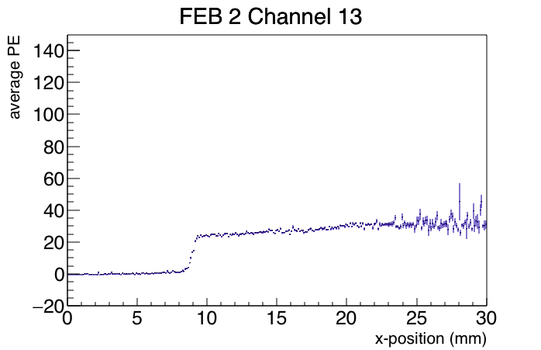
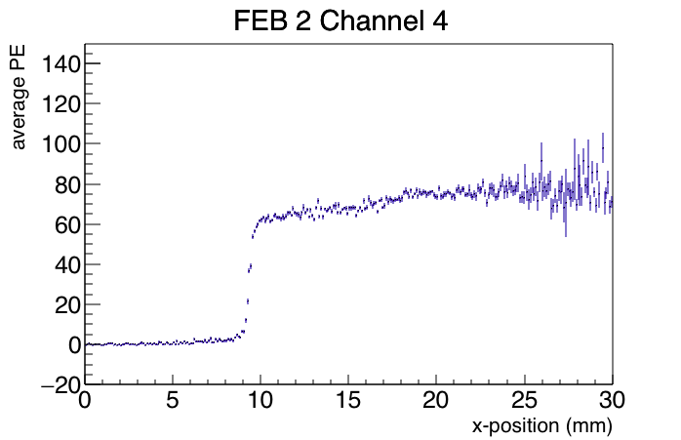
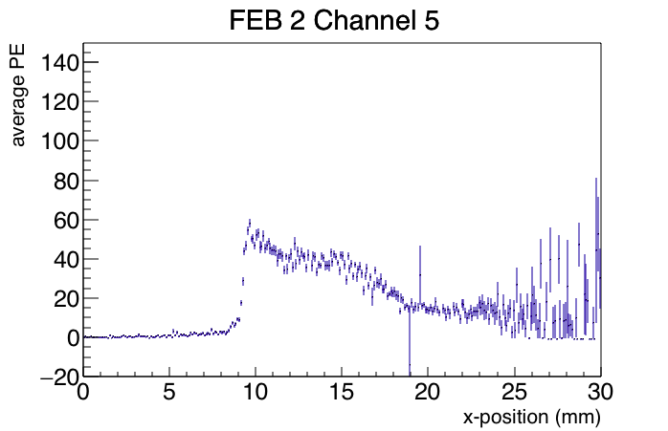
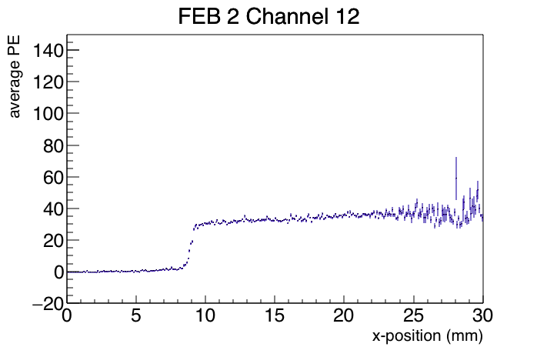
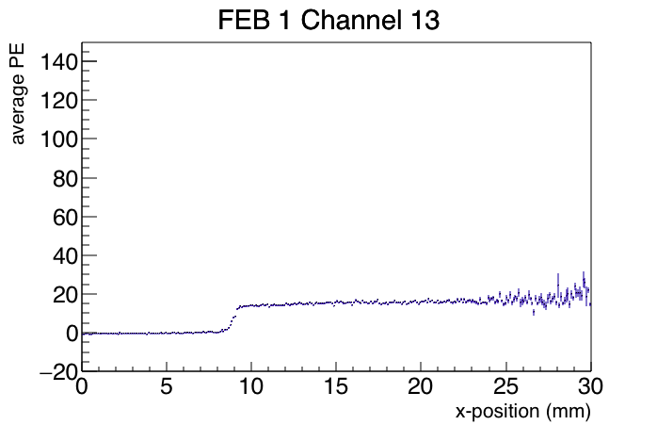
Average PE vs. Proton Beam X-Position Plots
FEB 1 @ x = 3000mm
FEB 2 @ x = 0mm
Channels with bare ends:???
Channels 4,5 counters w. 3*3 SiPM
Channels 12,13 counters w. 2*2 SiPM

Slide 5
Average PE vs. Proton Beam X-Position Plots

Slide 6
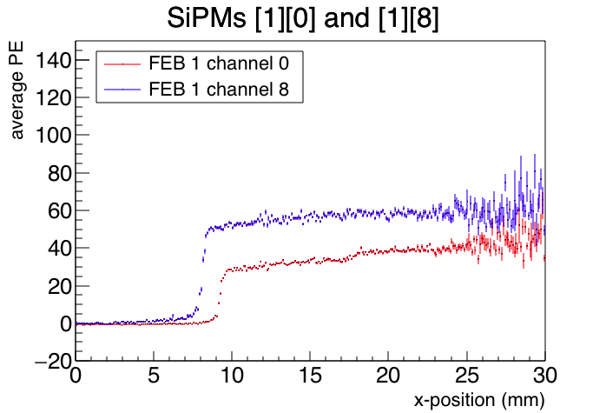
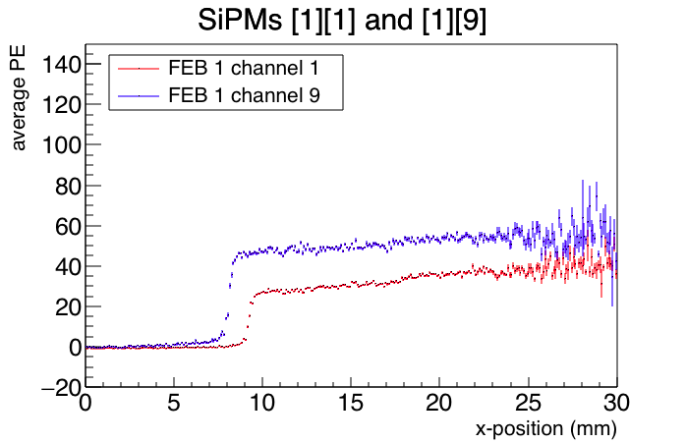
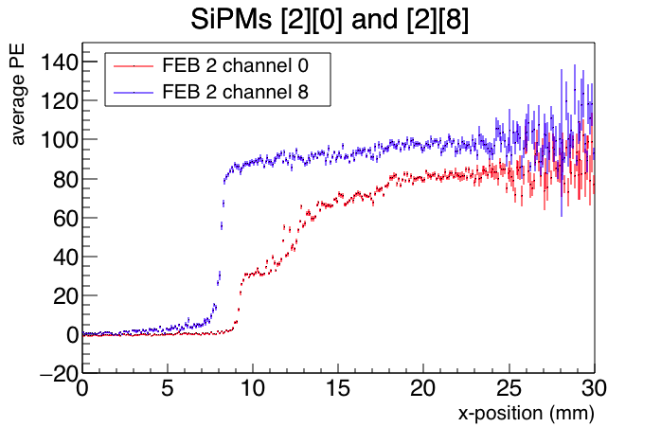
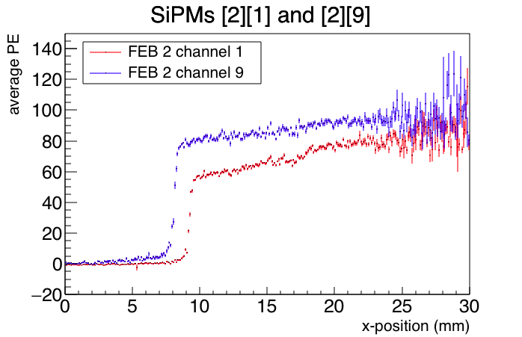
Overlay Plots
FEB 1 @ x = 3000mm
FEB 2 @ x = 0mm
Channels with 2*2 SiPM:
Channels 0,1 counters w. bare ends
Channels 8,9 counters w. reflective ends
Bin size = 0.1mm (300 bins)

Slide 7
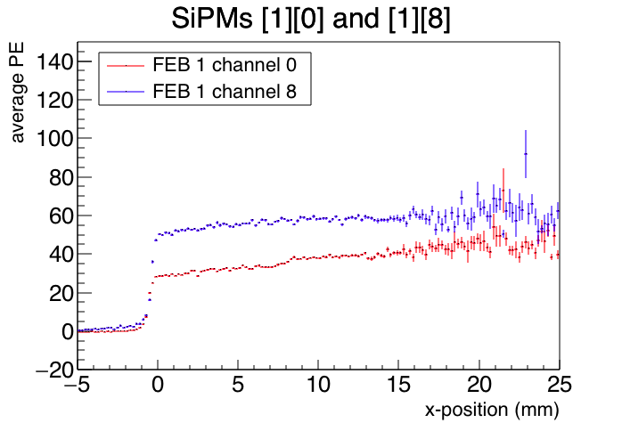
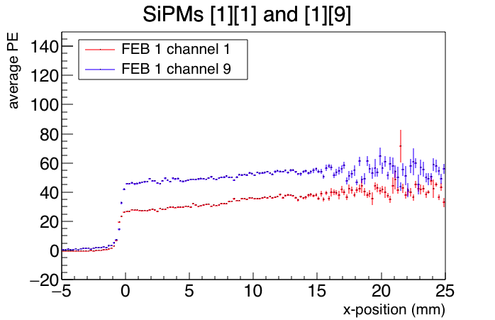
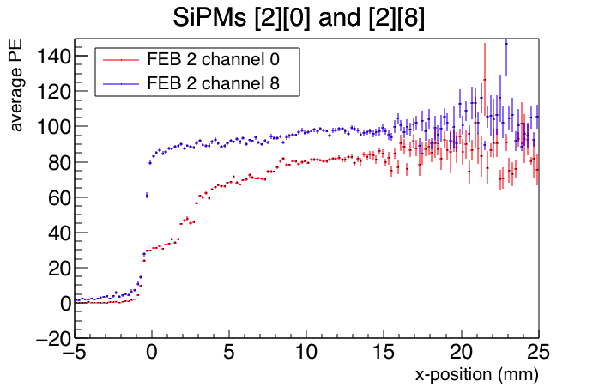
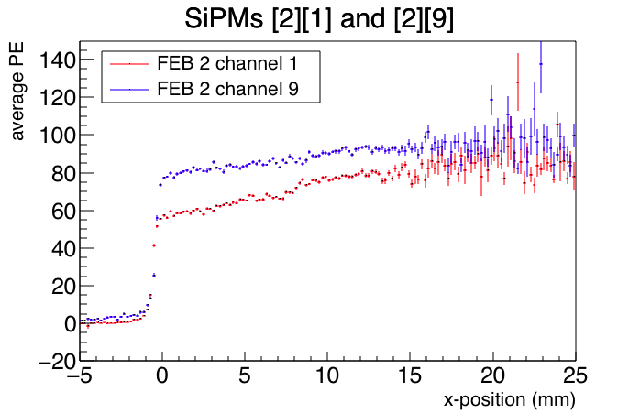
Overlay Plots Shifted (-1.3mm) Zero-Centered (-8.5mm)
FEB 1 @ x = 3000mm
FEB 2 @ x = 0mm
Channels with 2*2 SiPM:
Channels 0,1 counters w. bare ends
Channels 8,9 counters w. reflective ends
Bin size = 0.2mm (150 bins)

Slide 8
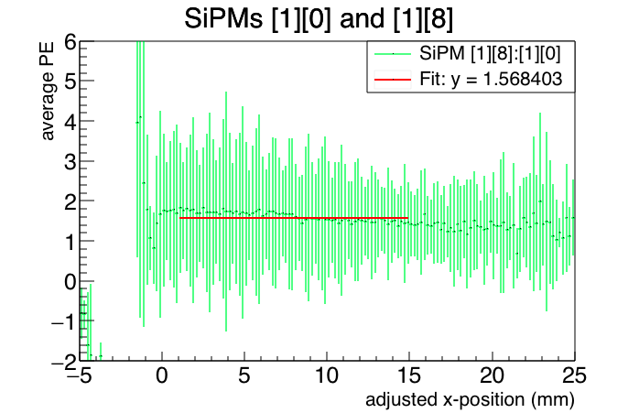
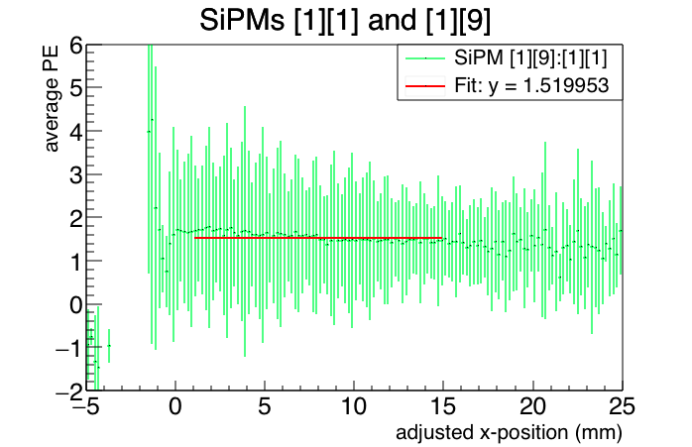
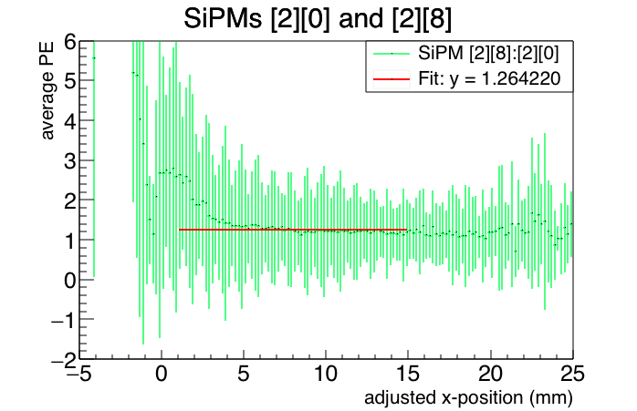
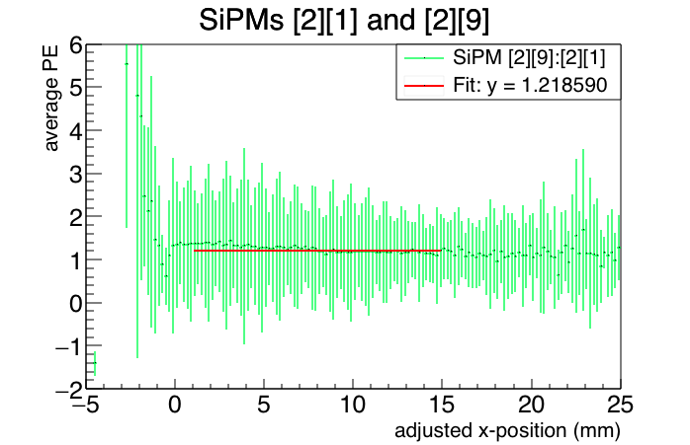
FEB 1 @ x = 3000mm
FEB 2 @ x = 0mm
Channels with 2*2 SiPM:
Channels 0,1 counters w. bare ends
Channels 8,9 counters w. reflective ends
Overlay Plots Divided
(X = 1mm to 15mm)

