Slide 1
“End Data” Analysis
Studying light drop-off effects for proton beams at the end of counter
Test runs 669, 706-709,711,713-722, 725

Slide 2
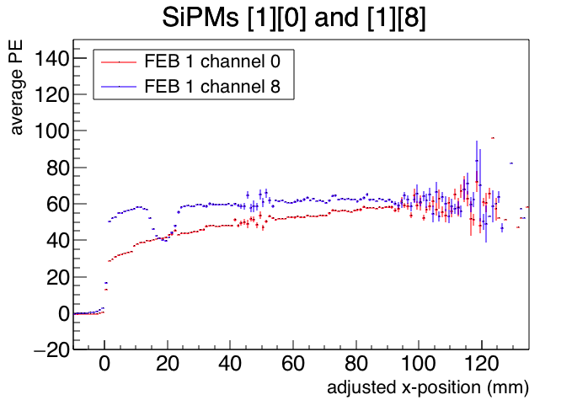
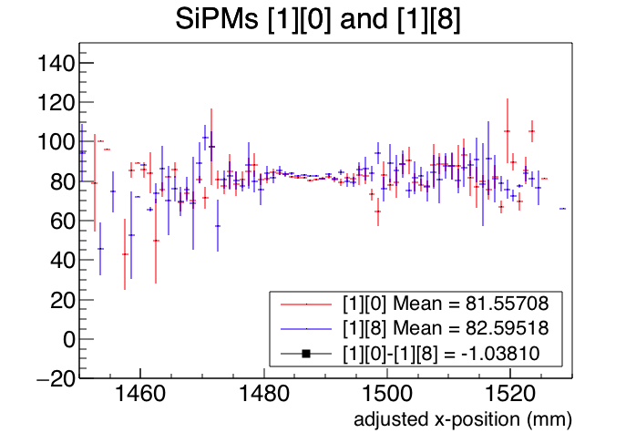
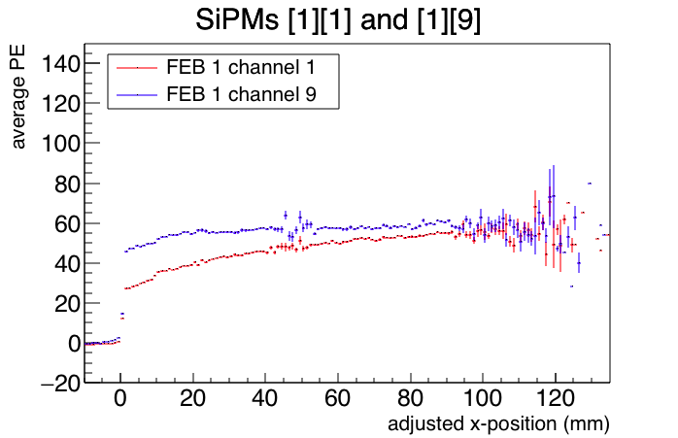
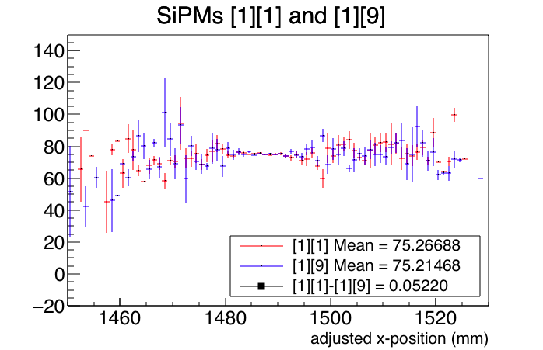
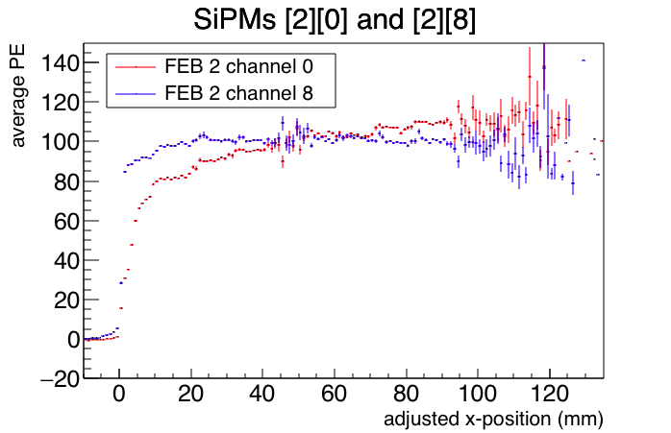
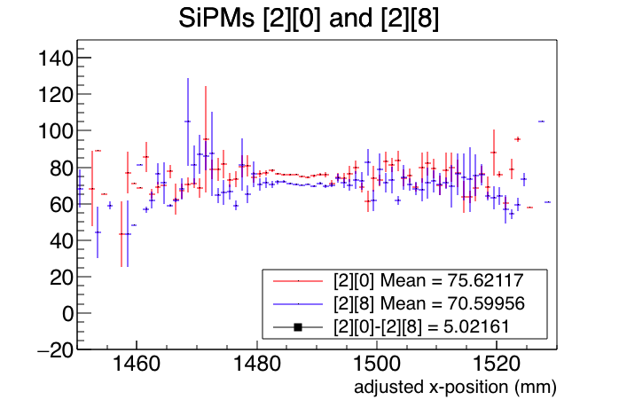
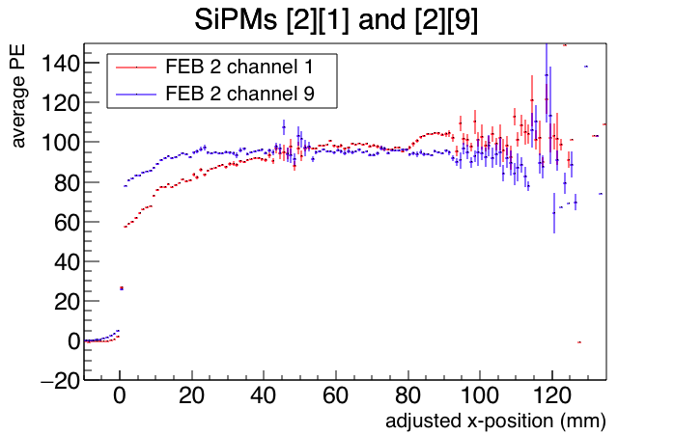
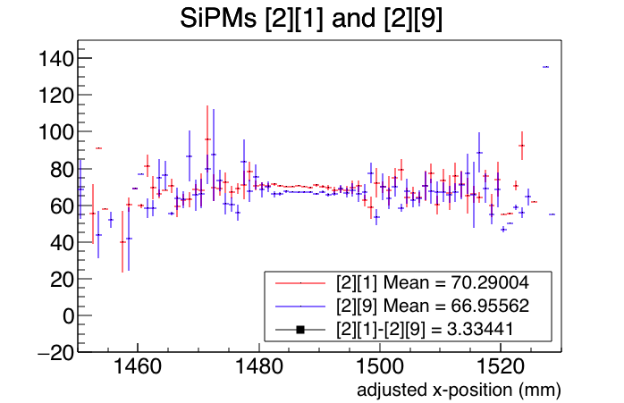
FEB 1 @ x = 3000mm
FEB 2 @ x = 0mm
Channels with 2*2 SiPM:
Channels 0,1 counters w. non-reflective ends
Channels 8,9 counters w. reflective ends
SiPM [FEB #][Channel #]
Average PE vs. Proton Beam X-Position Plots
Shifted (-1.3mm), Zero-Centered (-7.4mm)
1mm / bin

Slide 3
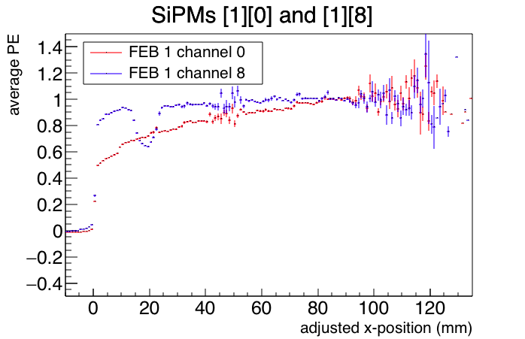
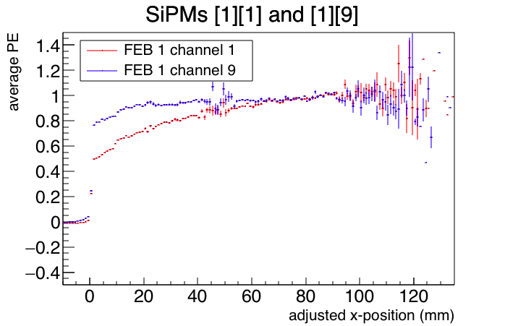
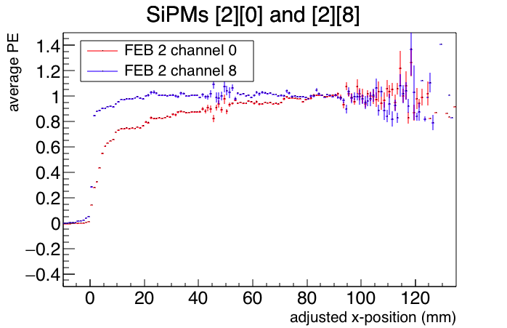
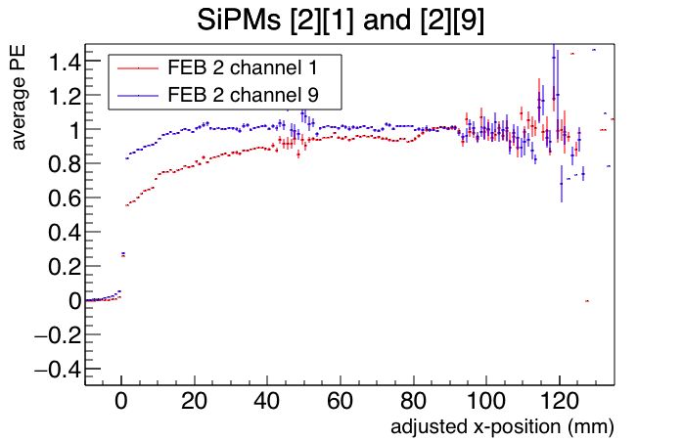
FEB 1 @ x = 3000mm
FEB 2 @ x = 0mm
Channels with 2*2 SiPM:
Channels 0,1 counters w. non-reflective ends
Channels 8,9 counters w. reflective ends
SiPM [FEB #][Channel #]
Average PE vs. Proton Beam X-Position Plots
Shifted (-1.3mm), Zero-Centered (-7.4mm)
Normalized w.r.t. Average Value Between x = 80mm to x = 120mm for each channel
1mm / bin

Slide 4
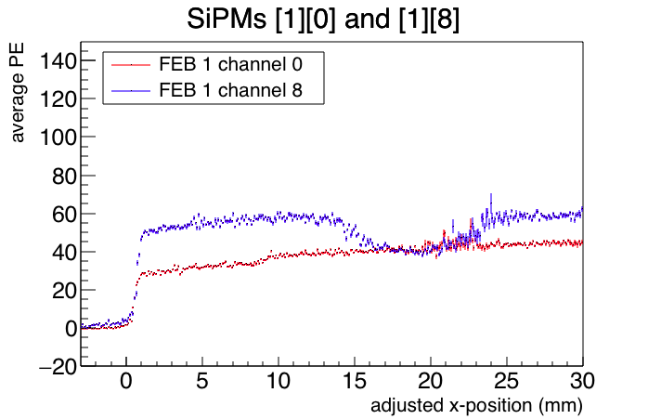
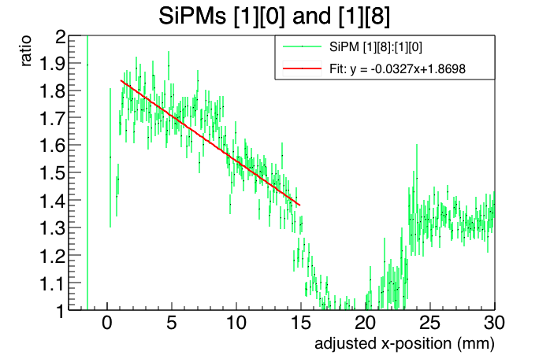
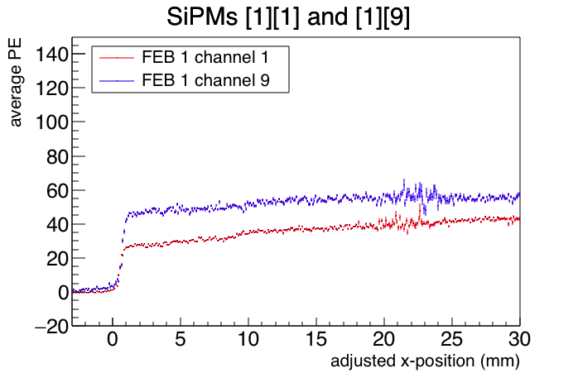
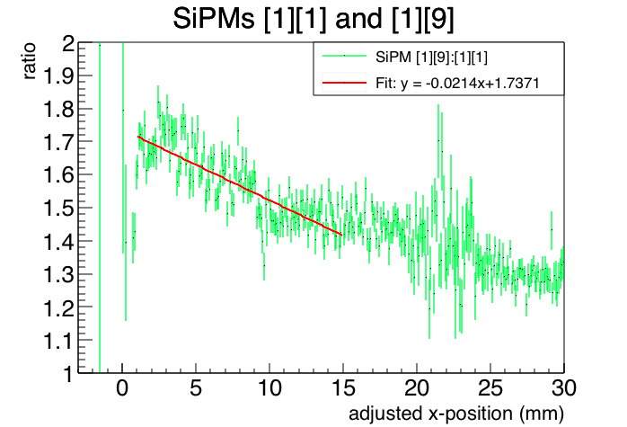
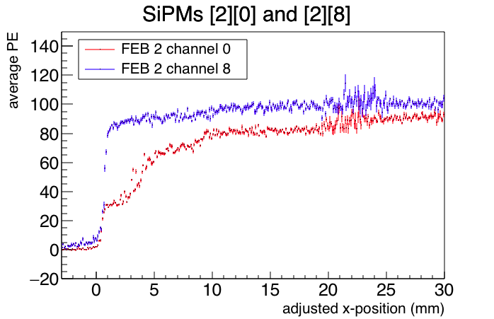
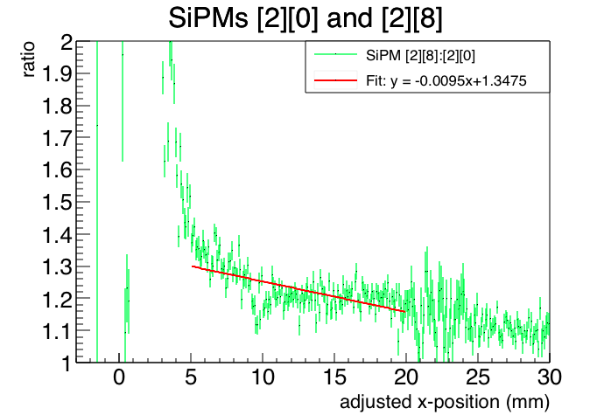
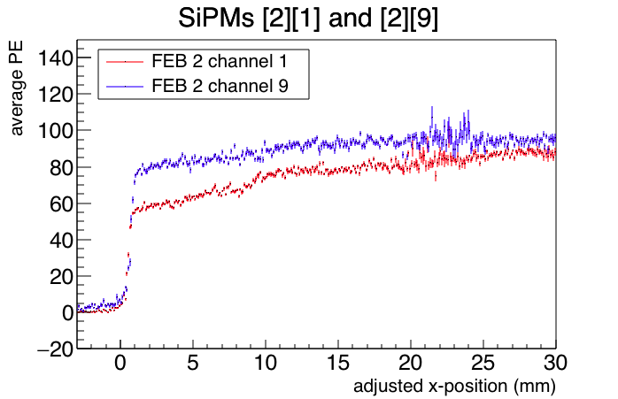
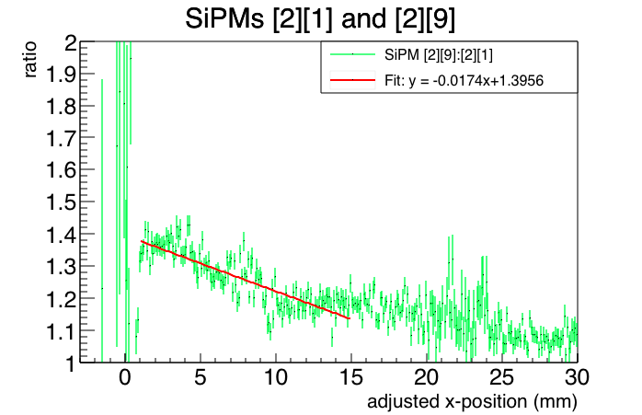
FEB 1 @ x = 3000mm
FEB 2 @ x = 0mm
Channels with 2*2 SiPM:
Channels 0,1 counters w. non-reflective ends
Channels 8,9 counters w. reflective ends
SiPM [FEB #][Channel #]
Ratio Plots
With PE Plots
Fitted over x = 1mm to x = 15mm
0.1mm / bin

Slide 5
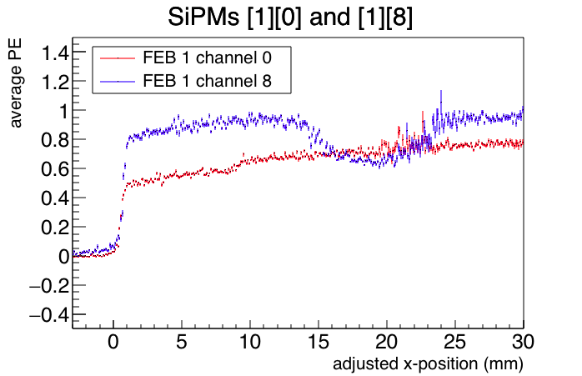
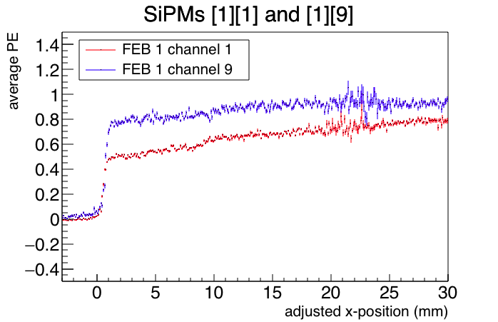
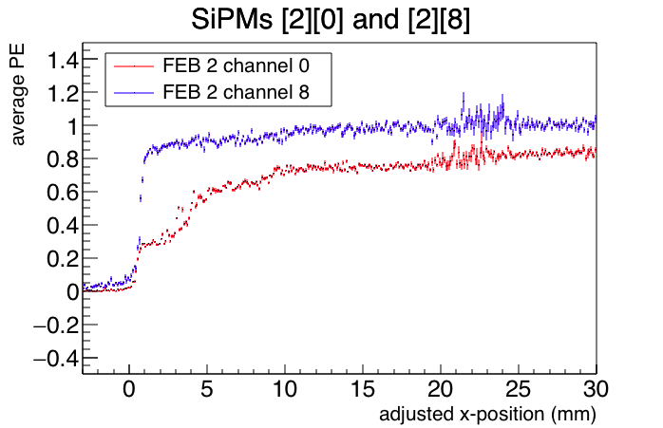
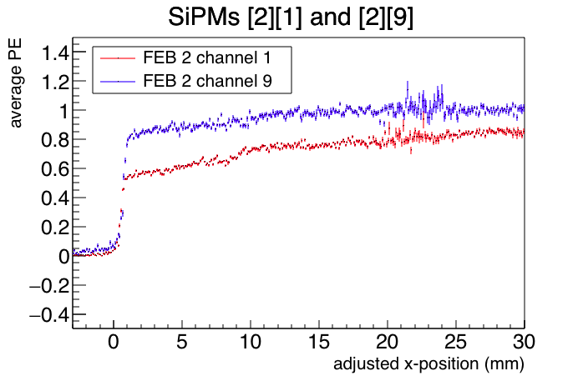
FEB 1 @ x = 3000mm
FEB 2 @ x = 0mm
Channels with 2*2 SiPM:
Channels 0,1 counters w. non-reflective ends
Channels 8,9 counters w. reflective ends
SiPM [FEB #][Channel #]
Ratio Plots
With Normalized PE Plots
Fitted over x = 1mm to x = 15mm
0.1mm / bin

Slide 6
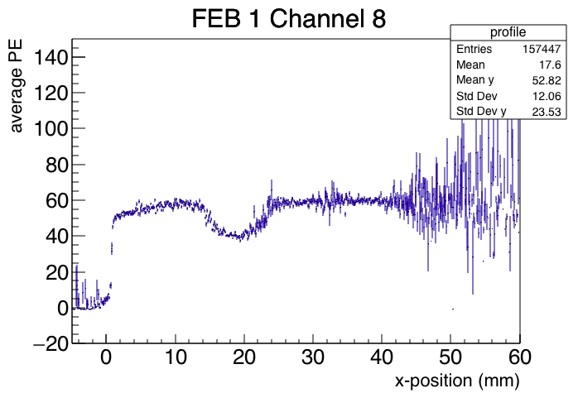
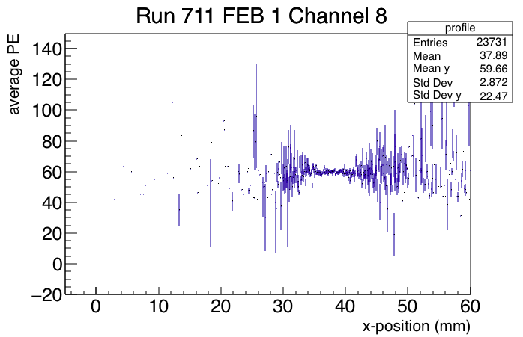
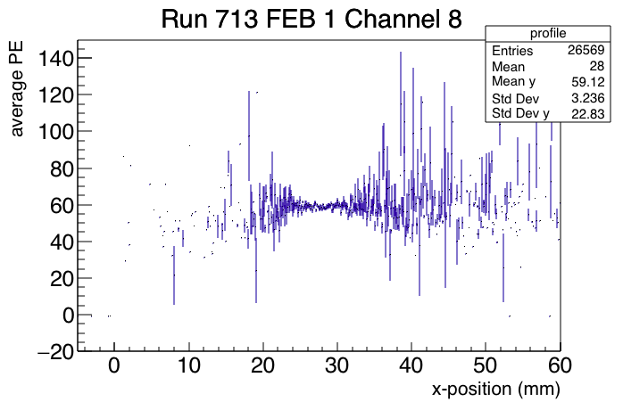
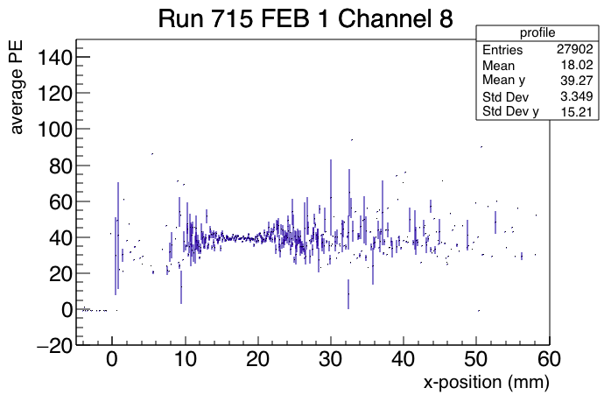
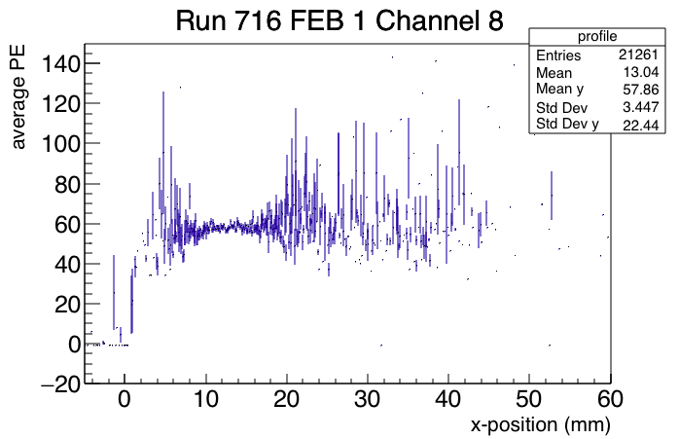
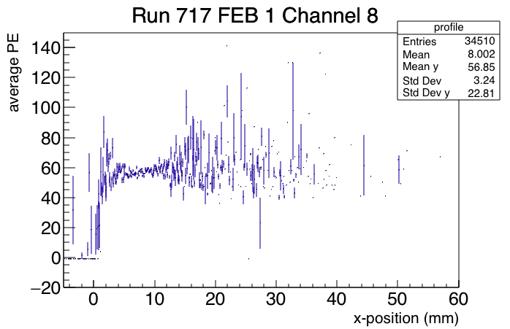
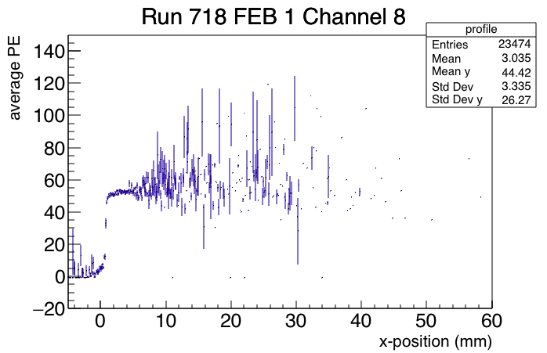
Dip in FEB 1 Channel 8

