Slide 1
“End Data” Analysis
Studying light drop-off effects for proton beams at the end of counter
Test runs 669,706-709,711,713-722,725 from February 2016

Slide 2
Motivation
Light response near the end of counter
Effect of the gap between the top and the side of CRV

Slide 3
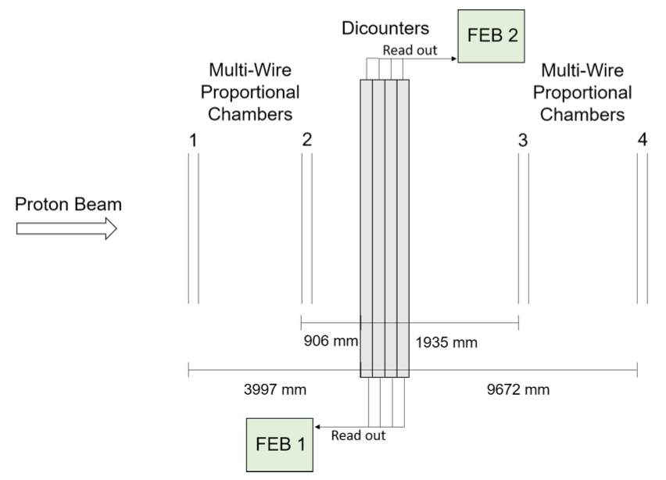
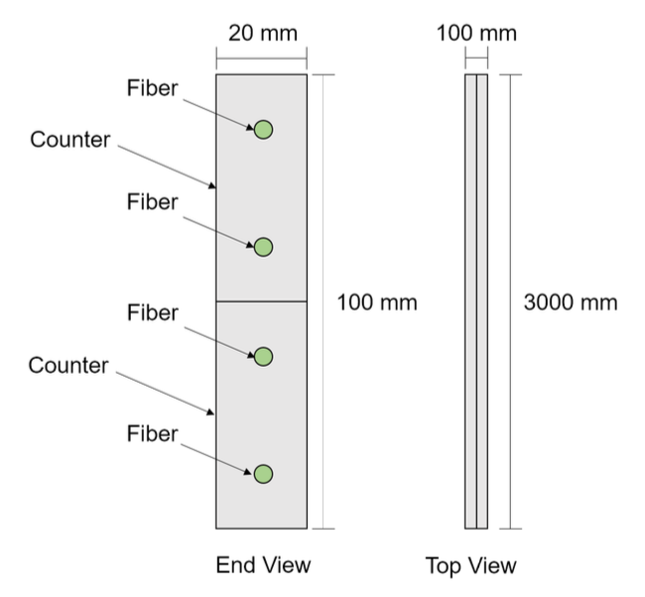
Go Figure (Test Beam Run Setup)
y
x

Slide 4
Method
Hand-picked test runs
proton beam aimed at the same y-position but varied in x-position near the end of counter and one at the center
706-709, 711, 713-722, 725
Runs 715 and 718 produced anomalies; several missing runs were empty
669 was aimed at the center
Channels of interest (with 2×2mm² SiPM)
Channels 0,1 correspond to counters with non-reflective ends
Channels 8,9 correspond to counters with reflective end
Beam aimed near the end corresponding to FEB2
PE yield vs. x-position of proton plotted
3×3mm² SiPM
x
0
4
8
12
p⁺
1
5
9
13
2
6
10
14
3
7
11
15
y
*not to scale

Slide 5
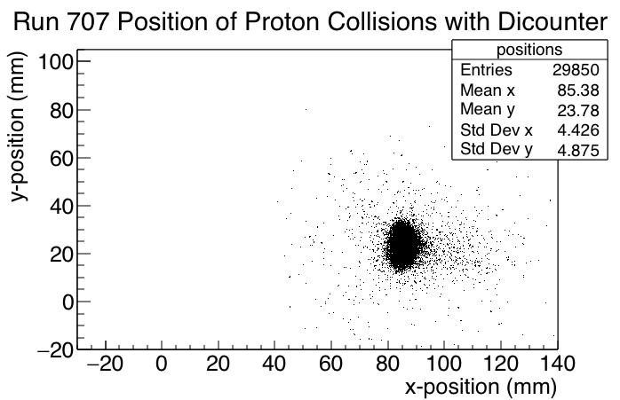
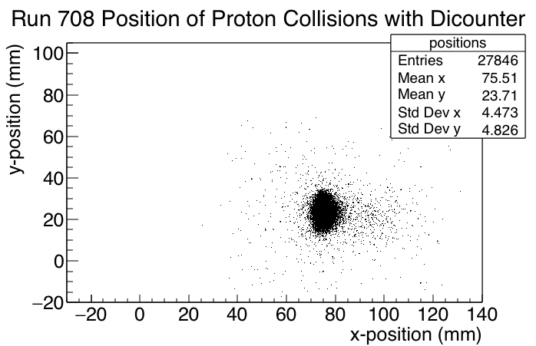
Position Plots

Slide 6
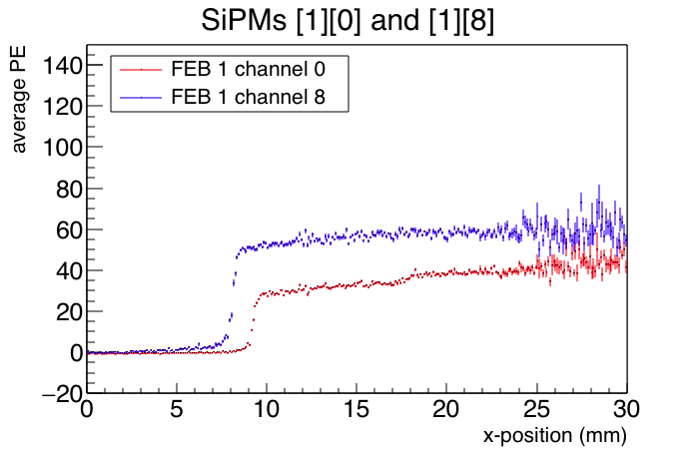
Initial Plot
Channels 0,1 counters w. non-reflective ends
Channels 8,9 counters w. reflective ends
0.1mm / bin

Slide 7
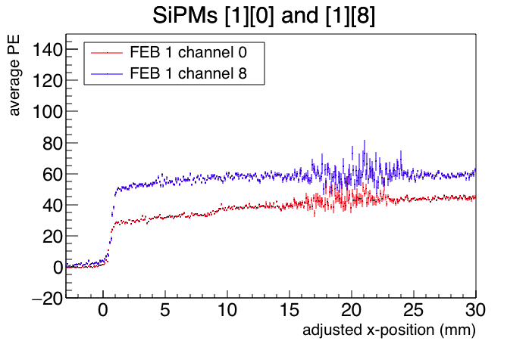
Horizontal Adjustments
Channels 0,1 counters w. non-reflective ends
Channels 8,9 counters w. reflective ends
After
-1.3mm
-7.4mm
Before
0.1mm / bin

Slide 8
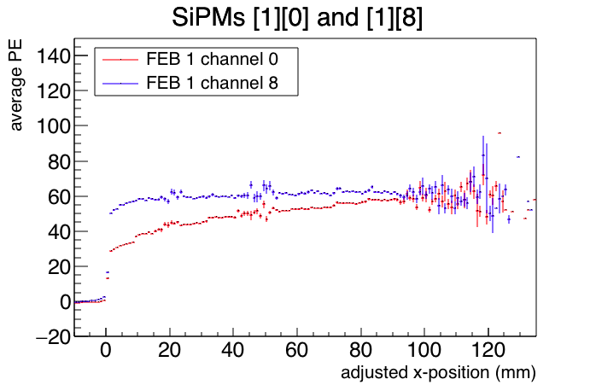
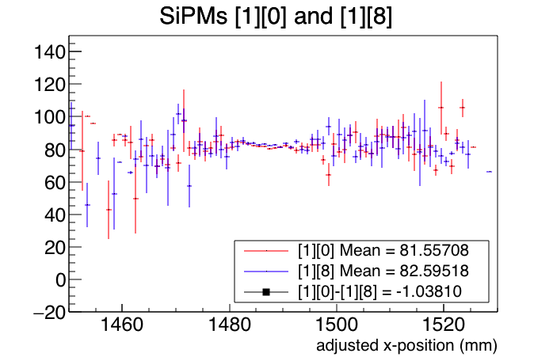
Vertical Adjustment
Channels 0,1 counters w. non-reflective ends
Channels 8,9 counters w. reflective ends
Run 669
*largest difference was < 5PE, not too significant for vertical adjustment
1mm / bin

Slide 9
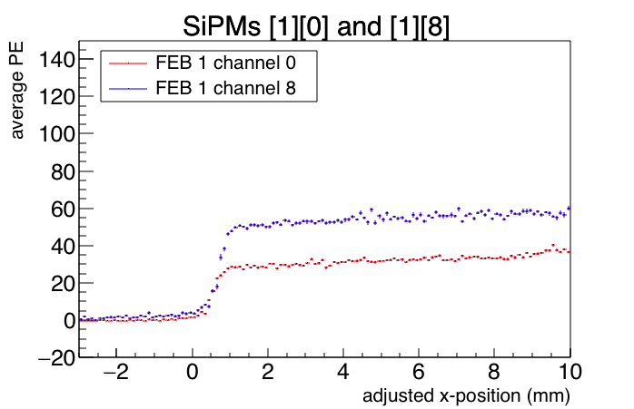
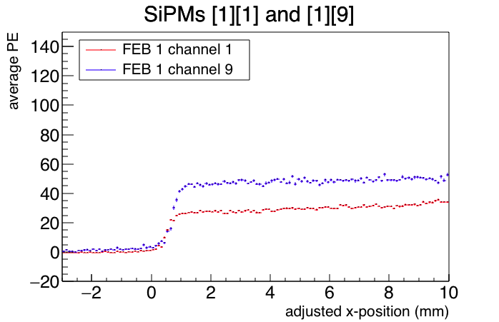
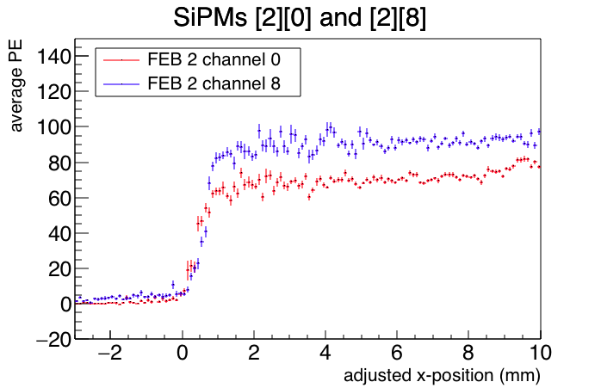
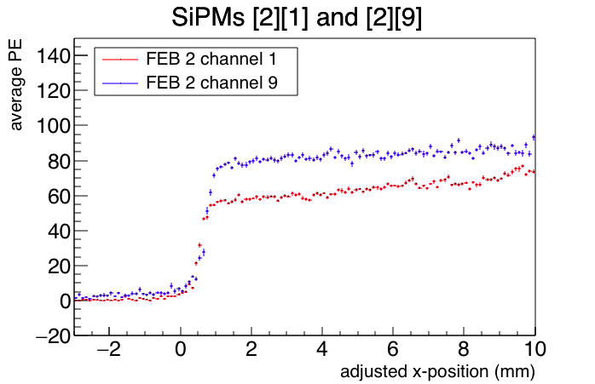
Adjusted Plots
Channels 0,1 counters w. non-reflective ends
Channels 8,9 counters w. reflective ends
*FEB2 is closer
to beam
0.1mm / bin

Slide 10
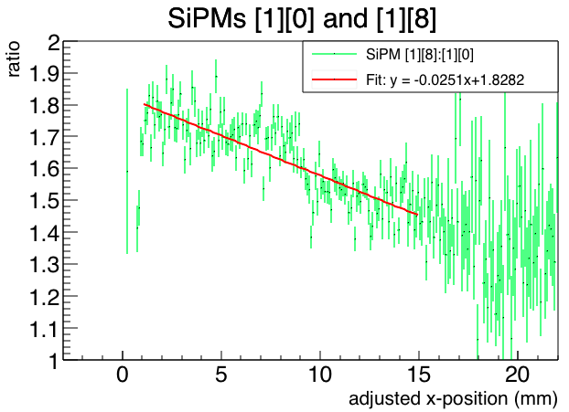
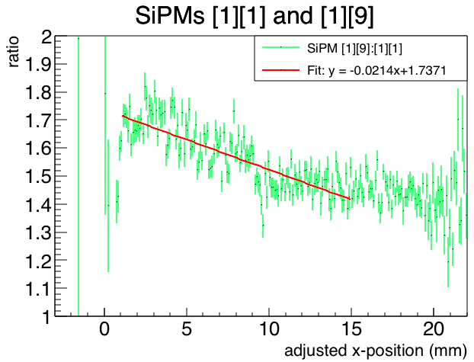
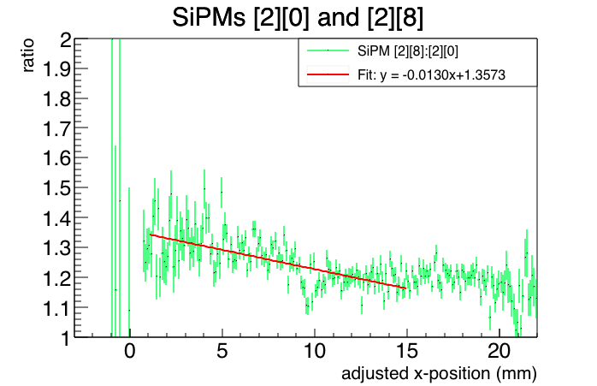
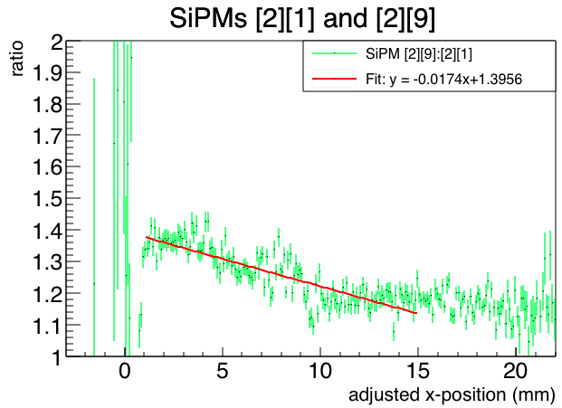
Ratio Plots
Channels 0,1 counters w. non-reflective ends
Channels 8,9 counters w. reflective ends
0.1mm / bin

Slide 11
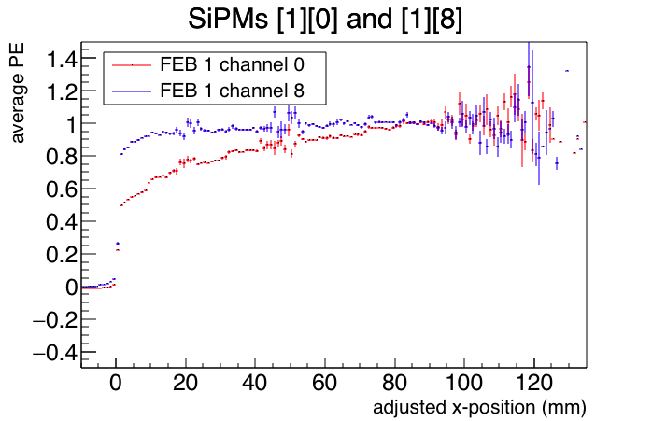
Normalization
Channels 0,1 counters w. non-reflective ends
Channels 8,9 counters w. reflective ends
After
(normalized/scaled w.r.t. average value
between x = 80mm and 120mm)
Before
1mm / bin

Slide 12
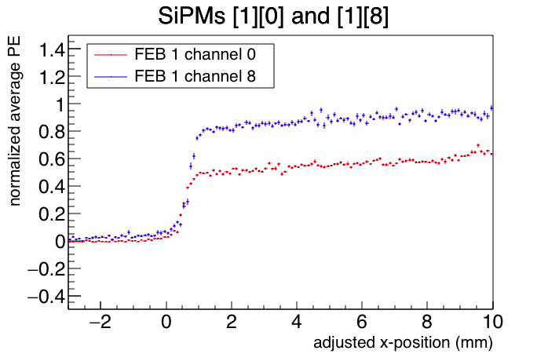
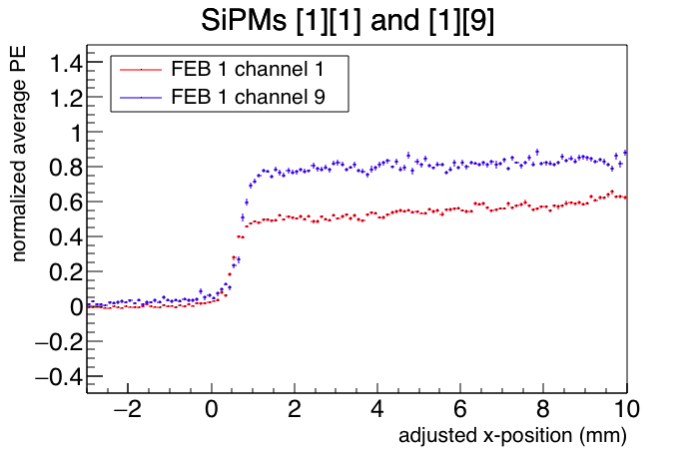
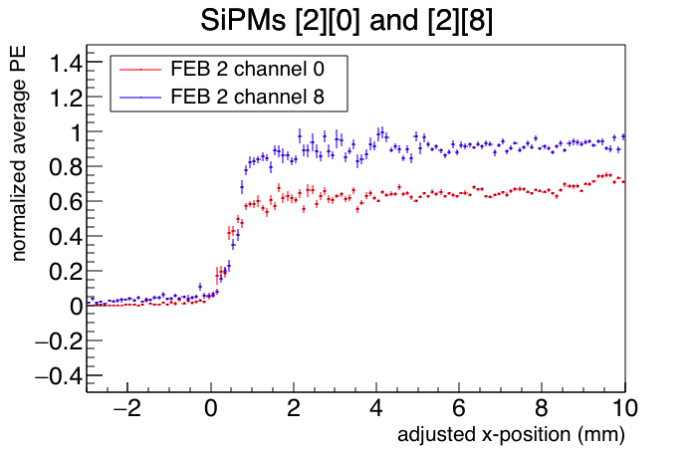
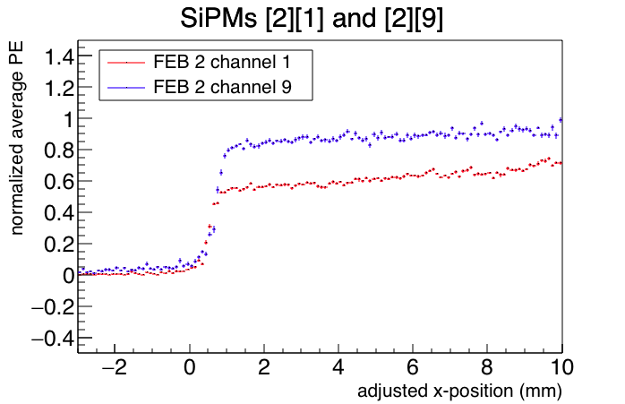
Normalized Plots
Channels 0,1 counters w. non-reflective ends
Channels 8,9 counters w. reflective ends
0.1mm / bin

Slide 13
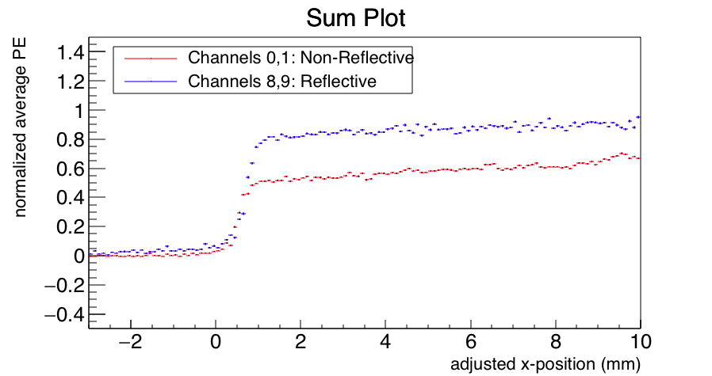
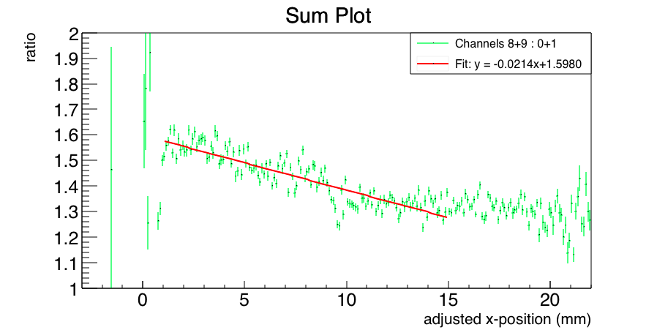
Sum Plots & Conclusion
Channels 0,1 counters w. non-reflective ends
Channels 8,9 counters w. reflective ends
Between 1-2mm, light leakage is at max
Steady increase in light yield after
≈ 20% reduction in average PE ratio at 10mm

Slide 14
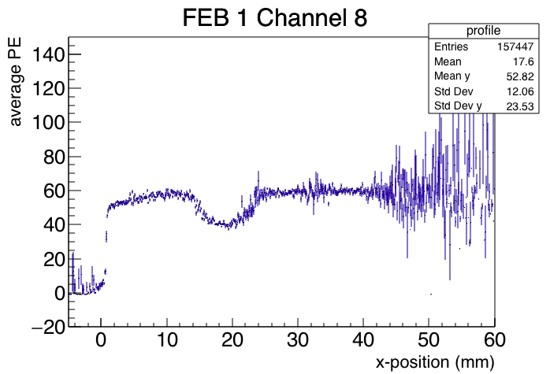
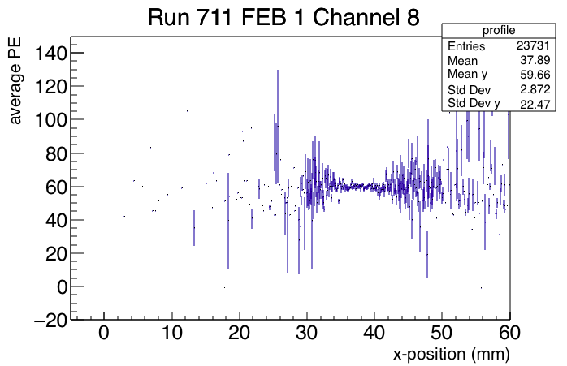
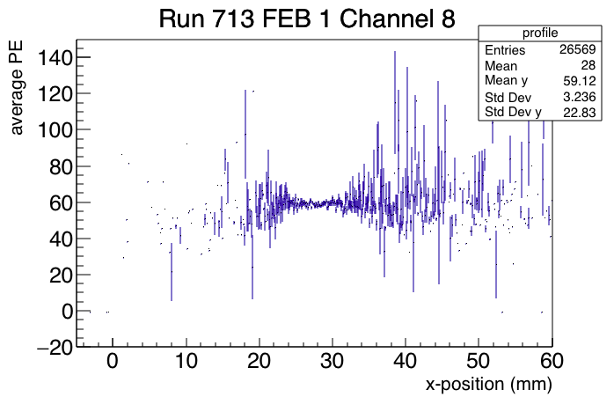
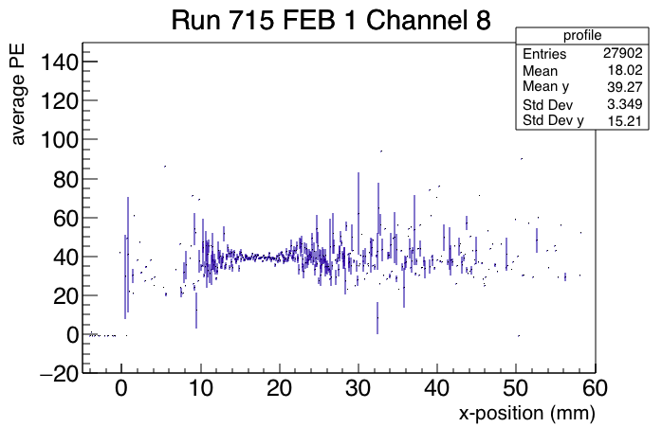
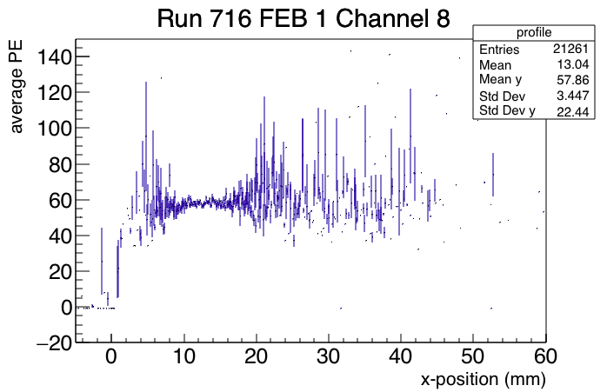
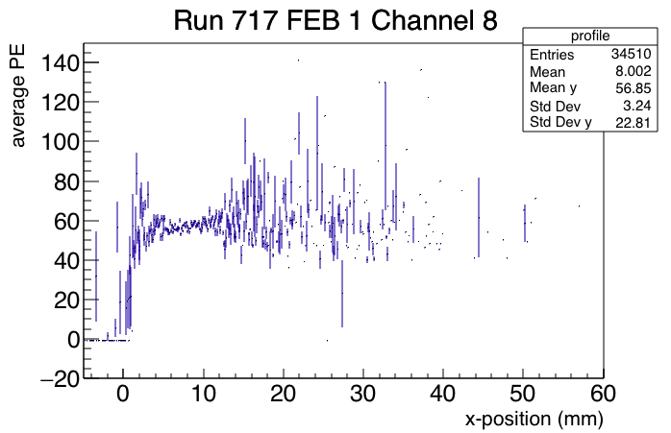
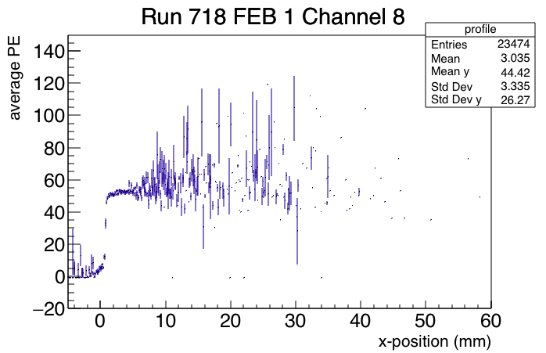
Dip in FEB 1 Channel 8 (Reflective)

Slide 15
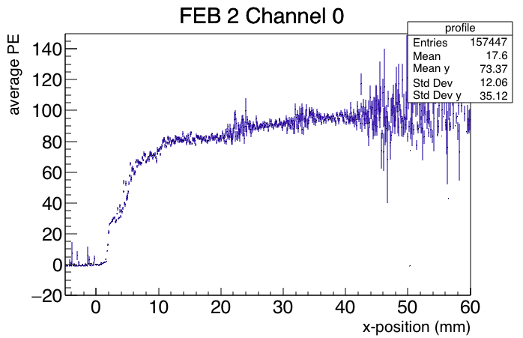
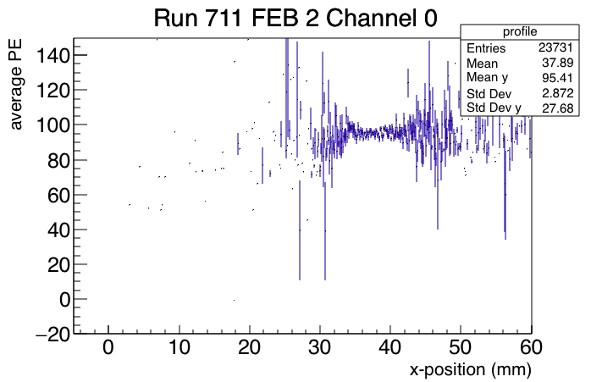
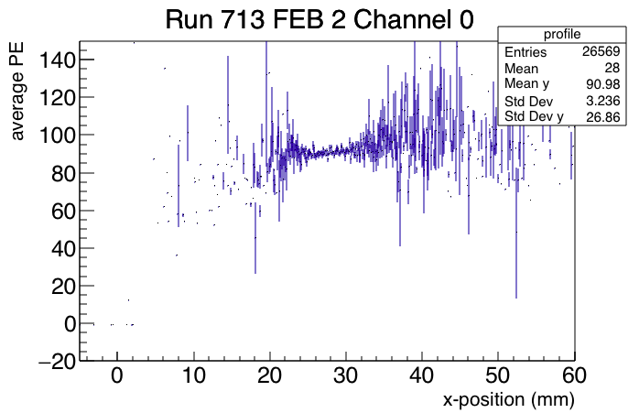
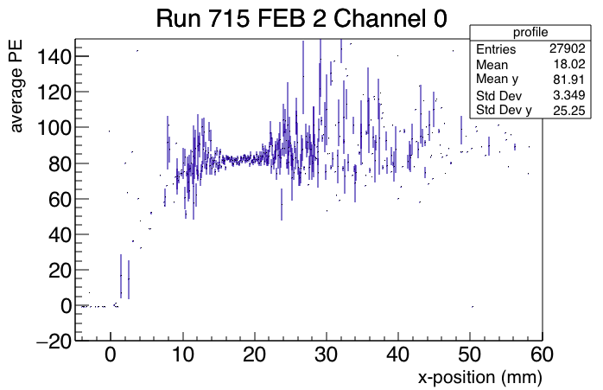
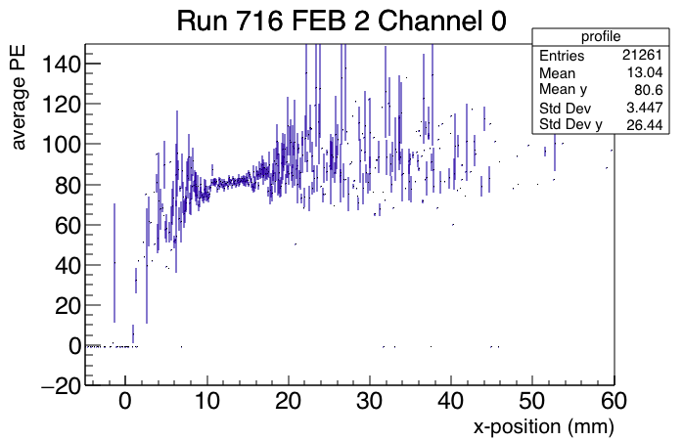
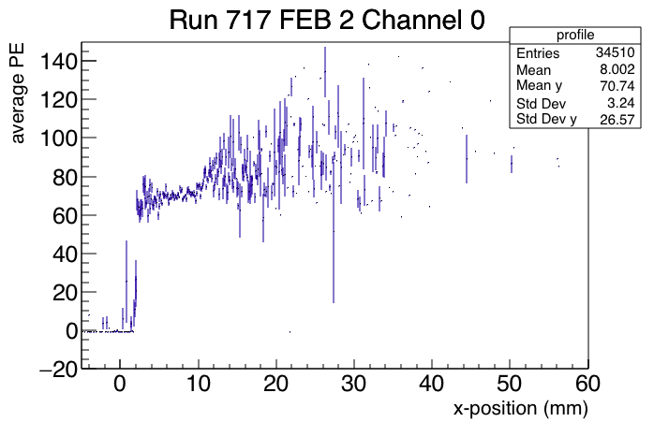
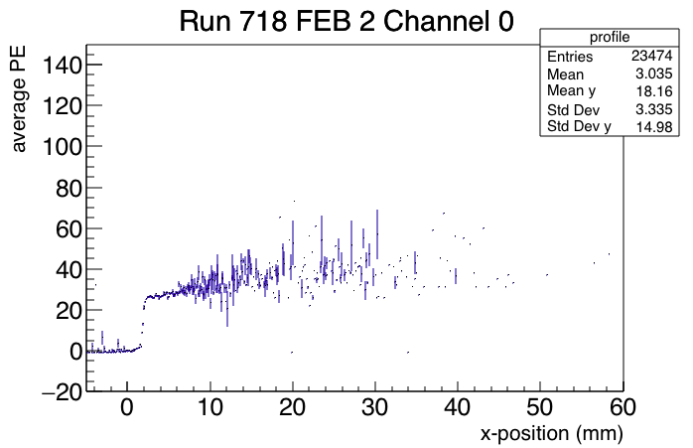
Odd Progression in FEB 2 Channel 0 (Non-Reflective)

