Slide 1
Comparing “End Studies”
February 2016 vs. June 2017

Slide 2
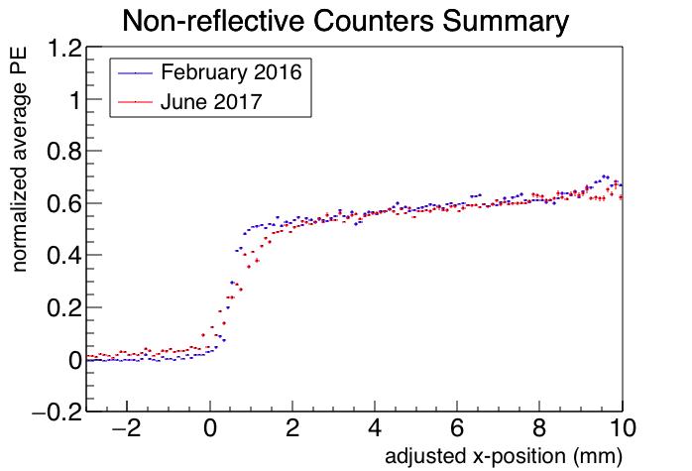
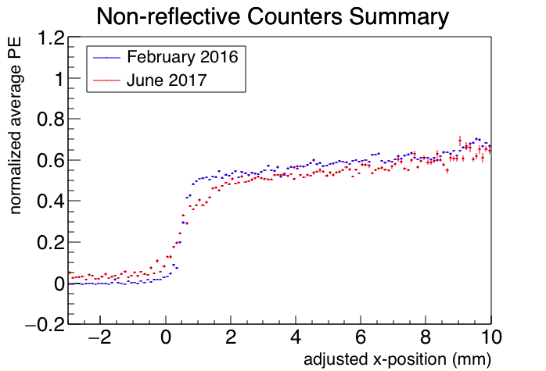

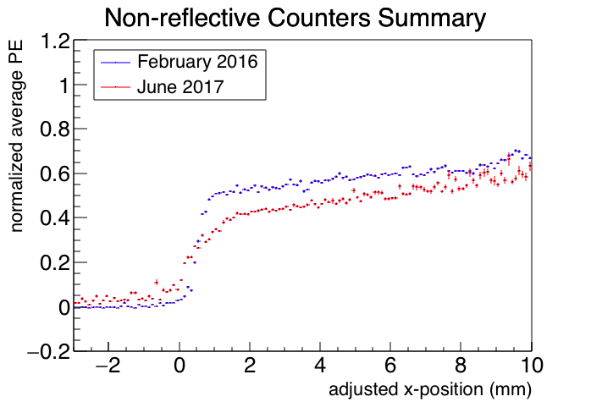
counters 2,4 for June 2017
counters 3,4 for June 2017
y = 25mm
y = 75mm

Slide 3
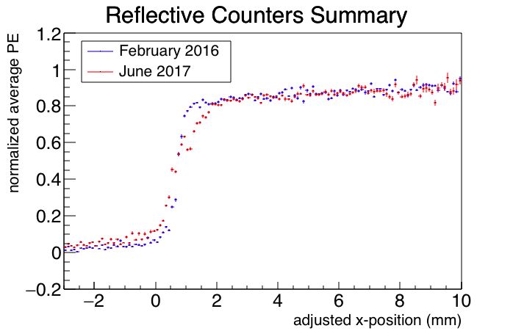
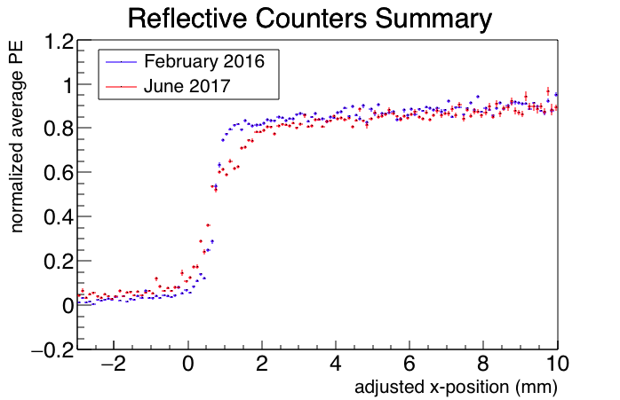
counters 2,4 for June 2017
counters 3,4 for June 2017
y = 25mm
y = 75mm

