Slide 1

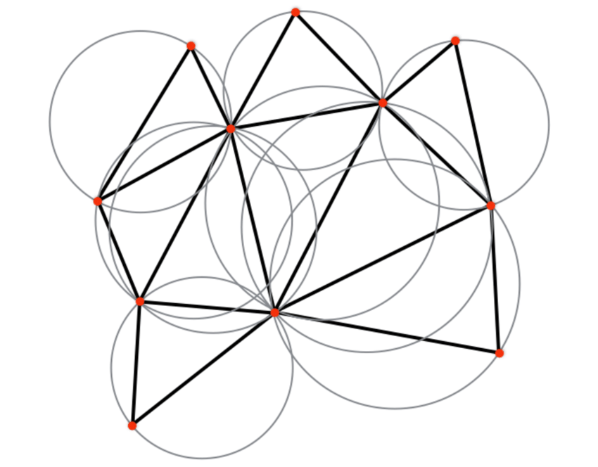
PDPM Indian Institute of Information Technology Design and Manufacturing, Jabalpur
Delaunay Triangulation
Mentor: Group members:
Dr. P.K. Jain Adarsh Singh 2016008
Aman Verma 2016023
Anshu Raj 2016035
Ritvij Dosi 2016212
Shreya Srivastava 2016252

Slide 2
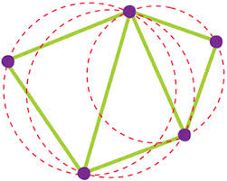
Introduction
The Delaunay triangulation is a triangulation which is equivalent to the nerve of the cells in a Voronoi diagram, i.e., that triangulation of the convex hull of the points in the diagram in which every circumcircle of a triangle is an empty circle.

Slide 3
Applications
Euclidean Minimum Spanning Tree
Modelling Terrain or other objects for a given set of sample points
Determining density or intensity of sampling points
Building meshes for space discretised solvers
Constrained Delaunay Triangulation in path planning in Automated driving

Slide 4
Algorithm
Take coordinates of points as input in a matrix for Triangulation.
Select 3 points from the matrix randomly.
Draw circumcircle for the selected points
Check all the remaining points if they are inside the circle or not.
If all the points are outside then draw the triangle for those points
If any of the point lie inside circle then select another 3 points from the matrix and repeat steps 3-6

Slide 5
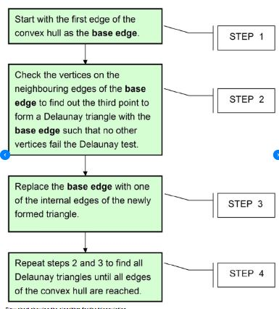
Flow Chart

Slide 6
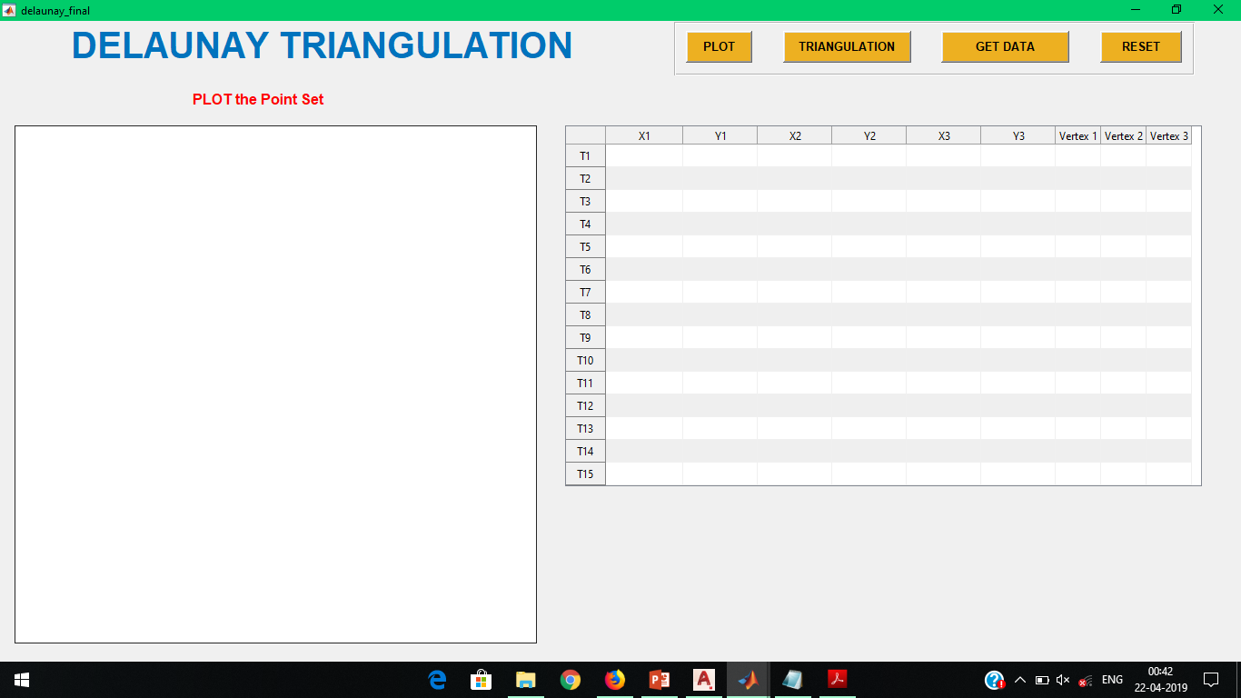
Layout of GUI

Slide 7
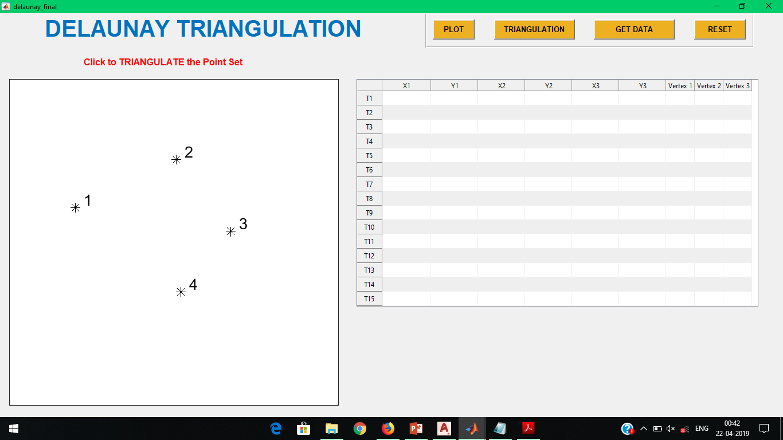
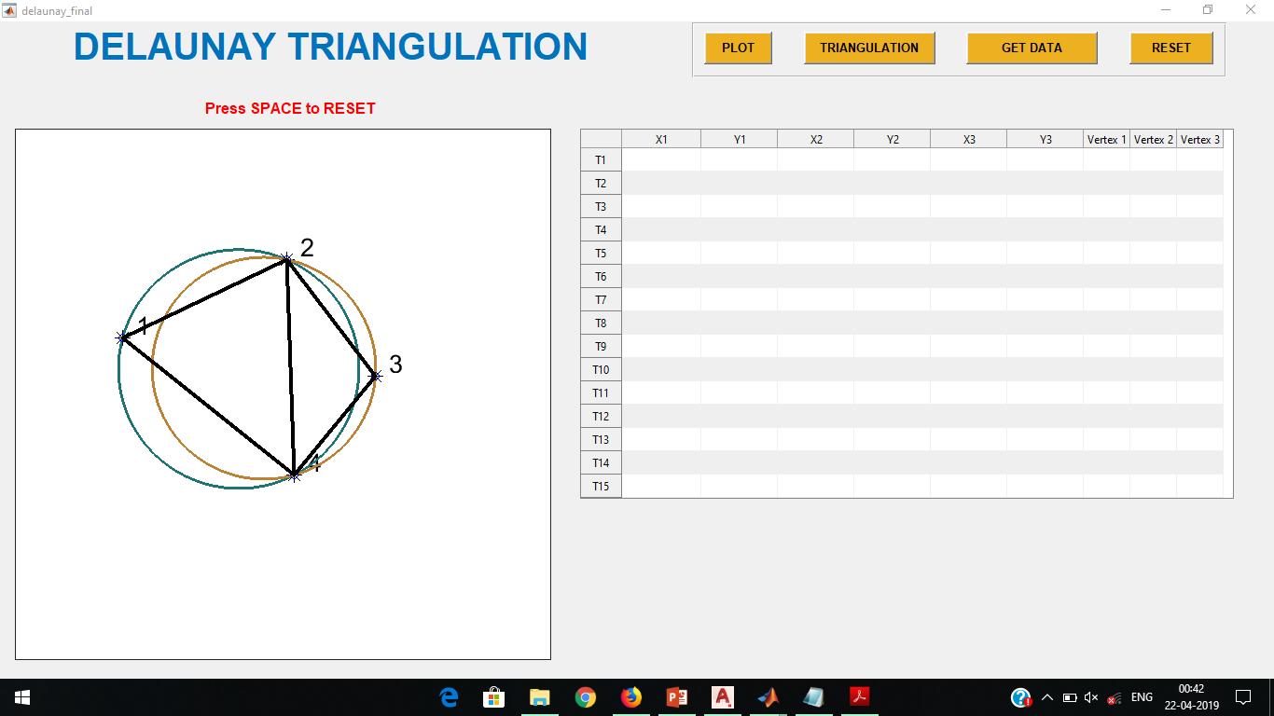
Output
For 4 points
Selecting random points in a plane
Triangulating the points

Slide 8
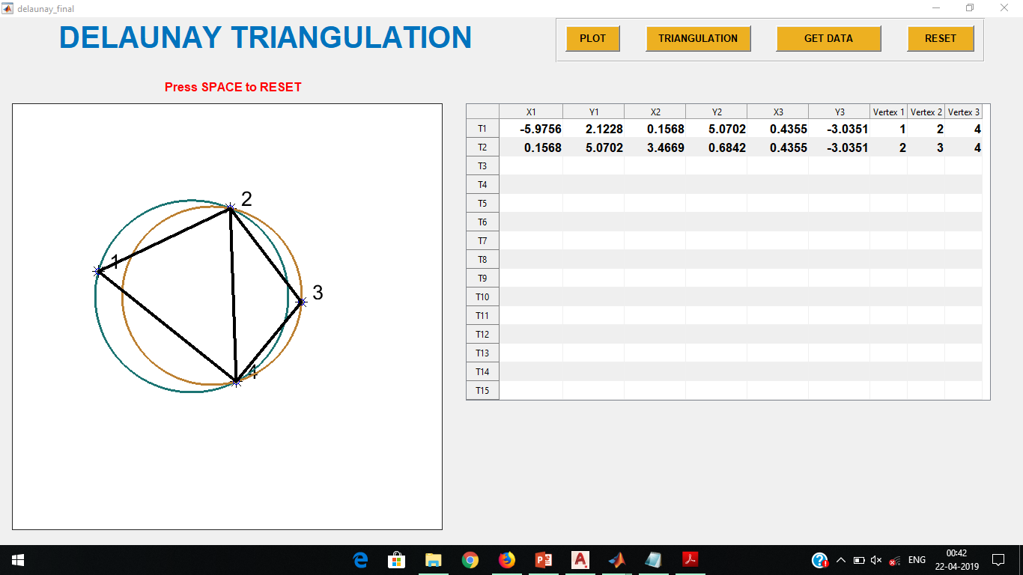
Storing Data points

Slide 9
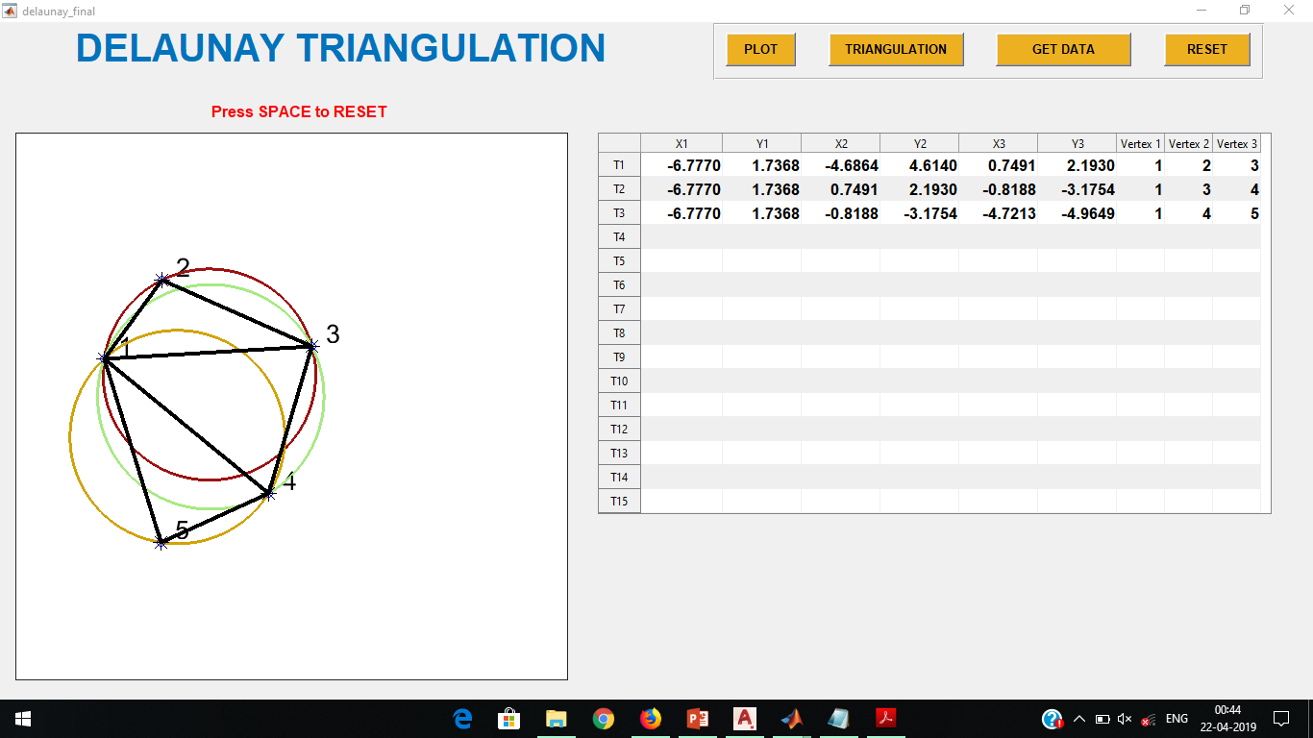
For 5 points

Slide 10
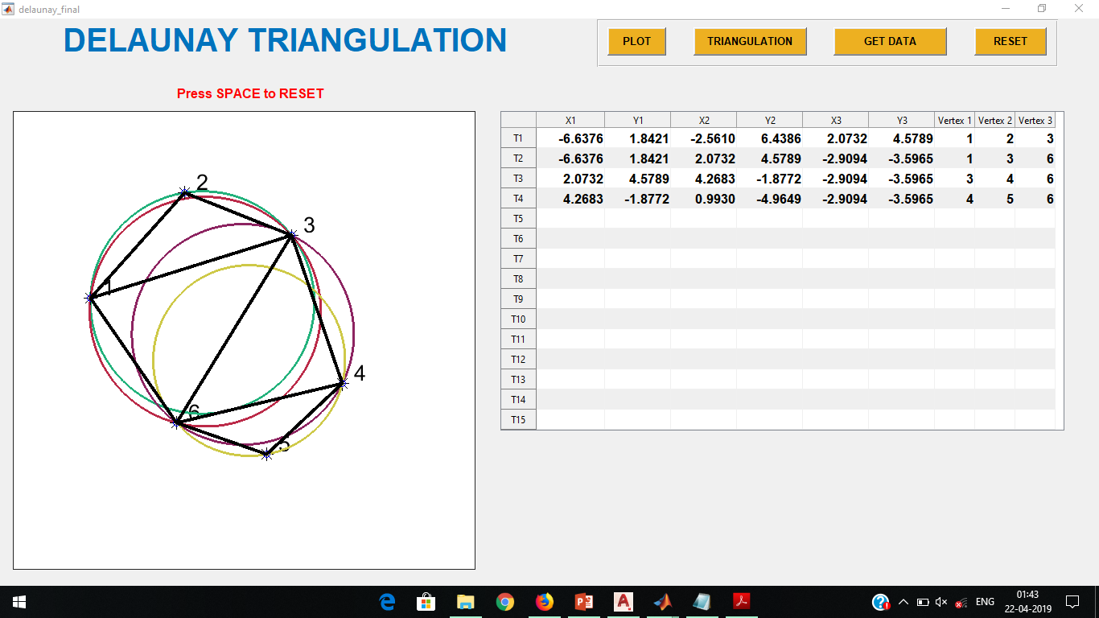
For 6 points

Slide 11
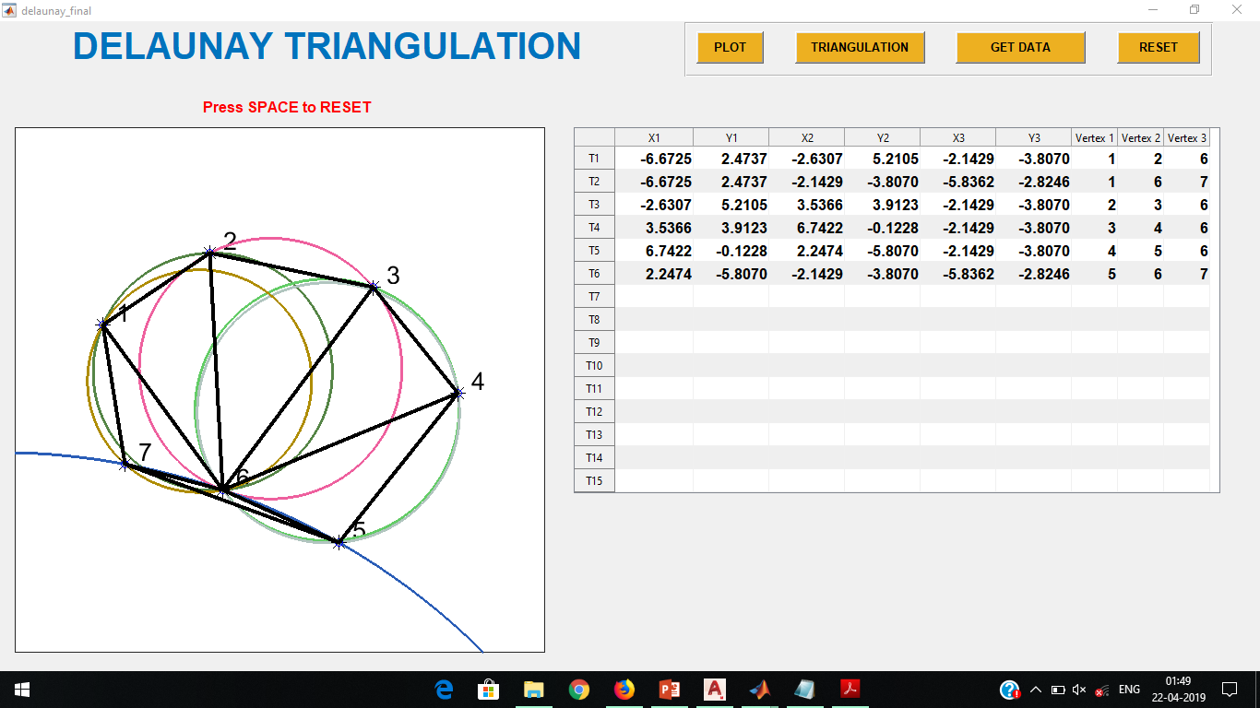
For 7 points

Slide 12
References
https://www.youtube.com/watch?v=7eCrHAv6sYY&list=PL3P3k2el9FTD0F1pycc6CkyB5bpqo3vjF
https://www.slideshare.net/AdritaChakraborty/delaunay-triangulation
https://www.youtube.com/watch?v=Y5X1TvN9TpM&list=PL3P3k2el9FTD0F1pycc6CkyB5bpqo3vjF&index=2
https://www.coursera.org/learn/geometric-algorithms/lecture/DfWlT/delaunay-triangulations

Slide 13
Thank You!

