Slide 1
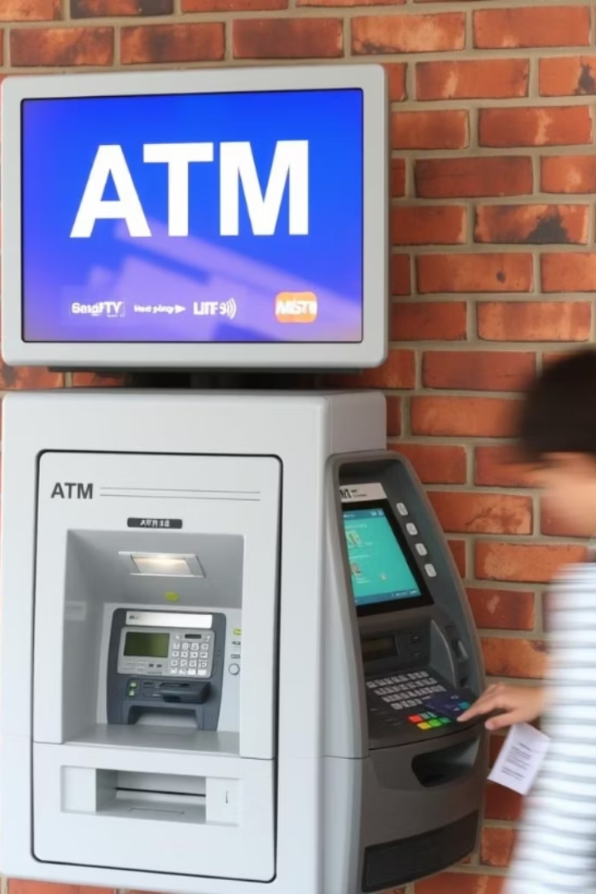
ATM Simulator with PIN Validation
Presented by: Ntarindwa Nshuti Allan

Slide 2
Problem Statement
ATM systems require secure PIN validation to prevent unauthorized access.
However, many basic simulations fail to demonstrate proper authentication, leaving a gap in understanding digital security.
There is a need for a secure, interactive ATM simulation to support learning and system testing.

Slide 3
Objectives
To create a simple and functional ATM simulator that allows users to perform key banking operations such as checking balance, withdrawing, and depositing money.
To include a secure PIN validation system that protects user access and prevents unauthorized transactions.
To help users understand how ATM systems work, especially the importance of authentication in digital banking.
To provide a practical learning tool for students and developers interested in system design, user interaction, and basic security measures.

