Slide 1
CleanWave
Laundry Service Management System
Phase 1 — System Analysis & Design Documentation
Course: SENG 8240 – Best Programming Practices & Design Patterns
Student: RUDASINGWA NSHUTI Bonheur
Instructor: RUTARINDWA JEAN PIERRE | Academic Year: 2025/2026, Semester II

Slide 2
TOPIC & CASE STUDY
Topic & Case Study
TOPIC
CASE STUDY — CleanWave Ltd
Application of Best Programming Practices and Design Patterns in Developing a Laundry Service Management System (LSMS) This project demonstrates the use of the MVC design pattern, RESTful API design, JWT authentication, input validation, and containerization using Docker.
CleanWave Ltd is a laundry and dry-cleaning company based in Kigali, Rwanda.
The company provides pickup, washing, ironing, and delivery services to households and businesses.
Currently, CleanWave operates manually — using phone calls and paper records — leading to errors, delays, and poor customer experience.
SENG 8240 – Best Programming Practices & Design Patterns | CleanWave LSMS | 2025/2026

Slide 3
PROBLEM STATEMENT
Problem Statement
01
No Order Tracking
02
Manual Payment Recording
03
No Delivery Visibility
Orders are recorded on paper. Staff cannot check order status in real time, leading to lost or forgotten orders.
Payments are collected and written in notebooks. There is no way to verify if a customer has paid or track outstanding balances.
Drivers receive verbal instructions. There is no system to assign, track, or confirm deliveries digitally.
04
No Role-Based Access
05
Customer Data Scattered
06
Proposed Solution
All staff share the same information with no separation. Counter staff can see driver data; drivers can modify orders.
Customer records (phone, address, order history) are stored in multiple notebooks — impossible to search or analyze.
A web-based LSMS with JWT-secured REST API, role-based access, real-time order pipeline, and Dockerized deployment.
SENG 8240 – Best Programming Practices & Design Patterns | CleanWave LSMS | 2025/2026

Slide 4
FUNCTIONAL DIAGRAM
Functional Diagram — How CleanWave Works
1
Customer
Registration
2
Order
Creation
3
Laundry
Pipeline
4
Payment
Processing
5
Delivery
Assignment
▶
▶
▶
▶
• Phone / name
• Link to customer
• received→sorting
• Cash / M-Money
• Assign driver
• Address saved
• Set amount
• washing→drying
• Card payment
• Track status
• Assigned ID
• Assign counter
• ironing→ready
• Linked to order
• Mark delivered
Roles Involved:
Admin
Counter Staff
Driver
Technician
SENG 8240 – Best Programming Practices & Design Patterns | CleanWave LSMS | 2025/2026

Slide 5
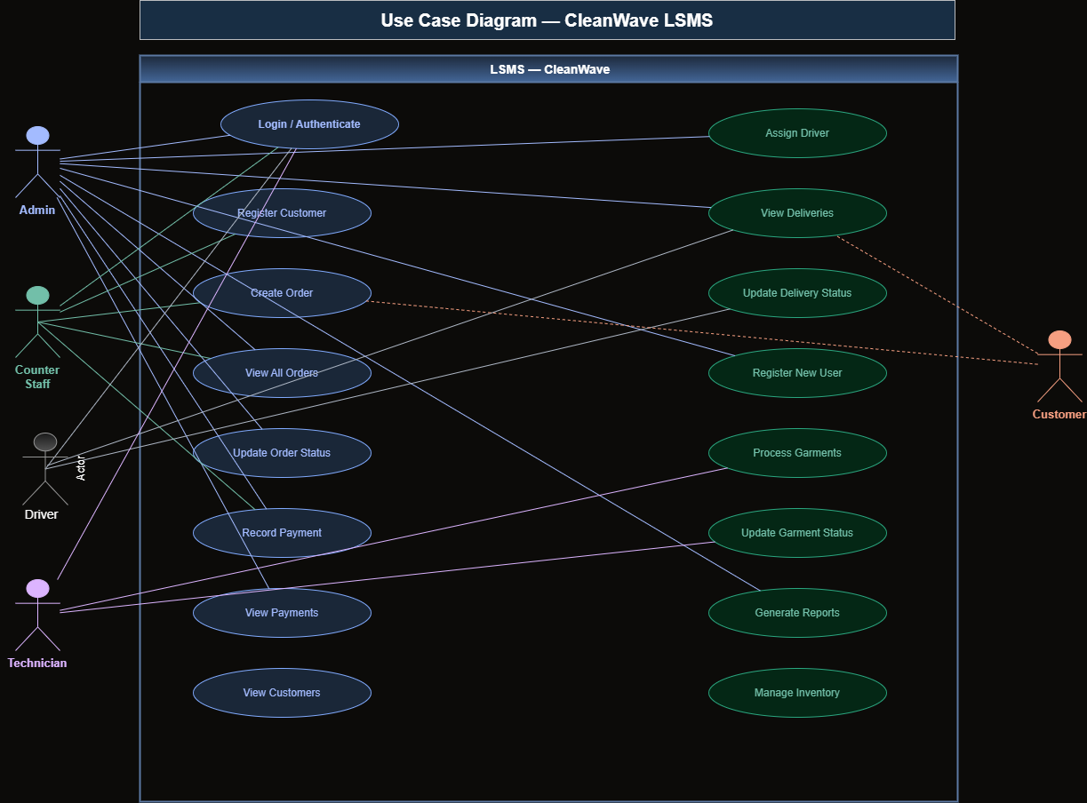
USE CASE DIAGRAM
Use Case Diagram
About This Diagram
Shows all system actors (Admin, Counter, Driver, Technician) and the use cases they interact with, including login, manage orders, process payments, and track deliveries.
Diagram 5 of 9
SENG 8240 – Best Programming Practices & Design Patterns | CleanWave LSMS | 2025/2026

Slide 6
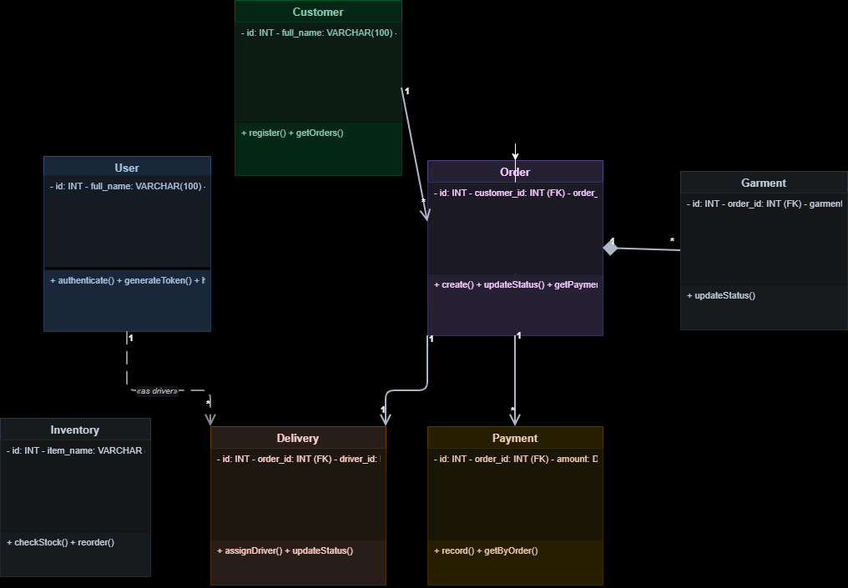
CLASS DIAGRAM
Class Diagram
About This Diagram
Shows the main classes:
User, Customer, Order, Payment, Delivery — with their attributes, methods, and relationships (associations and dependencies).
Diagram 6 of 9
SENG 8240 – Best Programming Practices & Design Patterns | CleanWave LSMS | 2025/2026

Slide 7
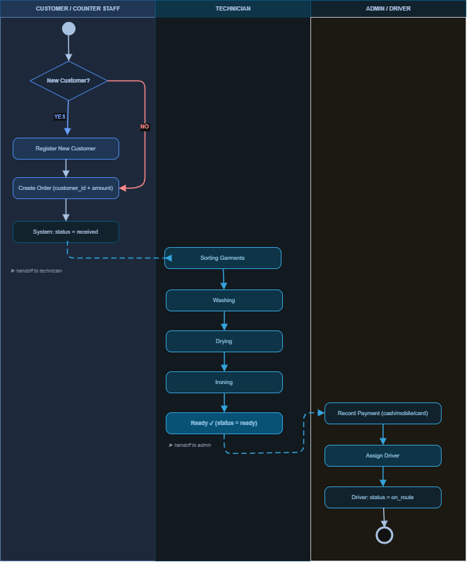
ACTIVITY DIAGRAM
Activity Diagram
About This Diagram
Illustrates the workflow of the laundry order process — from customer registration through washing pipeline stages to final delivery and payment confirmation.
Diagram 7 of 9
SENG 8240 – Best Programming Practices & Design Patterns | CleanWave LSMS | 2025/2026

Slide 8
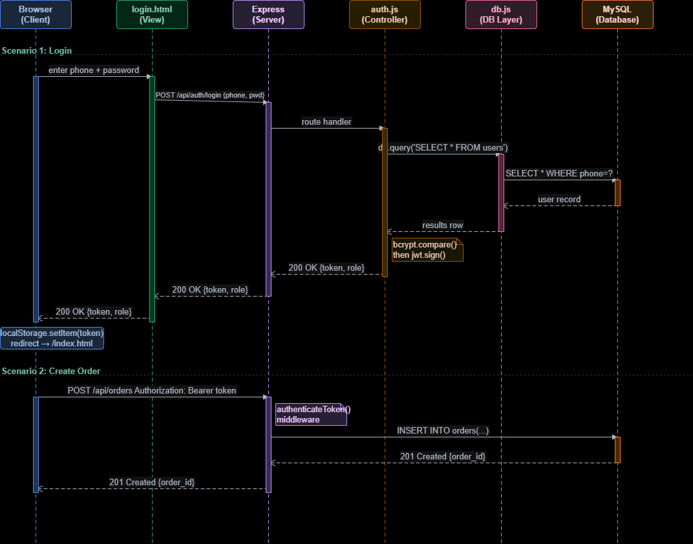
SEQUENCE DIAGRAM
Sequence Diagram
About This Diagram
Shows the interaction between the View (browser), Controller (Express routes), Middleware (JWT), and Model (MySQL) during a login and order creation flow.
Diagram 8 of 9
SENG 8240 – Best Programming Practices & Design Patterns | CleanWave LSMS | 2025/2026

Slide 9
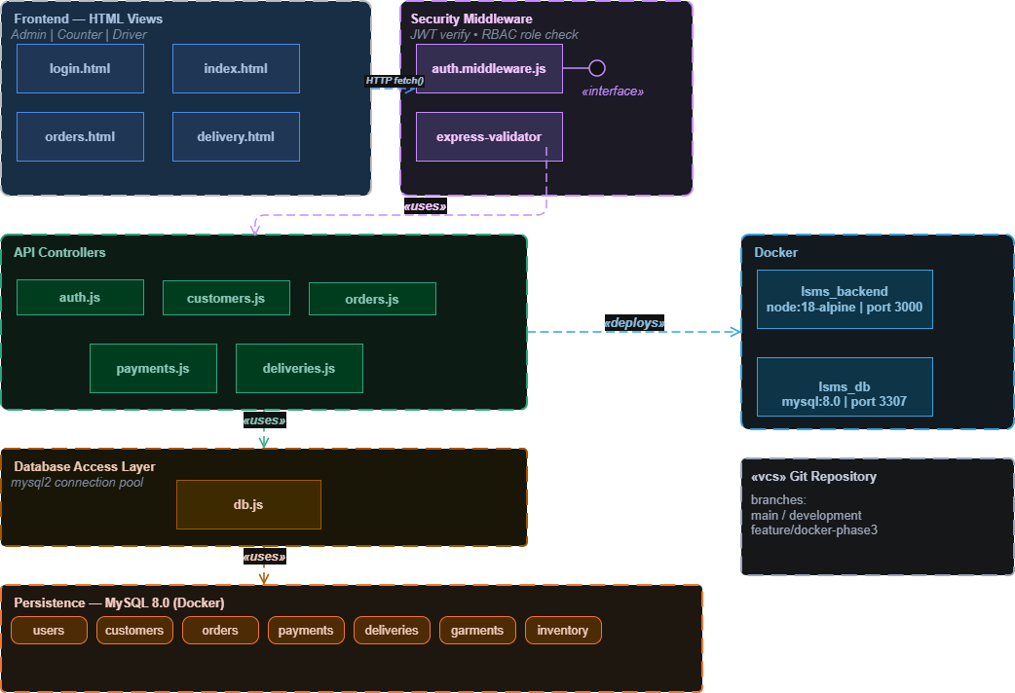
COMPONENT DIAGRAM
Component Diagram
About This Diagram
Depicts the software components: Frontend (HTML pages), Backend (Node.js/Express), Database (MySQL), Docker containers, and their interfaces.
Diagram 9 of 9
SENG 8240 – Best Programming Practices & Design Patterns | CleanWave LSMS | 2025/2026

Slide 10
Phase 1 Complete
CleanWave Laundry Service Management System
✔ Topic & Case Study defined
✔ Problem Statement articulated
✔ Functional Diagram presented
✔ 5 UML Diagrams included
RUDASINGWA NSHUTI Bonheur | SENG 8240 | 2025/2026

