Slide 1
Appen-10.1
Minor Axis
Dimension
Spacecraft
Ground
Track
Major Axis
Dimension
Measurement
Footprint
North
Nadir Point at
Time of
Measurement
Azimuth
Angle
Relative
to North
East

Slide 2
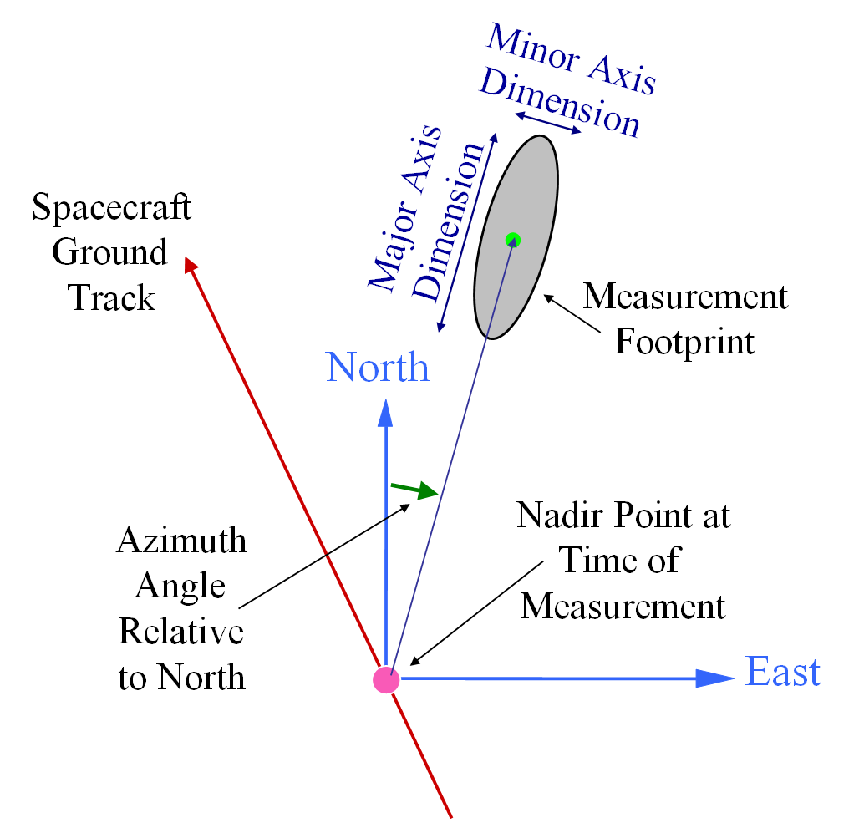

Slide 3
Descending
180°
150W
150E
Nadir position
at transition
120W
120E
Ascending
90W
90E
Pole
60E
60W
30W
30E
0°

Slide 4
Descending
180°
150W
150E
Nadir position
at transition
120W
120E
Ascending
90W
90E
Pole
60E
60W
30W
30E
0°

Slide 5
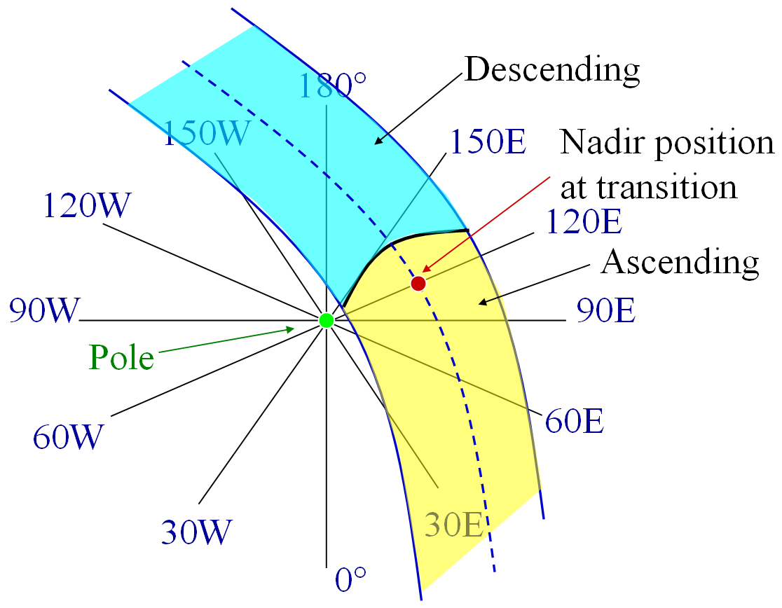
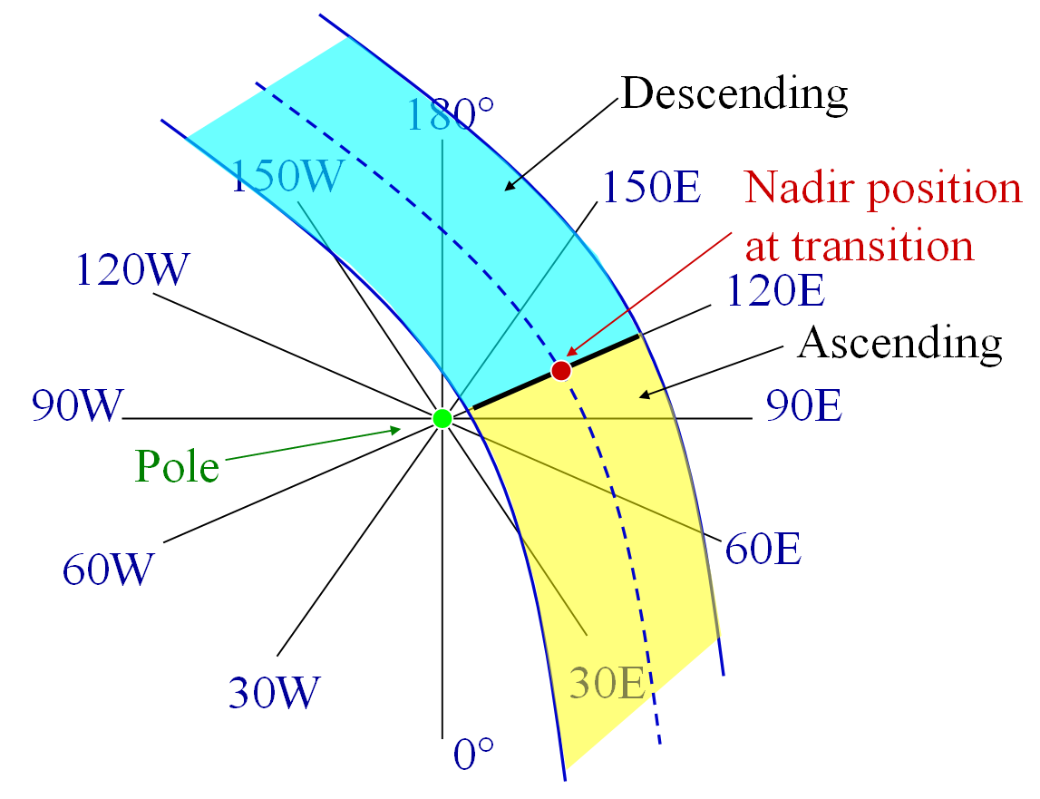

Slide 6
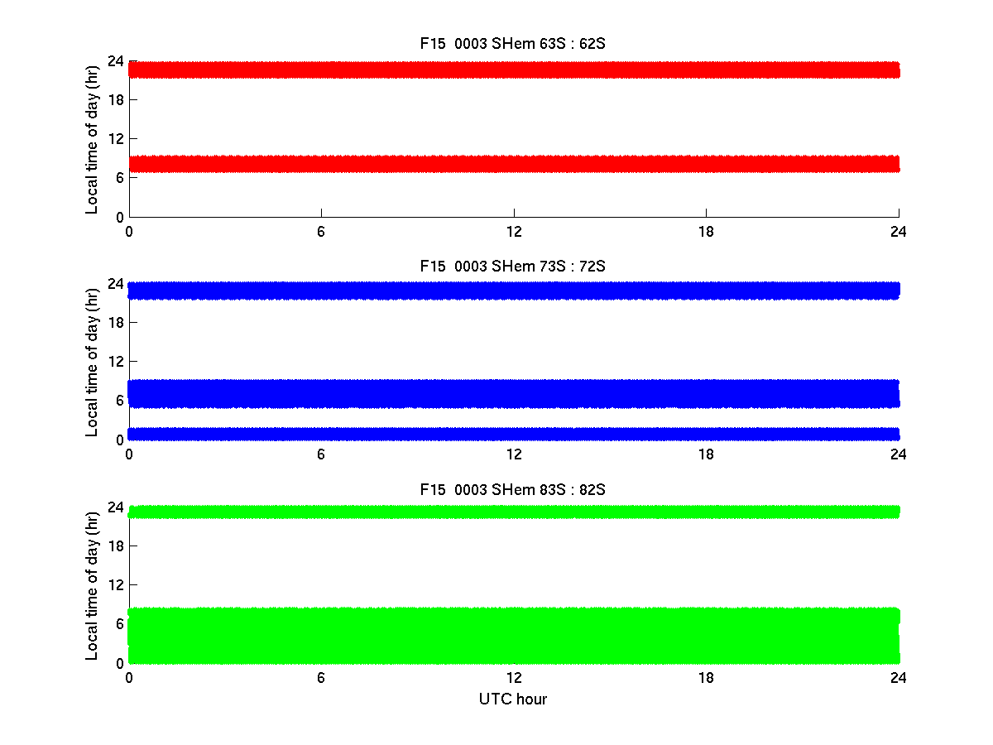
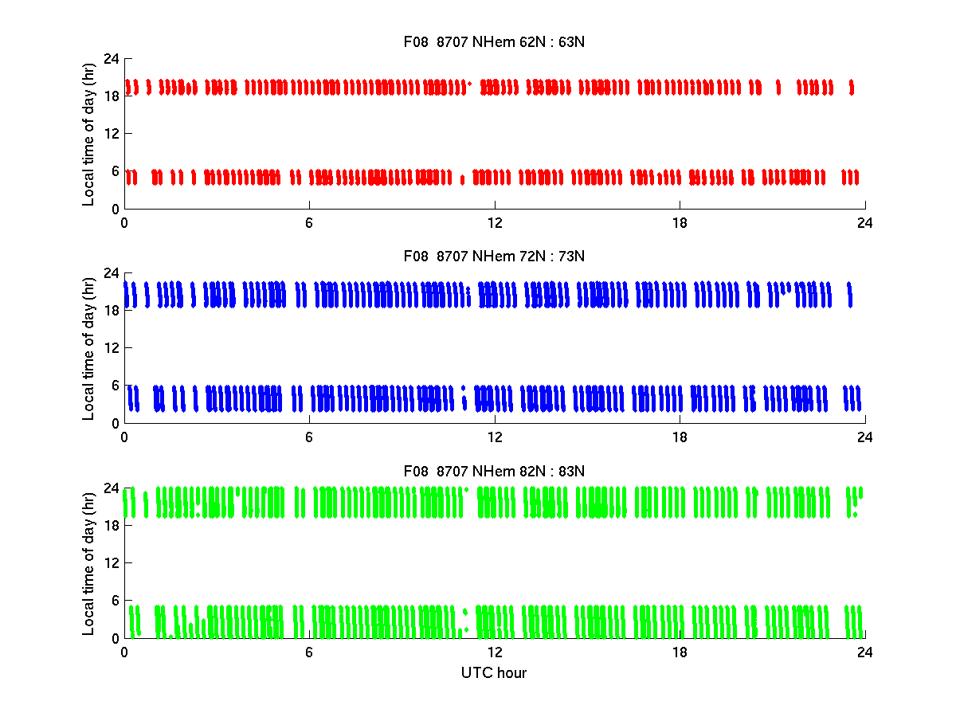
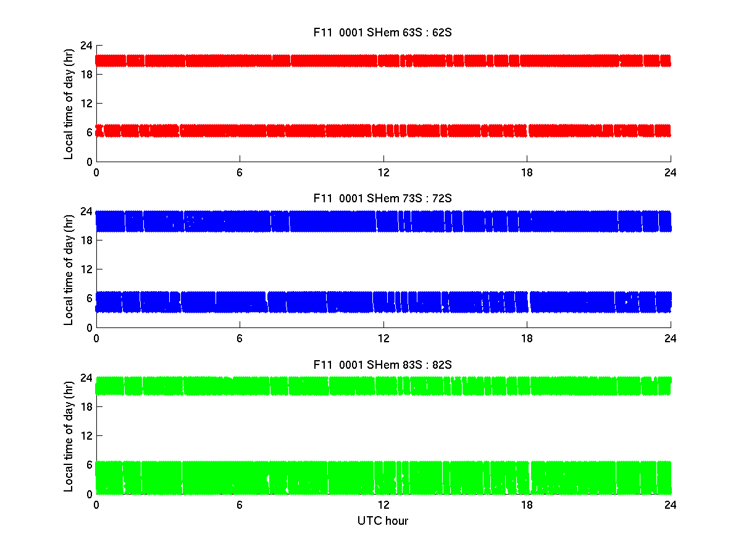
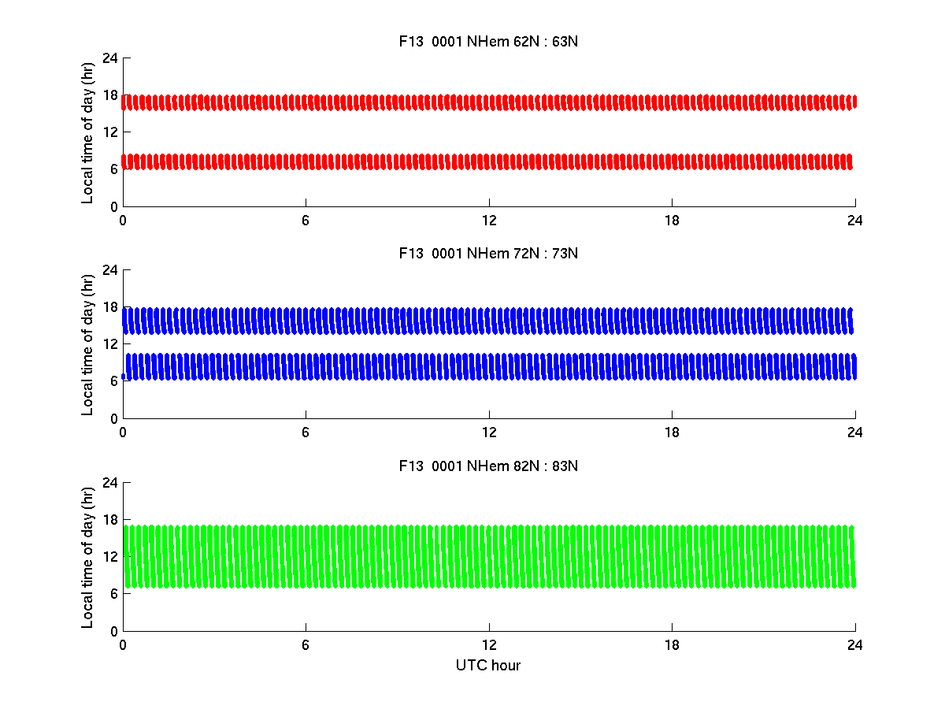
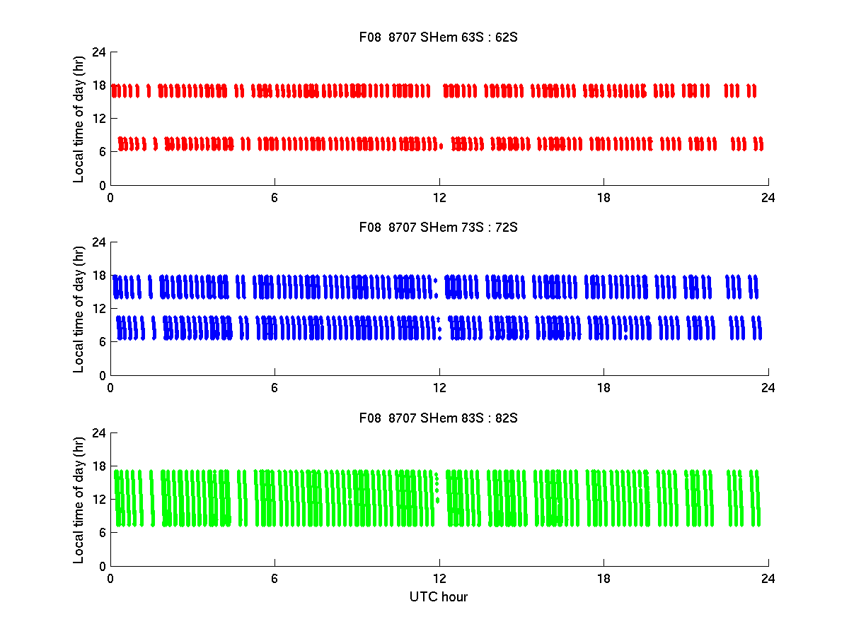
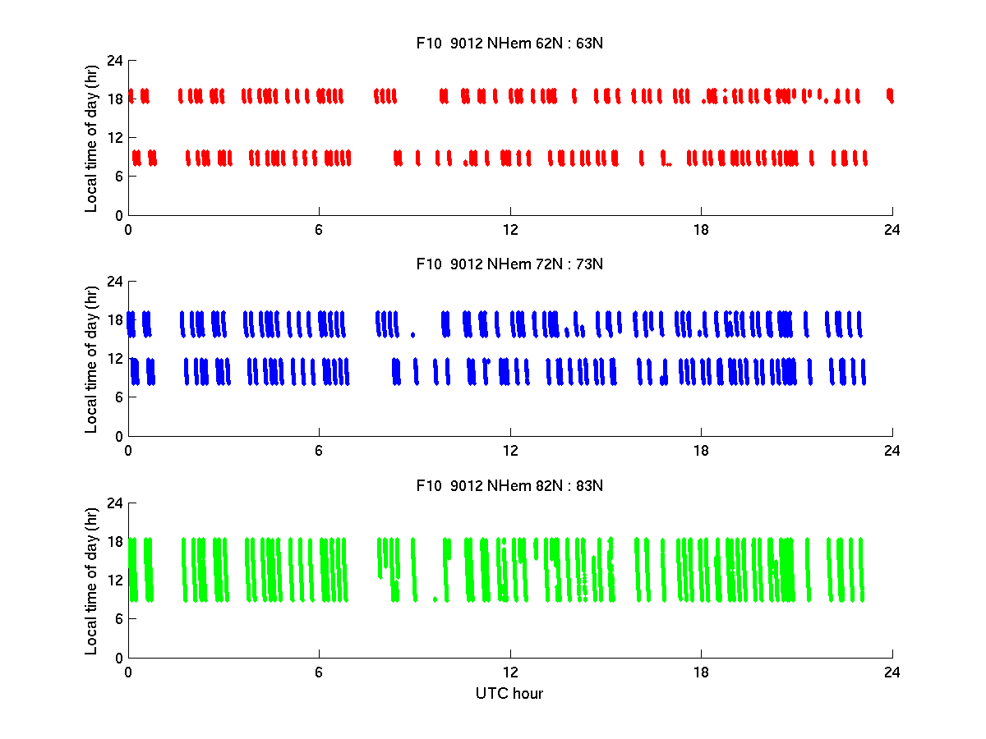
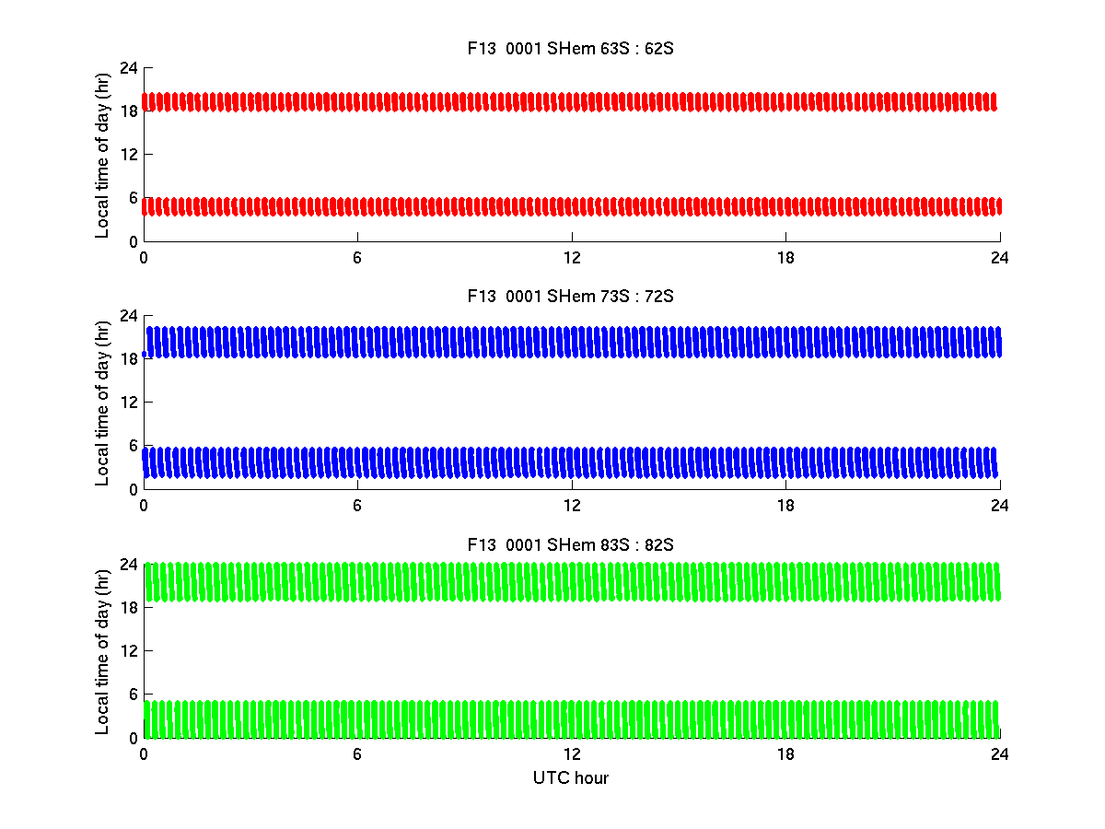
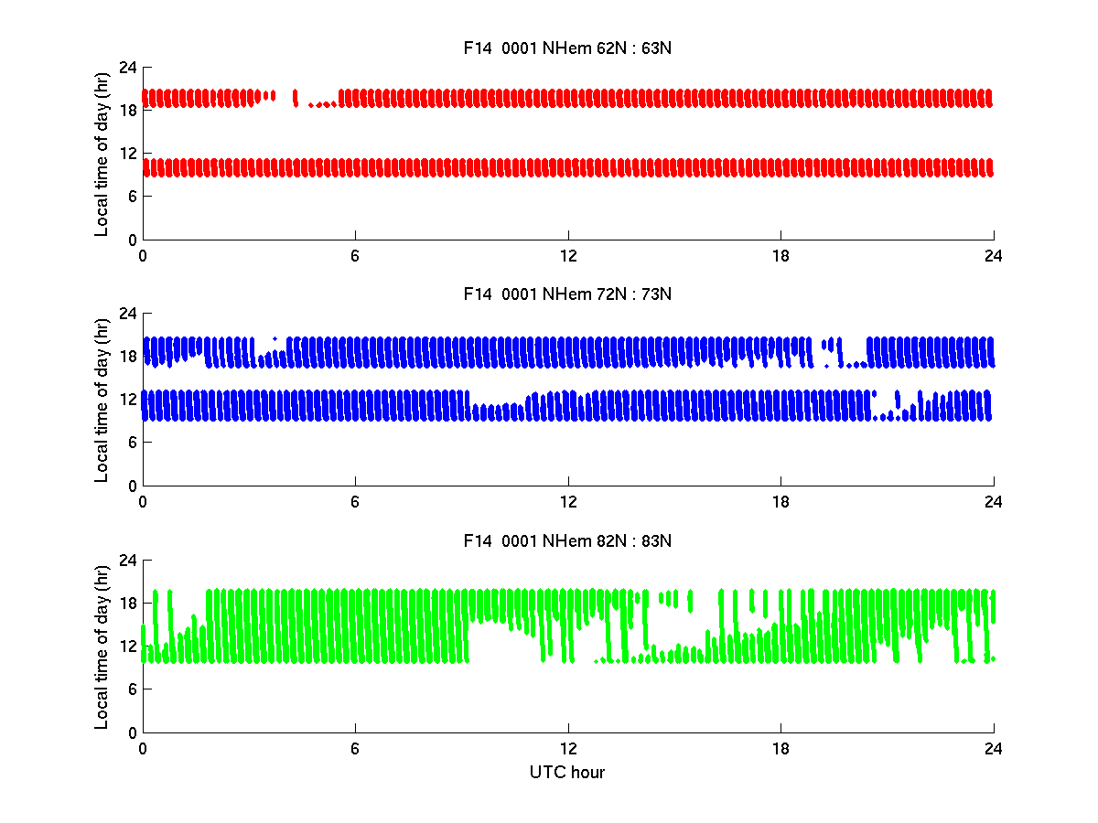
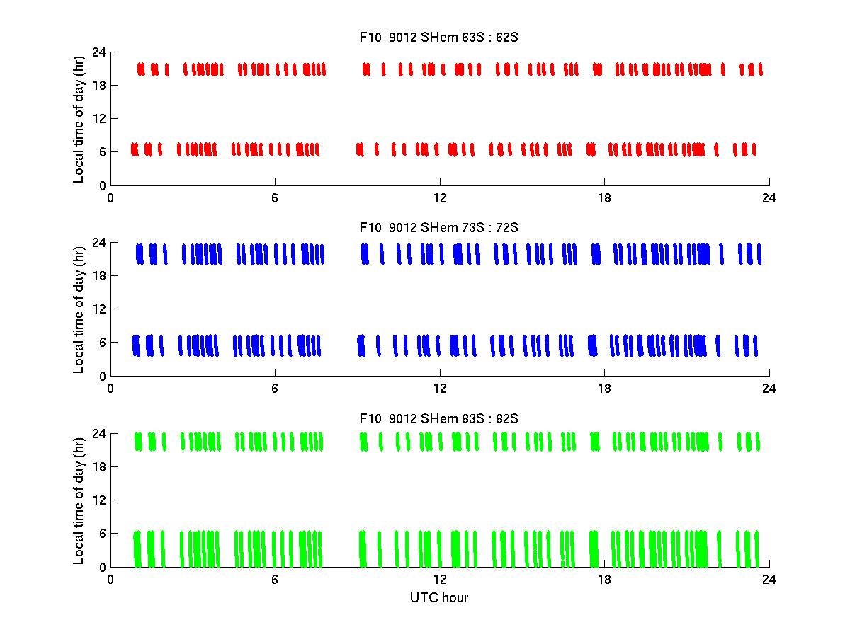
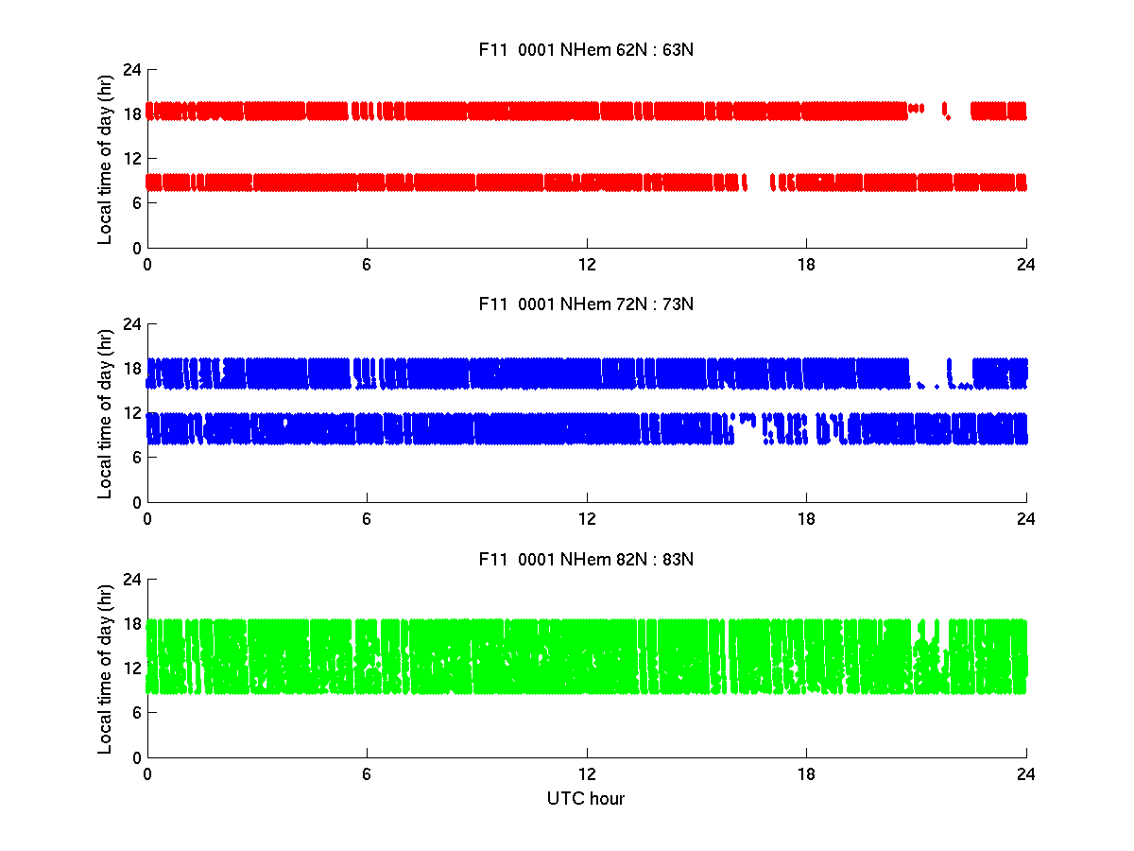
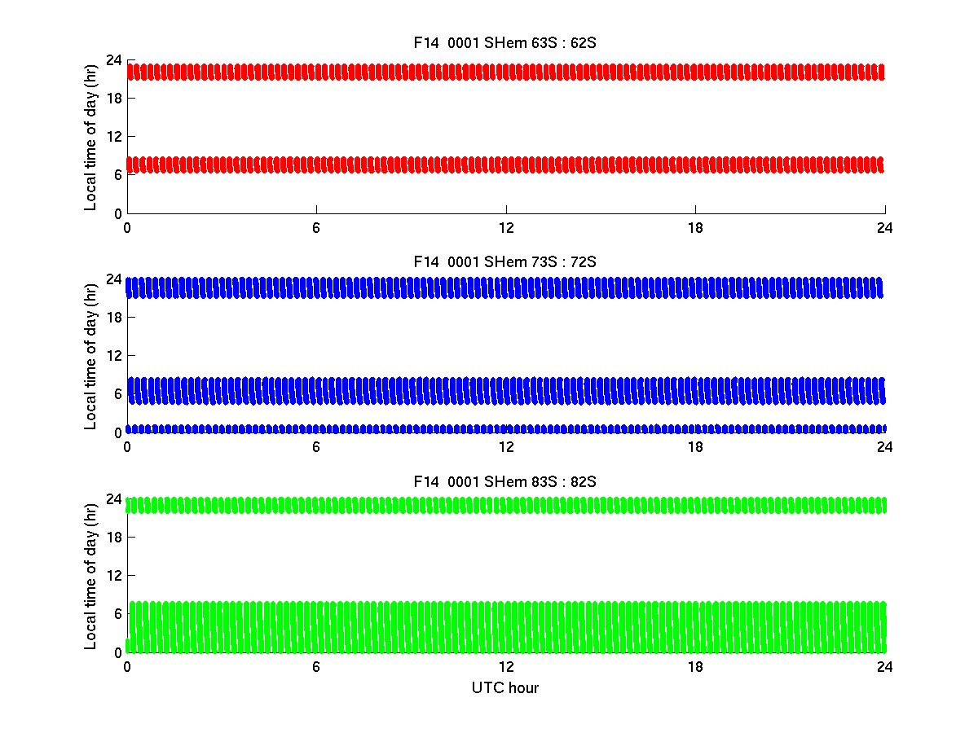
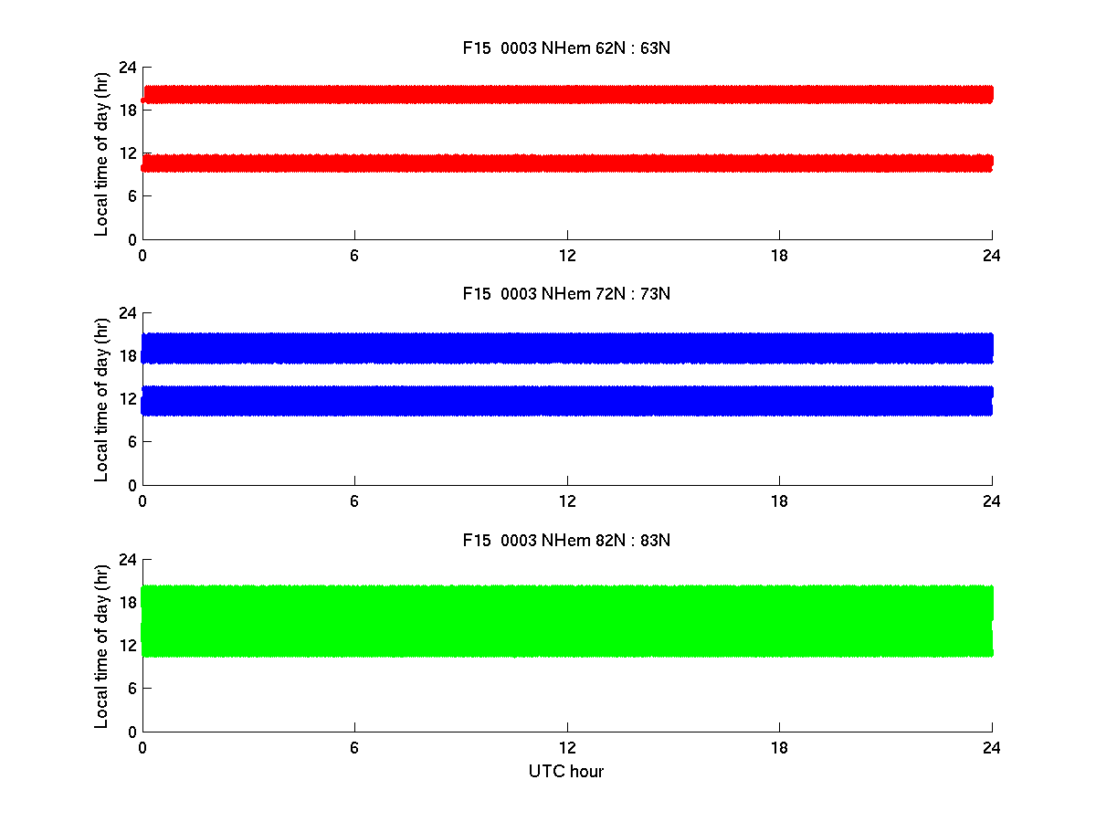

Slide 7
