Slide 1

MQTT DEMO 01
Hadrihl // hadrihilmi@gmail.com
School of Computer Science

Slide 2

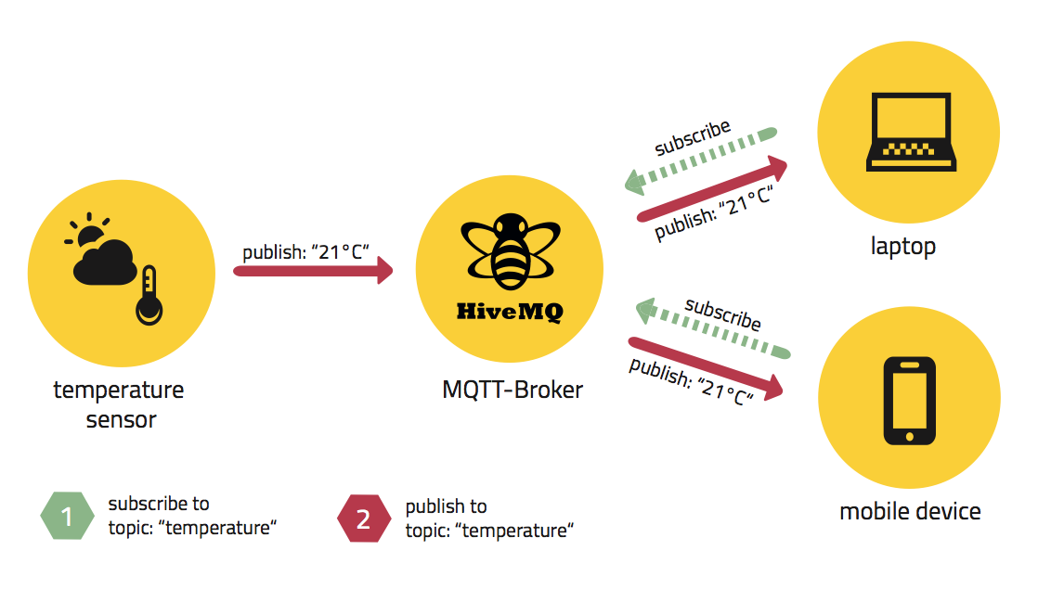

MQTT
IoT protocol
MQTT library is available on NPM
https://www.npmjs.com/package/mqtt
MQTT Broker:
https://www.npmjs.com/package/mosca

Slide 3
How to setup MQTT Demo 01
https://github.com/usmcs-pdcc/mqtt-demo-01

Slide 4
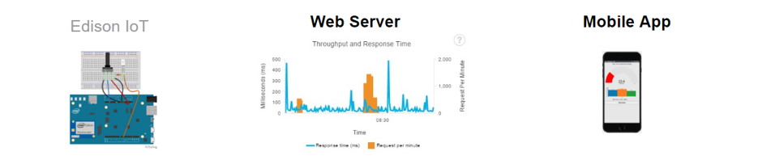


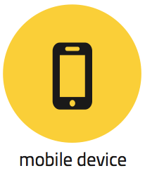
MQTT
Design&Implementation: 1
mqtt-sn.js
broker-mongodb.js
mqtt-client.js
Galileo/Edison
PC

Slide 5
Run broker-mongodb.js

Slide 6
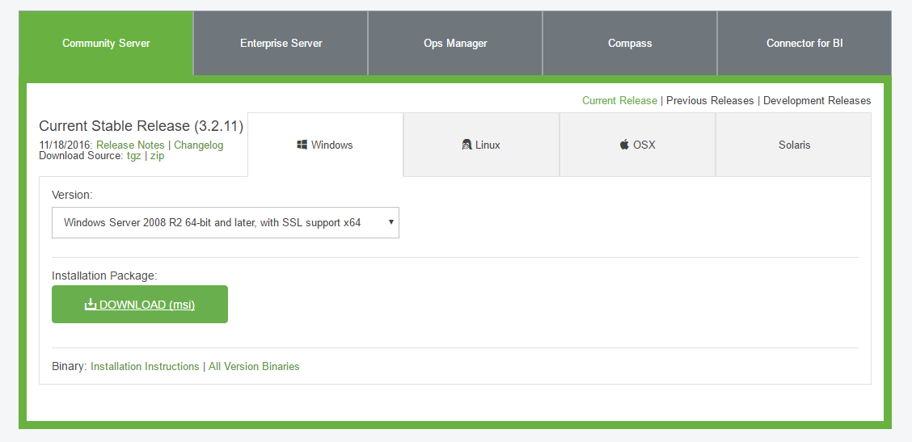
Download and install MongoDB
https://www.mongodb.com/download-center#community

Slide 7
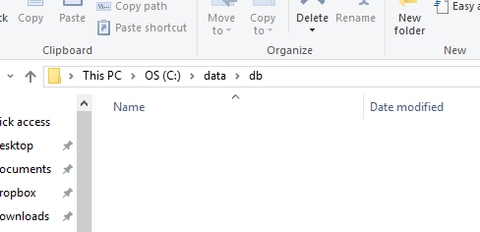
Create directory: C:\data\db
Open Command prompt: $ mkdir C:\data
$ mkdir C:\data\db

Slide 8
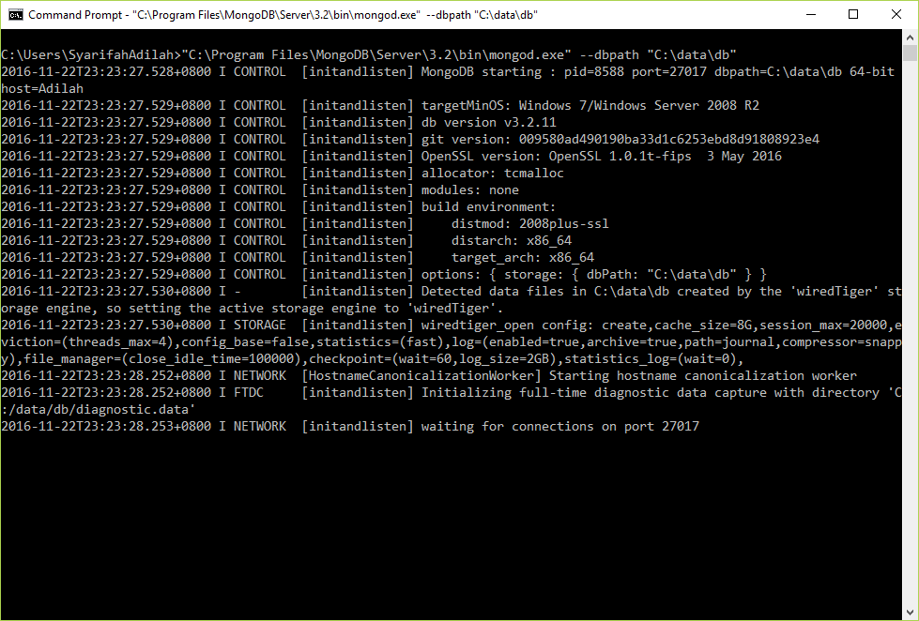
Run MongoDB (mongod.exe)
MongoDB is successfully running.
$ "C:\Program Files\MongoDB\Server\3.2\bin\mongod.exe" --dbpath "C:\data\db"

Slide 9
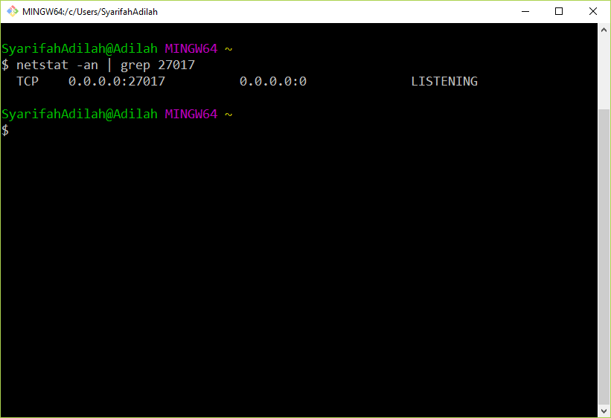
Verify:
MongoDB ready to receive connection. Please note that by default MongoDB runs on port 27017.

Slide 10
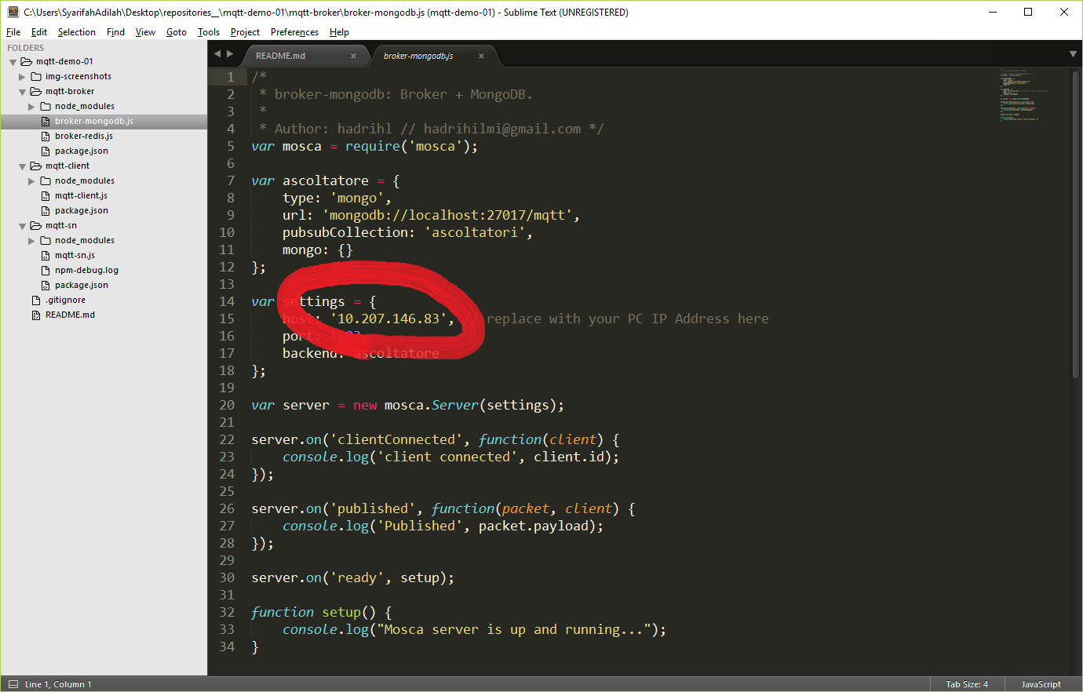
Set Broker IP Address in broker-mongodb.js
p/s: Make sure to set IP for broker-mongodb.js accordingly to your PC IP (run ipconfig in cmd).

Slide 11
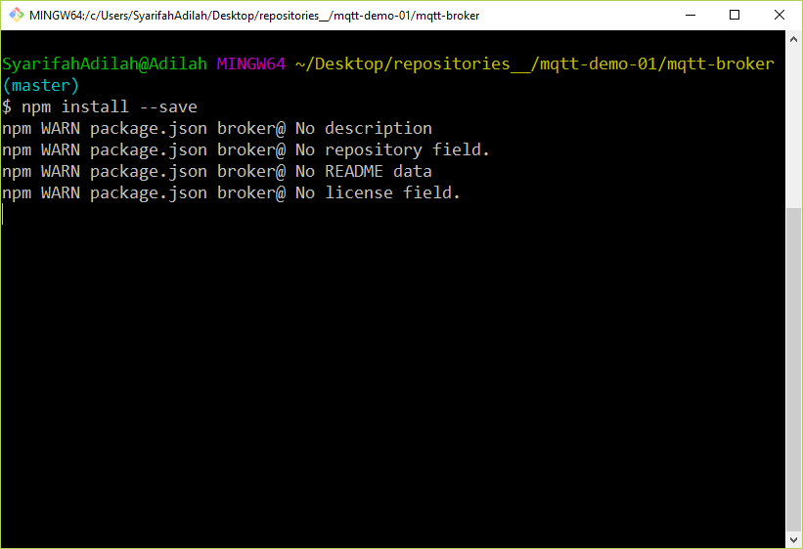
Resolve dependencies: broker-mongodb.js

Slide 12
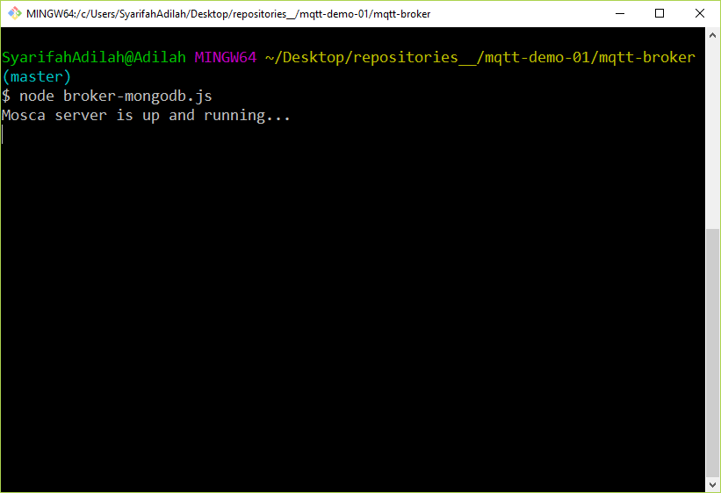
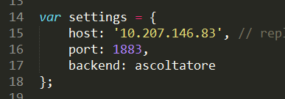
Run broker-mongodb.js
p/s: Windows might asks you (prompt) to allow Firewall access, so kindly allow it. Notice that Broker (broker-mongodb.js) runs on port 1883.

Slide 13
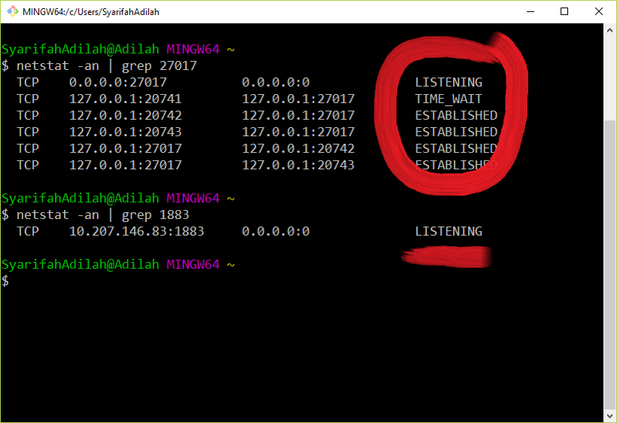
Verify: broker-mongodb.js
Broker use MongoDB to store the data. ESTABLISHED means broker is hooked up to MongoDB now.
Broker is ready to receive connection from either SN (Sensor Node, mqtt-sn.js) or client (mqtt-client.js)

Slide 14
Run mqtt-client.js

Slide 15
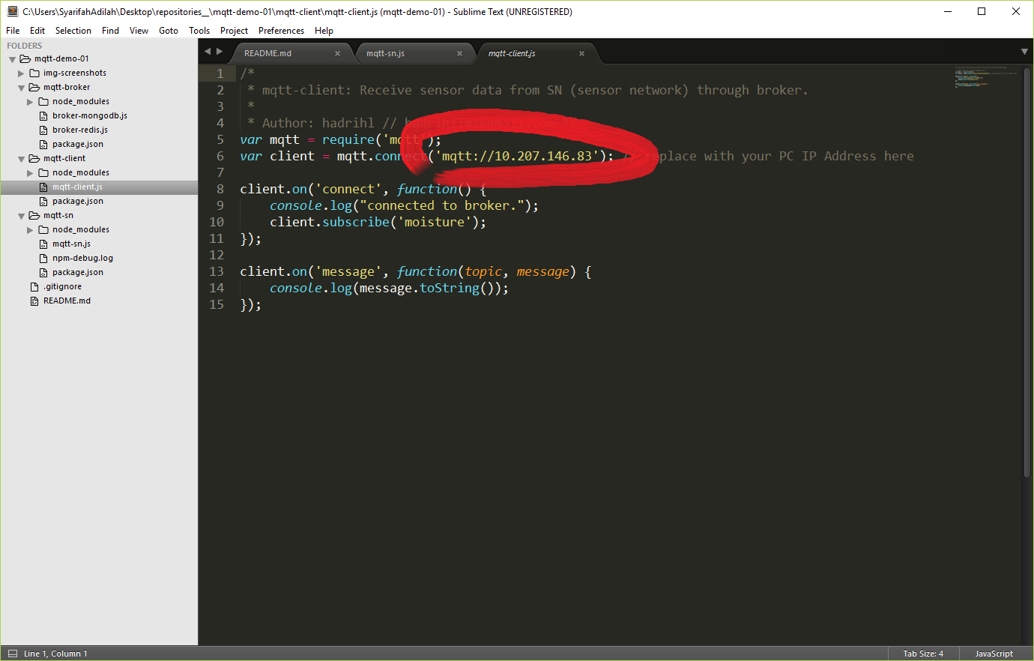
Set Broker IP Address in mqtt-client.js
p/s: Make sure to set IP for mqtt-client.js accordingly to your PC IP (run ipconfig in cmd).

Slide 16

Resolve dependencies: mqtt-client.js

Slide 17
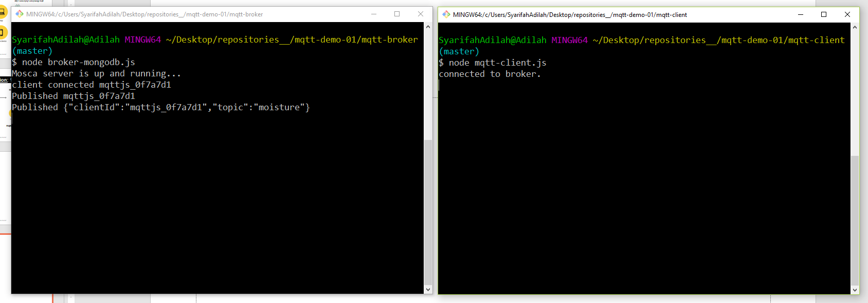
Run mqtt-client.js
p/s: When you run mqtt-client.js, your broker (broker-mongodb.js) will immediately receives the connection.

Slide 18
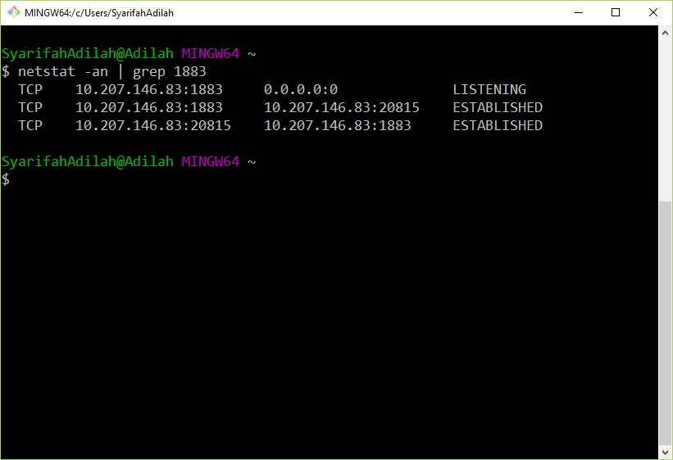
Verify:
Broker received connection from client (mqtt-client.js).
p/s: To make it real, you may setup mqtt-client.js on other PC.

Slide 19
Run mqtt-sn.js

Slide 20
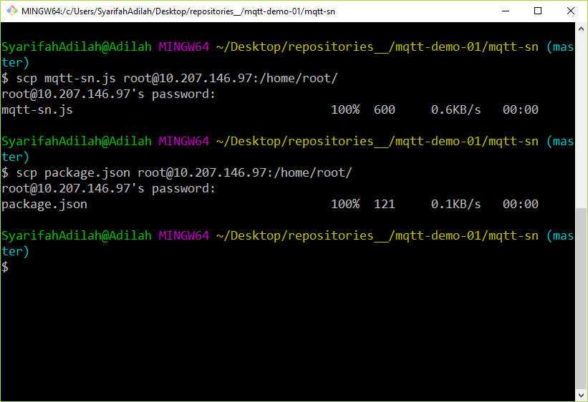
Transfer mqtt-sn.js & package.json into Galileo/Edison

Slide 21
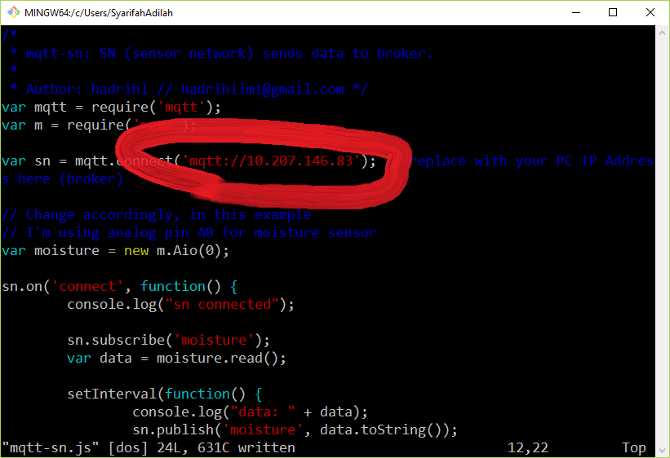
Set Broker IP Address into mqtt-sn.js
p/s: Access terminal of Galileo/Edison (PuTTY or SSH) first. You can use vim to edit mqtt-sn.js.

Slide 22
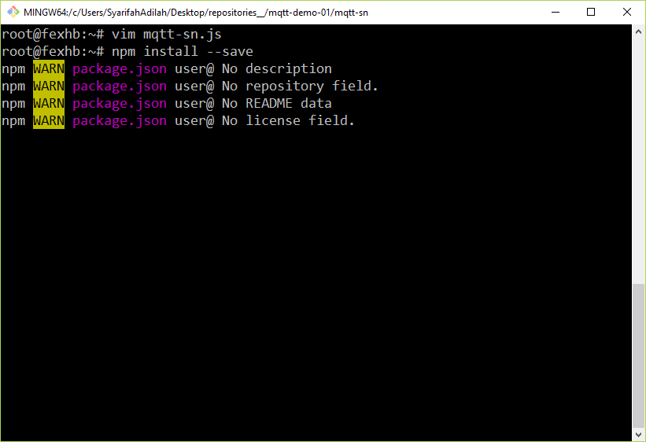
Resolve dependencies: mqtt-sn.js

Slide 23
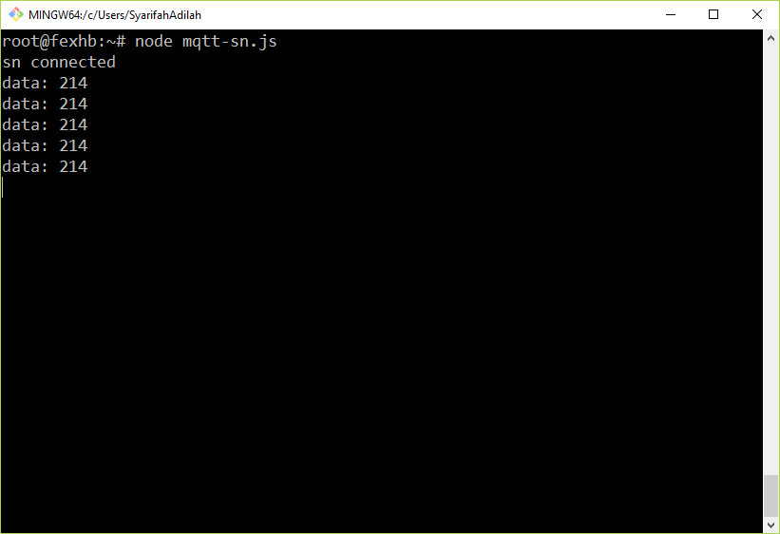
Run mqtt-sn.js

Slide 24
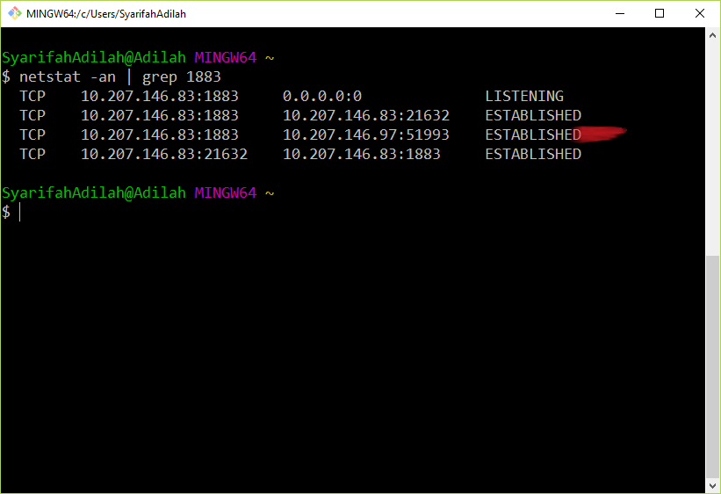
Verify:
p/s: You should be able to see your SN(Sensor Node) connected to broker.

Slide 25
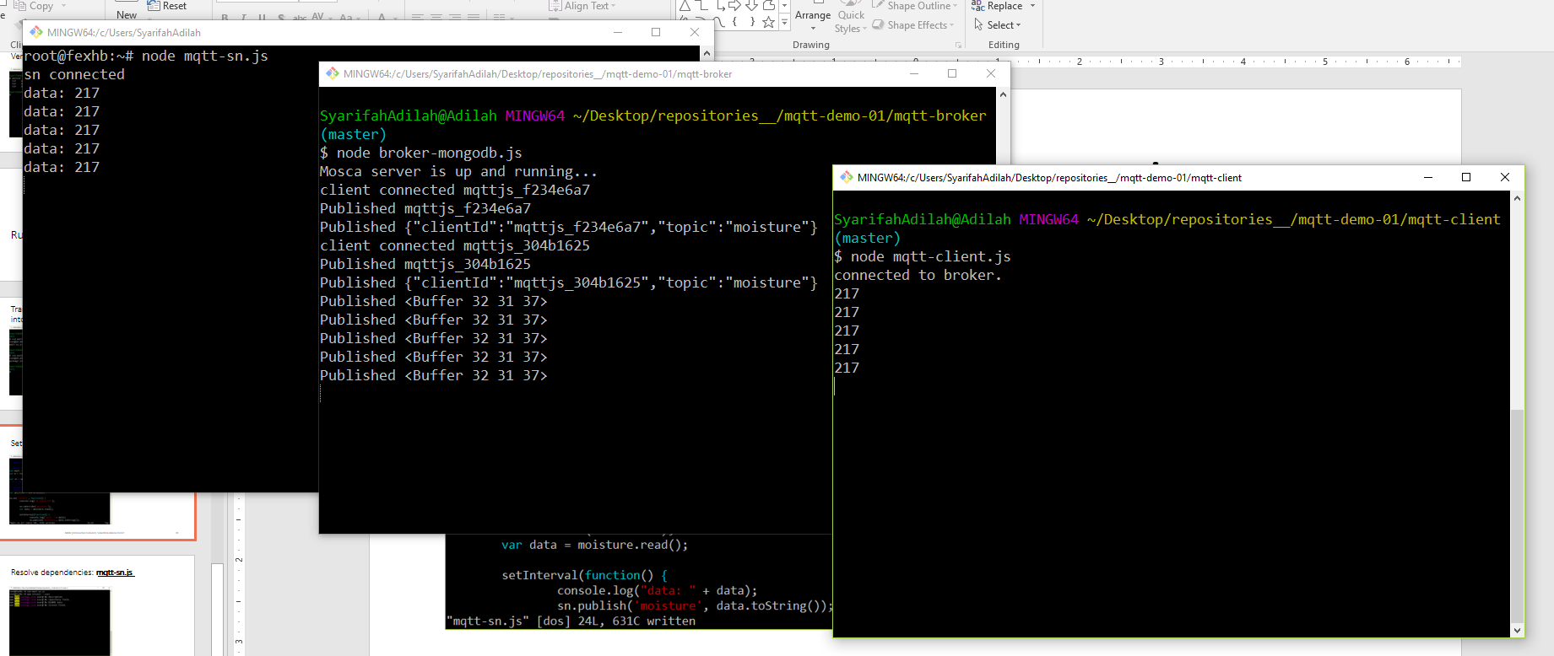
mqtt-sn.js
broker-mongodb.js
mqtt-client.js
Successful deployment

