Slide 1

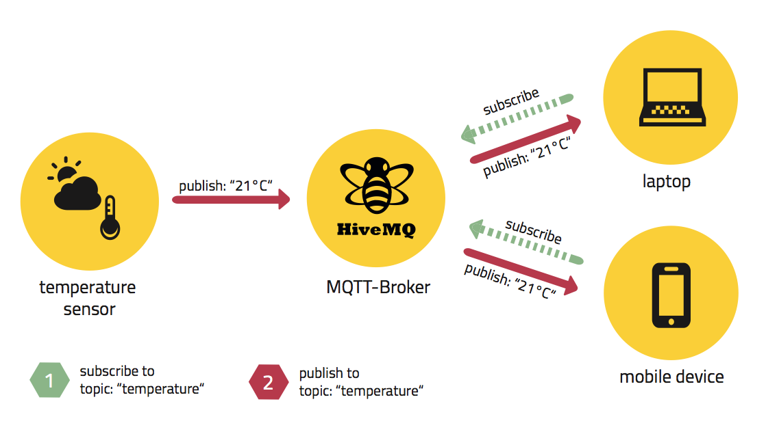

MQTT
IoT protocol
MQTT library is available on NPM
https://www.npmjs.com/package/mqtt
MQTT Broker:
https://www.npmjs.com/package/mosca

Slide 2
How to setup MQTT Demo 01
https://github.com/usmcs-pdcc/mqtt-demo-01

Slide 3
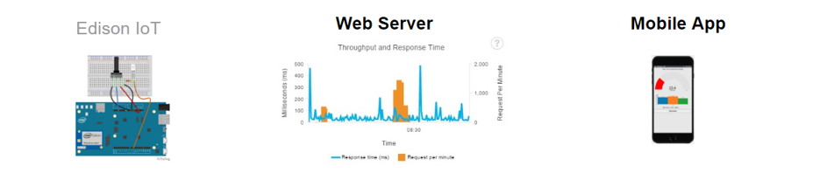


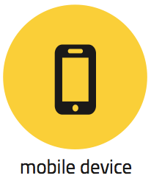
MQTT
Design&Implementation: 1
mqtt-sn.js
broker-mongodb.js
mqtt-client.js
Galileo/Edison
PC

Slide 4
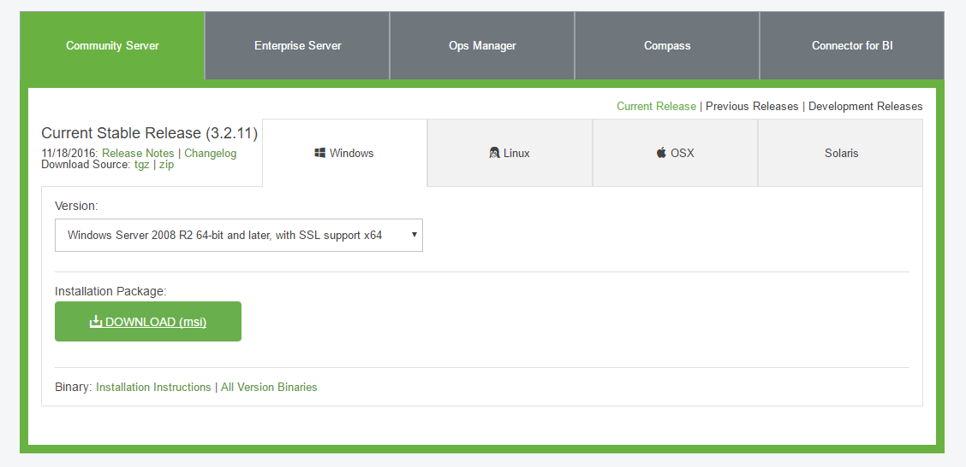
Download and install MongoDB
https://www.mongodb.com/download-center#community

Slide 5
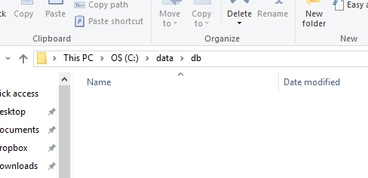
Create directory: C:\data\db
Open Command prompt: $ mkdir C:\data
$ mkdir C:\data\db

Slide 6
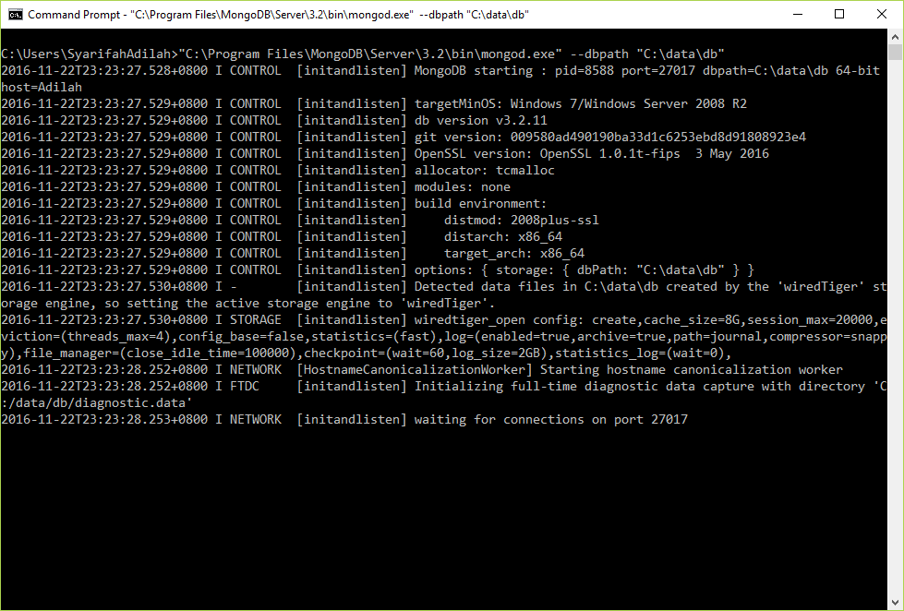
Run MongoDB (mongod.exe)
MongoDB is successfully running.
$ "C:\Program Files\MongoDB\Server\3.2\bin\mongod.exe" --dbpath "C:\data\db"

Slide 7
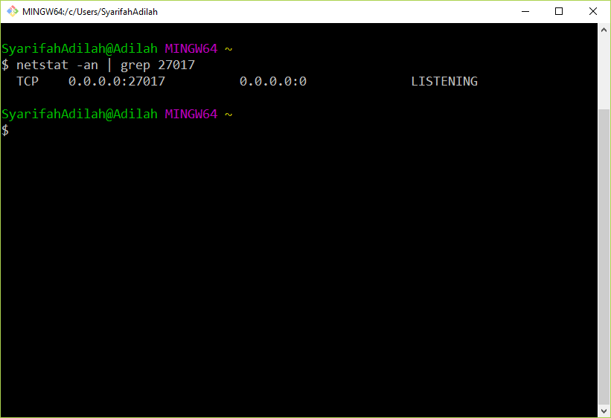
Verify:
MongoDB ready to receive connection. Please note that by default MongoDB runs on port 27017.

Slide 8
Run broker-mongodb.js

Slide 9
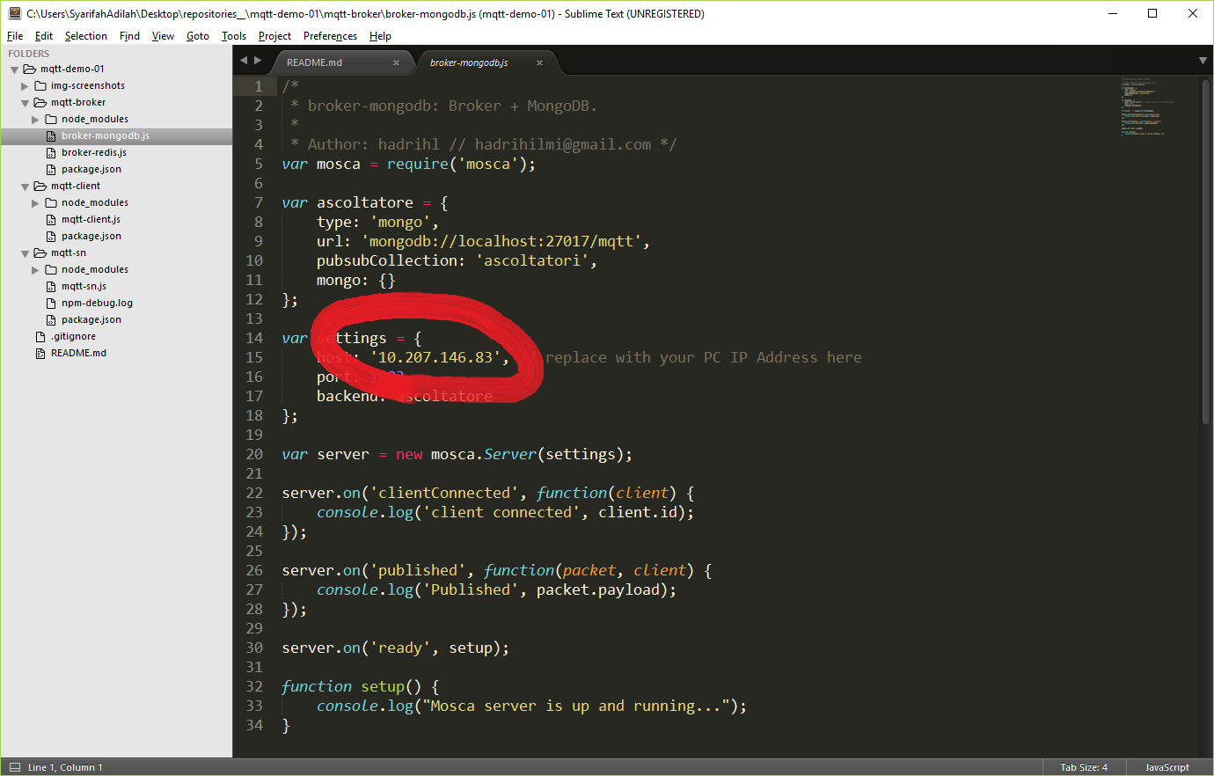
Set Broker IP Address in broker-mongodb.js
p/s: Make sure to set IP for broker-mongodb.js accordingly to your PC IP (run ipconfig in cmd).

Slide 10
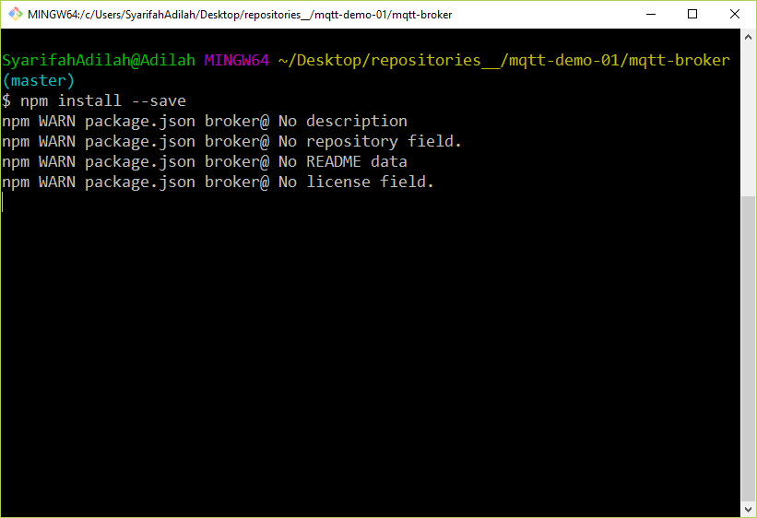
Resolve dependencies: broker-mongodb.js

Slide 11
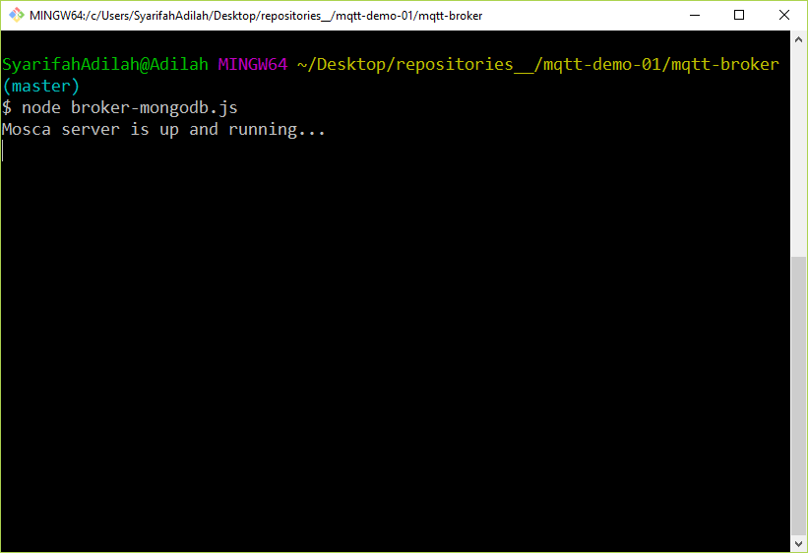
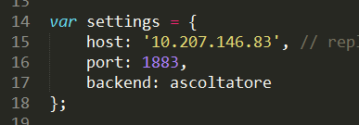
Run broker-mongodb.js
p/s: Windows might asks you (prompt) to allow Firewall access, so kindly allow it. Notice that Broker (broker-mongodb.js) runs on port 1883.

Slide 12
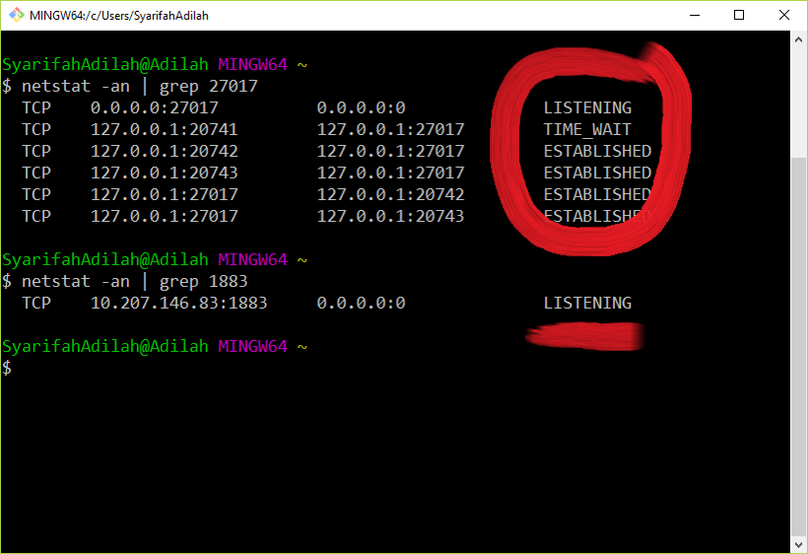
Verify: broker-mongodb.js
Broker use MongoDB to store the data. ESTABLISHED means broker is hooked up to MongoDB now.
Broker is ready to receive connection from either SN (Sensor Node, mqtt-sn.js) or client (mqtt-client.js)

Slide 13
Run mqtt-client.js

Slide 14
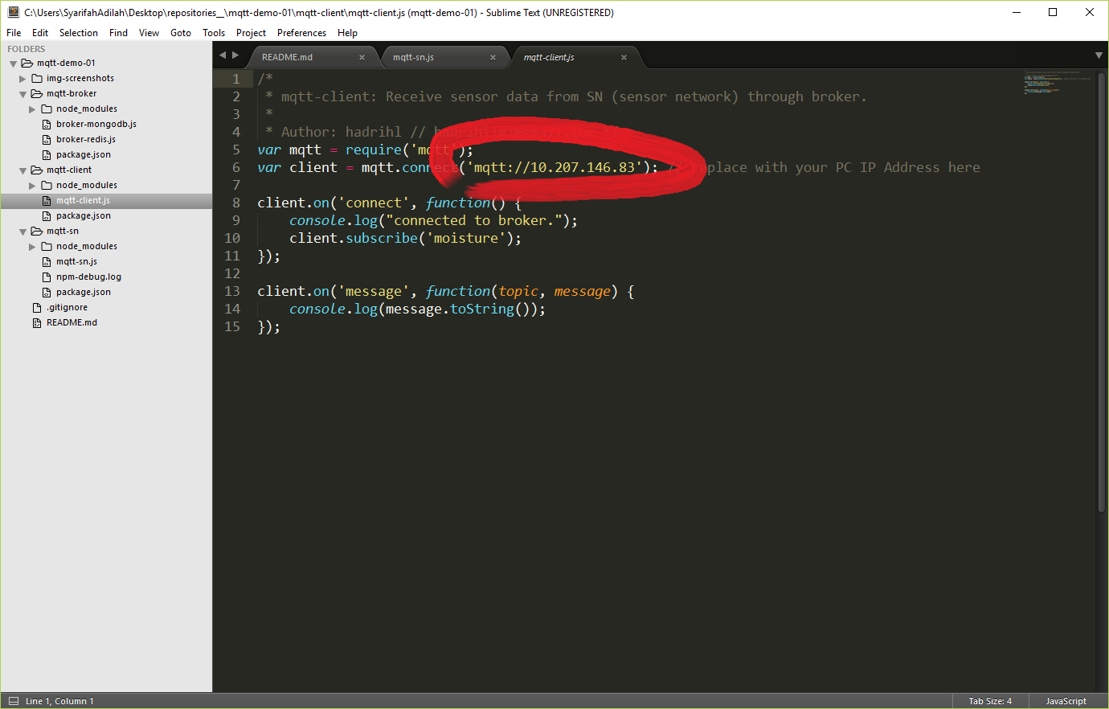
Set Broker IP Address in mqtt-client.js
p/s: Make sure to set IP for mqtt-client.js accordingly to your PC IP (run ipconfig in cmd).

Slide 15

Resolve dependencies: mqtt-client.js

Slide 16
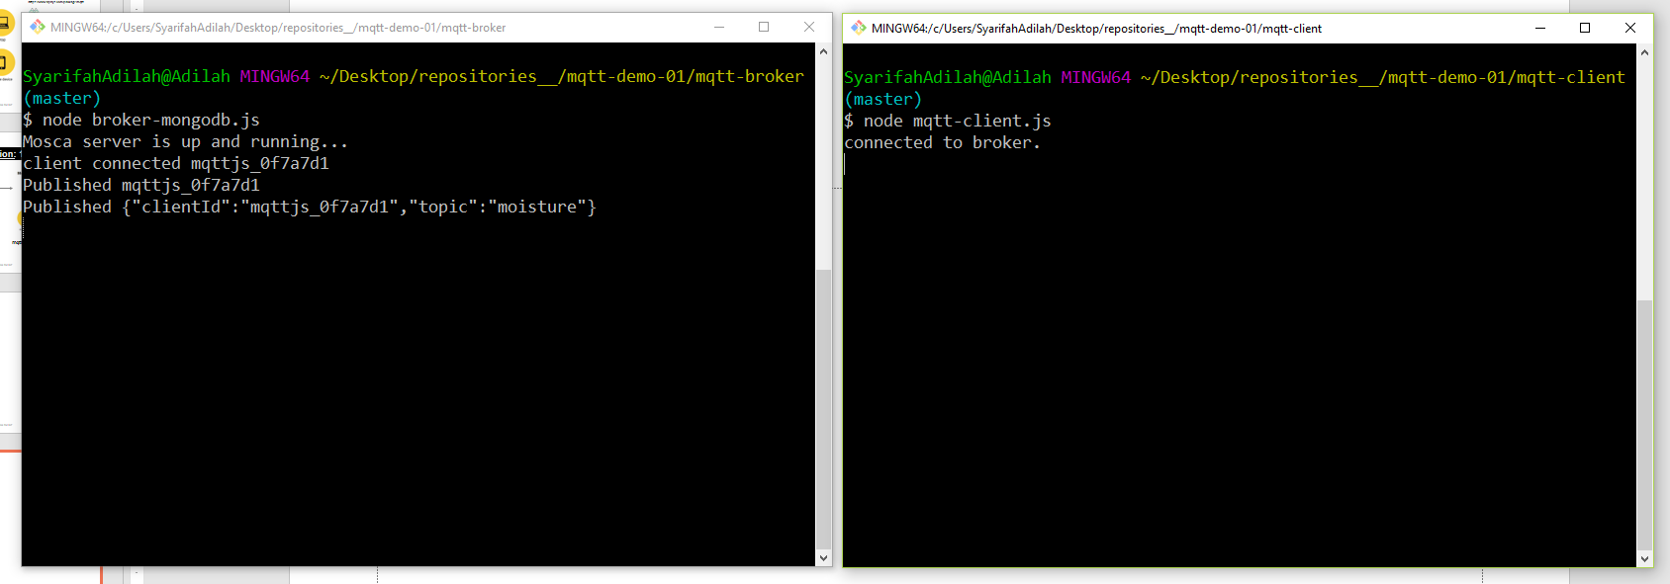
Run mqtt-client.js
p/s: When you run mqtt-client.js, your broker (broker-mongodb.js) will immediately receives the connection.

Slide 17
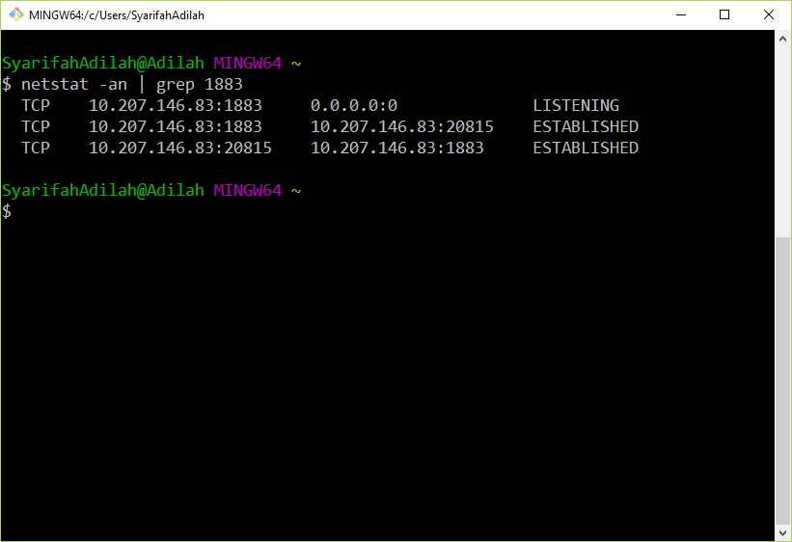
Verify:
Broker received connection from client (mqtt-client.js).
p/s: To make it real, you may setup mqtt-client.js on other PC.

Slide 18
Run mqtt-sn.js

Slide 19
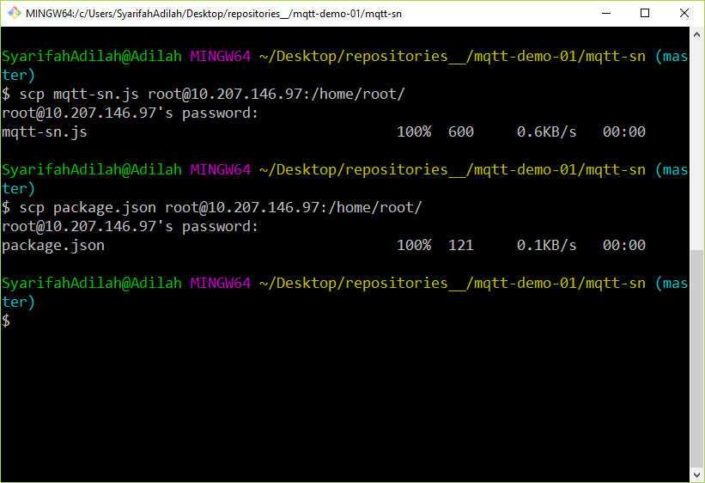
Transfer mqtt-sn.js & package.json into Galileo/Edison

Slide 20
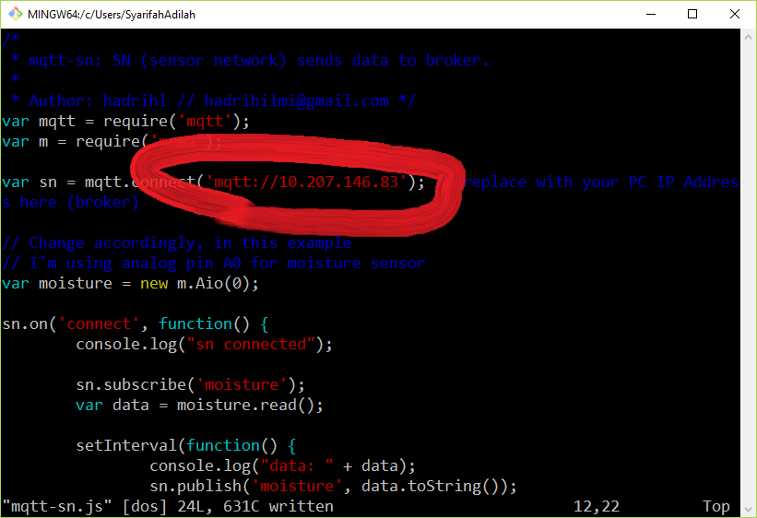
Set Broker IP Address into mqtt-sn.js
p/s: Access terminal of Galileo/Edison (PuTTY or SSH) first. You can use vim to edit mqtt-sn.js.

Slide 21
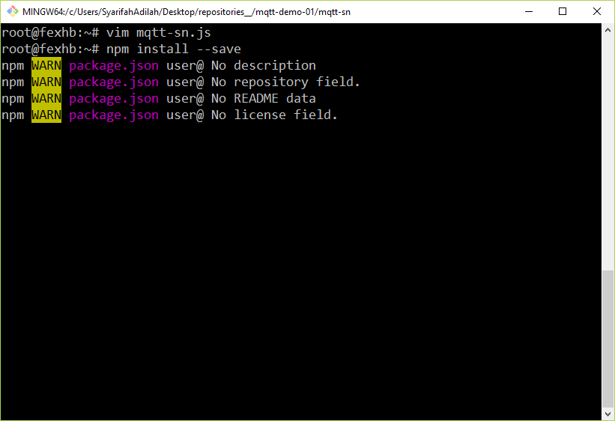
Resolve dependencies: mqtt-sn.js

Slide 22
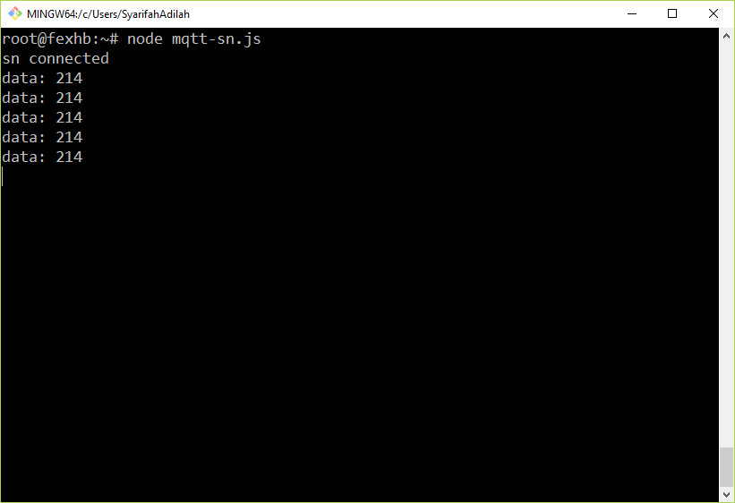
Run mqtt-sn.js

Slide 23
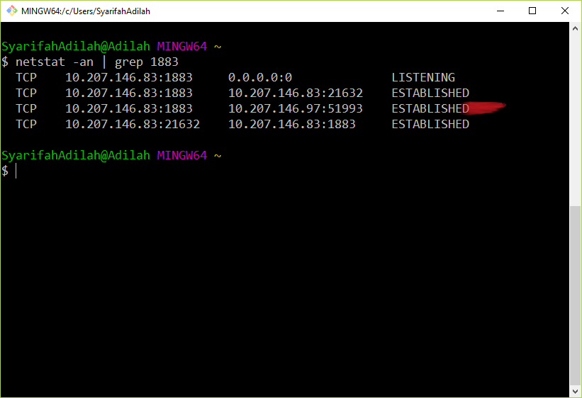
Verify:
p/s: You should be able to see your SN(Sensor Node) connected to broker.

Slide 24
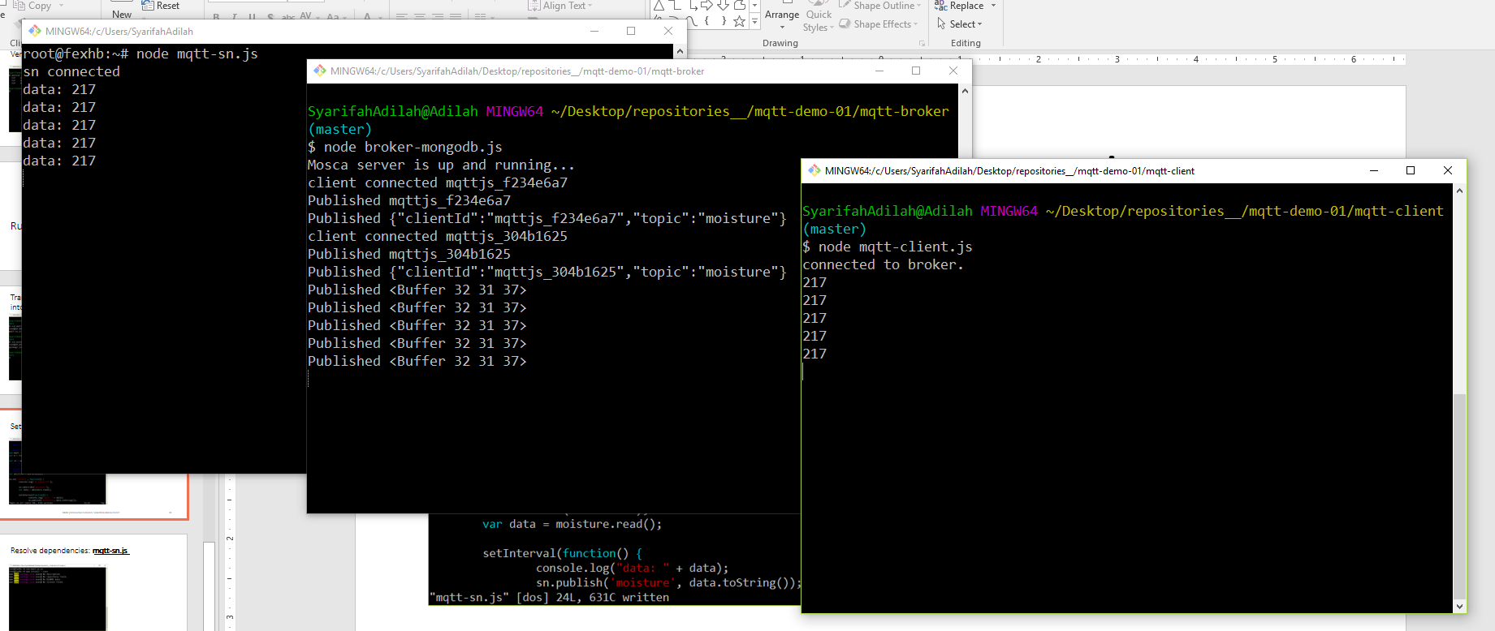
mqtt-sn.js
broker-mongodb.js
mqtt-client.js
Successful deployment

