Slide 1
Multivariate Two sample Hypothesis Testing
Nikolay A. Simakov
November 24, 2020
Project for STA621:Theory of Stat Inference

Slide 2







Introduction: Multivariate Two sample Hypothesis Testing
$$i.i.d.$$
$$i.i.d.$$
$$X_{1},…, X_{m} \sim F$$
$$Y_{1},…, Y_{n}\sim G$$
Majority of modern datasets are multivariate
Medical field:
Imaging data (Ultrasound, MRI, etc.)
Gene expression arrays
Testing that two samples are from same or different distributions is critical in many scenario.
Control vs treatment
Healthy vs diseased
Distribution is often unknown or can not be approximated by normal distribution
X_{i} and Y_{i} are p-variate, i.e.:
$$X_{i}={\left(X_{i,1} …X_{i,p}\right)}^{′}$$
$$Y_{i}={\left(Y_{i,1} …Y_{i,p}\right)}^{′}$$
$$H_{0}:F=G vs H_{1}:F≠G$$
Ultrasound image of eyeball segments [Silva, 2018]

Slide 3
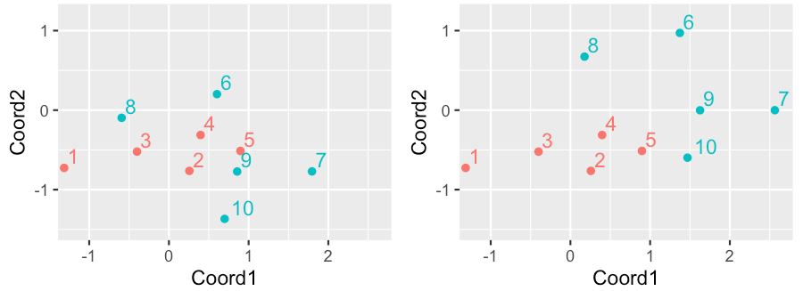

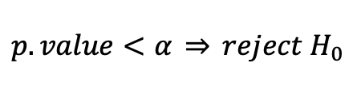


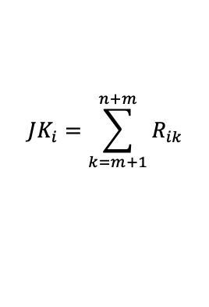



Extending of Wilcoxon Rank Sum Test: Jereckova-Kalina (JK) Test
True: Same Distr.
True: Different Distr.
$$iid$$
$$iid$$
$$X_{1},…, X_{m} \sim F(ζ)$$
$$Y_{1},…, Y_{n}\sim G(ζ+μ)$$
$$H_{0}:μ=0 vs H_{1}:μ≠0$$
1. Randomly select X_{i}
2. Calculate l_{ik} - distance from X_{i} to Z
3. Calculate ranks R_{ik} (skipping X_{i})
4. Calculate ranks statistics
$$JK_{i}=\sum_{k=m+1}^{n+m}{R_{ik}}$$
5. Calculate p-value
k | 1 | 2 | 3 | 4 | 5 | 6 | 7 | 8 | 9 | 10
l_{ik} | 1.6 | 0.0 | 0.7 | 0.5 | 0.7 | 1.0 | 1.5 | 1.1 | 0.6 | 0.7
R_{ik} | 9 |  | 4 | 1 | 3 | 6 | 8 | 7 | 2 | 5
k | 1 | 2 | 3 | 4 | 5 | 6 | 7 | 8 | 9 | 10
lik | 1.6 | 0.0 | 0.7 | 0.5 | 0.7 | 2.1 | 2.4 | 1.4 | 1.6 | 1.2
Rik | 7 |  | 3 | 1 | 2 | 8 | 9 | 5 | 6 | 4
$$p.value={Pr}_{H0}\left\{T_{JK}>JK_{i}\right\}$$
Using exact perturbation or normal approximation for large sample sizes (R wilcox.test)
JK₂=22
JK₂=24
p-value=0.492
p-value= 0.056
6. Make decision: keep H0 or reject H0
$$p.value<α \underset{⇒}{} reject H_{0}$$
p-value>0.05 keep H₀
p-value>0.05 keep H₀

Slide 4
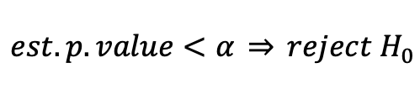


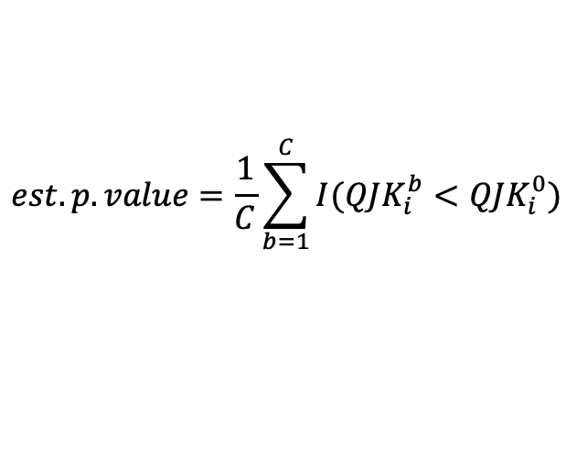



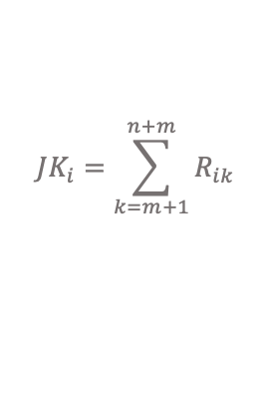


Permutated Jereckova-Kalina (PJK) Test
True: Same Distr.
True: Different Distr.
$$iid$$
$$iid$$
$$X_{1},…, X_{m} \sim F(ζ)$$
$$Y_{1},…, Y_{n}\sim G(ζ+μ)$$
$$H_{0}:μ=0 vs H_{1}:μ≠0$$
1. Randomly select X_{i}
2. Calculate l_{ik} - distance from X_{i} to Z
3. Calculate ranks R_{ik} (skipping X_{i})
4. Calculate ranks statistics
$$JK_{i}=\sum_{k=m+1}^{n+m}{R_{ik}}$$
5. Calculate p-value
$$QJK_{i}^{0}={Pr}_{H0}\left\{T_{JK}>JK_{i}\right\}$$
k | 1 | 2 | 3 | 4 | 5 | 6 | 7 | 8 | 9 | 10
l_{ik} | 1.6 | 0.0 | 0.7 | 0.5 | 0.7 | 1.0 | 1.5 | 1.1 | 0.6 | 0.7
R_{ik} | 9 |  | 4 | 1 | 3 | 6 | 8 | 7 | 2 | 5
k | 1 | 2 | 3 | 4 | 5 | 6 | 7 | 8 | 9 | 10
lik | 1.6 | 0.0 | 0.7 | 0.5 | 0.7 | 2.1 | 2.4 | 1.4 | 1.6 | 1.2
Rik | 7 |  | 3 | 1 | 2 | 8 | 9 | 5 | 6 | 4
6. Permutate l_{ik} a distance vector
Repeat C times
7. Calculate ranks R_{ik} statistics and p-value
k | 1 | 8 | 7 | 4 | 5 | 6 | 3 | 2 | 9 | 10
l_{ik} | 1.6 | 1.1 | 1.5 | 0.5 | 0.7 | 1.0 | 0.7 | 0.0 | 0.6 | 0.7
R_{ik} | 9 | 7 | 8 | 1 | 3 | 6 | 4 |  | 2 | 5
k | 1 | 8 | 7 | 4 | 5 | 6 | 3 | 2 | 9 | 10
lik | 1.6 | 1.4 | 2.4 | 0.5 | 0.7 | 2.1 | 0.7 | 0.0 | 1.6 | 1.2
Rik | 7 | 5 | 9 | 1 | 2 | 8 | 3 |  | 6 | 4
$$QJK_{i}^{b}={Pr}_{H0}\left\{T_{JK}>JK_{i}^{b}\right\}$$
8. Calculate p-value
JK₂*=20
JK₂*=23
$$est.p.value=\frac{1}{C}\sum_{b=1}^{C}{I(QJK_{i}^{b}<QJK_{i}^{0})}$$
Est. p-value ~ 0.492
Est. p-value ~ 0.056
9. Make decision: keep H0 or reject H0
p-value>0.05 keep H₀
p-value>0.05 keep H₀
$$est.p.value<α \underset{⇒}{} reject H_{0}$$

Slide 5
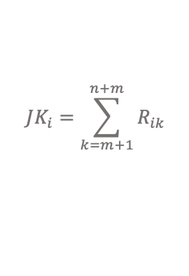






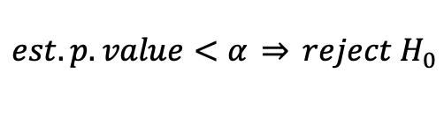

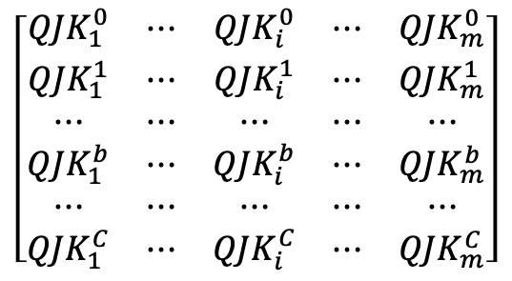


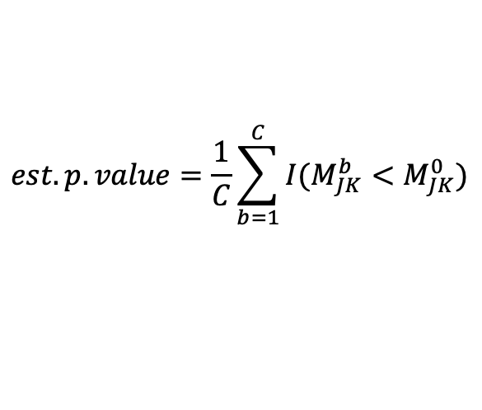
Using all X_{i}
$$iid$$
$$iid$$
p-value matrix:
$$X_{1},…, X_{m} \sim F(ζ)$$
$$Y_{1},…, Y_{n}\sim G(ζ+μ)$$
p-values calculated from X_{i} distances
$$H_{0}:μ=0 vs H_{1}:μ≠0$$
$$\left[\begin{matrix}QJK_{1}^{0} & ⋯ & QJK_{i}^{0} & ⋯ & QJK_{m}^{0} \\ QJK_{1}^{1} & ⋯ & QJK_{i}^{1} & ⋯ & QJK_{m}^{1} \\ ⋯ & ⋯ & ⋯ & ⋯ & ⋯ \\ QJK_{1}^{b} & ⋯ & QJK_{i}^{b} & ⋯ & QJK_{m}^{b} \\ ⋯ & ⋯ & ⋯ & ⋯ & ⋯ \\ QJK_{1}^{C} & ⋯ & QJK_{i}^{C} & ⋯ & QJK_{m}^{C}\end{matrix}\right]$$
Original order
1. Select X_{i}
2. Calculate l_{ik} - distance from X_{i} to Z
Perturbed order
3. Calculate ranks R_{ik} (skipping X_{i})
4. Calculate ranks statistics
$$JK_{i}=\sum_{k=m+1}^{n+m}{R_{ik}}$$
Repeat for all X_{i}
5. Calculate p-value
Mixing criterium:
$$QJK_{i}^{0}={Pr}_{H0}\left\{T_{JK}>JK_{i}\right\}$$
$$M_{JK}^{0}=M(QJK_{1}^{0},…,QJK_{m}^{0})$$
$$M_{JK}^{b}=M(QJK_{1}^{b},…,QJK_{m}^{b})$$
6. Permutate l_{ik} a distance vector
Estimate p-value:
$$est.p.value=\frac{1}{C}\sum_{b=1}^{C}{I(M_{JK}^{b}<M_{JK}^{0})}$$
Repeat C times
7. Calculate ranks R_{ik} , statistics and
p-value
Make decision: keep H0 or reject H0
$$QJK_{i}^{b}={Pr}_{H0}\left\{T_{JK}>JK_{i}^{b}\right\}$$
$$est.p.value<α \underset{⇒}{} reject H_{0}$$
Mixing functions: Median, Tippet (min)

Slide 6
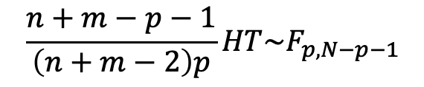






Hotelling Two-sample Test
$$iid$$
$$iid$$
$$X_{1},…, X_{m} \sim N_{p}(ζ,V)$$
$$Y_{1},…, Y_{n}\sim N_{p}(ζ+μ,V)$$
$$H_{0}:μ=0 vs H_{1}:μ≠0$$
Test statistic:
$$HT=\left(\overline{X}−\overline{Y}\right)V^{−1}\left(\overline{X}−\overline{Y}\right)$$
Test statistic has F distribution:
$$\frac{n+m−p−1}{\left(n+m−2\right)p}HT\sim F_{p, N−p−1}$$

Slide 7
MC Experiment
Normal Distribution
X_{ij}~Norm(0,1), Y_{ij}~Norm(mu,1)
p=2,4,18
n=m=10,30,50
mu=0.0,0.52,0.77,1.01
Cauchy Distribution
X_{ij}~Cauchy(0), Y_{ij}~ Cauchy(mu)
p=2,4,18
n=m=10,30,50
mu=0.0,1.95,3.25,5.45
N_{MC}=1000
C=250

Slide 8
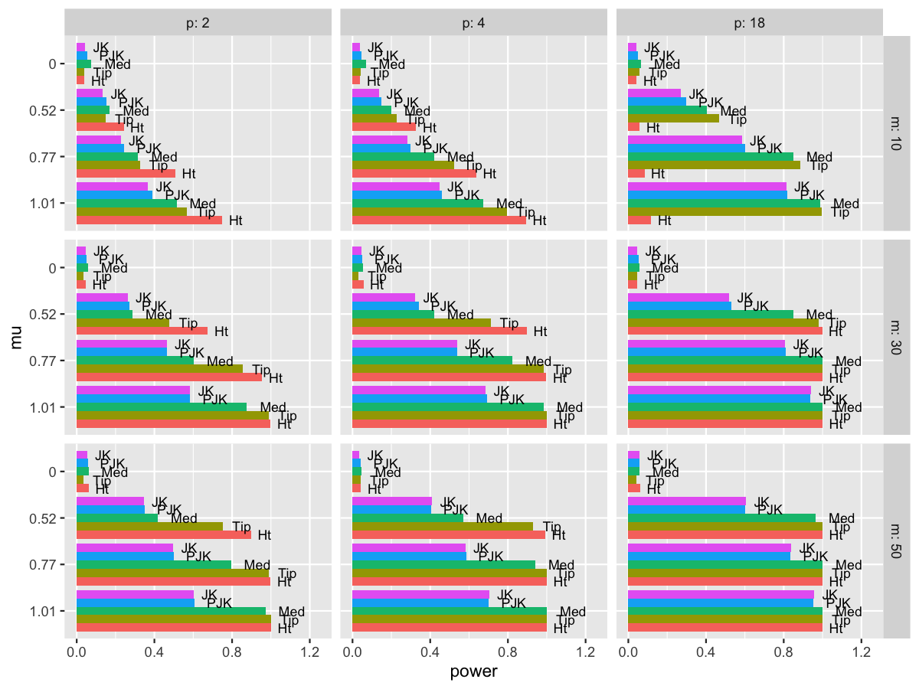

Results: Normal Distribution
$$Est. Pr⁡\{Reject H_{0}\}$$
mu | JK | PJK | Med | Tip | Ht
m=n=10 p=2
0.00 | 0.044 | 0.053 | 0.076 | 0.037 | 0.040
0.52 | 0.134 | 0.152 | 0.170 | 0.148 | 0.242
0.77 | 0.227 | 0.245 | 0.316 | 0.325 | 0.508
1.01 | 0.367 | 0.391 | 0.514 | 0.569 | 0.749
m=n=10 p=4
0.00 | 0.037 | 0.045 | 0.068 | 0.044 | 0.039
0.52 | 0.135 | 0.150 | 0.199 | 0.228 | 0.328
0.77 | 0.282 | 0.300 | 0.421 | 0.524 | 0.636
1.01 | 0.448 | 0.462 | 0.673 | 0.795 | 0.894
m=n=10 p=18
0.00 | 0.042 | 0.048 | 0.065 | 0.056 | 0.042
0.52 | 0.271 | 0.297 | 0.406 | 0.466 | 0.058
0.77 | 0.586 | 0.601 | 0.849 | 0.884 | 0.083
1.01 | 0.813 | 0.820 | 0.987 | 0.994 | 0.117

Slide 9
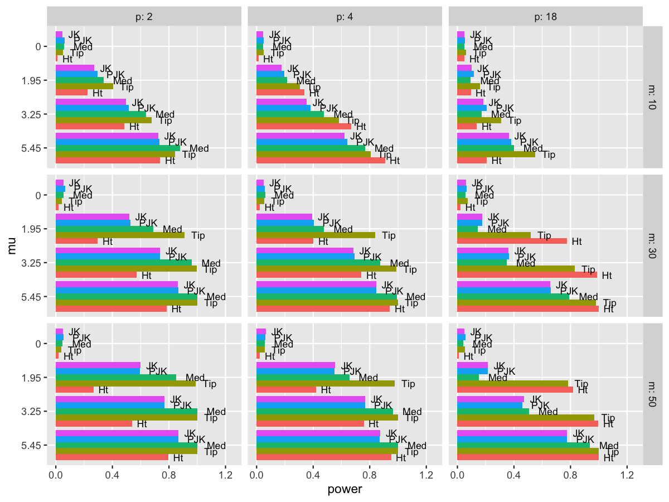
Results: Cauchy Distribution
$$Est. Pr⁡\{Reject H_{0}\}$$
mu | JK | PJK | Med | Tip | Ht
m=n=10 p=2
0.00 | 0.048 | 0.063 | 0.058 | 0.052 | 0.013
1.95 | 0.272 | 0.295 | 0.338 | 0.405 | 0.226
3.25 | 0.498 | 0.515 | 0.638 | 0.678 | 0.485
5.45 | 0.726 | 0.733 | 0.879 | 0.845 | 0.738
m=n=10 p=4
0.00 | 0.048 | 0.051 | 0.046 | 0.051 | 0.013
1.95 | 0.177 | 0.195 | 0.214 | 0.308 | 0.338
3.25 | 0.355 | 0.383 | 0.477 | 0.582 | 0.670
5.45 | 0.622 | 0.641 | 0.767 | 0.809 | 0.908
m=n=10 p=18
0.00 | 0.049 | 0.053 | 0.049 | 0.061 | 0.050
1.95 | 0.100 | 0.118 | 0.094 | 0.161 | 0.095
3.25 | 0.182 | 0.208 | 0.172 | 0.309 | 0.137
5.45 | 0.363 | 0.381 | 0.401 | 0.549 | 0.207

Slide 10
Conclusions
Extended Wilcoxon sum rank methods:
One-sided
Unbiased
Consistent
Methods can be applied for high dimensional data
Can be used on non-normal data
Usage of Tippet criterium significantly improves power
JK with Tippet criterium outperform Hotelling on small sized sample, especially with high dimentionality
For normally distributed data Hotelling test performs better on low dimensional, midsized samples
Enhanced JK methods are time-consuming
For Cauchy distribution enhanced JK methods often outperform Hotelling test
References
Jana Jurečková and Jan Kalina. Nonparametric multivariate rank tests and their unbiasedness. Bernoulli. Volume 18, Number 1 (2012), 229-251.
Marco Marozzi Multivariate tests based on interpoint distances with application to magnetic resonance imaging. Statistical Methods in Medical Research. 2016;25(6):2593-2610.

