Slide 1
BusNama Online Bus Reservation System
Team: SAMARPAN
Members:
Aditi Singh
Anshu Kumar
Mohammad Masharib Hussain
Vikas Singh

Slide 2
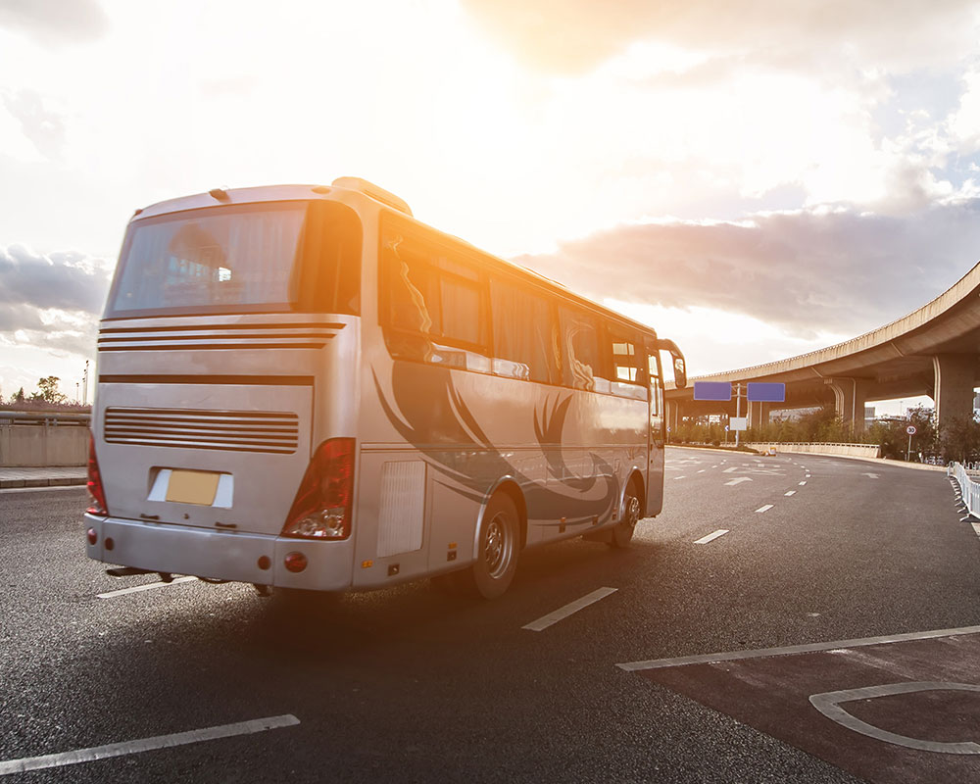
Objective
BusNama is created to meet the needs of online bus reservation system, with 2 actors:
Admin: Add a new bus, view all buses, cancel/ delete an existing bus
Customer: Make a booking, view existing bookings, cancel an existing booking

Slide 3
Technology Stack
Presentation Layer:
NodeJS 10.16.3 (Javascript Runtime Environment)
Angular 6 (framework to develop web apps)
VSCode 1.39 (to develop front end)
2. Business Layer:
Java 8 (base programming language)
Postman 7.9.0 (for running RESTful service)
Spring framework (for creating webservices)
Spring Boot 2.1.9 (auto configuring)
3. Persistence Layer:
Hibernate 2.1 (JPA implementation)
Spring Data 2.1.9 (performing repository ops)
MySQL 5.5.1 7(database storage)
4. Cross Cutting Concern:
Spring Security & JWT 2.1.9 (access restriction)
5. DevOps:
GIT 2.23.0 (VCS tool)
Maven 3.6.1 (Build & manage project)
6. Cloud Services:
AWS (collection of cloud services)
7. Containerize OS:
Docker 18.06.1 (to containerize OS)
8. Hardware and Software Requirements:
Windows 10, RAM 2GB, I.E 7+ or Google Chrome, Memory Space: 500MB.

Slide 4
Micro-Services
Bus Service: Insert a new bus, cancel or delete an existing bus
User Service: Register a new account and login (as a customer) and login (as the admin)
Booking Service: Create a new booking, cancel an existing booking, download ticket
Search and View Service: View customers (as the admin), view all buses (as the admin), explore buses (as a customer), view existing bookings, view booking details
Payment Service: Make a payment for the booked tickets after validating credentials
Feedback Service: Provide rating and feedback (as a customer)

Slide 5
Scope of the Project:
Design and implementation of online bus reservation system
A customer can view different buses after entering the boarding and arrival locations, which can be filtered and sorted on various bases.
All the mentioned micro-services will be integrated together with the help of a Eureka Server.
The user can give his ratings and feedback on a separate page.
There will be a page dedicated to contacting the website owner.

Slide 6
Outside the scope of the Project:
Providing the facility to link bank account to initiate and refund transaction in booking and cancelling of tickets.
Sending message or OTP regarding the details of the booking done to the customer's phone number.
Actual transaction of money to and from the user’s bank account.

Slide 7
Future Work:
Social Media Integration
Cloud Services with AWS
Using Docker to containerize the OS

Slide 8


