Slide 1

Capstone 2: Artificially Intelligent Hand Sign Recognition Using Computer Vision Systems
Shrey Raval – 100730265
Jigar Patel – 100730261
Nikhil Singh – 100766644
Tarunjot Singh - 100766653
https://github.com/nsinghbanga/Capstone

Slide 2
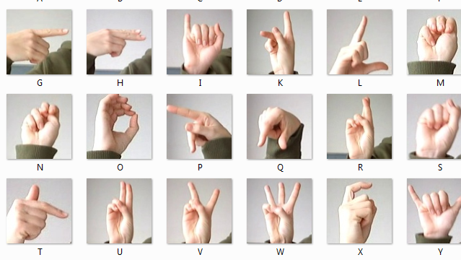
Abstract

Slide 3
Libraries & Datasets
MNIST
Numpy
Pandas
Tensorflow
Matplotlib

Slide 4
Model Architecture

Slide 5
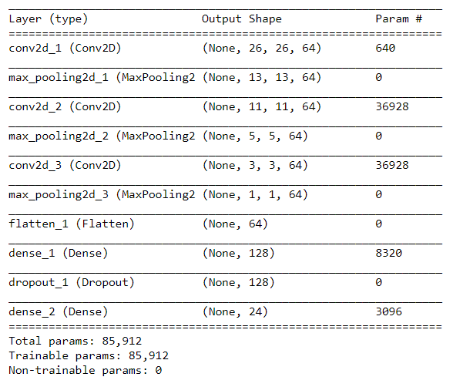
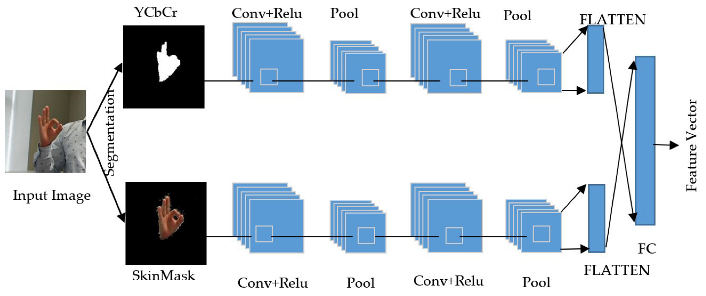
Convolutional Neural Network

Slide 6
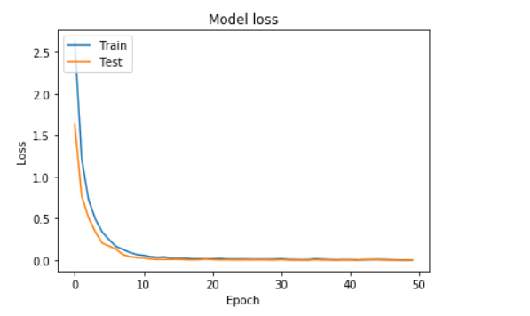
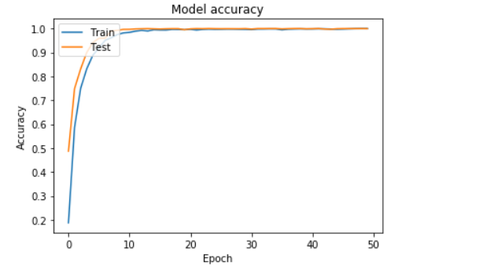
CNN Outputs

Slide 7
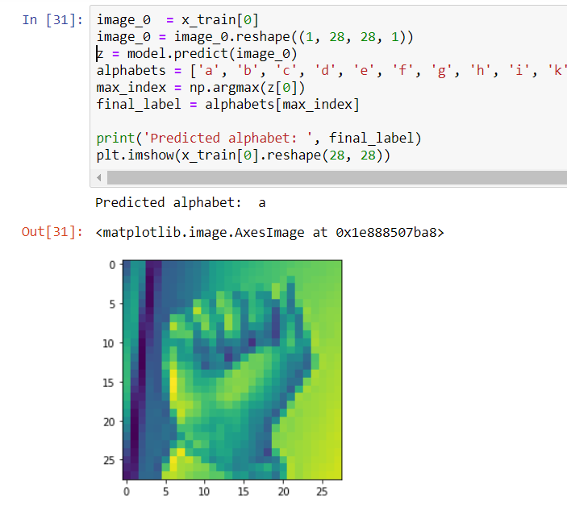
CNN Model Prediction

Slide 8
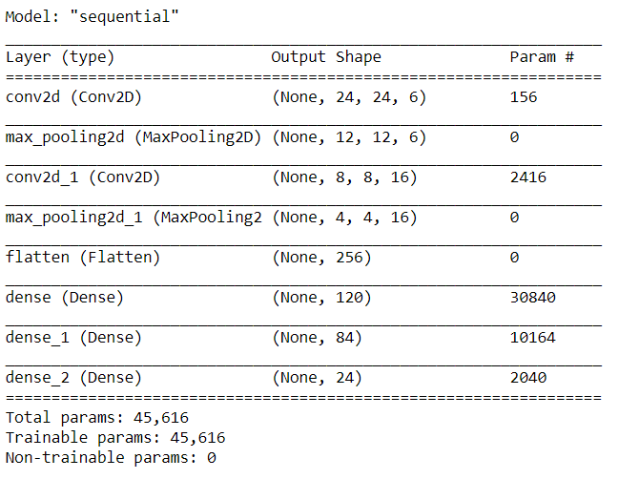
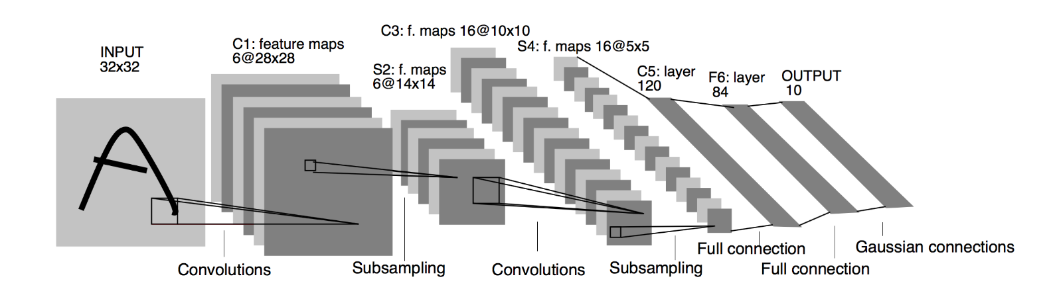
LeNet-5

Slide 9
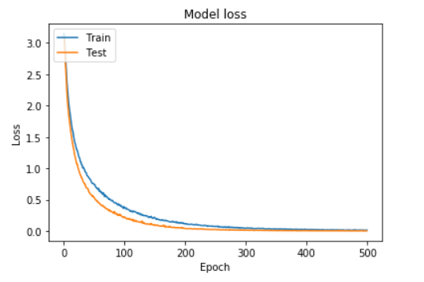
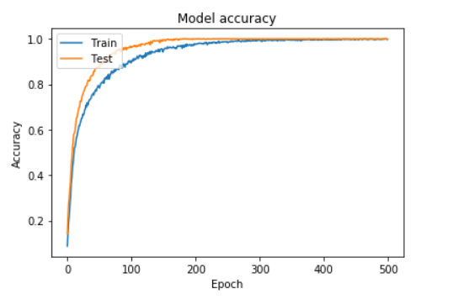
LeNet-5 Outputs

Slide 10
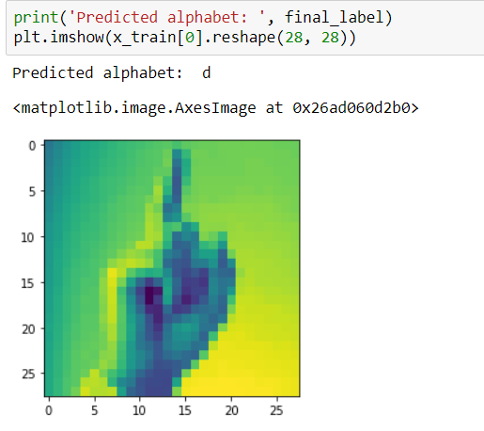
LeNet-5 Model Prediction

Slide 11
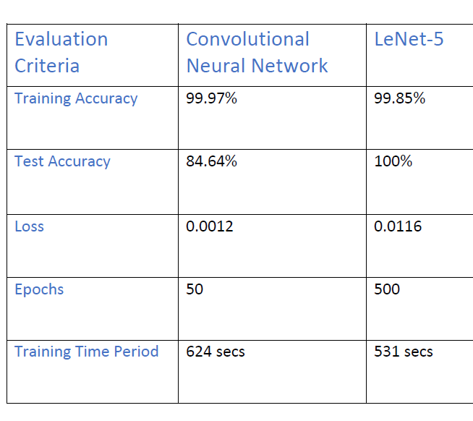
Final Evaluation Criteria

Slide 12
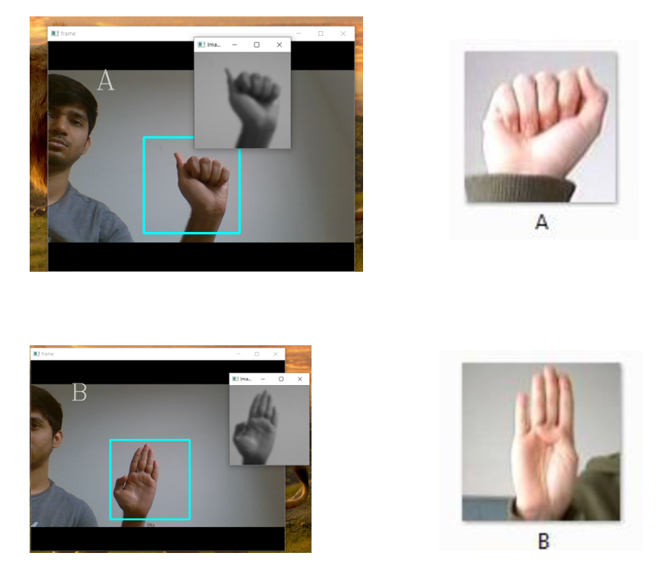
Real-time Implementation

Slide 13
Questions?

Slide 14
Thank you

