Slide 1
MuscleHub A/B Test
Results of the test
Nihal Singh Singh

Slide 2
The test
Prospective members were divided into two groups
A: Had a fitness test before filling the application
B: Skipped the fitness test
The test was done to see if the fitness test intimidated people
5400 people took part in this test

Slide 3
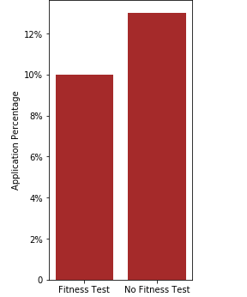
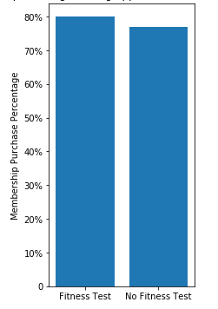
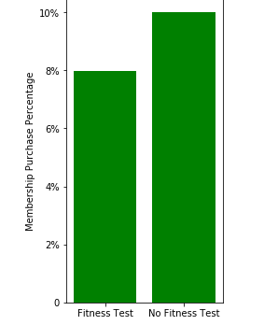
Analysis
The people in the B category was more likely to fill an application
After both groups filled their application their chances to become members were the same
Since B is more likely to fill an application, they are also more likely to become members

Slide 4
Result
For this I used. The Chi Square Test is optimal for comparing choices between different groups
The hypothesis of prospective members being intimidated by the fitness test has been confirmed

Slide 5
Summary
Visitors found the training too intense and ended up getting a bad impression of the gym
The visitors wanted to train at their own pace.
For the majority is B the better option since they can decide the amount of training themselves

Slide 6
Recommendations
Since A has been proven to be worse, I would suggest to make B the default option and A an option for people who want it.

