Slide 1
Operating Systems: What and Why

Slide 2
Agenda
Recap
What is an operating system
Why is it important
Summary of OS functionalities
Basics of UNIX OS
System calls
Path of a system call
User interfaces
System boot sequence

Slide 3
Recap
What do we know about computing systems
How to express algorithms in a programming language (ESC101)
How to design basic digital logic blocks (ESC102)
Design of algorithms (ESO207)
How to use the basic digital logic blocks to design simple computers (CS220)
For example, using adders, shifters, and other basic logic blocks, one can design an arithmetic logic unit (ALU)

Slide 4
What is an operating system
A piece of software application
Resource manager of any computing system
Schedules resources like CPU, memory, hard disks, and other I/O devices
Virtualizes the resources so that
a programmer does not have to worry about the low-level details of a physical resource
presents a virtual interface of the resource to the user

Slide 5
Why is it important
Let’s assume that we have a minimal hardware implementing some abstract instruction set architecture
Peripheral devices consist of memory, hard disk, keyboard, and a display
We have a simple problem to solve: add the elements of a vector and print the result on the display device
Let’s assume that somebody has written the program to solve it and prepared the binary image of the executable

Slide 6
Why is it important
Q1: How do I store the binary image on hard disk? Why is it important to store it on hard disk?
Learn to program the disk controller manually and write a stream of bytes (how?)
Q2: What if there isn’t enough contiguous space on disk? Is contiguous space necessary?
Learn to create this space (de-fragment)
Q3: How do I load the binary image on memory? Why is it necessary? What if memory is small?
Learn to program the memory controller manually; read from disk and write to memory

Slide 7
Why is it important
Q4: How to start executing the executable?
Learn to load the program counter with the address of the first instruction of the executable
This is a sequence of instructions (how?)
Q5: How to read the vector size from keyboard?
The program must handle keyboard interrupts

Slide 8
Why is it important
Q6: How to allocate memory for the vector?
The program must create enough memory space before the allocation
Q7: What if the vector size is larger than memory?
The program must check for this condition, divide the vector in portions, implement a swapping procedure, and operate only on portions that are in memory

Slide 9
Why is it important
Q8: How is the final result displayed?
The program must send the final result to the display device and command it to display the communicated characters
Q9: How does the program terminate?
A special instruction at the end can lead the CPU to an “idle” state

Slide 10
Why is it important
The example shows several interactions with the hardware that the user program has to take care of: write to disk, read from disk, memory and disk management, read from keyboard, write to display, control start/stop sequence on CPU
Shows the importance virtualizing disk and keyboard (as files?), memory, and CPU
Very poor utilization of the CPU
CPU is idle when swapping between disk and memory or reading from keyboard or writing to display

Slide 11
Why is it important
Q10: Is it possible to run multiple programs in a time-shared fashion? Also known as multi-tasking or multi-programming
A program before going on a long-latency event must save state in memory, restore saved state of another program, load it from disk, and start it from where it left off
Each program sees a virtual CPU
How to manage memory of multiple programs?
Each program sees a virtual view of the memory
Q11: What if there are many programs to select from?
Must invoke a “scheduling algorithm”

Slide 12
Why is it important
The addition of vector elements now begins to look really complicated
The programmer needs to take care of too many things that have no relation to the actual problem
After working with this system for a while, you realize that the disk contents should be organized in a better way
Related information should be grouped in a class (call it a directory) and each class may have subclasses

Slide 13
Why is it important
Q12: How to represent directories and subdirectories on a disk?
Call each independent entity on the disk a file. Directories are also files. Need to implement all necessary functionalities of a “file system” e.g., creating a file, reading from a file, writing to file, etc.
Notice that all these have to be handled by the end-user’s program which wishes to use the capabilities of the file system

Slide 14
Why is it important
One day you find that one program has overwritten the data belonging to another program in memory due to a wrong address in the former program
Q13: How to protect a program’s code and data from unintentional/intentional bugs/attacks?
Every program must incorporate an elaborate security solution
Every program’s memory must be isolated

Slide 15
Why is it important
Every program needs to do a common set of things
Read from keyboard
Write to display
Read from and write to disk
Manage disk
Manage memory
Switch between programs or “jobs”
Select jobs for scheduling
Protect program code and data

Slide 16
Why is it important
Back to the basic: pack commonly used functionalities in a library
Call the appropriate function from the library whenever needed
Still looks cumbersome: why should a programmer implement these calls?
Observation: every program is a marriage of computation and these “system library calls”
An operating system implements these system calls and takes over whenever such a service is needed by a running job
The C standard library is a wrapper around these system calls

Slide 17
Design goals of OS
Efficient virtualization of physical resources
Efficient support for correct handling of concurrent execution
Efficient file system for persistent storage
Appropriate abstraction for each resource to make it easy to use
Efficient means high-performance and low overhead in terms of space, time, energy
Protection, isolation, security
Reliability and failure-freedom
Support for mobile devices

Slide 18
Summary of OS functionalities
Two broad categories
Functionalities to improve performance
Job scheduling, context switch, memory management
Functionalities to improve ease of use
File systems, I/O, security
Two modes of operations
User mode and kernel mode
A system call from a user program leads to a switch to kernel mode
Kernel mode allows unrestricted access to hardware including execution of privileged instructions

Slide 19
Summary of OS functionalities
Two modes of operations
User mode avoids catastrophic failures
Isolated virtual address space for each process in user mode
Isolated execution of each process
No direct access to any hardware device
CPU needs to support a mode bit as part of the machine status word or processor status word
Switching modes is expensive
Needs to save and restore user and kernel register states

Slide 20
Summary of OS functionalities
System boots up in kernel mode
Kernel of the OS is loaded by the bootstrap loader from a fixed location in the disk
Only when a user program is scheduled to run on the CPU, does the mode bit switch to user mode
System calls invoke system call handlers
Locations of the handlers are found in an interrupt vector table residing in the low memory
Hardware interrupts are handled in the same way
System call arguments are passed in registers and/or in memory (by passing a pointer in a register); what are these arguments?

Slide 21
Summary of OS functionalities
OS does several book-keeping tasks periodically
Job scheduling is an important example
Implemented by setting up a timer register which is decremented on every processor clock tick
When the timer register expires, a hardware interrupt is generated
The interrupt handler services the periodic tasks one by one and sets up the timer register again

Slide 22
Summary of OS functionalities
Four basic OS modules
Process management, memory management, storage management, protection
Process management involves
Creation, deletion, scheduling of processes
Offering support for communication between processes
Synchronizing communicating processes
Handling deadlocks
Memory management involves
Handling memory allocation and de-allocation requests from user and kernel mode processes

Slide 23
Summary of OS functionalities
Four basic OS modules
Storage management involves
Implementing a virtual environment called file system
Protection cross-cuts all the three modules
Controls accesses to the resources managed by the OS
Usually the OS kernel is assumed to be trusted
A stricter protection model requires hardware-supported security

Slide 24
Basics of the UNIX OS
Bit of history
1965: Bell Telephone Labs, General Electric Company, and MIT join hands to build Multics (multiplexed information and computing service)
http://www.multicians.org/
1969: Early version of Multics runs on GE 645; Bell Labs terminate participation
1970: Honeywell takes over GE along with Multics
1969-1971: Ken Thompson and Dennis Ritchie of Bell Labs implement a minimal OS in Fortran on a PDP-7 machine, which was later migrated to a PDP-11
Brian Kernighan names it UNIX, a pun on the name Multics
1973: UNIX gets rewritten in C (which grew out of B)

Slide 25
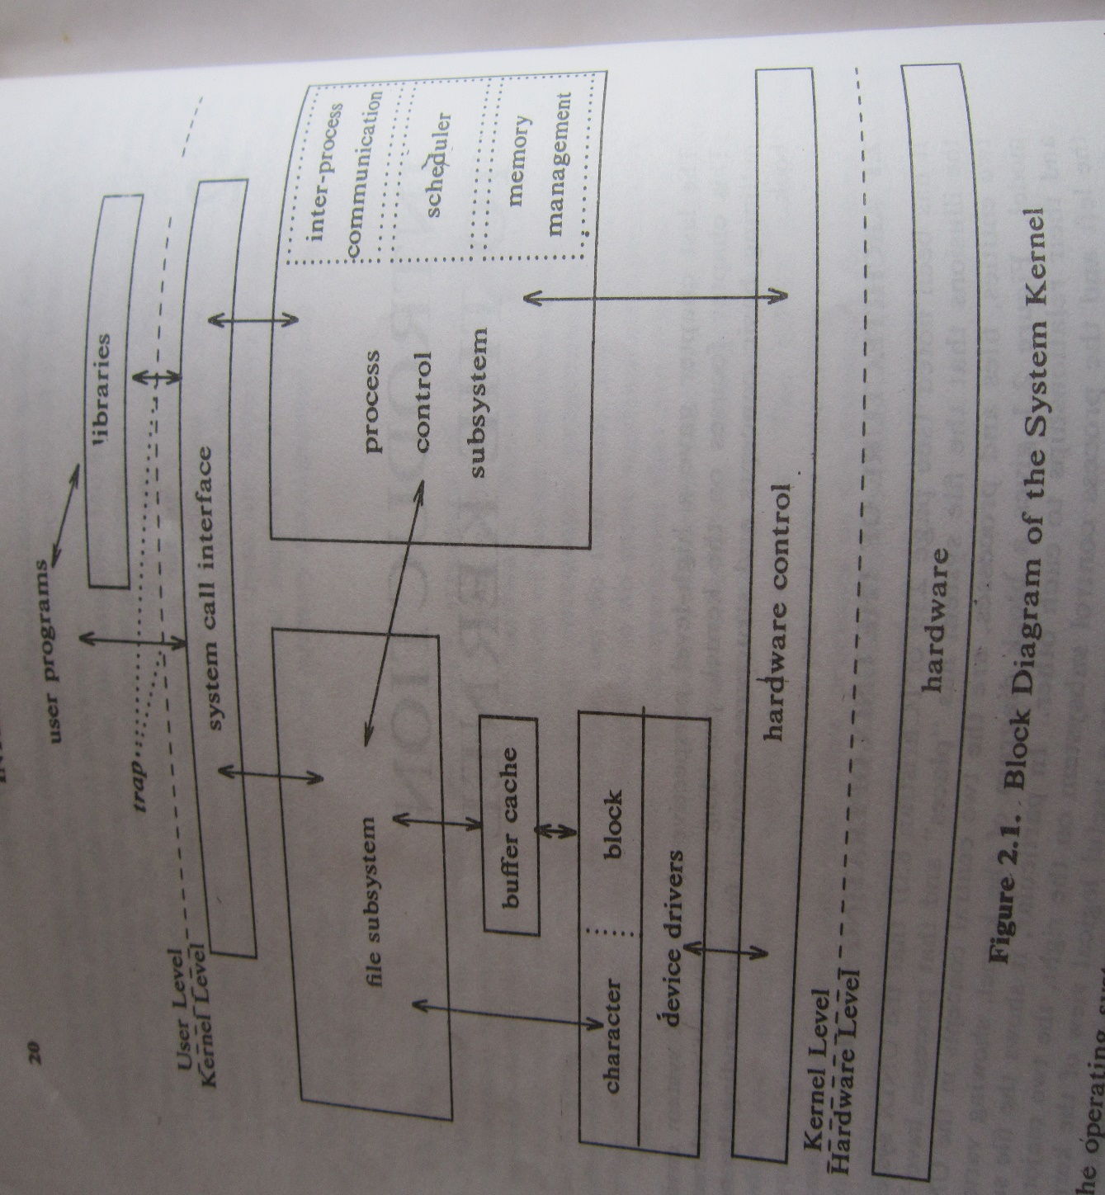
Basics of the UNIX OS
Reproduced from “The Design of the UNIX OS” by M J Bach

Slide 26
Basics of the UNIX OS
Two major parts
The OS kernel
Auxiliary system applications such as the shell command interpreter, the editors such as “vi”, etc.
UNIX kernel talks to the system and user applications through the system call layer
Two major sets of system calls: process control and file system
The process control layer implements inter-process communication, scheduling, and memory management

Slide 27
Basics of the UNIX OS: File system
Every I/O device is treated as a file
Keyboard is treated as a special file called the standard input
Display device is standard output
File system interacts with two types of I/O devices
Block device: transfers a block of data between the device and the kernel e.g., hard disk
Character device: communicates through a stream of bytes e.g., keyboard, display, etc.

Slide 28
Basics of the UNIX OS: File system
Block devices
Accessed through a buffer cache to exploit spatial locality
Seen by the kernel as random access storage devices even though physically they may not be
Character devices
Directly talk to the kernel without any caching
Even though the OS abstraction for a device is a file, every device needs a device driver to implement the hardware protocols

Slide 29
Basics of the UNIX OS: File system
Files are maintained using a data structure called index node (inode for short) table
Each file has one inode
Each inode stores the disk layout of the file data and other information such as file owner, access permissions, access times, etc.
On a file system call specifying a file name, the file name is translated to the corresponding inode
Maintains two more tables to do this: user file descriptor table (UFDT) and kernel file table (FT)

Slide 30
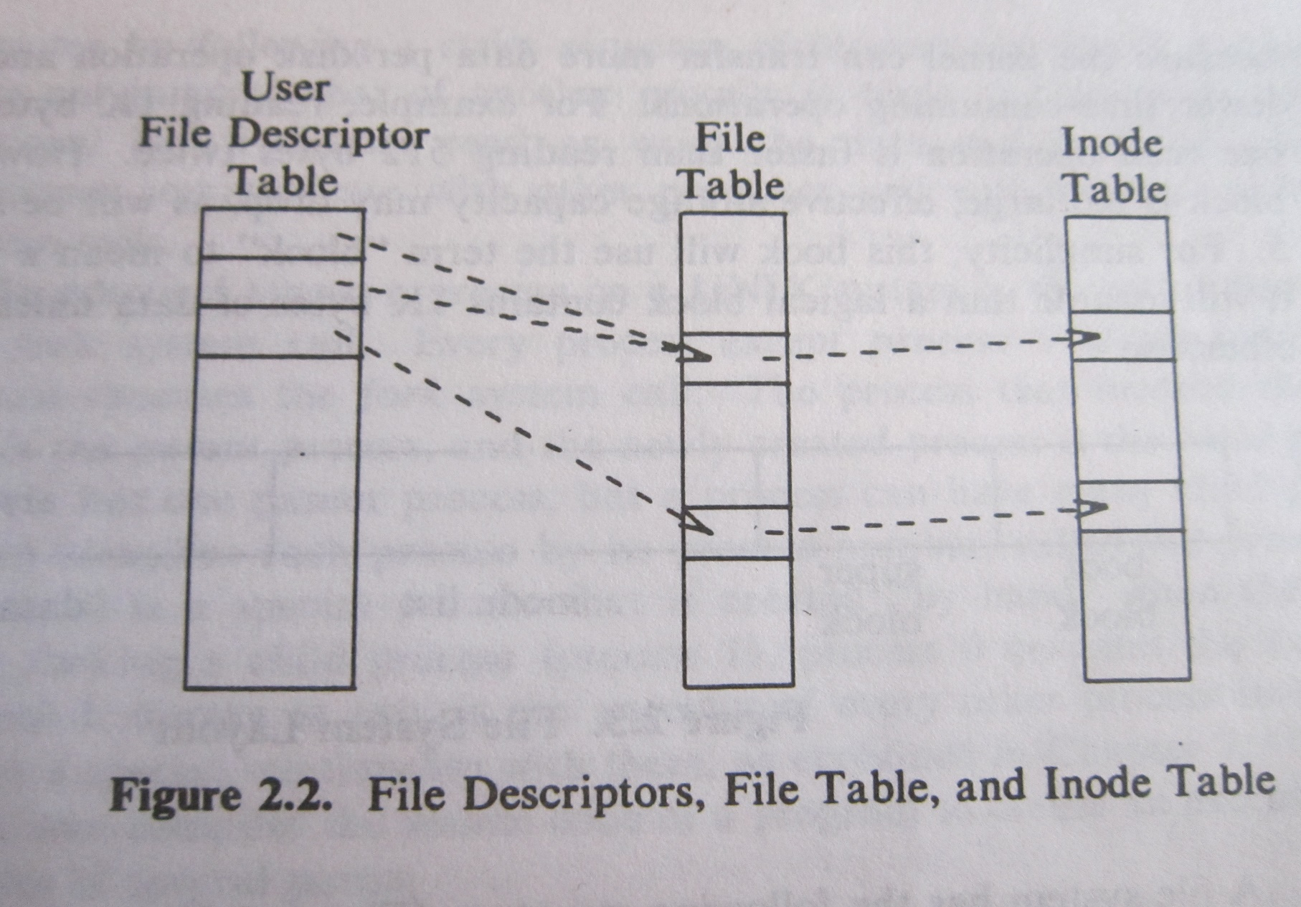
Basics of the UNIX OS: File system
Reproduced from “The Design of the UNIX OS” by M J Bach

Slide 31
Basics of the UNIX OS: File system
UFDT and FT
The UFDT maintains one entry for each open file of a process; each process has its own UFDT
The UFDT entry holds a pointer to the corresponding FT entry; two UFDT entries may point to the same FT entry (same file opened twice)
The open or creat call returns the index of the UFDT slot allocated to the file
Referred to as a file descriptor
Each FT entry stores the read/write byte offset into a file, access permissions, a unique pointer to the file inode; the FT is shared across all processes

Slide 32
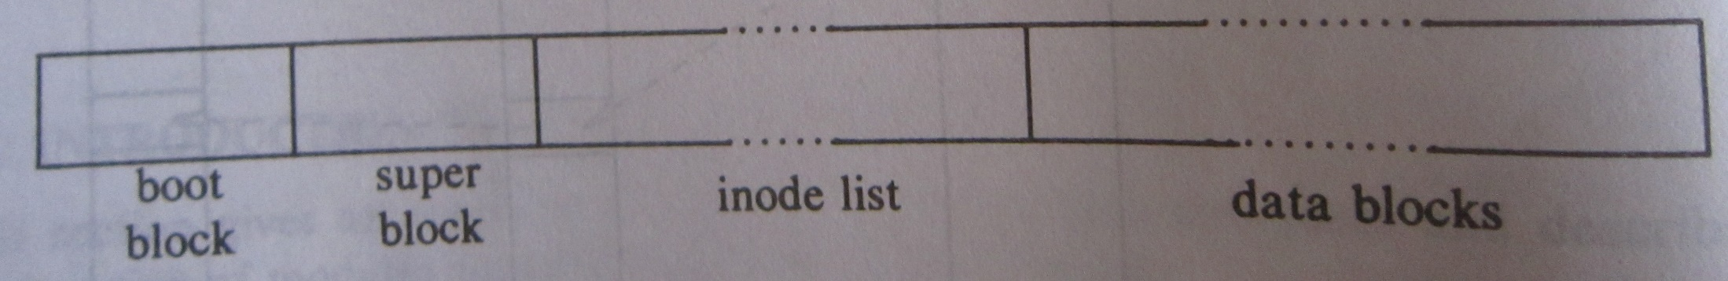
Basics of the UNIX OS: File system
File systems are kept on the block devices
Kernel remains oblivious to the physical block device addresses
The translation from the logical file system layout to the physical addresses is done by the device driver
Kernel treats the file system as a sequence of logical blocks, each of size multiple of 512 bytes
A file system starts with a boot block followed by a superblock, the inode list, and the data blocks
Reproduced from “The Design of the UNIX OS” by M J Bach

Slide 33
Basics of the UNIX OS: File system
File system
Boot block resides in the first sector and contains the bootstrap loader
Superblock describes the state of the file system: how large it is, how many files it can store, free list information, etc.
Inode list size is configured by the admin when building the kernel
Inode table contains the indices into the inode list
Root inode is used as the root of the directory system
An allocated data block can belong to exactly one file

Slide 34
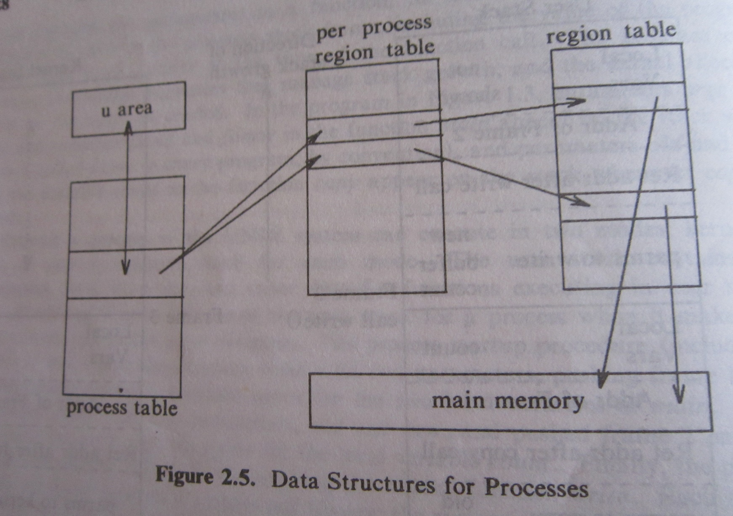
Basics of the UNIX OS: Process control
Reproduced from “The Design of the UNIX OS” by M J Bach

Slide 35
Basics of the UNIX OS: Process control
Kernel process table entry for each process and u area to store process information manipulated by kernel only
Each process table entry points to a per process region table and each per process region table entry points to a global region table
A region is a contiguous memory segment containing process text, data, stack
A global region table entry contains region attributes such as text/data, private/shared, and the starting address of the region

Slide 36
Basics of the UNIX OS: Process control
The u area contains information necessary to completely describe a process; kernel can directly access the u area of the currently executing process only; the u area contains
A pointer to the kernel process table slot of the currently executing process
Parameters, return values, and error codes of the last executed system call of the currently executing process
File descriptors of all open files of the currently executing process
Current directory and current root of the file system
Process and file size limits

Slide 37
Basics of the UNIX OS: Process control
The context of a process is its complete state including
Text (code)
Values of global user variables and data structures
Values of processor registers
Contents of its kernel process table slot and u area
Contents of its user mode stack and kernel mode stack

Slide 38
Basics of the UNIX OS: Process control
A process undergoes several state transitions from creation to termination
The kernel process table entry maintains the process state, user id of the owner, and an event descriptor if the process is in sleep state
A process undergoes a context switch on I/O or hardware interrupt or timer interrupt
Not all system calls cause a context switch
All system calls cause a mode switch
Context switch code or system call code executes in the context of the currently scheduled process
A mode switch changes the stack frame top pointer to user mode or kernel mode stack top depending on the direction of the switch

Slide 39
Basics of the UNIX OS: Process control
Three important system calls for process management
execv, fork, wait
An execv call from a user program executes a new program, starting address of which is passed to the call; does not create a new process
Overlays new text, data, stack regions on top of the old regions, sets up the region table pointers correctly
A fork call creates a new process (called the child process)
Kernel duplicates the address space for the child from the parent by copying or sharing depending on the situation

Slide 40
Basics of the UNIX OS: Process control
A process is always created by another process
Created process is the child of the creating process
The system boots up as a process
init process in UNIX
This is the root of all processes
Every process gets a unique integer ID known as the process ID or pid. The root process has pid zero.
In UNIX, the system boot process has pid zero and init has pid one.

Slide 41
Basics of the UNIX OS: Process control
The processes form a tree
The root of this tree in UNIX is init
The system boot process is killed after init is created
The pstree command shows the process tree in UNIX (pstree –p shows the pid also)
The pgrep processname command shows the pid of a process
pgrep init returns 1
To find the parent pid of a process with pid x
Check the fourth entry in file /proc/x/stat on UNIX
In a C program, you can use getppid()

Slide 42
Basics of the UNIX OS: Process control
A process can be created by calling fork()
Child pid is returned to parent, zero is returned to child. A negative return value indicates error in UNIX.
When the fork() call returns
The child process has been created
Its text and global data are loaded in memory
The process will start executing when it is scheduled
Since the child process gets an exact copy of the address space and registers of the parent, it starts executing at the instruction that returns from fork()
This is the value of the program counter in the parent
The only difference between the parent and the child is in the return value of the fork() call

Slide 43
Basics of the UNIX OS: Process control
The wait() system call makes a process wait for any one of its children to complete
It is a good practice to wait for all the children that a process has created
Can be programmed using a loop which runs number of times equal to the number of children
Each loop iteration makes one call to wait()
The wait() call takes one argument which is a pointer to the exit code of a completing child process
Can be passed NULL if we do not need the exit code of a child process

Slide 44
Basics of the UNIX OS: Process control
The waitpid() system call makes a process wait for the child with a specific pid
Takes three arguments: pid, exit code pointer, an option
First argument can be -1 if any child is waited for
The last argument is usually 0
waitpid(-1, &status, 0) is equivalent to wait(&status)
A useful value for the last argument of waitpid is WNOHANG
Allows the parent to return immediately irrespective of whether the child waited for has completed or not

Slide 45
Basics of the UNIX OS: Process control
The pipe() system call creates a communication channel with a write end and a read end
The ends of a pipe are implemented using a pair of file descriptors corresponding to a “common” file
A process can write to one end and read what it has written from the other end
Not very interesting for a process to do so
Gets interesting when one process writes to one end of the pipe and another process reads from the other end
The pipe() call takes an array of two file descriptors as argument
On return, the array is filled up appropriately by OS

Slide 46
Basics of the UNIX OS
External hardware interrupts
OS may delay handling these if currently in the kernel mode depending on the criticality of the code being executed
Every interrupt has a priority level
To mask an interrupt, the processor execution priority level is raised above the priority level of the interrupt
For example, before manipulating the inode list, the processor priority level is raised above the disk interrupt priority level
Typical interrupt priority (low to high): software interrupts (system calls), character devices, network, disk, timer, machine error

Slide 47
System calls
General mechanism of virtualizing a physical resource
Map virtual entities on to the physical resource in a time-shared manner
Swap out a virtual entity to make room for another virtual entity
Needed only if the physical resource is exhausted
Swap in the new virtual entity to occupy (portion of) the physical resource
Example: physical resource CPU is time-shared between virtual entities named “processes”
Example: physical resource memory is time-shared between virtual entities named “address spaces”

Slide 48
System calls
General goals of CPU virtualization
Performance: a process should be able to run at native CPU speed with minimum OS interference
OS control: periodically/occasionally the OS should be able to get control over what the CPU does
The two goals have somewhat contradictory demands
A middle ground is possible meaning that some OS interference must be tolerated
System calls play an important role in letting the OS control what other resources the CPU can access

Slide 49
System calls
OS defines a set of restricted operations
Usually involves accessing some other resource such as an I/O device, or allocating some resource such as memory, etc.
OS would like to check whether such an operation is legitimate before letting the currently running process do it
A process normally runs in user mode
Can do everything except any of the restricted operations
A process must switch to kernel mode to do a restricted operation

Slide 50
System calls
How does a process switch between user and kernel modes?
By executing a system call instruction (known as ecall in RISC-V ISA) a user mode to kernel mode switch can be achieved
Sometimes it is wrongly referred to as a trap instruction
Actually, there is no trap instruction; instead, trap is a mechanism for the CPU to transfer control to the OS
Trapping the process in a small cage to do the required restricted operation only and nothing else
A special return instruction (sret in RISC-V) switches the mode from kernel to user

Slide 51
System calls
Steps involved in handling a trap
Must be transparent to the currently running process
Switch mode to kernel
Trap handler saves registers and other necessary states on kernel stack so that the running process can be resumed correctly after returning from trap
Handle system call (invokes a system call handler routine)
Restore registers and other states from kernel stack
Return from trap (switches mode and stack to user)
A newly created process also switches to user mode through the return from trap instruction

Slide 52
System calls
How to locate the trap handler entry point?
The system call instruction jumps to a location stored in a privileged register (written using privileged inst.)
In RISC-V, this is the stvec register
Supervisor trap vector base address register
In other architectures, this may come in the form of a table or a vector
Depending on the cause of the trap, a particular entry in the vector is used as the jump address
The stvec register or the trap table is set up by the OS kernel as part of the boot code
Recall that a machine boots up in kernel mode and therefore, the boot process can do privileged operations

Slide 53
System calls
System calls have a lot of resemblance with function calls
The arguments of a system call are usually passed in the same registers used to pass function arguments
The return value of a system call uses the same register used for returning value from functions
There is a reason behind this resemblance
System calls are usually wrapped around by library functions e.g., system call to write to a file would be part of the fprintf function’s code
Keeping the same calling convention for syscalls and functions makes it easy to pass arguments and return results

Slide 54
System calls
How to distinguish between different system calls?
Memory allocation, file read, file write, sleep, exit, fork, execv, wait, etc.
To distinguish among these, a system call instruction has a special argument called the system call number
Different system calls have different numbers
The basic xv6 kernel has 21 system calls exposed to user programs
Each system call is exposed to user programs through one or a group of wrapper functions
For example, fopen() is a wrapper around the open syscall

Slide 55
Path of a system call
Assume the RISC-V UNIX like platform
RISC-V system call convention (integer args)
System call arguments are passed in registers 10, 11, …, 16 (aka a0 to a6; same as function call args)
System call number is passed in register 17 (aka a7)
No system call has more than six args; so a6 is not used
System call return value is in registers a0 and a1
Only a0 will be used in xv6
System call instruction in RISC-V is ecall
Consider the read system call for reading from a file
C library calls read, fscanf, scanf, etc. all lead to this system call

Slide 56
Path of a system call
The read system call
Three arguments: file descriptor (in register a0), destination memory buffer address (in register a1), number of bytes to read (in register a2)
These registers should be set up before the syscall instruction executes
The ecall instruction stops instruction fetching, waits for all pending instructions to complete, does a mode switch, invokes the appropriate system call handler after examining register a7

Slide 57
Path of a system call
The read system call handler
If the file descriptor is bigger than two, various permission checks are done in the GFT and the UFDT
The inode is accessed and the data bytes are read from either the buffer cache or the disk if the file descriptor is bigger than 2; otherwise the bytes are read from the character device
The data bytes are written to the memory buffer by setting up a DMA depending on the device driver interface
After initiating the DMA, a context switch can take place
The system call returns the number of bytes read

Slide 58
Path of another system call
Consider the open system call
Used to open a file
Takes two arguments: file name (pointer in register a0), access flags and permission mode flags if the file is to be created (in register a1)
The system call handler allocates a free file descriptor by looking up the UFDT and GFT, sets the permission bits in the allocated entry according to the flags, retrieves the inode and puts it in the inode cache
The normal return value of the system call is the allocated file descriptor id

Slide 59
Path of yet another system call
Consider the exit system call
Every program on termination invokes this system call
In C programs after the main function returns, the exit system call gets invoked
Takes one argument: the exit code (in register a0)
The system call handler deletes the calling process
An example of a system call belonging to the process management subsystem

Slide 60
User interfaces
Two types: command line interface and graphical user interface (GUI)
Command line interface is provided by a shell program or a command line interpreter
The shell can be implemented in two ways
A command line parser interprets the user’s command and executes it (MS-DOS style)
A command line interface program only checks if the command exists, forks a child, and passes the command line to the child for execution (mostly used today)
The fork model allows background and concurrent execution of commands
A GUI usually involves a large number of system calls

Slide 61
A skeleton shell
while (1) {
// read command into character array buf[][]
if (buf[0] is “exit”) break;
else if (program with name equal to buf[0] exists) { if (fork() == 0) execv (buf[0], buf);
else {
if (last character in buf is not `&’) wait(NULL);
}
} else printf(“%s: command not found.\n”,buf[0]);
}

Slide 62
System boot sequence
Boot sequence involves the following steps
Run diagnostic codes from a ROM or EEPROM
Load the bootstrap loader from the boot block
The bootstrap loader loads the necessary parts of the kernel
The bootstrap loader can be changed easily by modifying the boot block only
A boot disk or a system disk contains the bootstrap loader

