Slide 1

Topic Modeling on Medium Articles
Nimesh Sinha

Slide 2
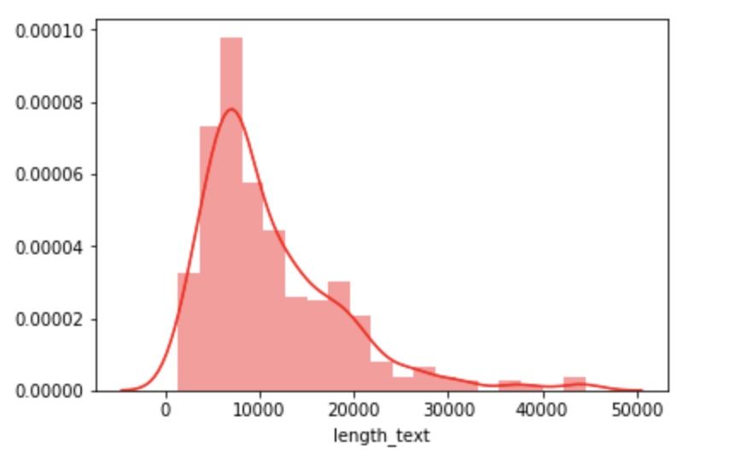
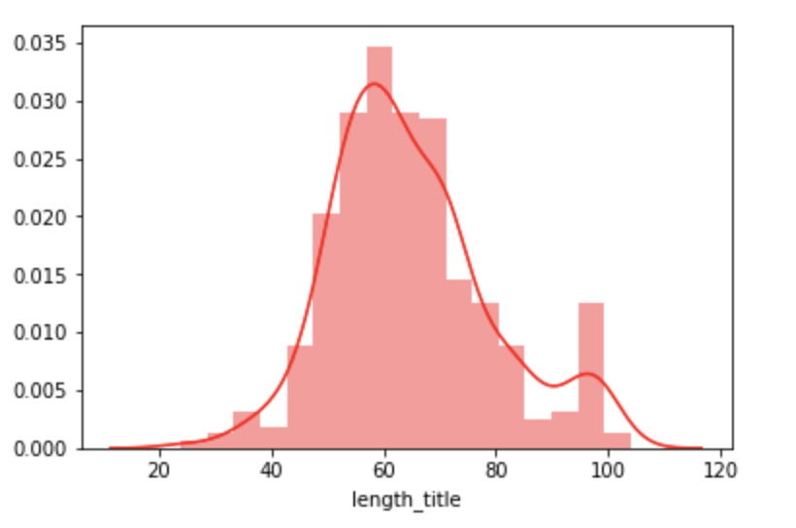
Data
https://www.kaggle.com/hsankesara/medium-articles
337 medium articles
Title
Text
Number of claps
Author Name
Number of characters in text of articles
Number of characters in title of articles

Slide 3
Pre-processing
Data Cleaning
Removing punctuations
Removing English stop words
Lemmatization
Creating dictionary of words using Gensim
Number of unique words in initial documents: 20777
Number of unique words after removing rare and common words: 3042

Slide 4
LDA (Linear Discriminant Analysis)
LDA assumes documents are produced from a mixture of topics.
Those topics then generate words based on their probability distribution.
Given a dataset of documents, LDA backtracks and tries to figure out what topics would create those documents in the first place.
It is a matrix factorization technique

Slide 5
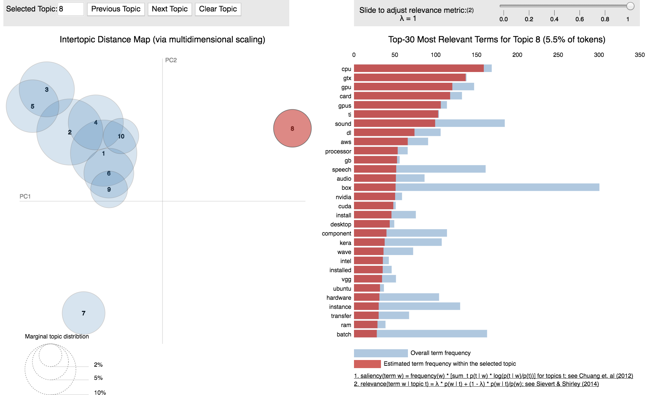
Topic Modeling - LDA
Create Document- term matrix
Perform LDA
Choose the number of topics

Slide 6
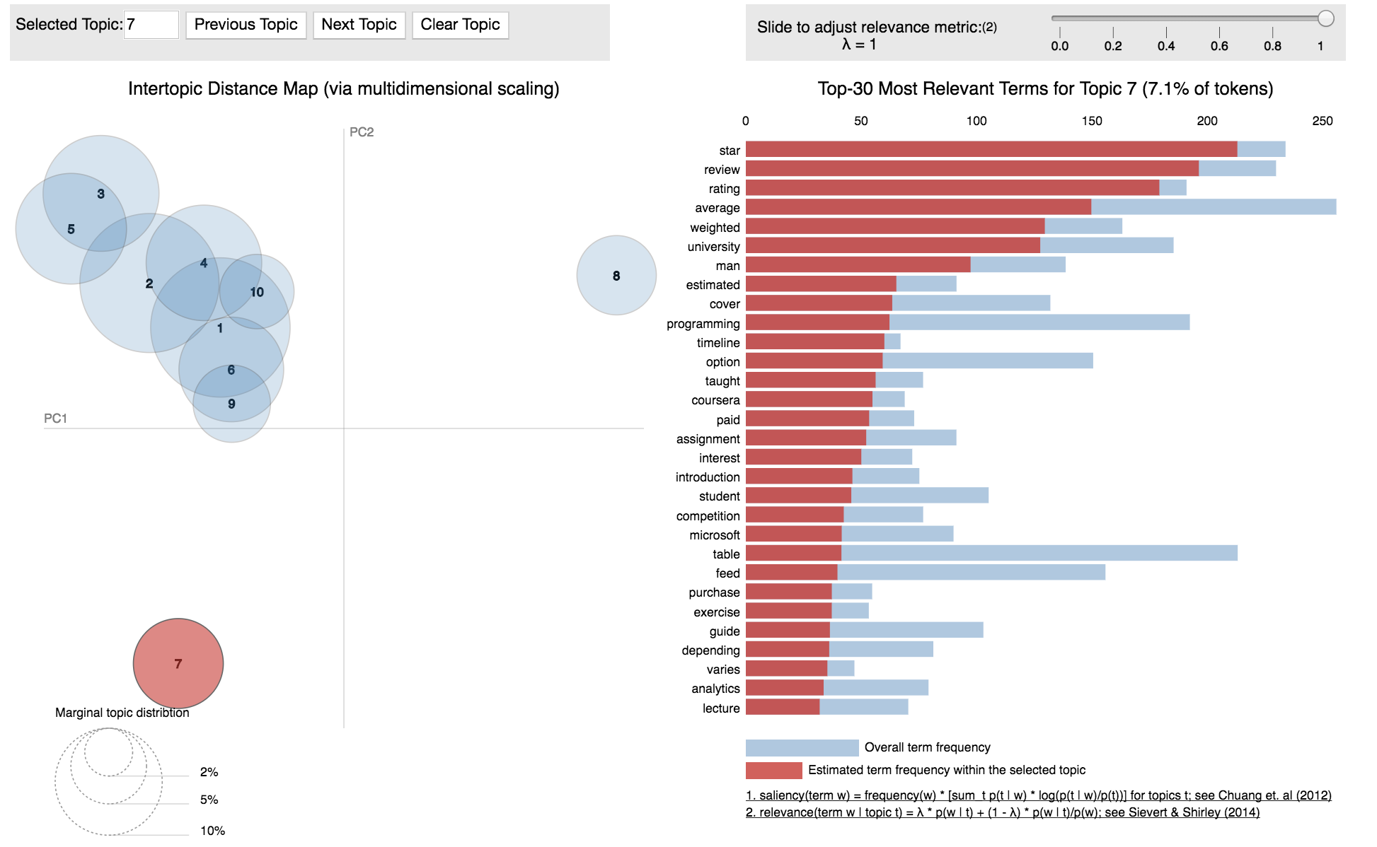
Topic Modeling - LDA

Slide 7
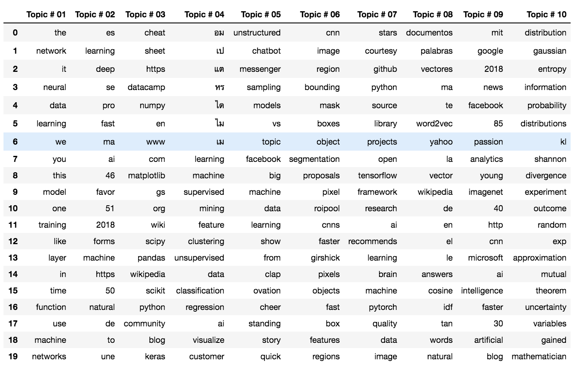
Topic Modeling - NMF (Non negative Matrix Factorization)
Obtain count design matrix
Set TFIDF transformer
Normalize the TFIDF values
Fit the NMF model
Get the topics with their words

Slide 8
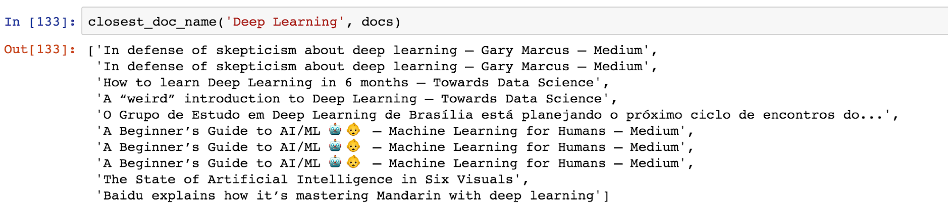
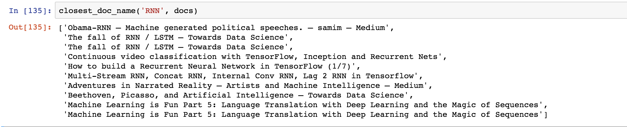
Article Recommendation - TFIDF
TFIDF Vectorizer
Cosine Similarity

Slide 9
Conclusion
LDA and NMF work equally well for topic modeling.
Words related to computers like gpu, processors, cpu come under once topic.
Words like Python, pandas, numpy, scipy come under one topic. These verify our results
Recommendation of articles using TFIDF works well.

