Slide 1

Topic Modeling on Medium Articles
Nimesh Sinha

Slide 2
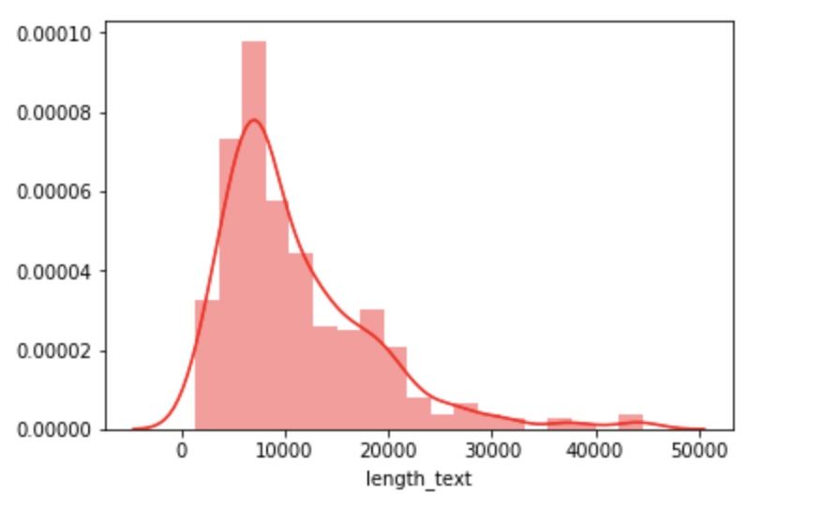
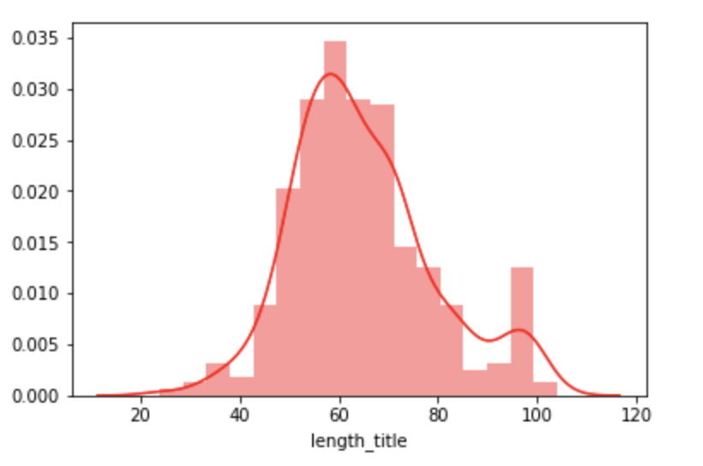
Data
https://www.kaggle.com/hsankesara/medium-articles
337 medium articles
Title
Text
Number of claps
Author Name
Number of characters in text of articles
Number of characters in title of articles

Slide 3
Pre-processing
Data Cleaning
Removing punctuations
Removing English stop words
Lemmatization
Creating dictionary of words using Gensim
Number of unique words in initial documents: 20777
Number of unique words after removing rare and common words: 3042

Slide 4
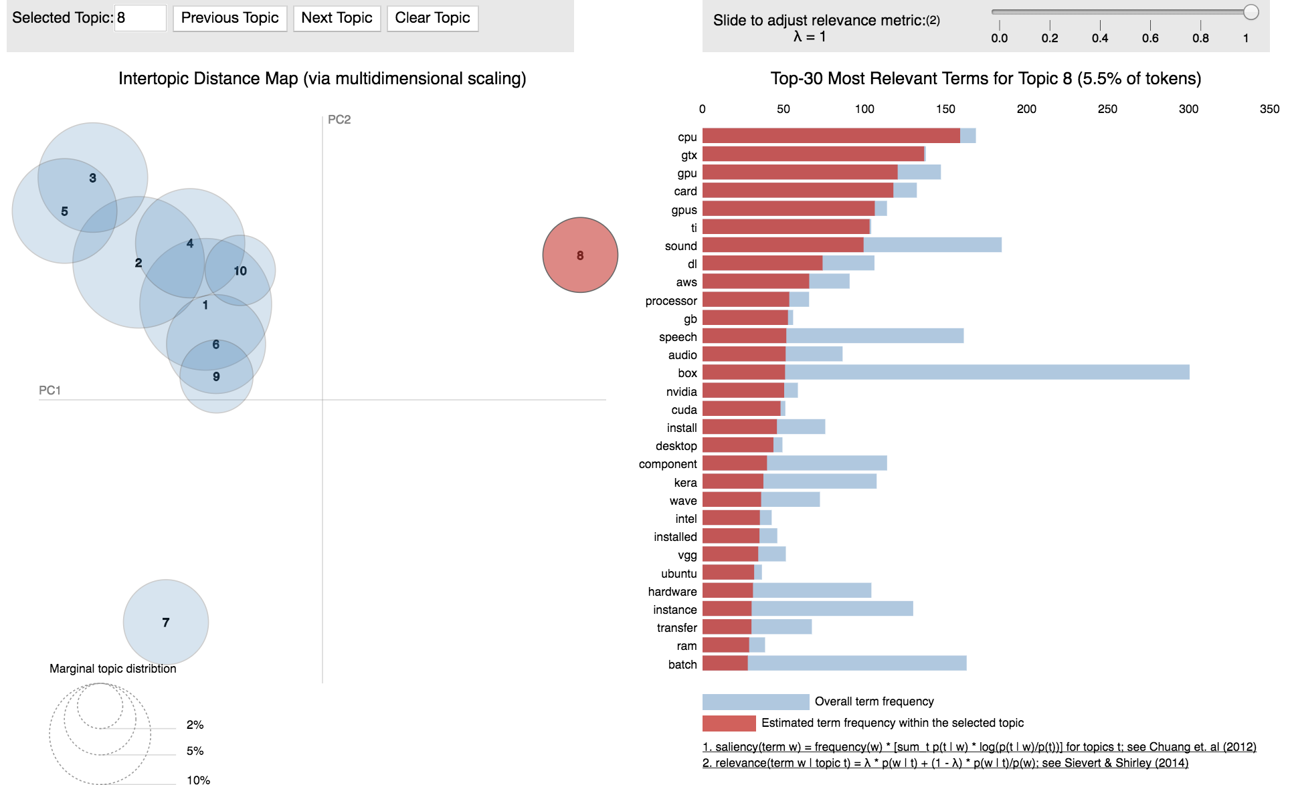
Topic Modeling - LDA
Create Document- term matrix
Perform LDA
Choose the number of topics

Slide 5
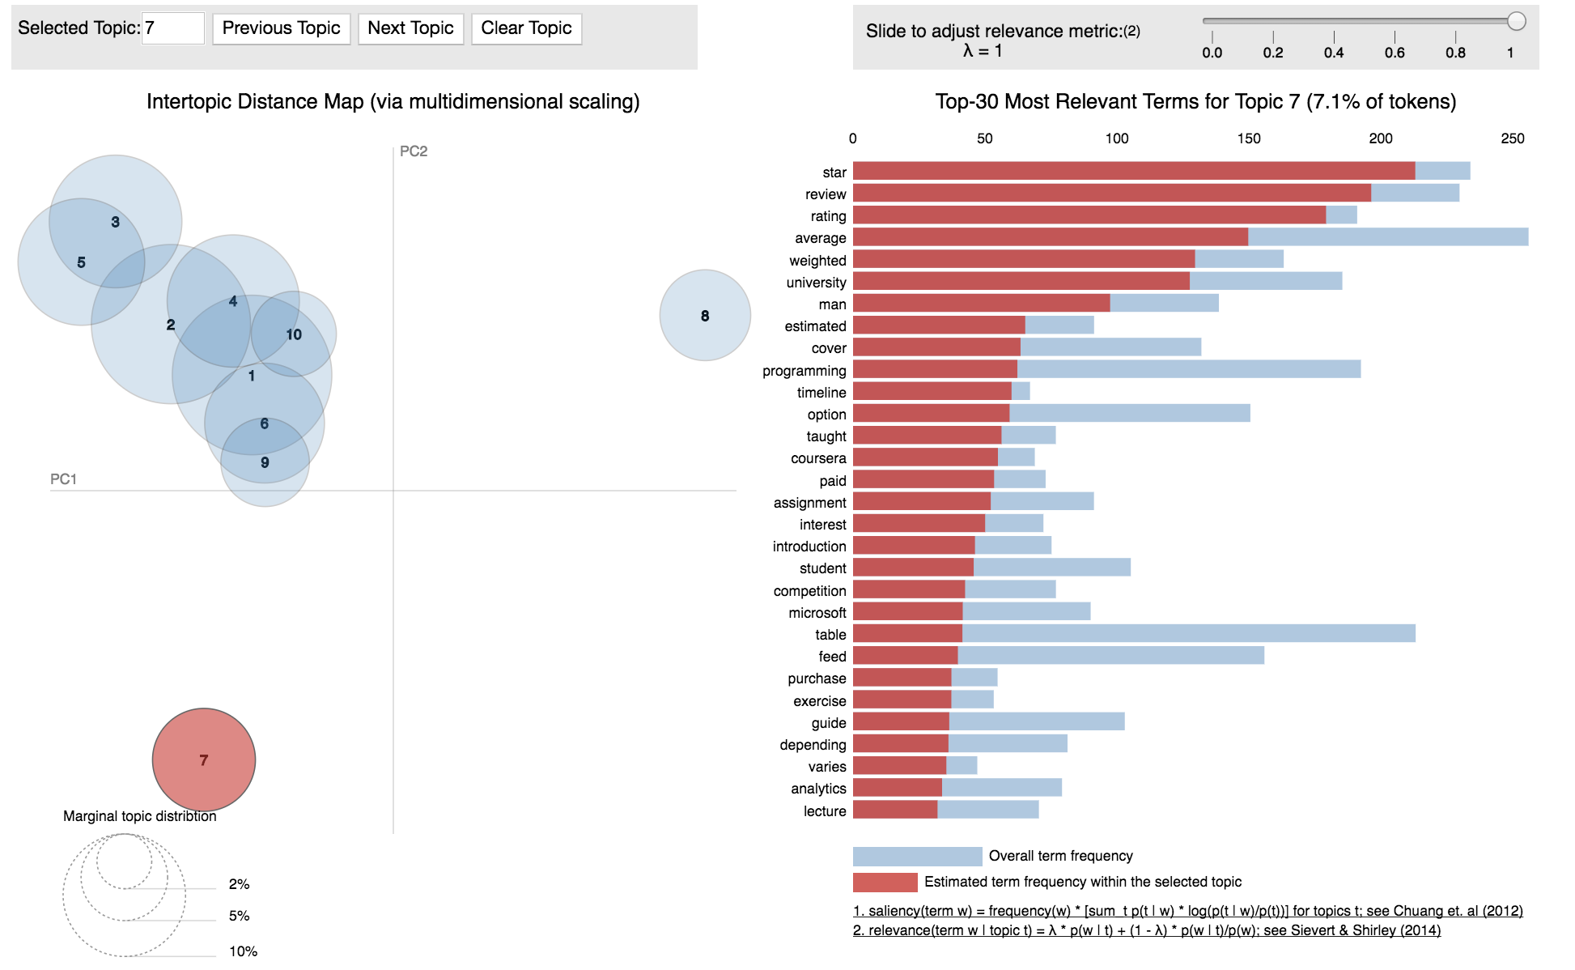
Topic Modeling - LDA

Slide 6
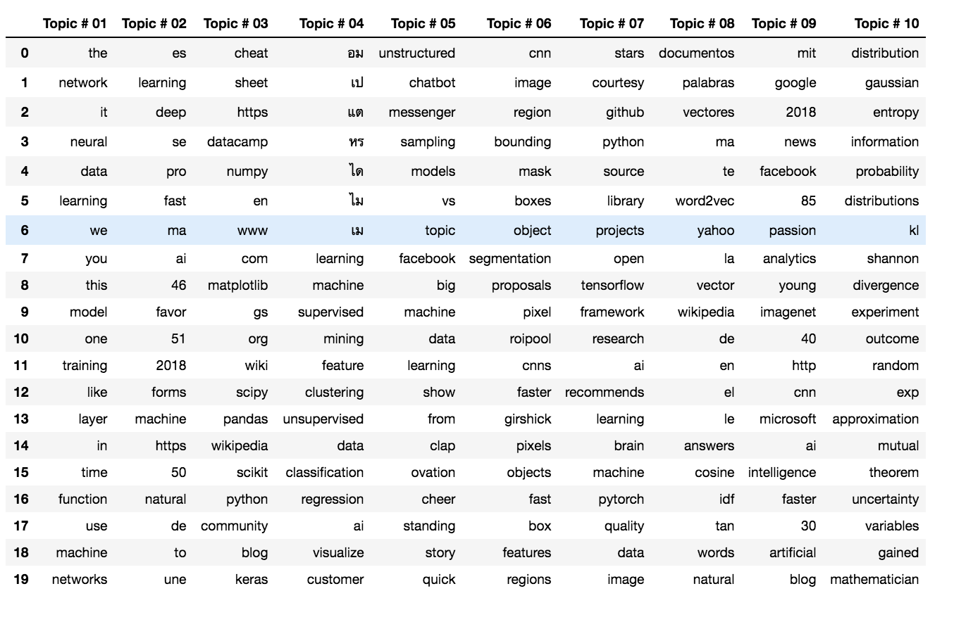
Topic Modeling - NMF
Obtain count design matrix
Set TFIDF transformer
Normalize the TFIDF values
Fit the NMF model
Get the topics with their words

Slide 7
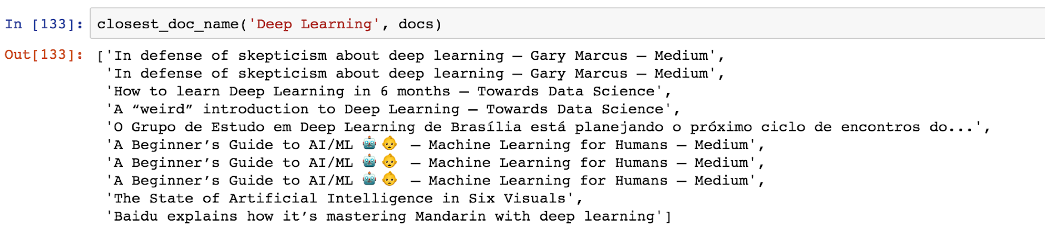
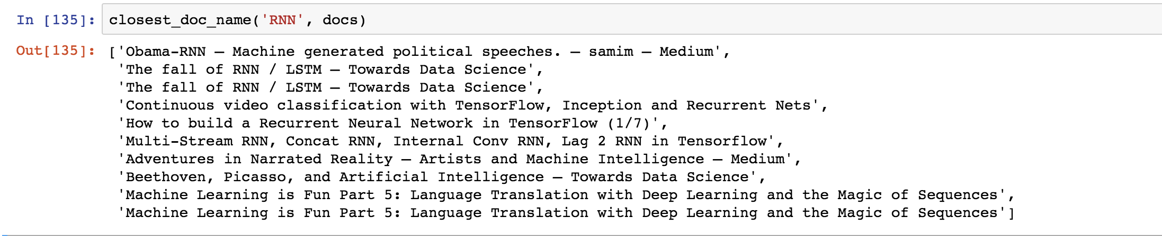
Article Recommendation - TFIDF
TFIDF Vectorizer
Cosine Similarity

Slide 8
Conclusion
LDA works better than NMF in topic modeling.
Recommendation of articles using TFIDF works well.

