Slide 1
Agent Development Kits
Ways of developing/’configure’ Agents
Joerg Huber
www.systemic.com.au

Slide 2
What Kit are there?
OpenADK (Java, .Net) - Open Source
  https://launchpad.net/open-adk
  Low Level APIs (Hundreds of Classes)
  Start from Scratch and all ‘hand hoded’
Visual’s ZI Agent (Windows)
  http://www.visualsi.com
  Fully Configurable Agent, no coding
  Expects DB and that it is in a semi-nice form
  Deployment on Windows environment only
RM CPSI Agent Developemt Kit (.Net)
  Low Level APIs (.Net only)
  All hand hoded

Slide 3
Frameworks
SIFCommon Framework (Java, .Net)
  Developed by Systemic Pty Ltd (www.systemic.com.au)
  Sophisticated yet simple API based on OpenADK
  Few Classes easy to Manage
  Latest Version October 2011
  Bootcamp will concentrate on this Framework
  Open-Source (Download from Github)
    Java: https://github.com/nsip/SIFCommonOpenADK-Java
    .Net: https://github.com/nsip/SifCommonFramework-dotNet

Slide 4
Frameworks (cont.)
SBP Agent Framework (Java, .Net)
  Developed by Systemic Pty Ltd (www.systemic.com.au)
  Built on top of SIFCommon Framework to Support the Australian SIS Baseline Profile
  Object Cache, Startup Sync, Basic Query Processing
  Latest Version November 2011
  Open-Source (Download from Github)
    Java: https://github.com/nsip/SBPAgentFramework-Java
    .Net: https://github.com/nsip/SbpAgentFramework-dotNet

Slide 5
Frameworks (cont.)
Concise Agent Framework (.Net)
  Basic API based on RM’s CPSI ADK
  Not currently maintained (last release Sept 2009)
  Open-Source

Slide 6
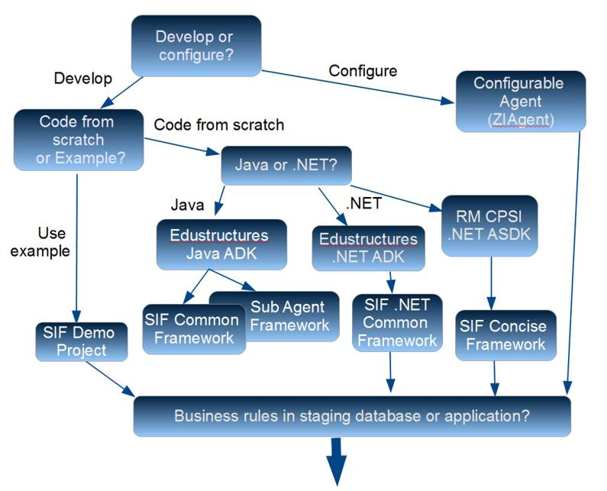
What Should I Use?

