Slide 1
ITWS PROJECT : IIIT+ BOOK
Submitted by:
Nonidh Singh Roll no:20171203
Pratyush Roll no: 20171168
Mentored by:
Harshit Mahajan

Slide 2
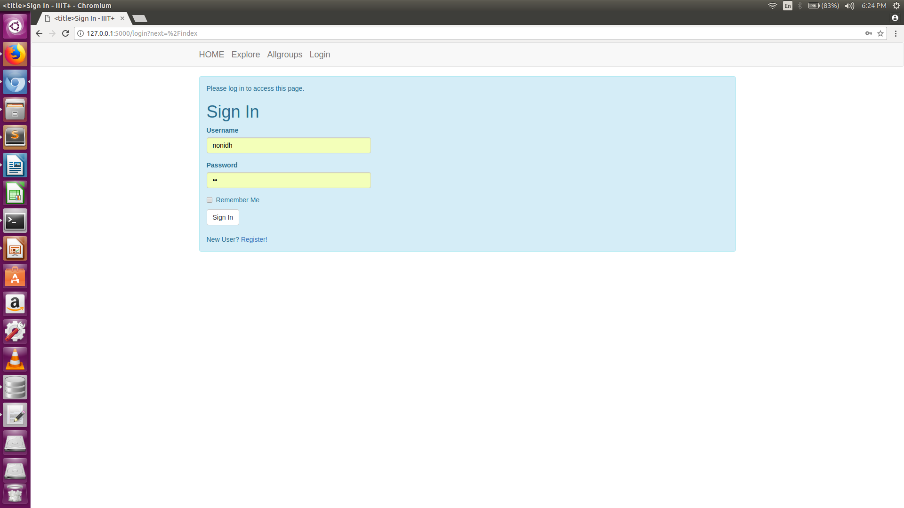
Login page:

Slide 3
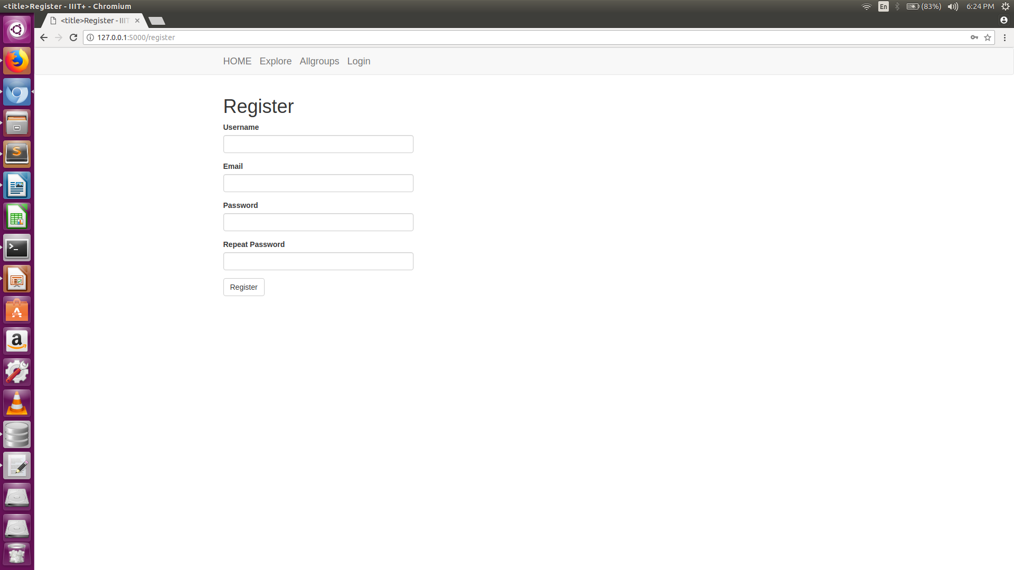
Register Page:

Slide 4
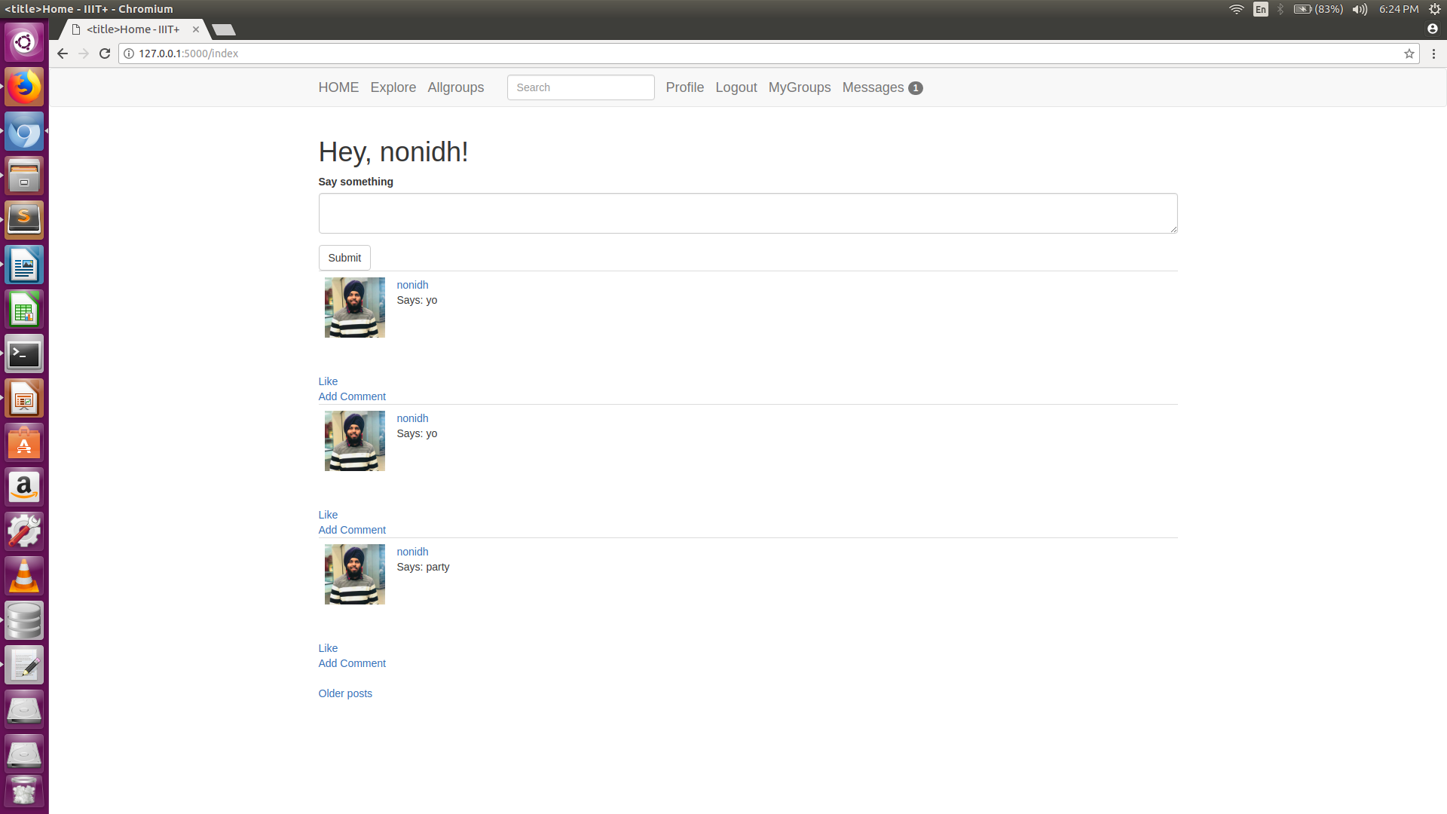
Home Page:

Slide 5
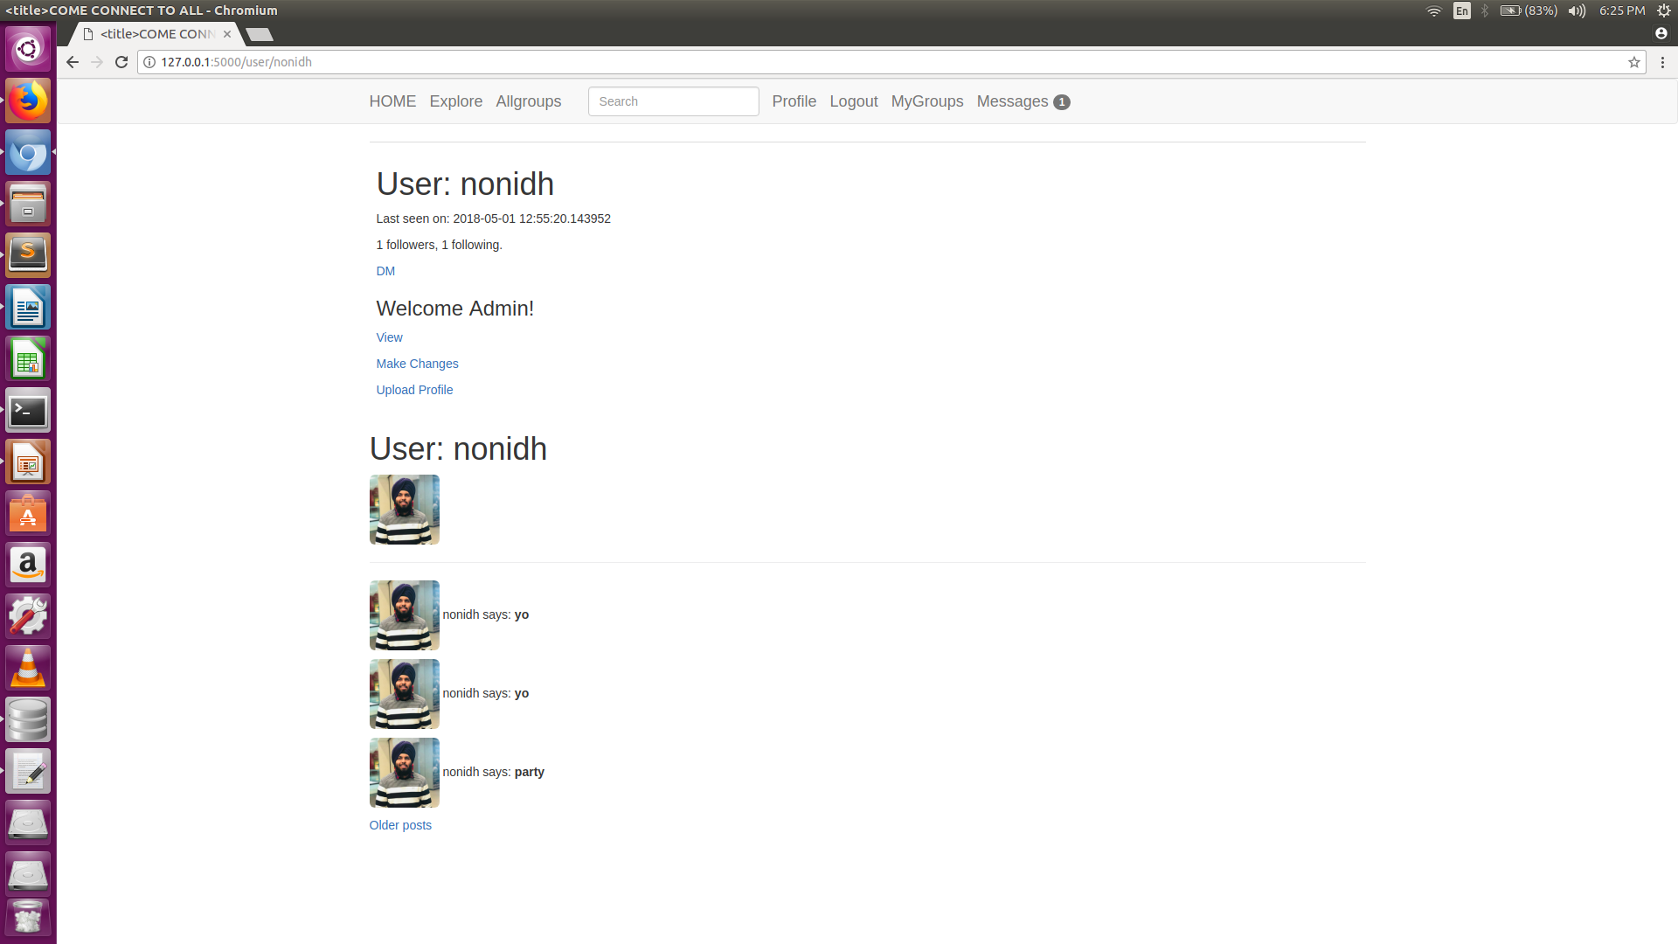
User Profile:

Slide 6
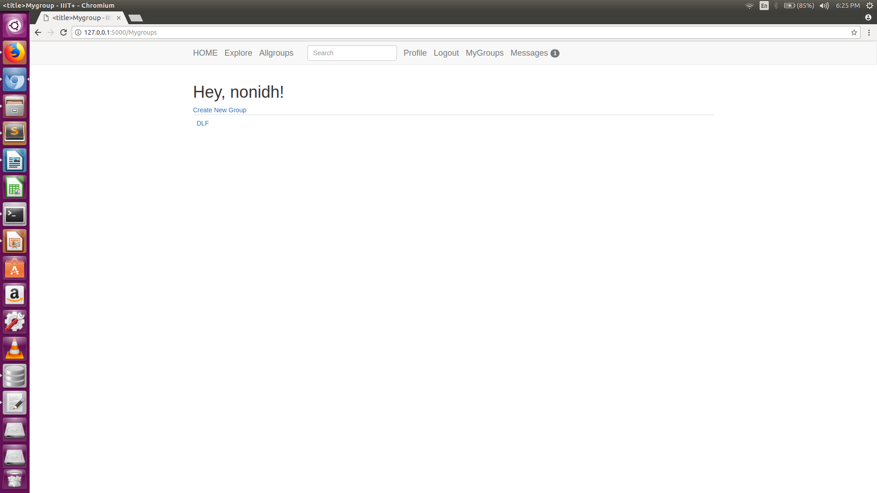
Mygroups:

Slide 7
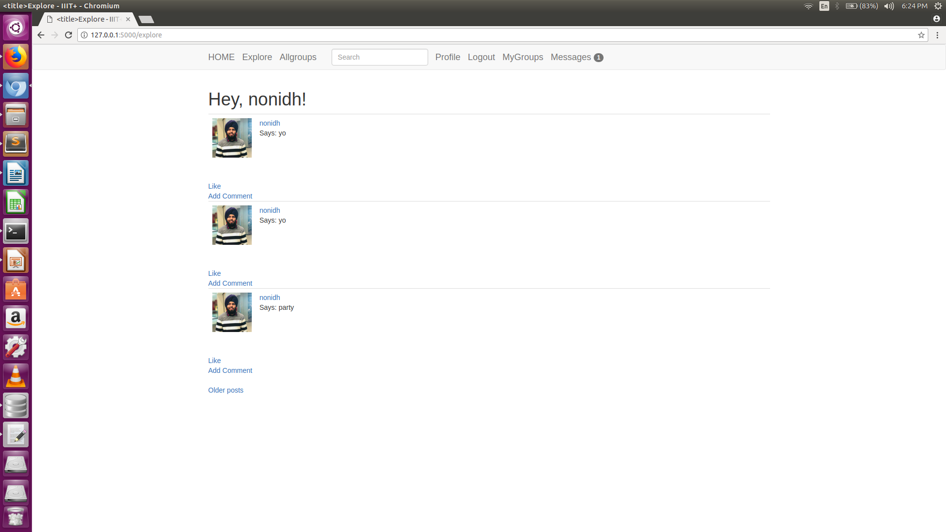
Explore:

Slide 8

AllGroups:

Slide 9
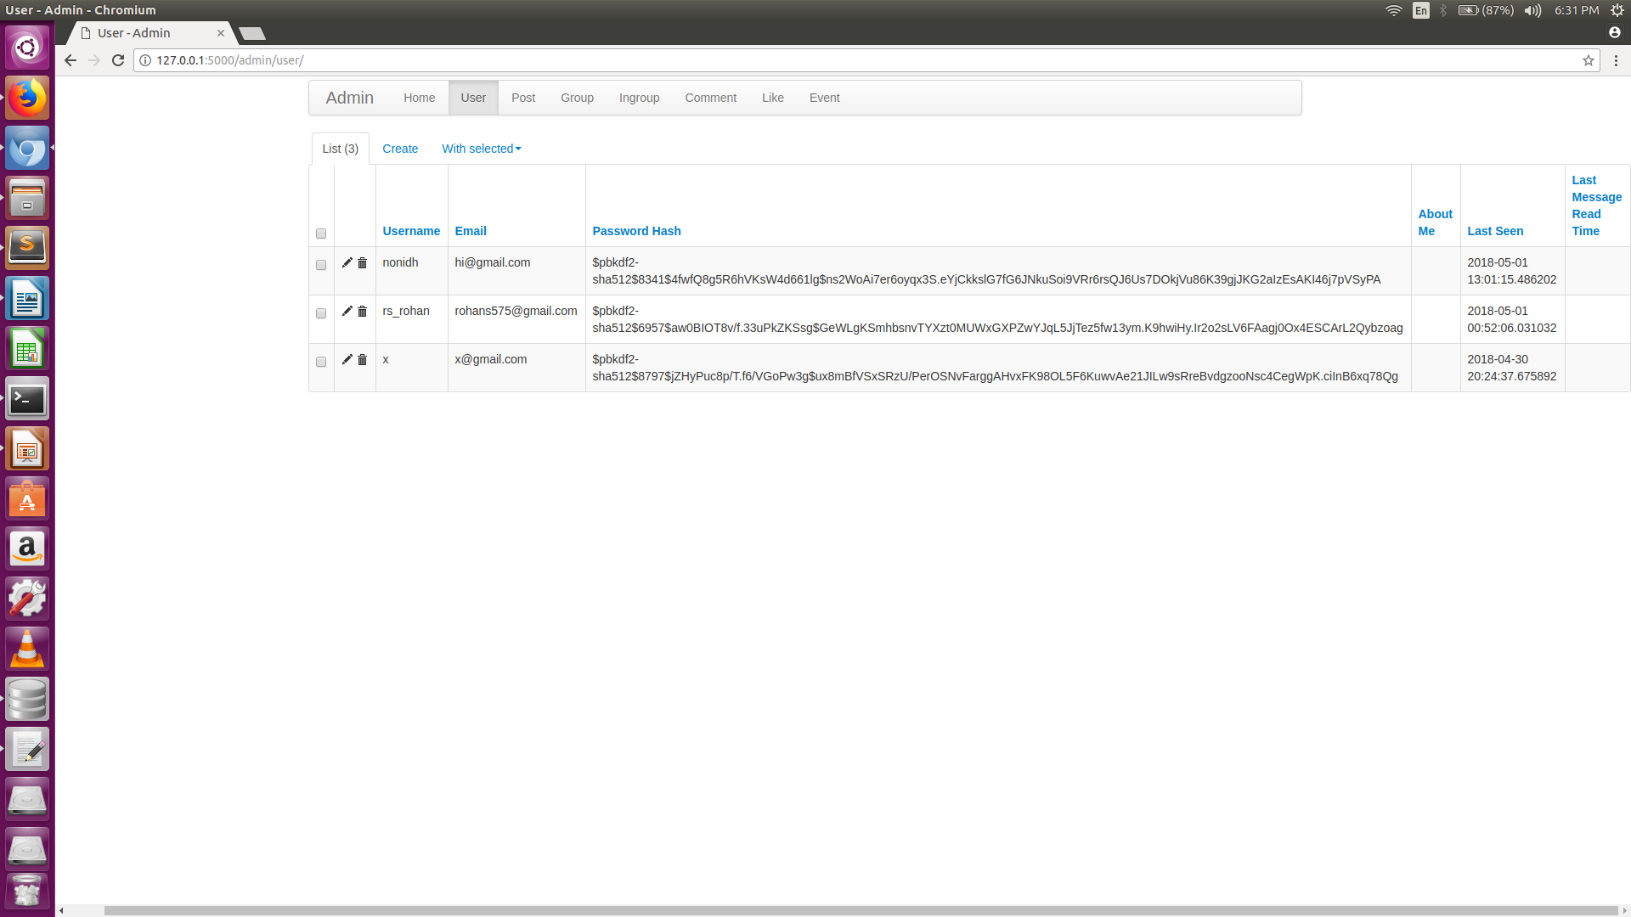
AdminView

Slide 10
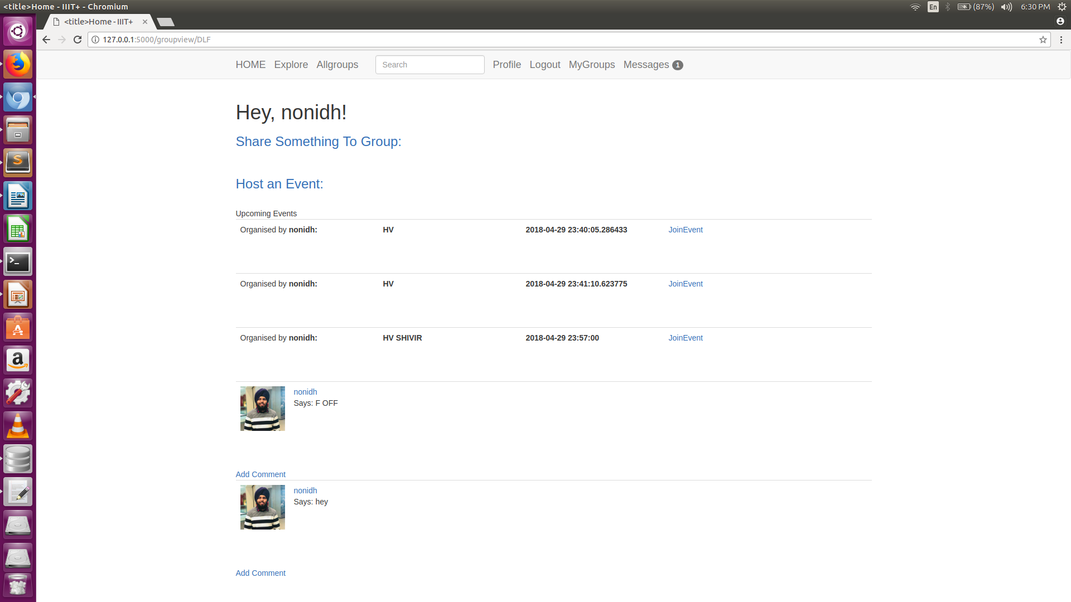
GoupView

Slide 11
Experiences:
This project was a tiresome yet interesting experience.The amount of efforts were extreme but so was the learning.This has laid the basis of learning which will help me in future projects.

Slide 12
Errors and Resolving
The development process involved many errors and experiences.The primary ones are listed as follows:
1)As i have used flask migration so the major error was migration not found or database not upto date.
Resolve:As in alembic the revisions are orered in linear way so if any migratory update is done and previous one is not linked properly the this error throws up. For this delete the previous versions and set down revision to none

Slide 13
2)The other major error was of Key error.
Resolve:
To correct it we need to set up the head in versions in env.py file in migration.
3) The other error was of elastic search reference.
It was due to the non response of default port of elastic search i.e port number 9200
Resolve:Kill this port and reconfigure the elastic search again also the elastic search should always be on else the code will show internal server error.
4) The other error was of using git to upload and download code It was resolved by adding files to gitignore as some migration files were not to be uploaded.
5) I tried hard to build the tag feature but it was showing some error in html as i wasnt able to show link to the tagged user though was able to send the notification to him about tag.
So i dropped this idea of tag due to this.
6)As elasticsearch is external service so i had hard time integrating it with the app

Slide 14
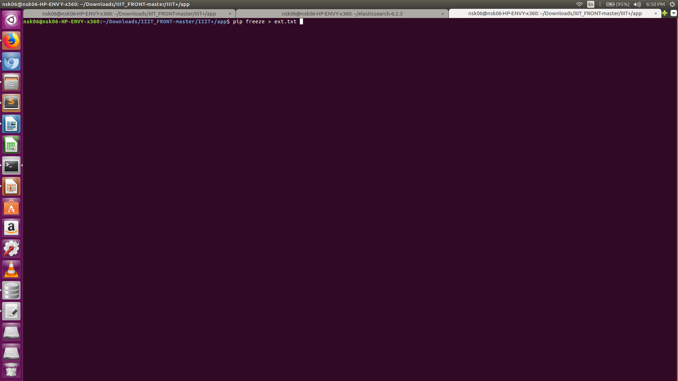
Working:

Slide 15
Next export FLASK_APP=views.py
And set FLASK_DEBUG=1.
Also user has to download the elasticsearch module from their official site.
Now do flask run and voila the web app is up and running.
The app interface is easy to use and quite intuitive

Slide 16
Lookout features:
1)Site admin functionalit which can control data on site (update and delete)
2)User can follow unfollow other users and only the post of followed users will be displayed on home page in chronological order of time.
3)A user can comment or like a particular post.
4)User popup is quite a fascinating feautre i have used ajax for its implementation
5)The user can send and recieve messages

Slide 17
6) Security has been taken care of with password hashing csrf setting and special care of xss has been taken.
7)we can create multiple groups post within groups join a group based on interest post in group and host event in a group.
8) Error handling has been taken care of.

Slide 18
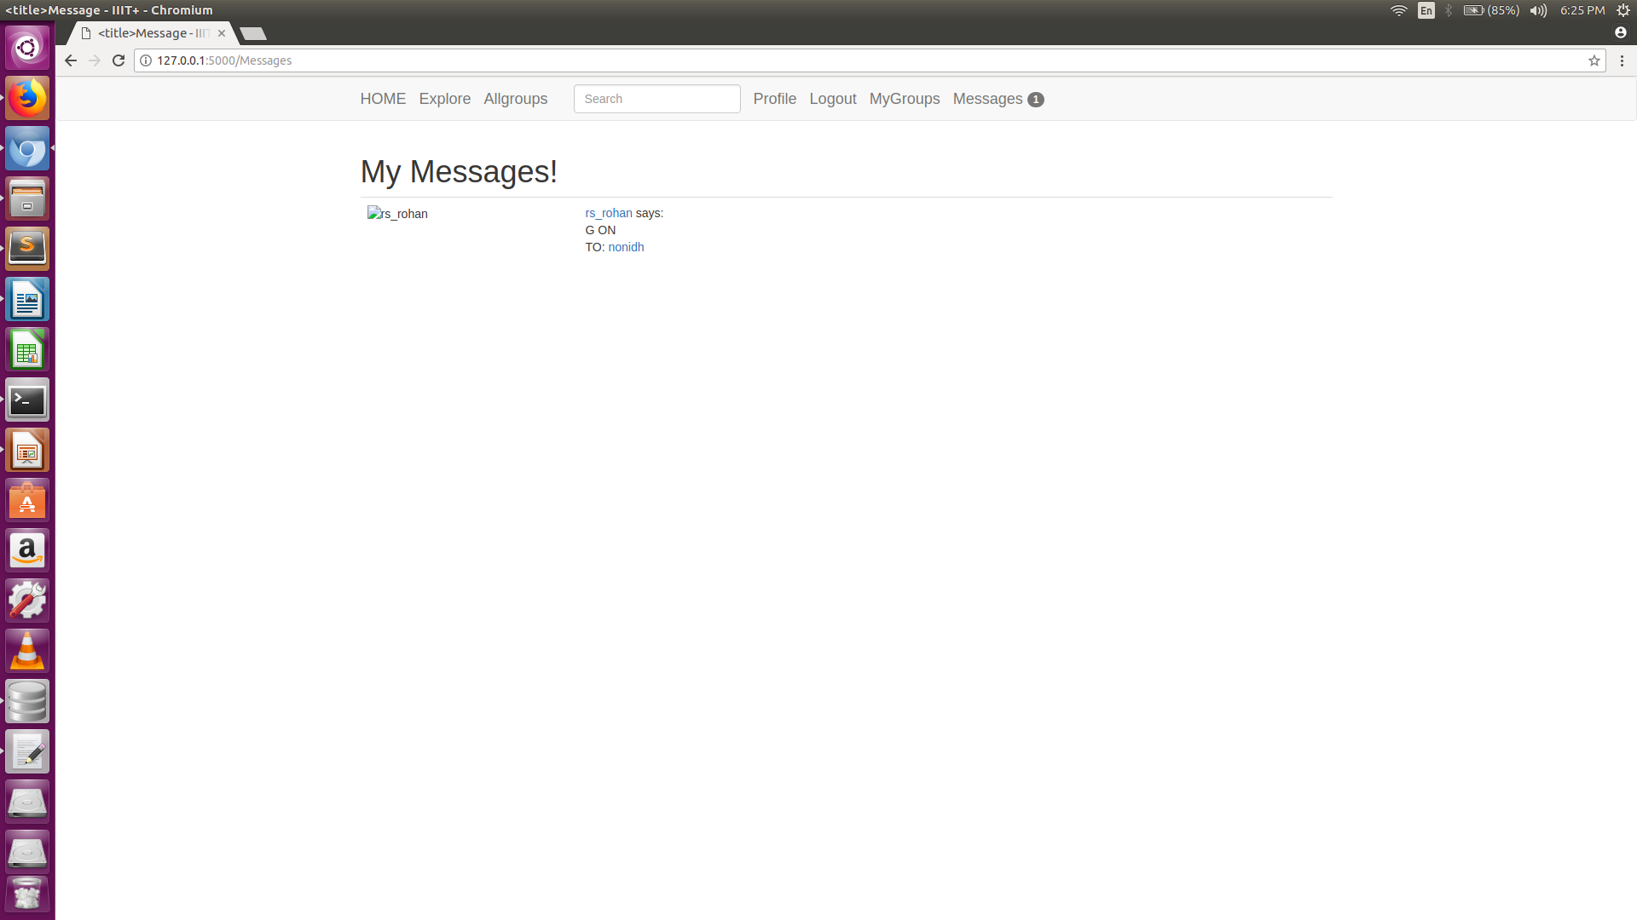
MyMessages:

