Slide 1
Spam Classifier
Sikai Ni：Preprocessing and feature extracting
Jing Zheng：Training SVMs model
Hongzhi Liu：Kernel and parameter selection
Yaoshan Liu：Naïve Bayes model vs SVM

Slide 2
Introduction
Task
Use support vector machines(SVMs) to build a spam classifier.
Why SVMs ?
In the case of binary linear classification, the main idea is to create a hyperplane space line according to the feature vector of hyperspace.

Slide 3
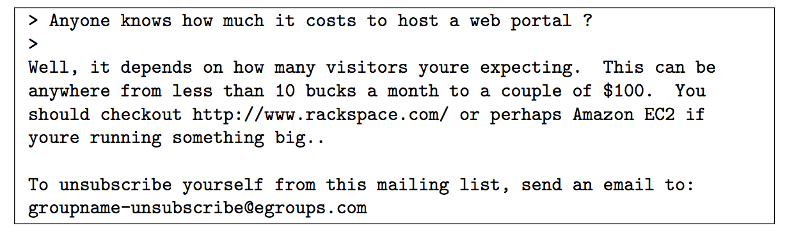
Preprocessing emails
Figure 1: Email Sample
How to deal with URL, email address, numbers, dollar amounts
and so on?

Slide 4
Preprocessing emails
Lower-casing
Stripping HTML
Normalizing URLs
Normalizing Email Addresses
Normalizing Numbers
Normalizing Dollars
Word Stemming
Removal of non-words

Slide 5
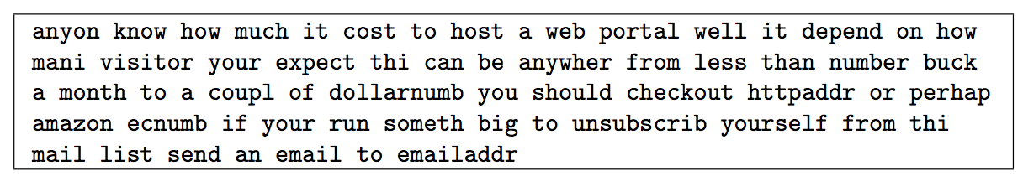
Preprocessing emails
Figure 2: Preprocessed Email

Slide 6
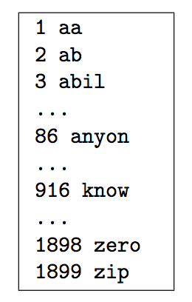
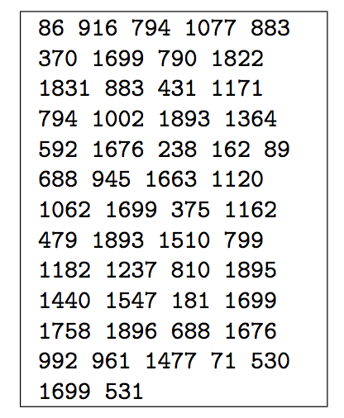
Vocabulary list
Figure 3: Vocabulary List
Figure 4: Mapping for Sample Email

Slide 7
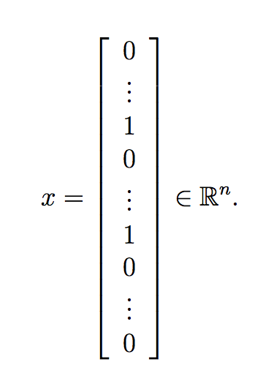
Extracting Features from Emails
feature vector had
length 1899 and 45
non-zero entries.
Figure 5: Convert Each Email into a Feature Vector x

Slide 8
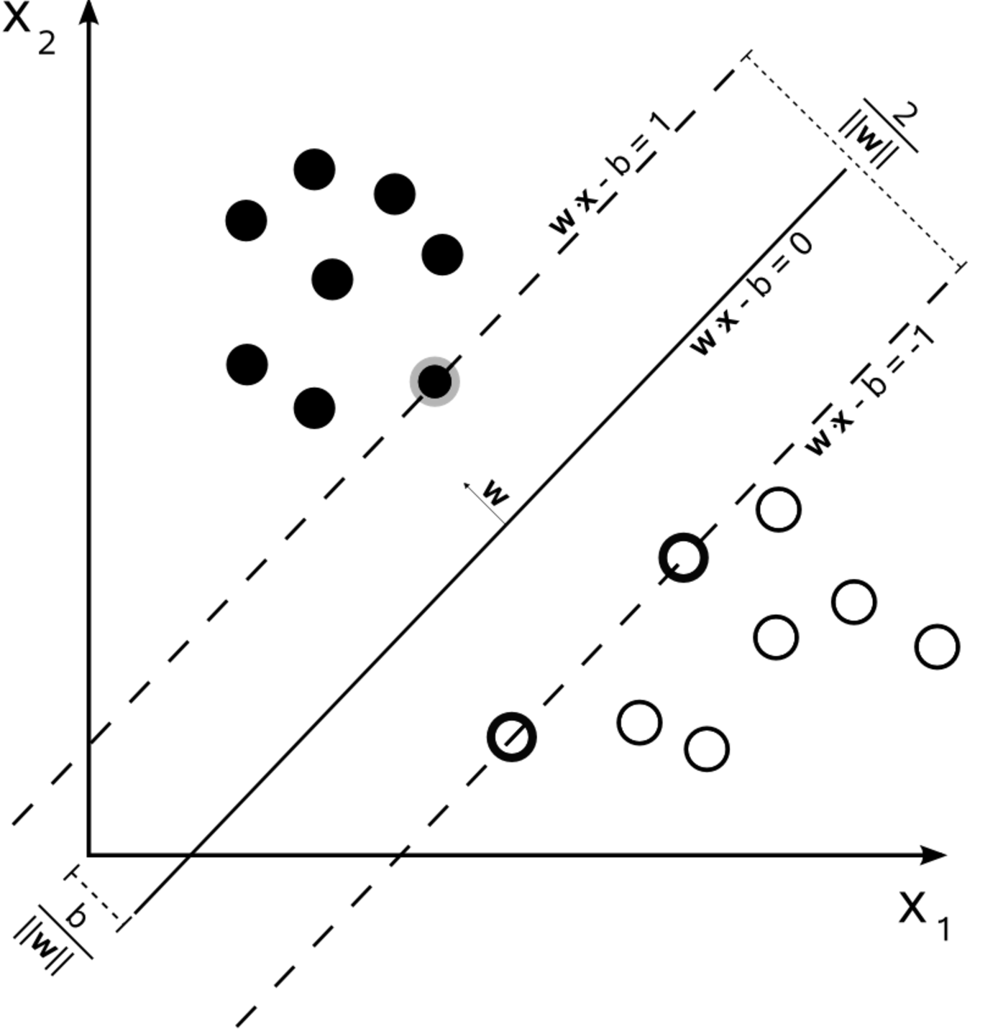
Support Vector Machine(SVM)
A supervised learning models used for classification and regression analysis.
Given a set of training examples, each marked as belonging to one or the other of two categories, an SVM training algorithm builds a binary linear classifier.
Figure 6 : Optimal Classification Plane

Slide 9
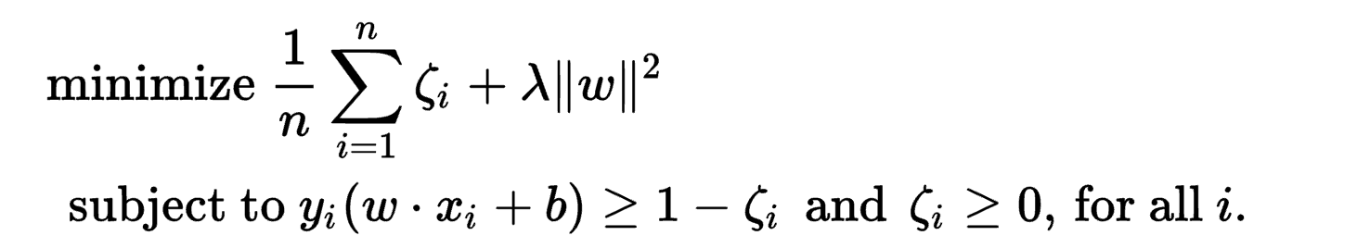
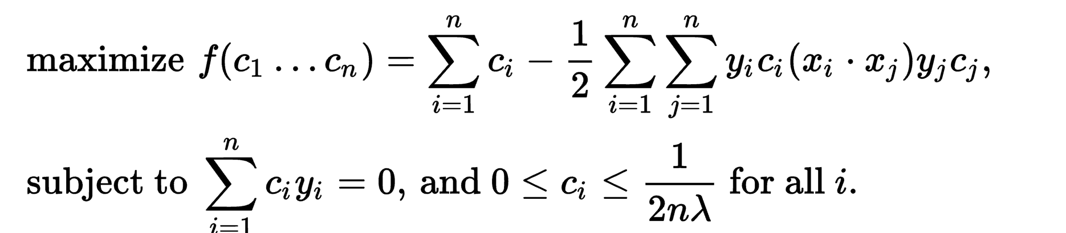
SVM
The primal problem:
The dual problem:

Slide 10
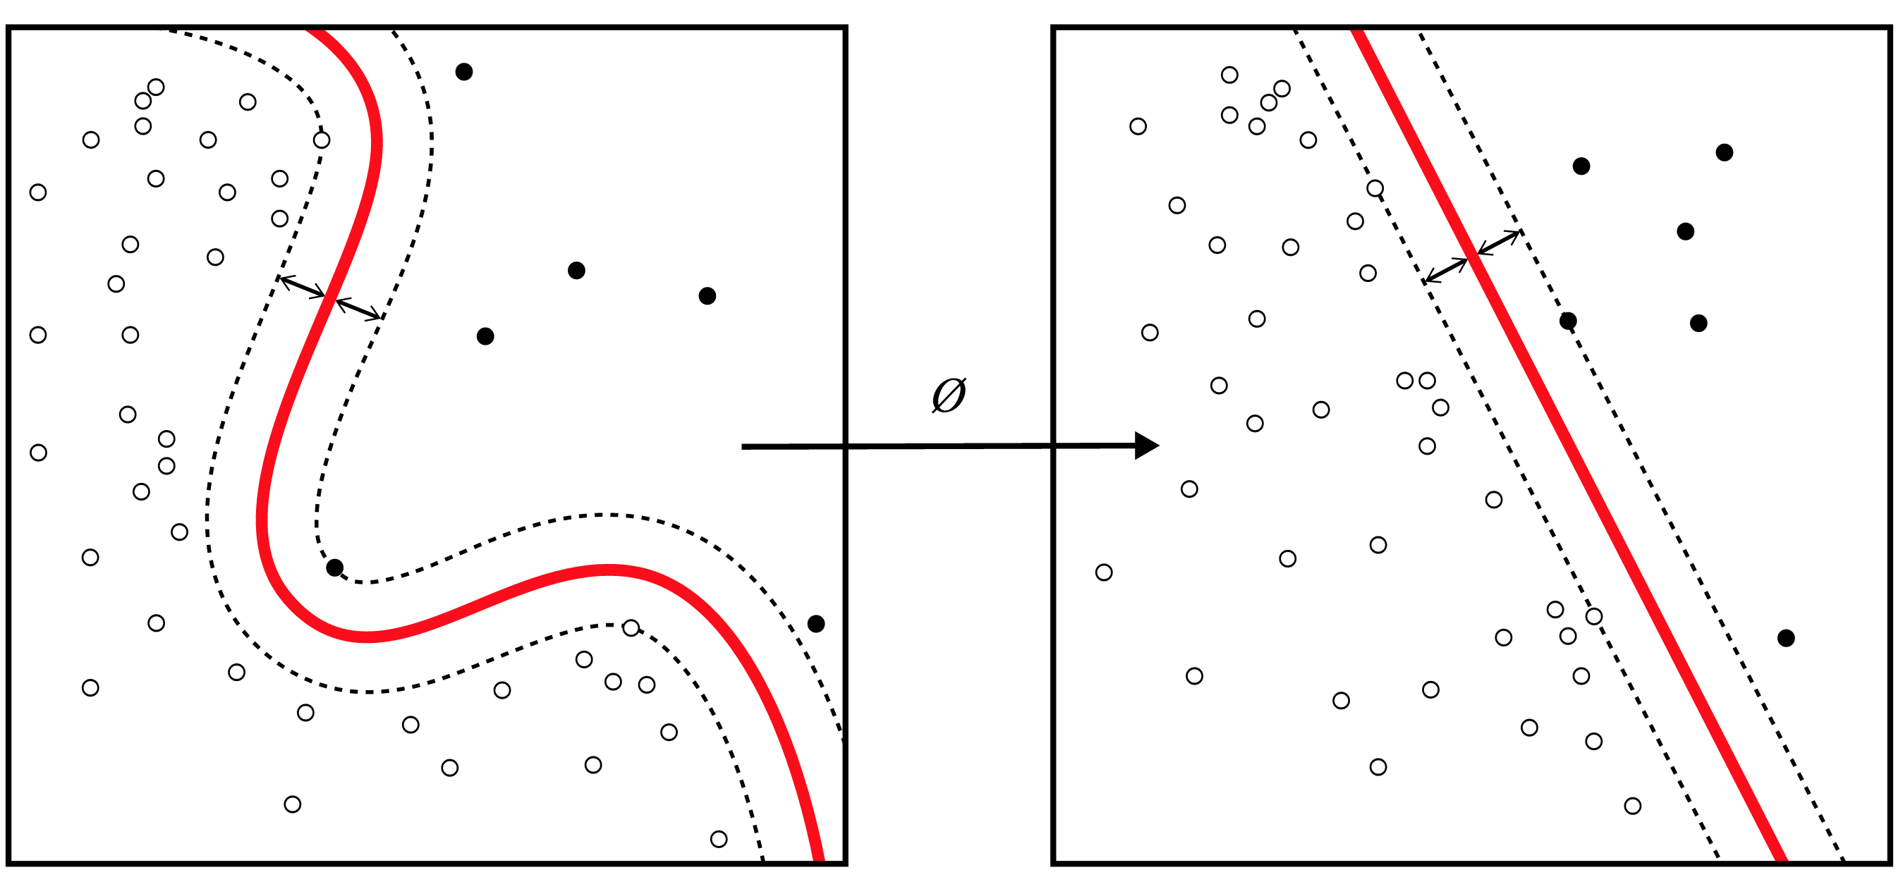
Kernel
SVMs can efficiently perform a non-linear classification using what is called the kernel trick, implicitly mapping their inputs into high-dimensional feature spaces.
Figure 7:Kernel Machines are Used to Compute a Non-linearly Separable Functions into a Higher Dimension Linearly Separable Function.

Slide 11

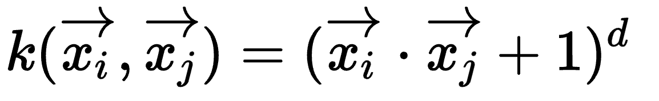
Kernel
Linear Kernel：
Polynomial Kernel:
Gaussian Kernel:

Slide 12
Sequential minimal optimization (SMO)
Solve the quadratic programming (QP) problem that arises during the training of support vector machines.
SMO breaks this problem into a series of smallest possible sub-problems, which are then solved analytically.
The algorithm proceeds as follows:
Find a Lagrange multiplier that violates the KKT conditions;
Pick a second multiplier and optimize the pair;
Repeat steps 1 and 2 until convergence.

Slide 13
Training & Testing SVM
1000 training samples of spam and non-spam emails.
100 testing samples for the examination of spam classifier.
The dataset included in this exercise is based on a subset of the SpamAssassin Public Corpus.

Slide 14
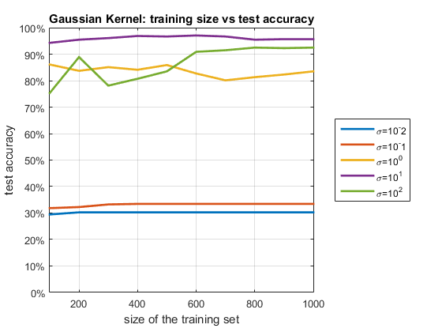

Training & Testing – Gaussian Kernel
Trying exponentially growing of the Gaussian variance so as to identify good values
Figure 8: Gaussian Kernel

Slide 15
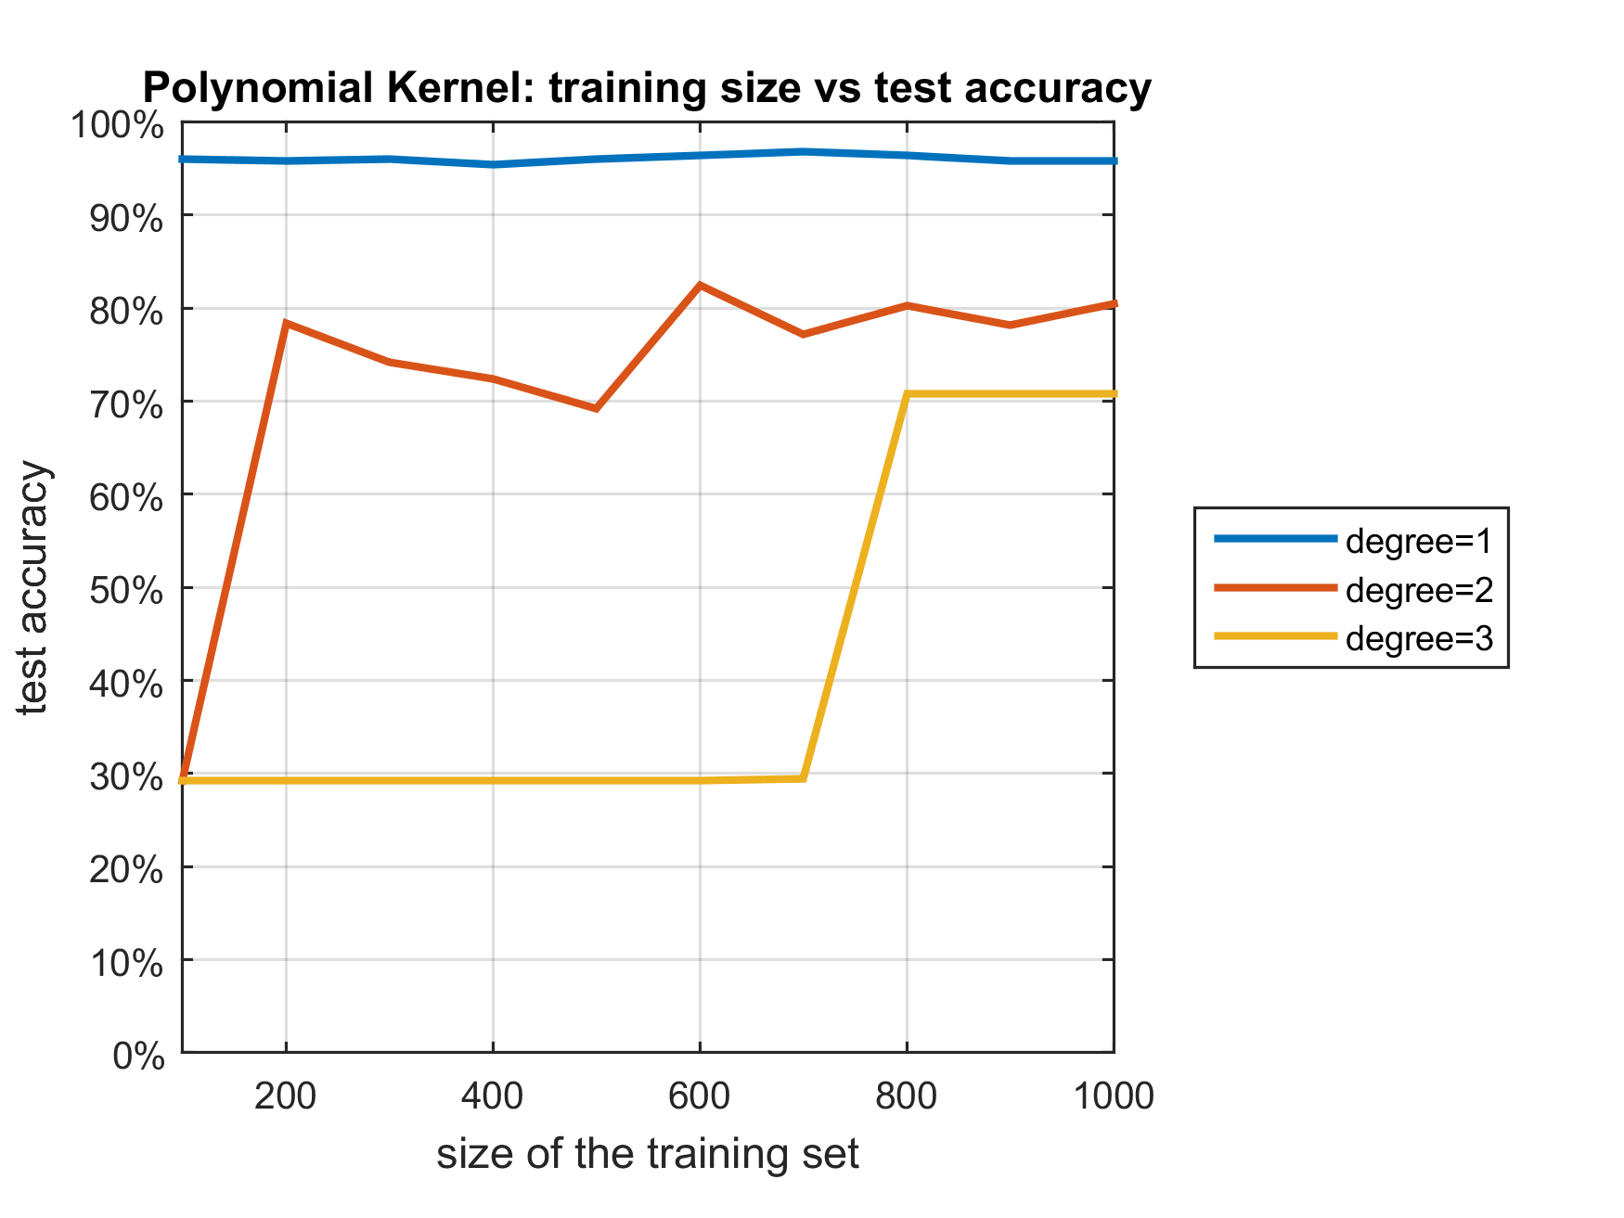

Training & Testing – Polynomial Kernel
Change the degree of polynomial kernel
Figure 9: Polynomial Kernel

Slide 16
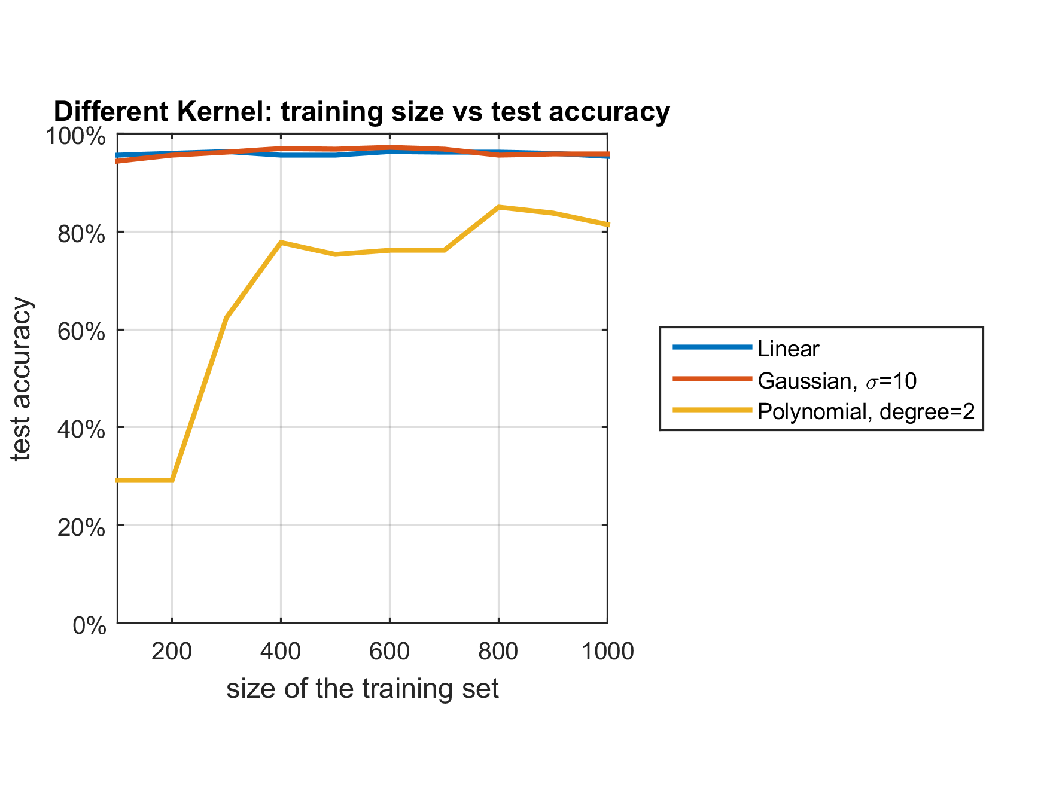
Training & Testing – Linear Kernel
In this project, Linear kernel performs best compared to Gaussian and Polynomial, and fastest
Figure 10: Kernel Selection

Slide 17
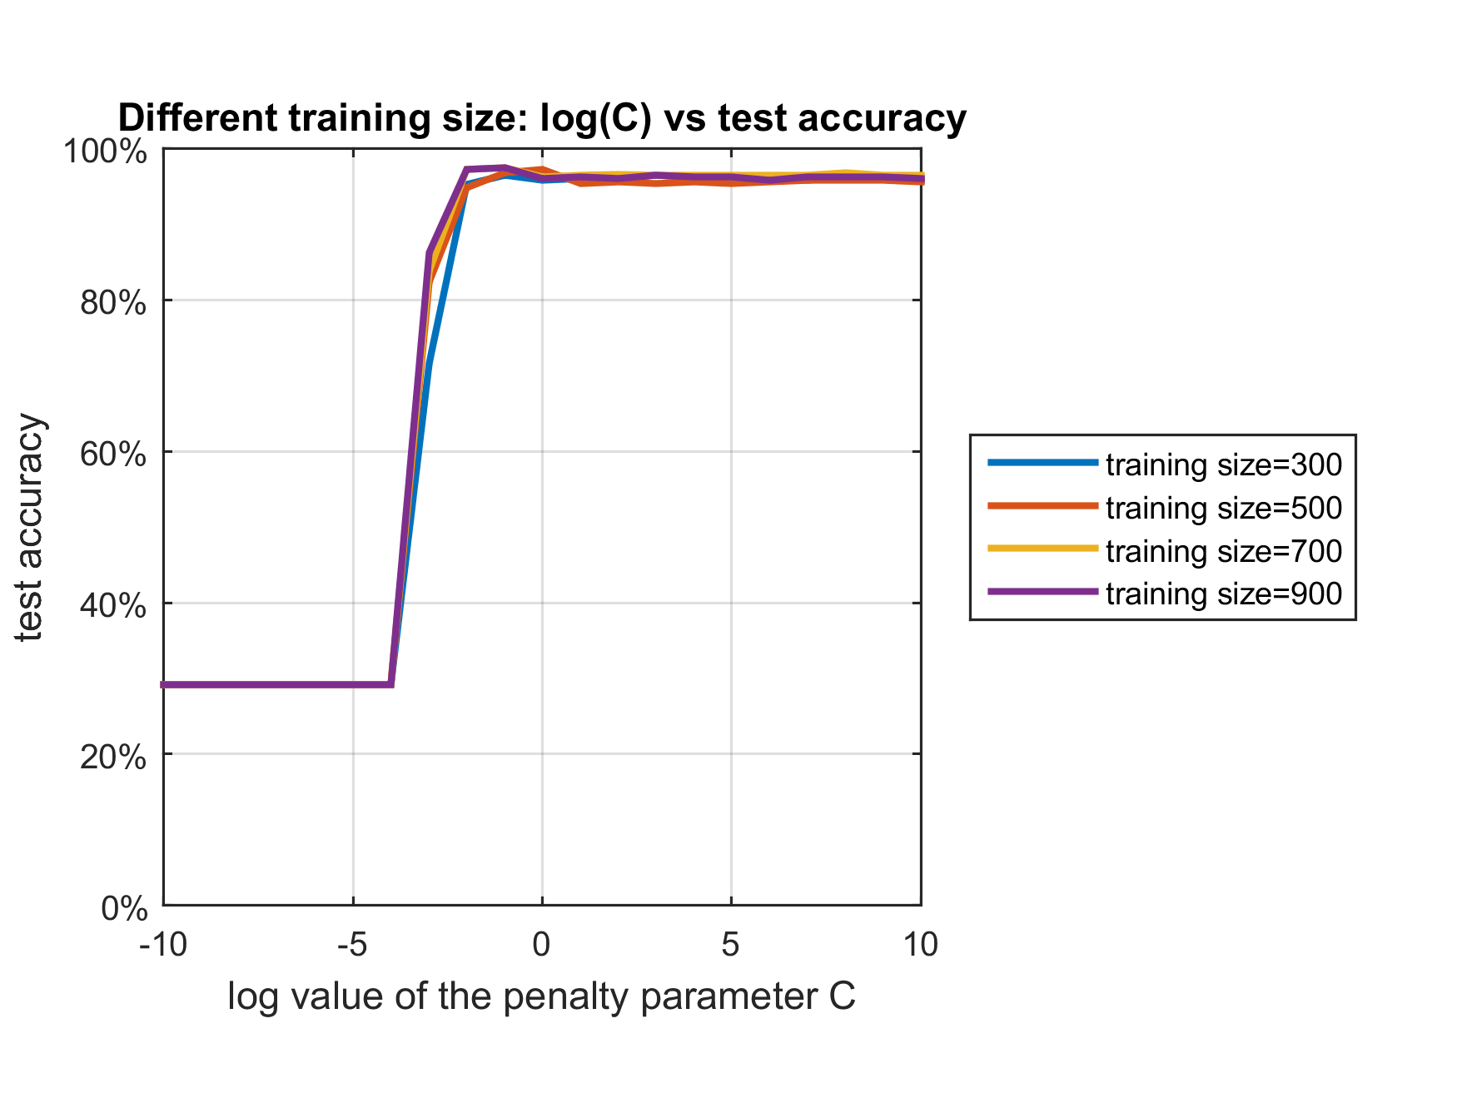
Training & Testing – penalty parameter
C indicated the penalty of miss-classification, when it is infinite, the classifier become linearly separable
Trying exponentially growing of C so as to identify good values
Figure 11: Penalty Parameter

Slide 18
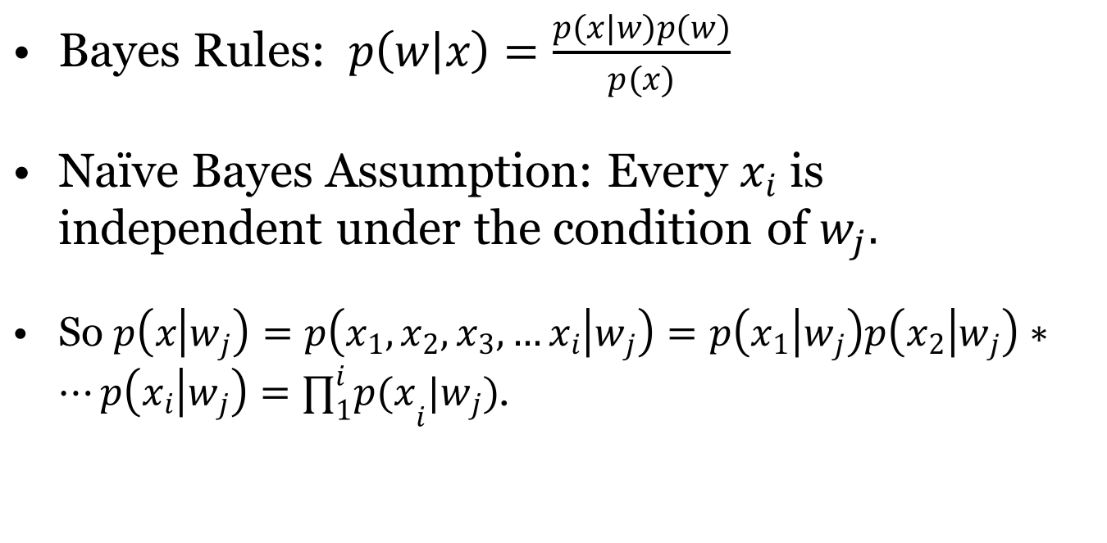
Naïve Bayes Model

Slide 19
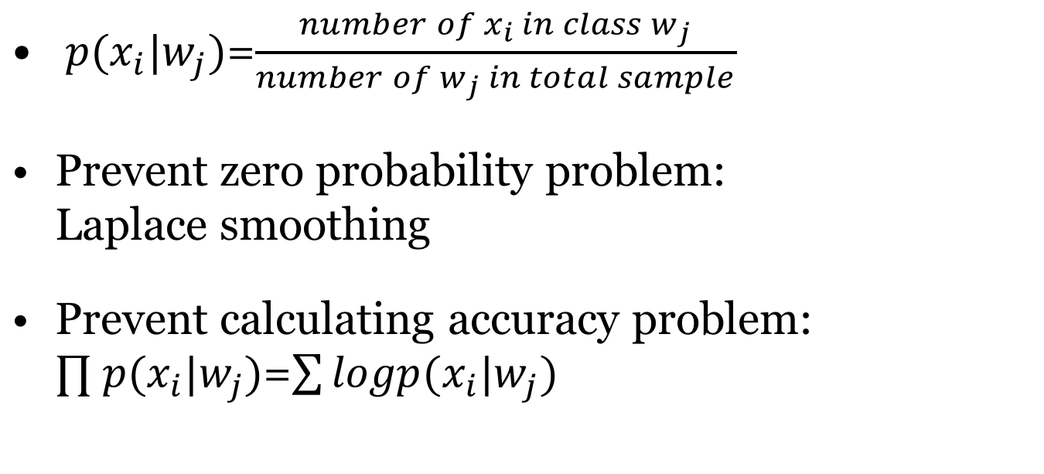
Naïve Bayes Model

Slide 20
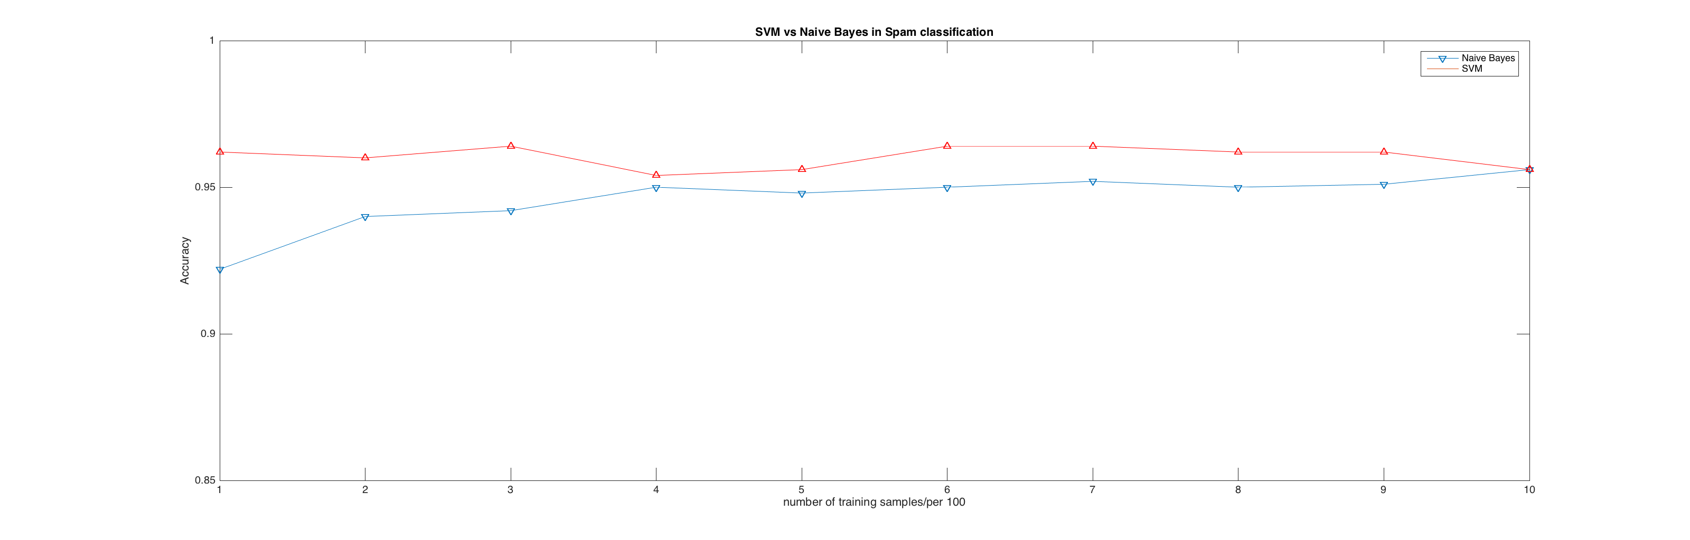
SVM vs Naïve Bayes
Figure 12: SVM vs Naïve Bayes

