Slide 1
Procedural Dungeon Generation
Advisor Richard Sinn
Akash Mattaparthy [akash.mattaparthy@sjsu.edu]
Ganesh S Tulshibagwale [ganesh.tulshibagwale@sjsu.edu]
Shyam Kumar Nalluri [shyam.nalluri@sjsu.edu] Srikari Veerubhotla [srikari.veerubhotla@sjsu.edu]

Slide 2
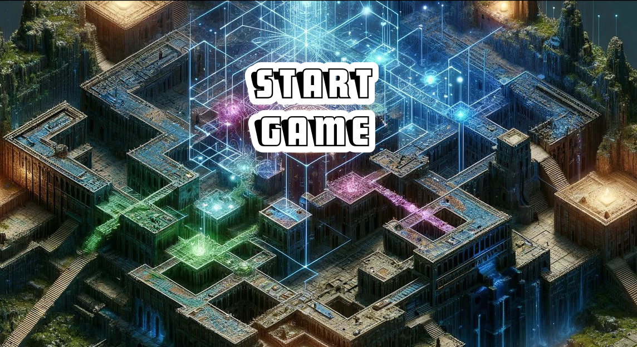
Project Overview
Procedural Content Generation (PCG) in video games
Focus on dungeon generation
Balancing creative control and variety

Slide 3
Project Objective
Create a mixed-initiative editor for designing video game dungeons
Allow human users to design logical narrative structure and floor plans
Provide algorithmic assistance and feedback
Simulate dungeon gameplay with AI adventurers

Slide 4
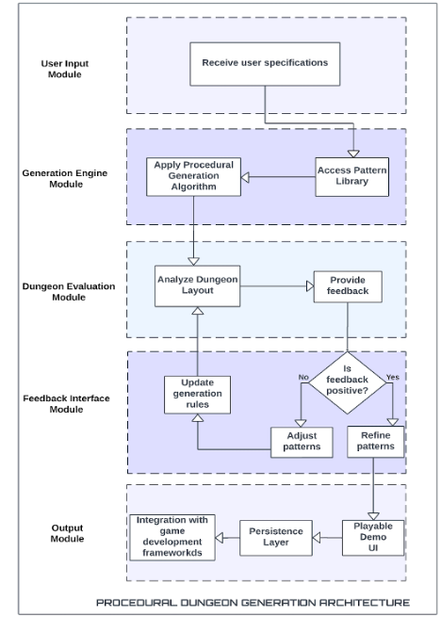
System Architecture
User Input Module: Allows users to customize dungeon generation with settings like size, complexity, and theme through an easy-to-use interface.
Generation Engine Module: Creates varied and visually appealing dungeon layouts based on user preferences using advanced algorithms.
Dungeon Evaluation Module: Evaluates generated dungeons with procedural personas and algorithms, providing feedback on gameplay metrics.
Feedback Module: Presents evaluation results with visuals and reports, helping developers refine dungeon designs and algorithms.
Output Module: Prepares and exports the final dungeon, making it ready for integration into game environments.

Slide 5
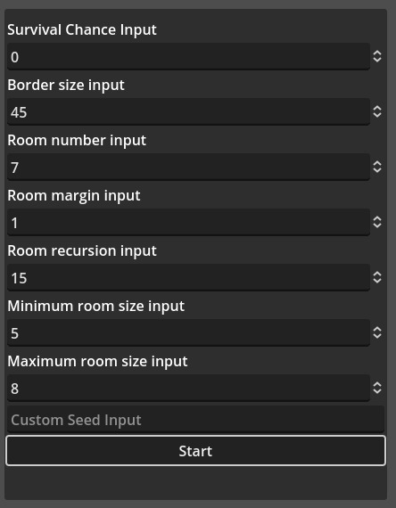
1. User Input Module
Customization options for users
Interface design principles
How user preferences affect dungeon generation

Slide 6
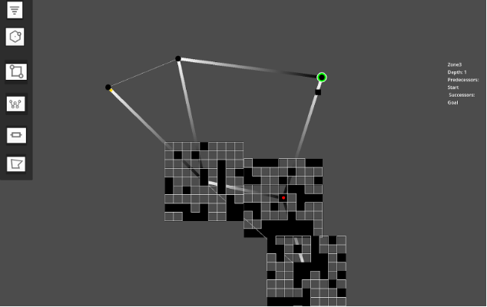
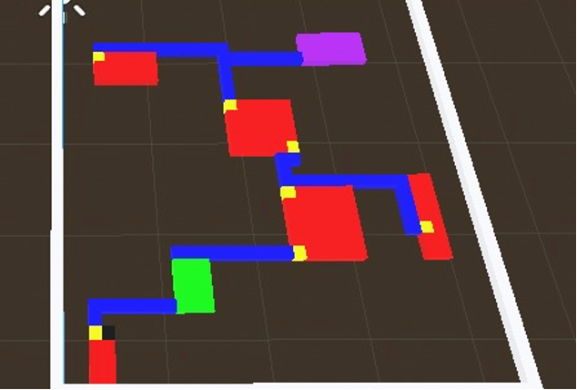
2. Generation Engine Module
Graph rewriting algorithm for logical flow
Floor plan generation
Placement of rooms, corridors, obstacles, and interactive elements
Graph Rewriting Representation
Floor Plan Generation

Slide 7
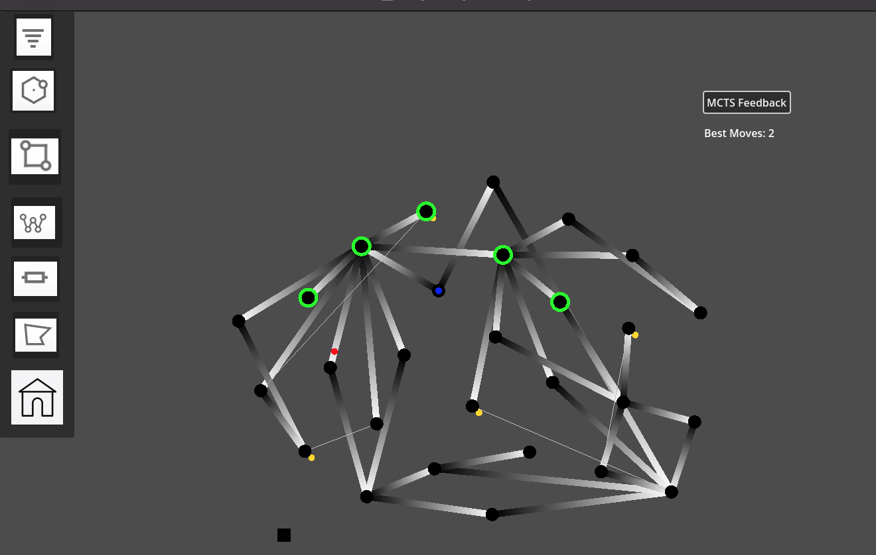
3. Dungeon Evaluation Module
Procedural personas for playtesting Monte Carlo Tree Search algorithm
Generation of metrics for user feedback
Importance of user feedback in optimizing algorithms

Slide 8
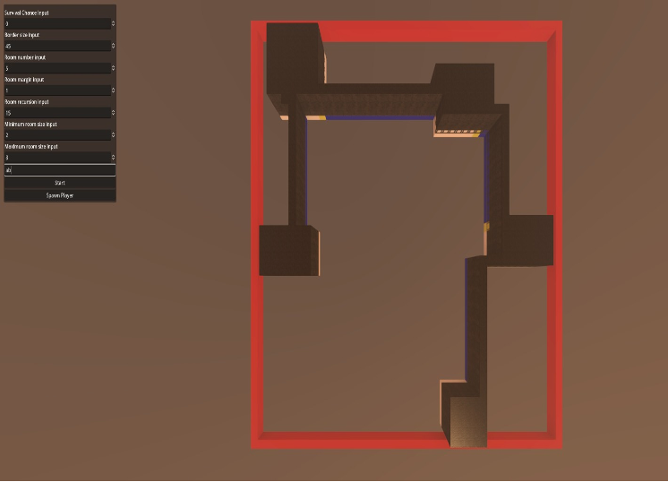
4. Output Module
Preparation of playable demos and prototypes
Export options for game integration
Compatibility with existing game environments

Slide 9
Project Demo
https://drive.google.com/file/d/1PLc6IL38ZpCHdq2Kb7pRbC3jTo9-5BY3/view?usp=drive_link

Slide 10
Academic Contribution
Algorithm enhancement in PCG for dungeon generation
Feedback-driven adaptation in game development
Advancement in adaptive PCG and human-centered design
Conclusion
Summary of key project achievements
Potential areas for further research and development

Slide 11
Thankyou!
Q&A

