Slide 1
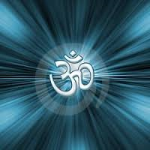
AUM
Yoga Studio

