Slide 1
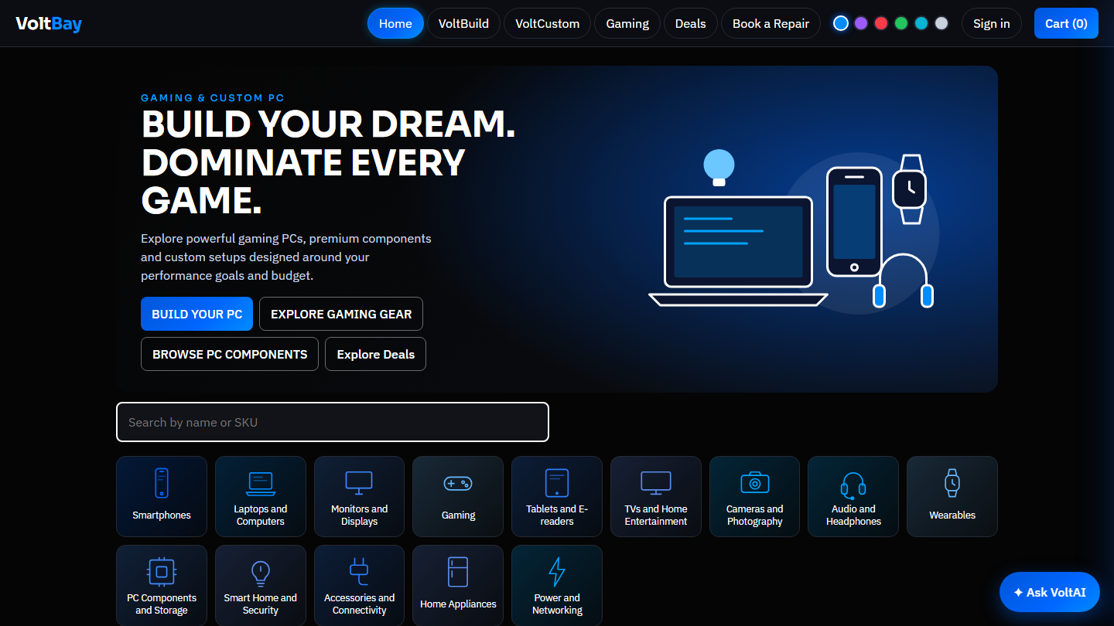
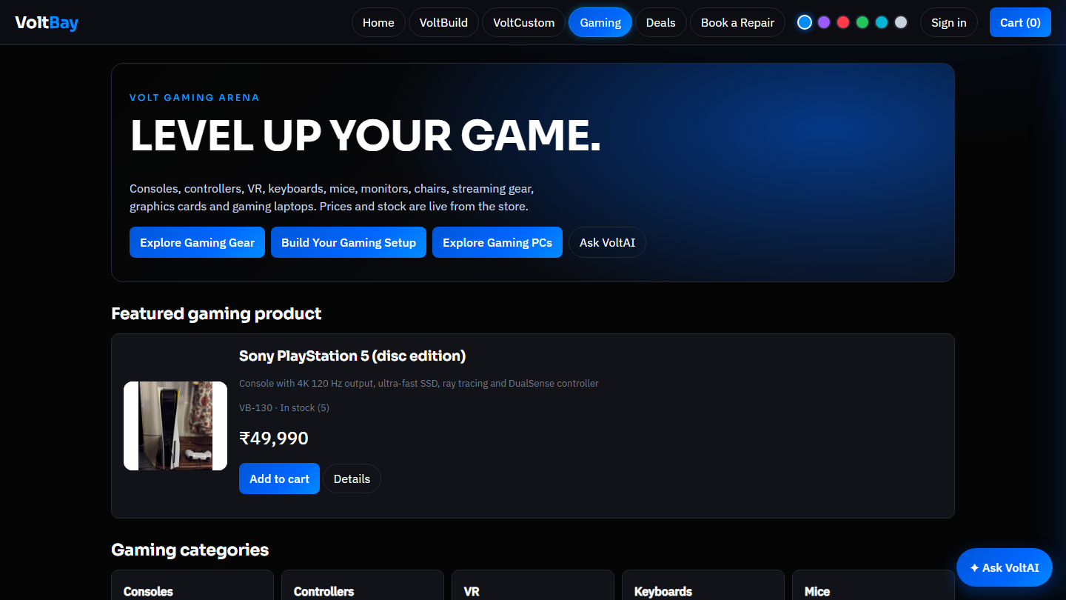
PROJECT PRESENTATION
VoltBay
A smart electronics store with saved carts, personalised picks and a Gemini shopping assistant
Team of six · Member 1 to Member 6
voltbay-store.onrender.com
Notes:
Welcome. VoltBay is a working online electronics store that we built and deployed. Six of us will present two slides each. Replace "Member 1..6" with real names.

Slide 2
Our team and who covers what
1
Member 1
2
Member 2
3
Member 3
The idea and the storefront
The foundation
The intelligence
What VoltBay is, the shop and Gaming Arena
How it is built, saved sessions and carts
Recommendations and the VoltAI assistant
4
Member 4
5
Member 5
6
Member 6
Buying and trust
The back office
Quality and launch
Checkout and pricing, reviews and tracking
Admin panel, orders, inventory and repairs
Security, testing, deployment and next steps
Notes:
Each member owns one theme and has two slides. Replace "Member N" with the names.

Slide 3
What is VoltBay?
1
Member 1 · slide 1 of 2
An online store for phones, laptops, gaming gear and home tech. Your cart is remembered between visits, the shelf adapts to what you browse, and an AI assistant helps you choose.
69
15
2
real products with photos
departments to browse
AI modes: Gemini and offline
Notes:
VoltBay is an online electronics store: phones, laptops, tablets, cameras, gaming gear, PC parts and home tech. Three things set it apart: carts are remembered, picks are personalised, and an AI assistant helps you choose. Everything on the next slides is built and running.

Slide 4
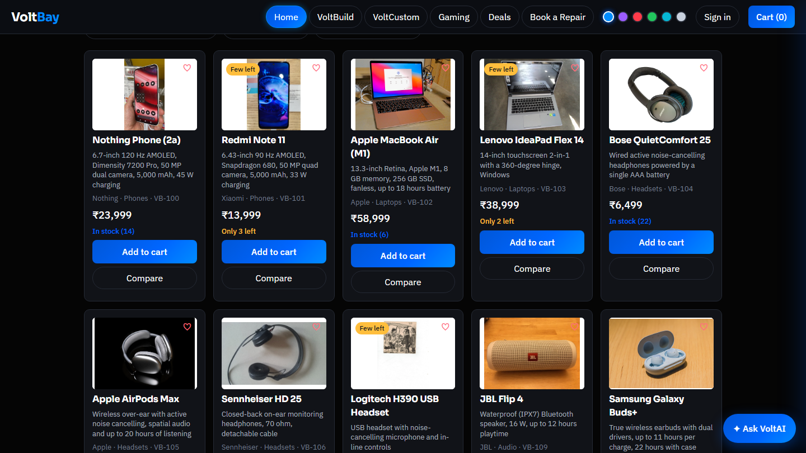
Storefront and Gaming Arena
1
Member 1 · slide 2 of 2
Cards show photo, price, stock and stars
Gaming Arena: 10 categories and ready-made setups
Search, sort, stock filter, wishlist and compare work on every page.
Notes:
The shop has search, sorting, an in-stock filter, wishlist and compare. Every product has a real photo with its licence, a summary and full specifications. The Gaming Arena groups consoles, controllers, VR, keyboards, mice, monitors, chairs and PC parts, and offers ready-made setups with Add all to cart.

Slide 5
How VoltBay is built
2
Member 2 · slide 1 of 2
Wikimedia
photos, licensed
Node.js 22 with no extra packages
Built-in SQLite database
One REST API for the shop and admin
Photos and credits stored with each product
Browser
page and scripts
Node.js server
API and rules
SQLite
saved data
Gemini AI
assistant
Notes:
The browser talks to one small Node.js server. The server keeps everything in a built-in SQLite database, calls Google Gemini for the assistant, and the product photos were downloaded once from Wikimedia Commons with their licences. There are no extra packages to install.

Slide 6
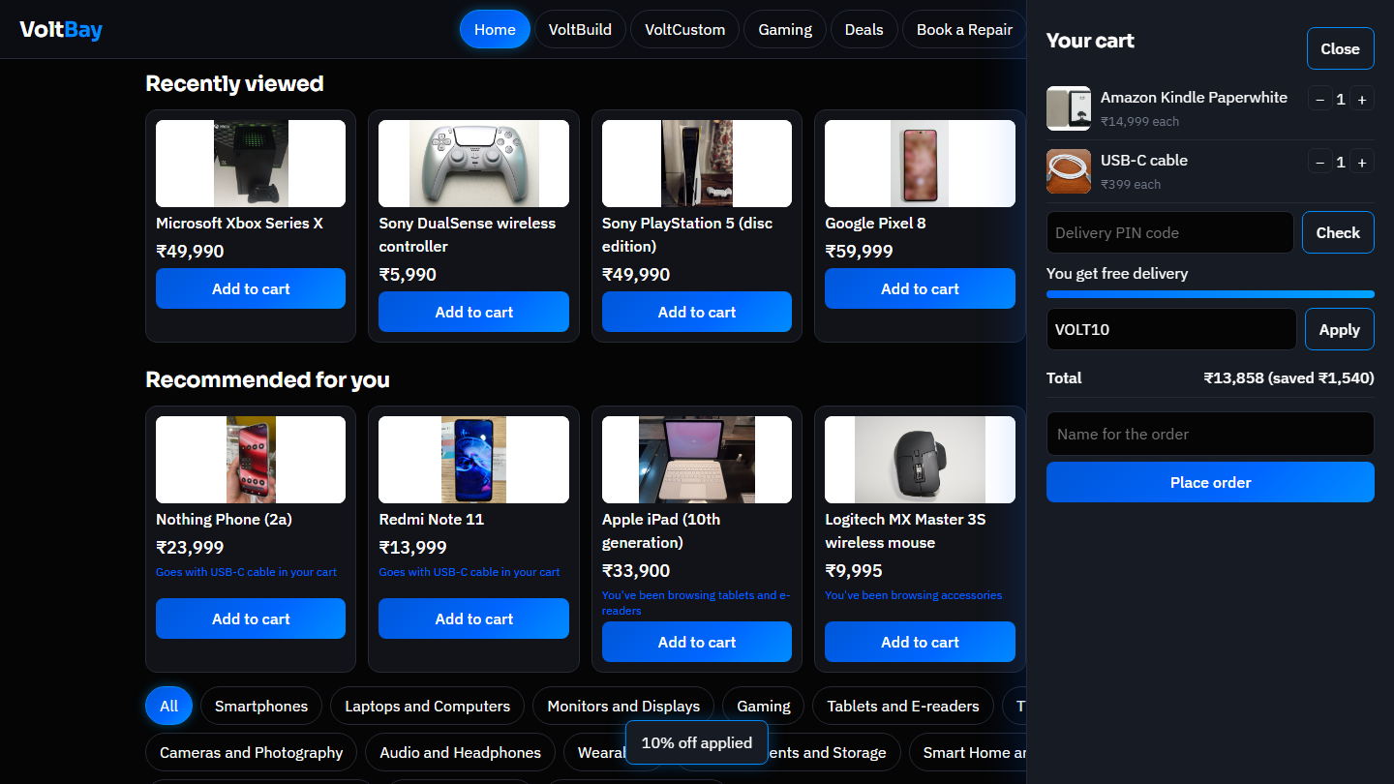
Carts that remember you
2
Member 2 · slide 2 of 2
1
First visit
2
Saved on the server
3
Come back
4
Sign in
A private token is saved in the browser
Cart, wishlist and history go to the database
Within 90 days the same cart is waiting
The guest cart merges into your account
Tokens are stored hashed, never in plain form
Changes are saved within a second
Stock is checked on the server, not the page
Notes:
On the first visit the browser gets a private random token. Only a hash of it is stored on our server. The cart, saved items and recently viewed products live in the database, so coming back within 90 days shows the same cart. Signing in merges the guest cart into the account.

Slide 7
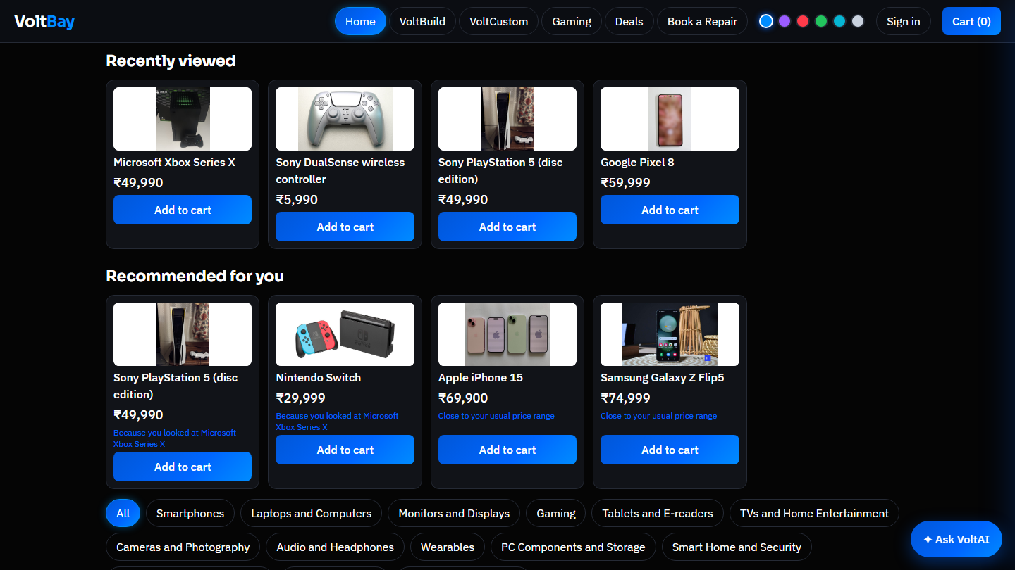
Recommendations that fit you
3
Member 3 · slide 1 of 2
Signals
1
Views, searches, wishlist, cart, orders and budget
Scoring
2
Category, brand, price fit and matching accessories
Reason
3
Every card says why it was picked
After viewing Xbox gear, the shelf explains its picks
Notes:
We only use what the shopper actually did: products viewed, searches, saved items, the cart, past orders and a stated budget. Recent actions count more. Each product is scored on category, brand, price closeness and accessories that go with the cart, and every card says why it was picked.

Slide 8
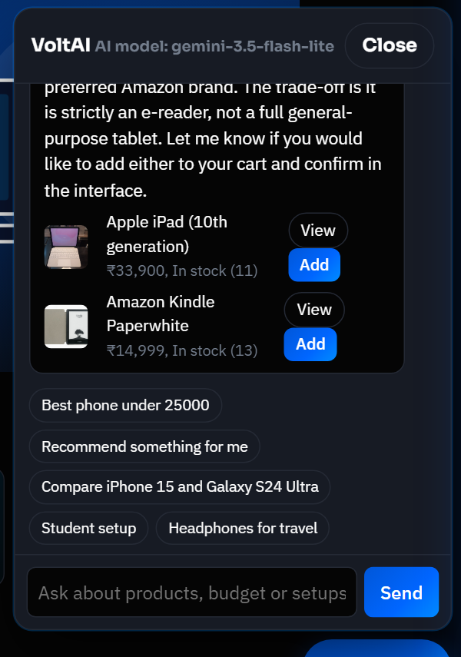
VoltAI, our shopping assistant
3
Member 3 · slide 2 of 2
Google Gemini with 9 shopping tools
Searches, compares and tracks orders
Adds to cart only after you confirm
Daily limits keep the key safe
Offline assistant if the model is down
Notes:
VoltAI uses Google Gemini flash-lite with nine tools: search, product details, compare, recommend, view cart, track orders, add or remove from the cart, and remember preferences. Cart changes always wait for the shopper to press Confirm. A daily cap protects the key, and if the model is unavailable an offline assistant answers instead.

Slide 9
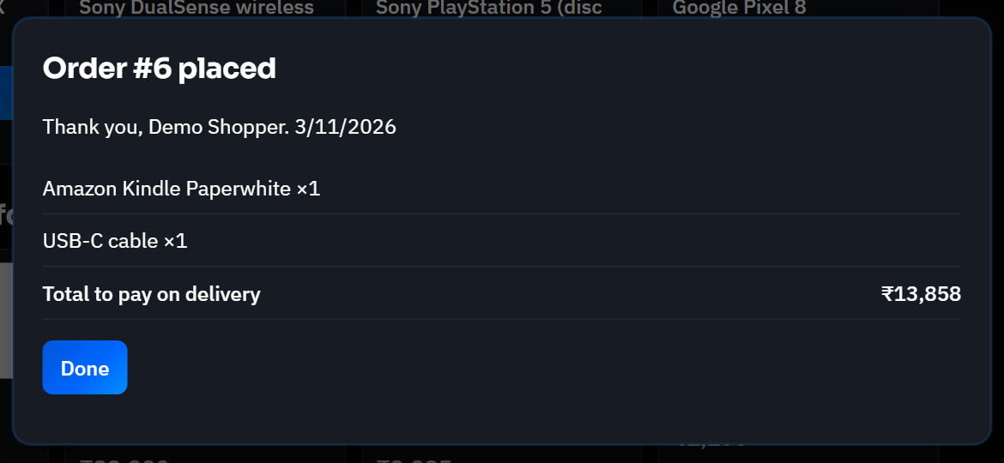
Cart, coupons and checkout
4
Member 4 · slide 1 of 2
Total = subtotal - coupon - deals + add-ons
Stock and price are checked again at checkout
Notes:
Prices are worked out on the server, so the receipt, the stored order and the admin revenue always match. Deals, the VOLT10 coupon and add-ons such as warranty are applied there. Checkout checks stock, reduces it and saves the order in one safe step, so two shoppers cannot buy the last unit.

Slide 10
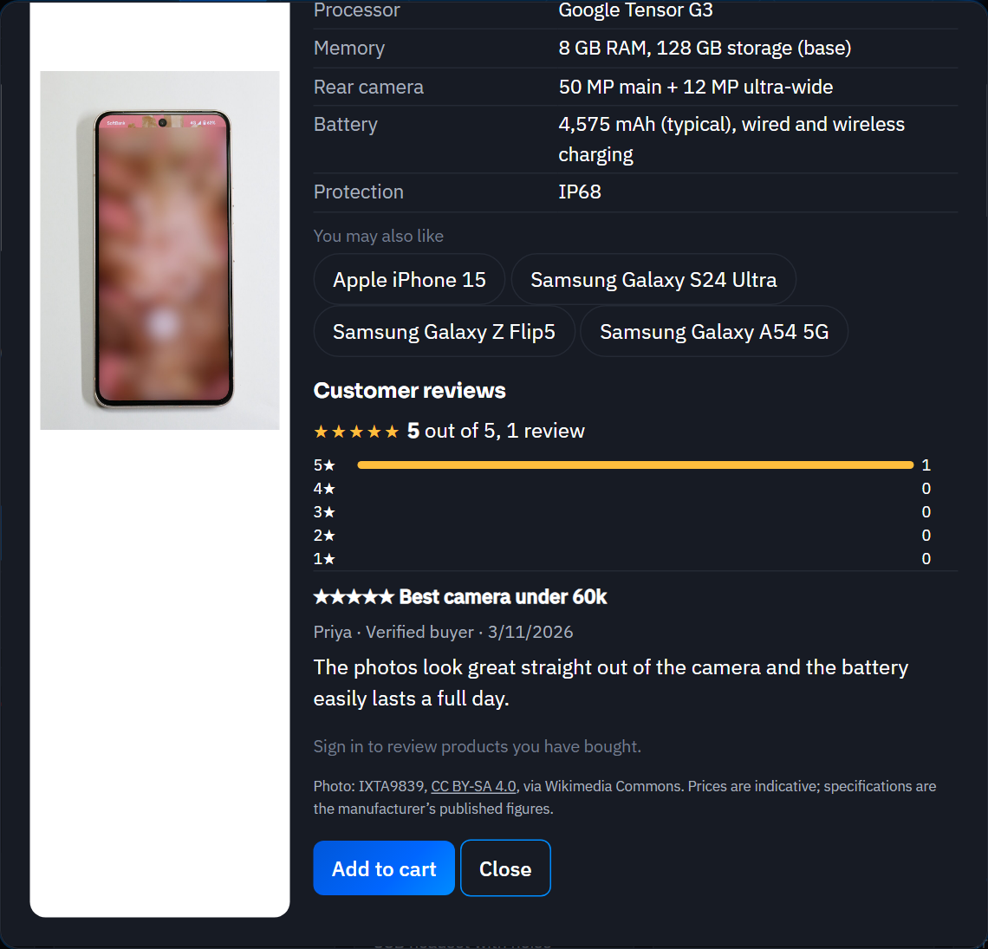
Reviews and order tracking
4
Member 4 · slide 2 of 2
Verified buyers only
The server checks the order history
One editable review each
Posting again updates it
Real averages
Stars on cards come from stored reviews
Order status
Pending, Packed, Shipped, Completed
Notes:
Only signed-in customers who really bought a product can review it, once per product and they can edit it later. Ratings are true averages of stored reviews and appear as stars on cards. Orders move from Pending to Packed, Shipped and Completed, and customers can see the status in their account or ask VoltAI.

Slide 11
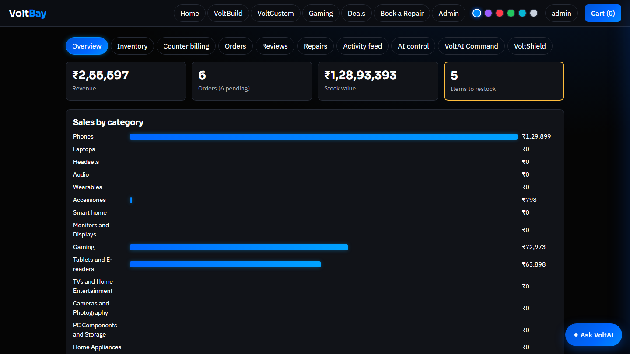
Admin panel, sign-in only
5
Member 5 · slide 1 of 2
Hidden from shoppers
No menu, and the server says no
Code sent after sign-in
Even the admin script is private
Real store data
Orders, revenue, stock and audit log
Notes:
Shoppers never see an Admin menu. This is enforced by the server: admin routes return 401 or 403 to everyone else, and the admin script itself is only sent after an admin signs in. The panel shows real data: revenue from stored orders, stock value, a low-stock list, sales by category and an audit log.

Slide 12
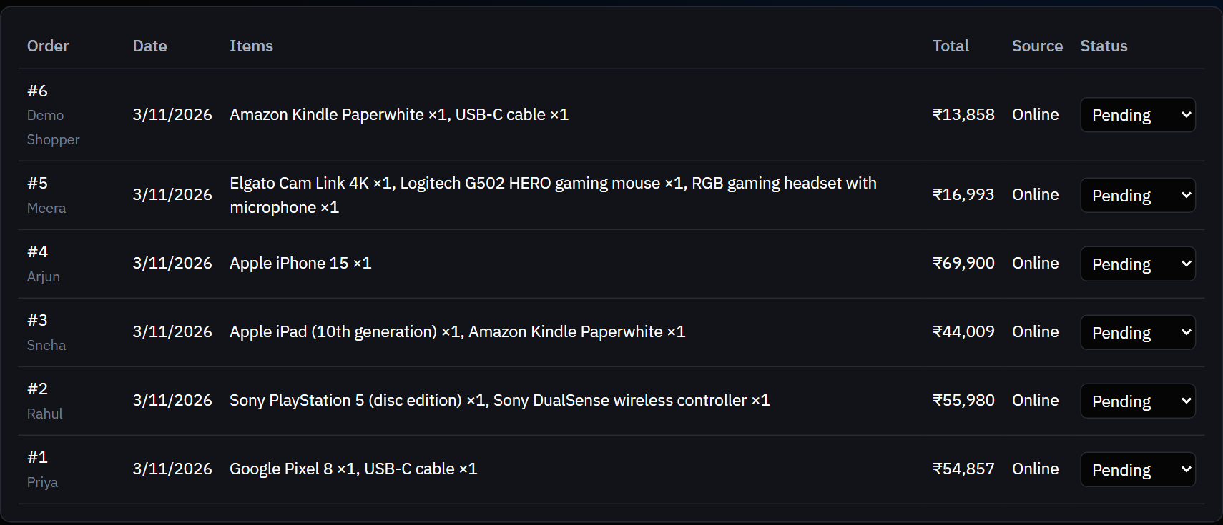
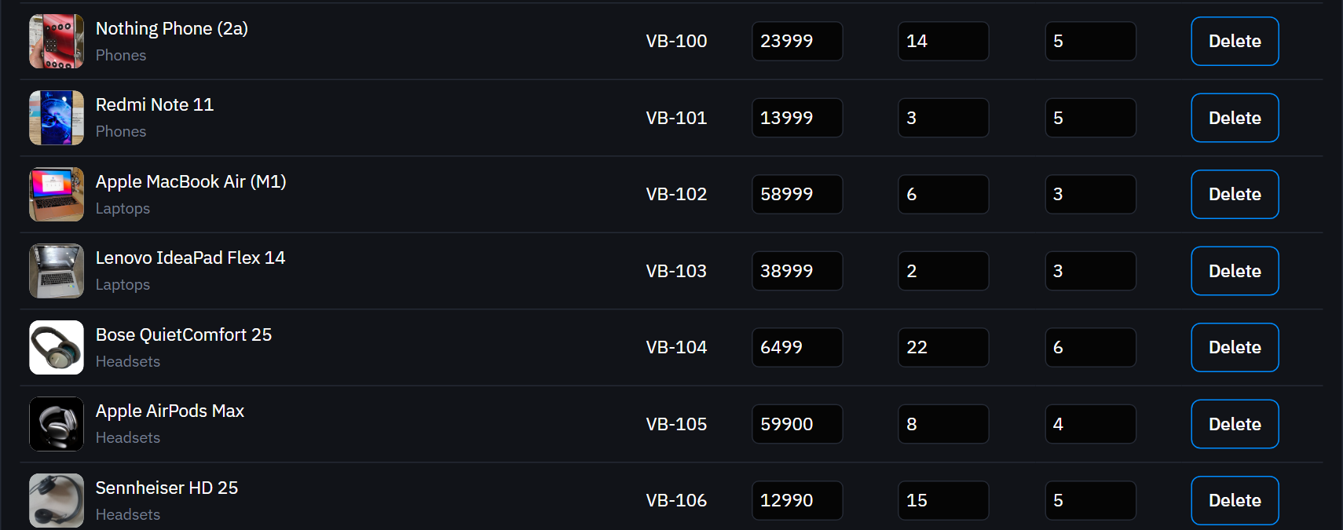
Running the store
5
Member 5 · slide 2 of 2
Orders: update status as they ship
Inventory: edit price and stock
Also in the panel
Counter billing
Reviews
Repairs
AI control
Activity log
Notes:
From the admin panel the owner updates order status, edits price and stock, adds products, bills walk-in customers at the counter, moderates reviews and handles repair bookings. The AI control tab shows model usage and has a kill switch and per-tool switches. Edits are saved on the server.

Slide 13
Security and testing
6
Member 6 · slide 1 of 2
Passwords hashed with scrypt
19
OK
Login attempts throttled
OK
automated API tests, all passing
Session tokens stored hashed
OK
9
Private files and admin API locked
OK
Strict browser security headers
real-browser tests, all passing
OK
Notes:
We hardened the app: passwords are hashed with scrypt, login attempts are throttled, session tokens are stored hashed, private files return 404, the admin API is locked, and strict browser security headers are set. 19 automated API tests and 9 real-browser tests all pass.

Slide 14
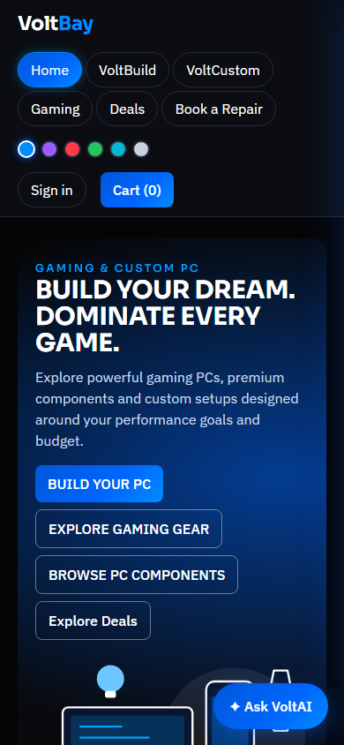
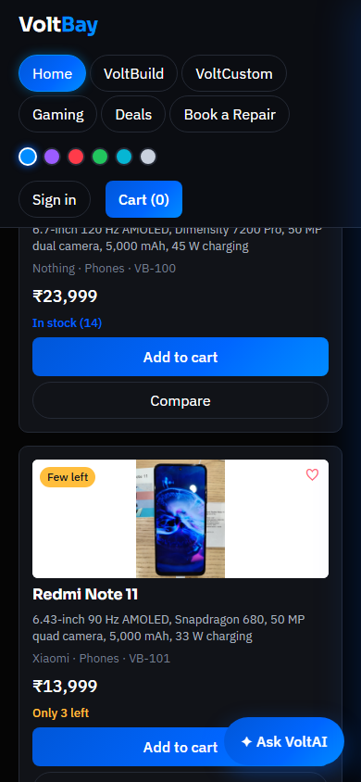
Going live and what comes next
6
Member 6 · slide 2 of 2
Code
built and tested
GitHub
public repository
Docker
packaged app
Render
live on the web
What comes next
Online payments and email confirmations
A permanent database
More real products and monitors
Works on phones too
Notes:
The code lives on GitHub. A Dockerfile packages the app and Render builds and runs it, with the Gemini key and admin password kept as private settings. On the free plan the site sleeps when idle and its disk resets on restart. Next steps are online payments, a permanent database, email confirmations and more real products.

Slide 15
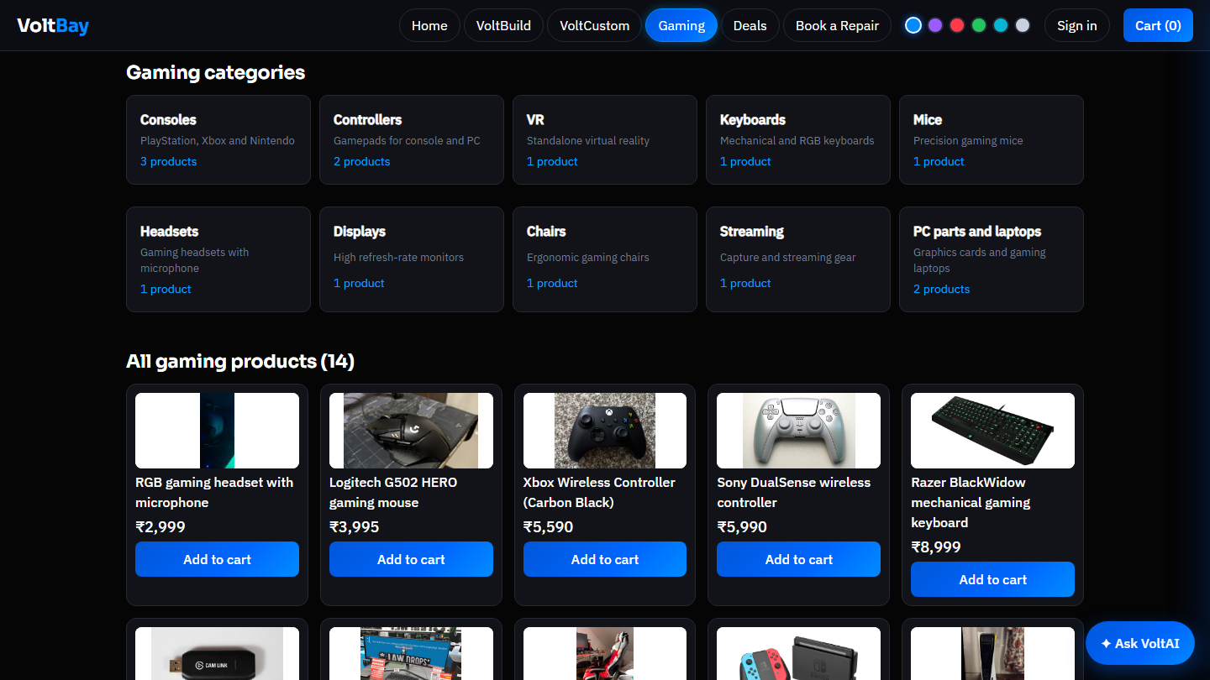
Thank you
Questions?
Live site
voltbay-store.onrender.com
Source code
github.com/nskpr2008/Python-Project
Notes:
Thank you. Happy to take questions or show the live site.

