Slide 1
Scientific communication
Nikolai Slavov

Slide 2
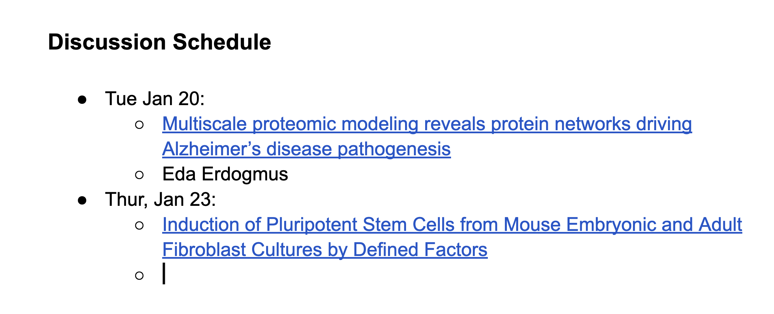
Research articles for discussion
Schedule of research articlesLinks to an external site. for discussion. You can also suggest articles

Slide 3
Reading a research paper
What problem is being addressed?
Why care?
What are the main results?
So what?
What is the supporting evidence?
What are the caveats?
How direct is the evidence?

Slide 4
Writing
What is your message?
What do your readers need to know to appreciate the message?
What is the best way to structure the information?

Slide 5
Principles for writing up research
Writing up research is first about thinking, framing and interpretation, and then about writing per say.
Start with why. Then move to how and what.
Make the most general statements supported by the results. Try to negate each statement until you cannot.

Slide 6

References
Primary function
Secondary function
Is self-citation ever acceptable ?

Slide 7
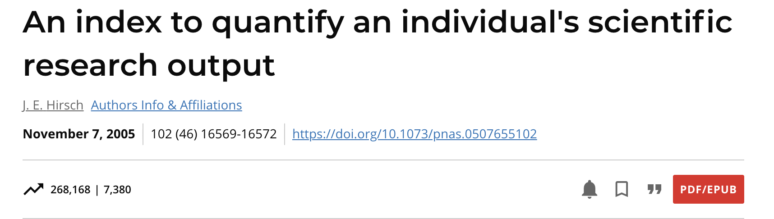
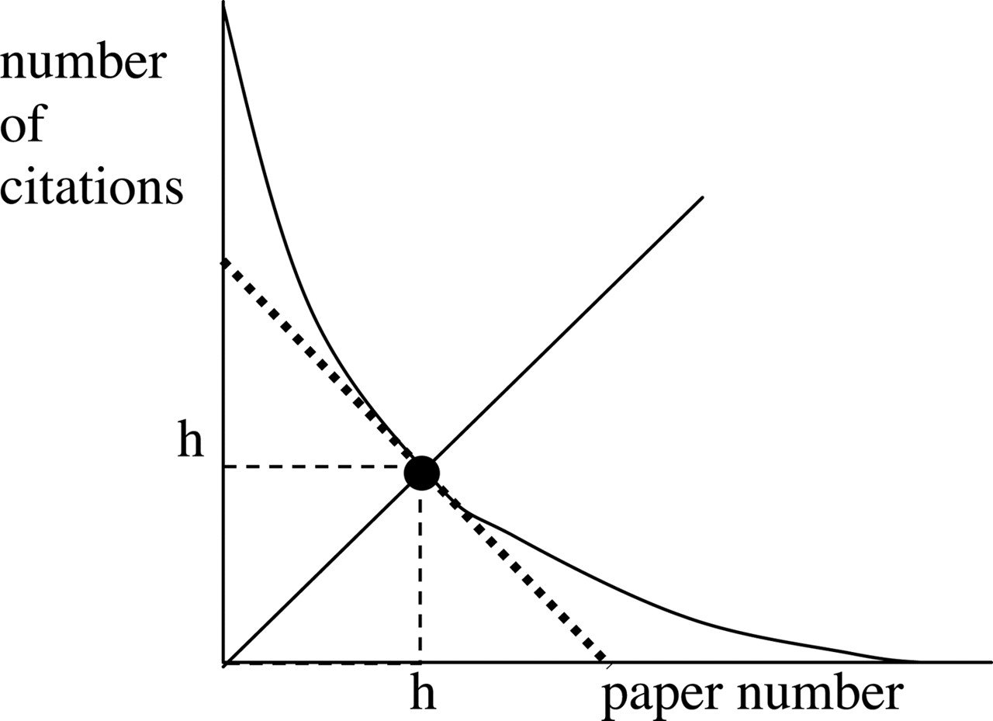
The index h, defined as the number of papers with citation number ≥h, as a useful index to characterize the scientific output of a researcher.

Slide 8
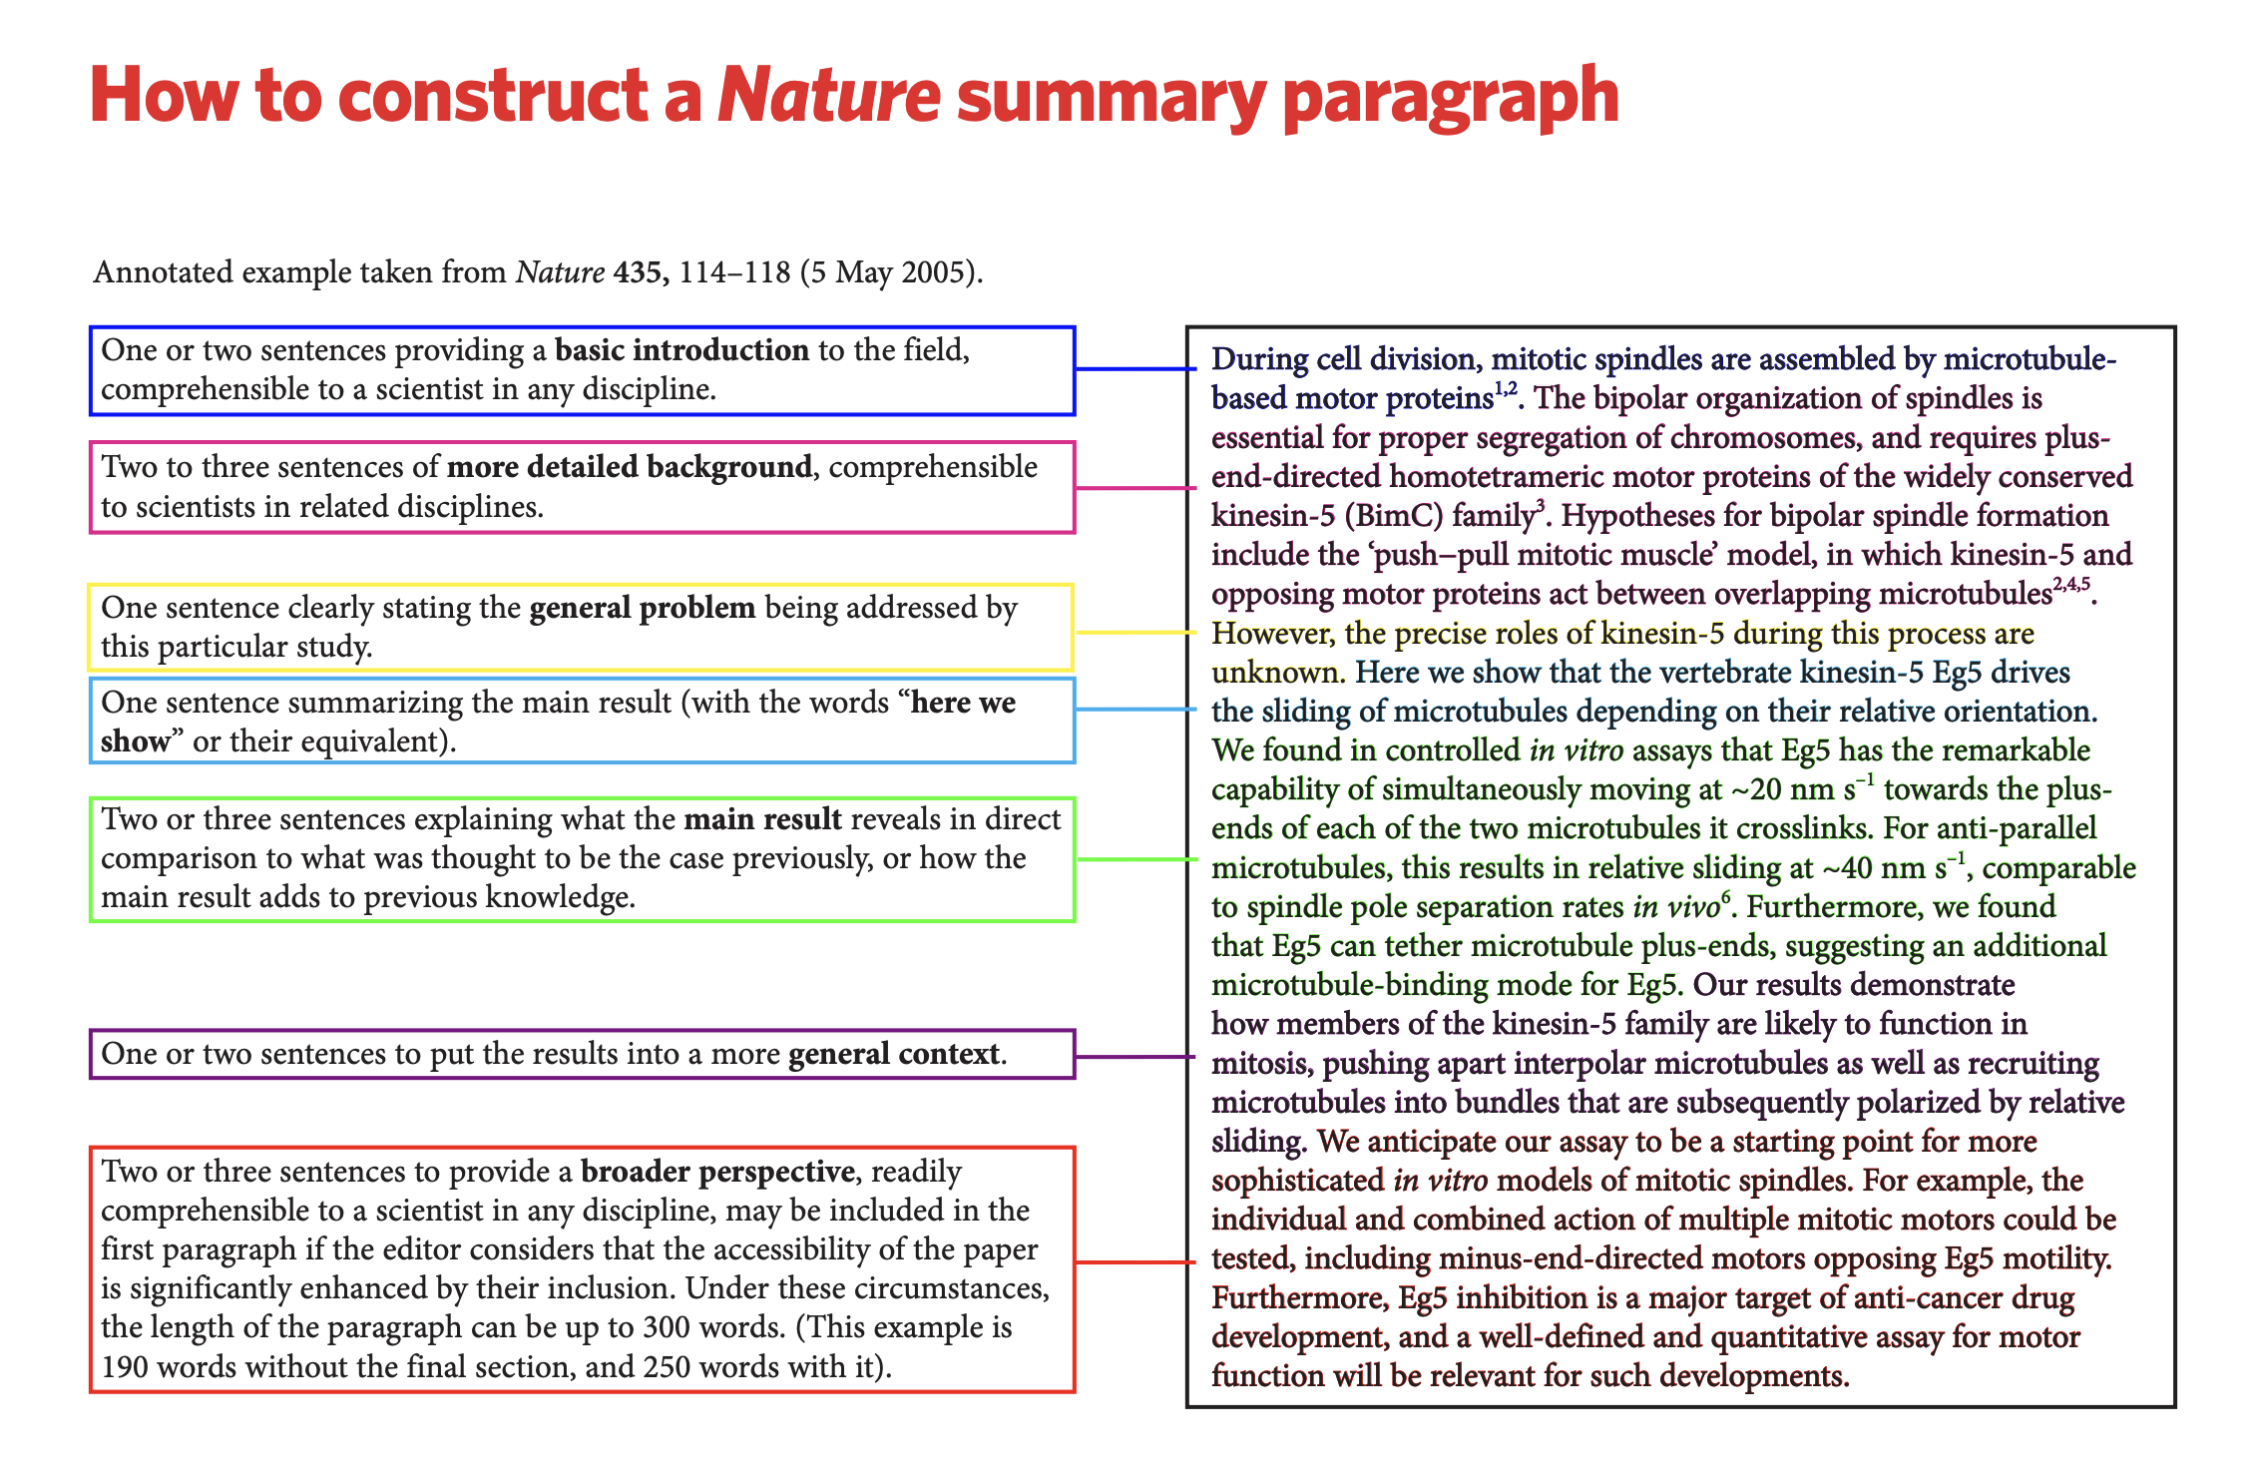
https://www.nature.com/documents/nature-summary-paragraph.pdf

Slide 9
Clarity is a primary goal. It is helped by consistent use of precise words.
Brevity is a virtue. Aim for short, streamlined sentences that are seamlessly connected in building up your logical arguments.
Always begin with the reason. Tell the readers why you’re writing the things that you’re writing. Do not describe what you did before you explain why you did it.
Minimize the use of adjectives and make sure the remaining ones do not do much work.
Read your draft and pause after each statement to think of counterexamples, counterarguments or possible misinterpretations. If you can think of one, revise it.
Be willing to critically evaluate your own writing and take constructive feedback as much as possible.
Writing tips

Slide 10
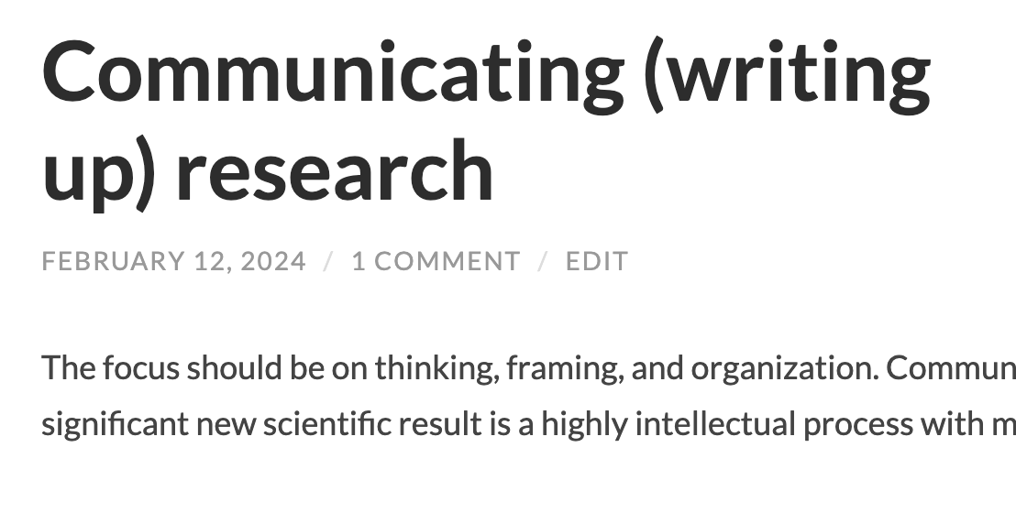
https://blog.slavovlab.net/2024/02/12/communicating-writing-up-research

Slide 11
Ethics, plagiarism & chatbots
Plagiarism
Assigning credit
Using chatbots
https://www.nature.com/nature-portfolio/editorial-policies/authorship

Slide 12
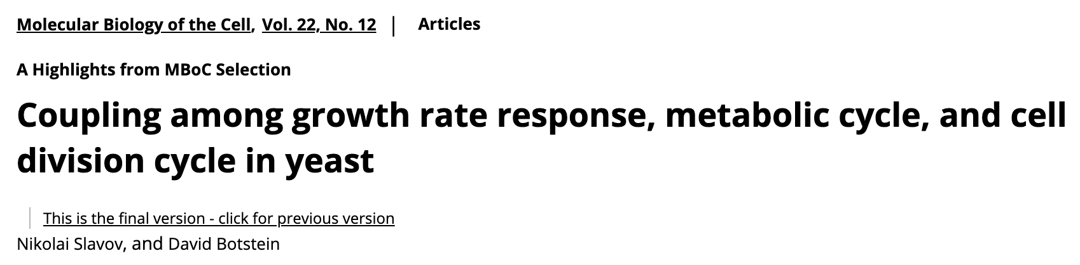
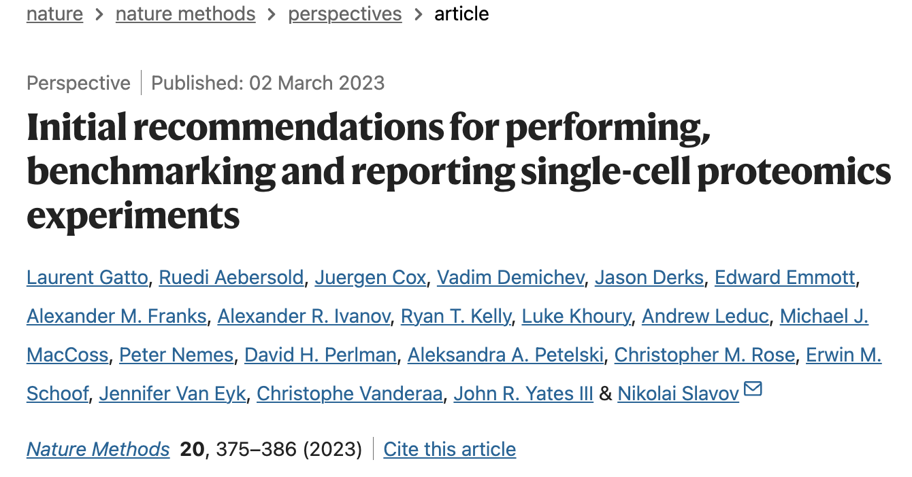

Slide 13
Writing proposals

Slide 14

Proposing
The only means to independence
Unless independently wealthy

Slide 15
Who should write proposals?
Positions that require writing proposals
What if your advisor is well funded?
How do you find funding opportunities
Sometimes they find you
Network
https://slavovlab.net/people.htm#Prospective_Applicants

Slide 16
The science
Good question (essential)
Important (somewhat depends on agency)
You can answer it
Why is this question suitable for you
What is your approach (most of the text)

Slide 17
Start with the question
Why?
Approach / Results
Notes:
Start the process. You need many skills

Slide 18
Determinants of success
The proposal
The perceived strength on the PI
HHMI funding

Slide 19
Determinants of success
The proposal
The perceived strength on the PI
HHMI funding
Strategy
Fining the right RFA
Knowing the members of the review section

Slide 20
Collaboration
Is it advantageous or adventitious?
Have you worked together?

Slide 21
Preliminary data
Published
Unpublished
How much?
R21
R01
High-risk high-reward RFAs
Emphasis on the PI qualifications

Slide 22
Writing proposals
Have a clear message
Conceptual clarity first, technical clarity second
Frame the questions & expected conclusions
What is plan B? C ?
Communication clarity
Quantity cannot substitute quality

Slide 23
The budget
Ask for what you need
Too much or too little undermines the proposal

