Slide 1
Quantitative Biology
Nikolai Slavov

Slide 2
A sense of scale
What is larger ?
A protein molecule or its mRNA template?

Slide 3
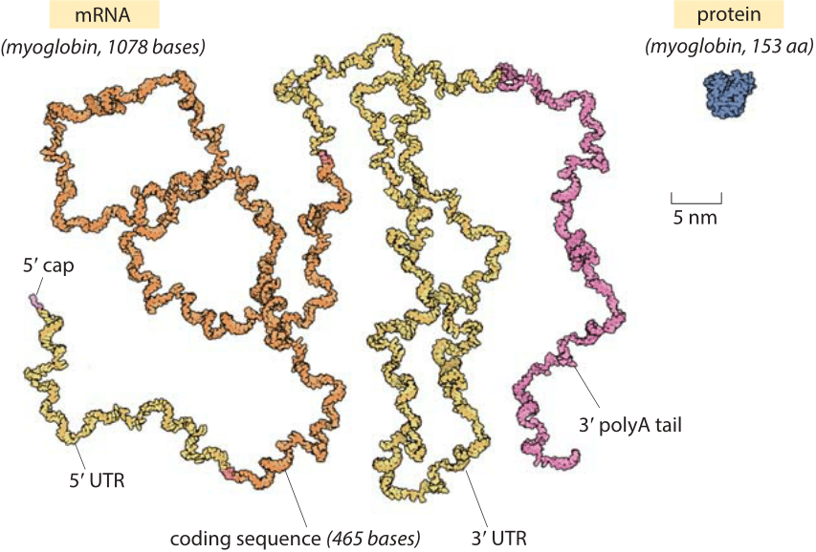
Cell biology by the numbers
https://book.bionumbers.org/which-is-bigger-mrna-or-the-protein-it-codes-for

Slide 4
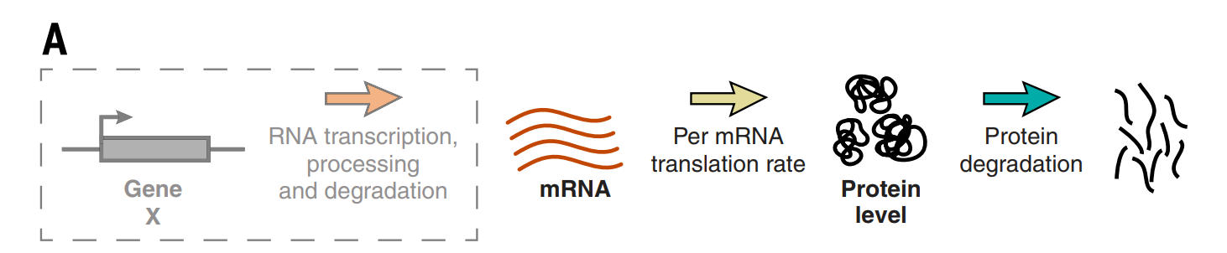
Introduction to our next article

Slide 5
Measuring synthesis & degradation rates
?

Slide 6
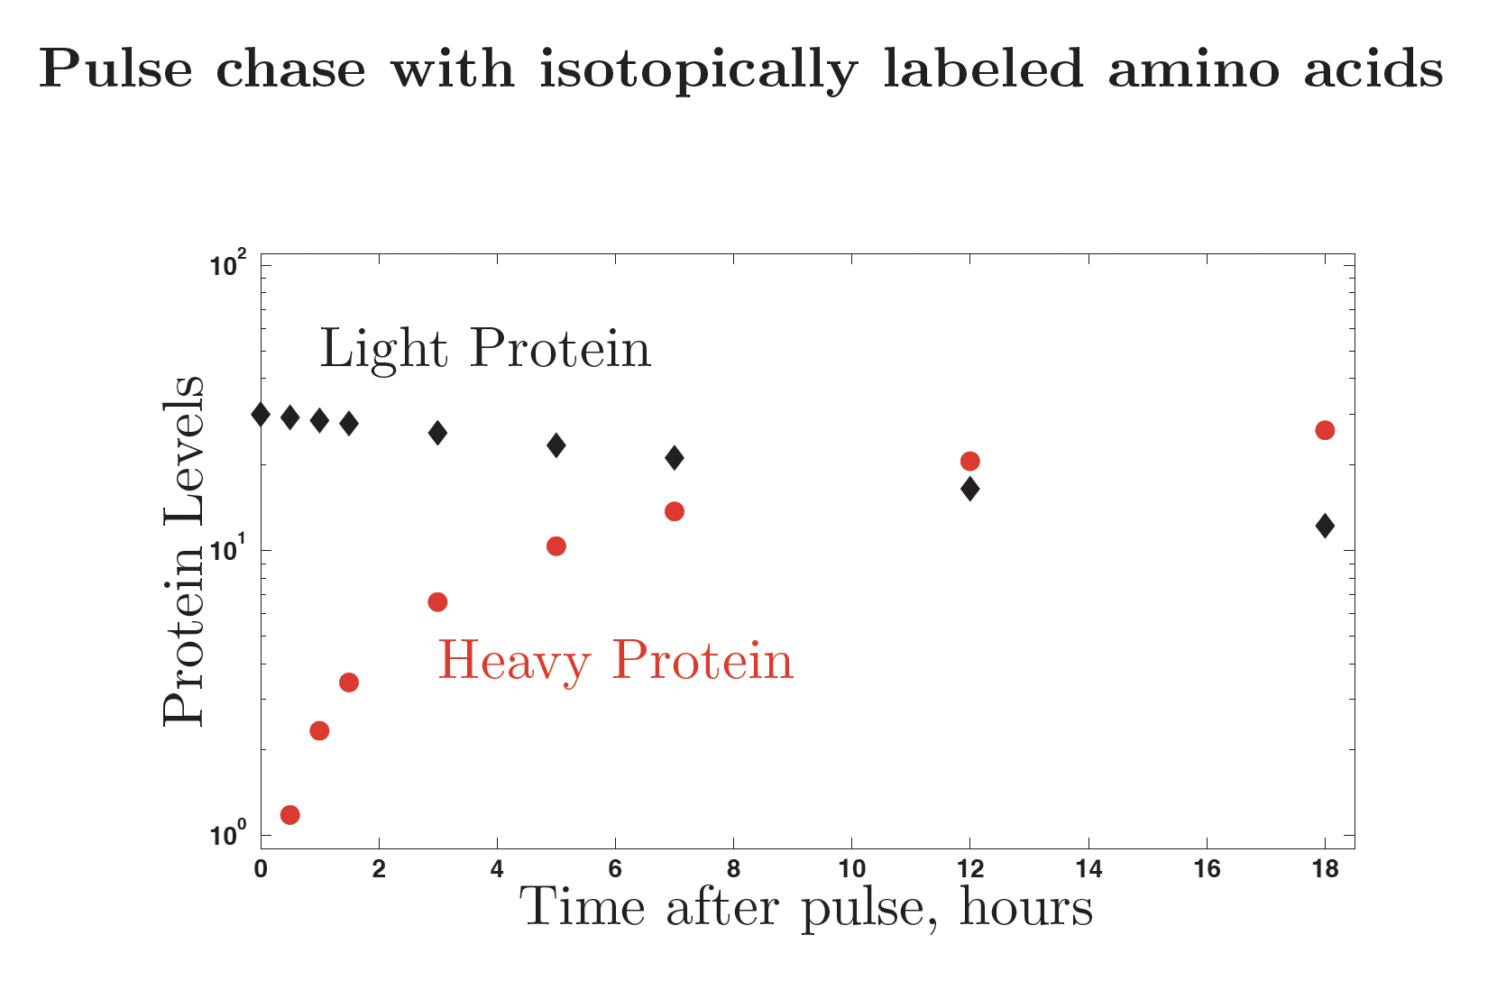
Measure protein synthesis and degradation

Slide 7
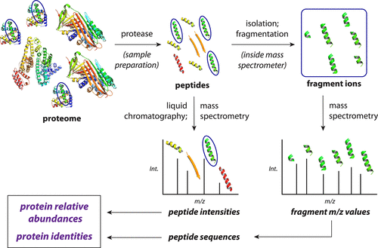
Mass spectrometry proteomics

Slide 8
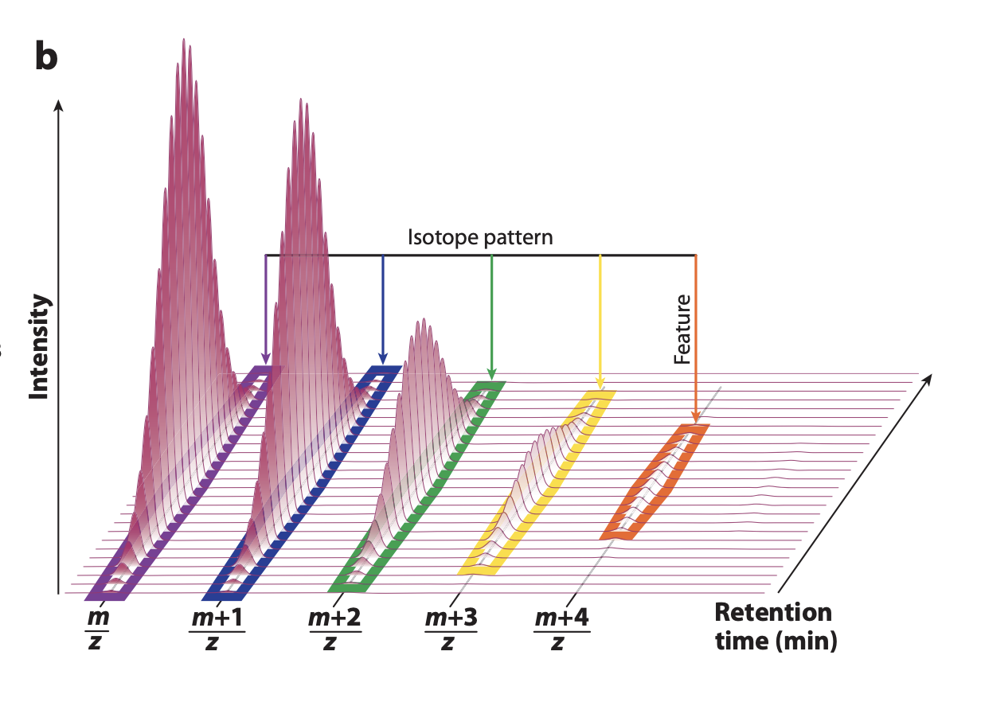
Isotopic envelopes

Slide 9
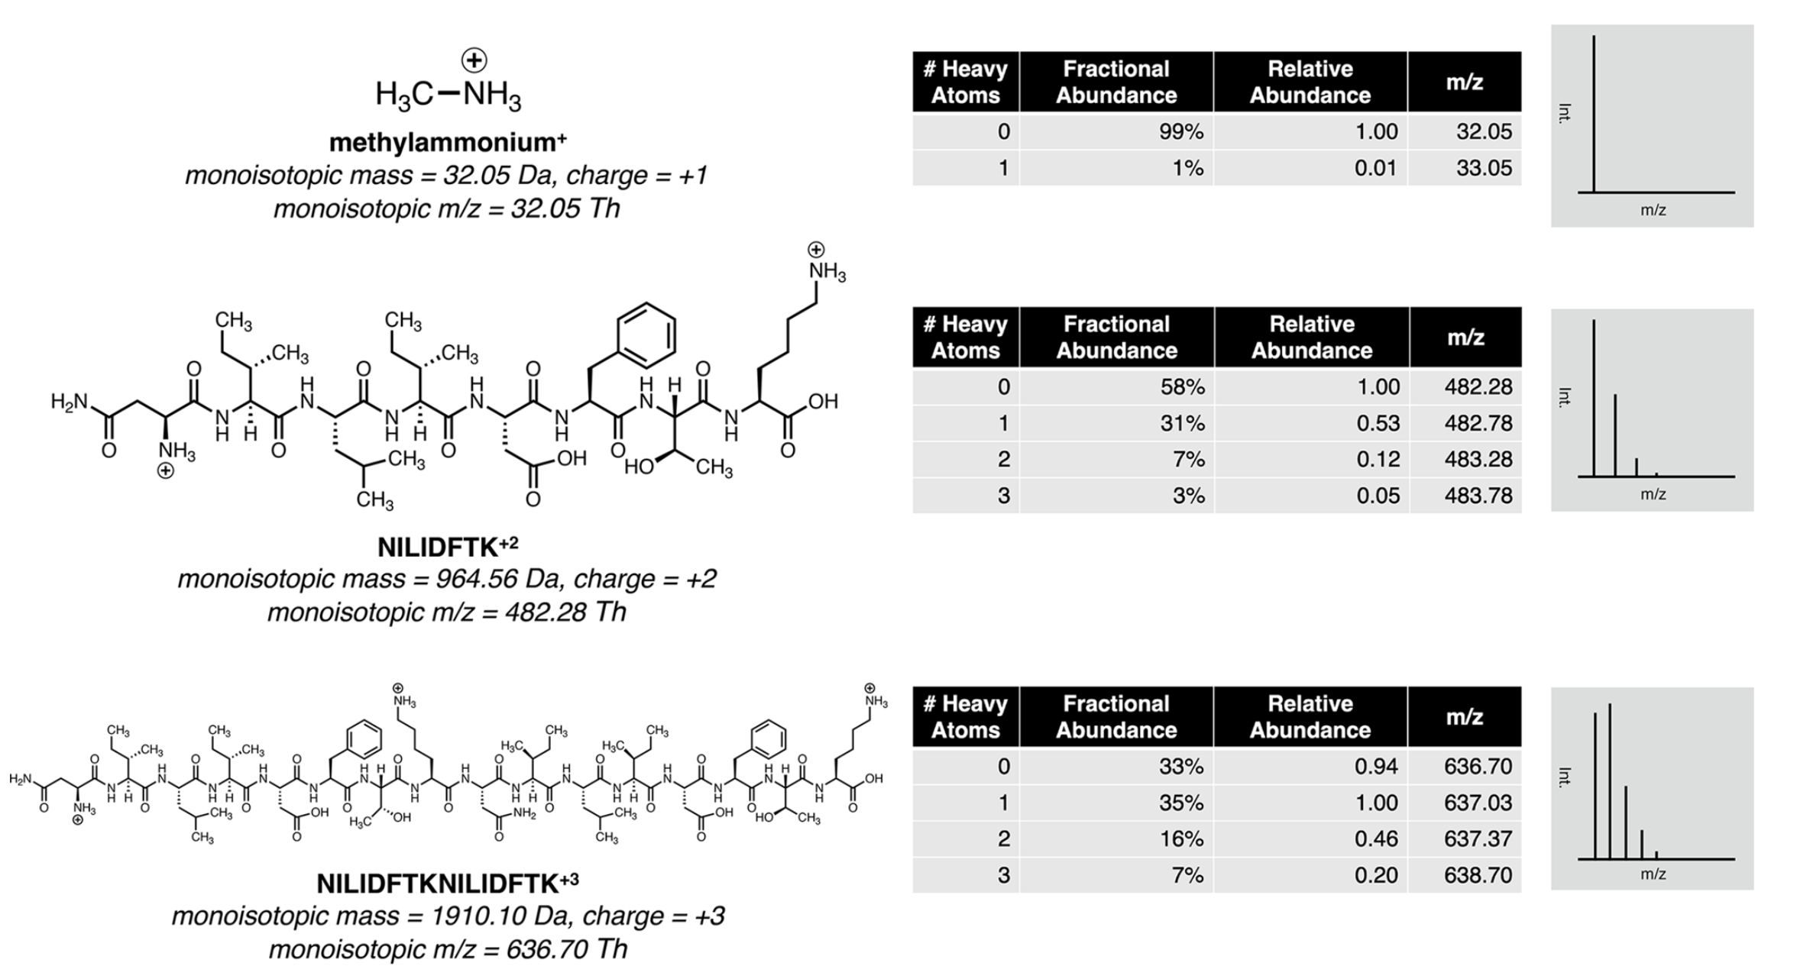
Isotopic envelopes Examples

Slide 10
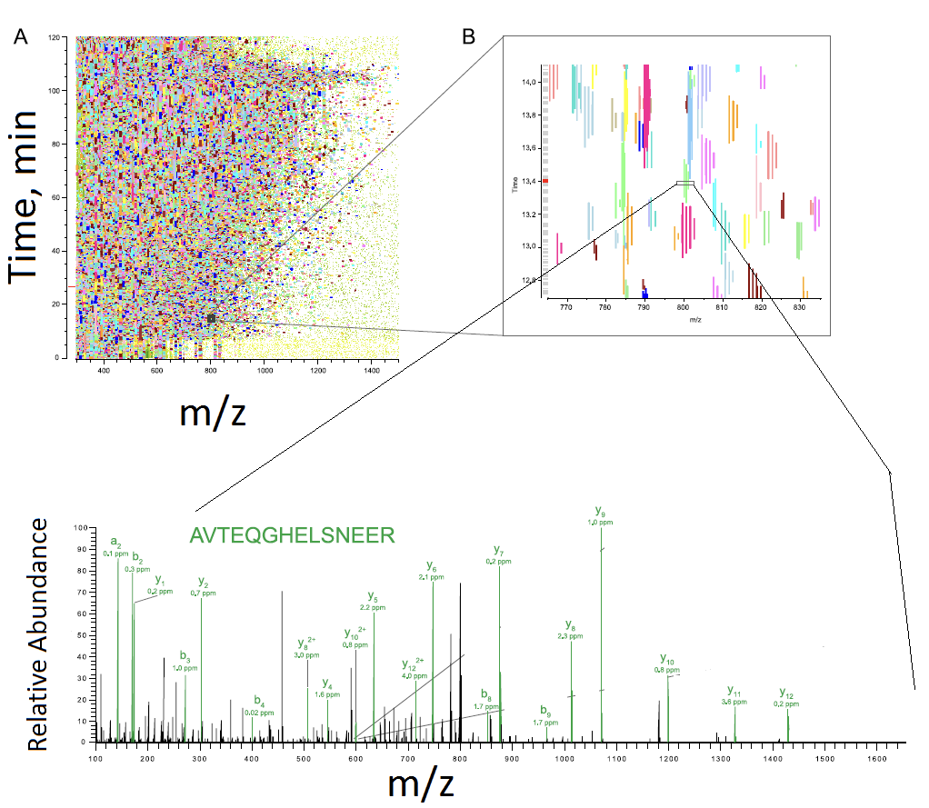
﻿Identifying peptides by tandem MS

Slide 11
Measure protein synthesis and degradation

Slide 12
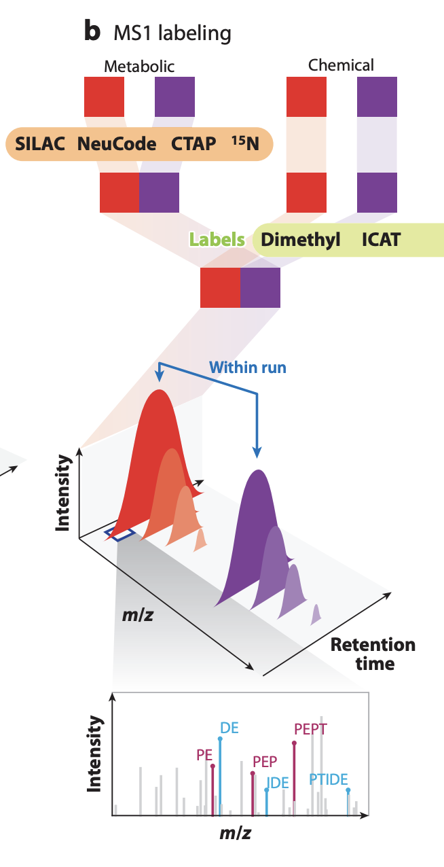
Quantification

Slide 13
Global Quantification of Mammalian Gene Expression Control
Schwanhäusser et al., Nature 2011
Journal Club – Critical Discussion

Slide 14
Motivation
• Fundamental questions ?
• Practical questions ?

Slide 15
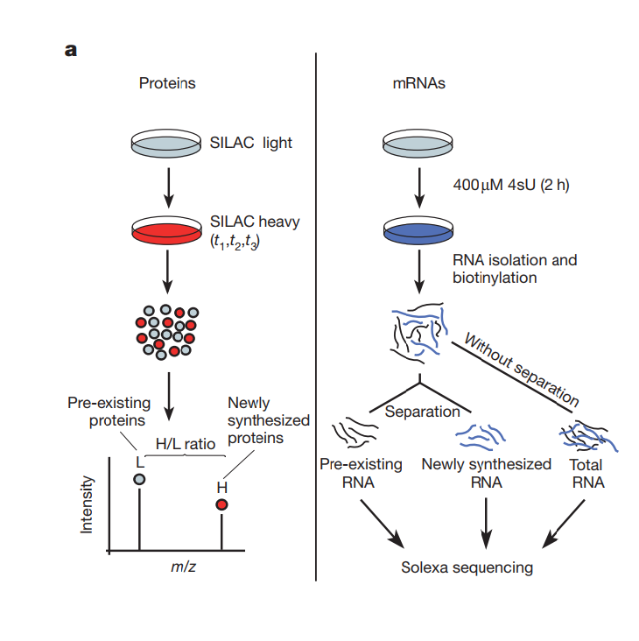
Figure 1 – Experimental design & datasets

Slide 16
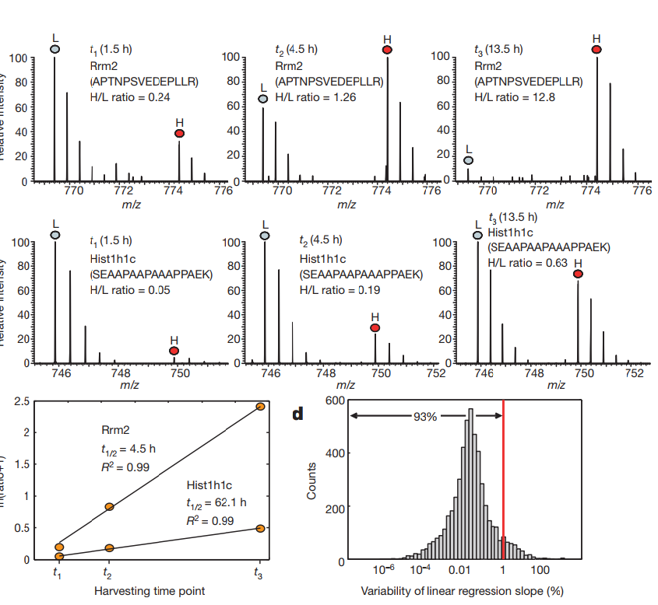
Figure 1 – Metabolic pulse

Slide 17
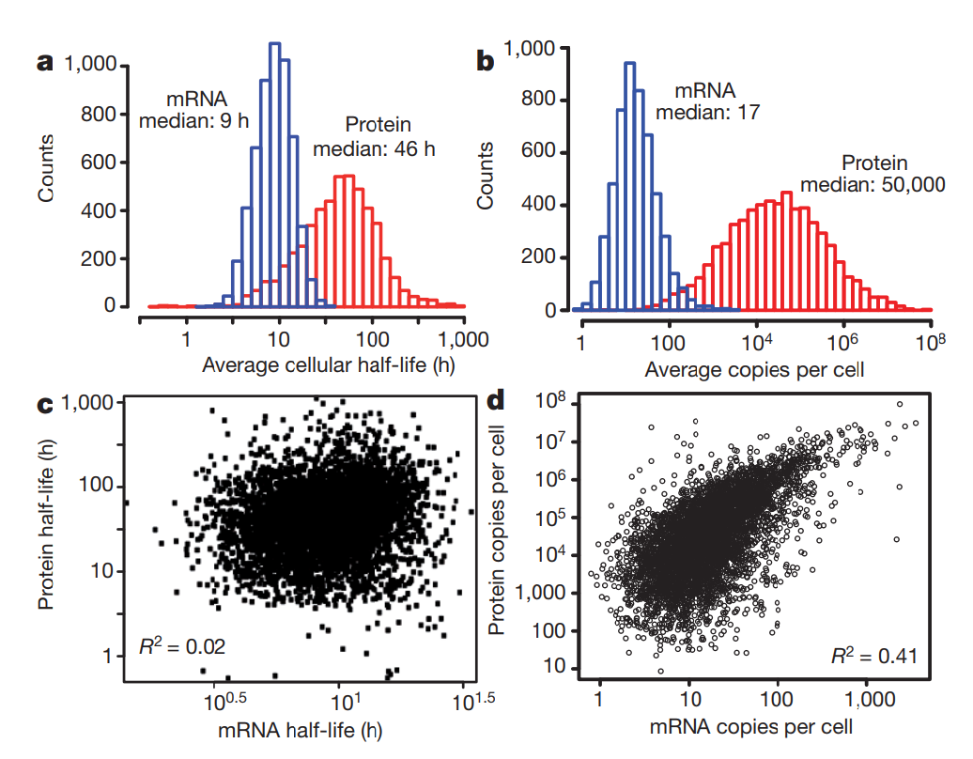
Figure 2 – mRNA and protein levels and half-lives.

Slide 18
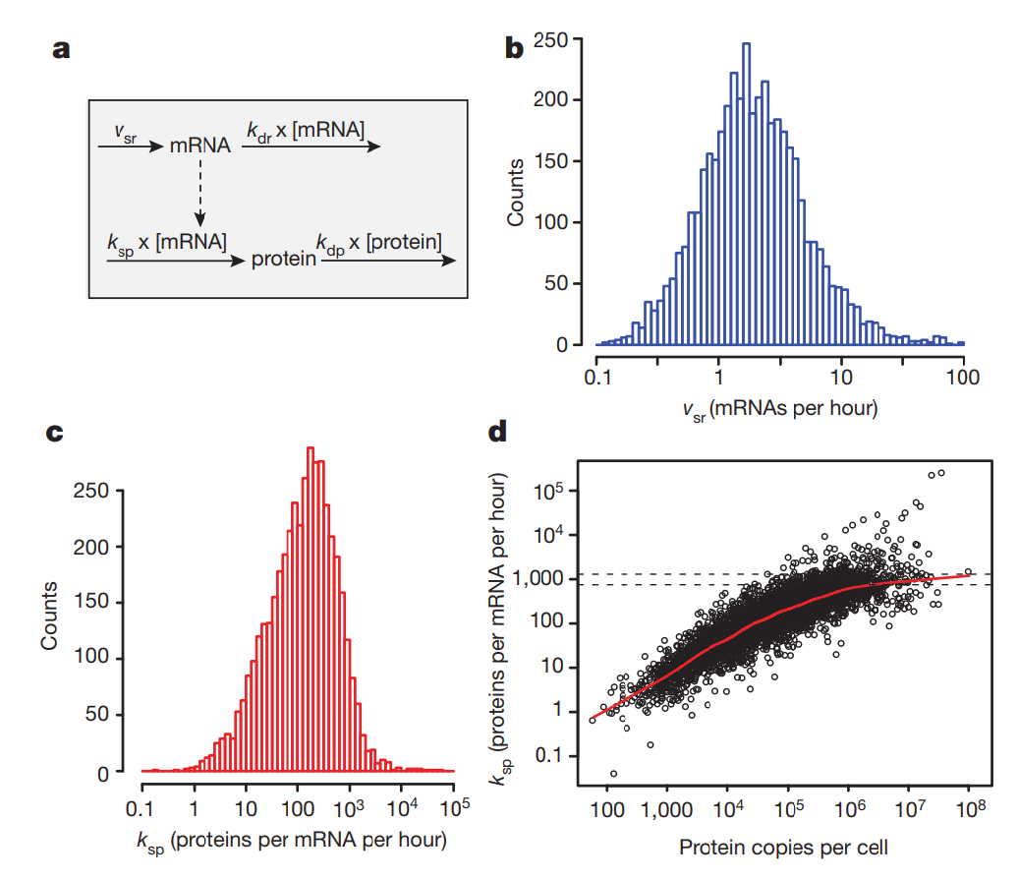
Figure 3 –﻿ Quantitative model of gene expression in growing cells.

Slide 19
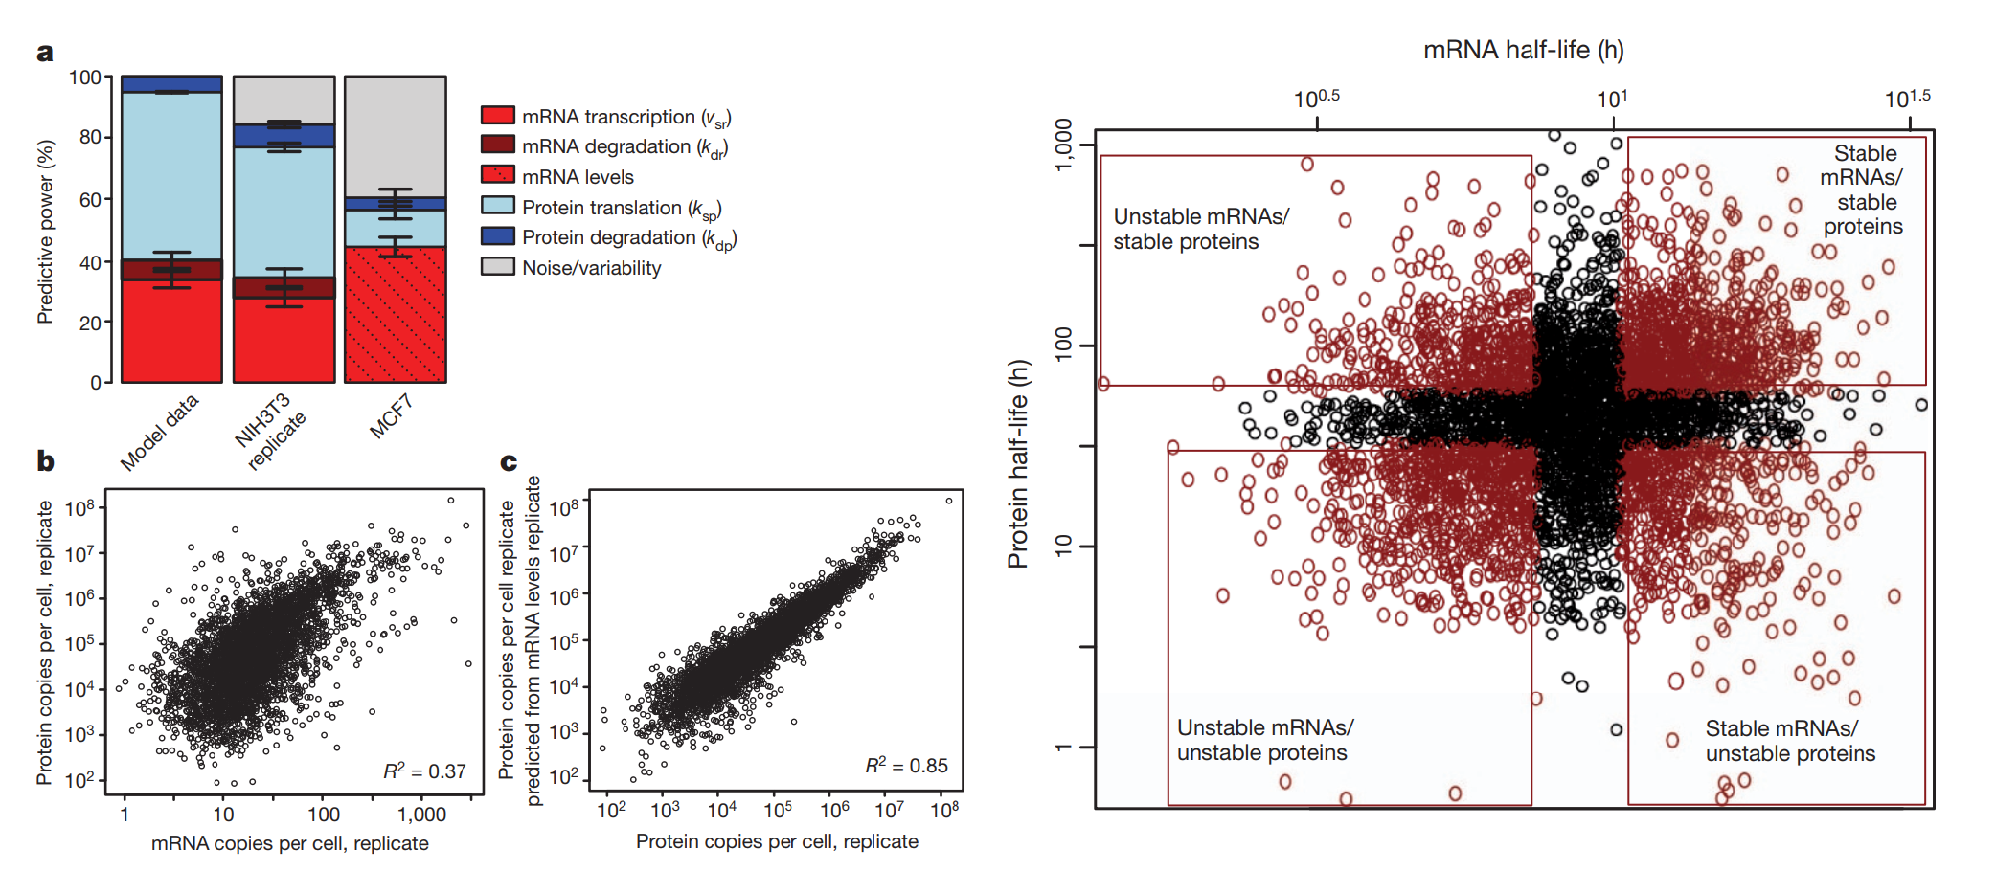
Figure 4 – ﻿Impact of different rates and rate constants

Slide 20
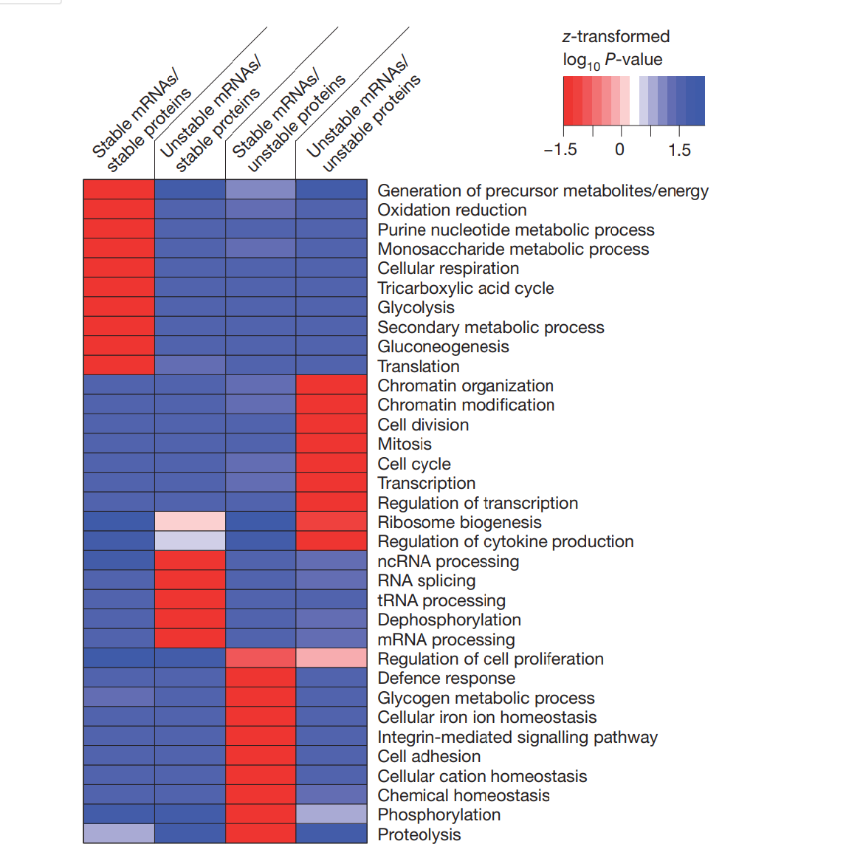
Figure 5 – Functional enrichment

Slide 21
Discussion

Slide 22
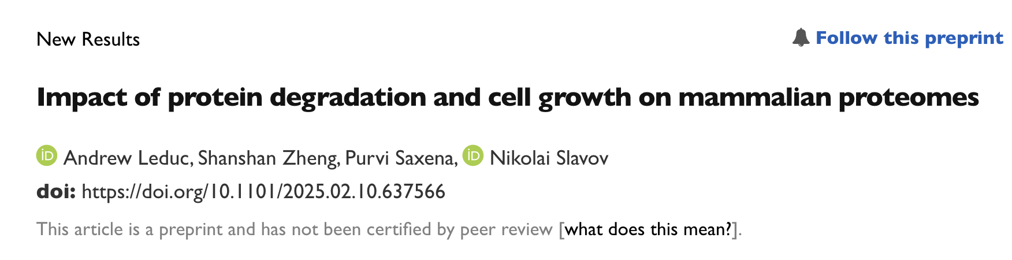
https://www.biorxiv.org/content/10.1101/2025.02.10.637566v3.full

Slide 23
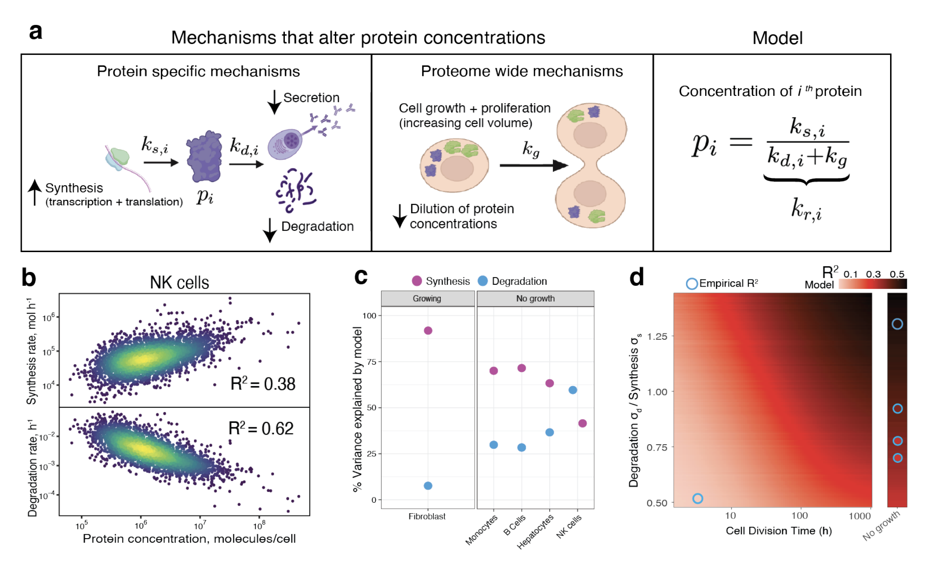
Growth rate dependance

