Slide 1


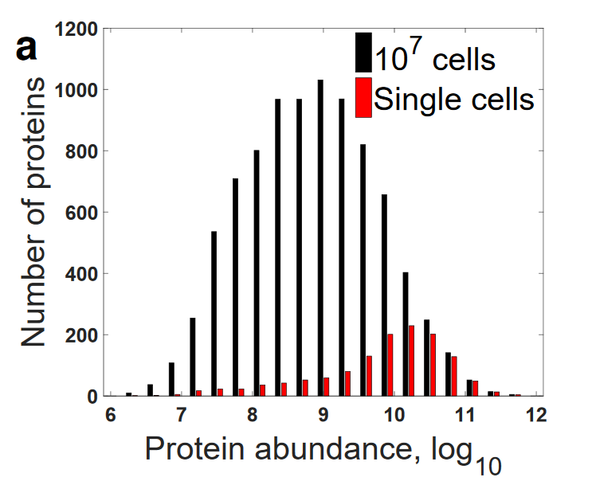
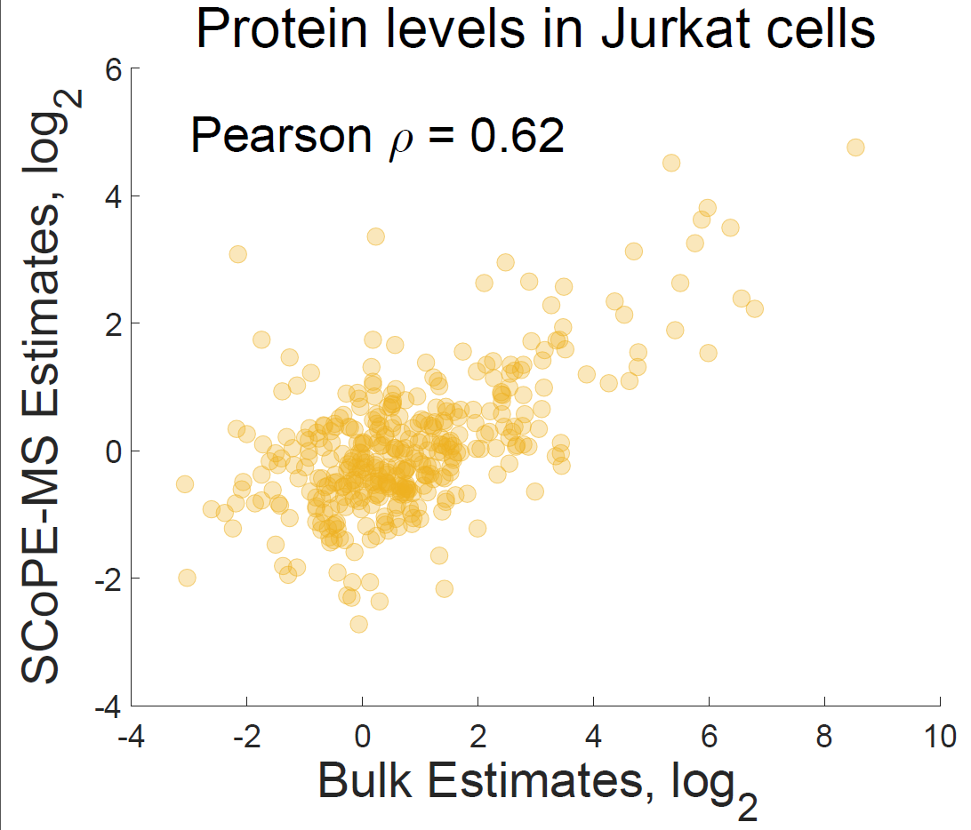
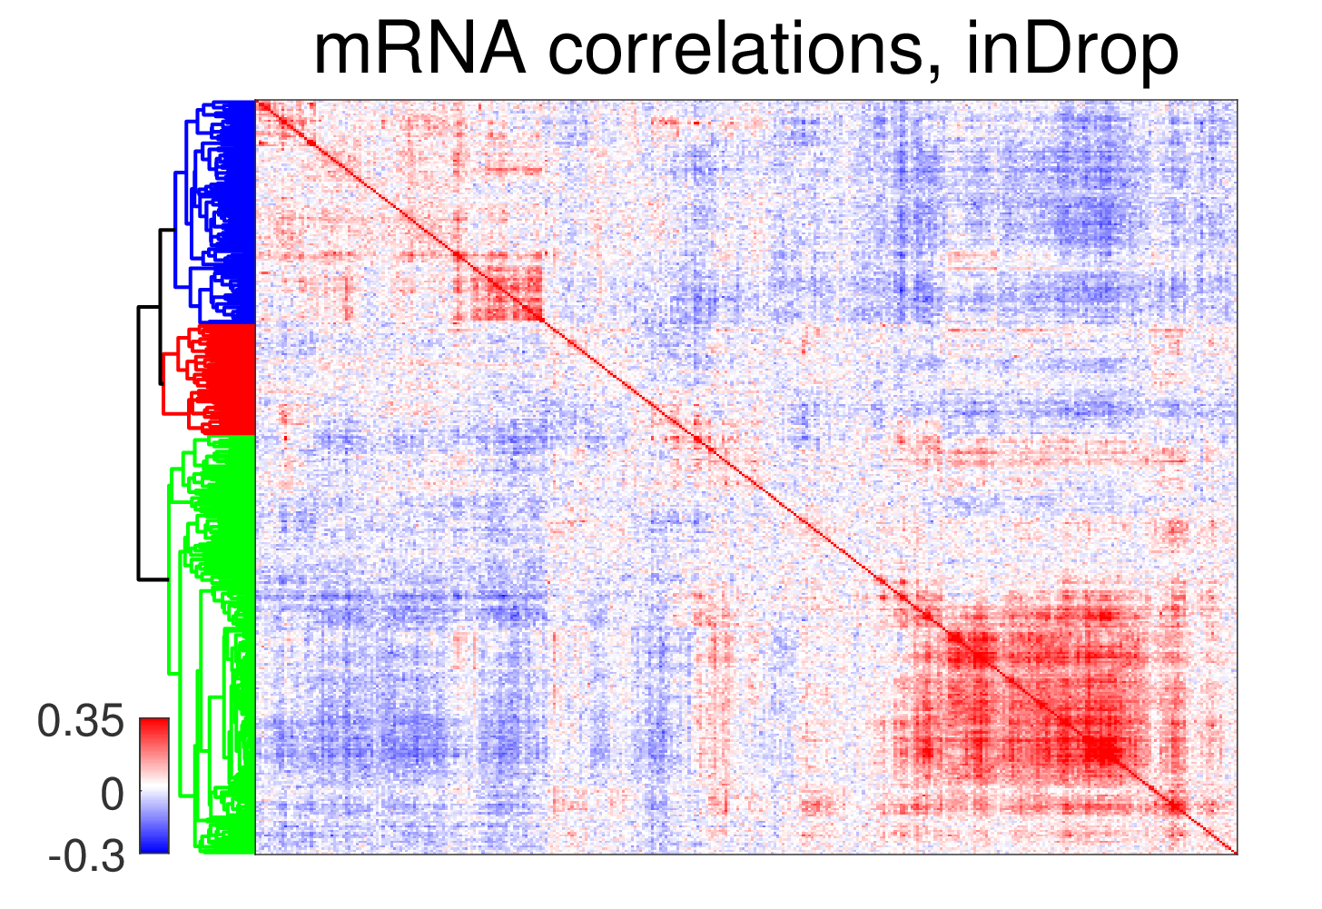
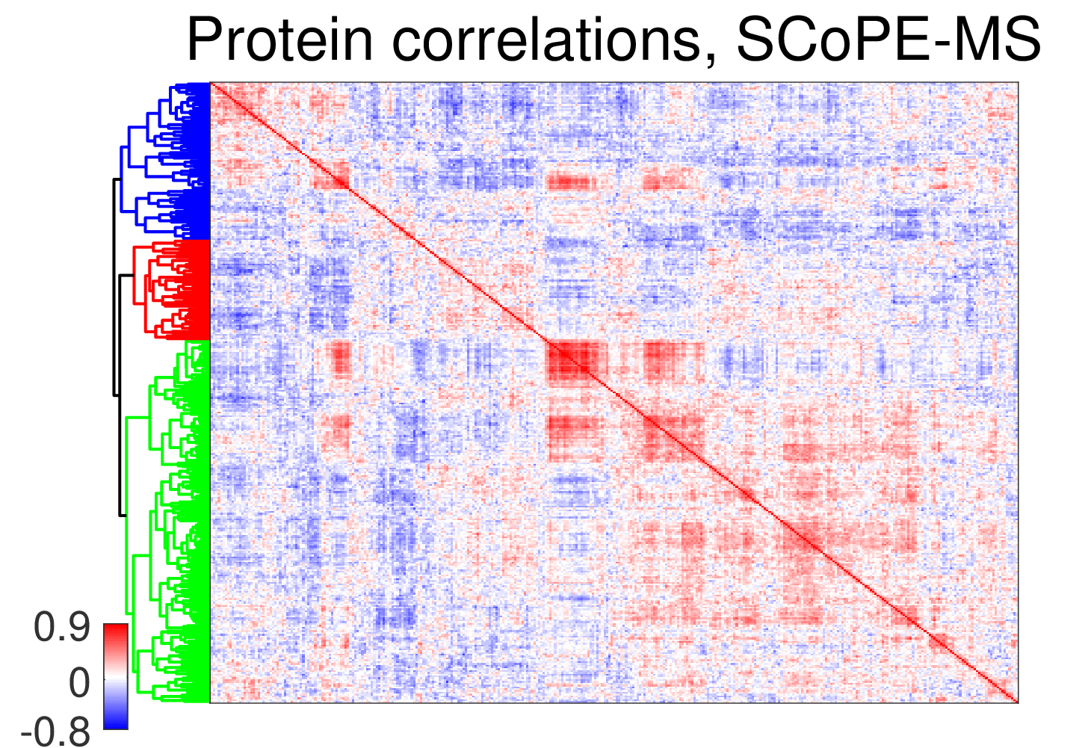
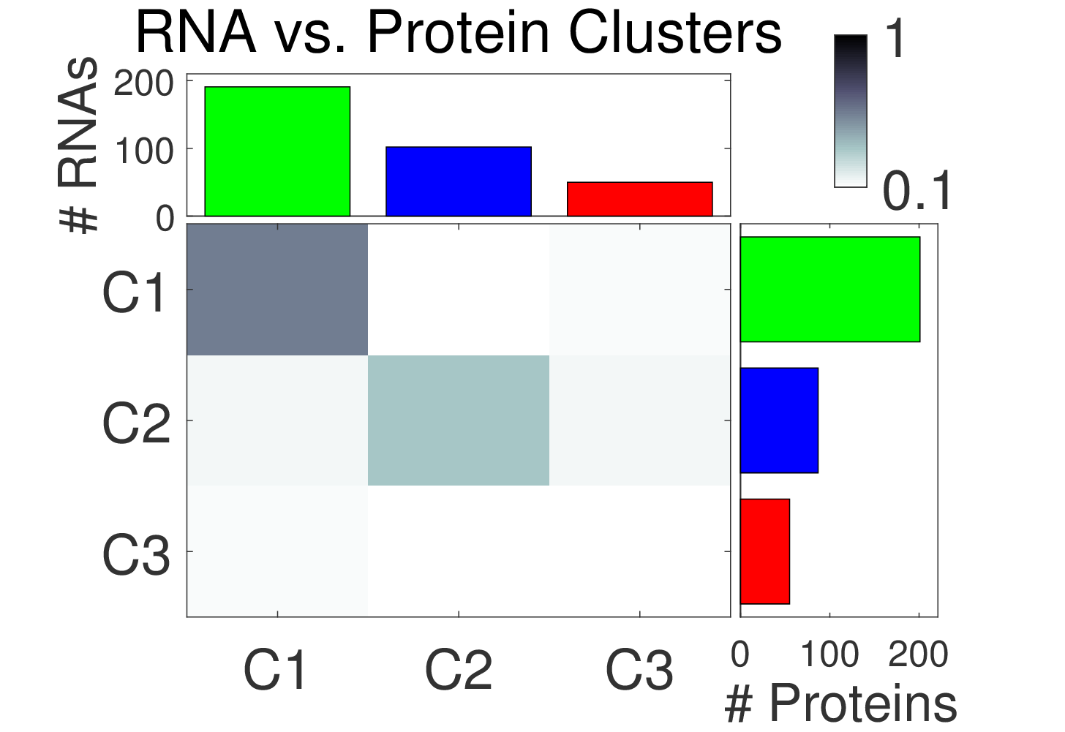
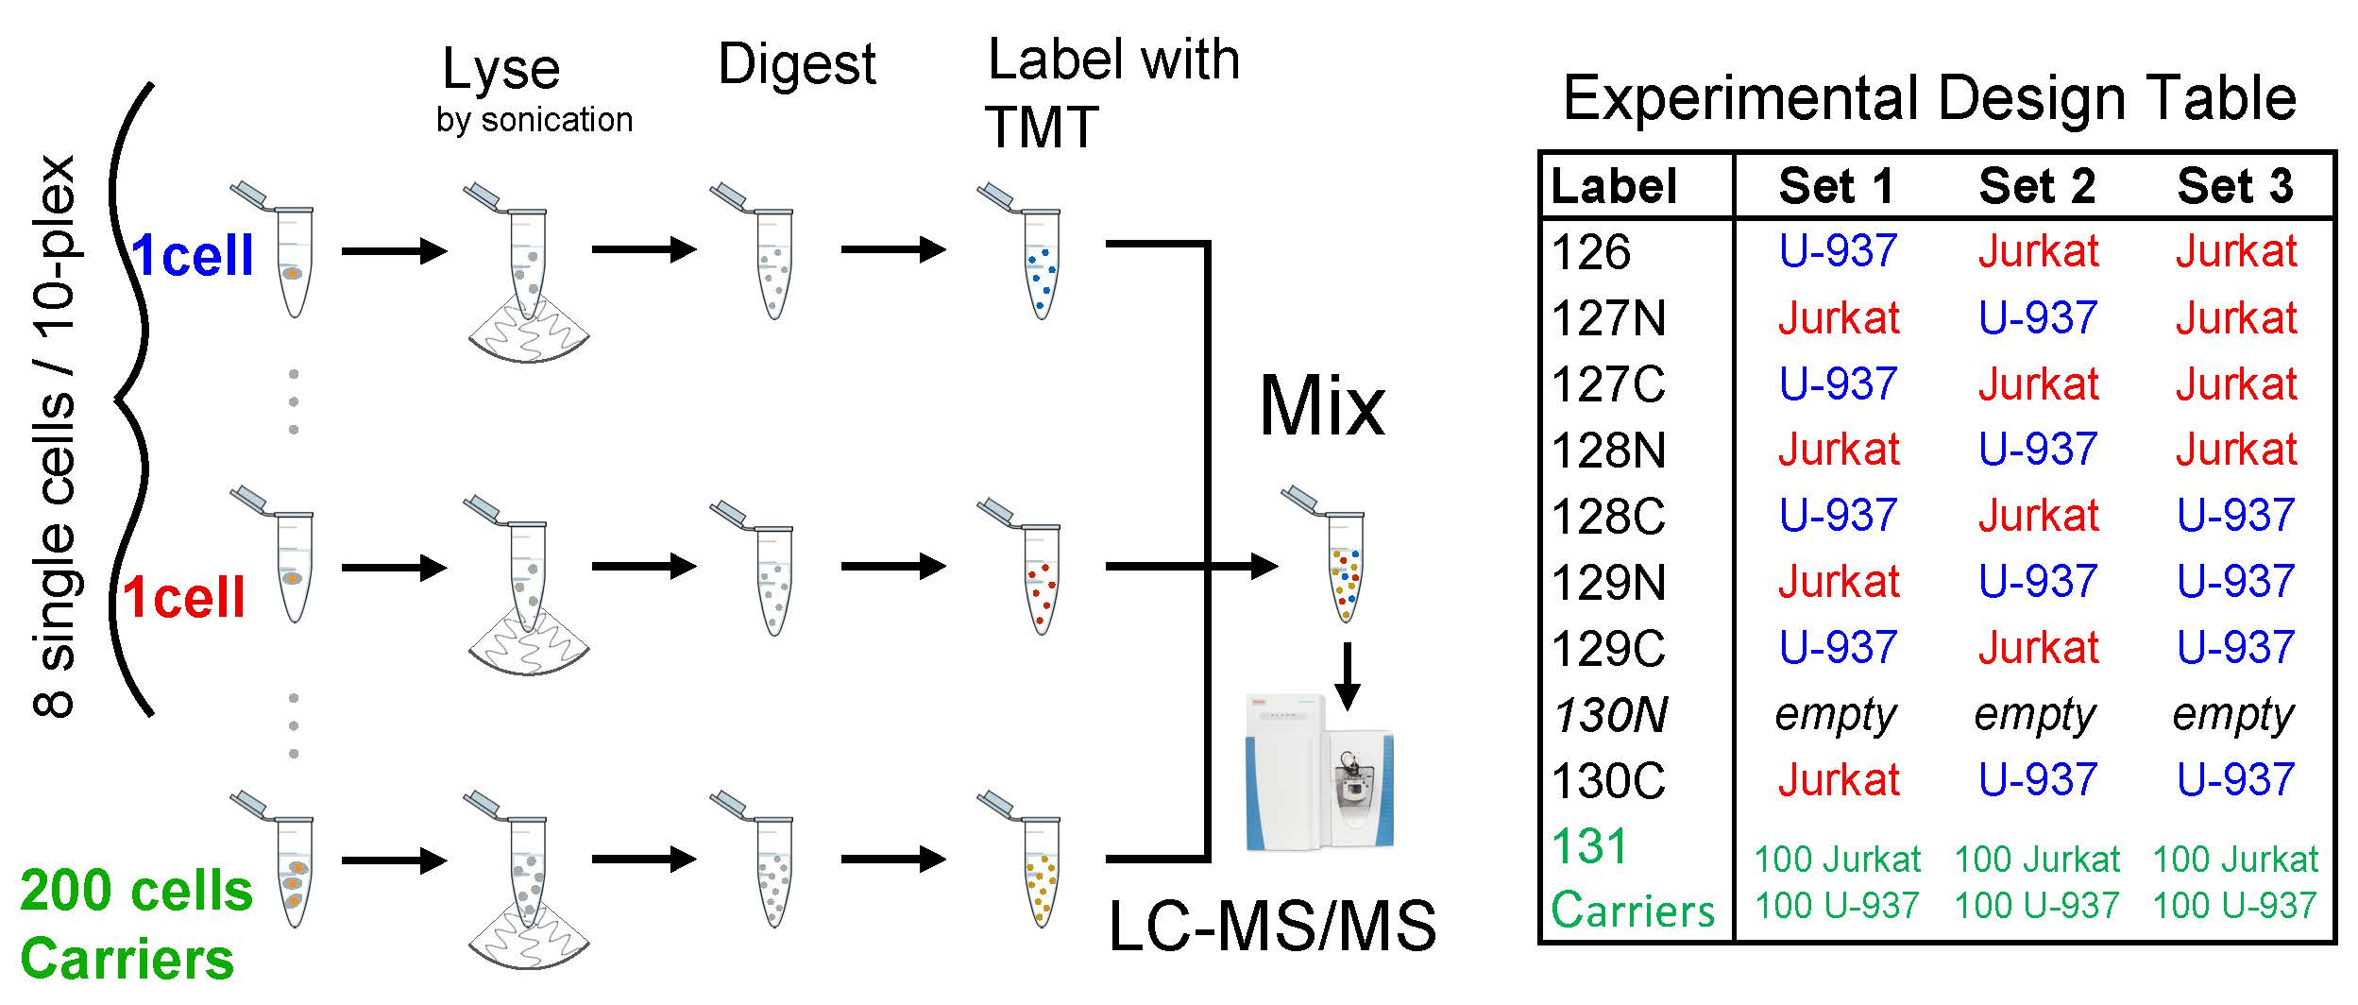
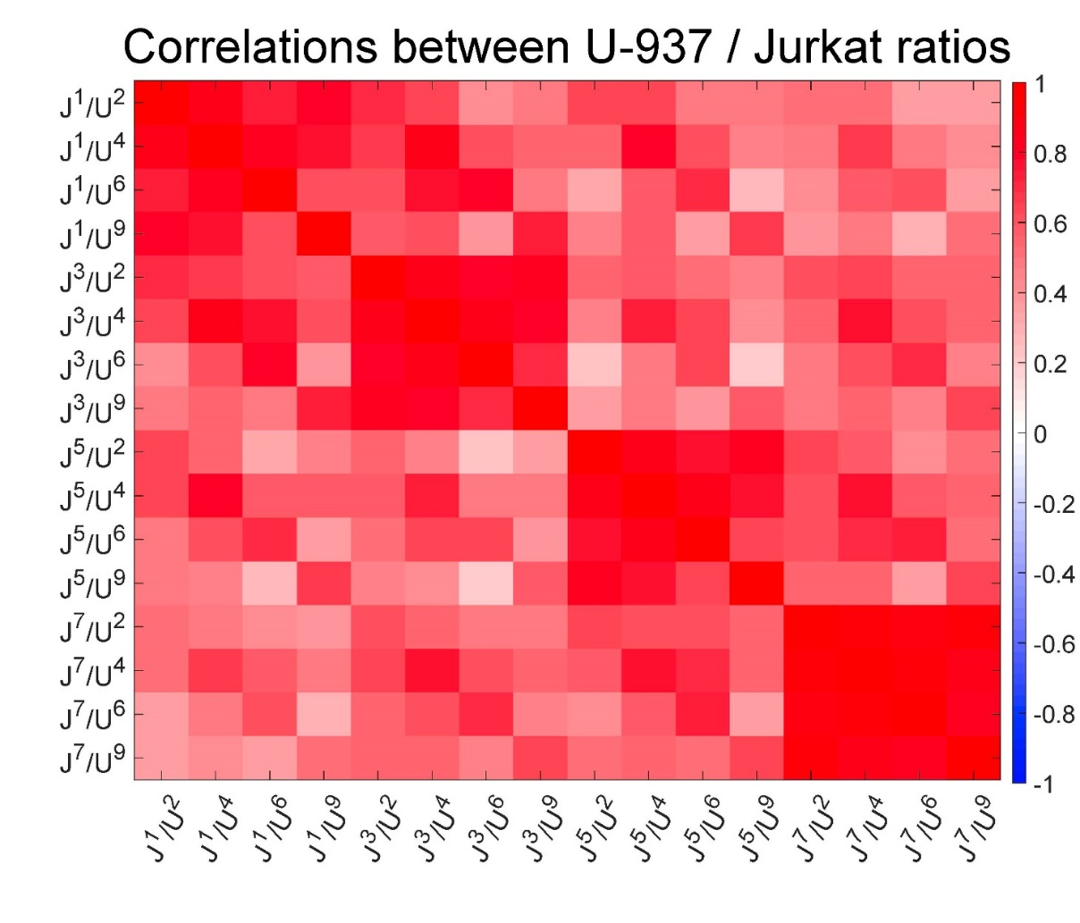
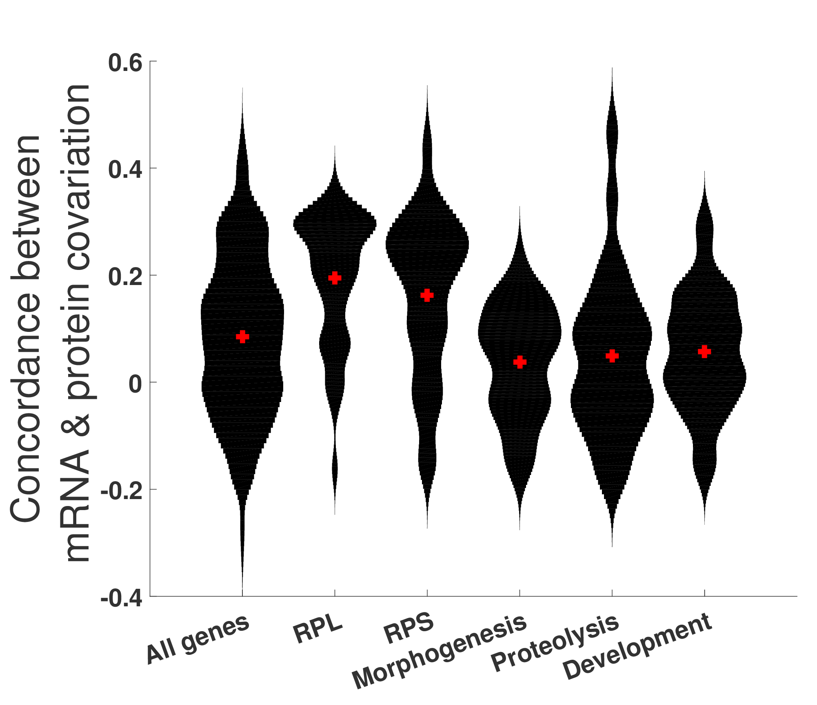
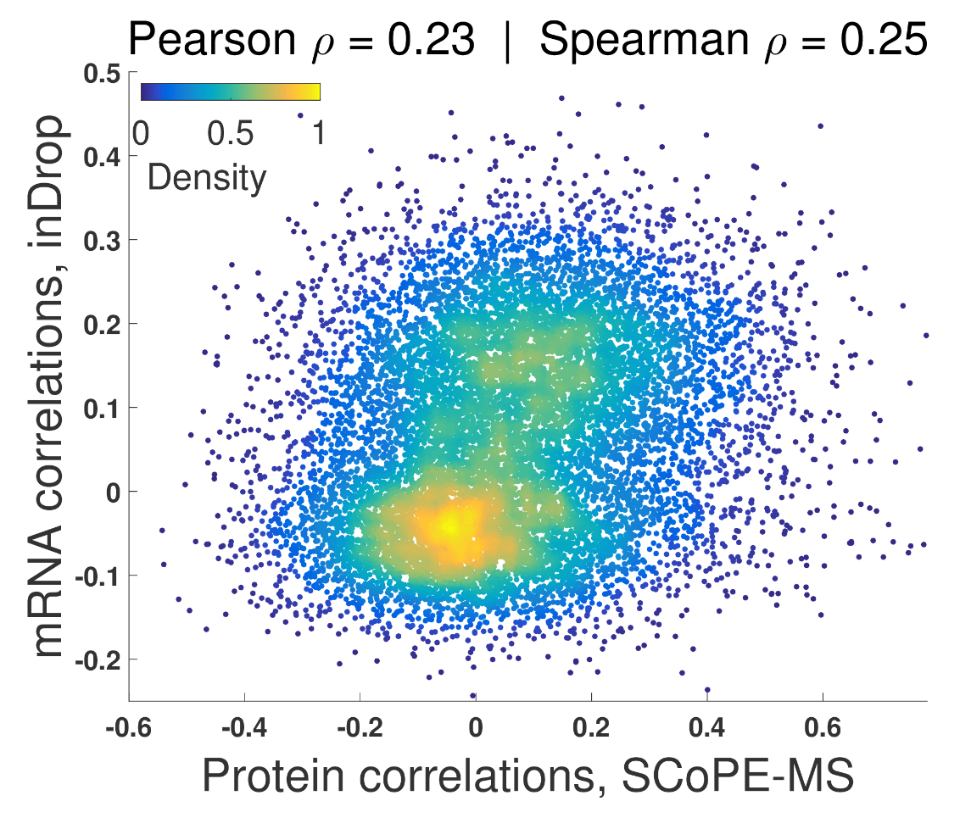
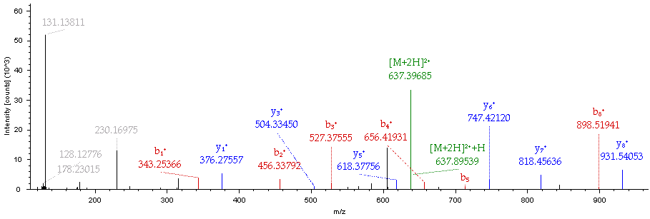
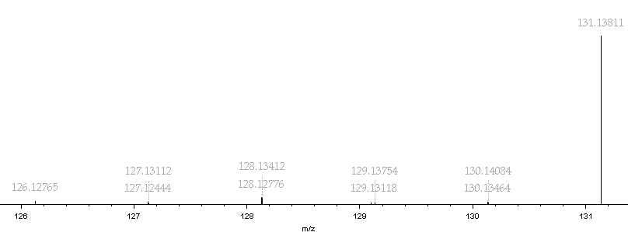
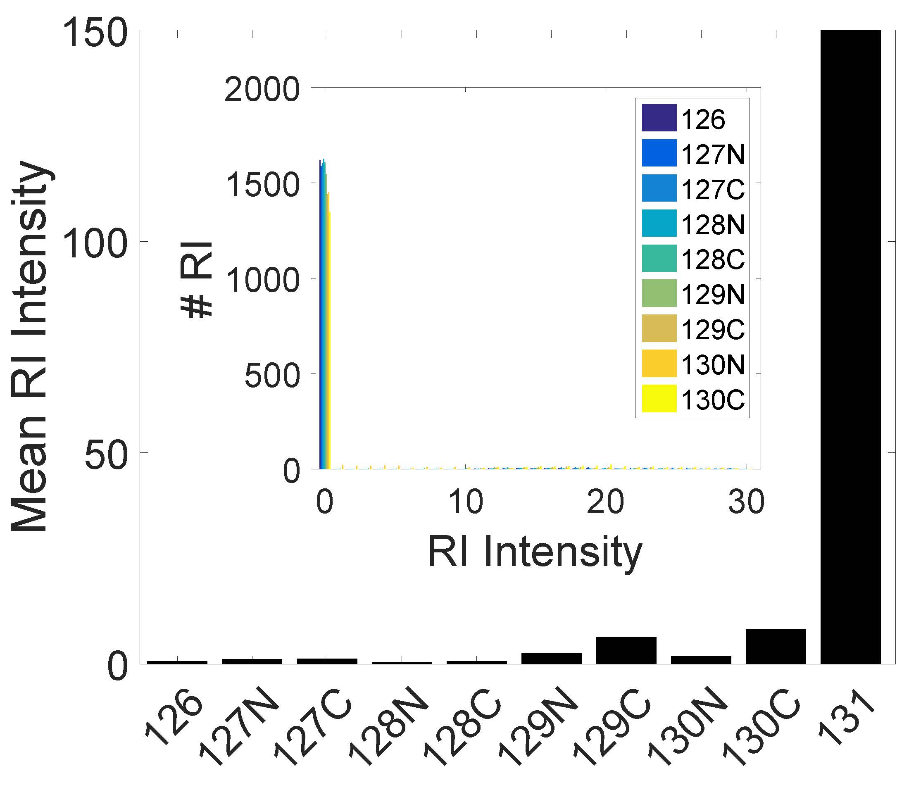
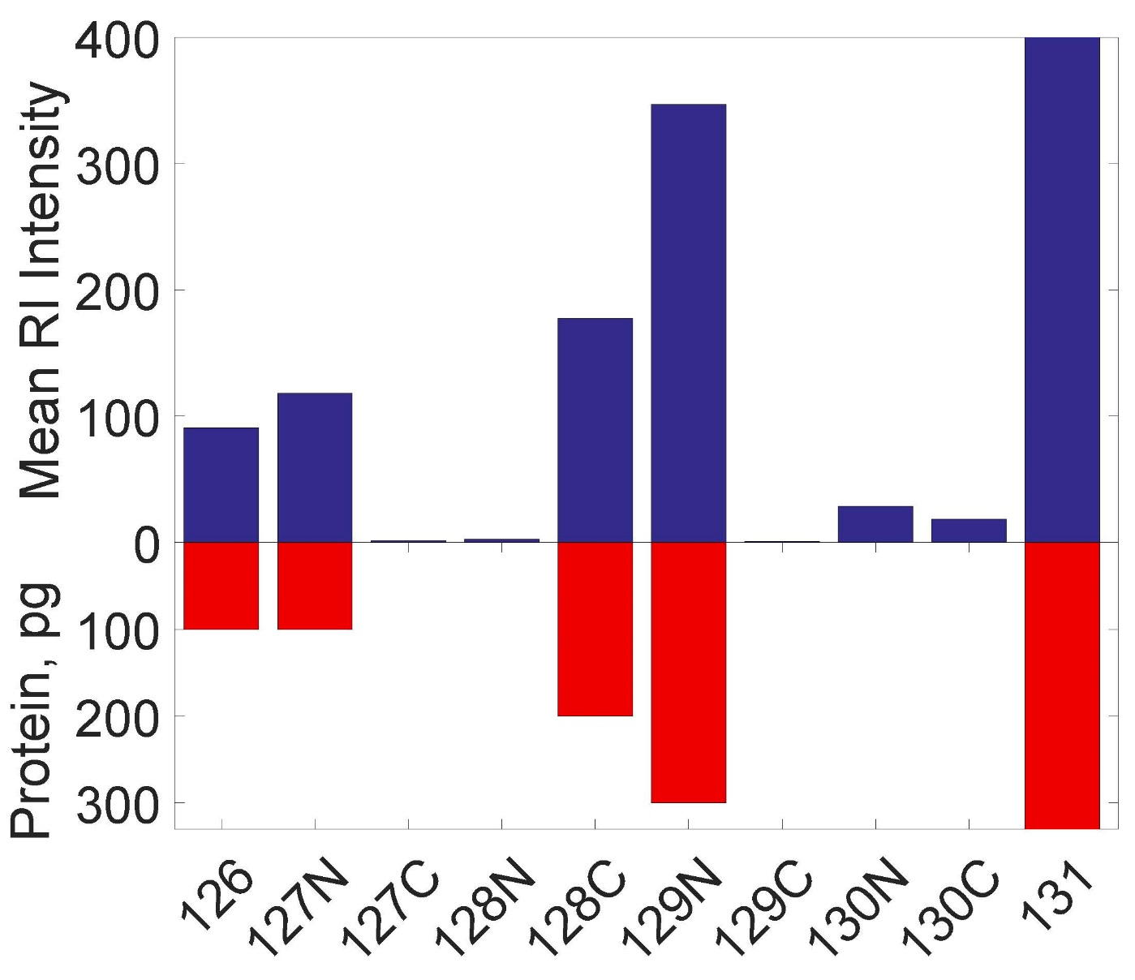
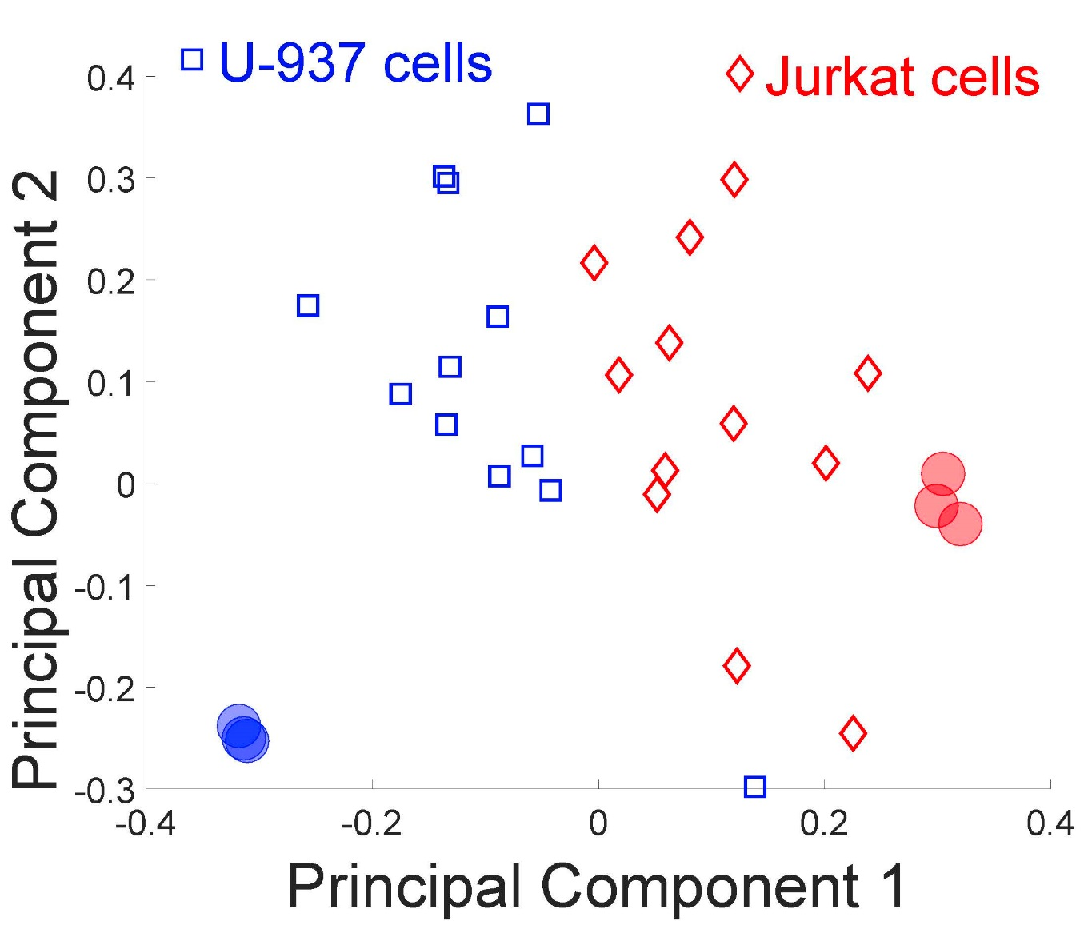
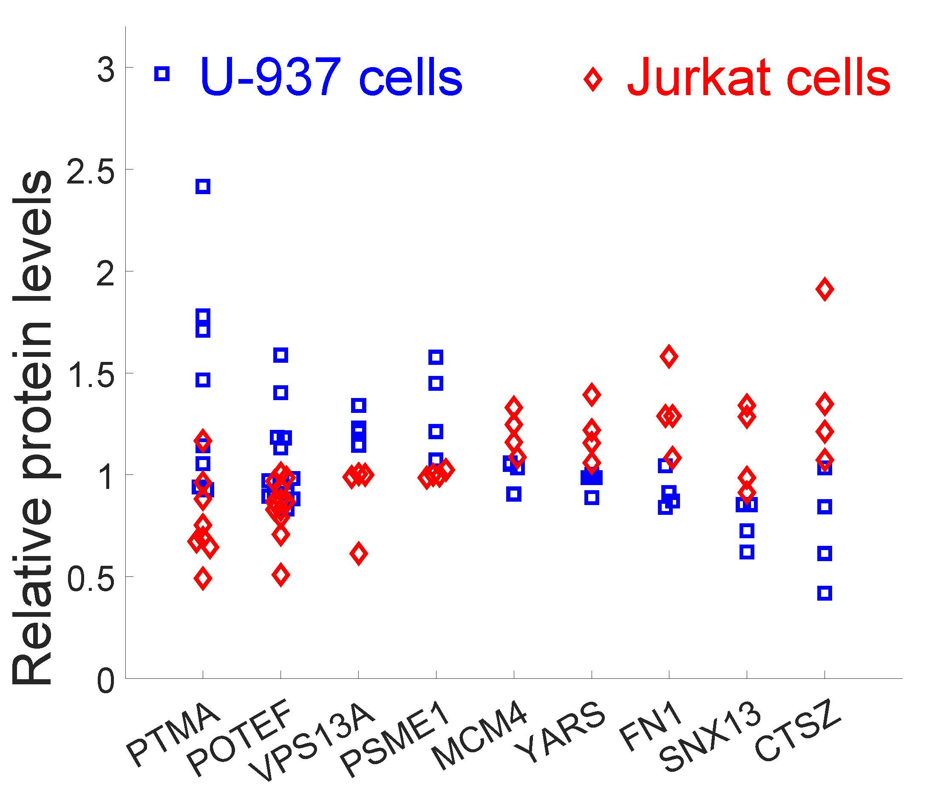

SCoPE-MS: Quantifying Proteomes of Single Mammalian Cells
Bogdan Budnik¹, Ezra Levy², Harrison Specht², Nikolai Slavov²
1 MSPRL, FAS Division of Science, Harvard University, Cambridge, MA 02138, USA 2 Departments of Biology and Bioengineering, Northeastern University, Boston, MA02115, USA
Summary
Proteome heterogeneity is largely unexplored because of the limitations of existing methods for quantifying protein levels in single cells. Two major hurdles were:
Delivering the proteome of single cell to mass spec with minimal losses
Simultaneously identifying and quantifying peptides from single cell samples
SCoPE-MS overcomes these hurdles and quantifies over 1000 proteins in single mammalian cells.
Comparison with mRNA data indicates coordinated mRNA and protein covariation.
Comparison to bulk proteomic measurements
Comparison between mRNA and protein clusters
Carrier channel minimizes losses in sample preparation
Clustergrams of pairwise correlations between mRNAs with 2.5 or more reads per cell as quantified by inDrop and proteins quantified by SCoPE-MS in 12 or more single mouse embryoid body cells.
Overlap between mRNA and protein clusters indicates similar clustering patterns.
Probability of quantifying a protein by SCoPE is close to 100 % for the most abundant proteins quantified in bulk samples and decreases with protein abundance.
SCoPE-MS estimates are the average from 12 Jurkat cells from the experiments described in the figure below.
Reproducible relative quantitation allows separation of mammalian cell types
Concordance between single cell mRNA and protein correlations suggests covariation for certain cellular functions
TMT and carrier channel enable separation of peptide quantitation and identification
Background noise is low compared to signal from peptides
Conclusion
SCoPE-MS is broadly applicable to measuring proteome configurations of single cells and linking them to functional phenotypes, such as cell type and differentiation potentials.
Acknowledgements
We thank S. Semrau, M. Jovanovic, R. Zubarev, and members of the Slavov laboratory for discussions and constructive comments, as well as the Harvard University FAS Science Operations for supporting this research project. This work was funded by startup funds from Northeastern University and a New Innovator Award from the NIGMS from the National Institutes of Health to N.S. under Award Number DP2GM123497.
(a) Reporter ion intensities in a SCoPE-MS set in which the single cells were omitted while all other steps were carried out.
(b) Mean RI intensities for a TMT set corresponding to 100, 100, 200, and 300 picograms of cellular proteome.
Budnik B., Levy E., Slavov N. (2017) Mass-spectrometry of single mammalian cells quantifies proteome heterogeneity during cell differentiation, bioRxiv, DOI: 10.1101/102681

