Slide 1

Method and Logic in Systems Biology and Bioengineering
Introduction

Slide 2
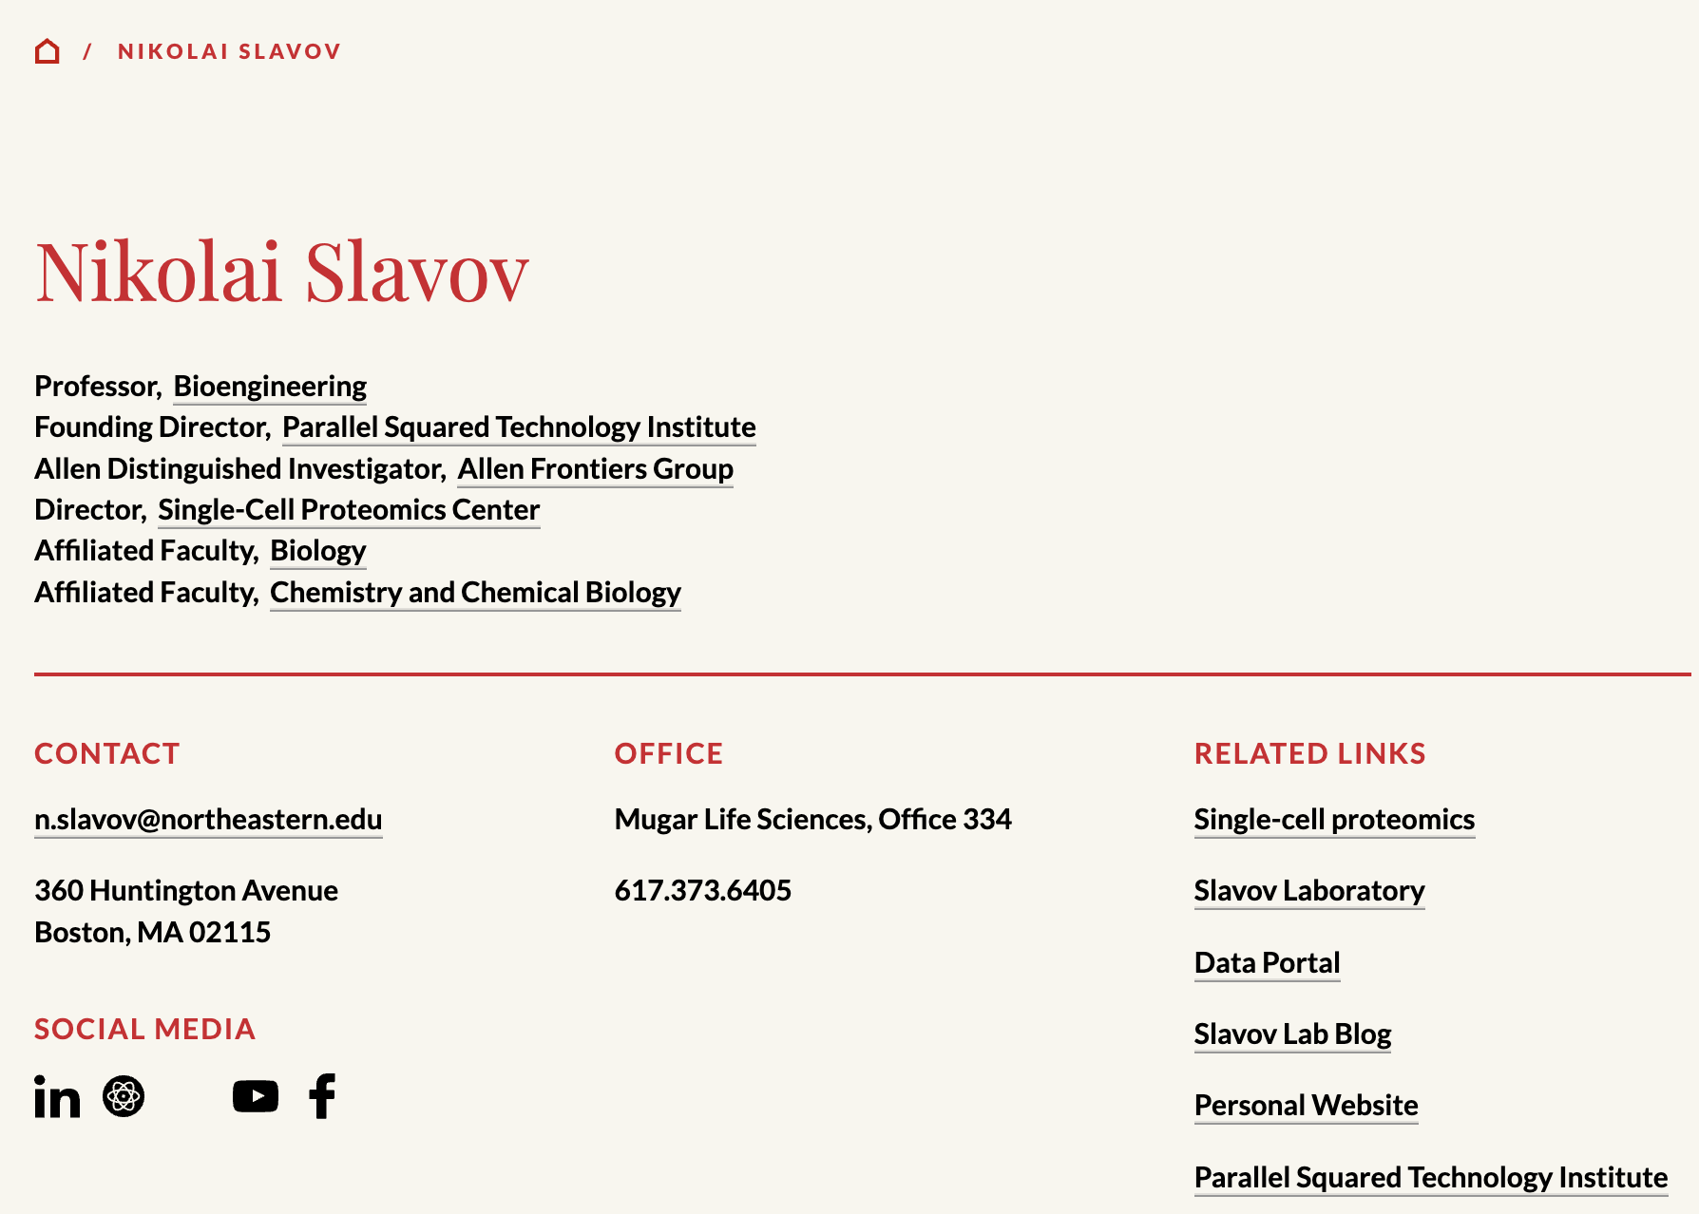
Introduction
https://coe.northeastern.edu/people/slavov-nikolai

Slide 3
Goals
Introduction to research
Student → Researcher
Interactive discussions
Conceptual questions
Notes:
Start the process. You need many skills

Slide 4
Syllabus & classes
3 Lecture & discussion
9 Paper discussions -- 1 student / article
3 Faculty presentations
9 Student presentations
Present a proposal

Slide 5
Logistics
Office Hours: Tuesdays @ noon at Mugar 334
Student presentations:
Written proposal up to 3 pages
Proposals are due before March 20th

Slide 6
Grading
Proposal & presentation: 40 %
Paper discussion: 40 %
Class participation: 20 %

Slide 7
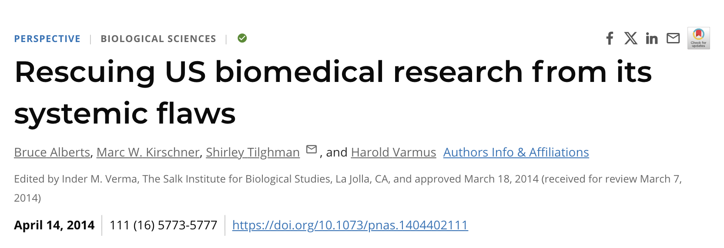
Research ecosystem, trends & challenges

Slide 8
Research within & outside of academia
Choosing direction and strategy
Communicating your results
Securing resources / funding

Slide 9
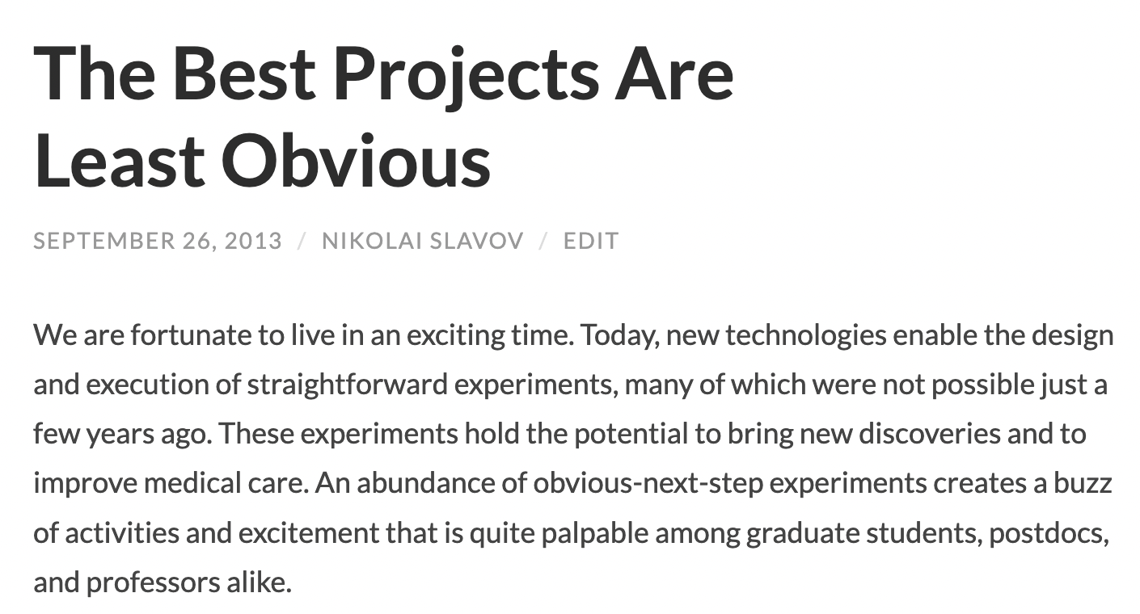
https://blog.slavovlab.net/2013/09/26/the-best-projects-are-least-obvious

Slide 10
Reading and evaluating papers
Key claims and supporting evidence
Standards of evidence appraisal
Critical evaluation: The earth is flat
Importance (subjective)
Background
Communication clarity

Slide 11
Writing papers and proposals
Have a clear message
Conceptual clarity
Framing the questions & conclusions
Communication clarity
Quantity cannot substitute quality

Slide 12
Two steps to making contributions
Get things right
Advancing science & getting credit

Slide 13
Advancing science & getting credit
Disclosing your results (priority)
Validation
Many ways: https://blog.slavovlab.net/ 2019/03/10/evaluating-preprints/
Evolving model

Slide 14
Publishing
Disclosure
Validation
Attracting attention
High profile journals are not the only way of attracting attention
Promoting research: https://blog.slavovlab.net/2020/07/15/promoting-your-research/

Slide 15
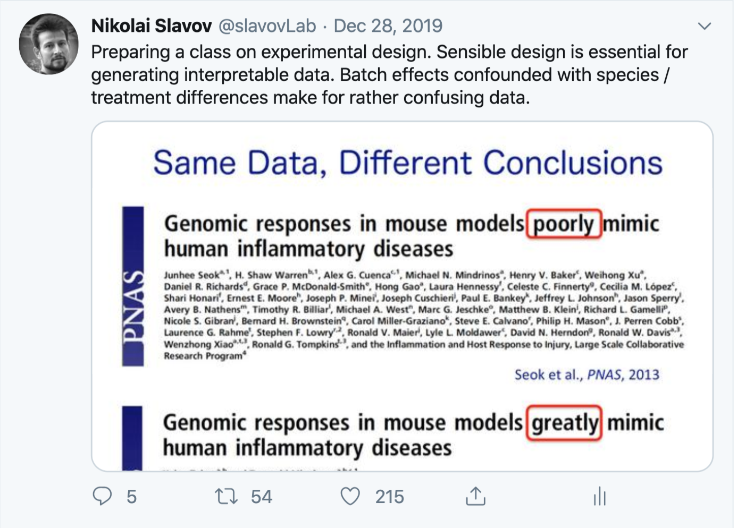
Experimental design & bias
https://twitter.com/slavovLab/status/1211007006208712706?s=20
Notes:
Science

Slide 16
Scientific communication
Nikolai Slavov

Slide 17
Reading a research paper
What problem is being addressed?
Why care?
What are the main results?
So what?
What is the supporting evidence?
What are the caveats?
How direct is the evidence?

Slide 18
Writing
What is your message?
What do your readers need to know to appreciate the message?
What is the best way to structure the information?

Slide 19
Principles for writing up research
Writing up research is first about thinking, framing and interpretation, and then about writing per say.
Start with why. Then move to how and what.
Make the most general statements supported by the results. Try to negate each statement until you cannot.

Slide 20

References
Primary function
Secondary function
Is self-citation ever acceptable ?

Slide 21
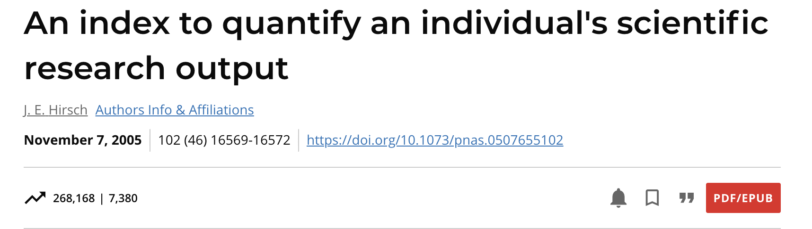
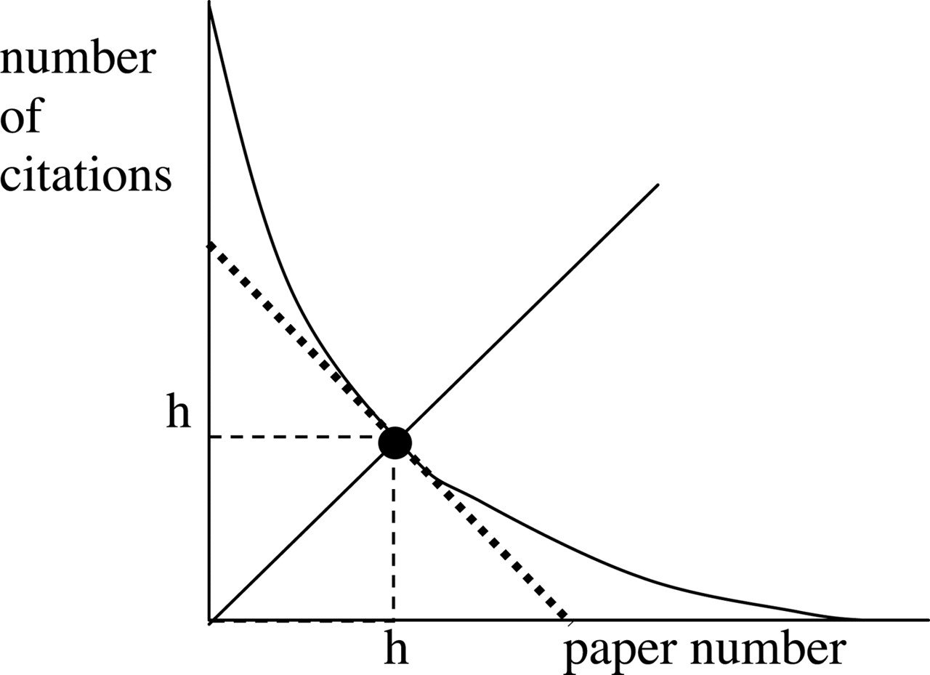
The index h, defined as the number of papers with citation number ≥h, as a useful index to characterize the scientific output of a researcher.

Slide 22
Ethics, plagiarism & chatbots
Plagiarism
Assigning credit
Using chatbots

Slide 23
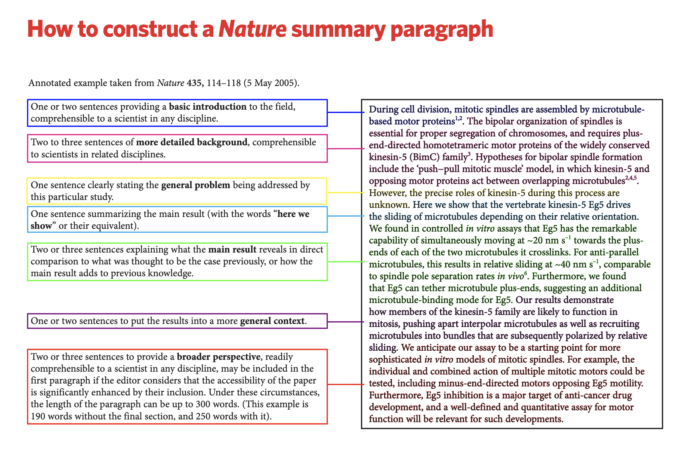
https://www.nature.com/documents/nature-summary-paragraph.pdf

Slide 24
Clarity is a primary goal. It is helped by consistent use of precise words.
Brevity is a virtue. Aim for short, streamlined sentences that are seamlessly connected in building up your logical arguments.
Always begin with the reason. Tell the readers why you’re writing the things that you’re writing. Do not describe what you did before you explain why you did it.
Minimize the use of adjectives and make sure the remaining ones do not do much work.
Read your draft and pause after each statement to think of counterexamples, counterarguments or possible misinterpretations. If you can think of one, revise it.
Be willing to critically evaluate your own writing and take constructive feedback as much as possible.
Writing tips

Slide 25
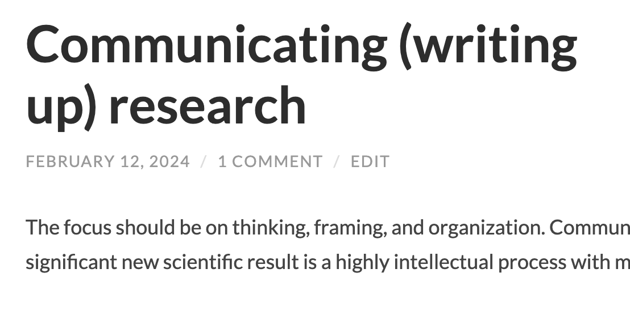
https://blog.slavovlab.net/2024/02/12/communicating-writing-up-research

