Slide 1
DATA SCIENCE naive bayes classification

Slide 2
I. probability and Bayes’ Theorem iI. Naïve Bayes classification
agenda

Slide 3
I. probability And Bayes’ Theorem
DATA SCIENCE

Slide 4
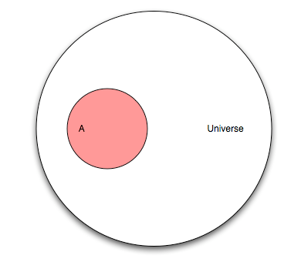
Probability

Slide 5
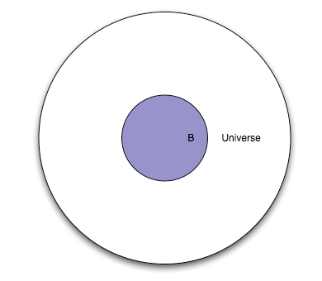
Probability

Slide 6
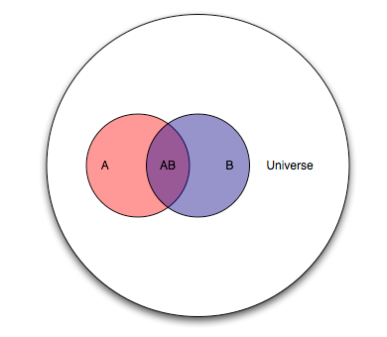
Probability

Slide 7
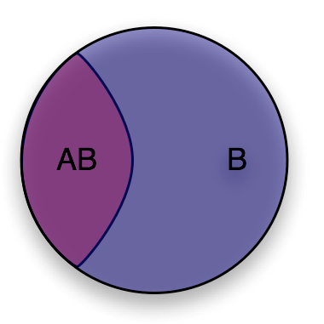
Probability

Slide 8
Probability

Slide 9
Bayes’ theorem
Bayes’ theorem:
P(A|B) = P(B|A) * P(A) / P(B)

Slide 10
II. Naïve bayes classification
DATA SCIENCE

Slide 11
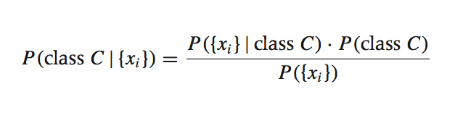
Bayesian inference
Suppose we have a dataset with features x₁, …, x_{n} and a class label C. What can we say about classification using Bayes’ theorem?
Bayes’ theorem can help us to determine the probability of a record belonging to a class, given the data we observe.
source: Data Analysis with Open Source Tools, by Philipp K. Janert. O’Reilly Media, 2011.

Slide 12
Bayesian inference
This term is the likelihood function. It represents the joint probability of observing features {x_{i}} given that that record belongs to class C.

Slide 13
Bayesian inference
This term is the prior probability of C. It represents the probability of a record belonging to class C before the data is taken into account.

Slide 14
Bayesian inference
This term is the normalization constant. It doesn’t depend on C, and is generally ignored until the end of the computation.

Slide 15
Bayesian inference
This term is the posterior probability of C. It represents the probability of a record belonging to class C after the data is taken into account.

Slide 16
Bayesian inference
This term is the posterior probability of C. It represents the probability of a record belonging to class C after the data is taken into account.
The goal of any Bayesian computation is to find (“learn”) the posterior distribution of a particular feature. This constitutes the training phase of the model.

Slide 17
Bayesian inference
The idea of Bayesian inference, then, is to update our beliefs about the distribution of C using the data (“evidence”) at our disposal.
Then we can use the posterior for prediction.

Slide 18
Naïve bayes classification
Q: What piece of the puzzle we’ve seen so far looks like it could intractably difficult in practice?
A: Estimating the full likelihood function.
P({x_{i}}|C) = P({x₁, x₂, …, x_{n}})|C)
Observing this exactly would require us to have enough data for every possible combination of features to make a reasonable estimate.

Slide 19
Naïve bayes classification
Q: So what can we do about it?
A: Make a simplifying assumption. In particular, we assume that the features x_{i} are conditionally independent from each other:
P({x_{i}}|C) = P({x₁, x₂, …, x_{n}}|C) ≈ P(x₁|C) * P(x₂|C) * … * P(x_{n}|C)
This “naïve” assumption simplifies the likelihood function to make it tractable.

Slide 20
DATA SCIENCE

