Slide 1
Introduction to
Decision Trees

Slide 2
Objectives - SWBAT
Describe the output of a decision tree to someone without a data science background
Describe how the algorithm creates the decision tree
Predict the likelihood of a binary event using the decision tree algorithm in scikit-learn
Create a decision tree visualization
Determine the optimal tree size using a tune grid and the AUC metric in Python
Describe the strengths and weaknesses of a decision tree

Slide 3
Objectives - SWBAT
Describe the output of a decision tree to someone without a data science background
Describe how the algorithm creates the decision tree
Predict the likelihood of a binary event using the decision tree algorithm in scikit-learn
Create a decision tree visualization
Determine the optimal tree size using a tune grid and the AUC metric in Python
Describe the strengths and weaknesses of a decision tree

Slide 4
What are decision trees?

Slide 5
What are decision trees?
A supervised learning technique that can be used for discrete and continuous output.

Slide 6
What are decision trees?
A supervised learning technique that can be used for discrete and continuous output.
Visually engaging and easy to interpret.

Slide 7
What are decision trees?
A supervised learning technique that can be used for discrete and continuous output.
Visually engaging and easy to interpret.
Excellent model for someone transitioning into the world of data science.

Slide 8
What are decision trees?
A supervised learning technique that can be used for discrete and continuous output.
Visually engaging and easy to interpret.
Excellent model for someone transitioning into the world of data science.
Foundational to learning some very powerful techniques.

Slide 9
What are decision trees?
A supervised learning technique that can be used for discrete and continuous output.
Visually engaging and easy to interpret.
Excellent model for someone transitioning into the world of data science.
Foundational to learning some very powerful techniques.
Are prone towards high-variance.

Slide 10
What are decision trees?
A supervised learning technique that can be used for discrete and continuous output.
Visually engaging and easy to interpret.
Excellent model for someone transitioning into the world of data science.
Foundational to learning some very powerful techniques.
Are prone towards high-variance.
We will focus on the CART algorithm.

Slide 11
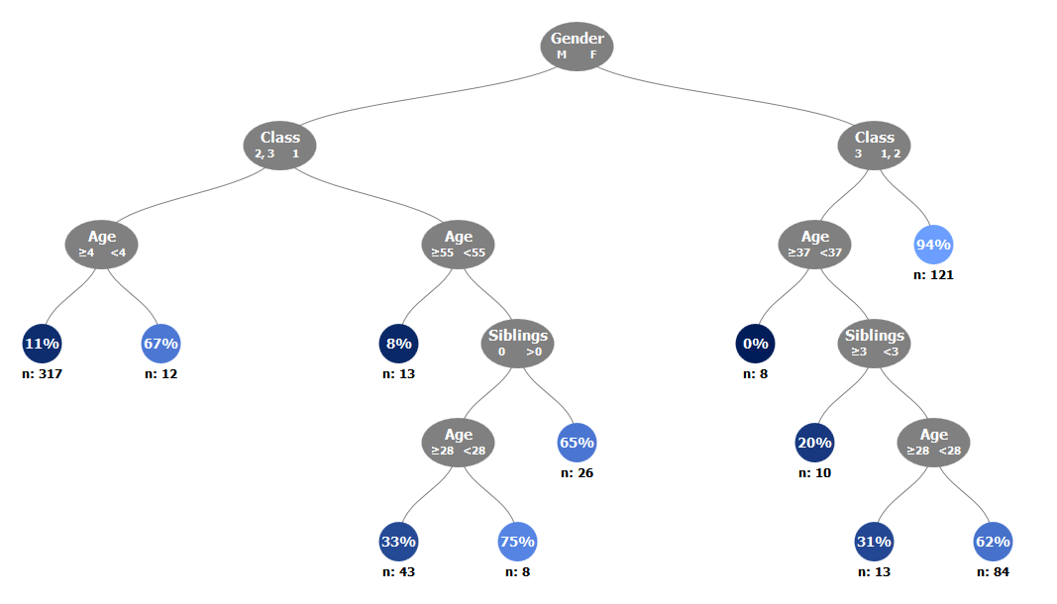
Description
Best place to start understanding decision trees is to look at one of them. The diagram below shows a decision tree trained on the titanic data set.

Slide 12
Description
Decision Trees are made up of interconnected nodes, which act as a series of questions / test conditions (e.g., is the passenger male or female?)

Slide 13
Description
Terminal nodes show the output metric, in this case the percentage of titanic survivors for a given combination of variables.

Slide 14
This raises questions
How does the algorithm choose which variables to include on the tree?
How does the algorithm choose where variables should be located on the tree?
How does the algorithm choose when to stop the tree?

Slide 15
Objectives - SWBAT
Describe the output of a decision tree to someone without a data science background
Describe how the algorithm creates the decision tree
Predict the likelihood of a binary event using the decision tree algorithm in Python
Create a decision tree visualization
Determine the optimal tree size using a tune grid and the AUC metric in Python
Describe the strengths and weaknesses of a decision tree

Slide 16
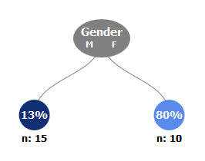
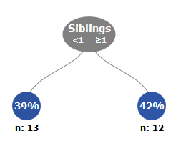
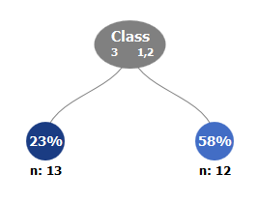
The Algorithm, Introduced
Different variables and split options are evaluated to determine which split will provide the greatest separation between classes.
Which split option would you select?

Slide 17
The Algorithm, Introduced
Different variables and split options are evaluated to determine which split will provide the greatest separation between classes.
Which split option would you select?
How can we determine the best split analytically?

Slide 18
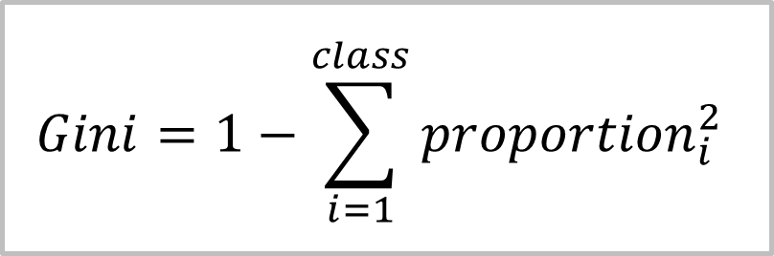
Measuring Purity
For decision trees, splits are chosen by measuring the class purity before and after the split. Purity can be calculated by the Gini index.
$$Gini=1−\sum_{i=1}^{class}{{proportion}_{i}^{2}}$$

Slide 19
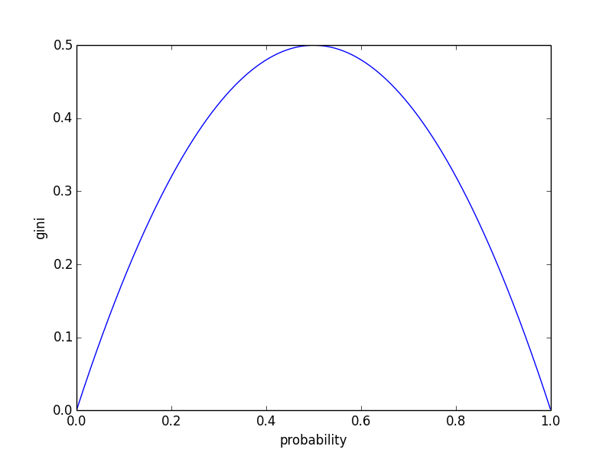
Measuring Purity
A Gini index of 0.5 indicates equal representation between both classes, and a Gini index of 0 indicates perfect separation between classes (i.e., perfect purity)

Slide 20
The Algorithm – Overview
Calculate the purity of the data

Slide 21
The Algorithm – Overview
Calculate the purity of the data
Select a candidate split

Slide 22
The Algorithm – Overview
Calculate the purity of the data
Select a candidate split
Calculate the purity of the data after the split

Slide 23
The Algorithm – Overview
Calculate the purity of the data
Select a candidate split
Calculate the purity of the data after the split
Repeat for all variables

Slide 24
The Algorithm – Overview
Calculate the purity of the data
Select a candidate split
Calculate the purity of the data after the split
Repeat for all variables
Choose the variable with the greatest increase in purity

Slide 25
The Algorithm – Overview
Calculate the purity of the data
Select a candidate split
Calculate the purity of the data after the split
Repeat for all variables
Choose the variable with the greatest increase in purity
Repeat for each split until some stop criteria is met

Slide 26
The Algorithm – Overview
Calculate the purity of the data
Select a candidate split
Calculate the purity of the data after the split
Repeat for all variables
Choose the variable with the greatest increase in purity
Repeat for each split until some stop criteria is met
Let’s go through an example

Slide 27
Before the Split
Before Split | All
Survived | 10
Died | 15

Slide 28
Before the Split
Before Split | All
Survived | 10
Died | 15
What is the gini coefficient?

Slide 29
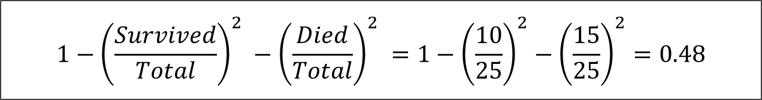
Before the Split
Before Split | All
Survived | 10
Died | 15
Gini_{O}
$$1−{\left(\frac{Survived}{Total}\right)}^{2} −{\left(\frac{Died}{Total}\right)}^{2} =1−{\left(\frac{10}{25}\right)}^{2}−{\left(\frac{15}{25}\right)}^{2}=0.48$$

Slide 30

After the Split
Gini_{O}
$$=0.48$$
Gender | M
Survived | 2
Died | 13
Gender | F
Survived | 8
Died | 2

Slide 31
After the Split
Gini_{O}
$$=0.48$$
Gender | M
Survived | 2
Died | 13
Gender | F
Survived | 8
Died | 2
What is the gini coefficient?

Slide 32
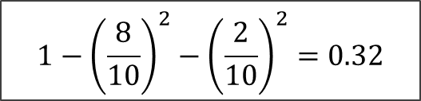
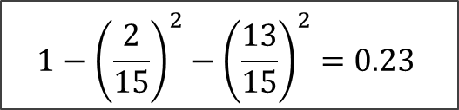
After the Split
Gini_{O}
$$=0.48$$
Gender | M
Survived | 2
Died | 13
Gender | F
Survived | 8
Died | 2
Gini_{M}
Gini_{F}
$$1−{\left(\frac{2}{15}\right)}^{2}−{\left(\frac{13}{15}\right)}^{2}=0.23$$
$$1−{\left(\frac{8}{10}\right)}^{2}−{\left(\frac{2}{10}\right)}^{2}=0.32$$

Slide 33
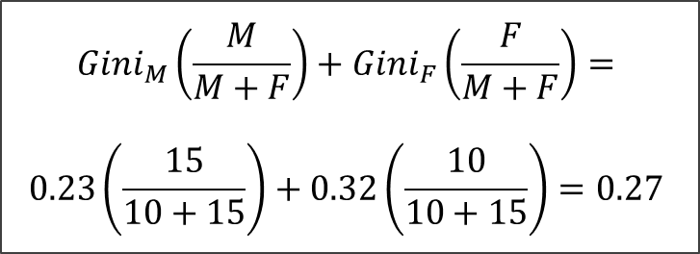


After the Split (continued)
Gini_{O}
$$=0.48$$
Gini_{M}
Gini_{F}
$$=0.23$$
$$=0.32$$
Gini_{C}
$${Gini}_{M}\left(\frac{M}{M+F}\right)+{Gini}_{F}\left(\frac{F}{M+F}\right)=$$
$$0.23\left(\frac{15}{10+15}\right)+0.32\left(\frac{10}{10+15}\right)=0.27$$

Slide 34
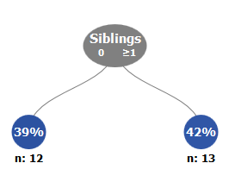
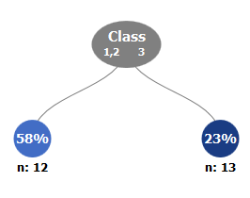
Choosing the Split
How does the gini coefficient compare for the Siblings and class variables?
Gender | M | F
Survived | 2 | 8
Died | 13 | 2
Gini_{C} | 0.27
Siblings | 0 | ≥1
Survived | 5 | 5
Died | 7 | 8
Gini_{C} | ??
Class | 1,2 | 3
Survived | 7 | 3
Died | 5 | 10
Gini_{C} | ??
Notes:
Edit these charts

Slide 35
Choosing the Split
How does the gini coefficient compare for the Siblings and class variables?
Gender | M | F
Survived | 2 | 8
Died | 13 | 2
Gini_{C} | 0.27
Siblings | 0 | ≥1
Survived | 5 | 5
Died | 7 | 8
Gini_{C} | 0.48
Class | 1,2 | 3
Survived | 7 | 3
Died | 5 | 10
Gini_{C} | 0.42
Notes:
Edit these charts

Slide 36
Choosing the Split
In this example, the algorithm will select the Gender variable since it provides the greatest increase in purity.
Gender | M | F
Survived | 2 | 8
Died | 13 | 2
Gini_{C} | 0.27
Siblings | 0 | ≥1
Survived | 5 | 5
Died | 7 | 8
Gini_{C} | 0.48
Class | 1,2 | 3
Survived | 7 | 3
Died | 5 | 10
Gini_{C} | 0.42
Notes:
Edit these charts

Slide 37
Objectives - SWBAT
Describe the output of a decision tree to someone without a data science background
Describe how the algorithm creates the decision tree
Predict the likelihood of a binary event using the decision tree algorithm in scikit-learn
Create a decision tree visualization
Determine the optimal tree size using a tune grid and the AUC metric in Python
Describe the strengths and weaknesses of a decision tree

Slide 38
Objectives - SWBAT
Describe the output of a decision tree to someone without a data science background
Describe how the algorithm creates the decision tree
Predict the likelihood of a binary event using the decision tree algorithm in scikit-learn
Create a decision tree visualization
Determine the optimal tree size using a tune grid and the AUC metric in Python
Describe the strengths and weaknesses of a decision tree

Slide 39
Meta-Evaluation
What do you think?

Slide 40
Meta-Evaluation
Advantages:
The nature of its output provides the decision tree algorithm with a degree of interpretability that other more complex algorithms don’t provide

Slide 41
Meta-Evaluation
Advantages:
The nature of its output provides the decision tree algorithm with a degree of interpretability that other more complex algorithms don’t provide
Understanding how the decision Tree works is foundational to understanding how more complex, and widely-used models work, such as random forests and boosted trees.

Slide 42
Meta-Evaluation
Advantages:
The nature of its output provides the decision tree algorithm with a degree of interpretability that other more complex algorithms don’t provide
Understanding how the decision Tree works is foundational to understanding how more complex, and widely-used models work, such as random forests and boosted trees.
Disadvantages:
The decision Tree tends to perform worse than more sophisticated modeling techniques due to their unstability

