Slide 1
Additional Pediatric POCUS Topics
SBO • Intussusception • Femur/Long-Bone Fracture • Pneumothorax • Constipation
Notes:
Speaker intro: These additional modules extend the Pass The Pointer curriculum to five high-yield pediatric POCUS applications. Each follows the same flow: case, indications, probe set-up, scanning technique, normal anatomy, pathology, and pearls/pitfalls. A blank slide follows every teaching slide so you can drop in your own clinical clips, and representative normal-vs-pathology images are embedded for reference.

Slide 2
Small Bowel Obstruction
Pediatric Bowel POCUS
Notes:
Topic divider. SBO in children: adhesions (prior surgery), incarcerated hernia, malrotation/volvulus, intussusception, atresia in neonates. POCUS is fast, repeatable and radiation-free at the bedside.

Slide 3
4-year-old with bilious vomiting & a distended belly
History
Prior abdominal surgery; 1 day of crampy pain
Multiple episodes of bilious (green) vomiting
No stool or flatus today; abdomen distended & tympanitic
Why POCUS first?
Avoid/limit ionizing radiation of serial plain films
Bedside, repeatable, dynamic assessment of peristalsis
Notes:
Classic obstructive picture: bilious emesis, distension, obstipation. In a child with prior surgery, adhesive SBO is the leading cause. Always keep malrotation with midgut volvulus on the differential in the vomiting infant – that is a surgical emergency. POCUS lets you look while you resuscitate (IVF, NG decompression, surgical consult).

Slide 4
Insert Image
▢ Insert image / clip here
Add a clinical photo of the distended abdomen or the triage vitals.
Notes:
Drop in a still or cine clip from your own scans here.

Slide 5
Indications for Bowel / SBO POCUS
Bilious or persistent vomiting
Abdominal distension and/or crampy pain
Obstipation – no stool or flatus
Prior abdominal surgery (adhesions) or known hernia
To reduce repeat radiographs in a child needing serial exams
Notes:
POCUS for SBO is best thought of as a rule-IN/rule-out adjunct, not a replacement for surgical evaluation or CT when the cause must be defined. Adult literature shows POCUS sensitivity ~90% and specificity ~85% for SBO – superior to plain radiographs; pediatric data are growing and favorable. Use it to triage who needs urgent imaging/surgery.

Slide 6
Insert Image
▢ Insert image / clip here
Add an institutional algorithm or indication list image.
Notes:
Drop in a still or cine clip from your own scans here.

Slide 7
Set Up For Success
Transducer: Curvilinear (low-frequency)
Linear high-frequency in infants/thin children for wall detail
Preset: Abdomen
Patient Position: Supine, head of bed flat; parent at bedside
Tips
“Mow the lawn” – cover all 4 quadrants systematically
Scan in transverse AND sagittal
Use graded compression to displace gas
Warm gel + distraction = a still patient
Notes:
Curvilinear gives the depth and field of view needed to survey the whole abdomen; switch to linear in small or thin children to resolve the bowel wall and plicae. Graded compression slowly pushes overlying gas out of the way. The single most common error is an incomplete survey – be systematic, quadrant by quadrant.

Slide 8
Insert Image
▢ Insert image / clip here
Add a photo of probe-in-hand / patient positioning.
Notes:
Drop in a still or cine clip from your own scans here.

Slide 9
Technique – “Mow the Lawn”
Survey all four quadrants in overlapping sweeps
Transverse sweeps top-to-bottom, then sagittal
At each loop assess FOUR things:
Diameter (measure outer-to-outer)
Wall – thickness and gut signature
Peristalsis – active vs to-and-fro vs absent
Free fluid between loops
Notes:
Be methodical. Dilation is measured outer wall to outer wall. Watch for at least 5–10 seconds per region to judge peristalsis. Try to find a transition point – dilated loops proximal, collapsed loops distal. Free fluid (especially complex/echogenic) between dilated loops raises concern for ischemia/strangulation and should prompt urgent surgical involvement.

Slide 10
Insert Image
▢ Insert image / clip here
Add a labeled scan-zone diagram of the abdomen.
Notes:
Drop in a still or cine clip from your own scans here.

Slide 11
Normal Bowel
NORMAL
Schematic on the following reference is described in notes; embed your own normal-bowel clip on the next slide.
Notes:
Normal small bowel: non-dilated (<2.5 cm), thin wall (<3 mm) with preserved ‘gut signature’ (alternating echogenic/hypoechoic mucosa-submucosa-muscularis layers), and active to-and-fro peristalsis that moves contents forward. Collapsed loops and intraluminal gas (dirty shadowing) are normal. No free fluid. Use this baseline mentally to recognize the dilated, fluid-filled, akinetic loops of obstruction.

Slide 12
Insert Image
▢ Insert image / clip here
Add your own NORMAL non-dilated bowel clip (note peristalsis).
Notes:
Drop in a still or cine clip from your own scans here.

Slide 13
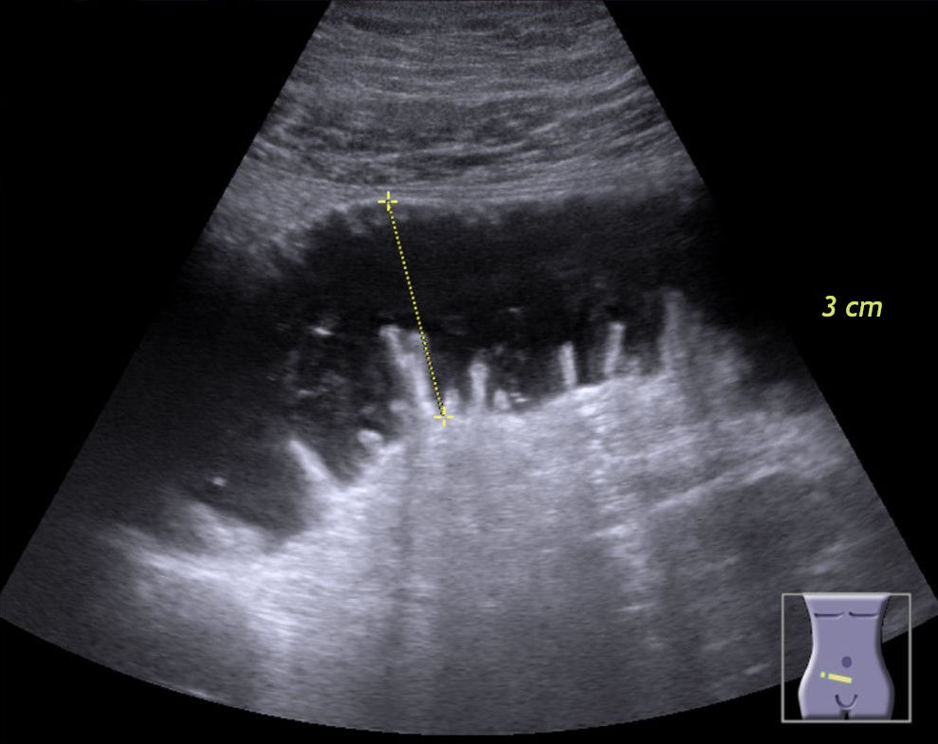
Pathology – Small Bowel Obstruction
SBO
Dilated fluid-filled loop with valvulae conniventes (“keyboard sign”), caliper ~3 cm. Hellerhoff, Wikimedia Commons, CC BY-SA 4.0.
Notes:
Findings of SBO on POCUS:
• Dilated fluid-filled loops > 2.5 cm (small bowel; > 3 cm large bowel)
• “Keyboard / piano-key sign” – plicae circulares (valvulae conniventes) projecting into the fluid-filled lumen, as in this image
• To-and-fro or back-and-forth peristalsis early (contents sloshing against the obstruction); akinetic loops later – a worrisome sign
• Transition point between dilated and collapsed bowel
• Free interloop fluid (“tanga/triangle sign”) – concern for ischemia
The more dilated and akinetic the bowel, and the more complex the free fluid, the higher the concern for strangulation.

Slide 14
Insert Image
▢ Insert image / clip here
Add your own SBO clip (dilated loops, keyboard sign, to-and-fro peristalsis).
Notes:
Drop in a still or cine clip from your own scans here.

Slide 15
Pearls & Pitfalls
Performance
POCUS Sn ~90% / Sp ~85% for SBO (adult data); outperforms plain films
Pearls
Dilation >2.5 cm + abnormal peristalsis is the key combination
Hunt for a transition point and interloop free fluid
Pitfalls
Operator-dependent; bowel gas can obscure deep loops
Does not define the cause – CT/surgery when etiology must be known
Always consider malrotation/volvulus in the vomiting infant
Notes:
Bottom line: dilated, fluid-filled loops with abnormal peristalsis = obstruction until proven otherwise. POCUS is excellent for rapid rule-in and serial follow-up but is operator dependent and cannot reliably identify the cause or transition anatomy the way CT can. Never let a ‘negative’ bedside scan override a convincing clinical picture, and escalate immediately for any infant with bilious vomiting (rule out midgut volvulus).

Slide 16
Insert Image
▢ Insert image / clip here
Add a summary graphic or your teaching take-home points.
Notes:
Drop in a still or cine clip from your own scans here.

Slide 17
Intussusception
The classic pediatric “telescoping” bowel
Notes:
Topic divider. Ileocolic intussusception is the most common abdominal emergency in children 3 months–3 years. POCUS is now considered the first-line imaging test and, in trained hands, is highly accurate.

Slide 18
10-month-old with intermittent screaming & leg-drawing
History
Sudden episodes of colicky pain every 15–20 min, drawing up legs
Lethargic and pale between episodes
Vomiting; one “currant-jelly” (bloody, mucousy) stool
Exam
Possible sausage-shaped RUQ mass
Often well-appearing between paroxysms – don’t be falsely reassured
Notes:
The classic triad (intermittent pain, palpable mass, currant-jelly stool) is present in a MINORITY of cases. Lethargy alone can be the presenting feature – intussusception is on the differential for the altered/lethargic infant. Peak age 3 months–3 years; most are ileocolic and idiopathic (hypertrophied Peyer patches as lead point, often post-viral).

Slide 19
Insert Image
▢ Insert image / clip here
Add a clinical photo or the classic currant-jelly stool image.
Notes:
Drop in a still or cine clip from your own scans here.

Slide 20
Indications for Intussusception POCUS
Intermittent / colicky abdominal pain in a young child
Vomiting, lethargy, pallor
Palpable abdominal mass
Currant-jelly or bloody stool
Unexplained lethargy in an infant/toddler
Notes:
POCUS by trained emergency clinicians has reported sensitivity ~85–100% and specificity ~88–100% for ileocolic intussusception, comparable to radiology-performed ultrasound. A positive scan expedites the air/contrast enema (or surgery); a high-quality negative scan that surveys the colon makes it very unlikely.

Slide 21
Insert Image
▢ Insert image / clip here
Add an indication list or department pathway image.
Notes:
Drop in a still or cine clip from your own scans here.

Slide 22
Set Up For Success
Transducer: Linear high-frequency (best resolution)
Curvilinear in larger children or for depth
Preset: Abdomen / Soft tissue
Patient Position: Supine, comfortable, parent present
Tips
Start in the RLQ at the cecum
Follow the colon clockwise: cecum → ascending → transverse → descending
Most ileocolic targets sit in the RUQ / subhepatic region
Graded compression to displace gas
Notes:
Trace the frame of the colon. Because the ileocolic junction telescopes through the ascending and transverse colon, the target is most often found in the right upper quadrant beneath the liver. Use graded compression and patience. A linear probe gives the resolution to count the concentric rings and to assess the wall and any trapped fluid.

Slide 23
Insert Image
▢ Insert image / clip here
Add a probe/positioning photo or colon-tracing diagram.
Notes:
Drop in a still or cine clip from your own scans here.

Slide 24
Technique – Trace the Colon
Graded-compression survey along the entire colon
Scan each segment in BOTH planes:
Transverse → look for the target/doughnut
Longitudinal → look for the pseudokidney
Add color Doppler to assess wall perfusion
Measure the diameter of any suspicious mass
Notes:
Every concentric ‘target’ must be confirmed in two planes – in long axis it becomes the pseudokidney. Apply color Doppler: preserved flow is reassuring, absent flow suggests ischemia. Note the diameter, presence of trapped fluid, enlarged lymph nodes, and any pathologic lead point (Meckel, polyp, duplication cyst, HSP, lymphoma) which is more likely in children outside the typical age range.

Slide 25
Insert Image
▢ Insert image / clip here
Add a labeled technique diagram.
Notes:
Drop in a still or cine clip from your own scans here.

Slide 26
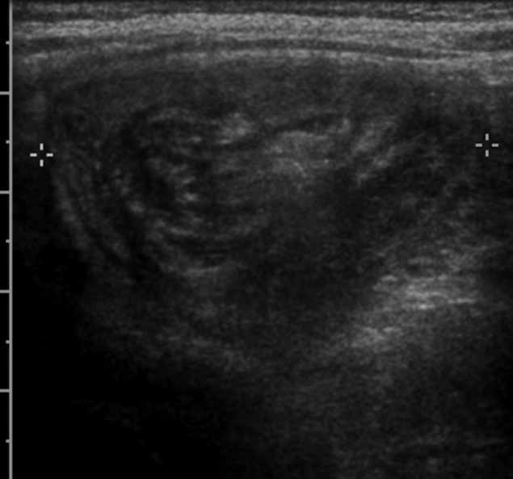
Pathology – Target Sign (Transverse)
TARGET
Ileocolic intussusception, transverse – “target / doughnut” sign (bowel-within-bowel). Frank Gaillard, Radiopaedia.org via Wikimedia Commons, CC BY-SA 3.0.
Notes:
Transverse plane = the “target,” “doughnut,” or “bull’s-eye” sign: concentric alternating hypo-/hyperechoic rings from the intussusceptum invaginated within the intussuscipiens. An overall diameter > 2.5 cm and a thick outer rim favor true ileocolic intussusception requiring reduction. Look for a hyperechoic “crescent-in-doughnut” (dragged-in mesentery ± nodes). Beware the smaller (<2 cm), transient small-bowel–small-bowel intussusception, which is usually self-limited.

Slide 27
Insert Image
▢ Insert image / clip here
Add your own transverse target-sign clip.
Notes:
Drop in a still or cine clip from your own scans here.

Slide 28
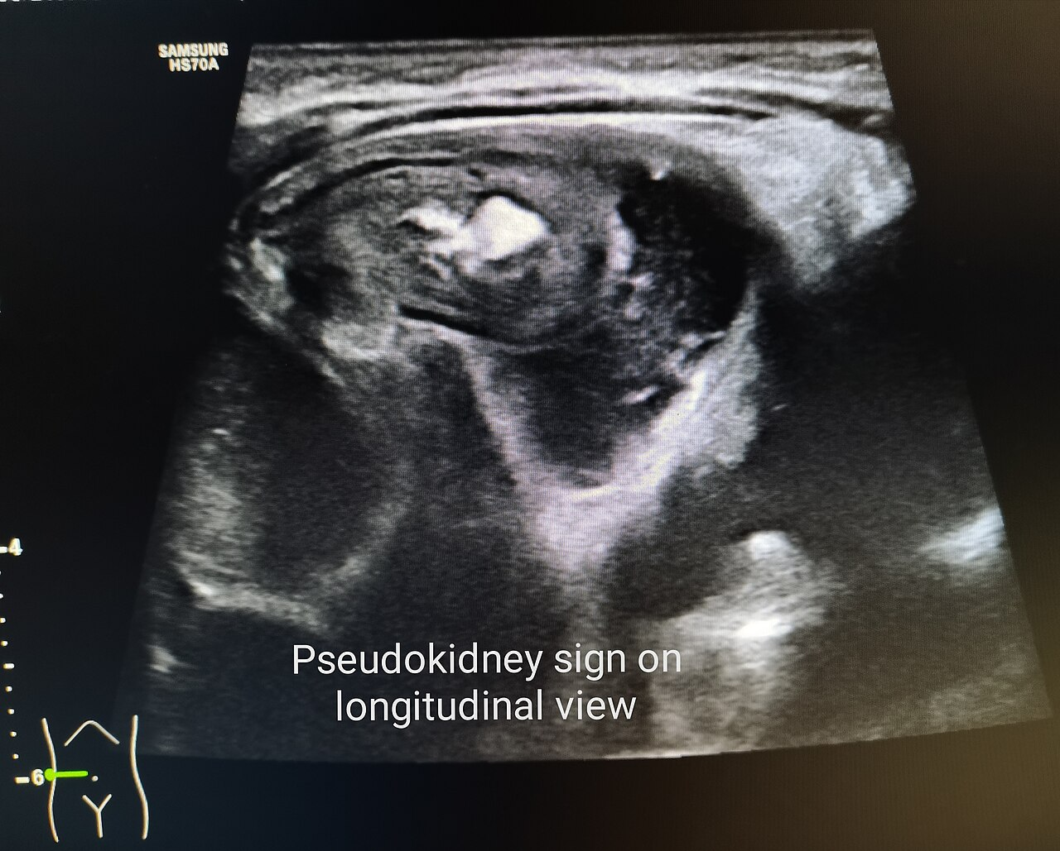
Pathology – Pseudokidney Sign (Longitudinal)
PSEUDOKIDNEY
Same pathology in long axis – “pseudokidney” sign. User:Cerevisae, Wikimedia Commons, CC BY-SA 4.0.
Notes:
Longitudinal plane = the “pseudokidney” (or “hayfork/sandwich”) sign: the hypoechoic edematous bowel wall layers mimic renal cortex while the central echogenic mesentery mimics the renal sinus. Confirming both the transverse target and longitudinal pseudokidney clinches the diagnosis. Findings that predict difficult reduction / ischemia: trapped fluid within the intussusception, absent color Doppler flow, enlarged nodes, and a discrete lead point.

Slide 29
Insert Image
▢ Insert image / clip here
Add your own longitudinal pseudokidney clip.
Notes:
Drop in a still or cine clip from your own scans here.

Slide 30
Pearls & Pitfalls
Pearls
Confirm in 2 planes: target (transverse) + pseudokidney (long axis)
Diameter > 2.5 cm and absent Doppler flow = higher-risk lesion
Most ileocolic targets are in the RUQ – look there first
Pitfalls
Small-bowel–small-bowel intussusception is usually small & transient
Classic triad is the exception, not the rule
Management
Confirm with radiology; treat with air/contrast enema reduction; surgery if failed/peritonitis/lead point
Notes:
Take-home: a target > 2.5 cm in the RUQ confirmed as a pseudokidney in long axis is intussusception until proven otherwise – mobilize surgery and radiology for enema reduction. Don’t over-call tiny, transient small-bowel intussusceptions. POCUS is a confirmatory/triage tool; institutional pathways still involve pediatric radiology and surgery for definitive reduction.

Slide 31
Insert Image
▢ Insert image / clip here
Add your take-home summary graphic.
Notes:
Drop in a still or cine clip from your own scans here.

Slide 32
Femur & Long-Bone Fracture
Musculoskeletal POCUS
Notes:
Topic divider. POCUS for long-bone fractures is fast and accurate, spares radiation, can be done at triage or in austere/prehospital settings, and guides ultrasound-guided regional anesthesia (e.g., femoral nerve / fascia iliaca block) and hematoma blocks.

Slide 33
2-year-old refusing to bear weight after a fall
History
Fall from a height onto the leg; immediate crying
Now refuses to stand or walk; thigh swollen
Exam
Focal mid-thigh tenderness, swelling, possible deformity
Pseudoparalysis of the limb
Consider non-accidental trauma in non-ambulatory infants
Notes:
Refusal to bear weight + focal tenderness is a fracture until proven otherwise. The femur is the most commonly fractured long bone requiring admission in young children. ALWAYS keep non-accidental trauma in mind – a femur fracture in a non-ambulatory infant, or any history that doesn’t fit, warrants a child-protection evaluation.

Slide 34
Insert Image
▢ Insert image / clip here
Add a clinical photo of the swollen thigh / deformity.
Notes:
Drop in a still or cine clip from your own scans here.

Slide 35
Indications for MSK / Fracture POCUS
Focal bony tenderness, swelling, or deformity
Limp or refusal to bear weight
Confirm a clinically suspected fracture at the bedside
Guide reduction and procedural anesthesia
Ultrasound-guided femoral nerve / fascia iliaca block
Hematoma block; confirm reduction adequacy
Radiation-sparing / prehospital / resource-limited settings
Notes:
POCUS is highly accurate for diaphyseal long-bone fractures (pooled sensitivity and specificity commonly in the high-80s to mid-90s %). Beyond diagnosis, its biggest value-add in peds is pain control: ultrasound-guided fascia iliaca / femoral nerve blocks for femur fractures markedly reduce opioid need. It can also confirm adequate reduction in real time.

Slide 36
Insert Image
▢ Insert image / clip here
Add an indication list or block-anatomy image.
Notes:
Drop in a still or cine clip from your own scans here.

Slide 37
Set Up For Success
Transducer: Linear high-frequency for superficial bone
Curvilinear for the deep femoral shaft in a larger thigh
Preset: MSK / Soft tissue
Patient Position: Comfortable; expose and scan the whole bone
Tips
Scan in TWO planes – long axis and short axis
Examine the entire length of the bone
Compare with the contralateral (uninjured) side
Copious gel; minimal pressure over the tender area
Notes:
The cortex is a bright (hyperechoic) line with dense posterior acoustic shadowing. Slide along the entire bone in long axis, then rotate 90°. The contralateral limb is your built-in normal reference – invaluable in children where open growth plates and ossification centers can mimic or hide fractures. Press gently: it hurts, and pressure can worsen displacement.

Slide 38
Insert Image
▢ Insert image / clip here
Add a positioning / probe-orientation photo.
Notes:
Drop in a still or cine clip from your own scans here.

Slide 39
Technique – Scan the Whole Cortex
Long axis: follow the bright cortical line end to end
Short axis: rotate 90° and sweep the length
Look for:
Step-off / break in the hyperechoic cortex
Periosteal elevation with hypoechoic hematoma
Cortical angulation or buckling (torus)
Compare directly with the normal opposite side
Notes:
Two findings clinch it: (1) a disruption/step-off in the otherwise smooth cortical line, and (2) an overlying hypoechoic periosteal/subperiosteal hematoma. In young children, look specifically for buckle (torus) fractures – a subtle cortical bulge rather than a clean break. Reverberation artifact changes and a fracture that ‘moves’ with gentle dynamic pressure or crepitus also support the diagnosis.

Slide 40
Insert Image
▢ Insert image / clip here
Add a labeled scanning-technique diagram.
Notes:
Drop in a still or cine clip from your own scans here.

Slide 41
Normal Cortex vs. Fracture
COMPARE
NORMAL
FRACTURE
Smooth, continuous hyperechoic cortex
Cortical step-off / disruption
Overlying periosteal hematoma (hypoechoic)
Schematic for teaching – embed your own paired clips on the following slide.
Notes:
Schematic comparison. NORMAL: the cortex is a smooth, uninterrupted, bright hyperechoic line with clean posterior shadowing. FRACTURE: an abrupt step-off / discontinuity of that line, frequently with an overlying hypoechoic periosteal hematoma lifting the periosteum. Always anchor your read against the contralateral side, especially around physes and ossification centers.

Slide 42
Insert Image
▢ Insert image / clip here
Add paired NORMAL vs FRACTURE clips (ideally the injured and contralateral side).
Notes:
Drop in a still or cine clip from your own scans here.

Slide 43
Pearls & Pitfalls
Pearls
Two findings: cortical step-off + periosteal hematoma
Always scan 2 planes and compare to the other side
Great for guiding fascia iliaca / femoral nerve blocks
Pitfalls
Open growth plates / ossification centers mimic fractures – compare sides
Cannot assess intra-articular extension or fully classify the fracture
Does not replace plain films for definitive management/orthopedic planning
Notes:
Bottom line: a cortical step-off with an overlying hematoma, confirmed in two planes and compared to the normal side, reliably identifies a long-bone fracture and lets you start a nerve block early. But POCUS does not characterize intra-articular extension, comminution, or Salter-Harris grade – obtain radiographs for definitive classification and orthopedic management, and keep NAT on the differential.

Slide 44
Insert Image
▢ Insert image / clip here
Add your take-home summary slide.
Notes:
Drop in a still or cine clip from your own scans here.

Slide 45
Pneumothorax
Lung POCUS for pleural air
Notes:
Topic divider. Lung ultrasound detects pneumothorax with higher sensitivity than supine chest X-ray and is a core component of the E-FAST. The principle: pleural air abolishes the normal sliding of visceral on parietal pleura.

Slide 46
16-year-old with sudden chest pain & dyspnea
Scenario A – Trauma
Blunt chest trauma, now dyspneic and hypoxic (E-FAST)
Scenario B – Spontaneous
Tall, thin teen with sudden pleuritic pain and breathlessness
Other settings
Post-procedure (central line, thoracentesis, biopsy)
Unexplained hypoxia or decreased breath sounds
Notes:
Two classic presentations: traumatic (part of E-FAST) and primary spontaneous pneumothorax in a tall, thin adolescent. Always think iatrogenic PTX after central lines, thoracentesis, or lung biopsy. In tension physiology (hypotension, distended neck veins, tracheal deviation) treat clinically – don’t wait for imaging.

Slide 47
Insert Image
▢ Insert image / clip here
Add a clinical photo, CXR, or the E-FAST sequence.
Notes:
Drop in a still or cine clip from your own scans here.

Slide 48
Indications for Lung POCUS (Pneumothorax)
Chest trauma – E-FAST
Acute dyspnea or pleuritic chest pain
Post-procedure surveillance (lines, thoracentesis, biopsy)
Unexplained hypoxia or unilateral decreased breath sounds
Sudden decompensation on the ventilator
Notes:
For pneumothorax, POCUS sensitivity is roughly 90% versus ~50% for supine chest X-ray, with high specificity, and it is faster than waiting for a film. It is most useful when the question is binary – is there pleural sliding at this spot or not – and as a rapid serial tool after procedures.

Slide 49
Insert Image
▢ Insert image / clip here
Add an E-FAST scan-points diagram.
Notes:
Drop in a still or cine clip from your own scans here.

Slide 50
Set Up For Success
Transducer: Linear high-frequency (pleural detail)
Phased/curvilinear to survey deeper or multiple zones
Preset: Lung
Patient Position: SUPINE
Air rises → collects at the least-dependent (anterior) chest
Tips
Scan the most anterior point: 2nd–4th intercostal space, midclavicular line
Probe longitudinal, marker to the head – find the “bat sign”
Center the pleural line between two ribs
Then use M-mode through the pleura
Notes:
In a supine patient, pleural air collects anteriorly – so start there (2nd–4th interspace, midclavicular line). The ‘bat sign’ (two rib shadows = wings, bright pleural line = body) confirms you are imaging the pleura. Identify the pleural line, assess sliding in 2D, then drop an M-mode cursor through it. Scan multiple anterior–lateral zones to map the extent.

Slide 51
Insert Image
▢ Insert image / clip here
Add a probe-position photo and the bat-sign image.
Notes:
Drop in a still or cine clip from your own scans here.

Slide 52
Signs – What Rules PTX In vs Out
Findings that EXCLUDE PTX at that spot
Lung sliding (shimmering pleura)
B-lines (arise from pleura, need both layers apposed)
Lung pulse; “seashore sign” on M-mode
Findings that SUGGEST PTX
Absent lung sliding
“Barcode / stratosphere sign” on M-mode
The confirmatory sign
“Lung point” – transition from sliding to no-sliding (highly specific)
Notes:
Logic: anything that requires the two pleural layers to be touching – sliding, B-lines, lung pulse – RULES OUT pneumothorax at that interspace (high negative predictive value). Their ABSENCE is sensitive but NOT specific (mainstem intubation, apnea, blebs, pleural adhesions, ARDS all reduce sliding). The lung point, where normally-sliding lung meets the pneumothorax, is ~100% specific and also estimates size, but it is absent in a large/complete pneumothorax.

Slide 53
Insert Image
▢ Insert image / clip here
Add a side-by-side seashore vs barcode reference.
Notes:
Drop in a still or cine clip from your own scans here.

Slide 54
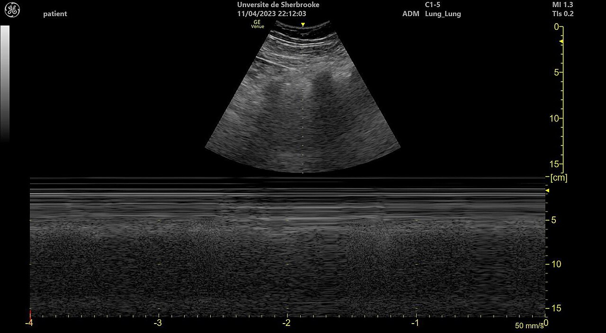
Normal Lung – Sliding & Seashore Sign
NORMAL
2D pleural line with A-lines (top) and M-mode “seashore sign” (bottom) – normal lung sliding. User:Tinss, Wikimedia Commons, CC BY-SA 4.0.
Notes:
Normal lung. 2D (top): bright pleural line with horizontal A-line reverberation artifacts and shimmering lung sliding. M-mode (bottom): the ‘seashore sign’ – motionless chest wall above (parallel ‘waves/ocean’) gives way to the granular ‘sandy beach’ below the pleural line, because moving lung scatters the signal. Seashore present = no pneumothorax at that spot. A-lines alone are NOT diagnostic of PTX – they are normal; you must assess sliding.

Slide 55
Insert Image
▢ Insert image / clip here
Add your own NORMAL lung-sliding cine + M-mode seashore.
Notes:
Drop in a still or cine clip from your own scans here.

Slide 56
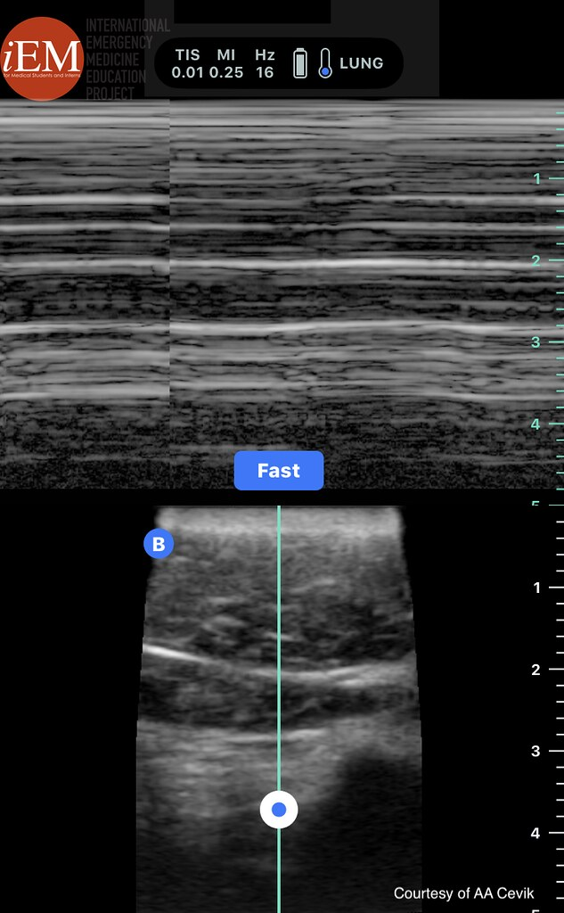
Pathology – Pneumothorax (Barcode Sign)
PNEUMOTHORAX
M-mode “barcode / stratosphere sign” (no sliding) over 2D. iEM Education Project / A. Cevik, Flickr, CC BY-NC-SA 2.0.
Notes:
Pneumothorax. With pleural air, the lung no longer slides, so M-mode shows only straight horizontal lines all the way down – the ‘barcode’ or ‘stratosphere’ sign – instead of the granular beach. In 2D, sliding is absent and there are no B-lines or lung pulse. Remember: absent sliding is sensitive but not specific. To CONFIRM, find the lung point (the exact spot where sliding reappears) – it is virtually 100% specific for pneumothorax and marks the edge of the collapse.

Slide 57
Insert Image
▢ Insert image / clip here
Add your own PTX clip (absent sliding, barcode, and a lung point if present).
Notes:
Drop in a still or cine clip from your own scans here.

Slide 58
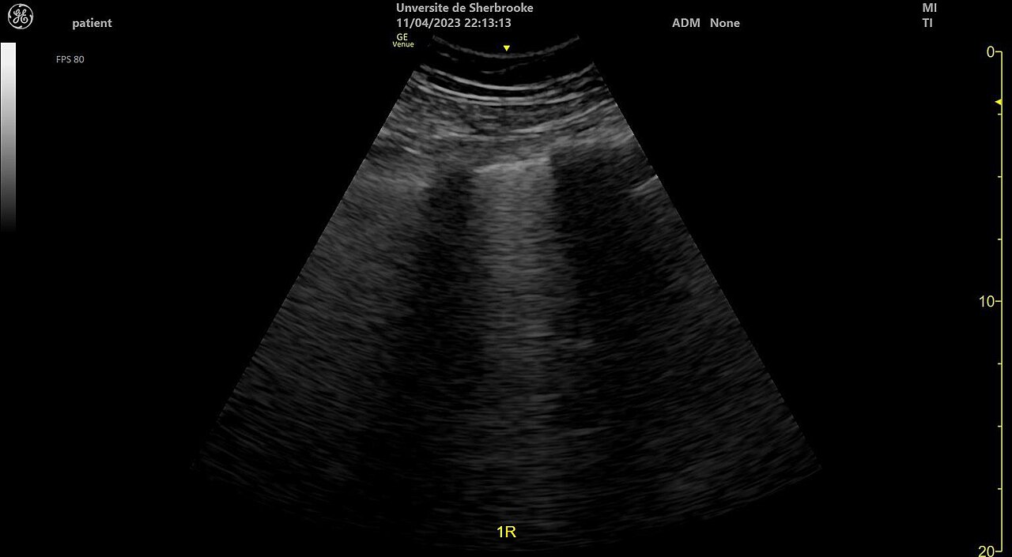
For Contrast – B-lines (Pleura Apposed)
B-LINES
Vertical B-lines arising from the pleural line – their presence excludes PTX at that spot (here, interstitial fluid). User:Tinss, Wikimedia Commons, CC BY-SA 4.0.
Notes:
Teaching contrast: B-lines are vertical, hyperechoic, laser-like artifacts that arise from the pleural line, extend to the bottom of the screen, move with sliding, and erase A-lines. Because they require the visceral and parietal pleura to be in contact, even a single B-line EXCLUDES pneumothorax at that interspace. (B-lines themselves indicate interstitial fluid – e.g., pneumonia, edema, ARDS – and are covered in the lung module.) Use this to reinforce why ‘B-lines present = no PTX here.’

Slide 59
Insert Image
▢ Insert image / clip here
Add your own B-line clip for teaching contrast.
Notes:
Drop in a still or cine clip from your own scans here.

Slide 60
Pearls & Pitfalls
Pearls
Sliding, B-lines, or lung pulse → NO pneumothorax at that spot
Lung point = ~100% specific and estimates size
POCUS Sn (~90%) >> supine CXR (~50%)
Pitfalls
Absent sliding is sensitive but NOT specific (mainstem intubation, blebs, ARDS, apnea, adhesions)
No lung point in a large/complete PTX
Subcutaneous emphysema obscures the pleura
Treat tension pneumothorax clinically – do not delay for imaging
Notes:
Bottom line: presence of sliding/B-lines/lung pulse reliably rules out PTX at that window; a lung point rules it in. Confirm absent sliding isn’t from a mimicker (check a contralateral side, confirm ETT position). A complete pneumothorax has no lung point, so don’t require one to act. And never delay needle/finger decompression for a clinically obvious tension pneumothorax.

Slide 61
Insert Image
▢ Insert image / clip here
Add your take-home summary graphic.
Notes:
Drop in a still or cine clip from your own scans here.

Slide 62
Constipation
Transrectal Diameter (TRD) on POCUS
Notes:
Topic divider. Constipation causes up to ~25% of pediatric abdominal-pain visits. Measuring the transrectal diameter (TRD) on POCUS offers an objective, radiation-free, non-invasive alternative to the abdominal radiograph and the (rarely performed, uncomfortable) digital rectal exam. Based on Doniger SJ, Dessie A, Latronica C. Pediatr Emerg Care 2018;34:154–159.

Slide 63
6-year-old with recurrent abdominal pain
History
Weeks of intermittent crampy peri-umbilical/LLQ pain
Hard, infrequent stools; occasional withholding
No red flags (no bilious vomiting, weight loss, or blood)
Exam
Soft abdomen, possible palpable LLQ stool
Avoid the digital rectal exam – uncomfortable & low-yield
Notes:
Constipation is a leading cause of pediatric abdominal pain (prevalence up to ~28%). History and physical exam are unreliable, the DRE is invasive and rarely performed (~<5% of abdominal-pain visits), and clinicians often default to abdominal radiographs – which are themselves unreliable for constipation and add ionizing radiation. TRD on POCUS gives an objective number at the bedside.

Slide 64
Insert Image
▢ Insert image / clip here
Add a clinical vignette graphic or the Rome IV criteria.
Notes:
Drop in a still or cine clip from your own scans here.

Slide 65
Indications for TRD POCUS
Suspected functional constipation as a cause of abdominal pain
Objective bedside data without radiation or a rectal exam
To support avoiding an abdominal radiograph
Track response after disimpaction / enema
Reference: Doniger et al., Pediatr Emerg Care 2018
Notes:
The Doniger 2018 prospective cohort (ages 4–17, abdominal pain, ED) used the Rome III questionnaire as the criterion standard. An enlarged TRD strongly correlated with constipation, performed similarly to abdominal radiographs, and – had it been used – could have avoided ~88% of the radiographs obtained. TRD is a fast, objective adjunct, not a stand-alone diagnosis.

Slide 66
Insert Image
▢ Insert image / clip here
Add the reference citation or study abstract image.
Notes:
Drop in a still or cine clip from your own scans here.

Slide 67
Set Up For Success
Transducer: Phased array 5–1 MHz (per study)
Curvilinear also works well
Preset: Abdomen
Patient Position: Supine
Bladder does NOT need to be full
Tips
Probe ~2 cm above the pubic symphysis
Angle 15° caudad (downward) from the transverse plane
Indicator to the patient’s right
Use the bladder as your acoustic window
Notes:
Technique per Klijn/Doniger: phased-array (or curvilinear) transducer placed transversely ~2 cm above the symphysis pubis, angled 15° downward, indicator to the patient’s right. The fluid-filled bladder is the acoustic window. Importantly, the TRD measurement is NOT affected by bladder fullness, age, height, or weight – so a full bladder is not required and is a common misconception.

Slide 68
Insert Image
▢ Insert image / clip here
Add a probe-placement photo (suprapubic, 15° caudal).
Notes:
Drop in a still or cine clip from your own scans here.

Slide 69
Technique – Measuring the TRD
Find the bladder in the transverse view
Identify the rectum POSTERIOR to the bladder
Hyperechoic crescent with posterior shadowing
Measure the transrectal diameter (TRD)
Outer wall to outer wall, anterior–posterior
Take TWO measurements and average them
Notes:
Center the bladder in transverse, then look just deep/posterior to it for the rectum – a hyperechoic crescent casting posterior acoustic shadowing (stool/gas). Measure across the rectum, outer wall to outer wall, in the AP dimension. Obtain two measurements and average. In the study a nonconstipated child measured ~1.76 cm; a constipated child measured ~8 cm – the difference is usually obvious.

Slide 70
Insert Image
▢ Insert image / clip here
Add a labeled measurement still (bladder, rectal crescent, calipers).
Notes:
Drop in a still or cine clip from your own scans here.

Slide 71
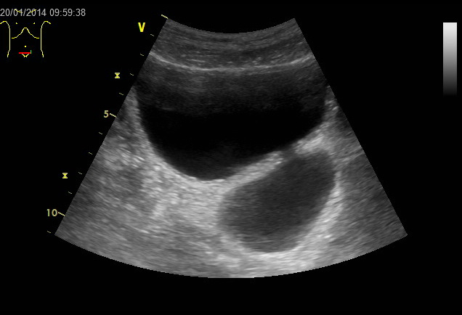
Normal – Transverse Suprapubic Window
NORMAL
Transverse suprapubic view; the anechoic bladder is the acoustic window. The rectum lies posterior (deep) to the bladder. Wikimedia Commons, CC BY-SA 3.0.
Notes:
Orientation image: transverse suprapubic view with the anechoic (black) bladder used as the acoustic window. The rectum sits immediately posterior (deep) to the bladder – that is where you measure the TRD. A NORMAL (nonconstipated) rectum has a TRD below the 3.8 cm threshold (study mean ~1.76 cm). Embed your own normal TRD measurement on the next slide for direct comparison.

Slide 72
Insert Image
▢ Insert image / clip here
Add your own NORMAL TRD still (rectal crescent < 3.8 cm).
Notes:
Drop in a still or cine clip from your own scans here.

Slide 73
Pathology – Enlarged TRD (Constipation)
CONSTIPATION
Add your own constipated TRD clip on the next slide. Key number below.
Notes:
PATHOLOGY – the headline number. A TRD ≥ 3.8 cm correlates with constipation:
• Sensitivity 86%, Specificity 71%
• Negative predictive value 0.87, Positive predictive value 0.70
The constipated rectum appears as a markedly dilated, stool-filled hyperechoic crescent posterior to the bladder, with prominent posterior shadowing. After a successful enema/disimpaction the TRD decreases (mean drop ~1.2 cm in the study). Because no clean, openly-licensed constipated-TRD ultrasound was available to embed, use the dashed slide that follows to insert a clip from your own archive or the Doniger 2018 paper.

Slide 74
Insert Image
▢ Insert image / clip here
Add a constipated TRD still: dilated, stool-filled rectum with TRD ≥ 3.8 cm.
Notes:
Drop in a still or cine clip from your own scans here.

Slide 75
Pearls & Pitfalls
The number to remember
TRD ≥ 3.8 cm = constipation (Sn 86%, Sp 71%, NPV 0.87, PPV 0.70)
Pearls
Not affected by bladder fullness, age, height, or weight
Fast (~1–4 min); avoids radiation and the rectal exam
Could have avoided ~88% of abdominal radiographs in the study
Pitfalls
Modest specificity – correlate clinically
Single-center data; one objective adjunct, not a stand-alone test
Always exclude red-flag causes of abdominal pain
Notes:
Bottom line: a TRD ≥ 3.8 cm is a quick, objective, radiation-free signal that supports constipation and can spare an abdominal radiograph and a rectal exam. Specificity is only moderate, so interpret alongside the history and exam, and never let it anchor you away from a serious cause of abdominal pain. Re-measuring after disimpaction can document treatment response.

Slide 76
Insert Image
▢ Insert image / clip here
Add your take-home summary slide.
Notes:
Drop in a still or cine clip from your own scans here.

Slide 77
Image Credits & Key References
Embedded image credits
SBO – “Keyboard sign” ileus: Hellerhoff, Wikimedia Commons, CC BY-SA 4.0
Intussusception target: F. Gaillard, Radiopaedia via Commons, CC BY-SA 3.0
Intussusception pseudokidney: User:Cerevisae, Commons, CC BY-SA 4.0
Lung seashore & B-lines: User:Tinss, Commons, CC BY-SA 4.0
Pneumothorax barcode: iEM Education Project / A. Cevik, Flickr, CC BY-NC-SA 2.0
Suprapubic bladder window: Wikimedia Commons, CC BY-SA 3.0
Key reference
Doniger SJ, Dessie A, Latronica C. Measuring the Transrectal Diameter on POCUS to Diagnose Constipation in Children. Pediatr Emerg Care 2018;34:154–159.
Notes:
All embedded ultrasound images are openly licensed and used for non-commercial education with attribution. Replace or supplement with your own clinical clips as needed. Verify license terms before any redistribution.

