Slide 1
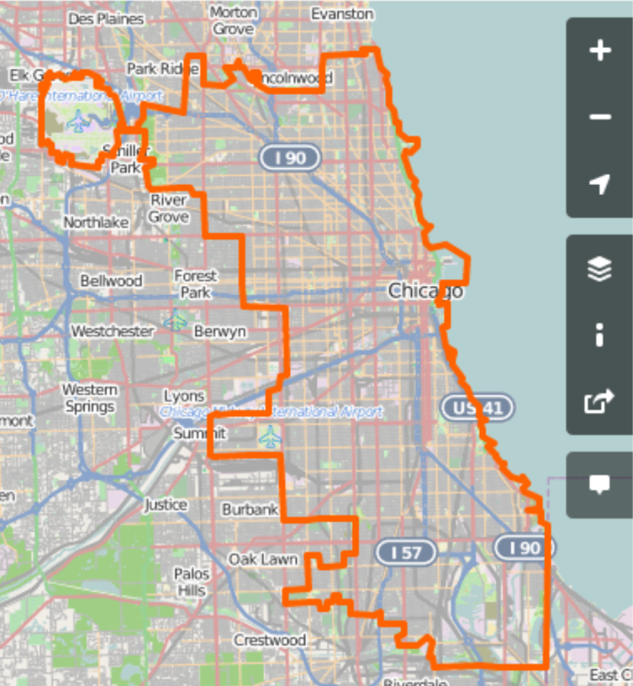

CANOPY Planning Tool for Allocating Staff to Ball Courts
Declarations for planning goals
Weight for attracting youth between 0-50% FPL
Weight for attracting youth between 50-100% FPL
Weight for attracting youth between 100-200% FPL
Weight for attracting youth greater than 200% FPL
Weight placed on youth enrolling nearby

